Slide 1
Plotting in R
Using GGPlot2
Lecturer: 電機所 吳承霖 (TA)

Slide 2
Outline
Common Plot Introduction
R Graphics Systems: Base R, Lattice, GGPlot2
GGPlot2 Tutorial
Reference

Slide 3
Common Plots

Slide 4
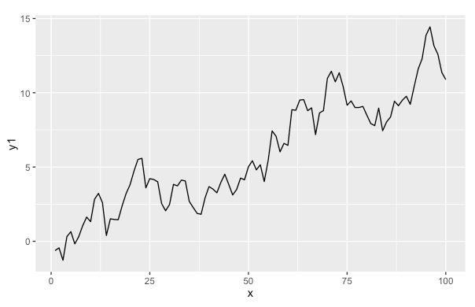
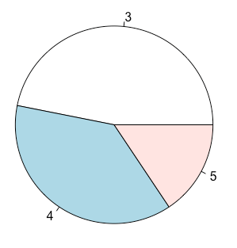
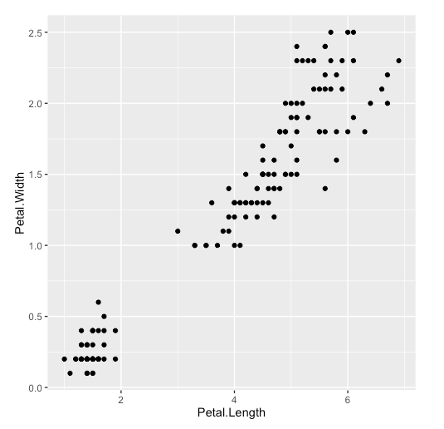
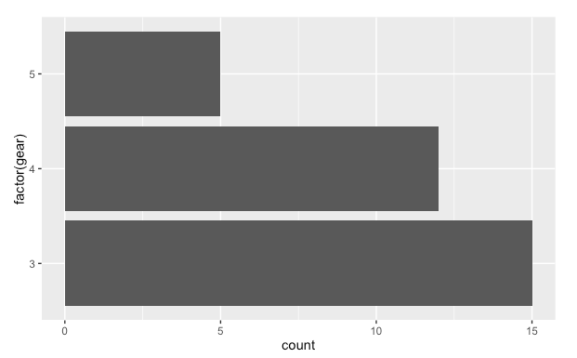
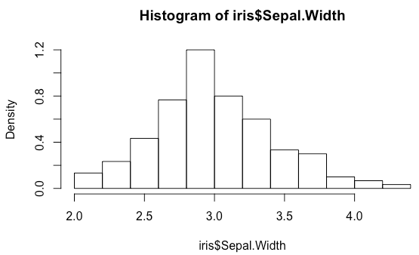
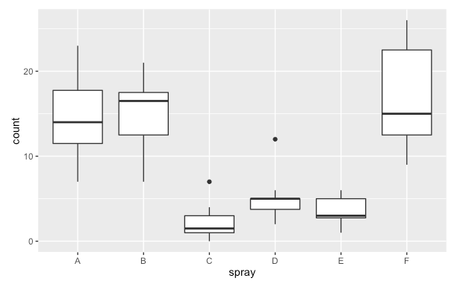
Common Plots
Line Plot
Pie Chart
Scatter Plot
Bar Plot
discover trends
show percentages
visualize distribution
show grouped values
Histogram
Box Plot
show frequency / count
show distribution
max
a type of bar plot,
but usually used for
showing counts
3rd quartile
median
1st quartile
min

Slide 5
R Graphics Systems
Base R, Lattice and GGPlot2

Slide 6
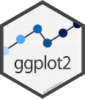
R Graphics System
Base R
Lattice
GGPlot2
Native plotting functions provided in built-in package base & grid .
Graphics system based on grid package which aim to improve base R graphics.
Graphics system for declaratively creating graphics which follows rule “The Grammar of Graphics”.
PROS
PROS
PROS
easy to use
no additional package required
plot can be saved into object
support multi-panel plotting
most comprehensive
inherent features from Lattice
highly adjustable plotting
elegant styling
CONS
CONS
limited plotting options
plots cannot be saved into object
plot cannot be adjusted once it is created
CONS
no 3D plotting function

Slide 7

GGPlot2 Tutorial

Slide 8
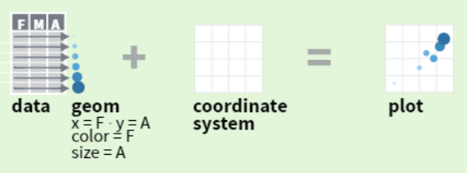
Introduction
GGPlot2 is a package for creating plots
“GG” in GGPlot2 stands for “Grammar of Graphics”, it brings syntax to create customized plots.
GGPlot2 Homepage: https://ggplot2.tidyverse.org/
How it works?
Step 1
you provide the data
Step 2
map variables to aesthetics,
set graphical primitives to use
Step 3
set up coordinate system,
labels, title

Slide 9
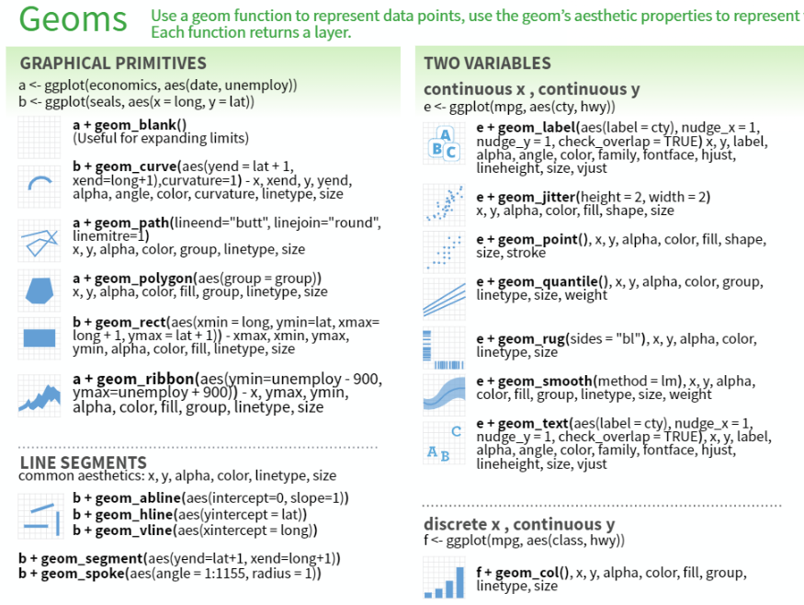
Introduction (Cont.)
Installation
Cheat Sheet is your friend
install ggplot2 directly:
> install.packages(‘ggplot2’)
install tidyverse since ggplot2 is part of it:
> install.packages(‘tidyverse’)
How to Learn
Swirl → Exploratory Data Analysis → GGPlot2
> install.packages(‘swirl’)
> library(‘swirl’)
> install_course(‘Exploratory Data Analysis’)
> swirl()

Slide 10
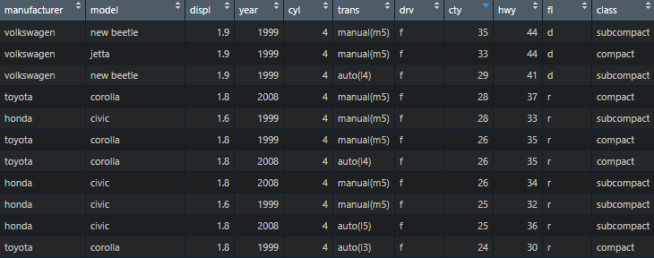
Dataset for Demo
MPG Data Set
The mpg data frame contains fuel economy data for 38 models of cars manufactured in 1999 and 2008.
NOTE
mpg is provided in ggplot2.
廠牌
排氣量
汽缸數
驅動方式
高速油耗
車型類別
車款
生產年分
變速系統
市區油耗
燃油種類

Slide 11
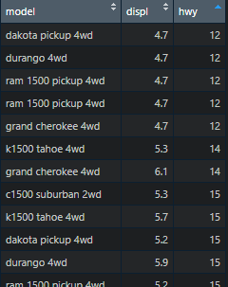
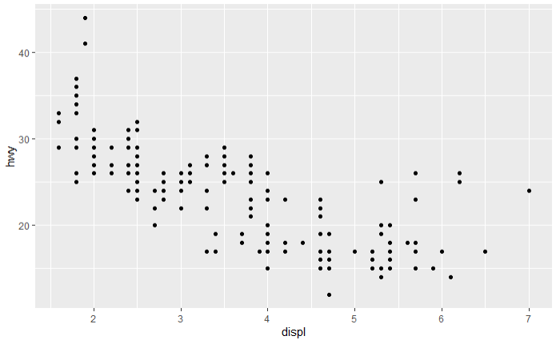
Quick Plotting
qplot()
--- q stands for “quick”
qplot(), or quickplot(), is a convenient shortcut for creating a number of different types of plots. It’s similar to plot() function in base R graphics.
Examples (Using MPG Dataset)
data (partial)
result plot (scatter plot)
qplot(displ, hwy, data = mpg)
X axis
column name
dataframe
Y axis
column name

Slide 12
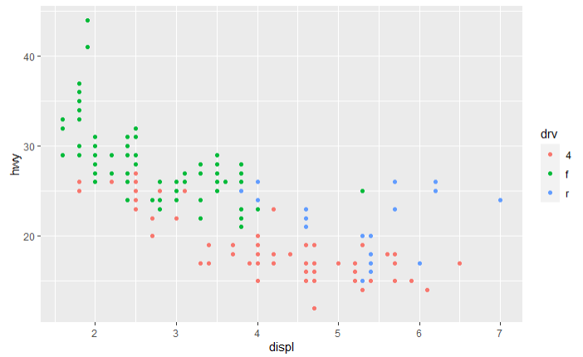
Quick Plotting (Cont.)
Specify Aesthetic ( = Style)
result plot (scatter plot)
qplot (displ, hwy, data = mpg, color = drv)
X axis
column name
dataframe
Y axis
column name
point color depends on column drv values

Slide 13
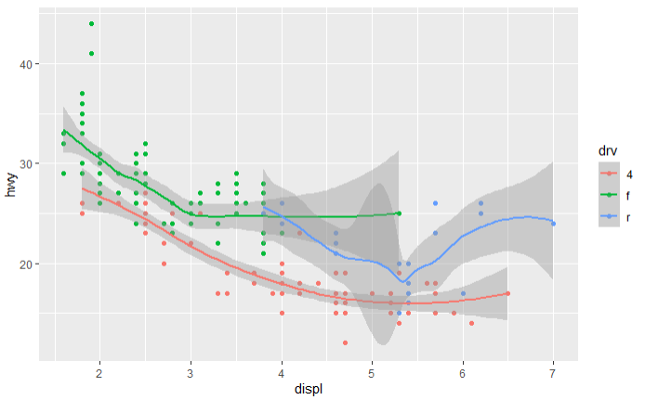
Quick Plotting (Cont.)
Specify Geometry (= Plot Type)
qplot(displ, hwy, data = mpg, color = drv, geom=c('point', 'smooth'))
result plot (scatter plot & line plot)
X axis
column name
dataframe
Y axis
column name
point color depends on column drv values
set to create scatter plot and smooth line plot
check HERE to view all available plot types
(e.g. histogram, boxplot, etc)
NOTE: If both X and Y are provided but geom is not specified, ggplot2 will plot scatter plot (geom = “point”) by default.

Slide 14
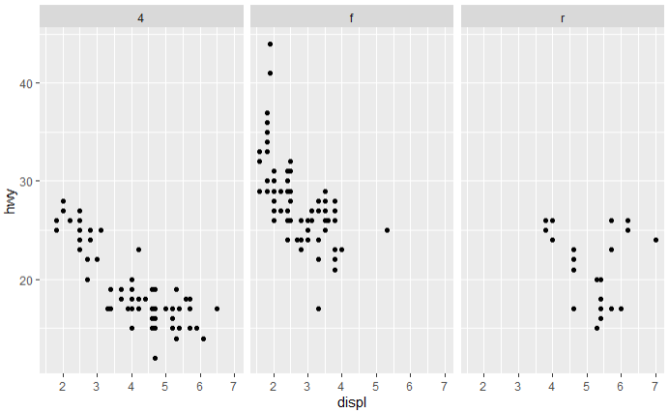
Quick Plotting (Cont.)
Create Multi-Panel Plot
result plot (multiple scatter plots)
qplot(displ, hwy, data = mpg, facets = . ~ drv)
X axis
column name
dataframe
Y axis
column name
create 1 x 3 plots,
data points in each subplot belong to one drv value

Slide 15
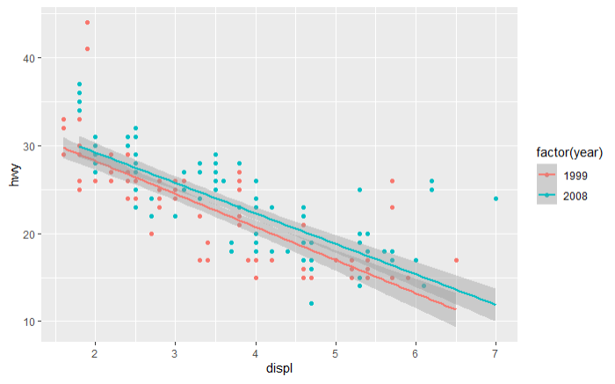

Create Flexible Plots
ggplot()
--- The core value of GGPlot2
ggplot() is used to construct the initial plot object, and is almost always followed by “+” to add component to the plot.
Aesthetic
Settings
Coordinate System Setting
Plot
Data
+
+
=
Examples (using MPG dataset)
result plot (scatter + line)
g <- ggplot(mpg, mapping = aes(displ, hwy))
dataframe
set mapping b/t data points and graphics
g + geom_point() + geom_smooth(method = 'lm')
plot object
add plot layers which draw data points using scatter plot & linear line plot

Slide 16
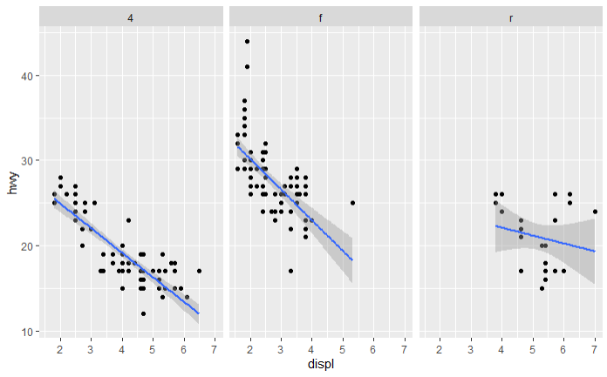
Create Flexible Plots (Cont.)
Create Multi-Panel Plot
g <- ggplot(mpg, mapping = aes(displ, hwy))
dataframe
set mapping b/t data points and graphics
g + geom_point()+geom_smooth(method = 'lm') + facet_grid(. ~ drv)
result plot (multiple plots)
plot object
add plot layers which draw data points using
scatter plot & linear line plot
create 1 x 3 plots,
data points in each subplot belong to one drv value

Slide 17
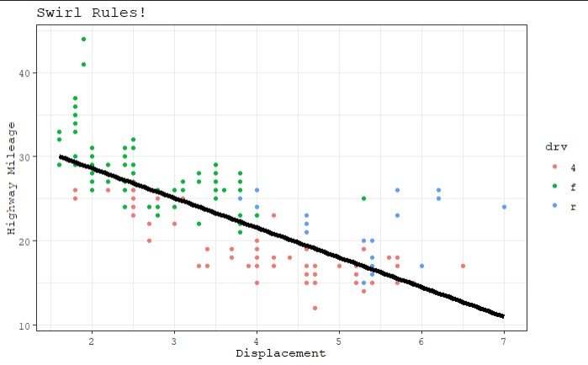
Create Flexible Plots (Cont.)
Set Title, Label, and Styles
g <- ggplot(mpg, mapping = aes(displ, hwy))
dataframe
set mapping b/t data points and graphics
g + geom_point(aes(color = drv))
+ geom_smooth(method = "lm", se = FALSE, size = 2, color = 'black')
set plot theme
+ theme_bw(base_family = "mono")
set plot labels and title
+ labs(x = "Displacement", y = "Highway Mileage", title = "Swirl Rules!")

Slide 18
Reference

Slide 19
Reference
GGPlot2 – Tidyverse : https://ggplot2.tidyverse.org/
GGPlot2 Cheat sheet : https://github.com/rstudio/cheatsheets/blob/master/data-visualization-2.1.pdf
Swirl – Exploratory Analysis : GGPlot2 : https://github.com/DataScienceSpecialization/courses/tree/master/04_ExploratoryAnalysis/ggplot2/ppt
R 資料探索與基本繪圖 : https://blog.gtwang.org/r/r-data-exploration-and-visualization/
StackOverflow – What’s the difference between ggplot and basic plot in R? : https://stackoverflow.com/questions/51013391/whats-the-difference-between-ggplot-and-basic-plot-in-r
StackOverflow – What are the pros and cons of using Lattice versus ggplot2? : https://stackoverflow.com/questions/2759556/r-what-are-the-pros-and-cons-of-using-lattice-versus-ggplot2

