Slide 1
Markdown Introduction

Slide 2



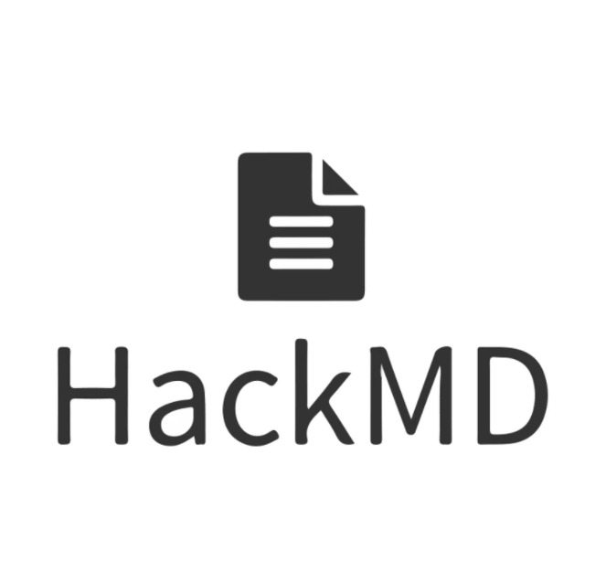

Markdown: What & Why
Markdown is a lightweight markup language, it is commonly used for writing documentation, online messages and reports.
Q. Benefit?
Q. What’s markup language?
lightweight, written with plain text
cross-platform, used everywhere
easy to learn, fast to use
widely supported by many tools and online services:
It’s a format which use different notations to mark the text with different styles.
For example:
# Title → Header using largest font size
### Title → Header using 3rd largest font size
…

Slide 3
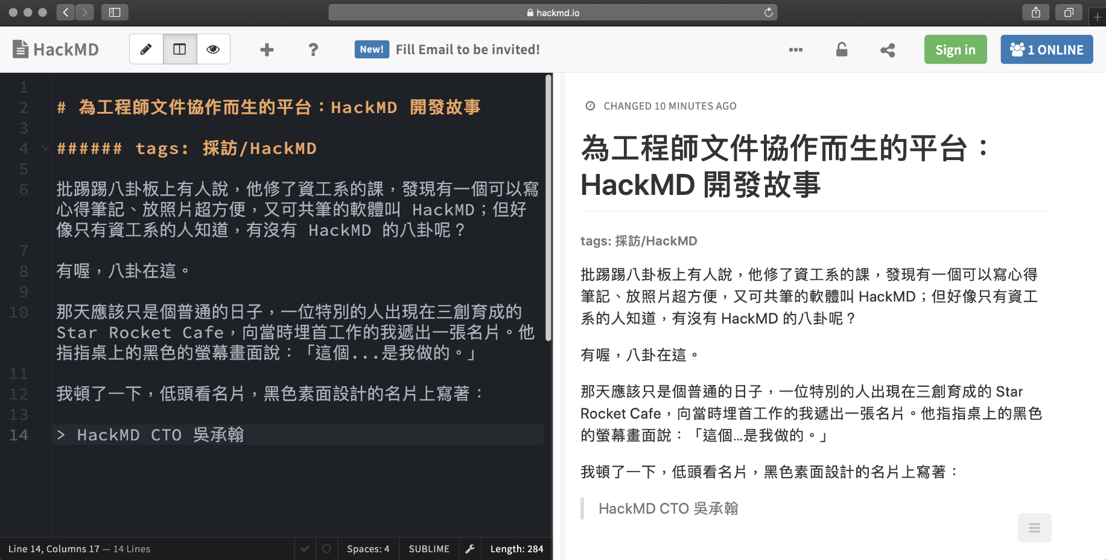
Where I Can Try Markdown?
HackMD – online document editor using Markdown format
https://hackmd.io/

Slide 4
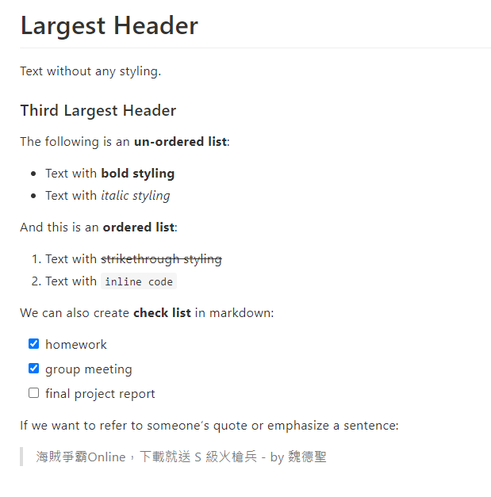
Basic Syntax
text in markdown format
rendered document
# Largest Header
Text without any styling.
### Third Largest Header
The following is an **un-ordered list**:
- Text with **bold styling**
- Text with *italic styling*
And this is an **ordered list**:
1. Text with ~~strikethrough styling~~
2. Text with `inline code`
We can also create **check list** in markdown:
- [x] homework
- [x] group meeting
- [ ] final project report
If we want to refer to someone's quote or emphasize a sentence:
> 海賊爭霸Online，下載就送 S 級火槍兵 - by 魏德聖
NOTE If you want to break a line, add 2 spaces at the end of line

Slide 5
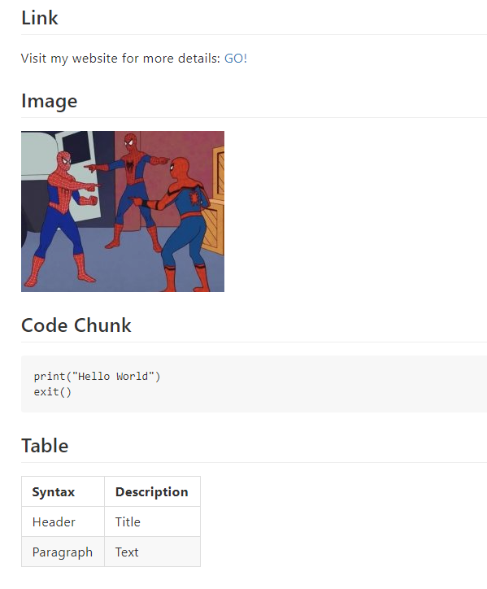
Basic Syntax (Cont.)
text in markdown format
rendered document
## Link
Visit my website for more details: [GO!](https://www.facebook.com/)
## Image
![spiderman meme](https://i.imgflip.com/4/3igo27.jpg)
## Code Chunk
```
print("Hello World")
exit()
```
## Table
| Syntax | Description |
| --- | --- |
| Header | Title |
| Paragraph | Text |

