Slide 1
Term Frequency x Keyword Extraction
Cheng-Lin Wu
NCKU EE

Slide 2
Outline
Dataset Introduction
Term Frequency
Term Frequency Visualization
Keyword Extraction using TF-IDF

Slide 3
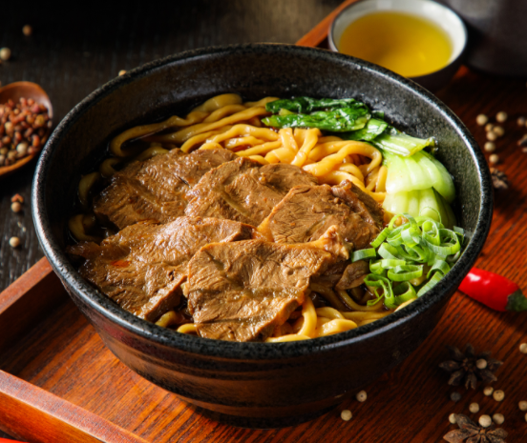
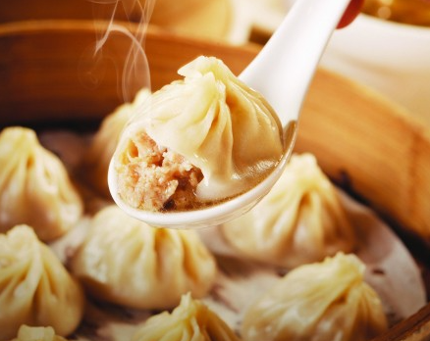
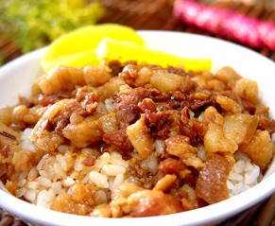
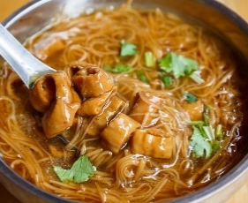
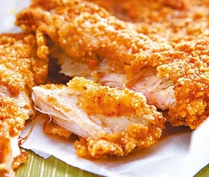
Dataset:
台灣五大美食!
food,
description
牛肉麵,
牛肉麵是臺灣的國民美食之一，牛肉麵要好吃，麵條、湯頭及牛肉三大元素缺一不可，湯頭更是牛肉麵的精華，牛肉麵大多分為紅燒、清燉，搭配上燉好的牛腩及牛筋居多。從小攤到老店，各門派莫不潛心專研牛肉麵學…
小籠包,
誕生於江南地區的著名點心，以體小、餡大、汁多、味鮮、皮薄、形美著稱。傳統肉餡小籠湯包來說，湯汁是靈魂，為了追求皮薄透亮的口感，許多師傅採用塗抹麵粉後用擀麵杖壓出薄如紙的麵皮…
滷肉飯,
看似普通的滷肉飯，一碗好吃的滷肉飯軟腴化口不油膩，小從小吃攤，大到五星級酒店，也曾登上總統府國宴，臺灣小吃教主的美食作家舒國治也曾說，滷肉飯是臺灣的國飯。滷肉飯一般指臺灣北部、中部的滷肉飯，肉用刀切碎後滷的，而這在…
大腸蚵仔麵線,
麵線是臺灣人生活中常見的食物，除了生日煮的壽麵、豬腳麵線、麻油麵線之外，紅麵線一脈的大腸蚵仔麵線更是臺灣著名的小吃。主要原料為蚵仔和麵線，蚵仔需先拌太白粉，也有使用滷大腸做搭配。蚵仔麵線的優劣…
雞排,
雞排可以說是邪惡國民美食之首，在小吃界已被賦予新的地位。口味變化從灑上辣椒粉的辣味雞排，改良出灑上五香粉、海苔粉、芥茉粉等調味雞排….

Slide 4


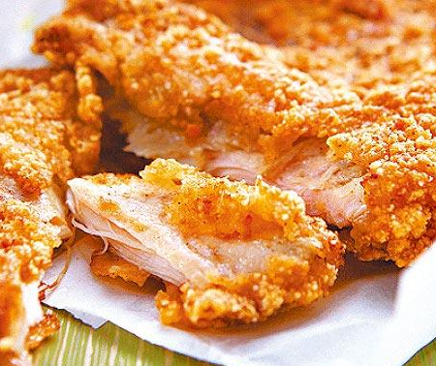
Dataset:
台灣五大美食!
Download: https://reurl.cc/r84j0r

Slide 5
Term Frequency

Slide 6
Introduction
What’s Term Frequency?
“how frequently a word occurs in a document”
Term frequency (or TF, word frequency) is one measure of how important a word may be.
Why we need TF?
Intuition: “If one word is frequently mentioned in a document, it might be a keyword!”
A central question in text mining and natural language processing is how to quantify what a document is about.
Related Concept: Bag of Word (BOW)
A set of words used in a document.
🡪 Set doesn’t store order of words, frequency of words.

Slide 7
TF HOW TO
Programming Workflow
1. Parse dataset / document into R objects
2. ???????????????????
3. Calculate term frequency

Slide 8
TF HOW TO
Programming Workflow
Useful Tools
1. Parse dataset / document into R objects
package readr
package dplyr
function count()
2. Do word segmentation
3. Calculate term frequency

Slide 9
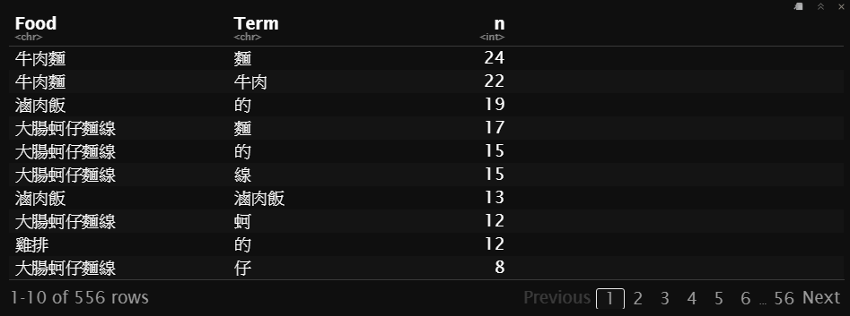
Practice!
Download and Run: https://bit.ly/3lehAyP
Execution Result

Slide 10
Term Frequency Visualization

Slide 11
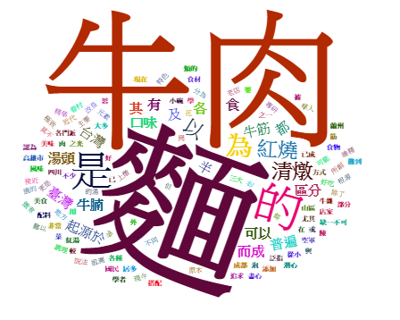
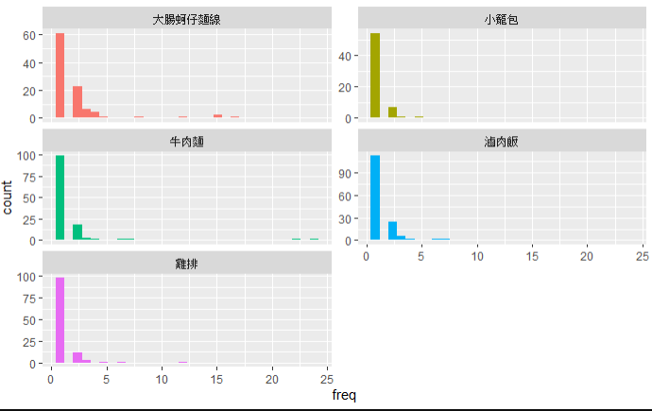
Visualization for Frequency
Word Cloud
Histogram
Recommended packages: wordcloud2
Recommended packages: ggplot2

Slide 12
Practice!
Download and Run: https://reurl.cc/r84A4y

Slide 13
TF-IDF For Keyword Extraction
Term Frequency – Inverse Document Frequency

Slide 14




Introduction
True or False:
“The more frequently a word shows in a document, the more important it is.”
The statistic TF-IDF is intended to measure how important a word is to a document in a collection of documents.
Formula:

Slide 15
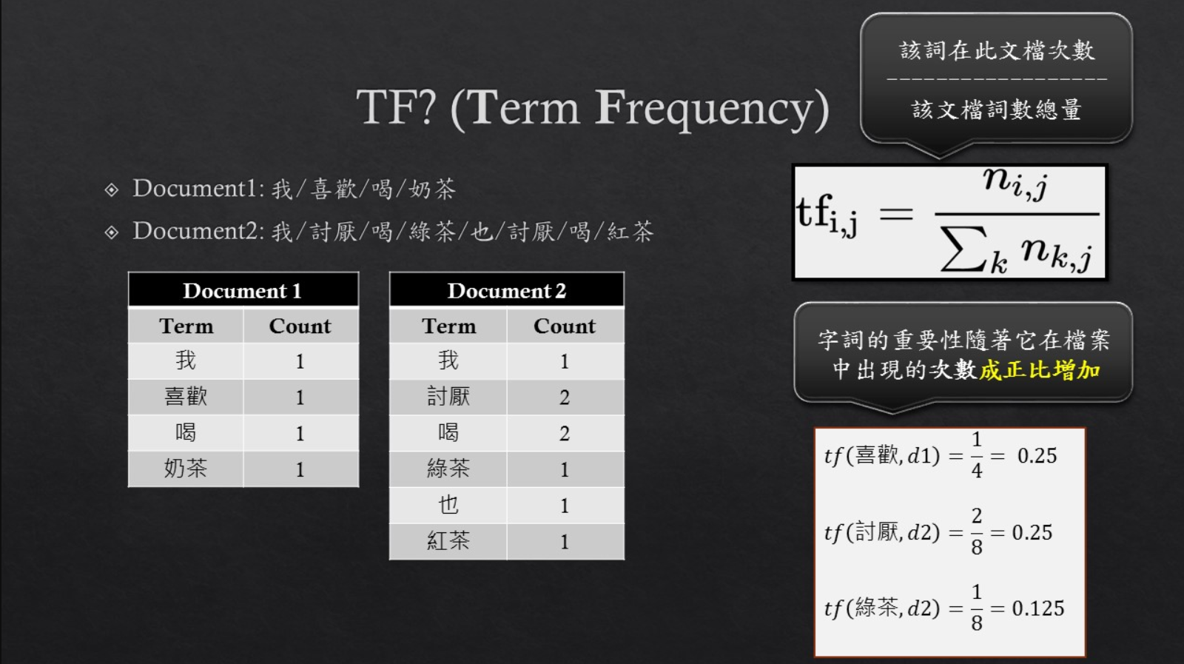
https://github.com/Larix/TF-IDF_Tutorial

Slide 16
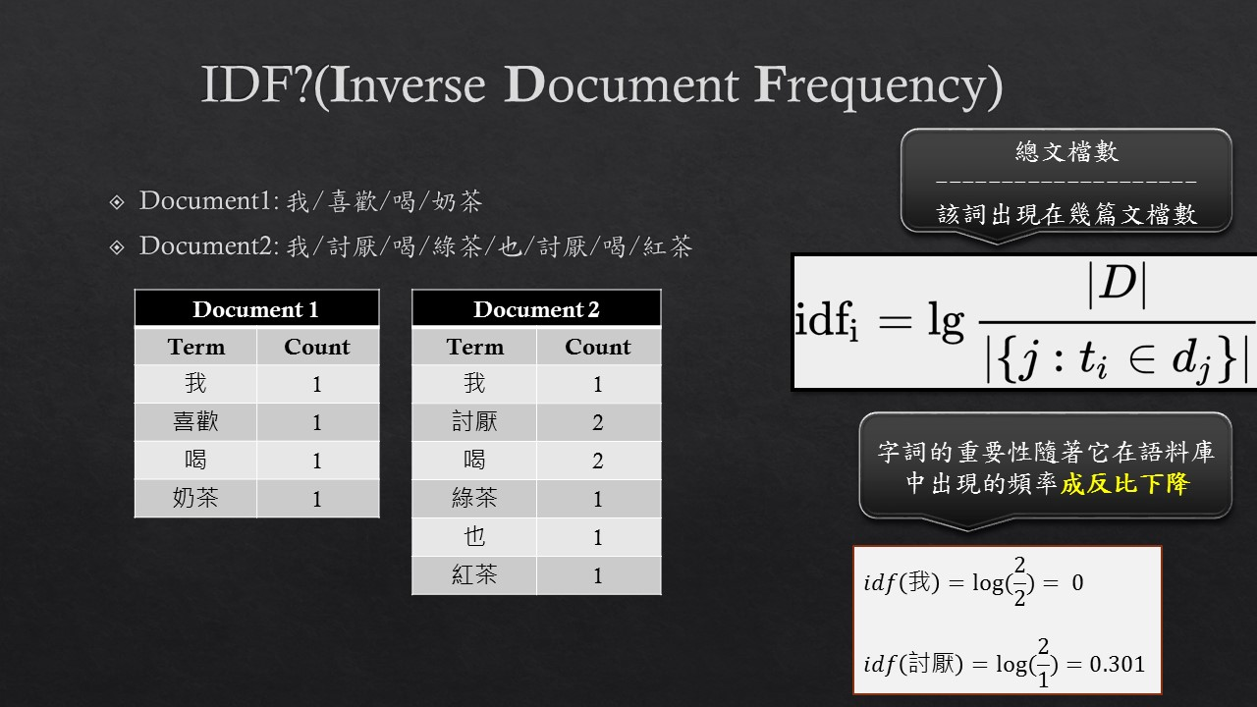
https://github.com/Larix/TF-IDF_Tutorial

Slide 17
HOW TO
Ways to calculate TF-IDF in R:
package tidytext 🡪 function bind_tf_idf()
implement by yourself
Practice!
Download and Run: https://reurl.cc/D6LMoj
Question:
Look at TF-IDF values, what are top 3 keywords for each 台灣美食?

Slide 18
Reference
TidyText - Analyzing word and document frequency: tf-idf
https://www.tidytextmining.com/tfidf.html
Term Frequency and Inverse Document Frequency (tf-idf) Using Tidy Data Principles
https://cran.r-project.org/web/packages/tidytext/vignettes/tf_idf.html
Larix/TF-IDF_Tutorial
https://github.com/Larix/TF-IDF_Tutorial
Wordcloud2 Introduction
https://cran.r-project.org/web/packages/wordcloud2/vignettes/wordcloud.html

