Slide 1
Notes from weekly meeting:
Based on discussions with WINEST, FUT Minna.
Students group (contact: Prof. James)
For contribution to ITU
10 May 2023
17 May 2023
31 May 2023
Topic: Basics of 5G wireless networks
Aim:
fill the gaps in the knowledge for new students
Increase the technical knowhow and basics
Data communications courses in school work.

Slide 2
ITU-T Y.3102 (Framework of the IMT-2020 Network)
https://www.itu.int/rec/T-REC-Y.3102/en
Management plane
App servers
Video server
Services Implemented in Cloud
CN
Core network
Orchestrator
1s
BS (Minna)
0.5s
BS (Abuja)
BS (Minna)
Base station
UE-1
UE-2
User equipment e.g. IoT sensors, smart phones

Slide 3
terminology
What is UE: user equipment (also called as smartphone)
Carried by Daniel, Aaron, Evangel, Flourish and Ojukannaiye
There are many such UEs in a network
What is BS: Base station (network functions – python programs)
End point in the network which transmits and receives signal from the UE, so that Daniel, Aaron, Evangel, Flourish and Ojukannaiye can communicate with Vishnu.
Made by network vendors e.g. Nokia, E///, Huawei, Samsung
What is CN: Core Network (network functions - python programs)
Supports connection of many UEs and BSs providing geographic coverage and interconnection and aggregation. E.g. Minna and Abuja.
Made by network vendors e.g. Nokia, E///, Huawei, Samsung, Cisco
What are Application Servers (network functions - python programs)
Are applications e.g. Video servers, Gaming servers, Zoom Servers, VoIP Server, video caching service.
E.g. Insta, YouTube, TikTok.
Who is a Network Operator
Are companies which operate the network and the service. E.g. MTN, Airtel, VF, KT, KDDI, NTT, China Mobile
Manage the service.
Solve the Faults in the network,
Provisioning of BS, CN, Applications – introduce, subscriptions etc.
Orchestrator (function in the network which helps the network operator in management)

Slide 4
platforms
What are Network functions:
One can think of them as (python programs) have to run/execute somewhere.
Hardware server e.g. like your laptop.
Cloud e.g. Azure, AWS, etc. Cloud service provider could be Azure or AWS or Google.
E.g. of Network function (NF) is a Base Station implemented in C/C++/Python in cloud.

Slide 5
Homework
Jitter vs. latency?
The different problems in voice calls, sometime we get a lot of voice bunched together (jitter).
Jitter = variation in latency.
Latency = delay in arrival of packets.
Sometimes we don’t hear the other party (packet loss).
Video are slow (packet latency)
In case of Youtube short videos:
Frame-loss (packet loss)
blurry videos (packet delay or loss)
Frame jump from one scene to another scene
Real time Interactive (e.g. remote surgery)
Low latency,
Low jitter
vs. bandwidth intensive applications.
Surveillance videos with many cameras which are monitored by a control center.
What is Circuit switched network?
The resources are reserved for the complete connection before hand.
Resources include compute, network and memory.
What is Packet switched network?
The data is split into packets and send using the resources without “reservation”
Different packets taking different routes
Packet loss, delays, jitter
Multiplexing of resources, if Daniel is not speaking, then Evangel can use the resources.
Next week:
Uplink (selfie) vs. downlink (youtube)
OSI layers.

Slide 6
Uplink (selfie)
Sending data from UE to the Core network and applications
Click a selfie and upload to Insta
vs. downlink (youtube)
Sent from the network to the UE.
Download a Netflix video

Slide 7
NF-1
NF-2
The line shows interface between NF-1 and NF-2.
Example of NF-1: BS
Example of NF-2: CN
Why interfaces are needed?
Because there is information/data which needs to be transferred?
“Daniel wants to make a video call to Evangel”
Daniel may be in FUT Minna and Evangel who is in Abuja.
Daniel is served by a Huawei BS and Evangel is under a Nokia BS.
So interoperability is needed.
How are they implemented?
Protocols specified by standards (ITU, 3GPP)
“Layers”
Usecase-1:
Bugs (which are in NFs) to be fixed without human intervention.
Currently:
Step-1: Look at the logs,
output of the program,
Step-2: find the problem, isolate the problem. E.g. search in google,
Step-3: finally make code changes.
Step-4: deploy the changes.

Slide 8
Packets and their behaviours
Split the file into small chunks
2. Send the chunk to the protocol layers
Video file (e.g. mp4 format)
Movie : harry potter
Application layer (video server, youtube)
Transport layer (TCP, UDP)
Network layer (IP)
Data link layer (Wlan, 3G, 4G, 5G)
Physical layer (Wlan, 3G, 4G, 5G)
Application layer (video server, youtube)
Transport layer (TCP)
Network layer (IP)
Data link layer (Wlan, 3G, 4G, 5G)
Physical layer (Wlan, 3G, 4G, 5G)
Network (operator)
combine the chunks into harry potter movie
Daniel’s UE (smart phone)
Network (operator)

Slide 9
Sharing of resources
Mux
(multiplexing)
Resources are shared
When they are not used by someone else.
Similar concept of Mux and Demux are taught in Logic Circuits (a second year course) and Digital System Design (a third year course).
You can relate these explanations to that course when you do it.

Slide 10
Packet loss
Minimise the impact of packet loss
1 packet (with the whole movie in it)
It is lost => Daniel is very sad.
Split the movie into 10 packets
Packet-1 is lost
Trailers are lost.
Daniel is relatively happy.

Slide 11
routing
Route the packets
even when there is a faulty network function.
Packet-1 of harry potter comes via BS1
Packet-2 to 10 comes via BS 2.
Reordered packets
Packet loss
Usecase-2:
Detecting faults and isolating packet loss in the network has to be done without human intervention.
Currently:
Step-1: lets take DL traffic
Step-2: in case of NF failure
Step-3: human (e.g. MTN engineer) intervenes
Step-4: deploys or correct the problem , e.g. rebooting the hardware, e.g. fixing a bug in the python code.
Step-5: DL traffic resumes.

Slide 12
Notes from weekly meeting: WINEST, FUT Minna. Students group (contact: Prof. James)
For contribution to ITU
18 Dec 2021
[updated on 27 apr 2022]
[updated on 08 June 2022]
Topic: Basics of 5G wireless networks

Slide 13
What is xyz?
CN
Multiple cities
~50 – 100 km
Mast/tower
Mast/tower
Transport network, fiber infrastructure, p2p wireless link
(e.g. Cisco, Juniper)
Minna
Abuja
BS1
Base station
BS2
Base station
L1, L2
UE1
L1, L2
L3
UE2
UE3
Cell width
And coverage
Cell width
And coverage

Slide 14

Refer: figure 8.1 from ITU-T Y.3102
TOSCA YAML (hand written)
xopera
Use case:
Traffic load balancing
Internet
Operator data center = cloud
(e.g. Airtel data center)
UL uplink traffic
DL uplink traffic
Hardware = Racks of routers (e.g. cisco)+
Racks of compute servers (e.g. Linux servers) +
Racks of external storage (e.g. hard disks)
Evolution
Experimentation
Hierarchy for adapting
Core network
2. analysis
Software = CN software + RAN software (part of) + management plane software
Base station-1
Base station-2
3. deciding
1.sensing
4. action
User equipment
Specialised hardware for RF
UE-1
UE-2
UE-n
UE-2
UE-n
UE-2
(Yemisi)
(Goodluck)
(Yemisi)
(Goodluck)

Slide 15
Christmas homework:
Read OSI layers – articles, text
https://ptabdata.blob.core.windows.net/files/2017/IPR2017-01502/v8_Ex.%201010.pdf (look at only the figures)
And this one here
Read 4G/5G protocol stacks - 3GPP/ITU.
https://www.3gpp.org/ftp/Specs/archive/23_series/23.501/23501-h20.zip
Figure 4.2.3-1: 5G System architecture
Figure 8.2.2.2-1: Control Plane between the UE and the AMF
Figure 8.3.1-1: User Plane Protocol Stack
-- kindly complete By 8 Jan 2022

Slide 16
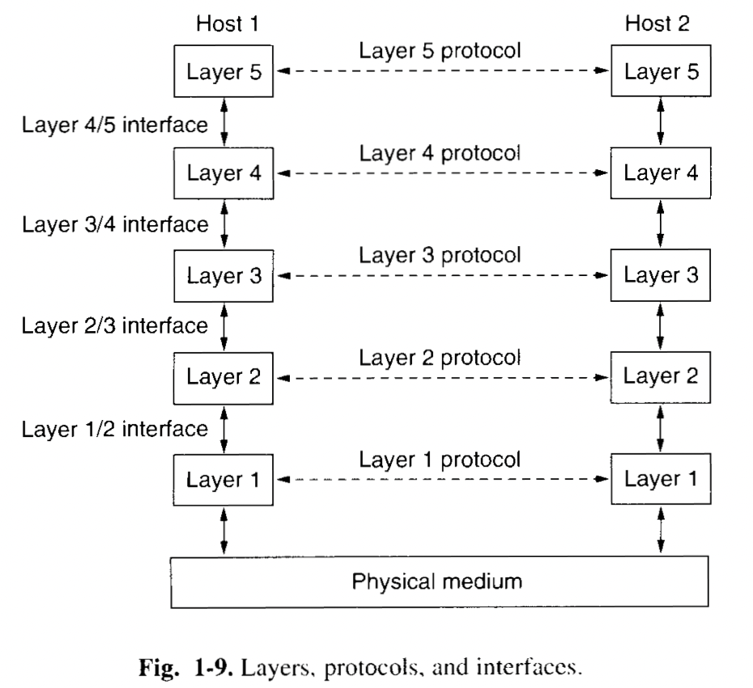
OSI layers [answers to homework]

Slide 17
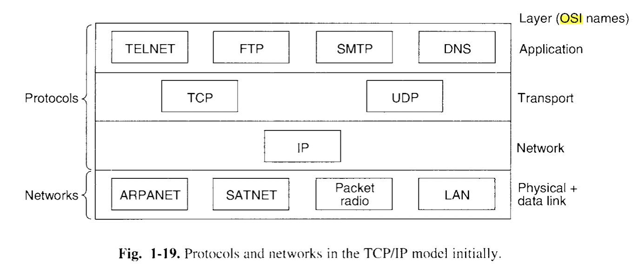
OSI layers [answers to homework]

Slide 18
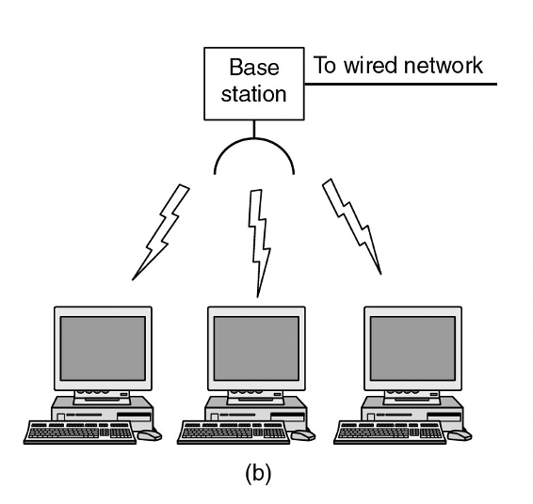
OSI layers [answers to homework]

Slide 19
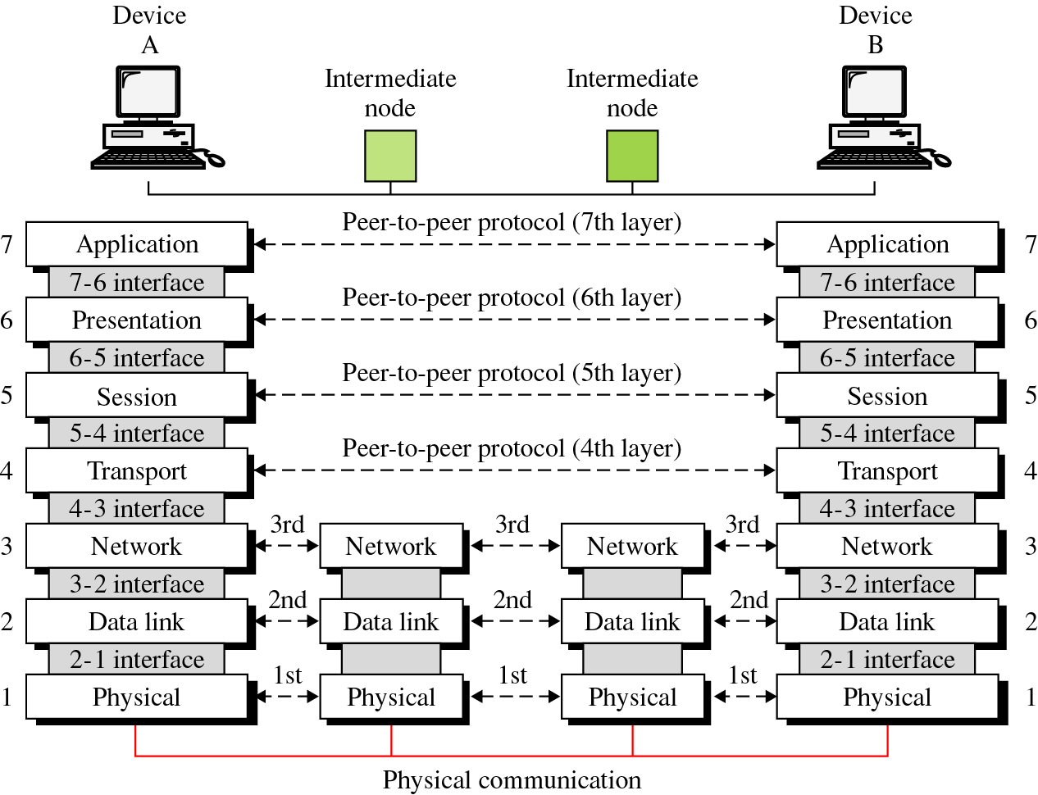
The OSI Layers Communications
19

Slide 20
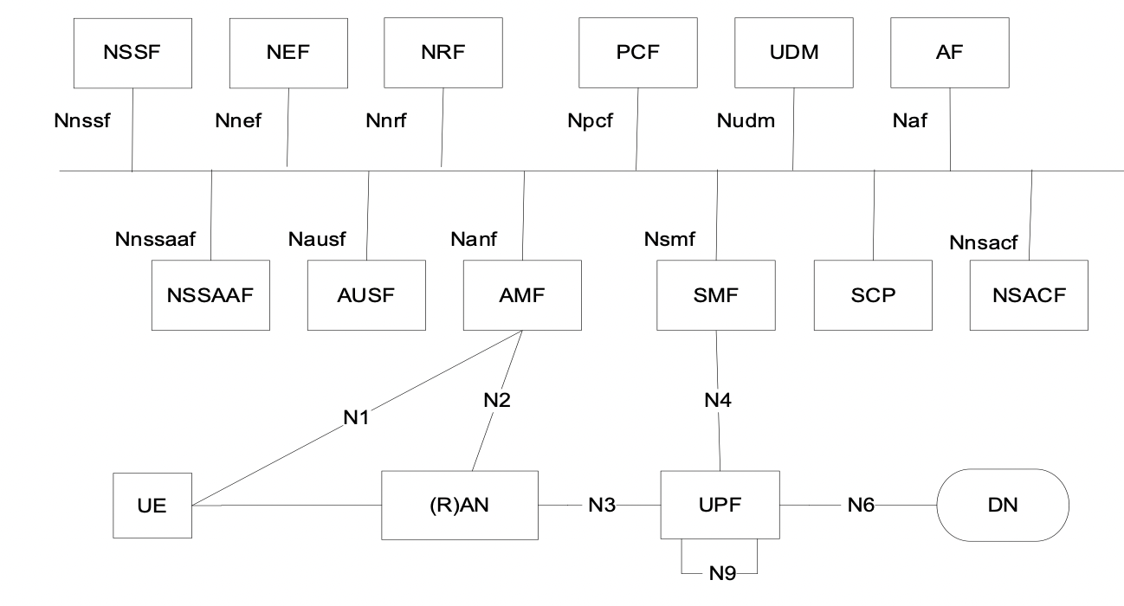
Service based architecture
Consumer
Producer
Service mesh
Yemisi
Insta
Control plane vs. user plane split is one of the important features of 4G
SBA (service based architecture) is one of the important features of 5G

Slide 21
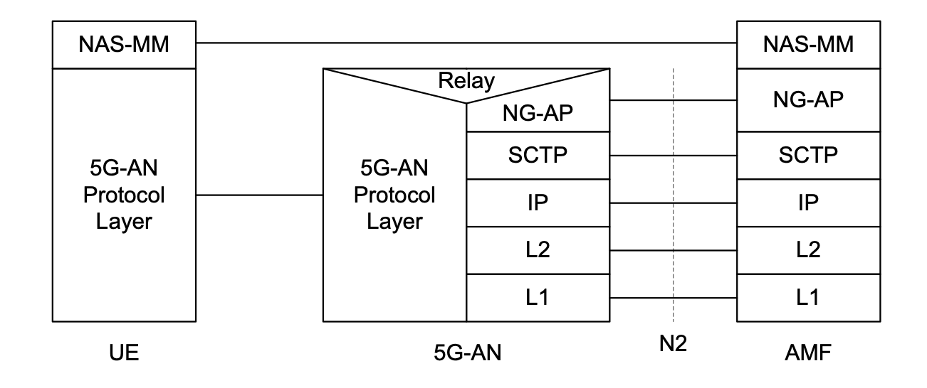
AMF is a control plane function
Control plane is carrying the control messages e.g. setup messages for calls.
It aggregates different base stations with respect to control messages
Create, delete user sessions (Yemisi calls Prof James) then registration happens first.

Slide 22
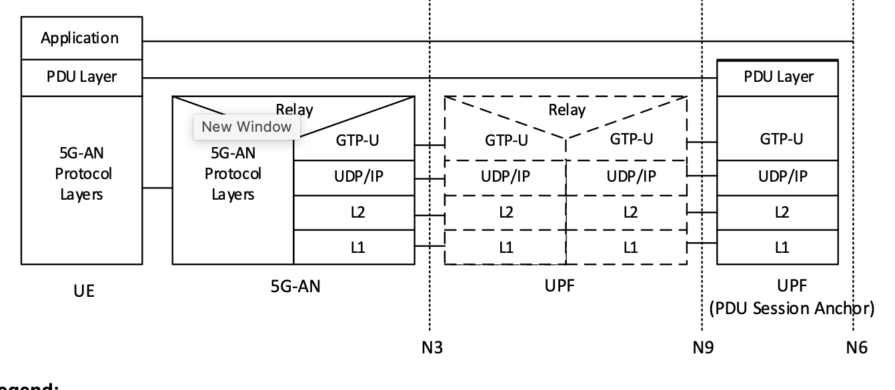
UPF is a user plane function
User plane carries actual data e.g. images to Insta or movie frames to nflix

Slide 23
What is a closed loop?
Sensing of data from the network :
Location, signal strength from the UEs.
logs from the network
(CPU, mem, io) → csv files
ANalysis of the data
ML models (prediction, classification)
Mobility prediction – when the students will move from campus or to campus
Failure conditions can be classified based on text logs from network functions
[Find the trend or pattern → if the CPU > 75 % then clearwater VNF crashes.]
Decisions based on the data
Resource allocation
Predictive maintenance
[Close unused applications → monitor and close applications, linux processes.]
Applying the decision in the network
Schedule Ues with priority,
Resource scaling, (CPU, mem and network)
[Add more CPUs and memory, network cards]

Slide 24
How to create closed loop?
English description of the use case for the closed loop
Airtel wants to reduce call failures in the network
Analyse the network logs regarding call failures
Network logs can come from Control plane or user plane.
E.g. of failure? CPU > 90%, mem> threshold level
Packet loss > threshold.
Control plane logs from AMF, RAN (base station)
User plane logs from UPF (user plane function)
Decisions? Resource allocation: more CPU, more mem, more network cards
Prioritization: Goodluck < Yemisi < Prof. James
Application of decisions: Orchestrator in management plane.
What is the closed loop: Use case? If high CPU, beyond a threshold, then close unwanted applications.
Source of data: Where is the CPU data? CSV file from the dataset.
Analysis: What is the threshold? 75%
Action: How to close unwanted applications? <<commands: kill, or APIs>>
Who started the application? Sudo? Superuser or Andrew?
Priority levels of applications
User configured list of processes.

Slide 25
Homework – 12 jan 2022
To analyse the Kaggle dataset for clearwater
Fault analysis in the network.
Reference notebooks
Find patterns, explore the data, no need for prediction.
To give you an idea about the data collected from the network
Thresholds, avg values, max, min
CSV.
https://www.kaggle.com/kerneler/starter-clearwater-vnf-virtual-ip-cc86a87e-a
A network operator has collected data from the deployment of the network
It has data collected from the application layer of IP multimedia services (IMS) used for Voice over IP,.
It has CPU (%), mem (MB) and network resource (packets per second) monitoring data.

Slide 26
Campus-1
(e.g. uni campus, I4.0,
Factory – shop floor)
BS + CN
UE
UE
UE

Slide 27
Create(basestation)
read configurations
create/spawn new processes
Set some parameters
Tx Power db
Ant orientation
Set some resource parameters
the number of CPUs
the max MB of mem
the max # of packets/s that will be used.
Modify()
modify the configurations
modify the parameters
modify the resource parameters
Delete()
kill the base station
remove some of the resources
remove the CPUs
remove the mem
Management plane
UE (phone)
Access Network – Base Stations. …
Core Network – user plane functions, Authentication functions, ….
Application server
What is managed?
-> network functions are managed.
-> by network operator (e.g. Airtel)
-> lifecycle of NF (network functions) is managed
-> Create, Modify, Delete are all part of lifecycle
-> what is a NF => base station, access management f(), session management f(), user plane f(), a piece of code which implements a specific functionality in the network. It can be running in a hardware (FPGA) or a virtualized sw (virtual box).
-> PNF (physical) and VNF (virtual)

Slide 28
Intro to 5G (network architecture)
CP/UP
Protocol stacks
Sequences - homework
Intro to closed loops
Clearwater example
Intro to management plane
Lec- Next week: Orchestrator
Lec - Closed loop examples
3GPP
ITU
ZSM
NFV
Lec- TOSCA structure
Basic format
Lec- Representation of closed loops using TOSCA
papers

Slide 29
Work methodology for 2022
Weekly call: Wednesdays 3pm Nigeria time
All materials would be uploaded in github. Kindly create a github account and send it to me so that I can invite you.
https://github.com/vrra/Students-mentoring-2022
All Q&A:
https://github.com/vrra/Students-mentoring-2022/discussions/categories/q-a

Slide 30
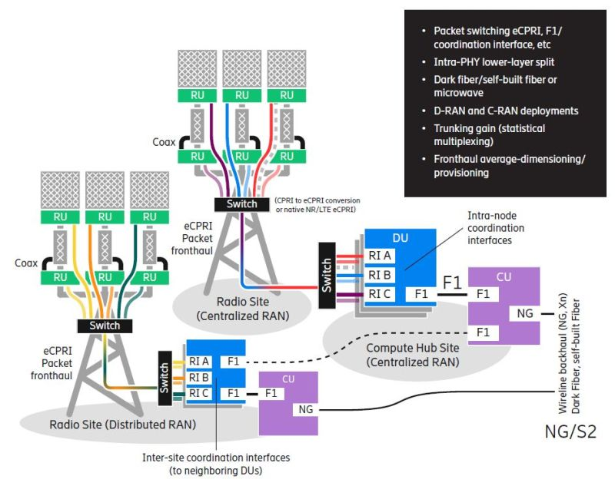
Source: Ericsson
Source: Ericsson

Slide 31
Lecture notes from 23 Feb 2022
Reference to the use case doc: <<click here>>
As the operator (e.g. Airtel) improves the closed loop functions in the network, the autonomy of the network (increases).
>> the closed loop (using data collection, analysis AI/ML and APIs is able to automate
>> and increase the autonomy
>> e.g. In clearwater VNF, if the CPU > 75 %, then a notification is provided to the operator to increase the CPU/mem/network cards.
>> e.g. due to this closed loop, operator avoids crash of clearwater VNF.
2. Cat 1: describes a scenario related to core autonomous behaviour itself.
>> e.g. Godswill has a car. It has 6 seater, …., powerful engine, …..
>> e.g. it moves fast, it has automatic gears, it has spare wheel, it has 6 seatbelts, etc
Cat 2: describes a scenario related to application of autonomous behaviour in the network.
>> e.g. Godswill drives the car to FUT Minna everday
>> e.g. Godswill uses the seatbelt to make himself safe.
Advantage: reducing troubleshooting time and error rate

Slide 32
Lecture notes from 23 Feb 2022
Source of data:
1. collect real-time data (vs. offline, non real time) – e.g. Yemisi is UL (uplink) upload of photo, while she is doing it, collect data from management plane. E.g. xopera orchestrator. Resource allocation. Resource = cpu, mem, network NIC.
2. from integrated network management : is the same as management plane
e.g. managing different network elements - allocate resources (cpu, mem, and network NIC), de-allocate resources , e.g. monitor the usage of resources , configuration of parameters in the network (e.g. maximum bitrate allowed for Mr. Goodluck). E.g. xOpera which Blessed explained.
3. diagnostics data is collected from network elements: decided based on the KPI (key performance indicator):
e.g. for a student. = GPA (grade point average) – how well you are studying.
e.g. for a network element = KPI = packets dropped, delay introduced, jitter introduced, throughput
4. network elements typically expose certain measurements (e.g. from clearwater VNF, packets processed per second, total number of packets dropped, etc) – there are functions which you can call to get this data.
5. we map the measurements to the KPIs e.g. by analysing the total number of packets dropped (real time) every 1 second, then operator can find the trend of packet loss in the network element.

Slide 33
Lecture notes from 23 Feb 2022
Analysis of data
3. Classification algorithms, outlier detection, are used for finding, predicting faults.
Homework: find the details of SVM (support vector machine).
SVM is used mostly in [o1: classification or o2: regression]
objective of the support vector machine algorithm is to find a hyperplane in an N-dimensional space(N — the number of features) that distinctly classifies the data points.
Decision
4. intelligent recommendation algorithms and search engines, and to directly provide reasons and recommend solutions of each abnormal network element
Homework: find recommendation algorithms from ML – tell me examples.
Application of the decision (where? O1: in the operator manual book or O2: directly in the network using APIs)
5. implementation, and evaluation and optimization

Slide 34
Student contribution to ITU focus group Autonomous networks
>Create a student paper
>discuss the student paper in this meeting
>present the student paper in the ITU meeting.
>30 Mar 2022 [23rd Mar - internal review with Prof. James]
>how to register: https://www.itu.int/net4/CRM/xreg/web/Registration.aspx?Event=C-00011095
>what is the content? What should go into the paper:
- introduction to 5G, closed loops
- background of 2021 work by WINEST team
- closed loop examples and use cases
- TOSCA based representations.
>format of the presentation
- will be explained in class.
- word document

Slide 35
TOSCA based representations
1. YAML (meta language) used for structured representation of services (service template).
2. What are services ? – network services
3. What are network services -> are virtualized software functions which implement network functions.
4. What are network functions - > are parts of the network which implements functionality in the different layers of the network. E.g. Control plane : AMF (access management function), SMF (session management function), User plane UPF (user plane function)
5. How to implement the network functions: C/C++/Python/Java.
6. Where does the NF (network functions) run? They execute in virtualized platforms – either in cloud or in virtualbox.
7. Who uses the TOSCA based YAML? – representation of services is created by humans (students, operators) and parsed/compiled by orchestrators (management plane, e.g. xopera), and network services are instantiated by orchestrators in the cloud/virtualized platforms.
8. What is meant by “instantiated”? – e.g. a linux process is created with the parameters mentioned in the service template.
TOSCA YAML
Orchestrator
Cloud + processes = set of network service for operator (e.g. Airtel)
YAML = “yet another meta language”

Slide 36
Use case-1
Title: use of knowledge in AN (autonomous networks)
Actors:
- actor 1) a human being (operator, e.g. Airtel trained personnel)
capability-1: knows an address (e.g. URL) from where import of knowledge can be done
requirement-1: operator needs to download reports.
- actor 2) a data base of knowledge (e.g. graph data base, an SQL database with facts which can be queried)
requirement-1: data base needs to import knowledge (e.g. a row of data base) from an external URL
capability-1: an address (e.g. URL) for referring to or querying the knowledge base (data base).
- actor 3) AN components (e.g. controllers in AN)
requirement-1: refer or query knowledge from a data base.
capability-1: it can produce reports : an address URL where reports can be downloaded.
actor 1’s requirement-1 is satisfied by actor 3’s capability -1
Actor 2’s requirement-1 is satisfied by actor 1’s cap-1
Actor 3’s requirement-1 is satisfied by actor 2’s cap-1
Homework: Refer to FG-AN-usecase-002 and figure 3 of FGAN-O-13-R1 and formulate the actors, capabilities and requirements as above

Slide 37
Use case-2
Title: Configuring and driving simulators from autonomous components in the network
Actors:
- actor 3) AN components (e.g. controllers in AN)
capability-1: knows the scenarios for experimentation.
requirement-1: it wants to trigger experimentation.
requirement-2: it wants reports on the experiments.
requirement-3: it wants to update knowledge.
- actor 4) Sandbox
requirement-1: it wants scenarios for experimentation
capability-1: it can trigger experimentation.
capability-2: it can monitor and analyse experiments
capability-3: it can produce reports on the experiments
- actor 2) a data base of knowledge (e.g. graph data base, an SQL database with facts which can be queried)
requirement-1: ……..
capability-1: it can update knowledge
actor 1’s requirement-1 is satisfied by actor-2 capability -1
actor 1’s requirement-2 is satisfied by actor-2 capability -3
actor 1’s requirement-3 is satisfied by actor-3 capability -1
Actor 2’s requirement-1 is satisfied by actor-1 cap-1
Actor 3 has no requirement.
Homework: Refer to FG-AN-usecase-xxx FGAN-O-13-R1 and formulate the actors, capabilities and requirements as above

Slide 38
r1
r1
r1
r1
a1
a3
a2
a4
c1
c2
c1
c1
Homework: complete the graph as per the use case analysis that we did

Slide 39
CODING TUTORIAL -1: Graphs showing relationships between the Use-case Actors

Slide 40

Prerequisites for the tutorial
Create a colab account https://colab.research.google.com
Create a github account https://github.com
Create a neo4j Aura account https://neo4j.com/cloud/platform/aura-graph-database/
Note the password
Visit https://github.com/vrra/FGAN-Build-a-thon-2022/blob/main/Notebooks2022/build_a_thon_graph_v1.ipynb make sure you can access this notebook
Click on “open in colab” and make sure you are able to open the notebook in colab.

Slide 41
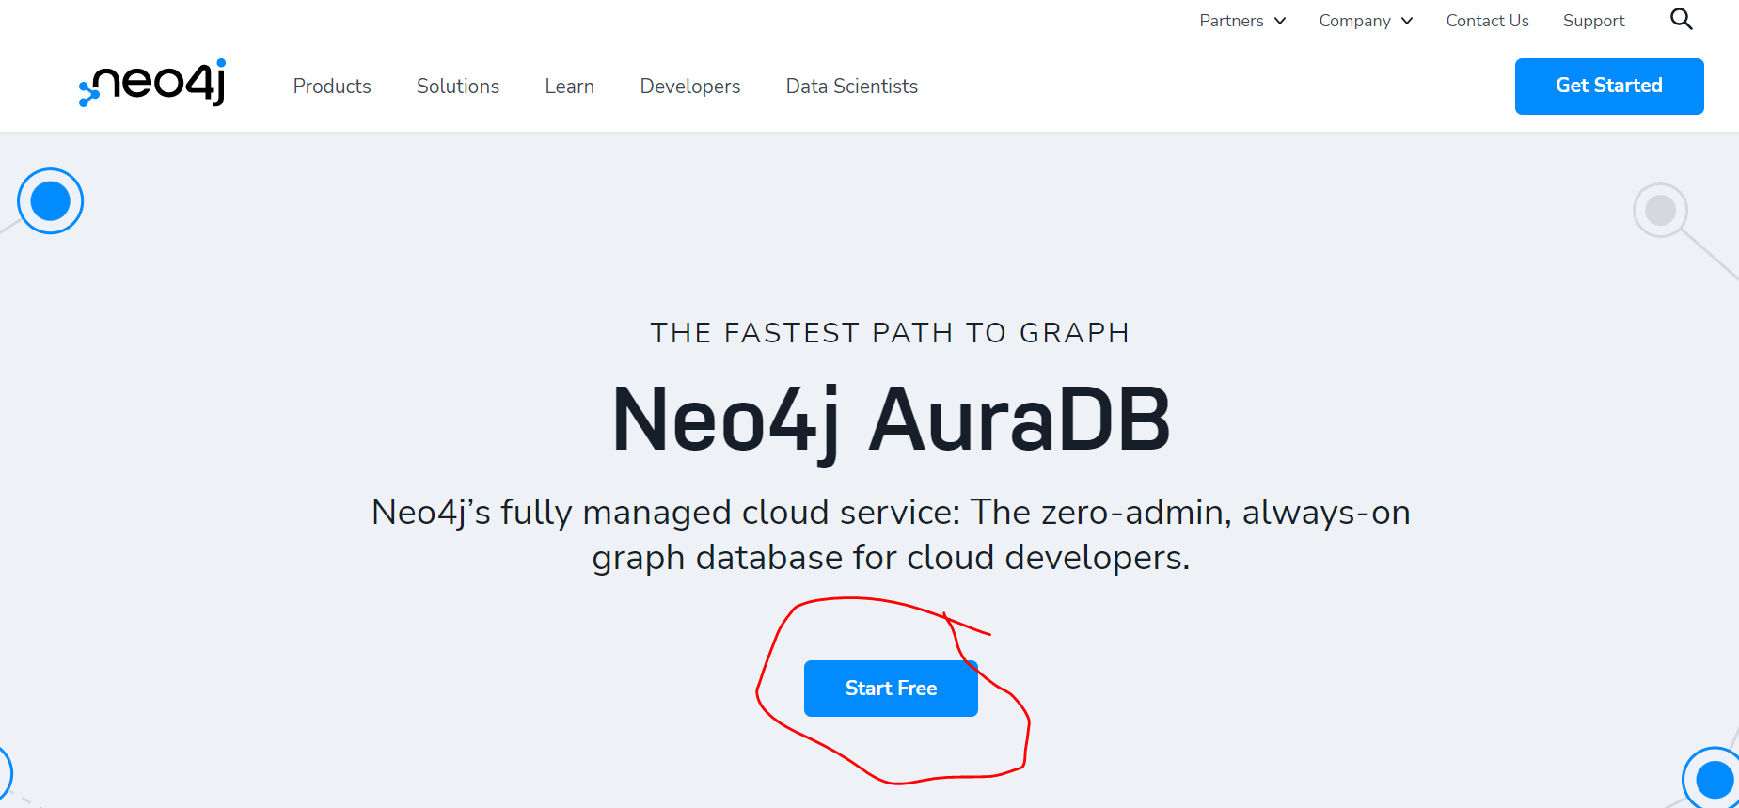

Slide 42
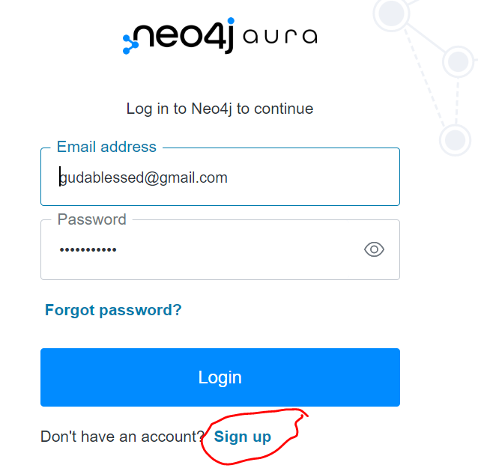

Slide 43
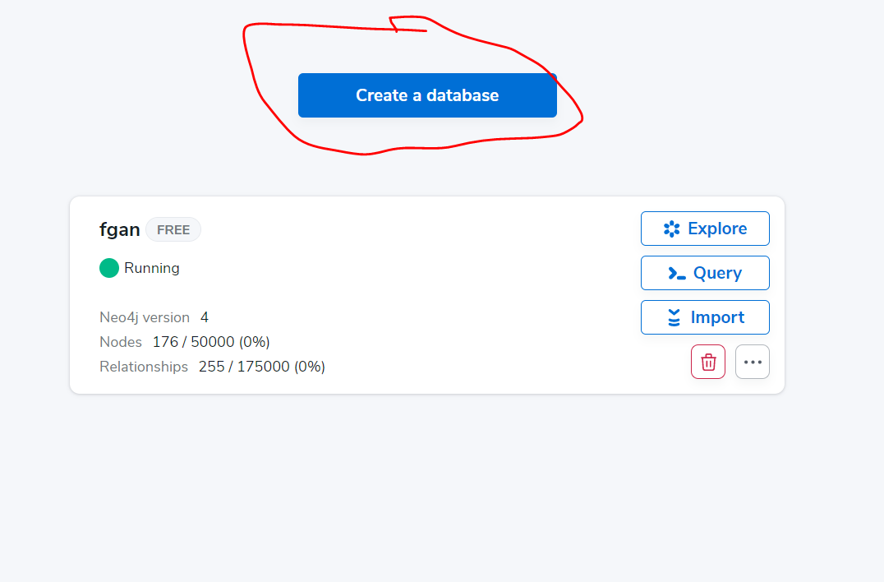
After creating a DB with the movie data then “Query”
Click on the query button to launch the “server connect page”

Slide 44
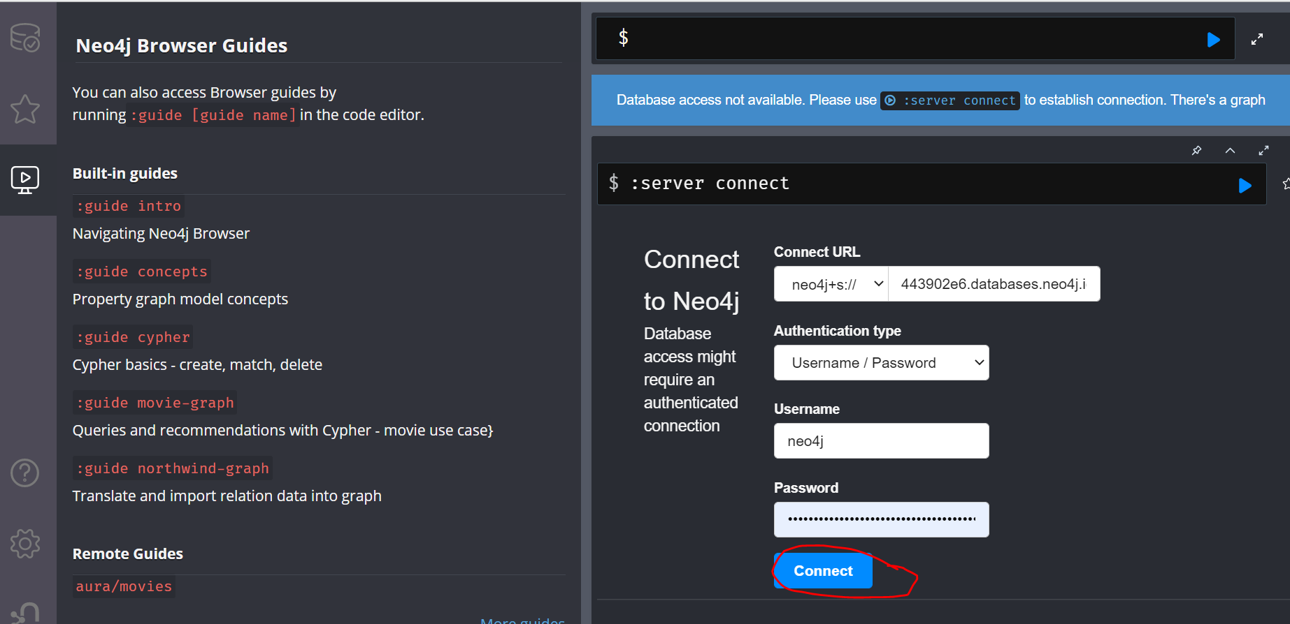
Note the URL which is shown here
Use the passwd created in prerequisites step 3
After connecting, click on aura/movies and follow the tutorials

Slide 45
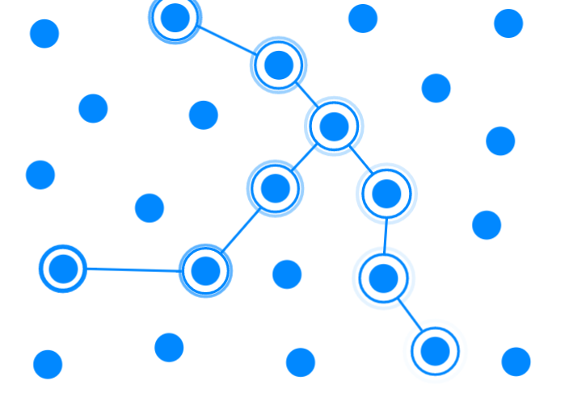
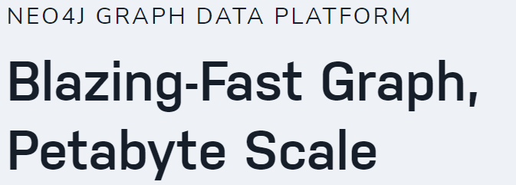
CODING TUTORIAL -1: Graphs showing relationships between the Use-case Actors
-Neo4j Graph Data Platform [https://neo4j.com ] can be used for Intelligent data analysis on graphs.
It possesses a Native Graph DB for speedy querying and data analysis.
Also, highly scalable – supports up to trillion of relationships amongst nodes at approx. 66ms latency.
Multi-language: Net, Java, Node.js, Python, and more
-
Related FUTMinna Courses CPE417- Data Structures & Algorithms, CPE418-Java, CPE311 – Python
Notes:
Java - CPE 418
Python – CPE322

Slide 46
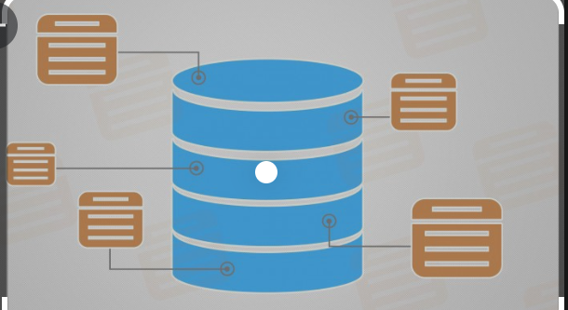
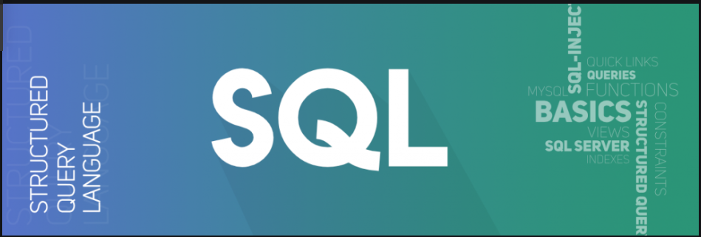
Neo4J Setup steps
Sign up for a free account [here]
DB is queried using the Cypher Syntax [here]
Create an empty DB and get details (uri, user, password)
Cypher is a graph query language that is used to query the Neo4j Database. Just like you use SQL to query a MySQL database, you would use Cypher to query the Neo4j Database
Related FUTMinna Courses CPE517- DBMS
Notes:
neo4j, IUKexu25CPGFgZ2hh2gTjdhMvA8fwEvkAkv6qCxTTLQ

Slide 47
Background Knowledge: Sample Student Tables
StdID | Fname | Level
100 | Frank | 3
101 | Moses | 3
104 | Yemisi | 3
109 | Othniel | 4
Query Language: It is used to extract the data from the relations
E.g SELECT Fname FROM STUDENT;

Slide 48
Open the notebook
Open the notebook in github
And open it in colab. As in steps 4 and 5 in prerequisites slide.
NOTE - DB is queried using the Cypher Syntax [here]
Cypher is a graph query language that is used to query the Neo4j Database. Just like you use SQL to query a MySQL database, you would use Cypher to query the Neo4j Database
Related FUTMinna Courses CPE517- DBMS
Notes:
neo4j, IUKexu25CPGFgZ2hh2gTjdhMvA8fwEvkAkv6qCxTTLQ

Slide 49
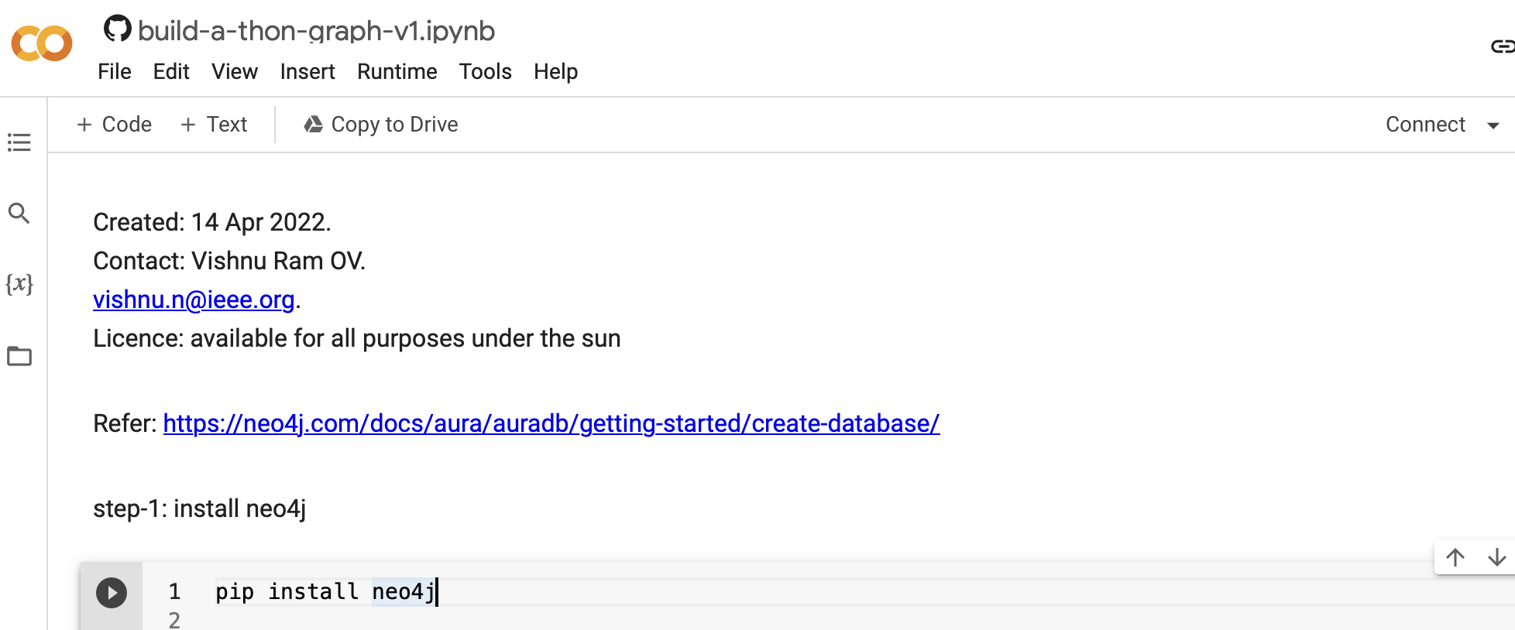

Slide 50
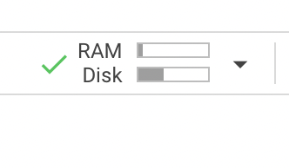
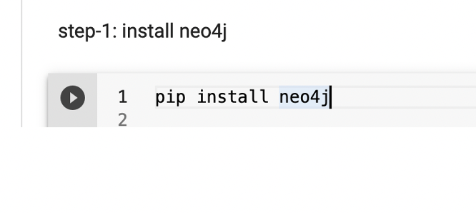
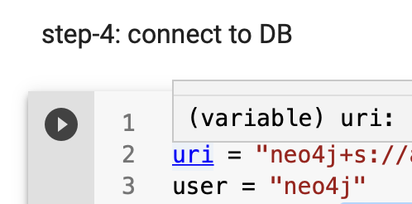
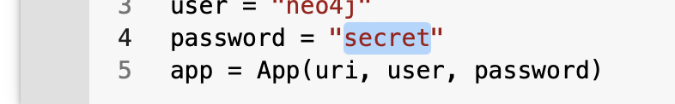
Wait for google to connect to a run time system
Click on the play button on the left of each cell
Change the URI to what you obtained from the server connect page of Aura. (do not copy others’ URL)
Use the passwd created in prerequisites step 3

Slide 51
Neo4J Cypher Syntax - Examples
A simple cypher query can look something like this
A node in graph database is similar to a row in a relational database.
In writing a cypher query, relationships are enclosed in square brackets
In writing a cypher query, a node is enclosed between a parenthesis — like (p:Person) where p is a variable and Person is the type of node it is referring to
Related FUTMinna Courses CPE517- DBMS
Notes:
Match (m:Movie) where m.released > 2000 RETURN m limit 5

Slide 52
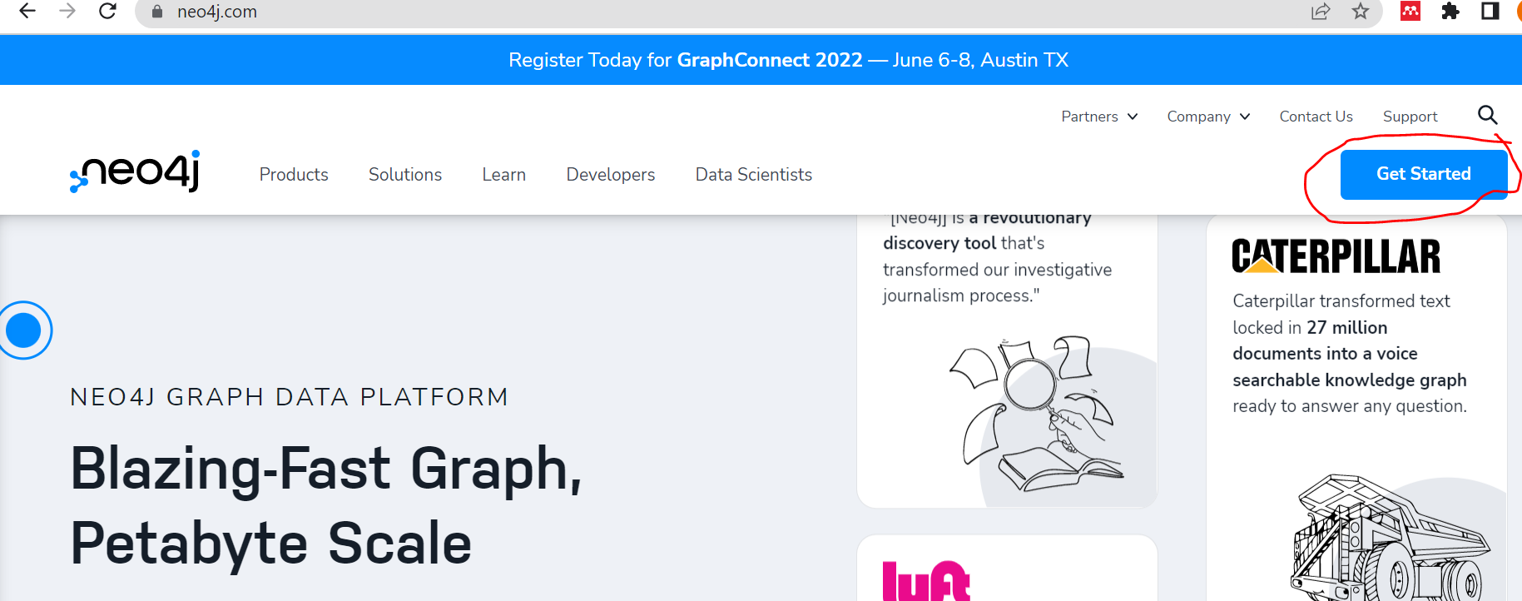

Slide 53
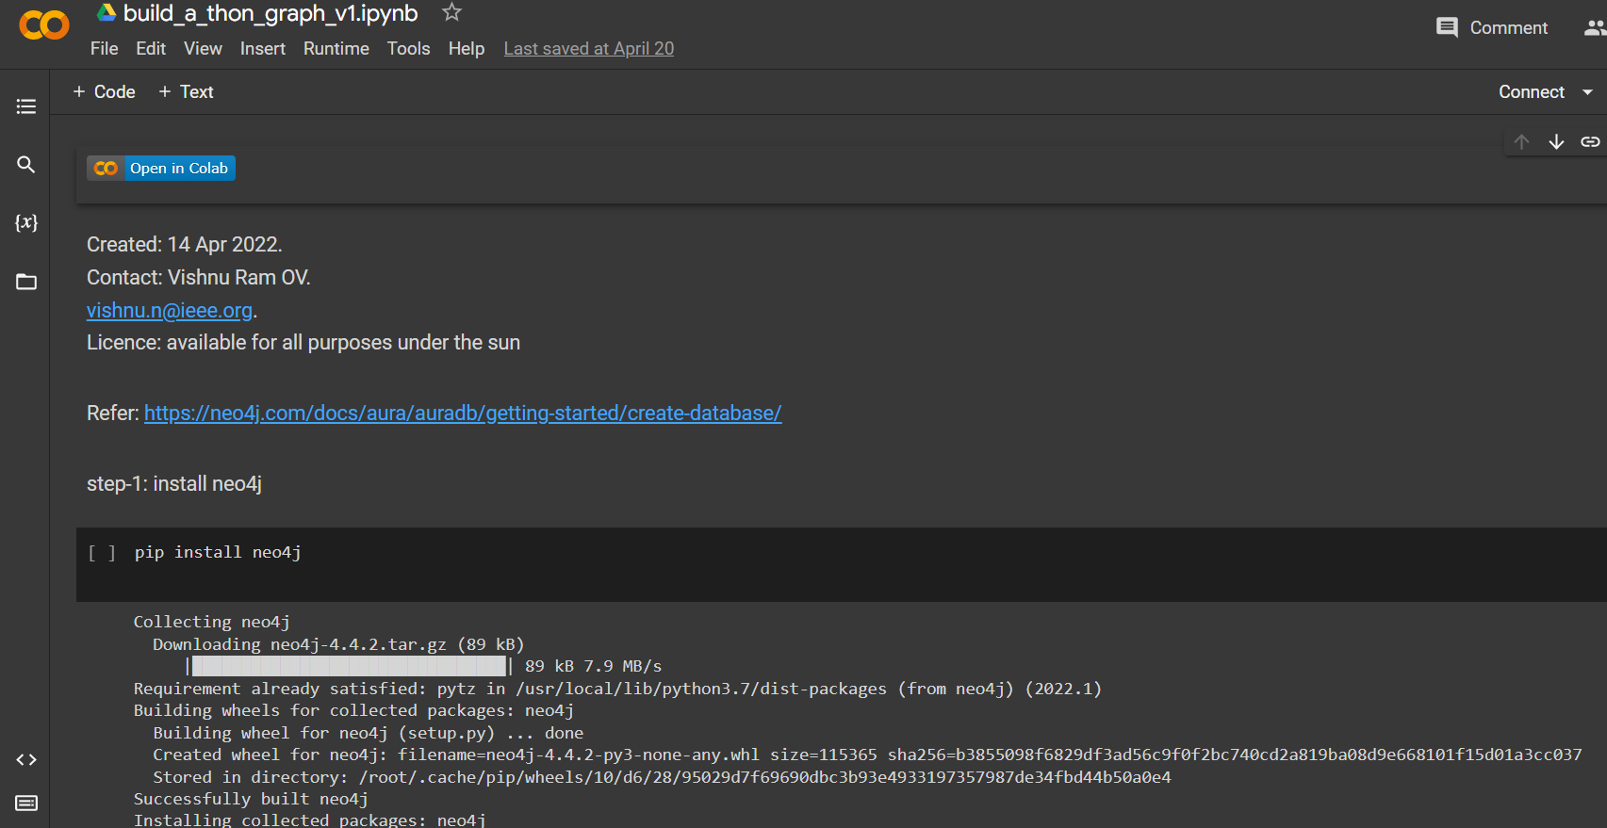

Slide 54
FAQ
My Aura DB got “suspended”, help!!!
Answer: go to the console and resume it.
How to register for June workshop?
https://www.itu.int/net4/CRM/xreg/web/Login.aspx?src=Registration&Event=C-00011377
3. I am not able to connect to my DB
Option-1: Use chrome browser
Option-2: Delete the db from the console, Create an empty db again
Option-3: Make sure you are using the correct URL of the DB, in the notebook, while connecting.
Option-4: If you are copying the url from the console, don’t include the port number in your copy.
Remember to use the new password
Option-5: if you are using a non-secure connection, you may face problems in connecting to the DB, so try changing to a more secure wireless connection.
4. Some common Cypher query commands:
Match (n) return (n)
#this will list/return all nodes and relationships
MATCH (n) DETACH DELETE n
#this will delete all nodes and relationships.
MATCH (n) OPTIONAL MATCH (n)-[r]-() delete n,r
#this is similar to the previous command, it will also delete all nodes and relationships.

Slide 55
Preparations for 2 Sep 2022
Identify speakers
TBD
TBD
Prepare document and demo.
Review
Practice.

Slide 56


Demo and tutorial on how to prepare TOSCA yml files from graphdb
Graphs (neo4j)
Yml generator
xopera
Cypher query
Yml files
Step-1: create yml manually (use 2021 yml as start)
Step-2: use ITU RR server to install xopera and compile yml
Step-3: use NLP to generate yml.
Step-4: go back to step-2 above to compile generated yml.

