Slide 1
Object Oriented Programming Review!
By Mainak Mondal
15BCA0005

Slide 2
Internet
One one most complex structures today .
Indexing Problem(Google Indexes 11%)*
Takes 22 days (average to index)
Importance(context)?

Slide 3
Before We Begin.
All programs should be written with modularity in mind.
Code should be reuseable
Any type of code once written, by anyone, shouldn’t be rewritten, no matter what*,
*only if you can write it better and faster !

Slide 4
VoodleChat

Slide 5
Concepts
LAN
Internet
Sharing Configuration
Platform
Differences!
Overview!

Slide 6

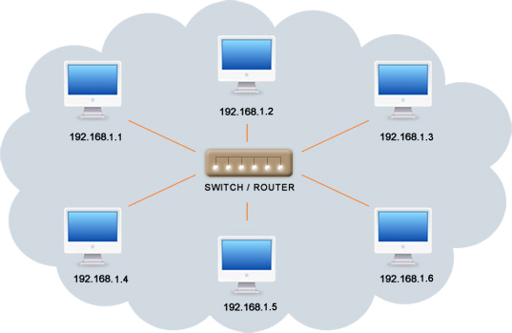
LAN
A closed group of computers interconnected to one another by a Router/Switch. (Wireless or Wired).
IP Address (local)
Computer Name.

Slide 7

Internet
A group of interconnected, structured, computers with a Domain Name System(DNS).
-A system which assigns names to IP Addresses, for easier accessibility.
Dynamic IP Address
Static IP Address
FTP (file transfer protocol)- Update to the current app.

Slide 8
The Current Project!

Slide 9
Local Configuration...

Slide 10
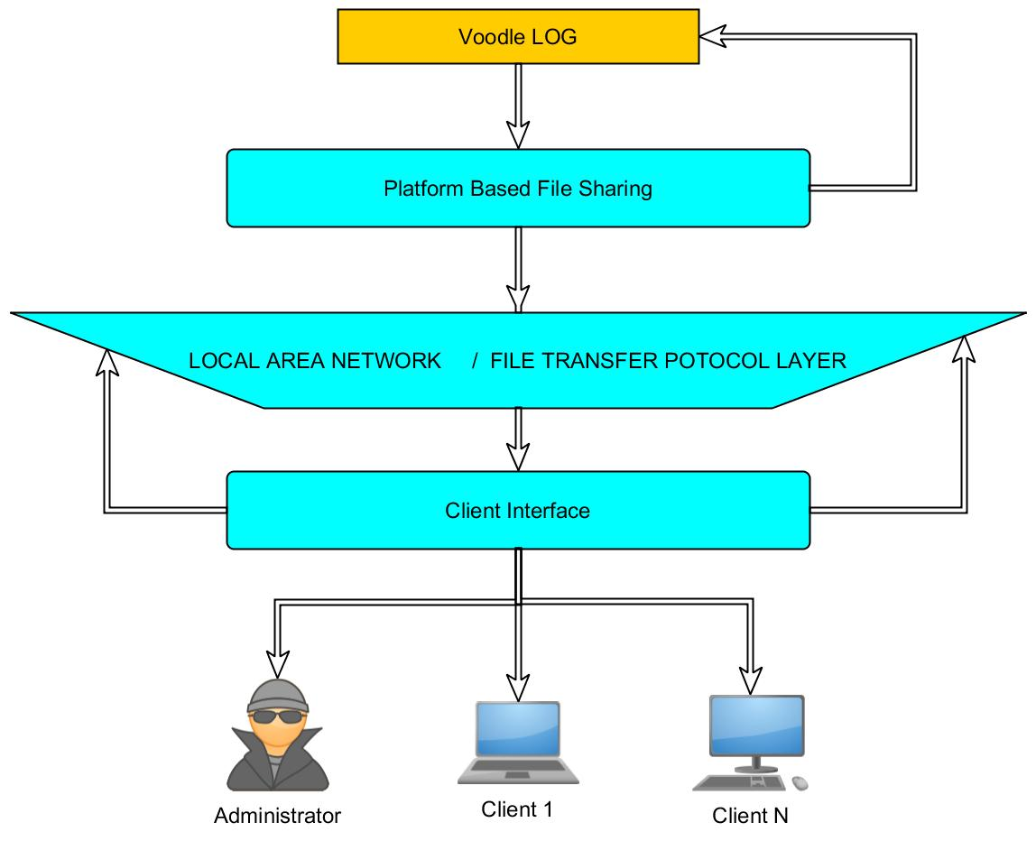

Slide 11
Features(and modules):
Chat log(variable size)
Server Module(optional) (1.3 MB)
Reader Module(1.3MB)
Client Module(1.3MB)
Combined Package: 4 MB

Slide 12
Feature : File Sharing
Sharing a file between 2 computers is very easy using the current sharing tools.
These tools are pretty easy to acquire and use but no one has ever done is console style.

Slide 13
Conclusion
There are a lot of Internet Relay Chat Clients available but a one with about a mere 300 slic lines of code is nearly impossible due to dynamic platform variations. The power of Object Oriented programming with the current platform file sharing modules overcomes those barriers and provides us with a console based IRC software that is exactly 4 Megabytes!

