Slide 1

Data Scientist Salary Analysis DSE 5002 - Project 1 - 4/2025 Student: J. Casey Brookshier
Introduction - Problem Definition
Given current market conditions, what would constitute a competitive salary range For a data scientist with proven skills and the potential to lead?
Define Pro’s & con’s to hiring a remote Data Scientist. Is there any advantage to hiring abroad?
How does the given dataset project the current competitive salary given market changes between now and then?
Is there a more current measure of salary range for data scientists and does it offer a significant divergence from the given data set?

Slide 2
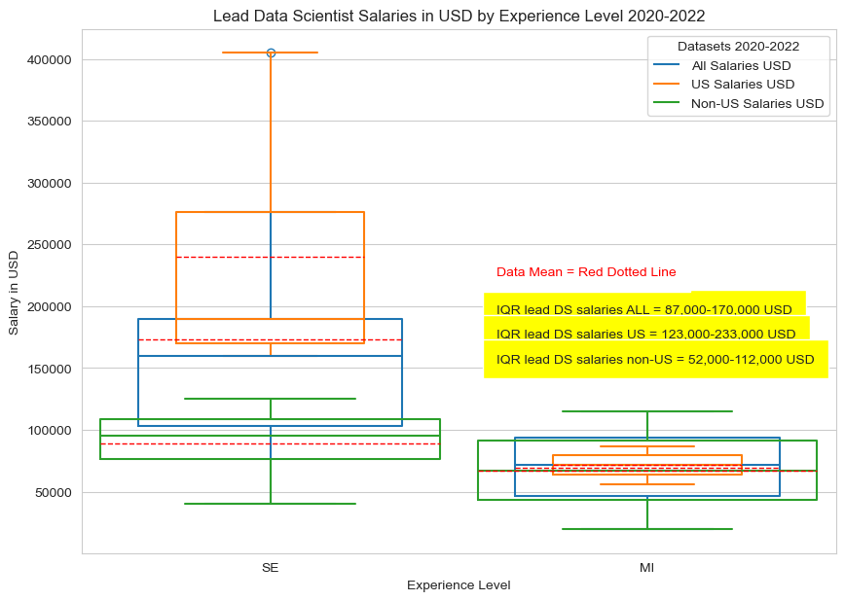
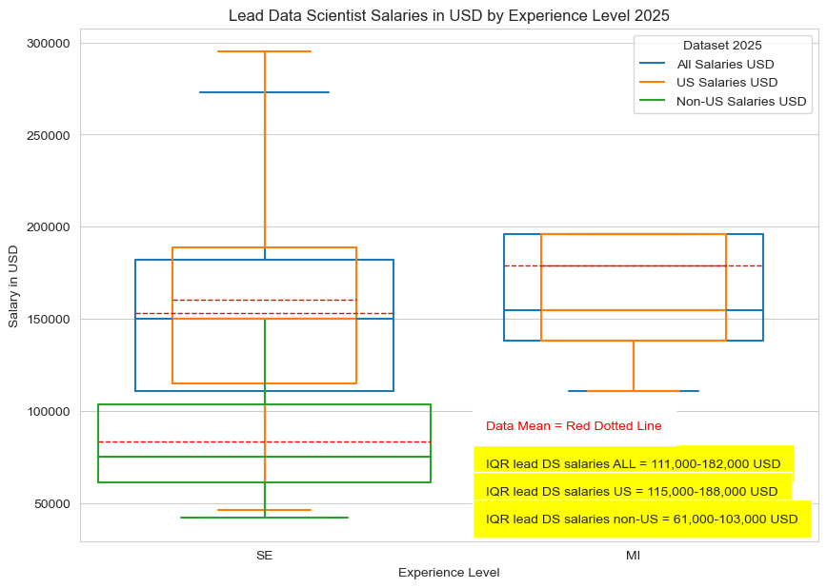
Problem Analysis
All data filtered to reflect salary ranges with the word ‘lead’ included in the job title. Analysis of the provided dataset compared to a more current data set indicates a marked difference between the Interquartile range of ‘lead’ filtered salaries. The interquartile range (25% to 75%) percentiles change from a range of 87,000 to 170,000 USD in the 2020-2022 set, to a range of 111,000 to 182,000 USD in the 2025 filtered set.
Both the original data set and the current set showed a substantive overall difference in ‘lead’ filtered salary ranges between US and non-US filtered subsets. The IQR for the 2025 set indicated a salary range of approximately 115,000 to 188,000 USD for US data scientists and an IQR of 61,000 to 103,000 USD for the non-US data scientist equivalent.
Notes:
All data filtered to reflect salary ranges with the word ‘lead’ included in the job title. Analysis of the provided dataset compared to a more current data set indicates a marked difference between the Interquartile range of ‘lead’ filtered salaries. The interquartile range (25% to 75%) percentiles change from a range of 87,000 to 170,000 USD in the 2020-2022 set, to a range of 111,000 to 182,000 USD in the 2025 filtered set.
Both the original data set and the current set showed a substantive overall difference in ‘lead’ filtered salary ranges between US and non-US filtered subsets. The IQR for the 2025 set indicated a salary range of approximately 115,000 to 188,000 USD for US data scientists and an IQR of 61,000 to 103,000 USD for the non-US data scientist equivalent.

Slide 3
Recommendation
To Attract a data Scientist with leadership Ability, it is recommended that to remain competitive in the 2025 US market, the offered salary range should fall between 110,000-180,000 USD to attract a data scientist with leadership experience.
While non-US data scientists can be hired for less money, a remote employee mayn’t offer the same level of inter-employee trust and stock stability as a local Data scientist (Inbusiness, 2024; xu 2020). Additionally, a non-English speaker may have trouble communicating technical ideas unless fluent with technical English.
The US is still considered a leader in data science (Business day, 2025). it follows that what is saved financially with an off-shore employee may be lost in cutting edge knowledge.
The provided data set only covered the years 2020-2022. Independent research reveals that the 87,000 – 167,000 USD interquartile range for data scientist with lead experience in 2020-2022 is substantively different from the comparable 2025 interquartile range of 110,000-180,000 USD.

Slide 4
Sources
Badole, Saurabh.(2025, March).latest data science job salaries 2020-2025. Kaggle. https://www.kaggle.com/datasets/saurabhbadole/latest-data-science-job-salaries-2024/data
Inbusiness. (2024, September). Are managers more invested in their in-person vs. remote employees’ growth?
https://inbusinessphx.com/leadership-management/are-managers-more-invested-in-their-in-person- vsremoteemployeesgrowth#:~:text=In%20terms%20of%20trustworthiness%2C%2040%%20favor% 20in%2Dperson,their%20teams%20without%20the%20traditional%20in%2Doffice%20presence.
Ogwo, Charles. (2025, February 23). Five best countries to study data science globally. Businessday. https://businessday.ng/careers/article/five-best-countries-to-study-data-science-globally/
Xu, limin.(2020,December). The benefit of being a local leader: evidence from firm-specific stock price crash risk. Journal of corporate finance. https://www.sciencedirect.com/science/article/abs/pii/S0929119920301966#:~:text=We%20find%2 0that%20local%20leadership%2C%20in%20terms,decreases%20a%20firm's%20stock%20price%20cr ash%20risk.&text=Overall%2C%20our%20results%20highlight%20a%20novel%20benefit,the%20fir m%20less%20prone%20to%20crash%20risk.

