Slide 1

Your next investment
BY CRAWFORD DAVIDSON

Slide 2

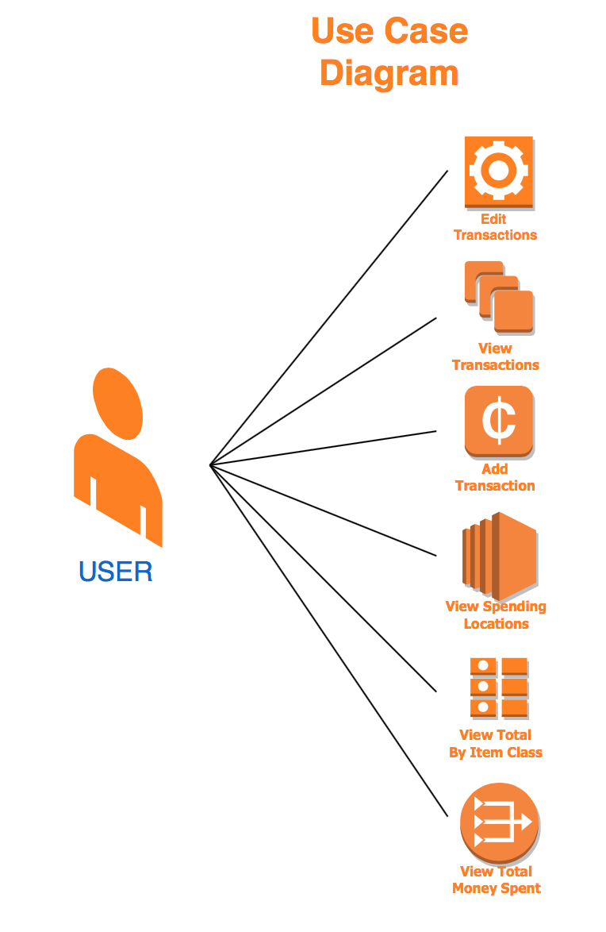
Use case
Quick and easy budgeting app
Allow users to track purchases
Easy to add/edit transactions
Provide info on user spending habits
Track locations as well as types of purchased items

Slide 3
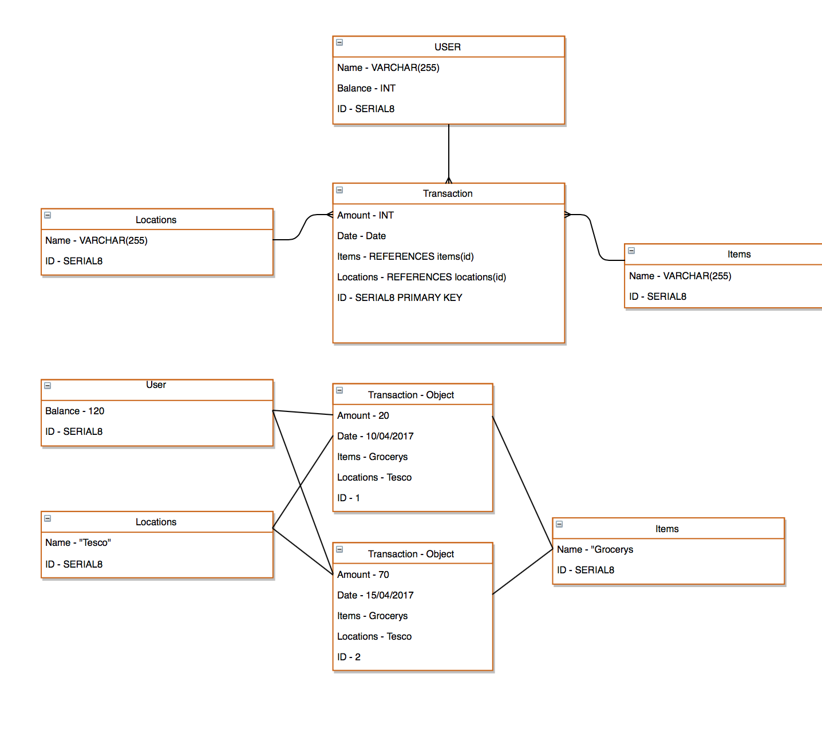
Tables/ relationships
Transactions
Merchant
Items
User

Slide 4
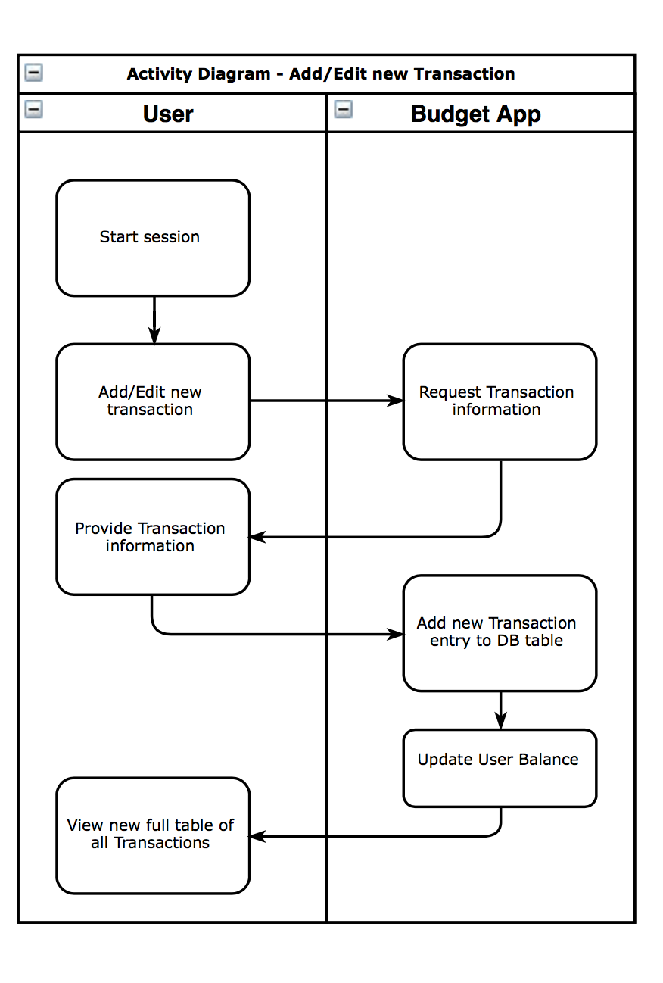
Activity – add/edit
User starts session (taken to view all transactions)
Once add/edit selected the entry fields will be shown, requesting input of new information
App will save to current DB tables, either updating or creating a new row. Will also update user table with new balance
User will be taken back to transaction page to view new entry or edited transaction

Slide 5
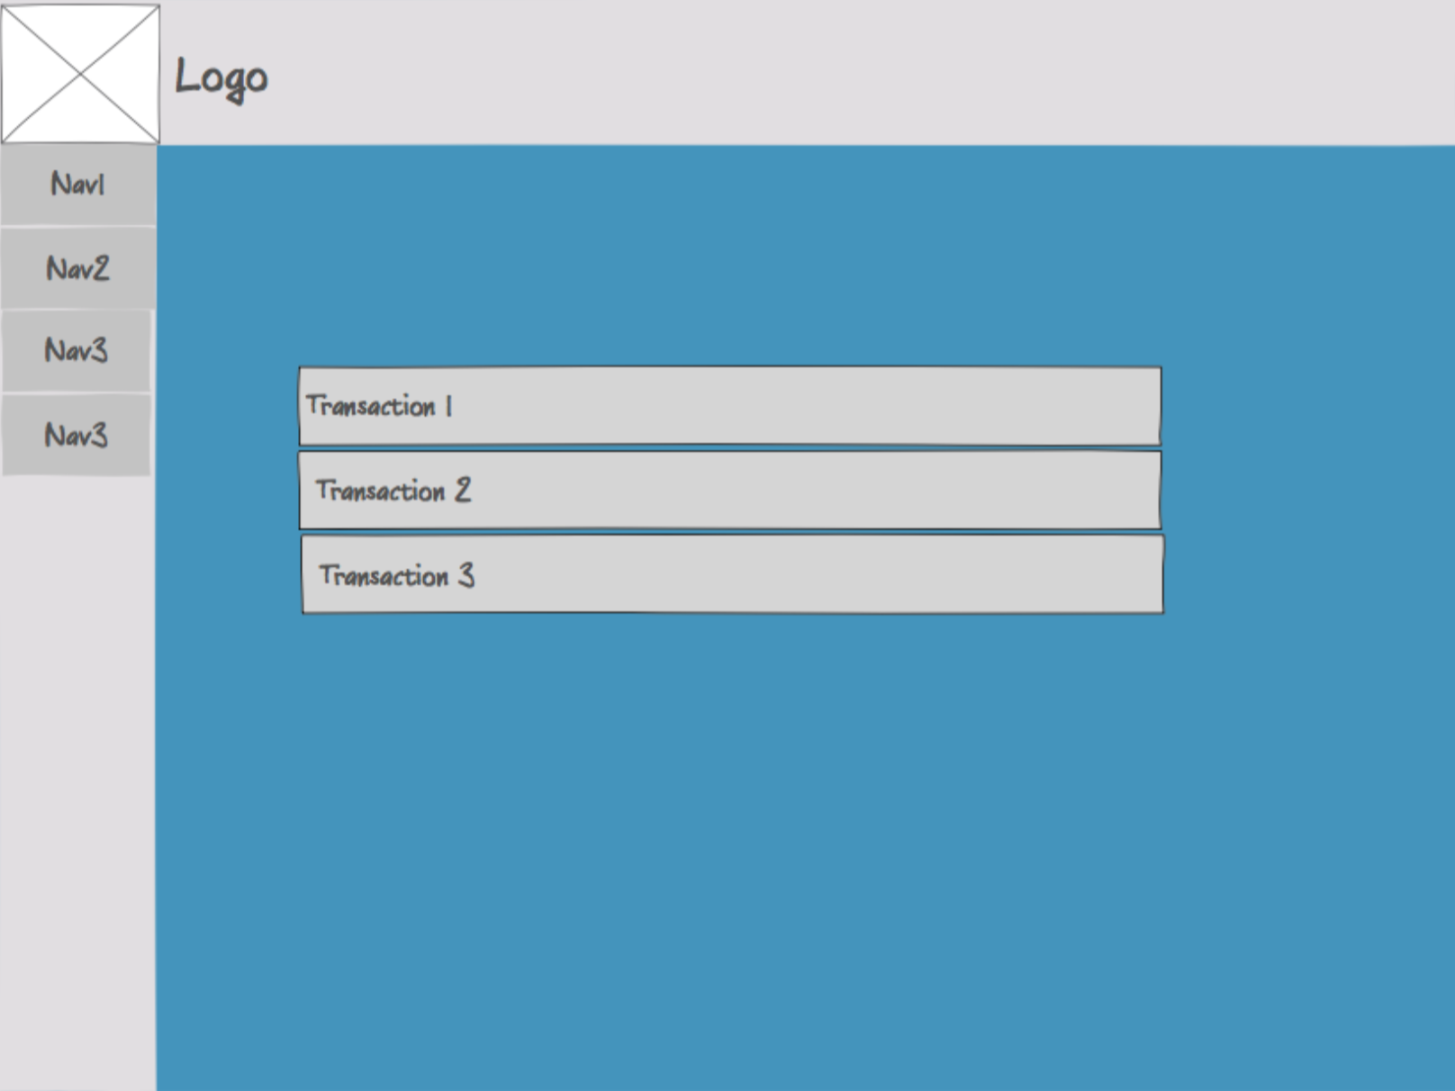
Wireframe
Very first layout wireframe
Information easy to access
Try not to have too much clutter

Slide 6
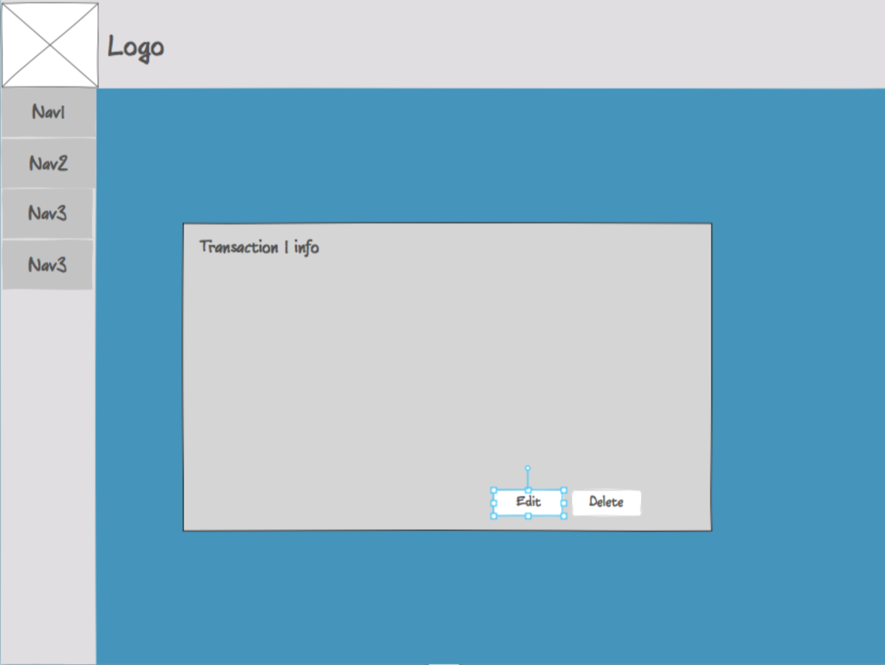
WIREFRAME
Showing a single transaction view that allows the user to edit or delete the entry

Slide 7
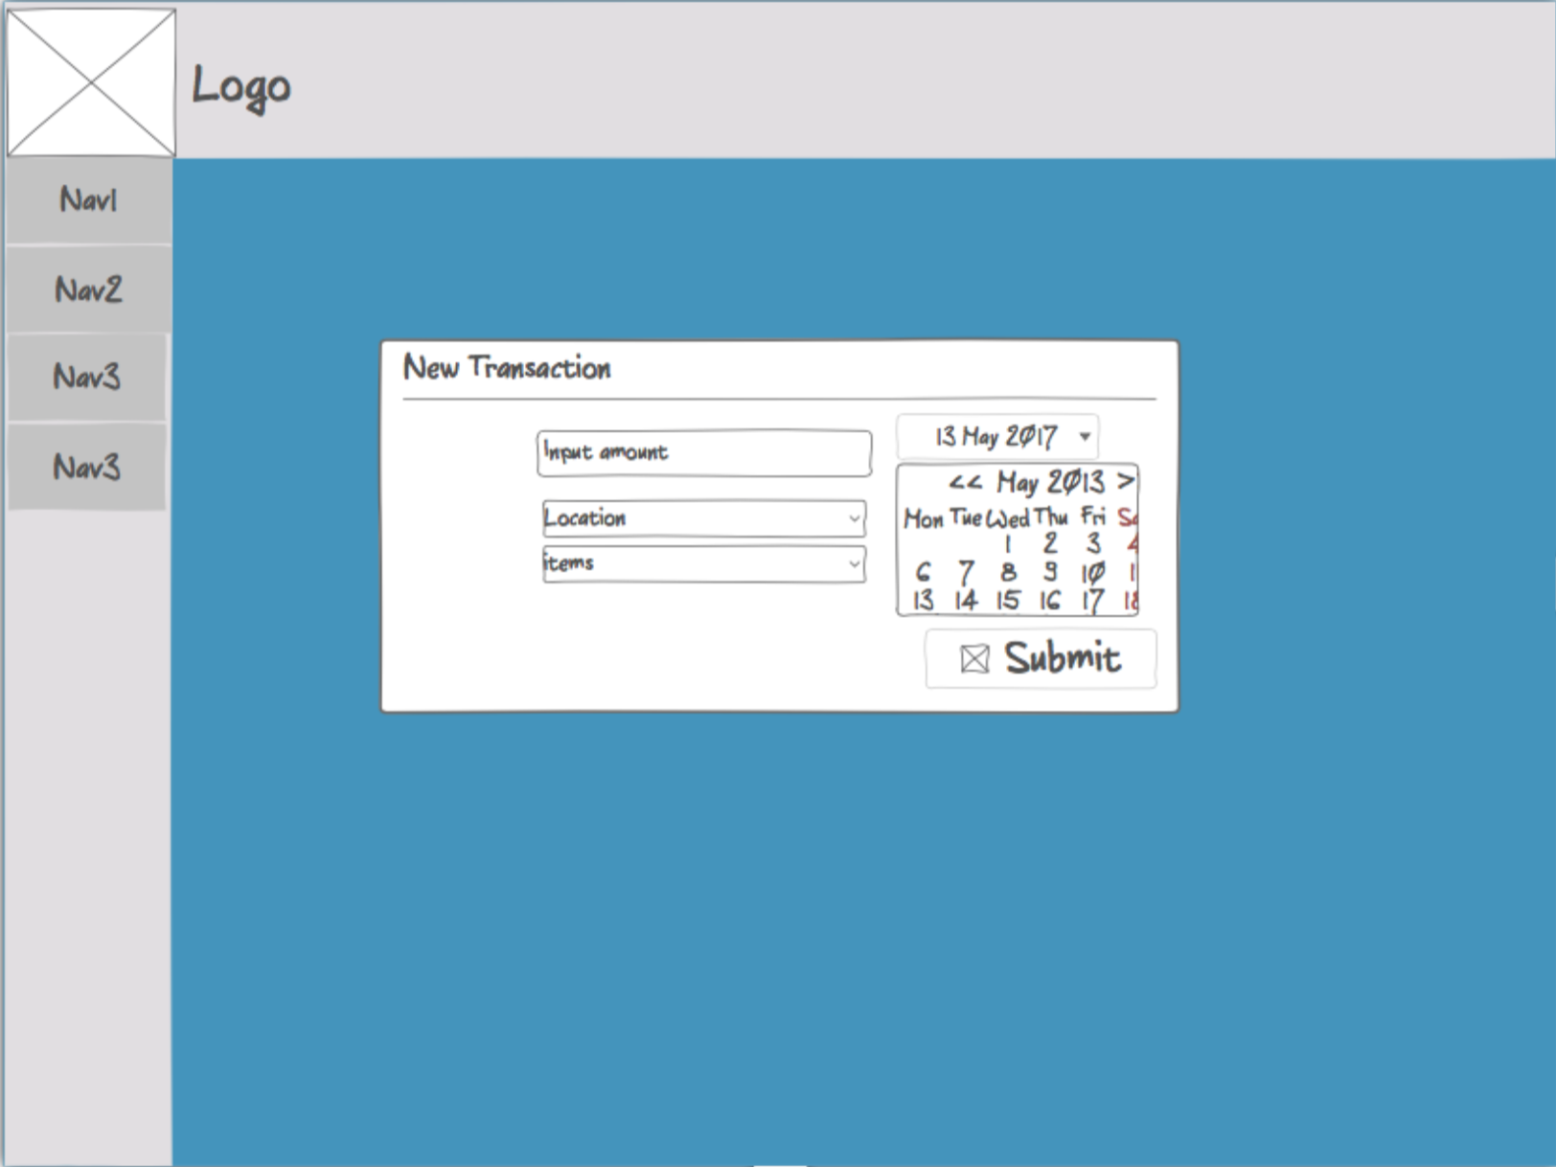
Wireframe
Add/edit transaction

Slide 8
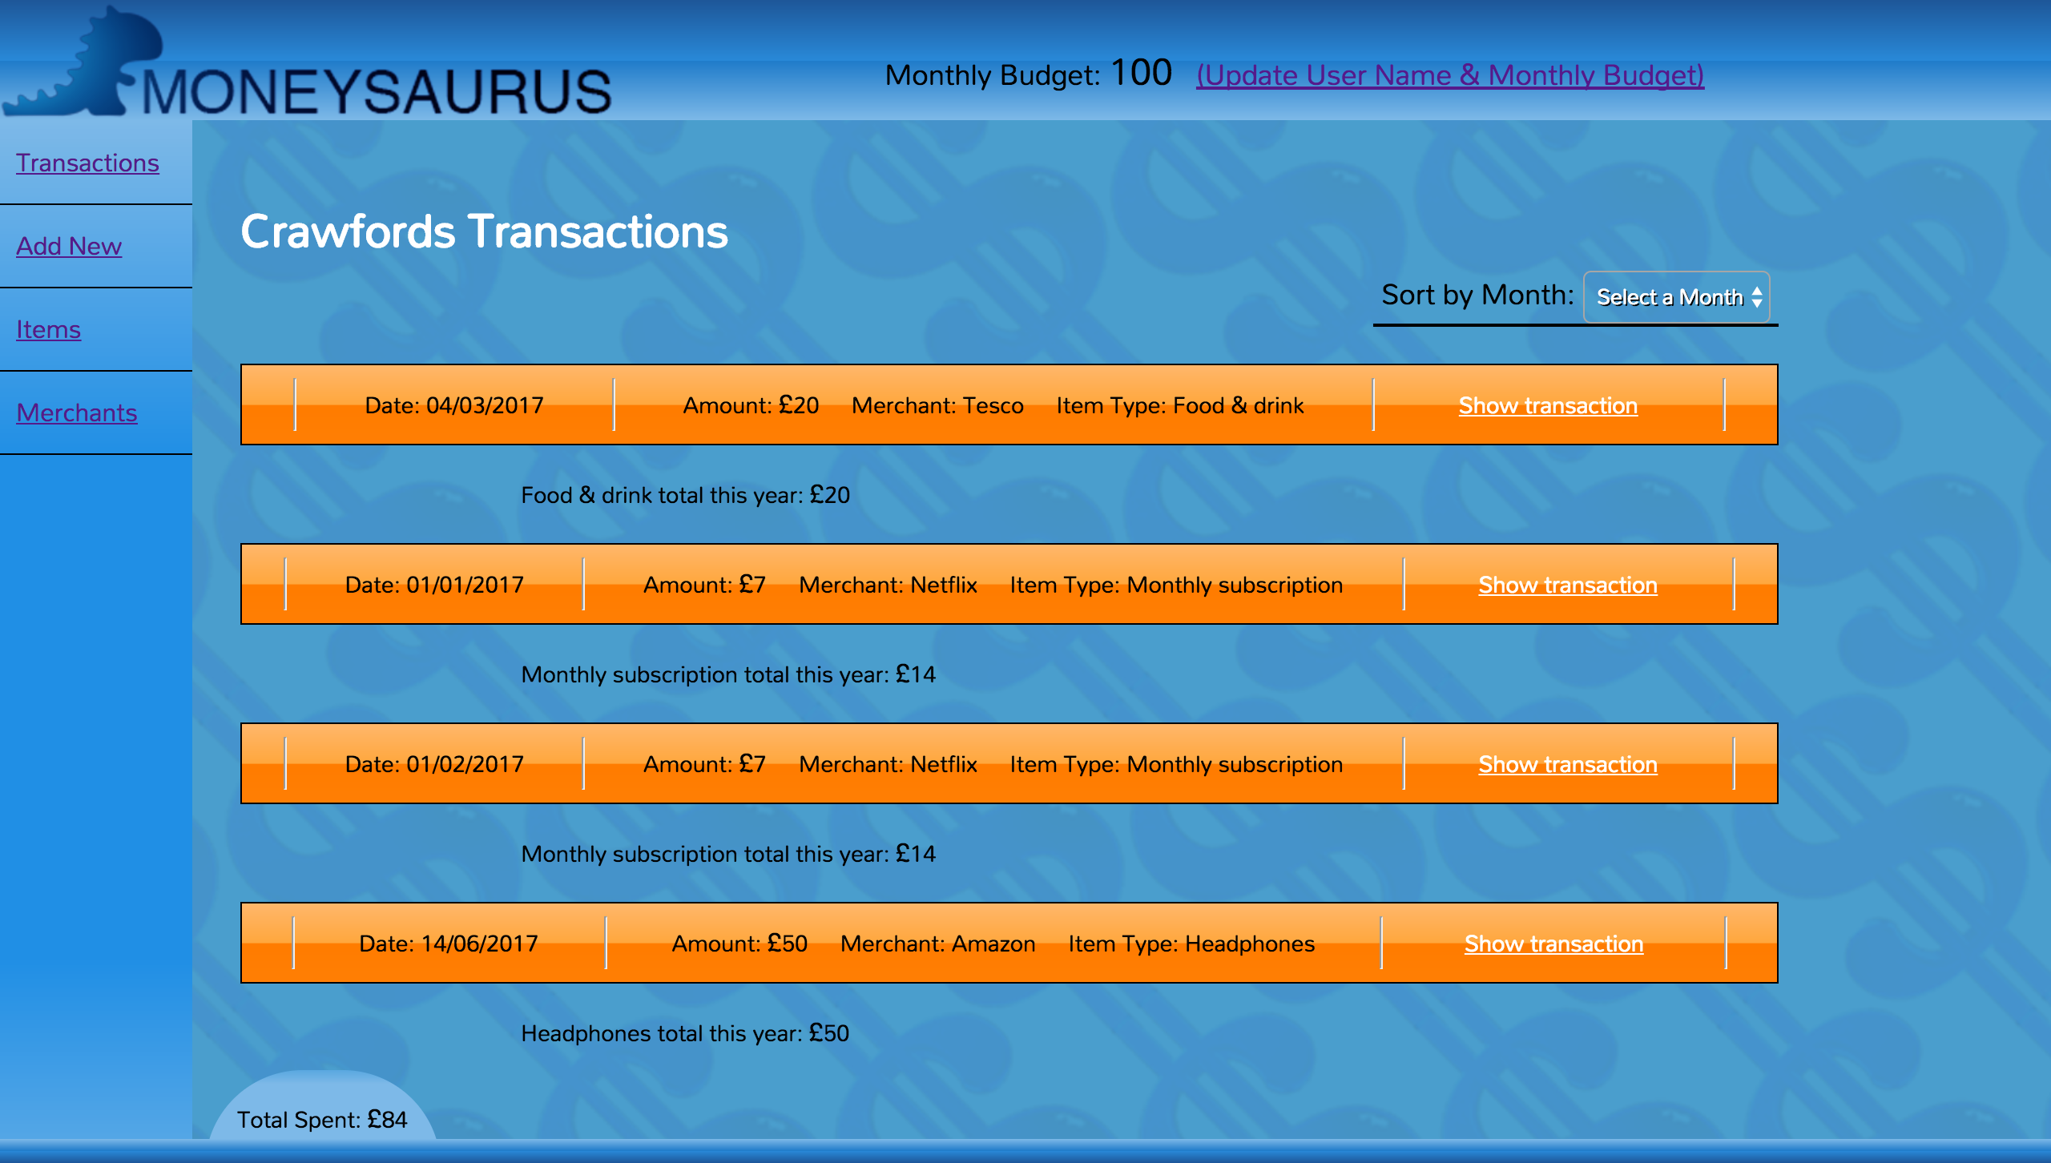
THEN & NOW
FIRST WIREFRAME/CONCEPT
FINAL LAYOUT/DESIGN

Slide 9
DEMO

Slide 10
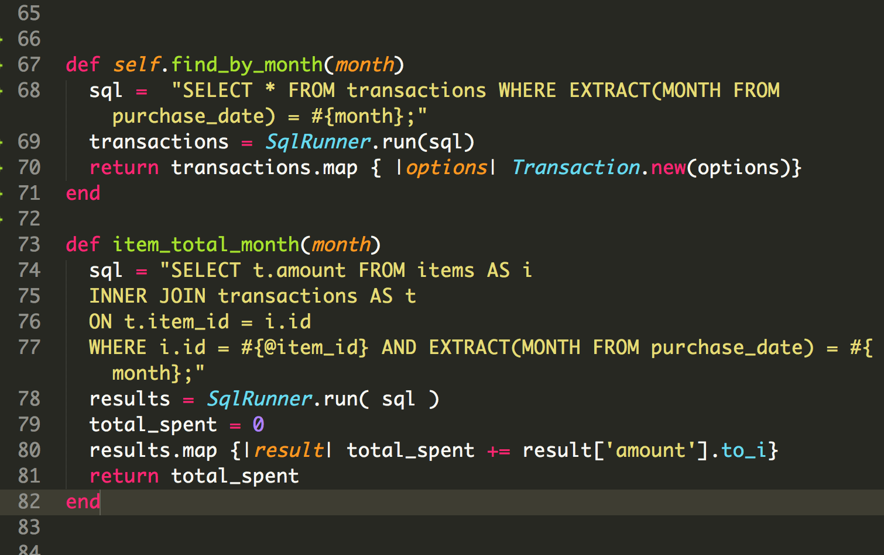
Month SORT: code
“WHERE EXTRACT (MONTH FROM…)"allows sorting from the date value in Postgres.

Slide 11
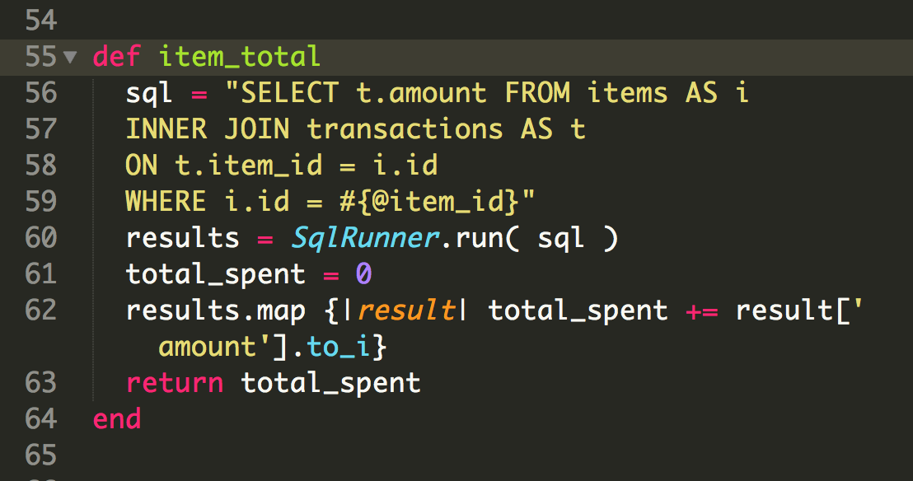
Item Totals
Returns total spent on a specific item tag on that transaction

Slide 12

Things to add
USER ACCOUNTS
RESPONSIVE DESIGN / SUPPORT FOR MOBILES
PRECISE MONEY TOTALS (ADD PENCE…)
MORE FILTERING OPTIONS
ADD AND REMOVE ITEMS/MERCHANTS FROM TRANSACTION ADD/EDIT PAGE

Slide 13
QUESTIONS?

