Slide 1
FNMS Introduction
Trevor Holmes

Slide 2


Slide Index
SAM Data Model
SAM Services Architecture
System Architecture
Measuring Compliance
Data & Tools Integration
FNMS UI
On-Prem Systems
FNMS Components
Data Imports
Agent Data Flow
Questions

Slide 3
Understanding the SAM Data Model
Purchase data sources
Flexera Content Libraries
Vendor data sources
Purchase
Application
Vendor
License
Contract
#Entitlements
User
HR data sources
Contract data sources
SaaS Usage
Inventory
Device
# Consumed
Organizational data sources
Enterprise
Group
SaaS data sources
Asset
Asset data sources
Inventory data sources

Slide 4

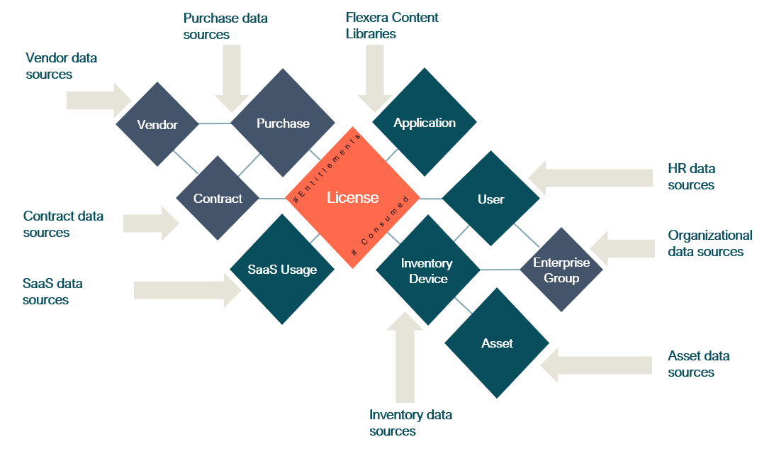
SAM Services Architecture
CMDB & Service Mgmt Systems
SAM Users
HR & Procurement Systems
SAM Systems
SAM Managed Service Administrators
Software Request System
EUC Network & Systems
Software Deployment Systems
Data Centre Network & Systems
Cloud SaaS & IaaS Networks & Systems
EUC Users

Slide 5




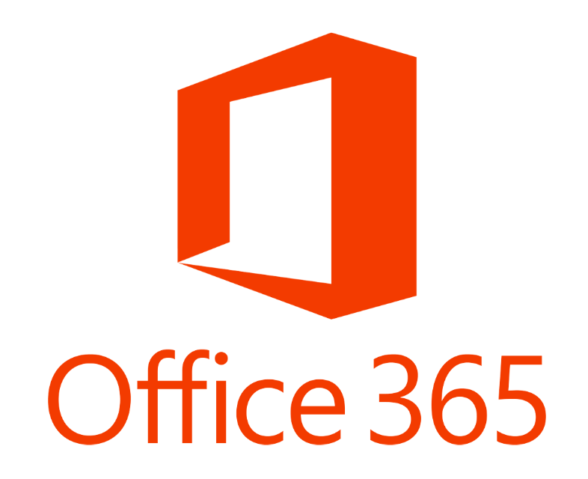




IMPLEMENTATION SCOPE
What systems and services are needed in Production ?
Cloud
VMware
Out of the box connectors
Azure
PRODUCTION
AWS
FNMS App Server
FNMS Beacon
svr0000001pr.acme.com
Oracle physical
servers
Site-2
Site-1
FNMS Beacon
svr0000004pr.acme.com
VMware
FNMS Beacon
svr0000005pr.acme.com
nbnTM
FNMS Cognos
svr0000003pr.acme.com
FNMS DB Server
VMware
svr0000002pr.acme.com
ETA Sep 30

Slide 6





SAM is all about Measuring License Consumption
License Counting Logic
Key considerations
Applications Assigned
License Type
User-based licenses
User on the Computer
Scoping Licenses
License Scope
Enterprise Group of Asset/User
Multiple Licenses against multiple Applications
License Priority
Application Priority
License Allocation
License Rules
Product Usage Rights
8 Licenses Consumed
License Reconciliation
11 Applications Installed
Right of 2nd use
Right of multiple use

Slide 7





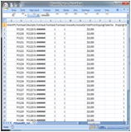




Data and Tools Integration
Business Process, Data & Tools Integration
Business Processes
Deployment
Retirement
Acquisition
Entitlement
Data Input
ARL
Contracts
Ts & Cs
Licensing Rules
Citrix
Altiris
SMS SCCM
IM
PURL
SKU
HR
ITAM/SAM Data Repository
PO
Text Files
Business Outcomes
License Entitlements
Usage Analysis
Payment Schedules
Audits
Re-harvest
Contract Renewals
Compliancy

Slide 8
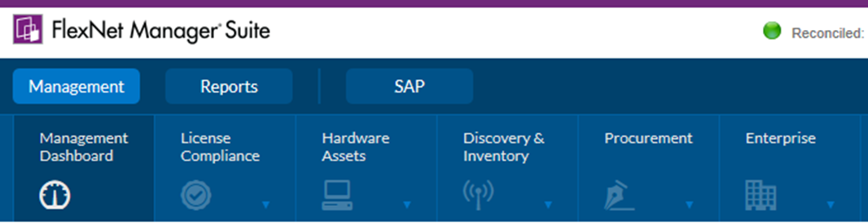
Data and Where it Resides in FNMS UI
Business Process, Data & Tools Integration
Data and Where it Resides in FNMS UI
ARL
PURL
Contracts
Ts & Cs
Licensing Rules
Citrix
Altiris
SMS SCCM
FNM
SKU
ITAM/SAM Data Repository
PO
HR-User
Assets

Slide 9
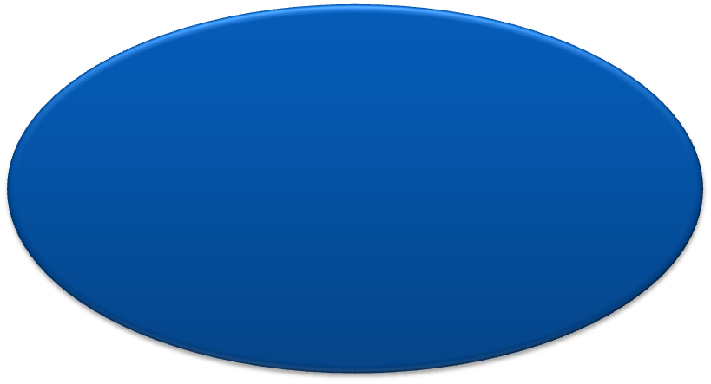


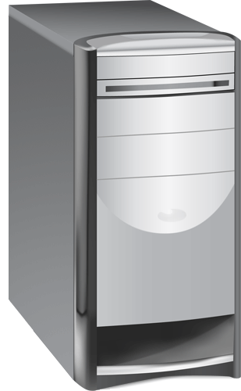







Most Common Architecture for On Premises
Business Process, Data & Tools Integration
Data and Where it Resides in FNMS UI
IIS Server
Inventory Agents
Flexera Inventory Beacons
Content Store
FNMSDataWarehouse
FNMSSnapshot
FNMSCompliance
FNMSInventory
FNMP Data Server
SQL Server
FNMP-Application Server
FNMP-Business Reporting Server
IIS Server
FNMS Web-UI
Apache Server

Slide 10
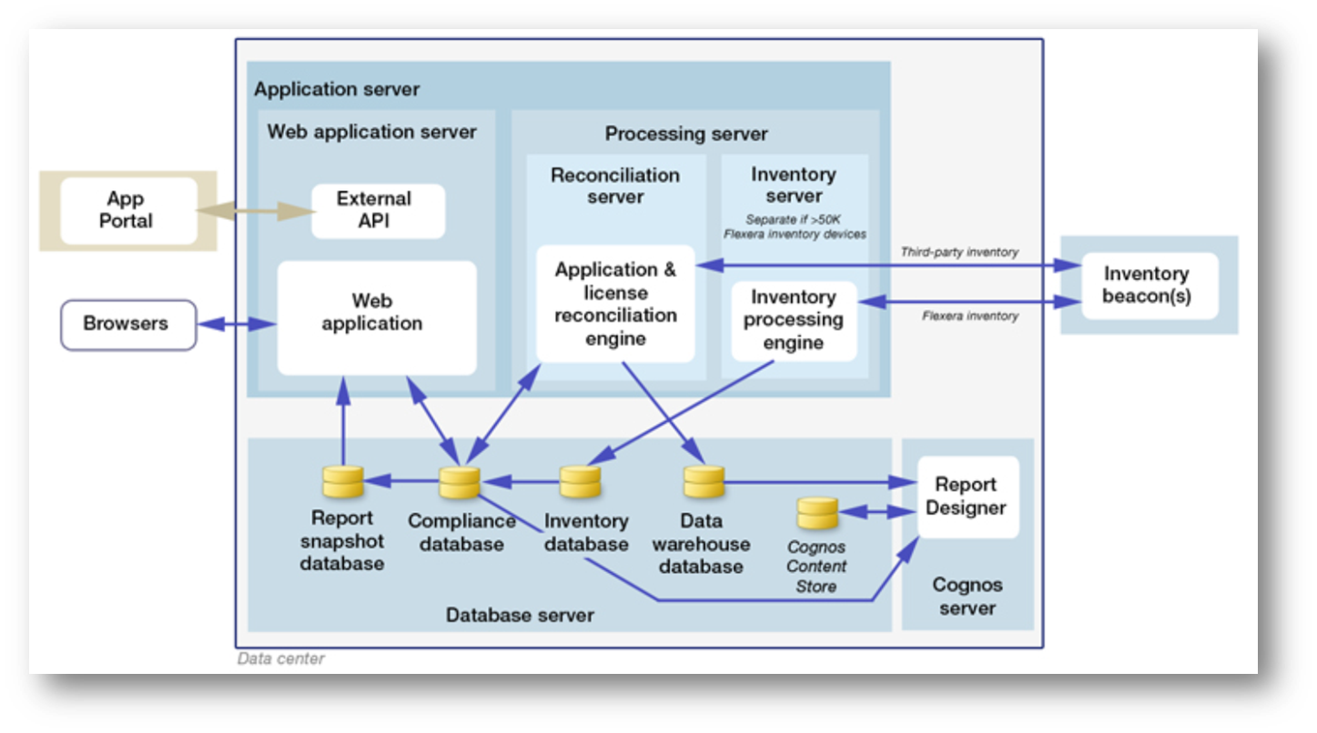
FNMS – On Premises Component Architecture
Business Process, Data & Tools Integration
Data and Where it Resides in FNMS UI

Slide 11
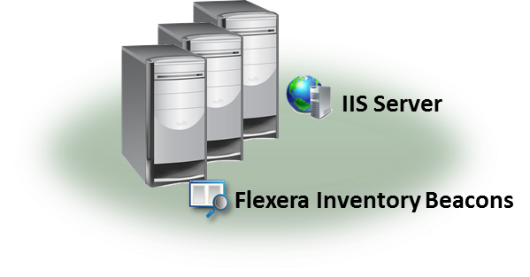



Data Imports
Business Process, Data & Tools Integration
Data and Where it Resides in FNMS UI
Inventory Adapter
SCCM
SCCM Server
Business Adapter
Oracle Financial
Business Data Source
FlexNet Manager Suite On-Premises

Slide 12
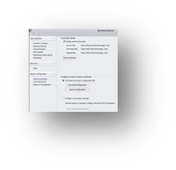




Data Flow Steps for collection of inventory on a client from an installed FlexNet Inventory agent
Business Process, Data & Tools Integration
Data and Where it Resides in FNMS UI
2
At a scheduled time, the inventory agent is run on the client system
The inventory agent collects inventory and stores results in a cached location on the client system, awaiting uploading
The client runs the NetSelector algorithm to identify and select the nearest Beacon
The client then uploads the inventory and log files to the http://beacon/ManageSoftRL share on the beacon. The inventory is temporarily stored in the \Program Data\Flexera Software\Incoming\Inventories folder on the beacon while awaiting upload to the Application Server
The Beacon will then upload any inventory files to the Application Server via a schedule task set to run every minute.
Web Resolvers on the Application server will immediately process the inventory files and write the inventory data to the Inventory Manager Database
Nightly, during a reconcile and inventory import, the updated inventory will be imported from the FNMS Inventory database into the FNMS Compliance database.
Devices
4
3
Beacon 1 Beacon 2 Beacon 3 …
1
Flexera Inventory Beacons
5
6
IIS Server
FNMS Inventory DB
FNMS Compliance DB
7
FNMS Web-UI
FNMS Application Server (Processing Server)
Notes:
Here’s a diagram of the common Steps for collection of inventory on a client from an installed FlexNet Inventory agent
At the scheduled time, the inventory is run on the client by the client’s Schedule Agent.
The remote agent collects inventory and stores the results in a cached location on the system awaiting uploading.
Usually in the System temp directory
The client then runs the NetSelector algorithm to identify the nearest Beacon and sets a priority for which beacons are the closest. The client will select the beacon with the highest priority to upload the resulting inventory and log files to.
The NetSelector algorithm is stored in the client registry
The client then uploaded to the http://beacon/ManageSoftRL share on the beacon. The inventory is temporarily stored in the following location on the beacon awaiting upload to the Application Server. \Program Data\Flexera Software\Incoming\Inventories
The Beacon will then upload any inventory files to the Application Server via a schedule task set to run every minute.
The Application server will process the inventory files immediately by the Web Resolver and placed in the IM Inventory Manager Database
Every night, during a reconcile and inventory import, the updated inventory will be imported from the IM Inventory Manager database into the FlexNet Manager Compliance database.

Slide 13

Q&A

Slide 14

More …

Slide 15







