Slide 1

Personal & Professional Development
By Ciarán Maher KTQ0855

Slide 2

Benefits of Personal Development
Self-awareness
A sense of direction
Improve focus and effectiveness
More motivation
Greater resilience
More fulfilling relationships

Slide 3


Benefits of
Sharpen your knowledge
Develop your skills
Keep up-to-date
Start networking
Reenergize your ideas

Slide 4




Development Opportunities for Personal Development
Being coached or mentored
Advice from colleagues
E-learning
Volunteering

Slide 5

Why these opportunities
Benefit from others’ experiences
Colleagues provide insight about corporate needs
Learning at every stage is vital to career development
Learn while helping others

Slide 6

How to reflect
Establish successes and failures
Understand the reasons
Opportunities for improvement next time
Identify lessons
Determine needed changes

Slide 7

Benefits of Reflection
Emotional Intelligence
Integrity
Confidence
Identify Mistakes
Notes:
Increase emotional intelligence Demonstrate and develop integrity
Build confidence Identify and overcome mistakes

Slide 8
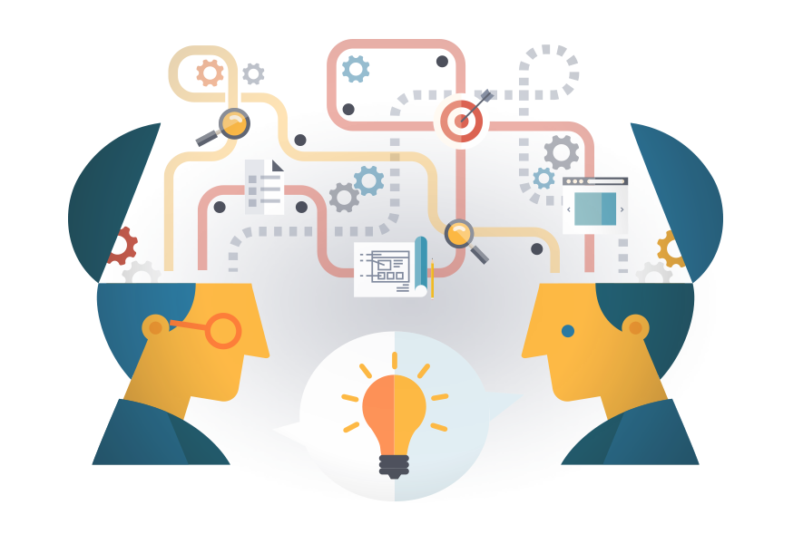
Analysis on How People Learn
We learn from relating new info to what we already know
We remember better when we employ new knowledge
Logical thinking develops primarily through feedback
A deep understanding is required to apply abilities in new situations
Social and psychological states heavily affect learning potential

Slide 9

How to learn
Identify Needs
Set Goals
Develop Lesson Plans
Independent Exploration
Reinforce Learning
Assess Progress
Reward Success
See Mistakes as Opportunities
Meet Emotional Needs
Get Feedback
Keep Learning

Slide 10
Useful Resources:
How to learn? From mistakes https://www.ted.com/talks/diana_laufenberg_3_ways_to_teach?language=en
The first 20 hours – how to learn anything https://www.youtube.com/watch?v=5MgBikgcWnY
How to teach (yourself) http://www.wikihow.com/Teach

Slide 11
Thank you
Contact info
Email
ciaranmaher@gmail.com
Linkedin https://goo.gl/V0R1dp

