Slide 1
Systems Analysis
FIT ICT Associate Professional 2015

Slide 2
Module Aims
Understand importance of structured systems life cycles
Perform Analysis Tasks using SSADM:-
Feasibility Study
Current System Analysis
Documentation of Requirements

Slide 3
SYSTEMS LIFE CYCLES

Slide 4
Systems Lifecycle Phases
Information systems planning
Investing in strategic planning for the development of future and existing information systems. Many methods have been put forward and take a variety of approaches but generally the result from the planning exercise will be an analysis of the organisations present position, recommendations as to which systems should be developed or enhanced, a plan showing the order in which these projects should be done and outline project plans and terms of reference for each project.
Project Initiation
The phase where the project is set up, terms of reference agreed, team members assigned and plans drawn up.
Feasibility study
Phase where it is decided if the project is technically possible, if it can be financially and socially justified and whether the new system will be accepted by the organisation.

Slide 5
Systems Lifecycle Phases (cont)
System analysis
Current system is analysed in great detail to determine the requirements for a new system.
Business systems design
The requirements for the new system will have been broadly specified in the previous phase. In this phase various technical solutions that meet the requirements are evaluated and one is selected. A detailed logical design of the new system is developed showing in a clear non-technical way how the new system will operate within the business.
Physical design
The logical design is converted into a design that fits the computer hardware and software selected. Physical design involves the specification of files, the specification of programs and the detailed operating and manual procedures that support them.

Slide 6
Systems Lifecycle Phases (cont)
Construction
This concerns the programming, the assembly of the programs into a system and the testing of the system.
Transition
This phase involves the transition from operating the old system to operating the new. It involved the installation of equipment, the conversion of old system data to the formats required by the new system and the training of users. Some systems life cycles join the construction and transition phase together to form an implementation phase.
Production
This phase begins when the system has been completely handed over to the users. The term production conveys that the system is operating and producing the information that was required of it.

Slide 7
Systems Lifecycle Phases (cont)
Maintenance and review
Throughout the production phase the system will require maintenance in various ways,
Correction of entries
Adaptation to new software and hardware releases
Minor enhancements
The system will have to be reviewed to show how well it has met the requirements and objectives set for it and whether it continues to meet the users requirements. These enhancements and reviews may lead to further system studies.

Slide 8
Examples of Structured Methodologies
Waterfall Model
Prototyping
SSADM

Slide 9
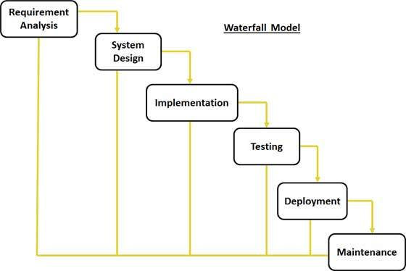
Traditional Waterfall Model
Notes:
Systems / Requirements analysis
Technical specialists identify the problem, gather information requirements, develop alternative solutions and establish a project management plan. Business users provide information requirements, establish financial or operational constraints on the solution and select the solution.
=>Systems proposal report.
Systems Design
Technical specialists model and document design specifications and select the hardware and software technologies for the solution. Business users approve the design specifications.
=>Design Specifications.
Implementation/ Programming
Technical specialists write program code
=>Program specifications and code.
Testing
Technical specialists develop test plans and conduct unit, system and acceptance tests. Business users provide test data and scenarios and validate test results.
=>System performance tests.
Conversion/ Deployment
Technical specialists prepare a conversion plan and supervise conversion. Business users evaluate the new system and decide when the new system can be put into production.
=>User sign-off.
Production and Maintenance
Technical specialists evaluate the technical performance of the system and perform maintenance. Business users use the system and evaluate its functional performance.
=>Post implementation audit.

Slide 10
Post-Implementation
After the system is installed and in production users and technical specialists will go through a formal post implementation audit that determines how well the new system has met its original objectives and whether any revisions or modifications are required.
After the system has been fine-tuned it will need to be maintained while it is in production to correct errors, meet requirements or improve processing efficiency.
Over time the system may require so much maintenance to remain efficient and meet user’s objectives that it will come to the end of its useful life span.
Once the systems lifecycle comes to an end a completely new system is called for and the lifecycle may begin again.

Slide 11
Discussion
The systems lifecycle is still used for building large complex systems that require a rigorous and formal requirements analysis, predefined specifications and tight controls over the systems building process.
The systems lifecycle approach is costly, time consuming and inflexible. Volumes of new documents must be generated and steps repeated if requirements and specifications need to be revised.
Because of the time and cost to repeat the sequence of lifecycle activities, the methodology encourage freezing of specifications early in the development process discouraging change.
The lifecycle approach is also not suitable for many smaller scale desktop systems which tend to be less structured and more individualized.

Slide 12
Prototyping
Step 1:- Identify basic requirements
Step 2:- Develop a working prototype
Step 3:- Use the prototype
Yes
User satisfied?
No
Operational prototype
Step 4:- Revise and enhance the prototype
Notes:
The four-step model of the prototyping process,
Step 1 Identify the users basic requirements. The system designer (usually an information systems specialist) works with the user only long enough to capture their basic needs.
Step 2 Develop an initial prototype. The system designer creates a working prototype quickly using 4th generation software, interactive multimedia or computer aided software engineering (CASE) tools.
Step 3 Use the prototype. The user is encouraged to work with the system in order to determine how well the prototype meets their needs and to make suggestions for improving the prototype.
Step 4 Revise and enhance the prototype. The system builder notes all the changes the user requests and refines the prototype accordingly. After the prototype has been revised the cycle returns to step 3 and steps 3 and 4 are repeated until the user is satisfied.

Slide 13
Discussion
Prototyping is most useful when there is some uncertainty about requirements or design solutions.
Prototyping is especially useful in designing an information systems end user interface – the part of the system that the users interact with.
Because prototyping encourages intense end-user involvement throughout the systems development process it is more likely to produce systems that fulfill user requirements.
However rapid prototyping can gloss over essential steps in systems development.
If the completed prototype works reasonably well management may not see the need for reprogramming, redesign or full documentation and testing to build a polished production system.
Some of these hastily constructed systems may not easily accommodate large quantities of data or a large number of users in a production environment.

Slide 14
Agile
Refer to separate presentation

Slide 15
Analysis using ssadm

Slide 16
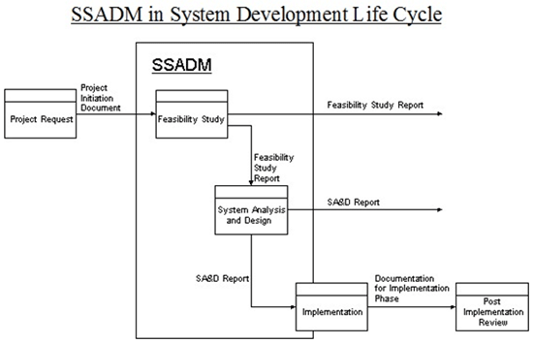
SDLC (Waterfall Variant)

Slide 17
Feasibility study
SSADM

Slide 18
Is your project feasible?
The best way to find out whether your project is feasible is to complete a Feasibility Study. This process helps you gain confidence that the solution you need to build can be implemented on time and under budget. So here’s how to do it in 5 simple steps…
Completing a Feasibility Study
A Feasibility Study needs to be completed as early in the Project Life Cycle as possible. The best time to complete it is when you have identified a range of different alternative solutions and you need to know which solution is the most feasible to implement. Here’s how to do it…

Slide 19
Step 1: Research the Business Drivers
In most cases, your project is being driven by a problem in the business. These problems are called “business drivers” and you need to have a clear understanding of what they are, as part of your Feasibility Study.
For instance, the business driver might be that an IT system is outdated and is causing customer complaints, or that two businesses need to merge because of an acquisition. Regardless of the business driver, you need to get to the bottom of it so you fully understand the reasons why the project has been kicked off.
Find out why the business driver is important to the business, and why it’s critical that the project delivers a solution to it within a specified timeframe. Then find out what the impact will be to the business, if the project slips.

Slide 20
Step 2: Confirm the Alternative Solutions
Now you have a clear understanding of the business problem that the project addresses, you need to understand the alternative solutions available.
If it’s an IT system that is outdated, then your alternative solutions might include redeveloping the existing system, replacing it or merging it with another system.
Only with a clear understanding of the alternative solutions to the business problem, can you progress with the Feasibility Study.

Slide 21
Step 3: Determine the Feasibility
You now need to identify the feasibility of each solution. The question to ask of each alternative solution is “can we deliver it on time and under budget?”
To answer this question, you need to use a variety of methods to assess the feasibility of each solution. Here are some examples of ways you can assess feasibility:
Research: Perform online research to see if other companies have implemented the same solutions and how they got on.
Prototyping: Identify the part of the solution that has the highest risk, and then build a sample of it to see if it’s possible to create.
Time-boxing: Complete some of the tasks in your project plan and measure how long it took vs. planned. If you delivered it on time, then you know that your planning is quite accurate.

Slide 22
Step 4: Choose a Preferred Solution
With the feasibility of each alternative solution known, the next step is to select a preferred solution to be delivered by your project.
Choose the solution that;
is most feasible to implement,
has the lowest risk, and
you have the highest confidence of delivering.
You’ve now chosen a solution to a known business problem, and you have a high degree of confidence that you can deliver that solution on time and under budget, as part of the project.

Slide 23
Step 5: Reassess at a lower level
It’s now time to take your chosen solution and reassess its feasibility at a lower level.
List all of the tasks that are needed to complete the solution.
Then run those tasks by your team to see how long they think it will take to complete them.
Add all of the tasks and timeframes to a project plan to see if you can do it all within the project deadline.
Then ask your team to identify the highest risk tasks and get them to investigate them further to check that they are achievable.
Use the techniques in Step 3 to give you a very high degree of confidence that it’s practically achievable.
Then document all of the results in a Feasibility Study report.
After completing these 5 steps, get your Feasibility Study approved by your manager so that everyone in the project team has a high degree of confidence that the project can deliver successfully.

Slide 24
Analysis phase
SSADM

Slide 25
Requirements Analysis
Stage 1 – Investigation of current environment.
The current system is investigated for several reasons
The analysts learn the terminology and function of the users environment
The old system may form the basis of the new system
The data required by the system can be investigated
It provides the users with a good introduction to the techniques
The boundaries of the investigation can be clearly set.

Slide 26
Requirements Analysis
The current system view built in stage 1 is redrawn to extract what the system does without any indication of how it is achieved. The resulting picture is the logical view of the current system. This allows the analyst to concentrate on what functions are performed in the current system and to make decisions about what must be included in the new system.

Slide 27
Requirements Analysis
Stage 2 – Business system options
They reflect different ways (options) in which the system might be organised to meet the requirements. A decision is made by the users as to which option or combination of options best meets their needs.

Slide 28
Requirements Specification
Stage 3 – Definition of requirements
Based upon the selected Business Systems option, a detailed specification of the required system is built up and checked extensively. In order that the new system will not be constrained by the current implementation there are a number of steps within this stage to lead the analysts gradually away from the current system towards a fresh view of the requirements.
This stage builds up the data design so that all the required data will be included. Is applies a relational analysis technique to groups of data items in the system to act as a cross check on the data definitions.

Slide 29
Logical Systems Specifications
The two stages in this module are often performed simultaneously
Stage 4 – Selection of technical options
At this stage the development team have enough information to compile the different implementation options for the system. Each option is costed out and the benefits weighed out against the costs to give the user some help in choosing the final solution. This might form the basis for selecting the final system hardware.
Stage 5 – Logical design
The specification developed in stage 3 is expanded to a very high level of detail so that the constructor can be given all the detail necessary to build the system

Slide 30
Physical design
Stage 6 – Physical design
The complete logical design – both data and processing – is converted into a design that will run on the target environment. The initial physical design is tuned before implementation so that it will meet the requirements of the system.

Slide 31
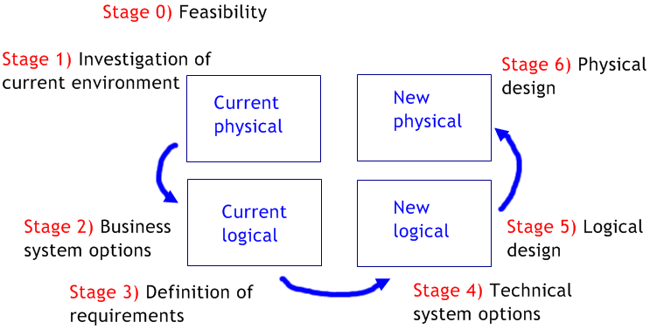
SSADM

Slide 32
SSADM
SSADM is a data driven model
this means that there is a basic assumption that the systems have an underlying, generic data structure which changes very little over time, although processing requirements may change.
Within SSADM this underlying data structure is modelled from an early stage.
The representation of this data structure is checked against the processing and reporting requirements and finally built into the systems architecture.

Slide 33
SSADM
The structured techniques of SSADM fit into a framework of steps and stages each with defined inputs and outputs.
Also there are a number of forms and documents that are specified which add information to that held within the diagrams. Thus SSADM consists of three important features
Structures - define frameworks of steps and stages and their inputs and outputs.
Techniques – define how the steps and tasks are performed.
Documentation – defines how the products of the steps are presented.
Each module is designed to be self-contained with the idea that projects might choose to use SSADM for one module and not for others. SSADM is divided into 5 modules and each of these are divided into stages. Each stage is divided into steps.

Slide 34
Discussion
One of the main advantages is that SSADM builds up several different views of the system that are used to cross check one another.
For example: Building a house, to help the customer visualize the final building the architect draws several different representations – a cross sectional view, artists impression etc. This will help the architect to validate the plans as he made sure that each view was consistent with the others throughout the building process.
In SSADM three different views of the system are developed in analysis. These views are closely related to each other and are crosschecked extensively for consistency and completeness.

Slide 35
Discussion
The equal weight given to these three techniques and the prescriptive procedures for checking them against one another is a great strength of the SSADM approach. The three views are,
Underlying structure of the systems data (Logical data structure)
How data flows in and out of the system and is transformed within the system (data flow diagrams)
How the system data are changed by events over time (entity life histories).
Another advantage of SSADM over a number of methods is that it combines techniques into a well-established framework and so as well as providing the techniques for the analyst it gives guidance on how and when to use them.
Even though SSADM adopts this rather prescriptive approach there is still a large amount of flexibility within the method and it should be tailored to specific project circumstances.

Slide 36
References
Five Steps to Determine Project Feasibility (Makar, 2012)
By Andrew Makar on January 26, 2010 in Project Portfolio Management
http://www.tacticalprojectmanagement.com/five-steps-to-determine-project-feasibility/

