Slide 1


!SABER!
By: Preston C. Wertz

Slide 2

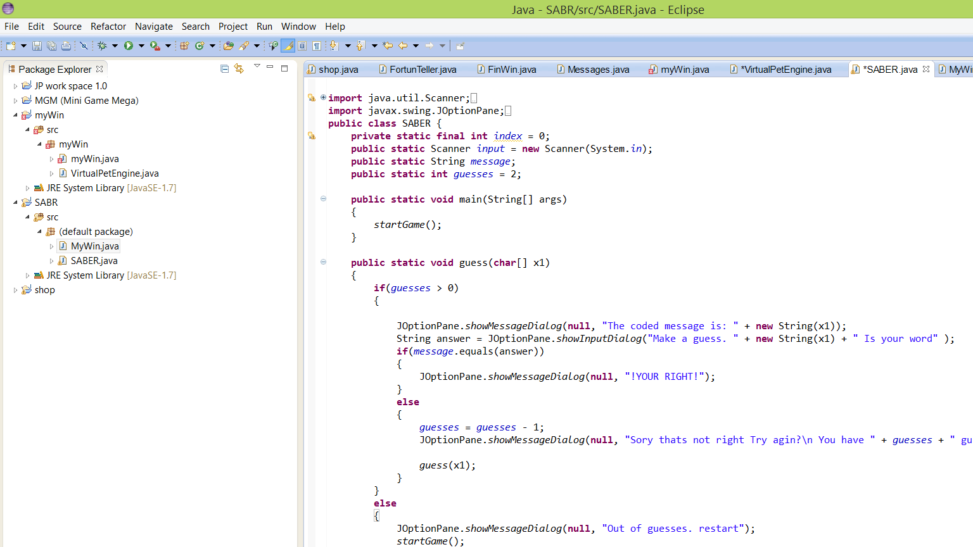
DU
(Programing with java)
(June 30th – July 4th)

Slide 3

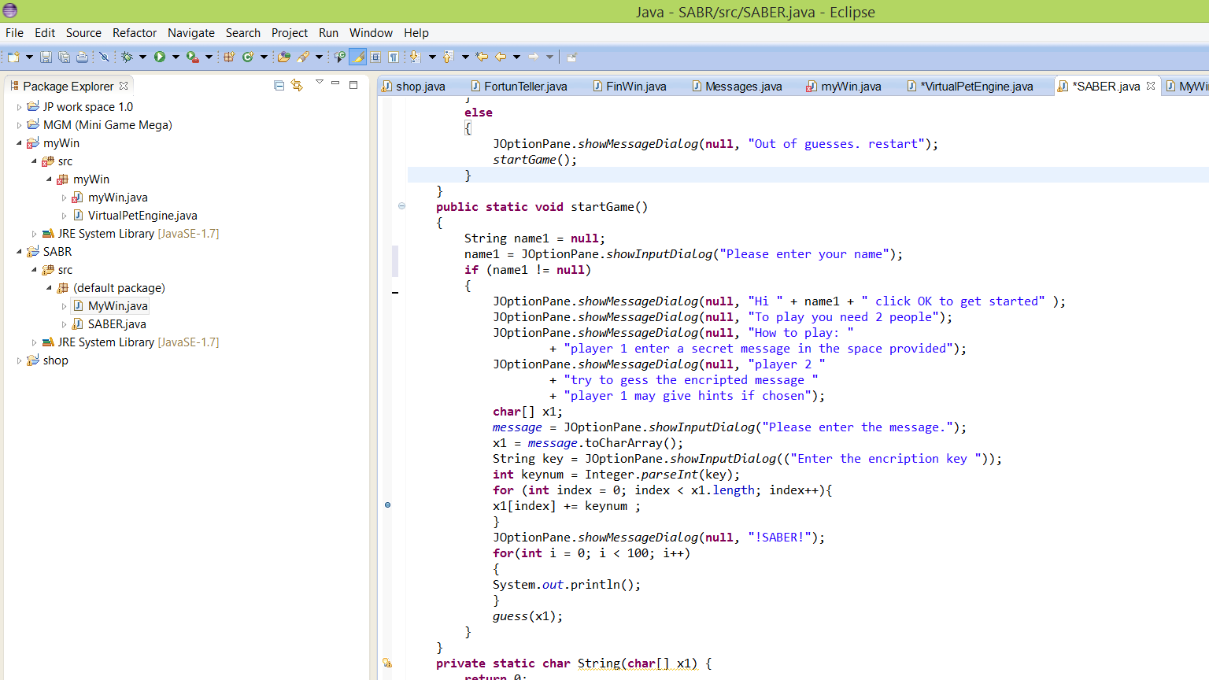
What I learned
“With great power often comes great confusion.” ― Dan Allen, Seam in Action

Slide 4
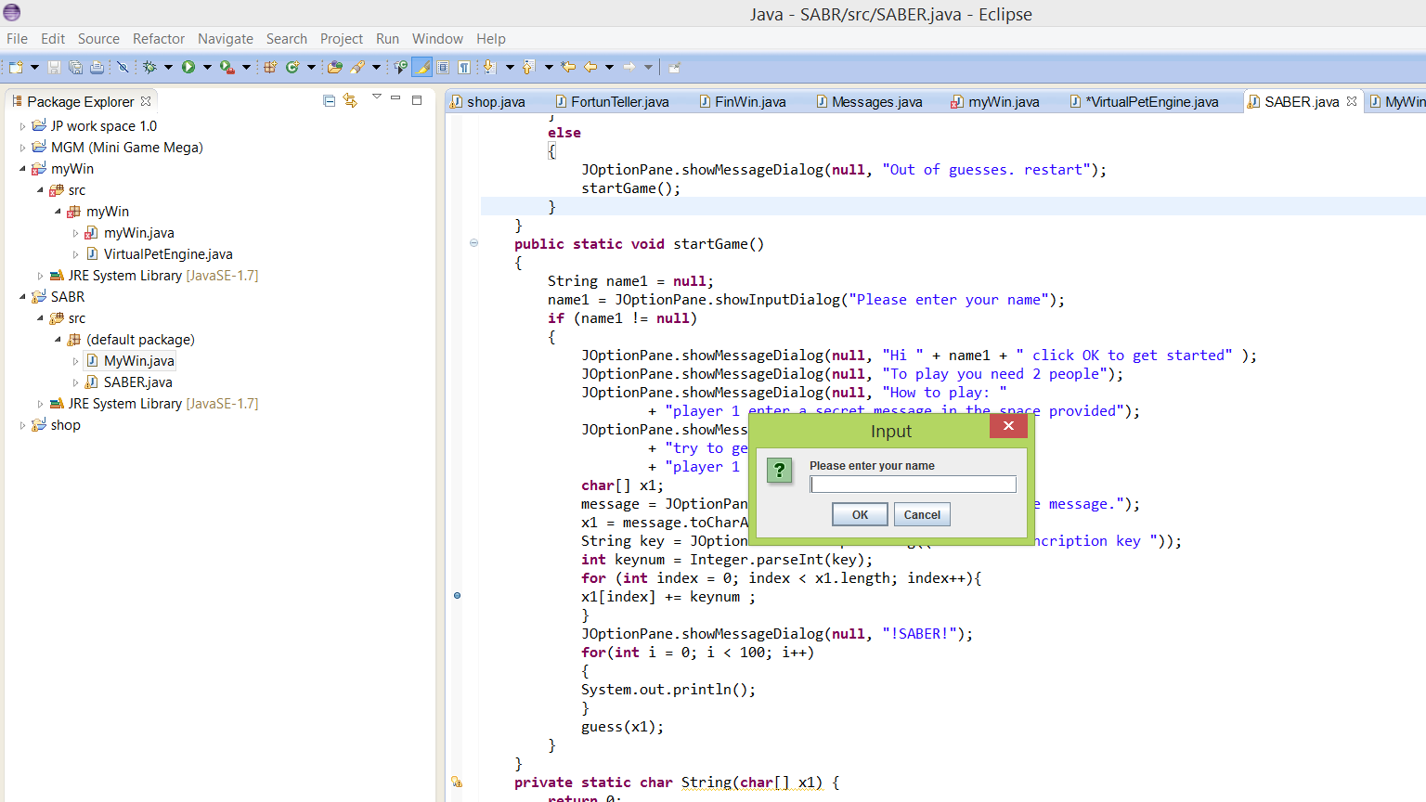
The start of my game.
To start the game you click run.
When the run button is clicked the program starts.
The first thing that pops up is a message box.
Notice how there is a cancel button. Before the cancel button would thro an error because the cancel button did not have a place in the program. Now when you click cancel the program will end.
To continue, type in your name and click “OK”.

Slide 5
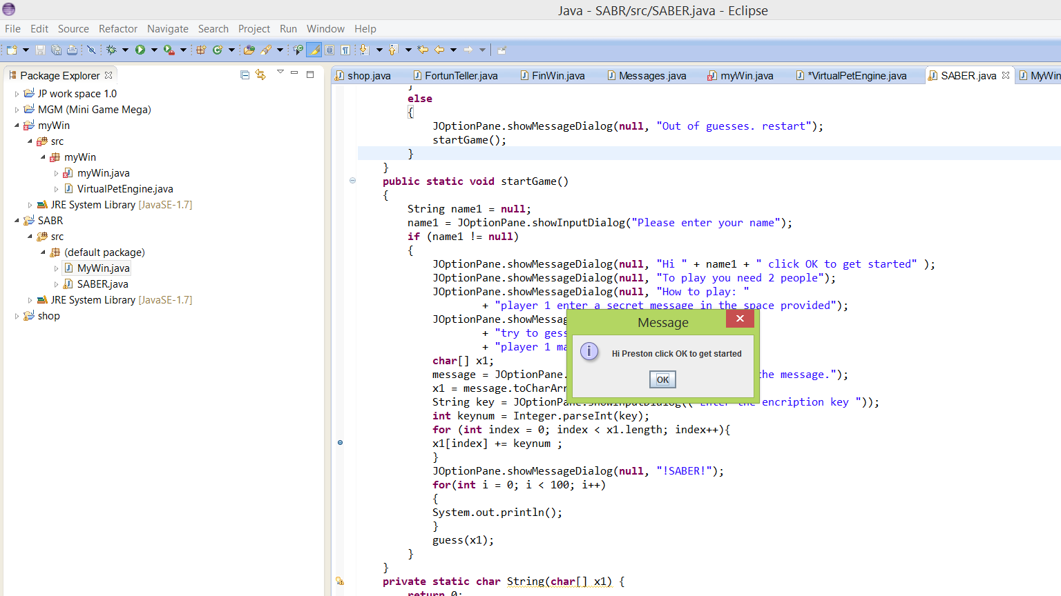
Directions
Flow the instructions that pop up and keep clicking ok to continue.

Slide 6

The message
Here you type the message that you want to encrypt.
Next you enter the encryption key that tells java to change each charter in the word that you typed to move it back or forward by the number you typed. Example:
Sentence: hi
Key: 5
Result: mn

Slide 7

Favorite Camp Memory
My favorite camp memory is going to launch and hanging out with my friend and my awesome instructor.

