Slide 1
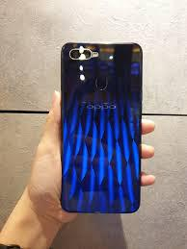
Fingerprint Touch Sensors
in Electronic Gadgets
-vIjay alagesan
EEE dpt-2nd year

Slide 2
Synopsis of this seminar
Definition of fingerprint Touch sensors
1. Types of Fingerprint touch sensor
2. Outline description for the working of fingerprint touch sensors
3. Capacitive type sensor
4. Optical type sensor
5. Ultra Sonic type sensor
6. Today facts
7. Conclusion
Sir Francis Galton published his book, "Finger Prints" in 1892, establishing the individuality and permanence of fingerprints.

Slide 3
Definition For the fingerprint Touch sensor
A Touch sensor is a device that detects and responds to some type of input from the physical environment. The specific input could be light, heat, motion, moisture, pressure, or any one of a great number of other environmental phenomena.
In 1891, Juan Vucetich, an Argentine Police Official, began the first fingerprint files based on Galton pattern types. At first, Vucetich included the Bertillon System with the files. (see Bertillon below) In 1892, Juan Vucetich made the first criminal fingerprint identification.

Slide 4
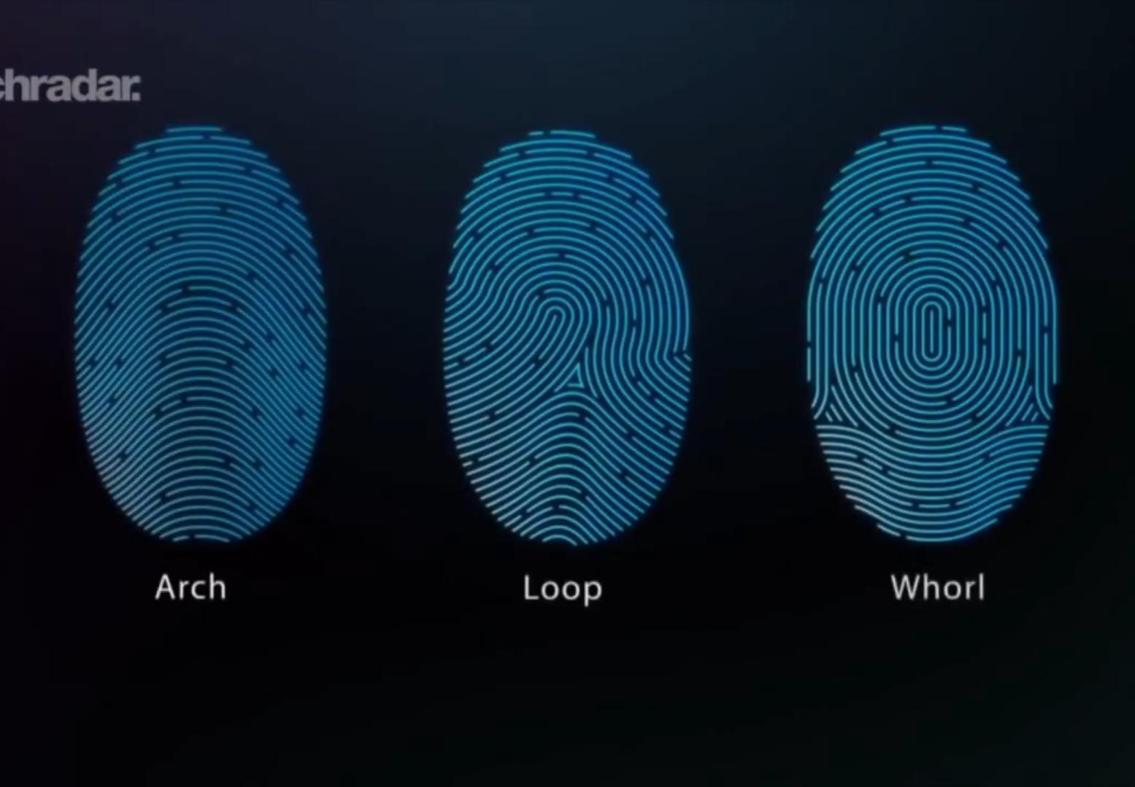
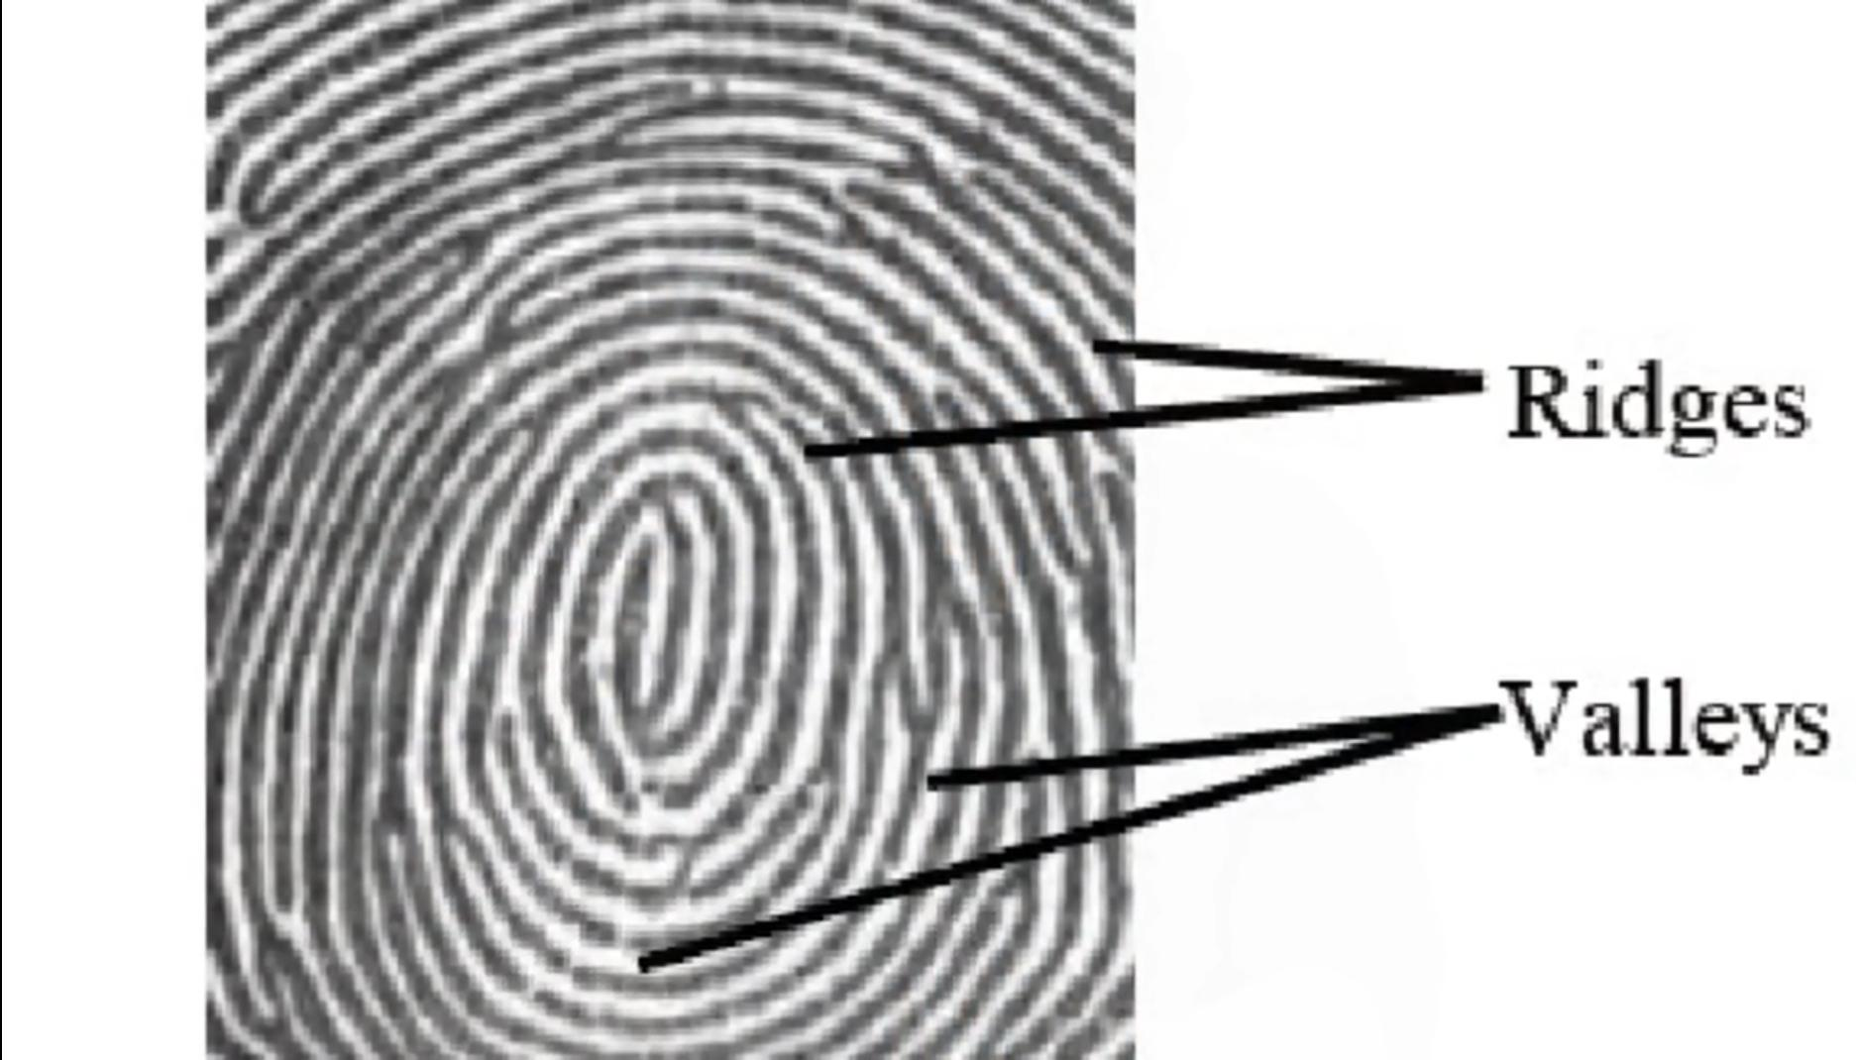
What is the meaning of the fingerprint?

Slide 5
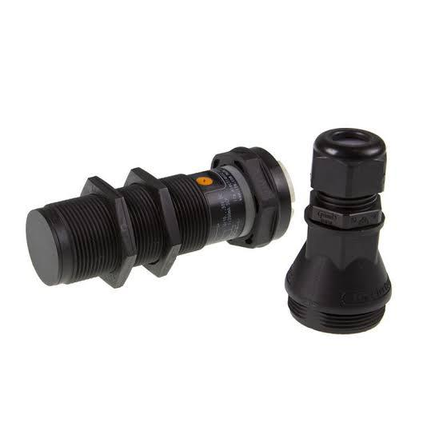
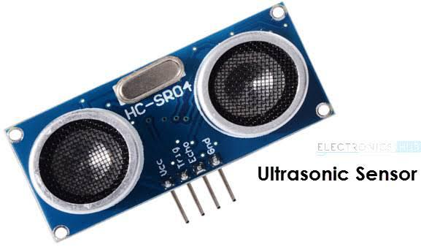
Types of fingerprint touchsensors
Capacitive type sensor
Optical type sensor
Ultrasonic Type sensor
Capacitive sensor use the principle of storing the information of fingerprint as ridges and valleys.
Optical sensor use the principle of total internl reflection to Scan the fingerprint in 2d mode.
Ultrasonic sensor use the ultrasonic waves to calculate the value of ridges and valleys on the fingerprint.

Slide 6
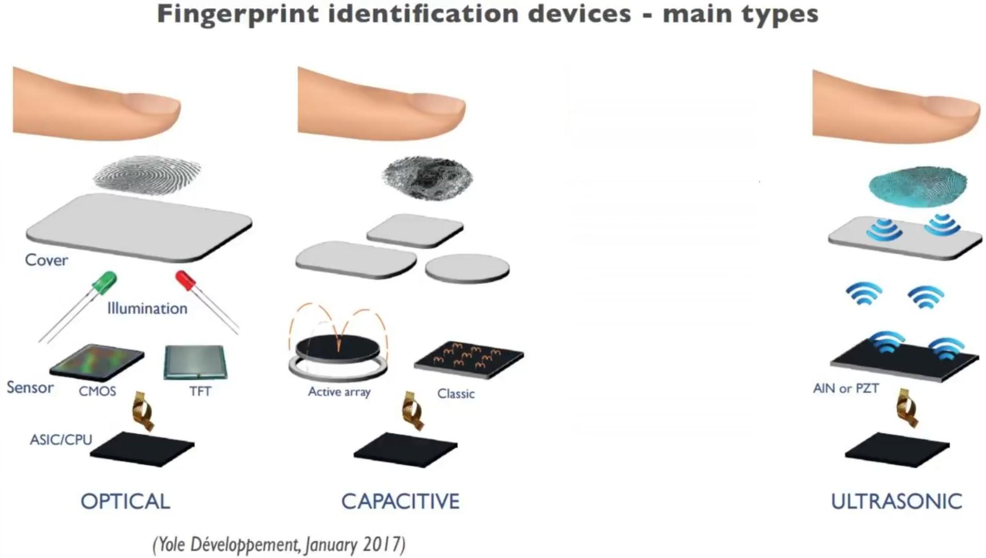
Outline Description for the Working of Fingerprint touch sensors

Slide 7
Capacitive type touch fingerprint sensor
Instead, they work with anything that holds an electric charge, including human skin. They are made from materials like copper and indium tin oxide that hold electric charges in an electrostatic grid of wire each smaller than a human hair. There's a glass substrate,a conductive layer , a protector, a controller and electrodes at the corners. The electrodes apply a low voltage to the conductive layer to form a electrostatic field. When a finger hits the screen, a tiny electrostatic charge is transferred to the field that completes the circuit. A voltage drop is created at that point. The location of the voltage drop is reported by the controller.

Slide 8
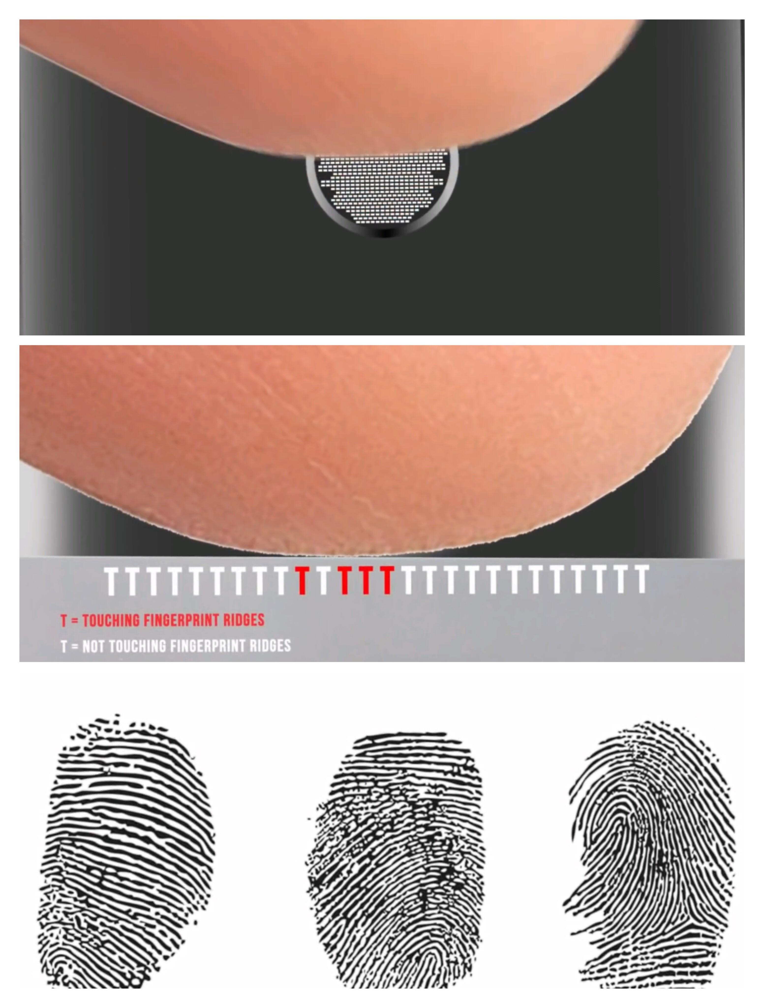
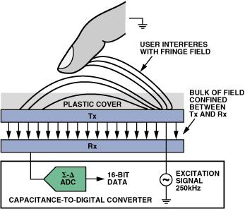
Exact view of working of Touch fingerprint sensor

Slide 9
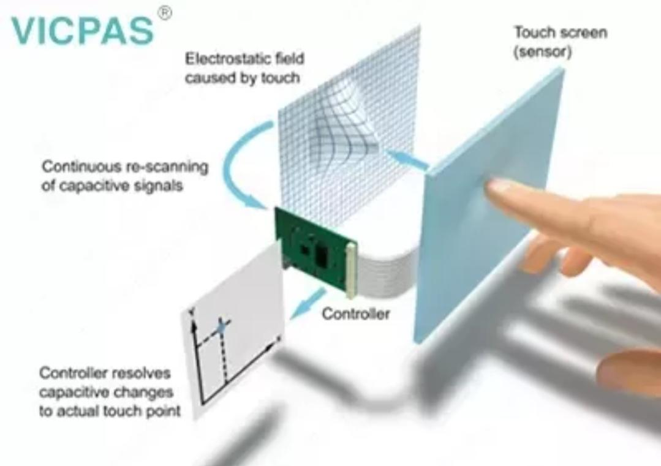
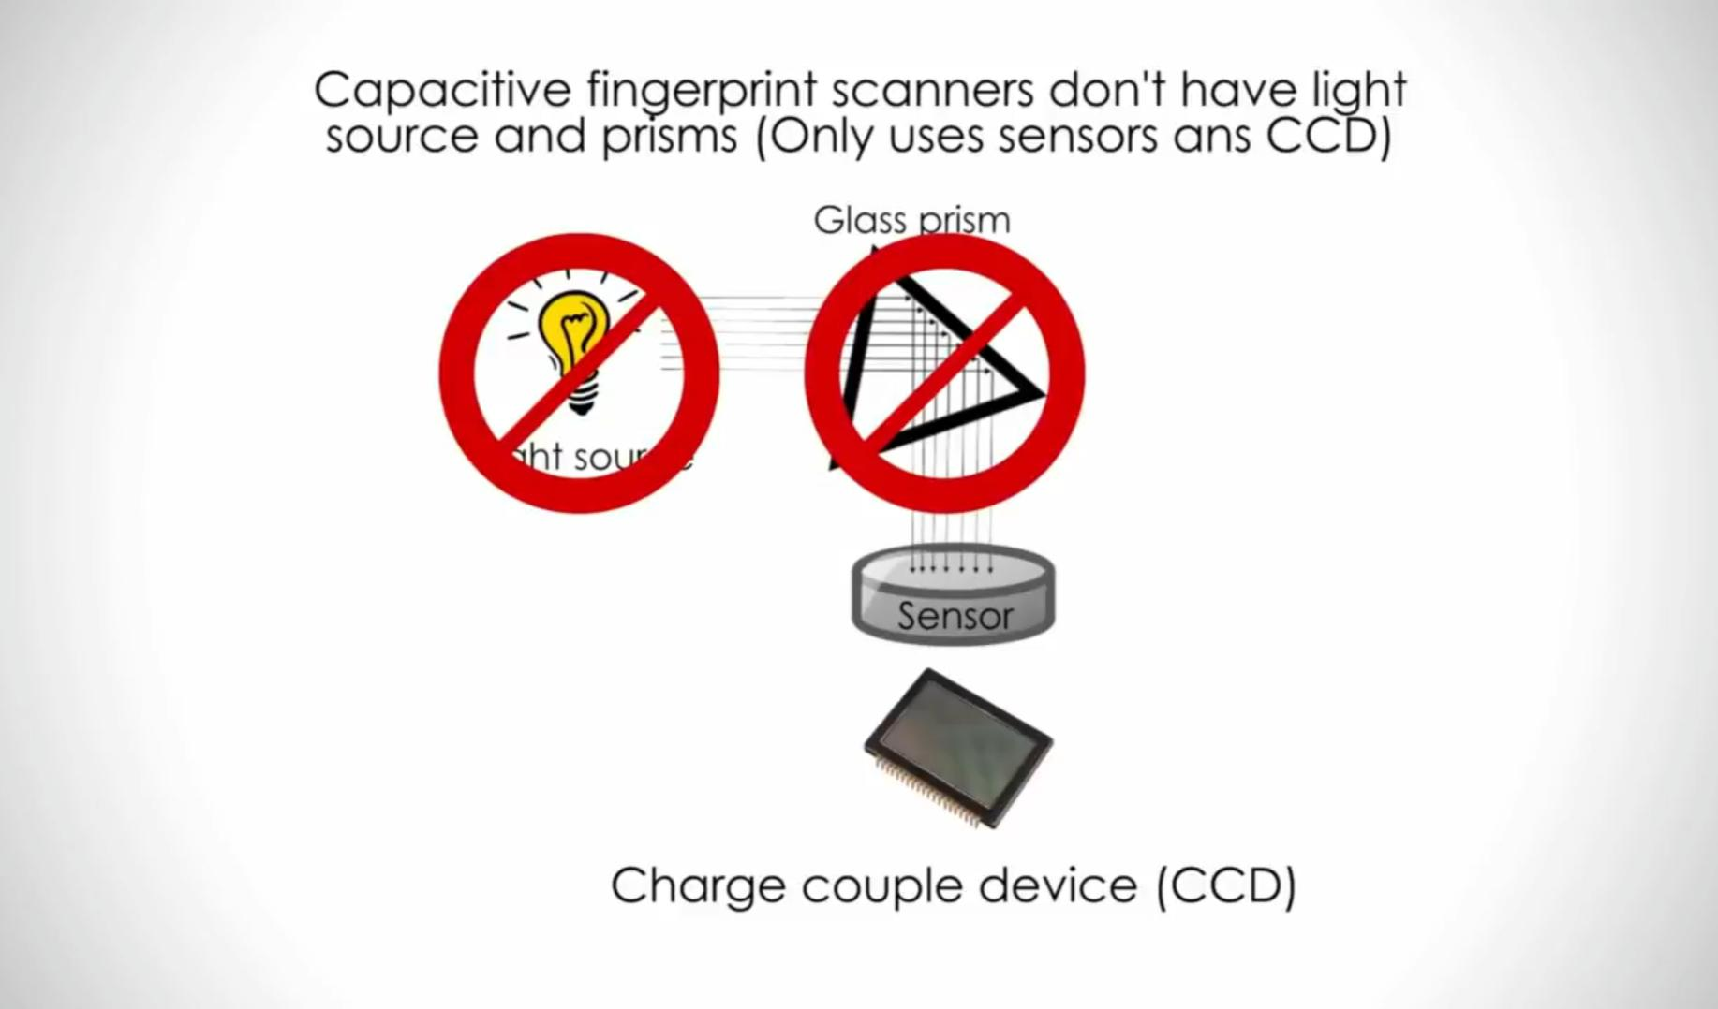
Working of capacitive touch sensor

Slide 10
Optical Type Touch fingerprint sensor
An optical sensor converts light rays into an electronic signal. The purpose of an Optical touch sensor is to measure a physical quantity of light and, depending on the type of sensor, then translates it into a form that is readable by an integrated measuring device.

Slide 11
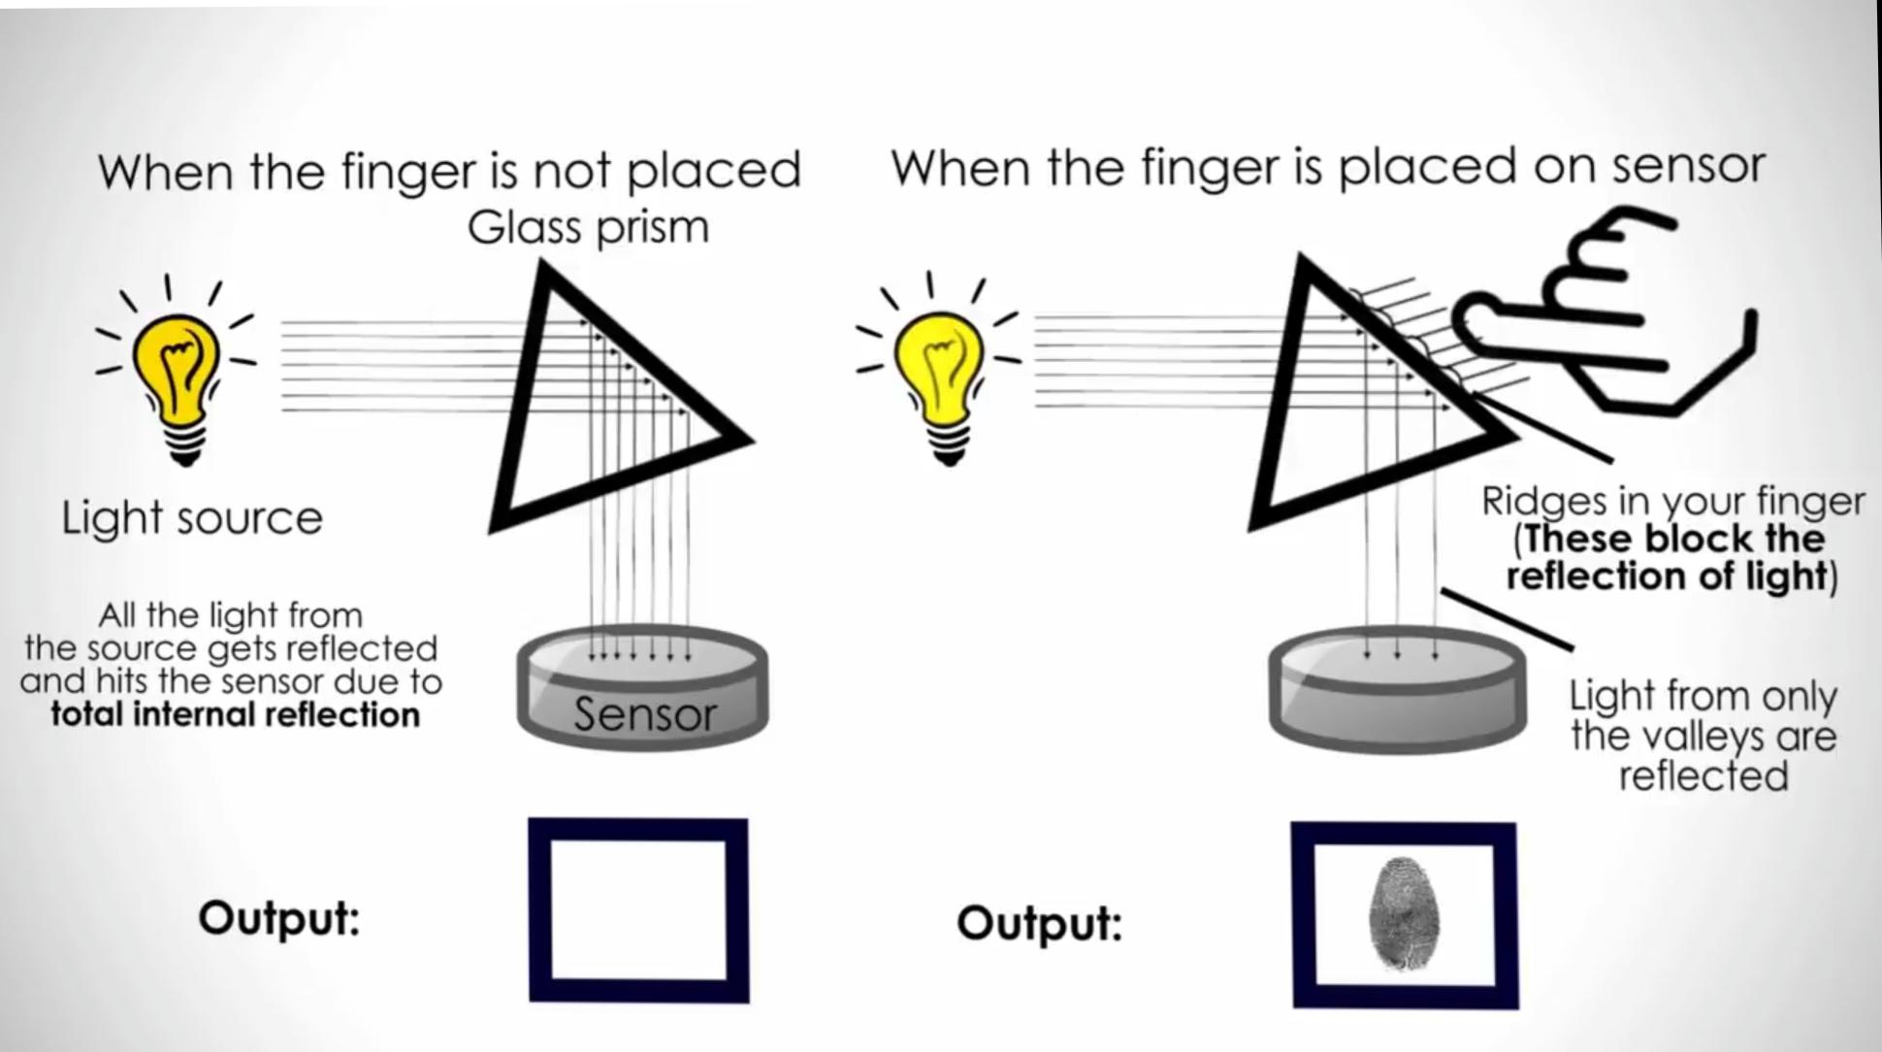
Working of optical type touch fingerprint sensor

Slide 12
Ultrasonic touch fingerprint sensor
Light waves to directly penetrate the outer layers of skin, detecting three-dimensional details and unique fingerprint characteristics, including fingerprint ridges and sweat pores that are not possible to detect with current capacitive touch-based fingerprint technologies.

Slide 13
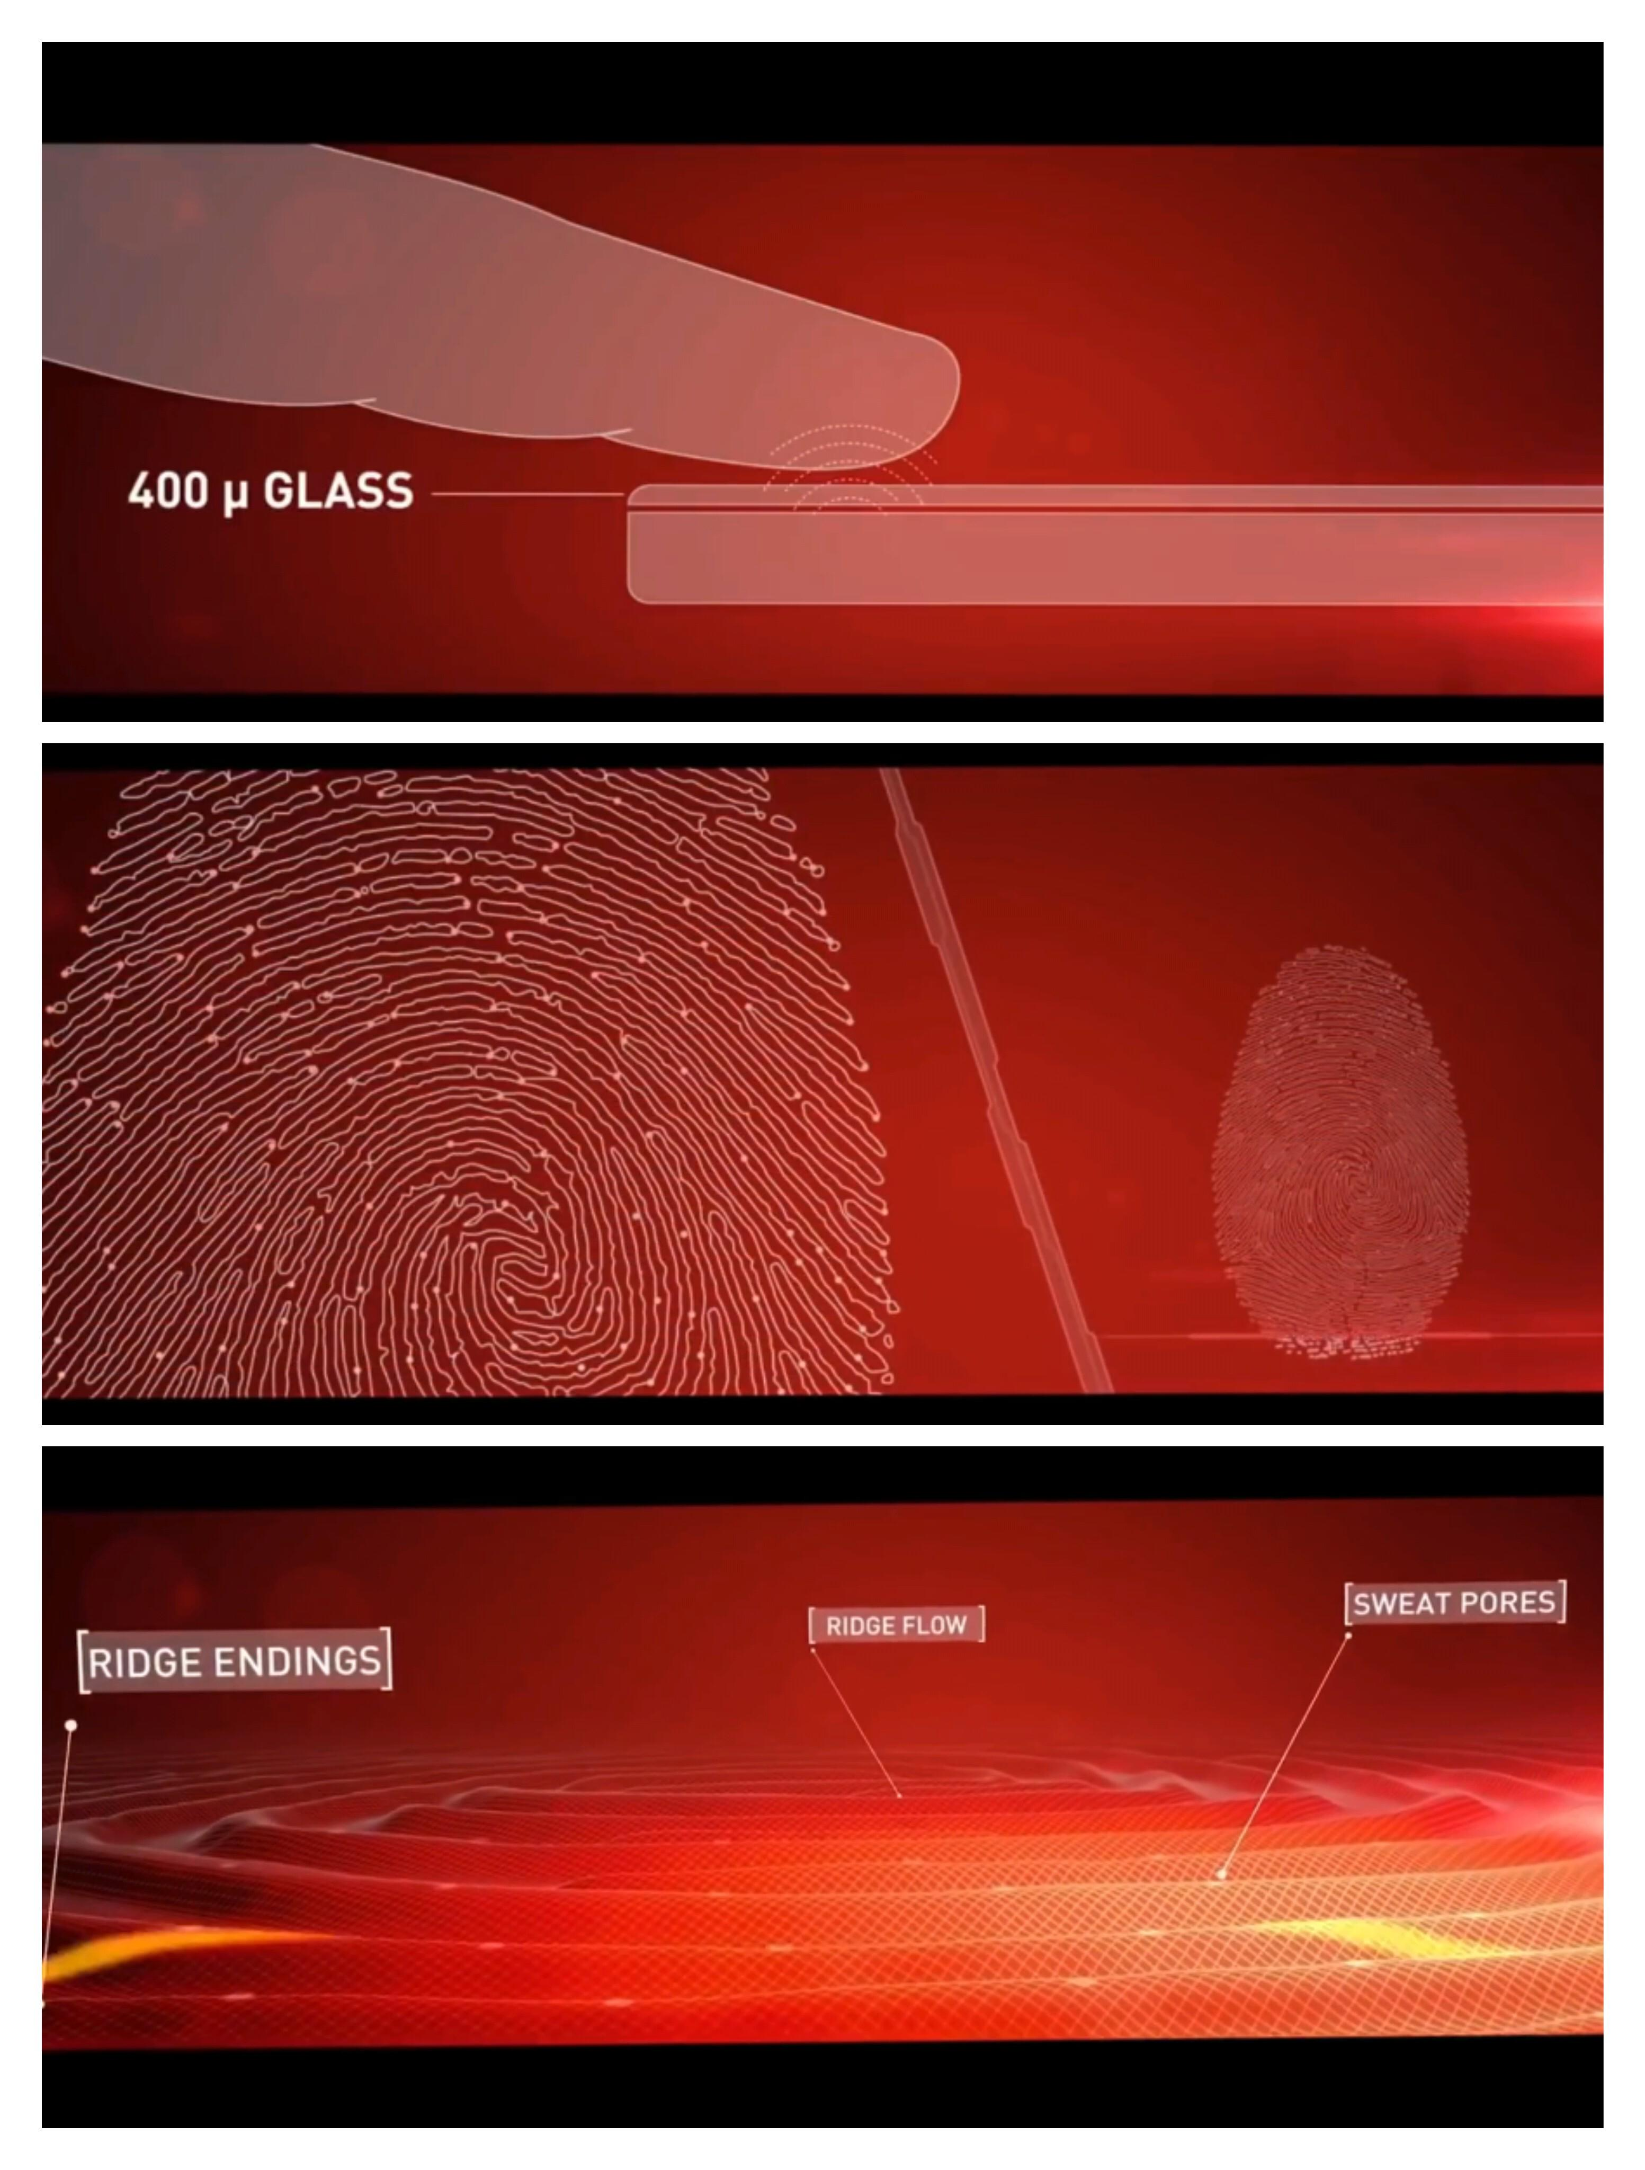
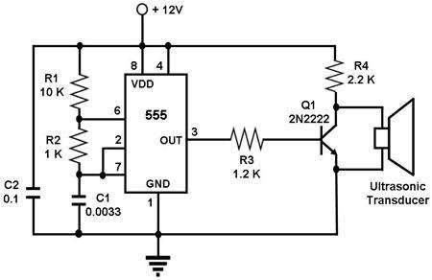
Working of Ultrasonic Fingerprint touch sensor

Slide 14
Today’s fact
The proximity sensor detects when a user is holding the phone near their face during a call and turns off the display to prevent keypad presses and battery consumption from the display. The proximity/light sensor is located to the right of the earpiece.

Slide 15
Conclusion
In this presention I am done with explaining the type of sensors. That’s which is to be embedded in future of electronic gadgets.
By the presentation my friends you will have the idea of touch screen fingerprint sensors
The next level of sensor is transducer which wil be explained in detail later ….

