Slide 1
My Game: Weightless
Maxim and Alicia

Slide 2
Hi, my name is Maxim. I am enthusiastic about programming, and have coded a website before this project.

Slide 3
My Project
I made a game about a strongman that could lift weights. My goal was to learn more about coding and create a game, without following a step-by-step tutorial for everything

Slide 4
Level and Tilemap
Player
Weight and Button
Interactions
How did I make
the game?
Create a level, with a tilemap. Upload your desired tilemap image, and tell Godot what the tile size is. Add a physics layer to your tilemap, and dray the hitbox for the tiles. Also add and occlusion layer to your tilemap, and draw the shapes for that too
Add a player, then use the built-in script to add basic movement functionality. Replace the inputs with your own custon inputs. Don’t forget to add a camera, sprite and hitbox as well.
Add a rigid body to act as the weight. Add a sprite and hitbox, and change physics to layer 2. On the tilemap, add the physics layer 2. For the button, use a static object, and do the same thing.
In the player script add a signal that checks if you’re touching a weight. Connect this to the level. Write a signal that connects back to the player, telling it what weight it is touching.

Slide 5
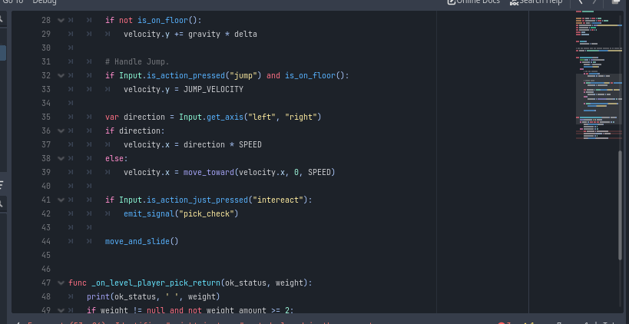
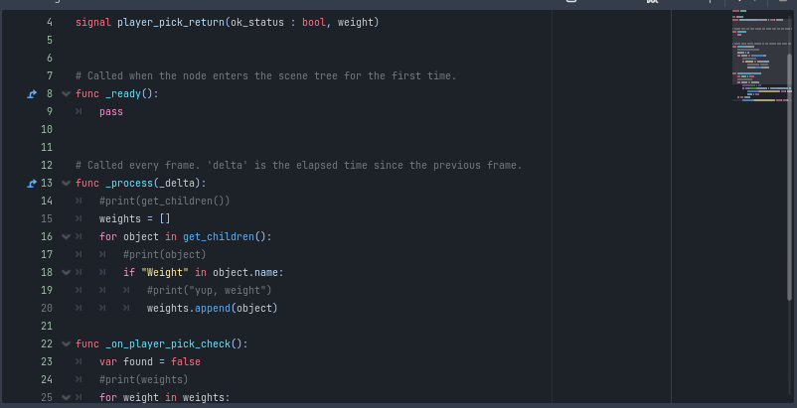
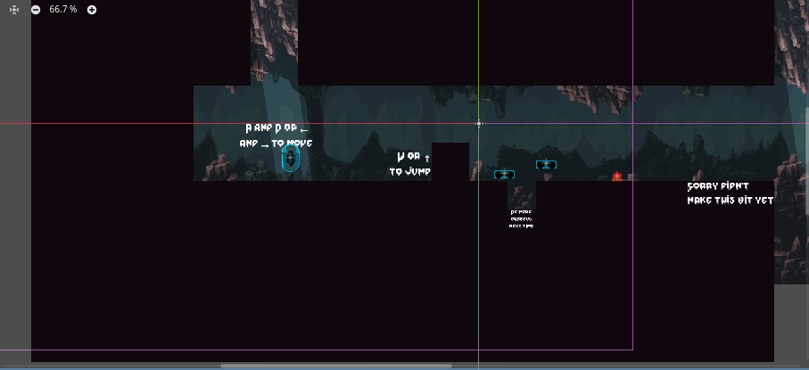
Weightless – My game
My Code
Screenshots
Here are some screenshots of my code:

Slide 6
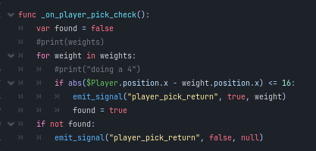
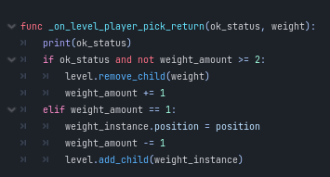
Weightless – My game
My Code
Explanation
The code is mostly made using the godot built-in code, but I also added some code to use my own inputs and pick up and drop weights. The code for the weights checks if the player is touching a weight. If the player is touching a weight, it picks it up. If the player is not touching a weight, but holding one, the player drops the weight. If the player does not have a weight and is not touching one, the player does nothing

Slide 7
Weightless – My game
Problems and Solutions
1. Weight Intereactions
2. Lighting Problems
3. Version Control
I had trouble working out the directional light, but I used an online tutorial that helped mr understand how to use the Godot lighting system
I couldn’t get the player to be able to detect if it is touching a weight, but I figured out that I could connect a signal from the player to the level. I made all the logic for the weights in the level
Learning how to use git was hard, but my dad helped me so that I could:
Commit the files
Save my work properly
Access commit history

Slide 8
Weightless – My Game
Reflections
Here are some of my reflections:
I didn’t choose my project quickly enough so I didn’t have time to work on the game. I took about a month to choose it when I should have taken about a week or so. This had the consequences of delaying my project, so I didn’t have time to work on it. If I chose my project quickly, I would be able to add more features and focus on making it look nice.
Also, when I didn’t have a plan, I couldn’t make my project efficently because I didn’t know what I had to do next, so I couldn’t make my project expecting that feature. But when I wrote a plan, I could work on the project much faster. When I didn’t have a plan, I wasn’t sure what I was doing.
Next time, I will use the Godot game engine again, as it comes with a lot of built-in functionality, so I don’t have to write much code. It makes making the game easier, because of it’s beginner-freindly interface and easy-to-use documentation.

Slide 9
Yellow Idea Template for LibreOffice Impress. Credit by : @ealita.id, 2020.
THANK YOU

