Slide 1
Fast Engine Startup
Zhenbang Liu
Notes:
Fast Engine Startup
Zhenbang Liu

Slide 2
01
Requirements
Fast Engine Startup
02 / 34
Notes:
01
Requirements
Fast Engine Startup
02 / 34

Slide 3
REQUIREMENTS
Requirements
REQUIREMENT 1
Preserve GPU capacity
REQUIREMENT 2
Faster new-engine startup
CONSTRAINTS
No loss in throughput or latency
Fast Engine Startup
03 / 34
Notes:
REQUIREMENTS
Requirements
Fast Engine Startup
03 / 34

Slide 4
02
Metrics
Fast Engine Startup
04 / 34
Notes:
02
Metrics
Fast Engine Startup
04 / 34

Slide 5
METRICS
Metrics
Time from request to first reply, and the GPU‑seconds billed before it.
Fast Engine Startup
05 / 34
Notes:
METRICS
Metrics
Time from request to first reply, and the GPU‑seconds billed before it.
Fast Engine Startup
05 / 34

Slide 6
METRICS
Baseline
WORKLOAD | WEIGHTS | STARTUP | GPU COST PER START
Qwen3-30B · 2×H100 | 61 GB | 229.8 s | $0.50
Qwen3-30B · 2 engines on 4×H100 | 61 GB | 223.9 s | $0.98
Qwen3-235B · 8×B200 | 470 GB | 951.5 s | $13.22
Cold start: a fresh sandbox per trial, stock SGLang v0.5.20, no caches. Weights pre-downloaded to a Modal volume.
Fast Engine Startup
06 / 34
Notes:
METRICS
Baseline
Cold start: a fresh sandbox per trial, stock SGLang v0.5.20, no caches. Weights pre-downloaded to a Modal volume.
Fast Engine Startup
06 / 34

Slide 7
03
Find the critical path
Fast Engine Startup
07 / 34
Notes:
03
Find the critical path
Fast Engine Startup
07 / 34

Slide 8
FIND THE CRITICAL PATH
Where the time goes
GPUS MOSTLY WAIT
On imports, file reads and kernel compilation.
EACH PHASE NEEDS ITS OWN FIX
Cache, prefetch, fewer graphs, less Python.
First cold start of a model is worse: GPUs are claimed first, so they also sit idle through the weight download: 30B 2–3 min on 2×H100, 235B ~17 min on 8×B200.
Fast Engine Startup
08 / 34
Notes:
FIND THE CRITICAL PATH
Where the time goes
Fast Engine Startup
08 / 34

Slide 9
FIND THE CRITICAL PATH
Phases and fixes
PHASE | 30B | BOTTLENECK | FIX
Imports + spawn | 58 s | Python imports, repeated per process | Bytecode, lazy imports
NCCL init | 19 s | Kernel compilation | Compile cache
Weight load | 62 s | Reading from the volume | Prefetch into RAM
CUDA graphs | 72 s | Compilation + 94 graphs | Compile cache + pow2
Other | 19 s | Warmup kernels | Compile cache
For 235B, weight load alone is 564 of 951 s.
Fast Engine Startup
09 / 34
Notes:
FIND THE CRITICAL PATH
Phases and fixes
For 235B, weight load alone is 564 of 951 s.
Fast Engine Startup
09 / 34

Slide 10
04
A solution for each component
Fast Engine Startup
10 / 34
Notes:
04
A solution for each component
Fast Engine Startup
10 / 34

Slide 11
WEIGHTS
Weights: cold start
A model's first start downloads its weights, on a CPU sandbox, before any GPU is claimed.
PROS
MODEL | DOWNLOAD | GPU COST IF CLAIMED FIRST
30B · 61 GB | 135–195 s | $0.30–0.43
235B · 470 GB | 1,004 s | ~$14
• No GPU billed during the download
• Saved to the model's own volume: later starts skip the download
CONS
• Storage cost: every model's weights stay on a volume (235B: 470 GB)
• Volumes must be managed: remove unused models, keep the catalog in sync
Now: $0 on GPUs. The cost is the download time × the GPU price.
Fast Engine Startup
11 / 34
Notes:
WEIGHTS
Weights: cold start
A model's first start downloads its weights, on a CPU sandbox, before any GPU is claimed.
PROS
No GPU billed during the download
Saved to the model's own volume: later starts skip the download
CONS
Storage cost: every model's weights stay on a volume (235B: 470 GB)
Volumes must be managed: remove unused models, keep the catalog in sync
Now: $0 on GPUs. The cost is the download time × the GPU price.
Fast Engine Startup
11 / 34

Slide 12
WEIGHTS
Weights: prefetch into RAM
16 threads read all shards into RAM while SGLang is still importing.
PROS
BEFORE
SGLang reads from the volume on demand, ~1 GB/s
• Faster SGLang init: weight load 62 → 13 s (30B), 564 → 75 s (235B)
CONS
• Needs a larger-memory host: about 2× the weights (235B: 940 GiB)
NOW
Parallel read into RAM during imports: ~2 GB/s median (30B), 4.2 GB/s (235B)
The drop combines faster parallel reads and overlap with imports. The 13 s left is the RAM → GPU copy.
Fast Engine Startup
12 / 34
Notes:
WEIGHTS
Weights: prefetch into RAM
16 threads read all shards into RAM while SGLang is still importing.
PROS
Faster SGLang init: weight load 62 → 13 s (30B), 564 → 75 s (235B)
CONS
Needs a larger-memory host: about 2× the weights (235B: 940 GiB)
The drop combines faster parallel reads and overlap with imports. The 13 s left is the RAM → GPU copy.
Fast Engine Startup
12 / 34

Slide 13
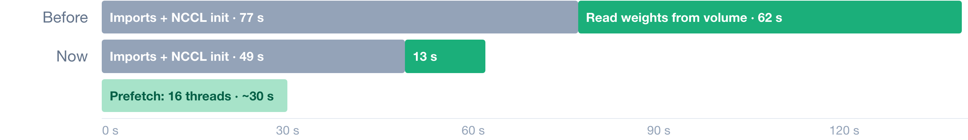
WEIGHTS
Why prefetch helps
WHY IT IS SLOW
SGLang starts reading weights only after imports and NCCL init, then reads them on demand from the network volume: ~1 GB/s.
HOW PREFETCH FIXES IT
At container start, 16 threads read whole shard files into the OS page cache, during the imports. SGLang's reads then hit RAM; only the copy to the GPU is left.
Qwen3-30B, 2×H100: baseline vs the current engine (median). "Now" also includes the other startup fixes.
Fast Engine Startup
13 / 34
Notes:
WEIGHTS
Why prefetch helps
Qwen3-30B, 2×H100: baseline vs the current engine (median). "Now" also includes the other startup fixes.
Fast Engine Startup
13 / 34

Slide 14
BACKGROUND
Memory layout: user space and kernel space
Virtual address space of one process (Linux, x86-64)
Page table (per process) + MMU
Translates each 4 KB virtual page to a physical frame. A missing page traps into the kernel: a page fault.
0xffff_8000_0000_0000
Kernel space
kernel code + data · direct map of all RAM (incl. page cache)
non-canonical gap
Physical RAM (4 KB frames)
0x0000_7fff_ffff_ffff
Stack ↓
mmap region
shared libraries · mmap of model-00001.safetensors
• User space: the program's own memory; it can't touch the kernel's
• Kernel space: entered through system calls and page faults
• mmap of a file: the user-space range points straight at page-cache frames, with no copy
Heap ↑
Python objects, tensors
0x0000_0000_0040_0000
Code + data
python, libtorch
Fast Engine Startup
14 / 34
Notes:
BACKGROUND
Memory layout: user space and kernel space
Virtual address space of one process (Linux, x86-64)
0xffff_8000_0000_0000
0x0000_7fff_ffff_ffff
0x0000_0000_0040_0000
User space: the program's own memory; it can't touch the kernel's
Kernel space: entered through system calls and page faults
mmap of a file: the user-space range points straight at page-cache frames, with no copy
Fast Engine Startup
14 / 34

Slide 15
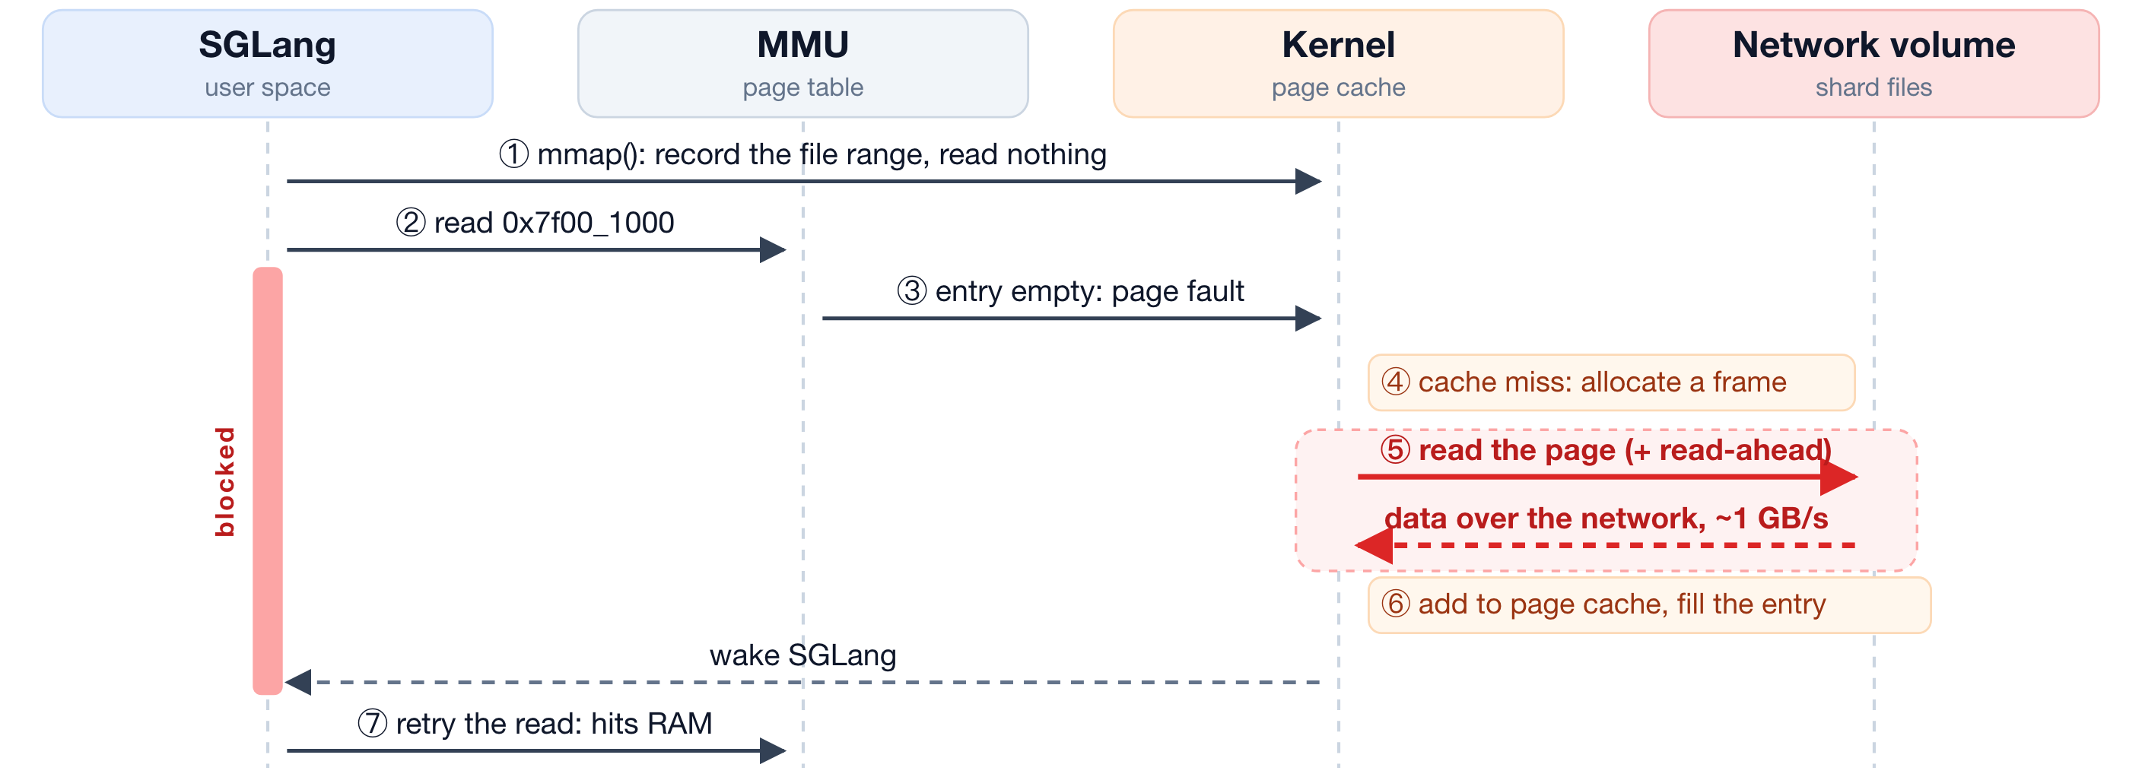
BACKGROUND
mmap read, page not cached: major fault
Major fault: every miss blocks SGLang for a network read; the 30B weights take 62 s this way.
Fast Engine Startup
15 / 34
Notes:
BACKGROUND
mmap read, page not cached: major fault
Major fault: every miss blocks SGLang for a network read; the 30B weights take 62 s this way.
Fast Engine Startup
15 / 34

Slide 16
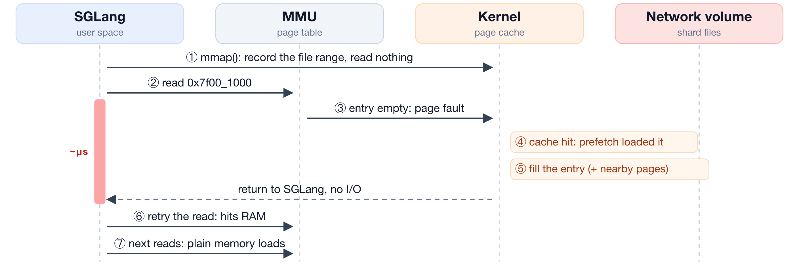
BACKGROUND
mmap read, page cached: minor fault
Minor fault: no I/O and the volume is never touched. The 30B weights load in 13 s, mostly the copy to the GPU. With prefetch, every fault is a minor one.
Fast Engine Startup
16 / 34
Notes:
BACKGROUND
mmap read, page cached: minor fault
Minor fault: no I/O and the volume is never touched. The 30B weights load in 13 s, mostly the copy to the GPU. With prefetch, every fault is a minor one.
Fast Engine Startup
16 / 34

Slide 17
WEIGHTS
ModelExpress GPU-to-GPU transfer REJECTED
UPSIDE
Load weights from a running engine
DOWNSIDE
Transfer backend does not start on Modal
Streaming loader: smaller gain than prefetch
+
−
−
Fast Engine Startup
17 / 34
Notes:
WEIGHTS
ModelExpress GPU-to-GPU transfer REJECTED
+
−
−
Fast Engine Startup
17 / 34

Slide 18
CUDA GRAPHS
CUDA graphs: power-of-two sizes
Capture only power-of-two batch sizes. Other batches pad up to the next size.
PROS
 | ORIGINAL | POW2
Decode | 36 | 9
Prefill | 58 | 12
Total | 94 | 21
• Faster SGLang init: graph capture 27 → 9.6 s
• Less graph memory: 1.69 → 1.18 GB
CONS
• Lower throughput: ~2%
• Higher latency: +0.05 ms per token
• Wastes GPU resources on padding: up to 2× (129 requests run as 256)
Fast Engine Startup
18 / 34
Notes:
CUDA GRAPHS
CUDA graphs: power-of-two sizes
Capture only power-of-two batch sizes. Other batches pad up to the next size.
PROS
Faster SGLang init: graph capture 27 → 9.6 s
Less graph memory: 1.69 → 1.18 GB
CONS
Lower throughput: ~2%
Higher latency: +0.05 ms per token
Wastes GPU resources on padding: up to 2× (129 requests run as 256)
Fast Engine Startup
18 / 34

Slide 19
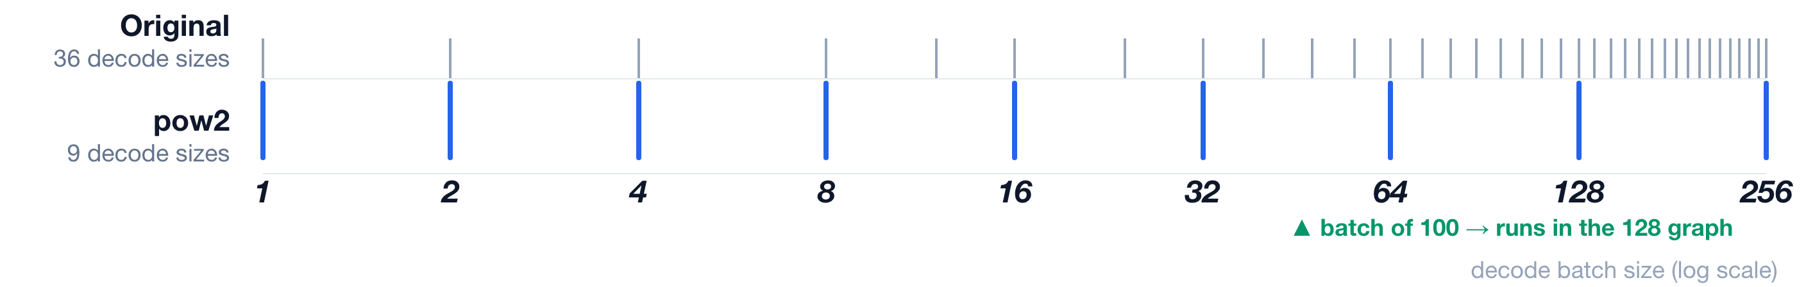
CUDA GRAPHS
Why power-of-two graphs work here
PADDING IS CHEAP HERE: HOW WE MEASURED
METRIC | LOAD ON THE FRESH ENGINE | FULL | POW2
Throughput | 128 requests, 32 at a time | 4,645 tok/s | 4,547 tok/s (−2.1%)
Latency per token | 16 requests, one at a time | 3.45 ms | 3.50 ms (+0.05)
800-word prompt, 256 output tokens. Latency = time between output tokens (median). Mean of 2 cold-start trials each.
Fast Engine Startup
19 / 34
Notes:
CUDA GRAPHS
Why power-of-two graphs work here
PADDING IS CHEAP HERE: HOW WE MEASURED
800-word prompt, 256 output tokens. Latency = time between output tokens (median). Mean of 2 cold-start trials each.
Fast Engine Startup
19 / 34

Slide 20
CUDA GRAPHS
Disable CUDA graphs REJECTED
UPSIDE
~27 s faster startup
DOWNSIDE
10–19× lower throughput
Latency 3.5 → 64.5 ms per token
+
−
−
DECISIONServing cost is far higher than the startup gain.
Fast Engine Startup
20 / 34
Notes:
CUDA GRAPHS
Disable CUDA graphs REJECTED
+
−
−
DECISIONServing cost is far higher than the startup gain.
Fast Engine Startup
20 / 34

Slide 21
PYTHON IMPORTS
Python imports
Imports are single-threaded and repeated by every worker process.
PROS
• Precompiled bytecode: ~7 s
• Import file prefetch
CONS
• Still ~48 s: the largest remaining phase
Fast Engine Startup
21 / 34
Notes:
PYTHON IMPORTS
Python imports
Imports are single-threaded and repeated by every worker process.
PROS
Precompiled bytecode: ~7 s
Import file prefetch
CONS
Still ~48 s: the largest remaining phase
Fast Engine Startup
21 / 34

Slide 22
PYTHON IMPORTS
How precompiled bytecode shortens init
import a module
→
no .pyc: read, parse and compile the source
CPU, single-threaded
→
run it
ENGINE IMAGE LAYERS
SGLang base image
BEFORE
lazy-import patch
compileall: every .pyc
built once, cached by Modal
import a module
→
.pyc already in the image: load the bytecode
→
run it
NOW
import manifest
our engine files
SGLang imports ~3,900 modules. A fresh container has no .pyc files, so every cold start compiled all of them.
# fes/common.py · with_bytecode(): runs once, at image build python -m compileall -q -j 0 /opt/sglang/lib/python3.12/site-packages /sgl-workspace/sglang/python
Fast Engine Startup
22 / 34
Notes:
PYTHON IMPORTS
How precompiled bytecode shortens init
BEFORE
→
→
NOW
→
→
SGLang imports ~3,900 modules. A fresh container has no .pyc files, so every cold start compiled all of them.
ENGINE IMAGE LAYERS
Fast Engine Startup
22 / 34

Slide 23
PYTHON IMPORTS
How import-file prefetch shortens init
Modal fetches image files on first read; SGLang's imports read ~14k of them one by one.
AT IMAGE BUILD
Record every file an engine's imports read, and save the list in the image.
AT CONTAINER START
Load those files into memory (the OS page cache) in parallel, while SGLang imports. Its imports then read them from RAM.
Result: ~2–4 s faster on real starts, within host-to-host noise.
Fast Engine Startup
23 / 34
Notes:
PYTHON IMPORTS
How import-file prefetch shortens init
Modal fetches image files on first read; SGLang's imports read ~14k of them one by one.
Fast Engine Startup
23 / 34

Slide 24
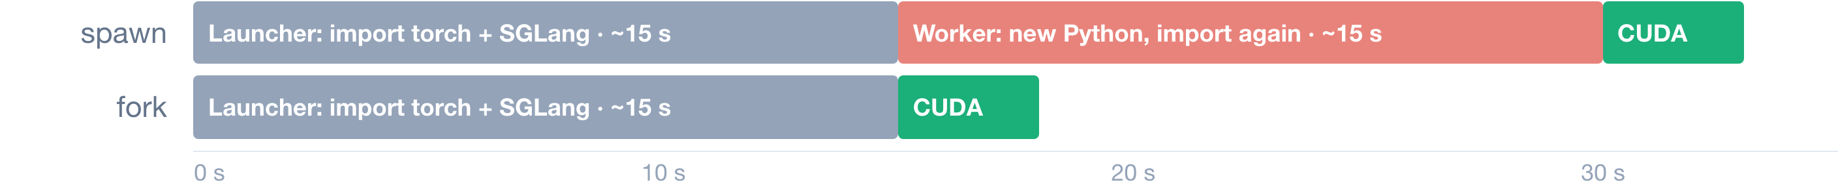
PYTHON IMPORTS
Why spawn is slower than fork
SPAWN: A FRESH PROCESS
Starts a new Python interpreter, which imports torch and SGLang again. Every TP worker pays it.
FORK: A COPY OF THE PARENT
Modules are already in memory. Pages are shared copy-on-write, so the worker starts in milliseconds.
One TP worker. ~15 s is the measured warm import per process; the CUDA block is only illustrative.
Why SGLang uses spawn: CUDA can't be used in a child forked after CUDA started.
Fast Engine Startup
24 / 34
Notes:
PYTHON IMPORTS
Why spawn is slower than fork
One TP worker. ~15 s is the measured warm import per process; the CUDA block is only illustrative.
Fast Engine Startup
24 / 34

Slide 25
PYTHON IMPORTS
Fork instead of spawn REJECTED
UPSIDE
Faster process startup
DOWNSIDE
Unsafe once CUDA is initialized
+
−
DECISIONA forkserver started before CUDA is future work.
Fast Engine Startup
25 / 34
Notes:
PYTHON IMPORTS
Fork instead of spawn REJECTED
+
−
DECISIONA forkserver started before CUDA is future work.
Fast Engine Startup
25 / 34

Slide 26
COMPILED KERNELS
Compiled kernels: compile cache
Save compiled kernels after the first start. Restore them on later starts.
PROS
 | COLD | CACHED
NCCL init | 19 s | 1 s
CUDA graphs | 73 s | 27 s
• ~60 s saved on 30B
• Shared across starts with the same SGLang, GPU, TP and model
CONS
• First start of a new configuration still compiles
• A dedicated volume per model (fes-artifacts-<model>) to store and manage
Fast Engine Startup
26 / 34
Notes:
COMPILED KERNELS
Compiled kernels: compile cache
Save compiled kernels after the first start. Restore them on later starts.
PROS
~60 s saved on 30B
Shared across starts with the same SGLang, GPU, TP and model
CONS
First start of a new configuration still compiles
A dedicated volume per model (fes-artifacts-<model>) to store and manage
Fast Engine Startup
26 / 34

Slide 27
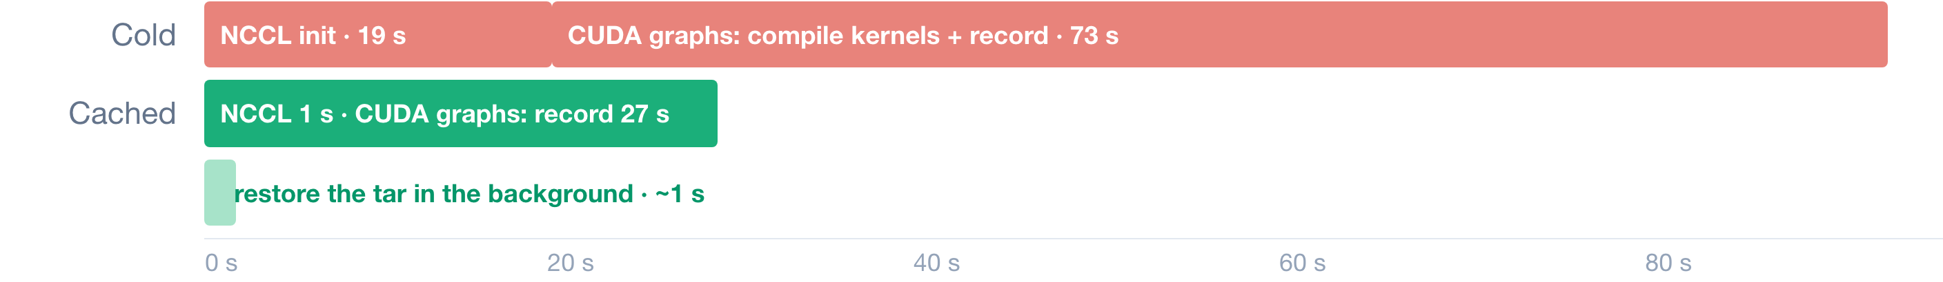
COMPILED KERNELS
How the compile cache helps
FIRST START: COMPILE, THEN SAVE
SGLang compiles its GPU kernels (Triton, FlashInfer, all-reduce). After READY, they are packed into one ~29 MB tar on fes-artifacts-<model>.
LATER STARTS: RESTORE, THEN REUSE
At boot the tar is unpacked beside the launch. SGLang finds every kernel already compiled and skips the compile.
Qwen3-30B, full CUDA graphs. Also saves ~9 s of warmup. Reused by any start with the same SGLang version, GPU, TP and model config.
Fast Engine Startup
27 / 34
Notes:
COMPILED KERNELS
How the compile cache helps
Qwen3-30B, full CUDA graphs. Also saves ~9 s of warmup. Reused by any start with the same SGLang version, GPU, TP and model config.
Fast Engine Startup
27 / 34

Slide 28
05
Make it work, then make it reliable
Fast Engine Startup
28 / 34
Notes:
05
Make it work, then make it reliable
Fast Engine Startup
28 / 34

Slide 29
ARCHITECTURE
Architecture
LOCAL CONTROL PLANE
Web UI
pages + JSON API
→
API
writes jobs, streams progress
→
Job queue
Postgres table (Docker)
→
Worker
claims a job, plans and runs it
⇄
Catalog
what is cached
↓ starts sandboxes
MODAL
GPU engine
at once: prefetch weights into RAM · restore compiled kernels · start SGLang
←
mount
Volumes
weights + compile cache, one set per model
←
CPU prep
only on a weights cache miss: downloads them, no GPU billed
Fast Engine Startup
29 / 34
Notes:
ARCHITECTURE
Architecture
LOCAL CONTROL PLANE
→
→
→
⇄
↓ starts sandboxes
MODAL
←
mount
←
Fast Engine Startup
29 / 34

Slide 30
ARCHITECTURE
API + job queue
The front door. It writes jobs; it never runs them.
HOW IT WORKS
QUEUE = A POSTGRES TABLE
Workers claim the oldest queued row with FOR UPDATE SKIP LOCKED, so two workers never get the same job.
• Flask app: Engines, Jobs, Playground, Catalog, Compare pages + JSON API
• POST /api/jobs inserts a row with status queued
• Progress streams to the page from the job's event log (SSE)
• Cancel sets a flag the worker checks every second
• Restarting the API never interrupts a running job
JOB STATES
queued → running → serving → stopped · timeout · failed
Fast Engine Startup
30 / 34
Notes:
ARCHITECTURE
API + job queue
The front door. It writes jobs; it never runs them.
HOW IT WORKS
Flask app: Engines, Jobs, Playground, Catalog, Compare pages + JSON API
POST /api/jobs inserts a row with status queued
Progress streams to the page from the job's event log (SSE)
Cancel sets a flag the worker checks every second
Restarting the API never interrupts a running job
Fast Engine Startup
30 / 34

Slide 31
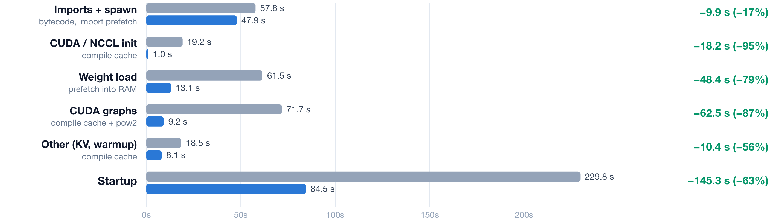
RESULTS
Results: Qwen3-30B · 2×H100
GPU cost per start $0.50 → $0.18. Medians: baseline n=3, now n=12.
Fast Engine Startup
31 / 34
Notes:
RESULTS
Results: Qwen3-30B · 2×H100
GPU cost per start $0.50 → $0.18. Medians: baseline n=3, now n=12.
Fast Engine Startup
31 / 34

Slide 32
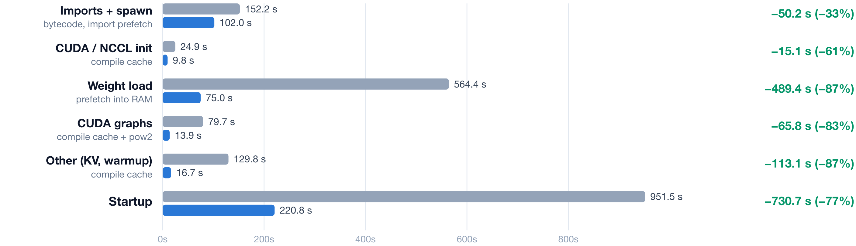
RESULTS
Results: Qwen3-235B · 8×B200
GPU cost per start $13.22 → $3.03. n=1 on each side.
Fast Engine Startup
32 / 34
Notes:
RESULTS
Results: Qwen3-235B · 8×B200
GPU cost per start $13.22 → $3.03. n=1 on each side.
Fast Engine Startup
32 / 34

Slide 33
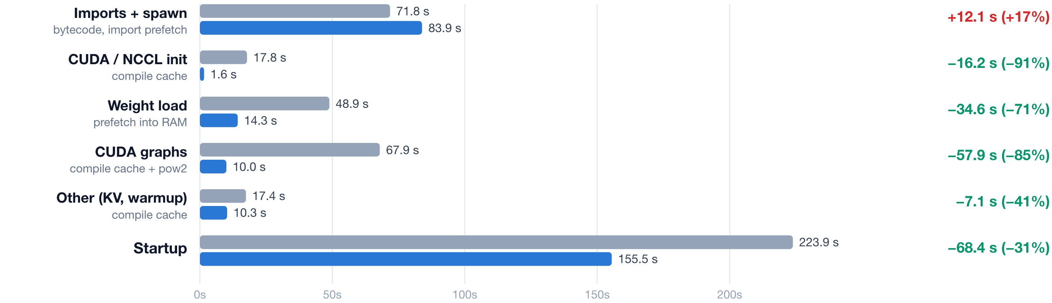
RESULTS
Results: Qwen3-30B · 2 engines on 4×H100
GPU cost per start $0.98 → $0.53. Baseline n=1, now n=2. Startup also includes ~35 s outside the phases: waiting for the second engine.
Fast Engine Startup
33 / 34
Notes:
RESULTS
Results: Qwen3-30B · 2 engines on 4×H100
GPU cost per start $0.98 → $0.53. Baseline n=1, now n=2. Startup also includes ~35 s outside the phases: waiting for the second engine.
Fast Engine Startup
33 / 34

Slide 34
OUTLOOK
Future Work
ENGINE
Validate pow2 graphs on production traffic
Fork TP workers from a pre-imported process (forkserver)
Pre-sharded checkpoints per GPU
SCHEDULER
Warm volume pool
Quotas and rate limits
Multi-cloud GPU scheduling
ENGINEERING
CI/CD: build and deploy the images on every merge
Unit tests: plan, catalog, queue
E2E tests: a real start on the smallest GPU, nightly
Monitoring and alerting: startup time, failures, queue wait
API authentication
Fast Engine Startup
34 / 34
Notes:
OUTLOOK
Future Work
Fast Engine Startup
34 / 34

