Slide 1
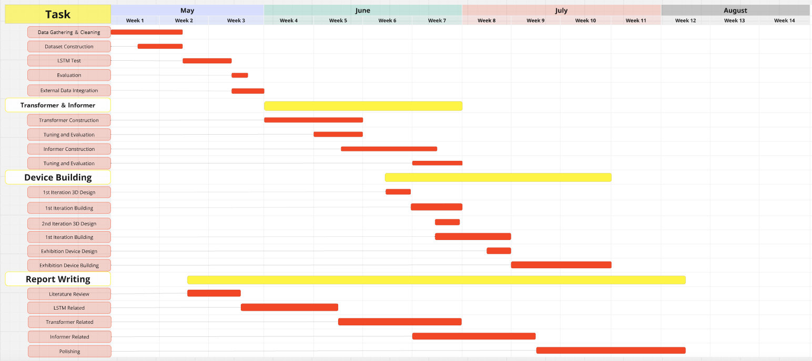

Slide 2
Rainfall–runoff modelling using Long Short-Term Memory (LSTM) networks 《Hydrology and Earth System Sciences 2018》
In: Rainfall + Temperature + Sun Radiation + Vapor Pressure
Out: River water flow level
Dataset similar
Proven LSTM can learn from a composite dataset

Slide 3
A TIME SERIES IS WORTH 64 WORDS: LONG-TERM FORECASTING WITH TRANSFORMERS 《ICLR 2023》
Tested with: Weather / Traffic / Electronic Usage / Influenza-Like Illness (ILI)
/ Transformer Temperature (ETT)
Convert time series data to “patches”
Kept local information + Reduced complexity

Slide 4
Informer: Beyond Efficient Transformer for Long Sequence Time-Series Forecasting 《AAAI2021》
Tested with: Electronic Usage (ECL) / Transformer Temperature (ETT) / Weather
Informer Self Attention will calculate attention with only “active points”
Distill to find important long-time features
Output future information about a period at once

Slide 5
Autoformer: Decomposition Transformers with Auto-Correlation for Long-Term Series Forecasting 《Neural IPS 2021》
Tested with: Electronic Usage (ECL) / Transformer Temperature (ETT) / Weather / Influenza-Like Illness (ILI) / Traffic / Exchange Rate
Best of All
Try to find long-time trend, and seasonal fluctuations
Use auto-correlation to find cycles in the dataset

Slide 6
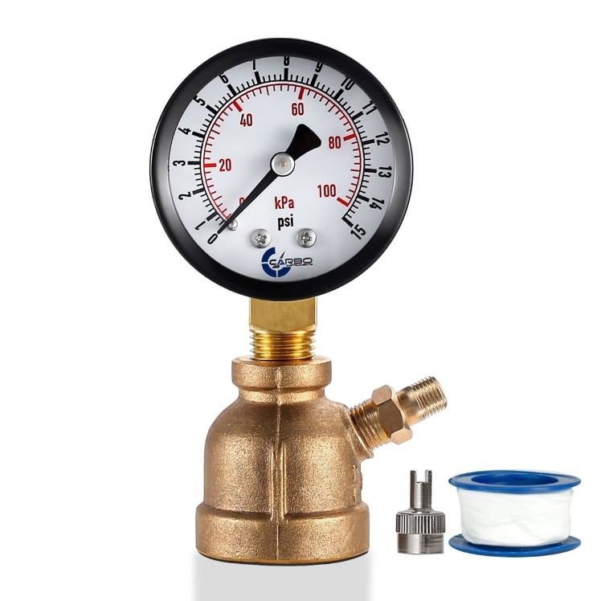

Device Design
Home Device: Steampunk gas gauge with sound cue
Exhibition Device: A house mill miniature with functional water pump to mimic floods

