Slide 1

Spark Ecosystem & Internals
陈 超 @CrazyJvm

Slide 2

outline
basis & internals
ecosystem

Slide 3
Current Major Release
Just released Spark 1.1

Slide 4
Spark : What & Why
Apache Spark is a fast and general engine for large-scale data processing.
Speed
Ease of Use
Generality
Integrated with Hadoop

Slide 5
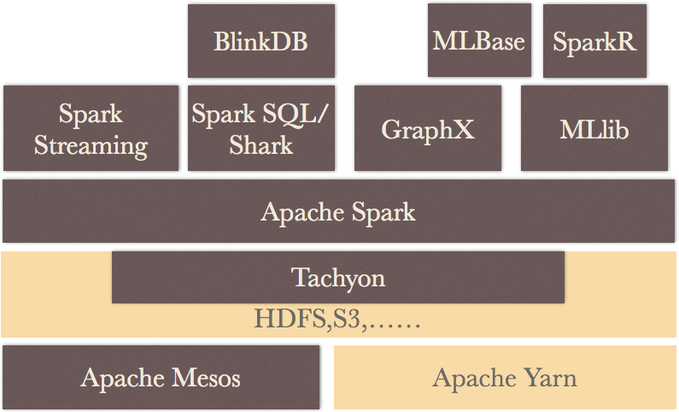
BDAS

Slide 6
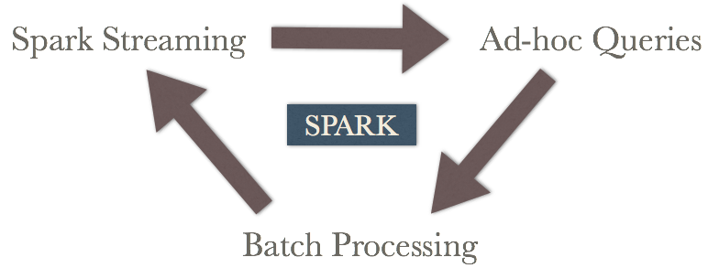
one stack to rule them all

Slide 7
Key Concept-RDD
A list of partitions
A function for computing each split
A list of dependencies on other RDDs
Optionally, a Partitioner for key-value RDDs
Optionally, a list of preferred locations to compute each split on

Slide 8
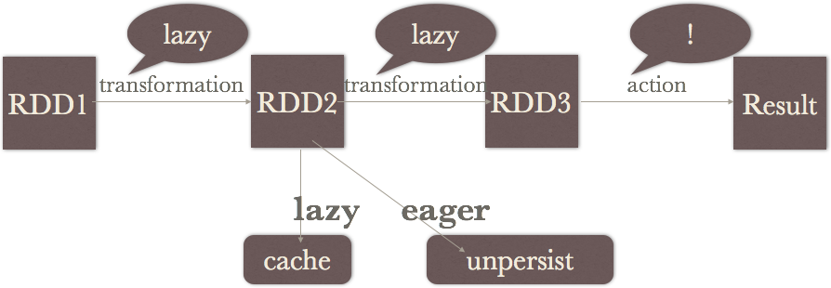
Key Concept-Lineage
unroll partition safely when caching

Slide 9
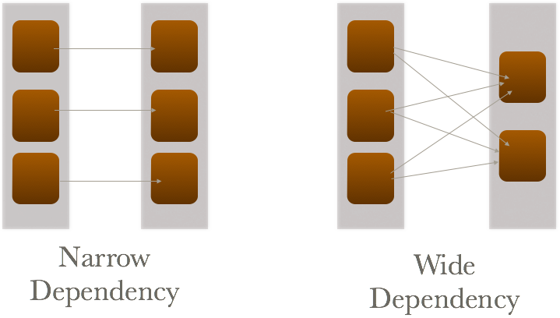
Key Concept-Dependency

Slide 10
Key Concept-ClusterManager
Local
Standalone
Yarn
Mesos

Slide 11
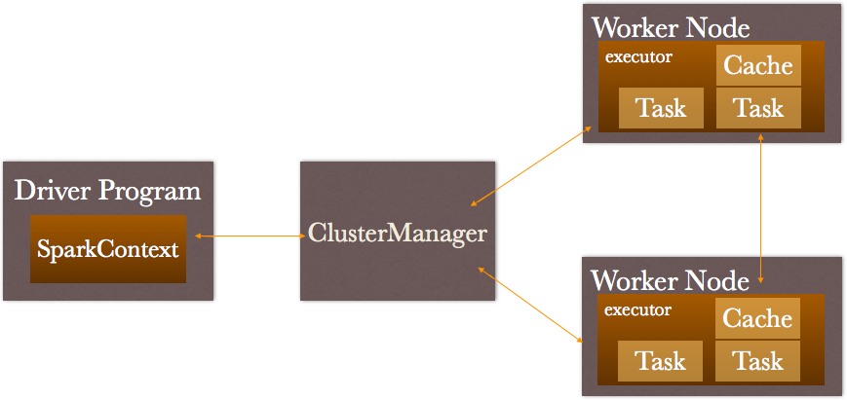
Cluster Overview

Slide 12
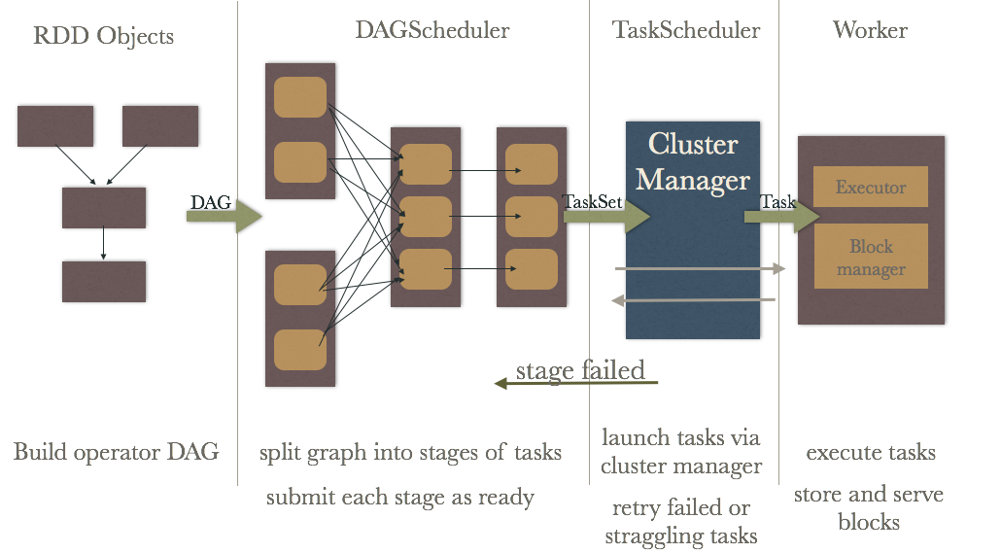
schedule

Slide 13
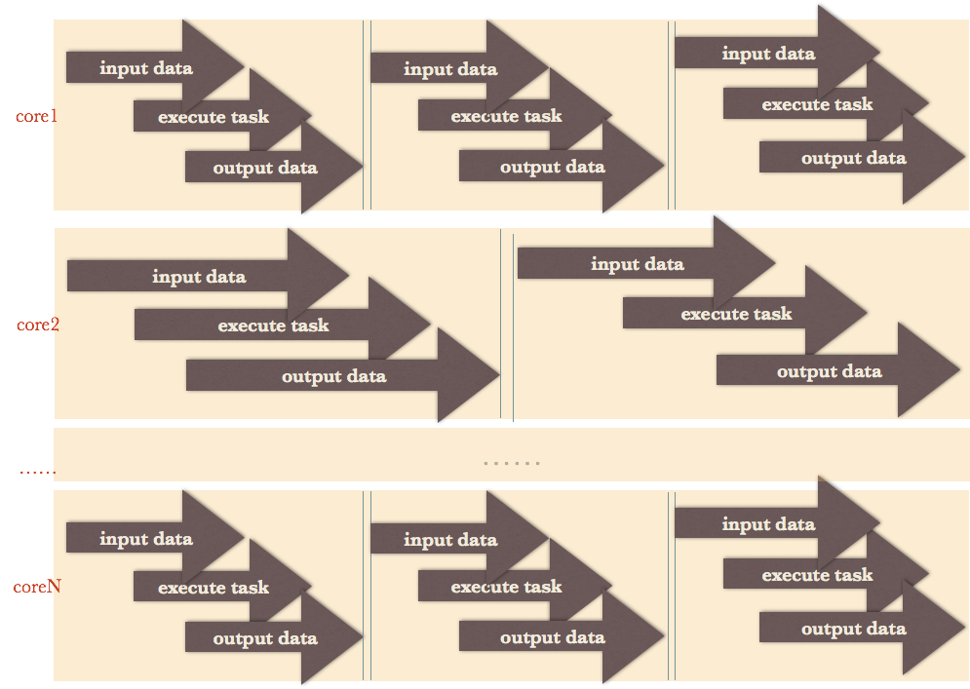
Executor

Slide 14
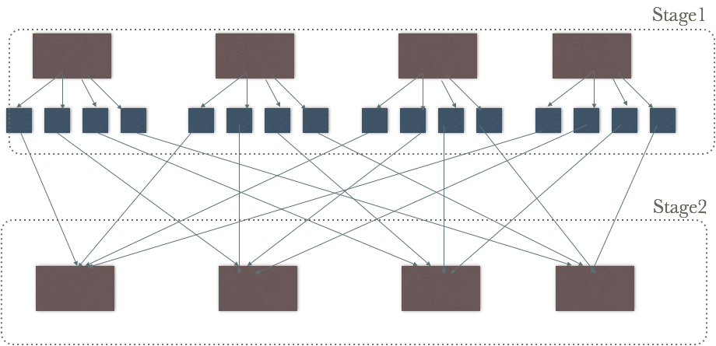
Shuffle
Sort-based shuffle supported

Slide 15
Shuffle
Pull-based (not push-based)
Write intermediate files to disk
Build hash map within each partition
Can spill across keys
A single key-value pair must fit in memory

Slide 16
Better Metrics System
Previously: only collect after task completed
Now : report when task is still running

Slide 17
outline
basis & internals
ecosystem

Slide 18
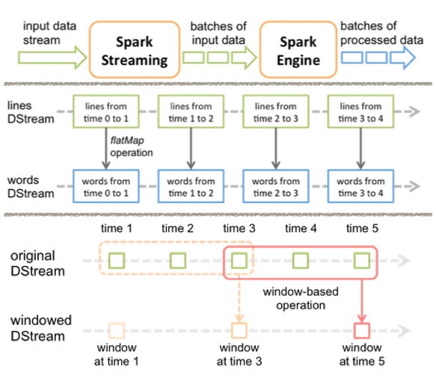
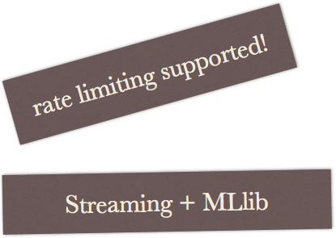
Spark Streaming
Mini-batch

Slide 19

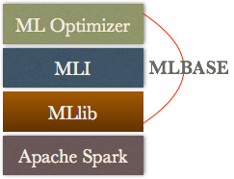
MLlib
Spark implementation of some common machine learning algorithms and utilities
classification
regression
clustering
collaborative filtering
dimensionality reduction
feature extraction supported:
Word2Vec , TF-IDF

Slide 20
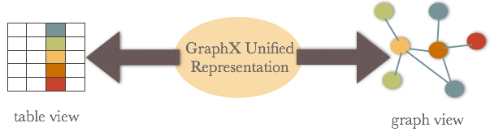
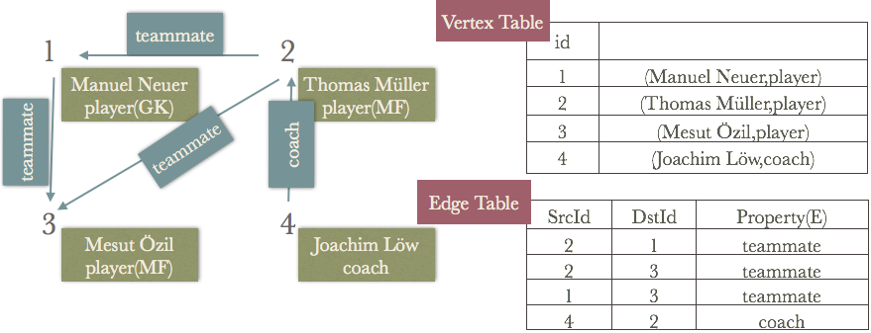
GraphX

Slide 21
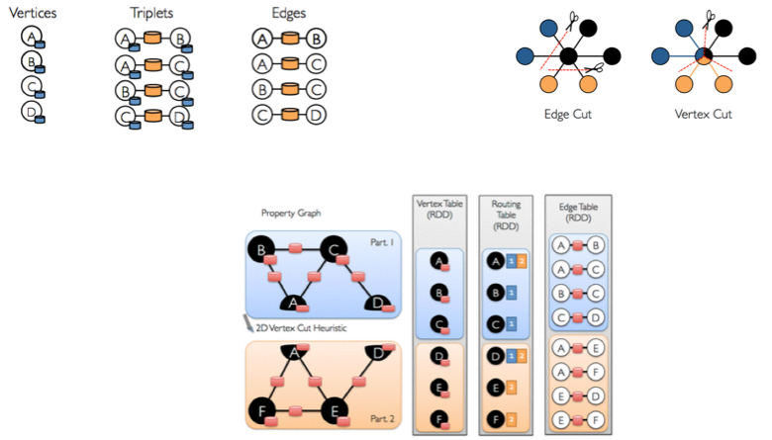
GraphX

Slide 22
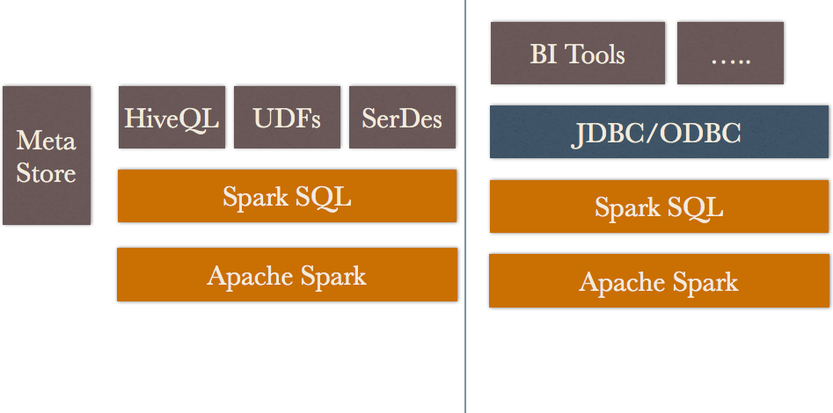
Spark SQL

Slide 23
Spark SQL
Data Sources
RDDs/Parquet Files/JSON Datasets/Hive Table
DSL
JDBC Server
Programmatically Specifying the Schema

Slide 24
Shark
Development in Shark has been ended and subsumed by Spark SQL
Mission completed !!!

Slide 25
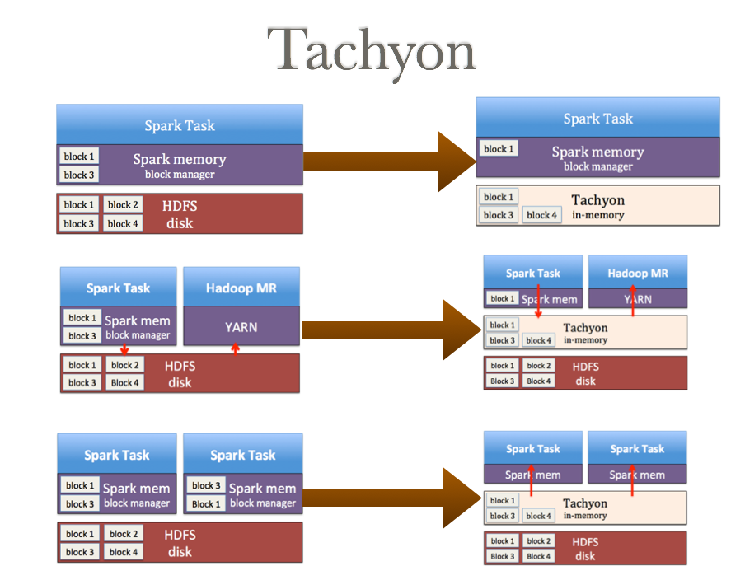
Tachyon

Slide 26
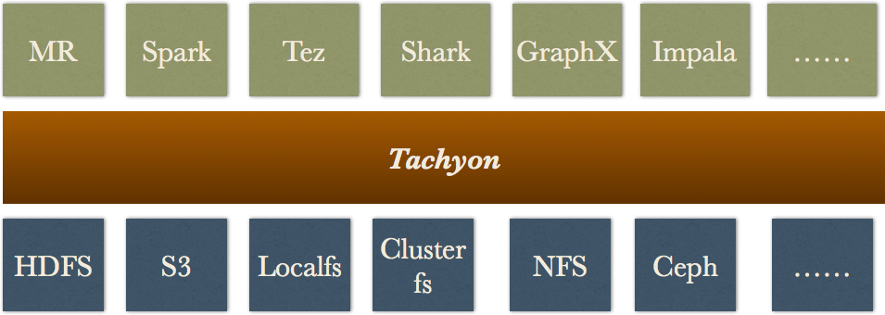
Tachyon

Slide 27
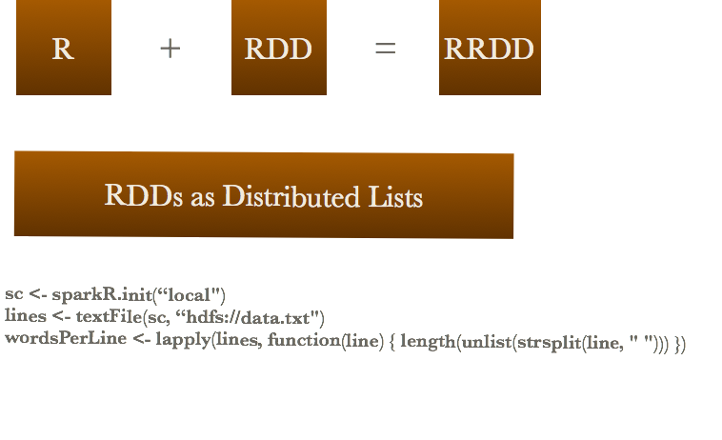
SparkR

Slide 28
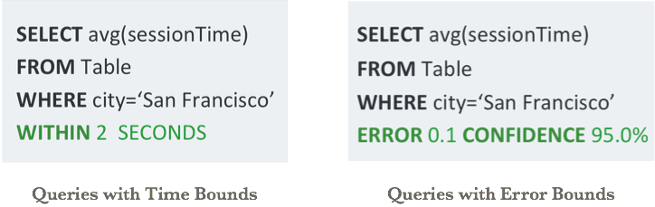
BlinkDB
Queries with Bounded Errors and Bounded Response Times on Very Large Data

Slide 29
contact me
^{weibo:@CrazyJvm}
wechat public account : ChinaScala

Slide 30

Q&A

