Slide 1
Final Project Proposal:
Hey Siri
By: Oke Amuwha & Mahz Alam

Slide 2
Motivation
Use siri hands free
Improves accessibility
Decrease time needed

Slide 3
Problem
Iphone:
Speed
Accuracy
False - positives
Watch:
Battery conservation

Slide 4
Solutions
Detector:
Probability distribution from acoustic model
Outputs are high enough in sequence
Confidence score
Uses two DNN

Slide 5
Solutions
Responsiveness & Power
Uses motion coprocessor (AOP)
Wakes up main processor
Apple Watch
Activates coprocessor on wrist raise
Allowance for possible truncation

Slide 6
Training & Testing Data
“Hey Siri” utterance for initial training
Accounts for edge cases
Different pronunciation & short break
Multiple sound classes for speech and silence
Adjusts weights using back-propagation

Slide 7
Training & Testing Data
Produces estimates for probability
Training model takes one day
Trains three types of models
Small model - “First pass”
Larger model - “Second pass”
Medium model - Apple Watch

Slide 8
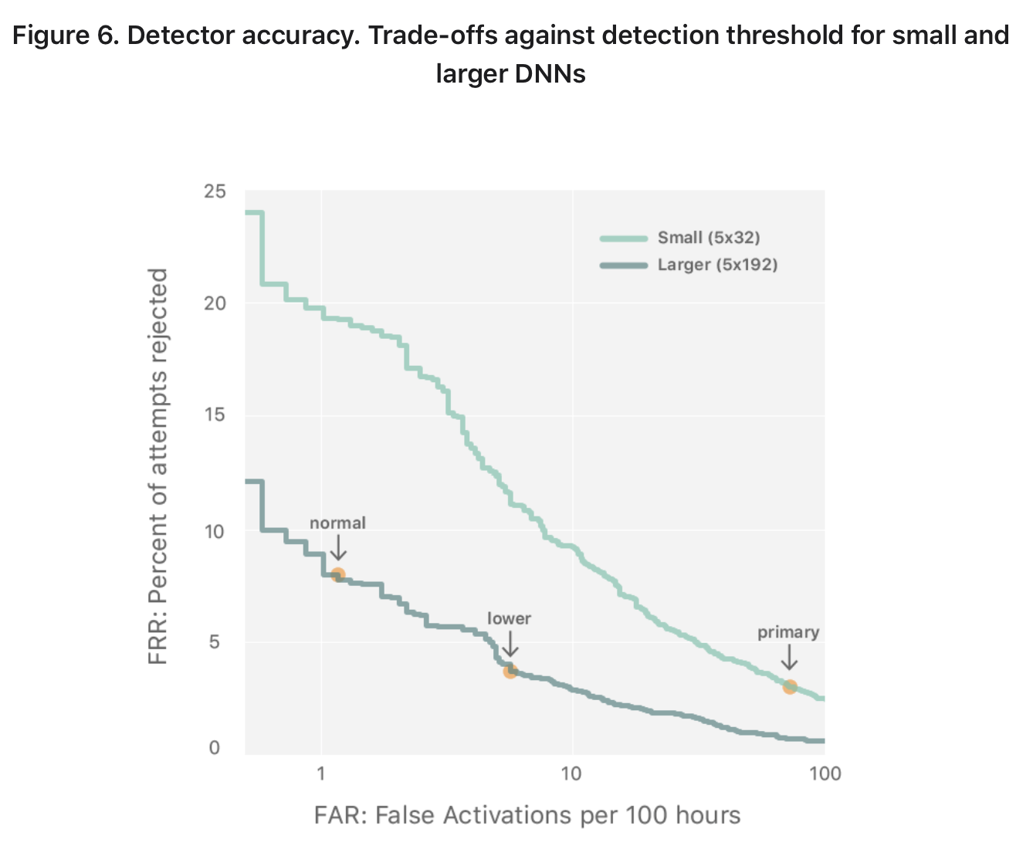
Evaluations
Accounting for false positives
Firing at the wrong time
Failing to fire at the right time
False-accept rate & False-reject rate
Adjusting threshold of FAR & FRR

Slide 9
Demonstration
Accounting for false positives
“Hey Siri” from across the room
Used native language
Negative data (Not trigger phrase)
Any false positives gets a retraining

Slide 10
Conclusions
Deep neural networks integral to hands-free Siri
Consider performance, energy and speed
Consider false-positives
Continuously improve product

Slide 11
References
Siri Team. (2017, October). Hey Siri: An on-device DNN-powered voice trigger for Apple's personal assistant. Apple Machine Learning Research. Retrieved March 1, 2022, from https://machinelearning.apple.com/research/hey-siri

