Slide 1
Forum

Slide 2
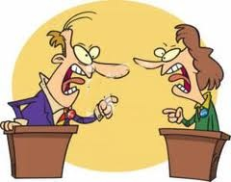
for
DebateForum

Slide 3
debates

Slide 4
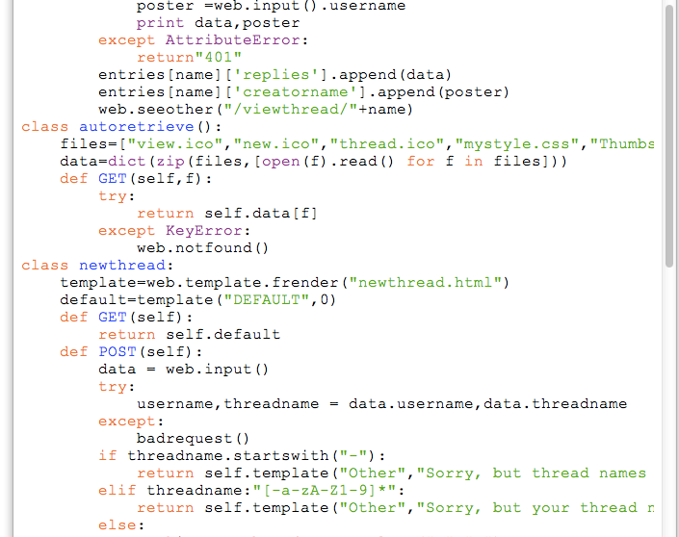
A snippet of my code

Slide 5
James Lu
5th grade
Mrs. helsel’s class
Now start reading
the poster!

Slide 6
How it works
Finished result*
Script
Web.py
Everything
My script
Data it needs**
Html template
The framework that does
the very basic processing
Does all the tracking,
responding to requests…
Request
Does basic things and renders
(Uses web.py templating language)
Does most of the stuff
*Goes directly to “My script”
**Gets processed with the templating
language.
Not shown:
Programming language:python
OS:Whatever python can run on
CPU:Whatever the OS is running on
User

Slide 7
What’s a template?!
These tell us what it looks like.
The particular templating language i’m using is the web.py templating language (the one that comes built-in to web.py).
This templating language uses html and some scripting that looks like python.

Slide 8
What’s HTML?
HTML stands for HyperText Markup Language.
In other words, it is a language that we use to display webpages.

Slide 9
What’s a script?!
A script tells us how to do things…
…scripts are stuff written in programming languages (used just like a regular language) to tell the computer what to do.Why don’t we use english instead? First, english is sometimes ambiguous (more than one meaning)(ex. “I shot an elephant in my pajamas. I don’t know how I got there.”) Second, english is hard to teach computers.

Slide 10


Contributing
GitHub
Yes, I do want fellow students to help!
http://bit.ly/1egfWaG or https://github.com/CrazyPython/DebateForum/tree/Dev or go to github.com,search DebateForum, click CrazyPython/DebateForum, click branch:master and click on “Dev” in the drop down menu.
This links to my Github repository’s development branch.
Translation: this is the place where I store my code, the version that is for changing
You need a GitHub account, but it’s free.

Slide 11
You can edit online, or download Github for Windows/Mac and edit on your desktop.
(you’ll get “Please read the instructions for contributing”)
When you edit, you actually copy it on your account, and make a “pull request”, or basically merge the copies.
If you contribute enough, you can ask me to make you become a collaborator, so you can edit without needing to do a pull request.
More at CONTRIBUTING in the repo.

Slide 12
Significance
There are many forums, but none are to debate big ideas/controversial things.
There aren’t any debates that let a everyman say something or let an everyman start a new topic.

Slide 13

Web.py
A web framework.

Slide 14

Python
The super-awesome programming language that helped me make this.

Slide 15
Play around
Try submitting a thread.
Reply to other people’s threads.
Come back and look at the forum again.
Feel free to ask me about anything about the project.
Ask to take a look at any of the scripts or templates.

