Slide 1
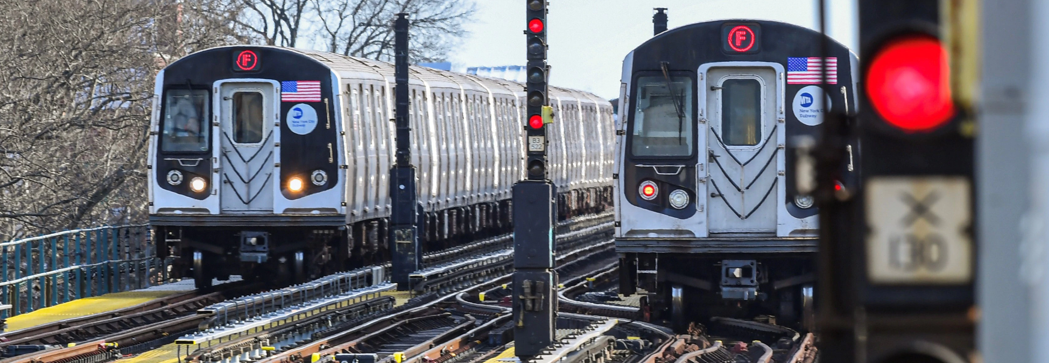
MTA EXPLORATORY DATA ANALYSIS
Yingqing Qiu
Metis Data Science Bootcamp
September 2021

Slide 2
Introduction
Motivation
NYC DOT and MTA want to add/construct several new stations to satisfy the growing post-pandemic daily public transit needs.
Objectives and goals
We plan to send out several groups of surveyors to collect information from the passengers entering the subway stations. So that it is necessary to come out a reasonable and efficient survey plan to save time and labor. We want to find out the busiest station and time blocks for the preliminary survey plan.
Final results
After the data analysis, we selected several stations for the survey plan. Additional metrics that can be discussed in the future are considered and presented.

Slide 3
Methodology
Pandas
Numpy
Matplotlib
Seaborn

Slide 4
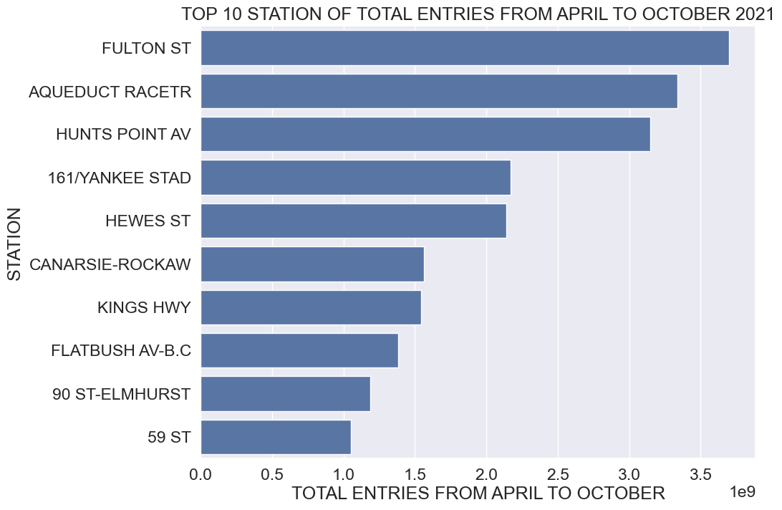
Results

Slide 5
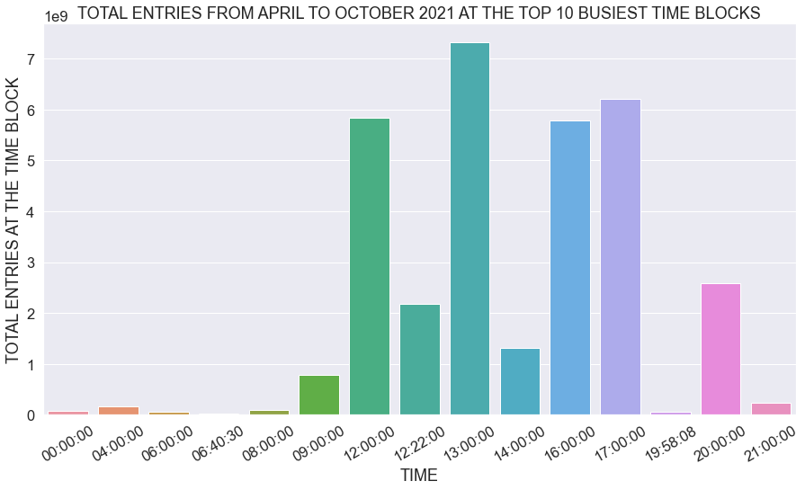
Results

Slide 6
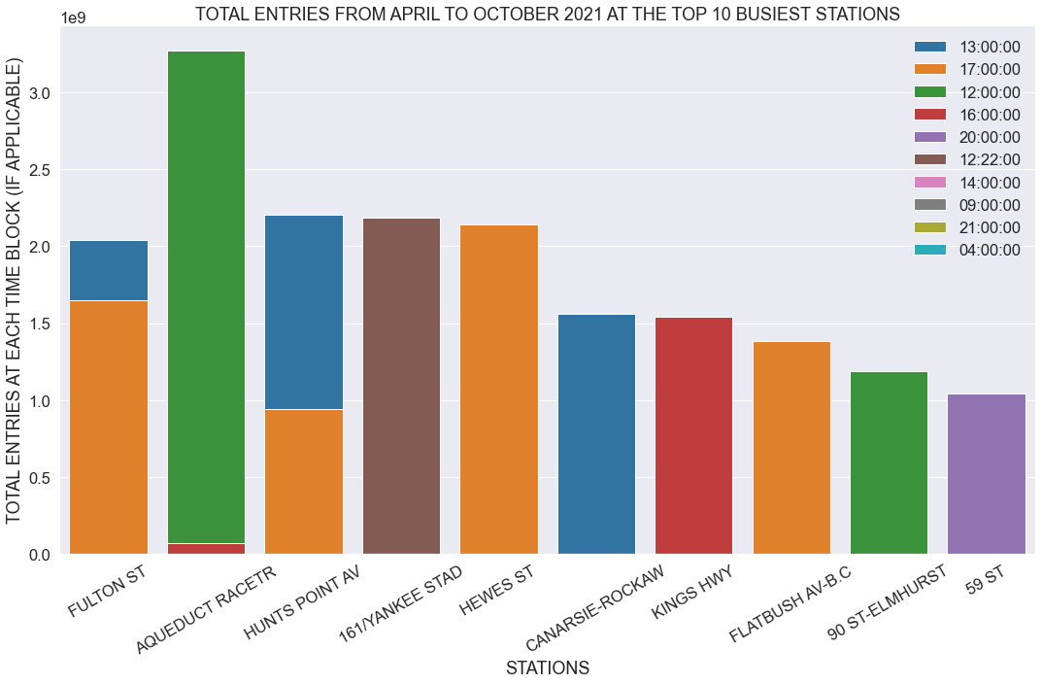
Results

Slide 7
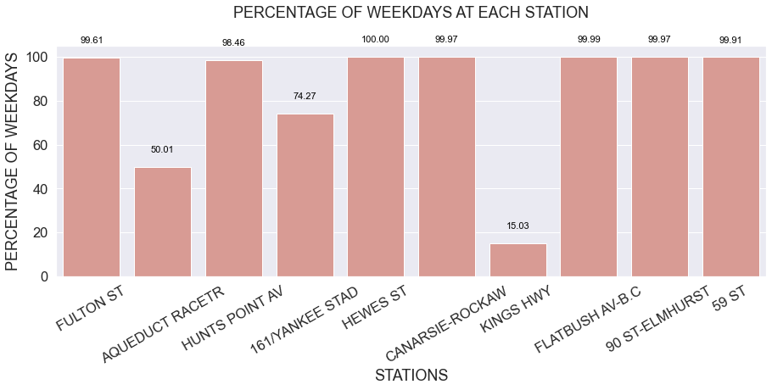
Results

Slide 8
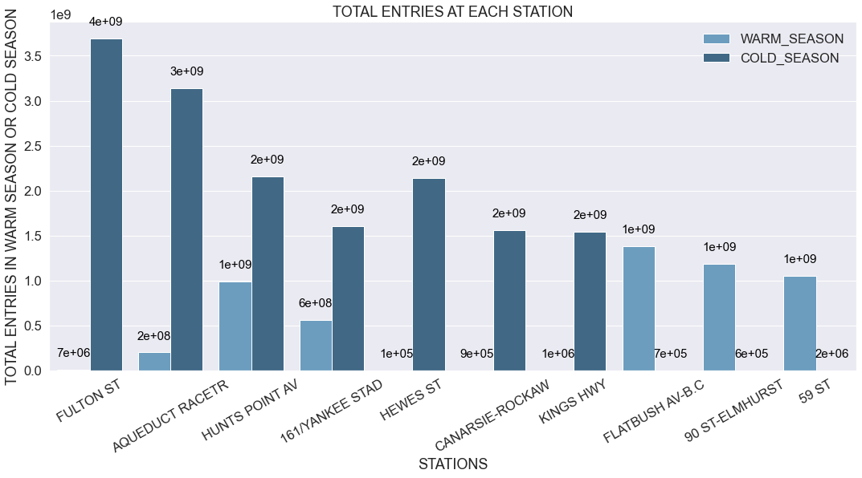
Results

Slide 9
Conclusions
PRELIMINARY SURVEY PLAN – TIME AND LOCATION
Station | Time | Weekday/Weekends | Season
FULTON ST | 17:00:00 | Weekday | Cold
AQUEDUCT RACETR | 12:00:00 | Both Weekday/Weekends | Cold
HUNTS POIN AV | 13:00:00 | Weekday | Cold/Warm
… …

Slide 10
Future Work
Distance between stations
Correlate the census characteristics near each station with the daily entries
… …

Slide 11
Thank you!

