Slide 1



Keith Dye karad.co.uk
Rob Miles
robmiles.com
We have come together for this competition to make something interesting.
We hope that it is.

Slide 2
“How am I doing?”
Use low cost cameras to monitor wellbeing in the home
Alert carers to changes in behaviour

Slide 3


Our Idea
There are lots of systems that track you as they move around your home by using passive infrared (PIR) sensors
We want to make a device that tracks how well you can do things
This won’t just tell us where you are, it will tell us how you are doing..

Slide 4
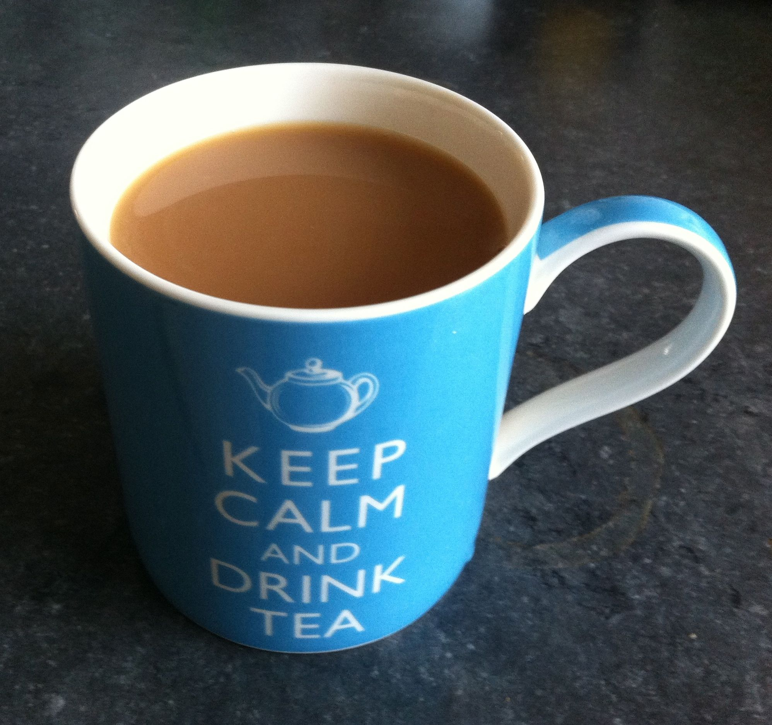
Making a cup of tea…..
Making a cup of tea is a complex activity
If we can measure how well you can make tea we can get a feeling for how “well” you are
We can break the activity down into a number of steps

Slide 5
Making a cup of tea…..
Walk into the kitchen
Go to the kettle
Go to the sink
Go back to the kettle
Go to the cupboard
Go back to the kettle
Wait for the kettle to boil
Go back to the kettle

Slide 6
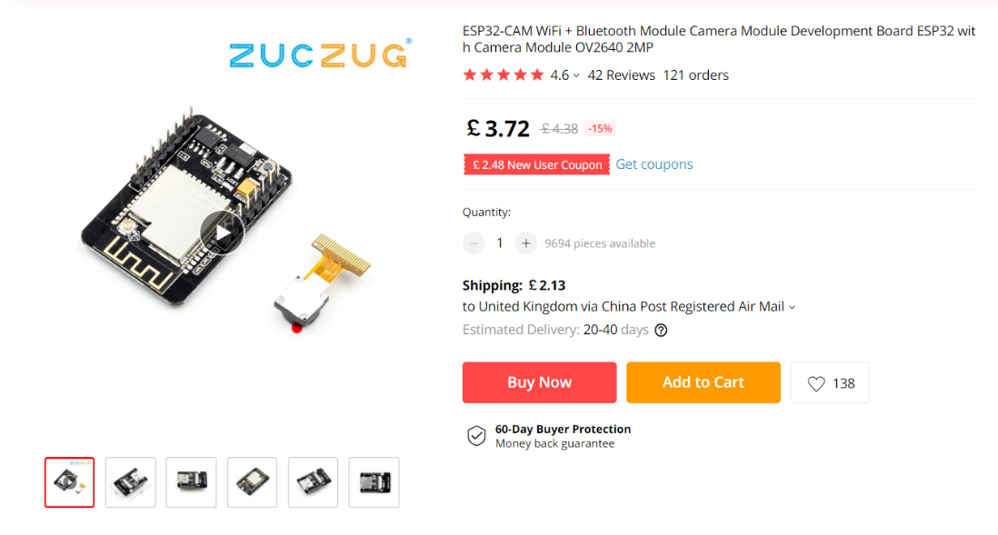
Low cost action tracking
We use a low cost camera and processor combination to track the stages of an activity like tea making
We deliberately simplify the video image to make it very easy to track movement
Our camera will look for movement against a static background (the kitchen)

Slide 7
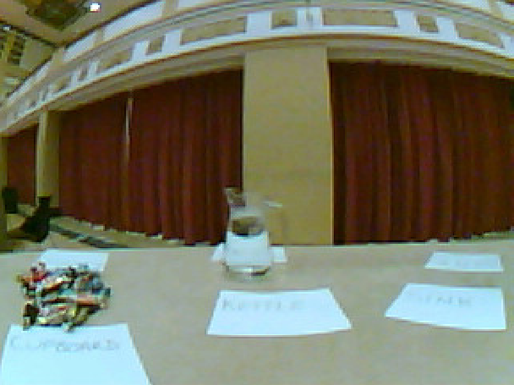
Our “kitchen”
The camera starts with a static image of the kitchen and then detects movement in the kitchen
We detect you in the frame by tracking the differences caused when you enter the frame and move around in it

Slide 8
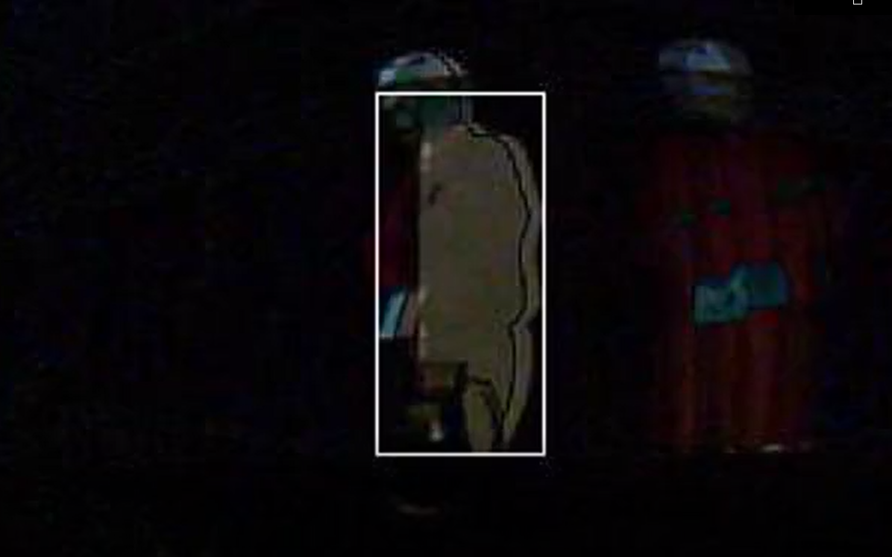
Go to the “kettle”
We can drawn a box around the largest difference area it has detected
The position of the box tells us where you are
This you have just moved to the kettle..

Slide 9
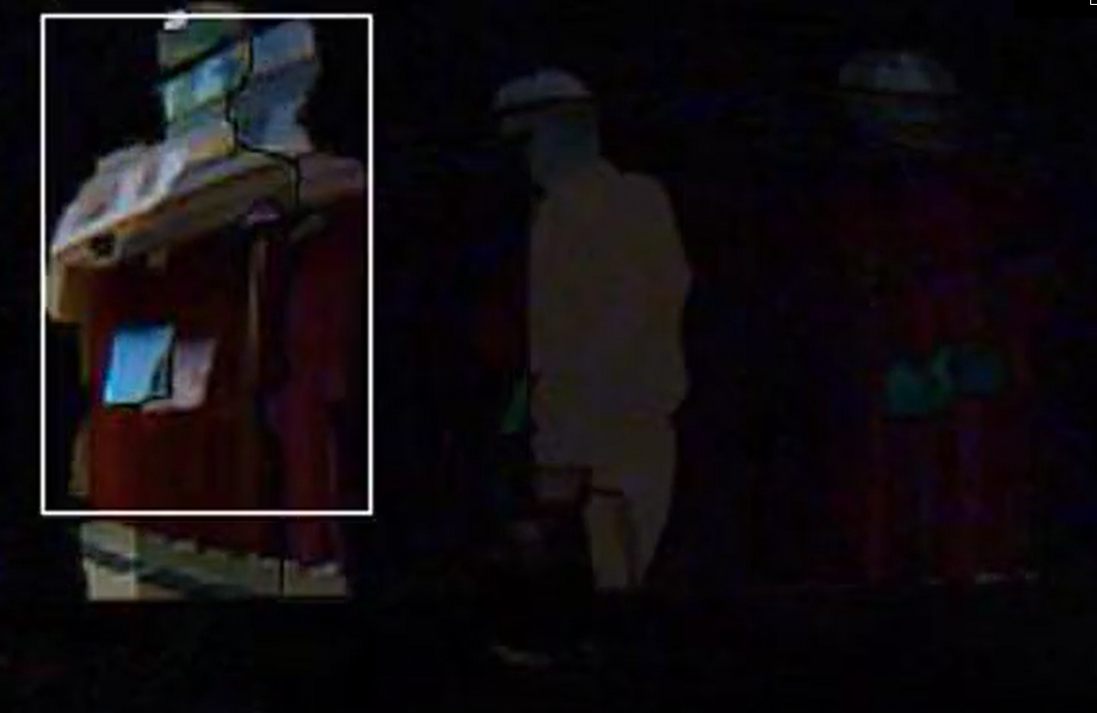
Go to the “cupboard”
When you move to the cupboard the we detect movement in a different part of the frame
You are now at the “kettle”

Slide 10
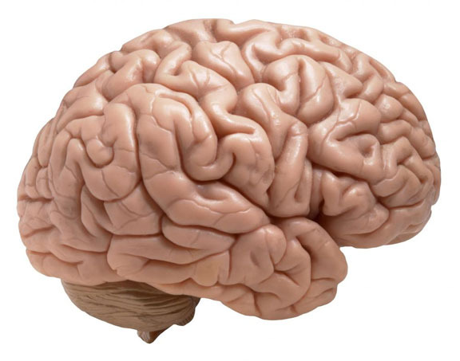
Tea making skills
We can time how long you spend at each location in the kitchen
Over time we create profiles of different activities
We can then track how well each activity is performed and check for variations
That way we can detect changes over time
This Photo by Unknown Author is licensed under CC BY

Slide 11
Our system in action
Detect changes in the image and track them
Smart Camera

Slide 12
Our system in action
Cloud
Detect changes in the image and track them
Smart Camera
Send movement profiles

Slide 13
Our system in action
Cloud
Detect changes in the image and track them
Smart Camera
Send movement profiles
Track movement against stored profiles

Slide 14
Our system in action
Messaging
OK
Cloud
Detect changes in the image and track them
Smart Camera
Send movement profiles
Track movement against stored profiles
If the movement fits an existing profile all is well

Slide 15
Our system in action
Messaging
OK
Cloud
Having Difficulty
Detect changes in the image and track them
Smart Camera
Send movement profiles
Track movement against stored profiles
If the movement is outside the regular pattern this could be flagged

Slide 16
Our system in action
Messaging
OK
Cloud
Having Difficulty
Detect changes in the image and track them
Smart Camera
Stuck
Send movement profiles
Track movement against stored profiles
If the movement is incomplete a carer is alerted

Slide 17
“Free Standing” solution
Provided when the client has no internet connection
Intelligent cameras build activity profiles by monitoring the activity of the client
The cameras send alerts and status messages over the LoRa WAN network
LoRa is a low power wide area network
LoRa devices talk to local LoRa gateways to send packets of status or alarm messages

Slide 18
“Connected” solution
Makes use of a home internet connection
Allows the system to monitor the completion of Alexa driven activities
Alexa can issue each instruction to make a cup of tea and the system could validate that the user has moved to the correct position
Carer would “train” the system by performing the action at installation

Slide 19
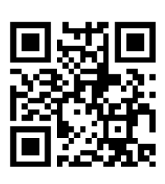
The Deployment Story
Cameras are factory configured with a network address
Each device is labelled with a QR code that contains a web address containing the camera ID
This initiates a web-based registration process in which the carer enters their details and linking them to the sensor

Slide 20

Business model
Customers are happy paying subscriptions
It means that the service has ongoing support
The system hardware would be sold at close to cost and customers would pay around £5.00 a month for ongoing support
This Photo by Unknown Author is licensed under CC BY-NC

Slide 21
Our company
We don’t have a company to take this to market
Unless you want to offer us a truck load of money – in which case we are all ears
Our plan would be to prototype the system and then make the designs and software freely available on GitHub for exploitation
We have a local community company which will be doing this: connectedhumbercic.com
It would be of interest to companies already operating in this space

Slide 22
Thank You
Thanks for listening
Hope you found it useful

