Slide 1
AVL Tree
44
2
3
17
88
32
1
2
1
65
97
1
1
54
82
Ref: Goodrich and Tamassia, 2nd edition

Slide 2
AVL Tree: Definition
An AVL tree is a binary search tree that is height balanced: for each node x, the heights of the left and right subtrees of x differ by at most 1.
  A subtree of an AVL tree is itself an AVL tree.
Height-Balance Property: For every internal node v of T, the heights of the children of v can differ by at most 1.
  Any Binary Search Tree (BST) that satisfies the height-balance property is said to be an AVL tree.
Named after its two Soviet inventors –
  G.M. Adelson-Velskii and E.M. Landis.

Slide 3
Binary Search Tree
44
17
88
Not an AVL Tree
1
32
4
65
97
28
54
82
76
29
80

Slide 4
Binary Search Tree
4
44
3
2
17
88
1
AVL Tree
1
2
32
65
97
1
1
54
82

Slide 5
Height of AVL Tree
Proposition: The height of an AVL tree T storing n elements is O(log n).
Justification:
Let, the minimum number of internal nodes be n(h), where h is the height of the tree.
so, n(1) = 1; n(2) = 2; and
n(h) = 1+ n(h-1) + n(h-2) for h≥3.
Since n(h) is a strictly increasing function, we have n(h-1) > n(h-2).
Then n(h) > 2.n(h - 2)
> 4.n(h - 4)
…
> 2^{i}.n(h - 2i).

Slide 6
Height of AVL Tree (contd.)
We pick i so that h -2i is equal to 1 or 2. That is, we pick
i =
so, n(h) > 2 . n(h- 2 )
≥ 2 . n(1)
≥ 2
⇒ log n(h) ≥
⇒ h ≤ 2 log n(h) + 2 ⇒ h ≤ O(log n)

Slide 7
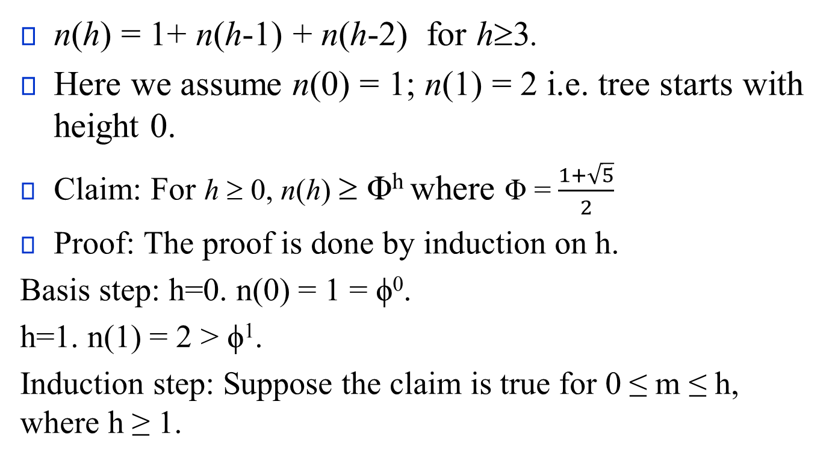
Get Height of an AVL Tree
n(h) = 1+ n(h-1) + n(h-2) for h≥3.
Here we assume n(0) = 1; n(1) = 2 i.e. tree starts with height 0.
Claim: For h ≥ 0, n(h) ≥ Φ^{h} where Φ = $\frac{1+\sqrt{5}}{2}$
Proof: The proof is done by induction on h.
Basis step: h=0. n(0) = 1 = ϕ⁰.
h=1. n(1) = 2 > ϕ¹.
Induction step: Suppose the claim is true for 0 ≤ m ≤ h, where h ≥ 1.

Slide 8
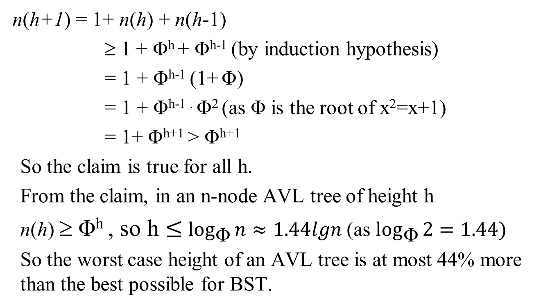
Get Height of an AVL Tree (contd.)
n(h+1) = 1+ n(h) + n(h-1)
      ≥ 1 + Φ^{h} + Φ^{h-1} (by induction hypothesis)
      = 1 + Φ^{h-1} (1+ Φ)
      = 1 + Φ^{h-1 .} Φ² (as Φ is the root of x²=x+1)
      = 1+ Φ^{h+1} > Φ^{h+1}
So the claim is true for all h.
From the claim, in an n-node AVL tree of height h
n(h) ≥ Φ^{h} , so h $≤$ $\log_{\text{Φ}}{n}$ $≈1.44lgn$ (as $\log_{\text{Φ}}{2}=1.44)$
So the worst case height of an AVL tree is at most 44% more than the best possible for BST.

Slide 9
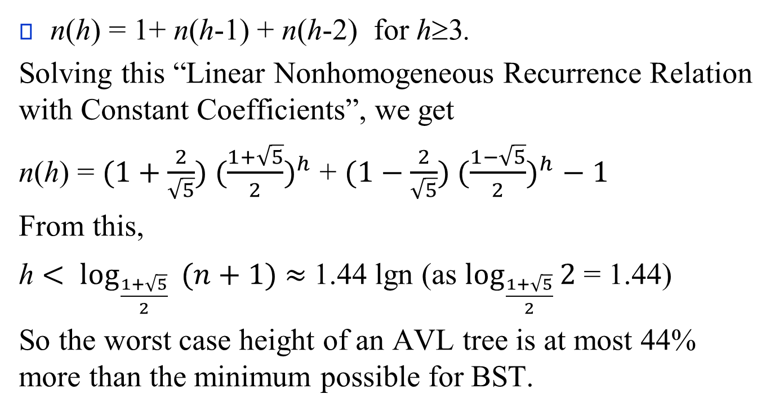
Another Way to Get Height of AVL Tree

Slide 10
AVL Tree (Insertion)
4
44
3
2
17
88
All the nodes are Balanced
1
2
1
32
65
97
1
1
54
82

Slide 11
AVL Tree (Insertion)
Insert Item 72
4
44
Step 1: insert Item(72) as done in the binary search tree
3
2
17
88
1
2
1
32
65
97
1
1
54
82
72

Slide 12
AVL Tree (Insertion)
Insert Item 72 (w)
5
Unbalanced
Step 3: find the child node y of z which has higher height
Step 4: find the child node x of y which has higher height
Step 2: find the first node z from w which is unbalanced
44
4
Unbalanced
2
17
z
88
y
1
3
1
32
65
97
x
1
2
54
82
1
72
w

Slide 13
AVL Tree (Insertion)
Insert Item 72 (w)
5
44
Step 5: a, b, c is the inoder listing of nodes x, y and z
4
2
17
z
88
y
1
3
1
32
65
97
x
1
2
54
82
a = y
b = x
c = z
1
72
w

Slide 14
AVL Tree (Insertion)
Insert Item 72 (w)
5
44
4
2
17
z
88
T₃
y
1
3
1
32
65
97
x
1
2
54
82
a = y
b = x
c = z
T₀
1
72
w
T₂
T₁

Slide 15
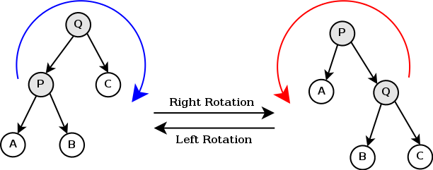
AVL Tree (Rotation)

Slide 16
AVL Tree (Rotation)
a = z
b = y
Single rotation
(y over z)
b = y
c = x
c = x
a = z
T₀
T₁
T₀
T₁
T₂
T₃
T₂
T₃

Slide 17
AVL Tree (Rotation)
c = z
b = y
Single rotation
(y over z)
b = y
c = z
a = x
a = x
T₃
T₂
T₀
T₁
T₂
T₃
T₀
T₁

Slide 18
AVL Tree (Rotation)
a = z
a = z
Single rotation
c = y
b = x
(First, x over y)
c = y
b = x
T₀
T₀
T₃
T₁
T₂
T₃
T₁
T₂
b = x
Single rotation
c = y
(Next, x over z)
Double rotation
a = z
(First, x over y,
Next, x over z)
T₀
T₁
T₂
T₃

Slide 19
AVL Tree (Rotation)
a = z
Double rotation
(First, x over y;
then x over z)
b = x
c = y
c = y
a = z
b = x
T₀
T₃
T₀
T₁
T₂
T₃
T₁
T₂

Slide 20
AVL Tree (Rotation)
c = z
b = x
Double rotation
a = y
c = z
a = y
b = x
T₃
T₀
T₀
T₁
T₂
T₃
T₁
T₂

Slide 21
AVL Tree (Insertion)
Insert Item 72 (w)
44
17
z
88
T₃
y
32
65
97
x
54
82
a = y
b = x
c = z
T₀
72
w
T₂
T₁

Slide 22
AVL Tree (Insertion)
Insert Item 72 (w)
44
17
z
88
T₃
32
82
x
97
y
65
T₂
54
72
w
T₀
T₁

Slide 23
AVL Tree (Insertion)
Insert Item 72 (w)
4
44
3
x
82
2
17
The tree is Balanced now
1
y
2
z
32
2
65
88
1
1
54
72
1
97
w
T₂
T₀
T₁
T₃

Slide 24
AVL Tree (Deletion)
Delete Item 32
4
44
Step 1: deleteItem(32) as done in the binary search tree
3
2
1
17
88
1
2
2
32
65
97
1
1
1
54
82
92

Slide 25
AVL Tree (Deletion)
Delete Item 32
4
z
44
y
3
1
17
88
2
2
65
x
97
1
1
a = z
b = y
c = x
54
82
1
92
After a single rotation

Slide 26
AVL Tree (Deletion)
y
4
88
z
2
x
3
44
97
All the nodes are Balanced Again
2
1
92
1
17
65
1
1
54
82

Slide 27
Original Paper
https://zhjwpku.com/assets/pdf/AED2-10-avl-paper.pdf

