Slide 1

CSE 207: Coping with NP-completeness
Adapted from the slide prepared by Dr. Md. Shamsuzzoha Bayzid
Reference: Dasgupta-Papadimitriou-Vazirani (Section 9.1)
Department of Computer Science and Engineering Bangladesh University of Engineering and Technology

Slide 2
Coping with NP-completeness
Knowing that a problem is NP-complete means this is among the hardest problems in NP
There is no existing polynomial time algorithms
But that does not necessarily mean that there won’t be any polynomial time algorithms
Currently you do not know how to solve it in polynomial time
Will you be satisfied with exponential time algorithms?
For many real-life problems, with large input data, exponential-time algorithms are not desirable
Then what would you do?
Proving a problem to be NP-complete is not the end.
Rather, the beginning of many exciting research directions

Slide 3
Coping with NP-Completeness
Many NP-C problems are efficiently solvable for specific input patterns
You may not be that lucky always
So we may want to do something to reduce the running time
Backtracking Algorithms
Branch-and-Bound Algorithms

Slide 4
Backtracking Algorithms
Pruning the search space (in a tree like space)
Incrementally grow a tree of partial solutions
Rejecting a solution by looking at a small portion of it.
if an instance of SAT contains the clause (x1 ∨ x2), then all assignments with x1 = x2 = 0 (i.e., false) can be instantly eliminated.
by quickly checking and discrediting this partial assignment, we are able to prune a quarter of the entire search space (in case of two variables).

Slide 5
Backtracking Algorithms
Backtracking looks at a subproblem and classifies that to one of the following:
Failure: the subproblem has no solution
Success: a solution to the subproblem is found.
Uncertainty

Slide 6
Example: SAT with Backtracking
(x’ ∨ y’) ∧ (x ∨ y’) ∧ (x’ ∨ y) ∧ (x ∨ y ∨ z)
4 clauses
x = 0
x = 1
(y’) ∧ (y ∨ z)
(y’) ∧ (y)
2 clauses
y = 0
y = 1
y = 0
y = 1
(z)
( )
( )
( )
z = 0
z = 1
The nodes of the search tree, representing
partial assignments, are themselves SAT
subproblems.
( )
YES

Slide 7
Example: SAT with Backtracking
We have to make the two decisions that repeatedly arise:
which subproblem to expand next, and
which branching variable to use.
Since the benefit of backtracking lies in its ability to eliminate portions of the search space, and since this happens only when an empty clause (not satisfiable clause) is encountered, it makes sense to choose the subproblem that contains the smallest clause and to then branch on a variable in that clause.
If this clause happens to be a singleton, then at least one of the resulting branches will be terminated.
If there is a tie in choosing subproblems, one reasonable policy is to pick the one lowest in the tree, in the hope that it is close to a satisfying assignment.

Slide 8
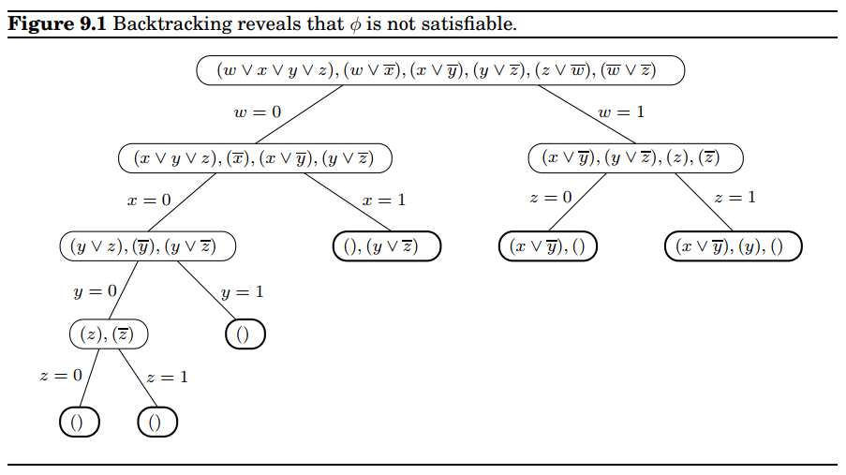

Slide 9
Branch-and-Bound Algorithms
A generalization of the concept of Backtracking for optimization problems
For each branch of the tree, we compute a rough bound on the solutions that can be obtained by exploring the solutions resulting from extending that branch.
A bound is a guarantee that any solution obtained from expanding the node will be:
Less than some number (upper bound; for maximization problems)
Or, greater than some number (lower bound; for minimization problems)
This is the basis for eliminating some “non-promising” branches.
We do not explore the branch that won’t lead us to better solutions that what we have already achieved.

Slide 10
Branch-and-Bound Algorithms
When we explore the search space, we get two costs in each node of the search space:
Cost of reaching the node from the root
When we reach a node, we have this cost computed.
Cost of reaching an answer from current node to a leaf (or solution)
We compute a bound on this cost to decide whether to ignore subtree with this node or not.
Here node and root are in terms of search space, not in terms of the problem that involves a graph.

Slide 11
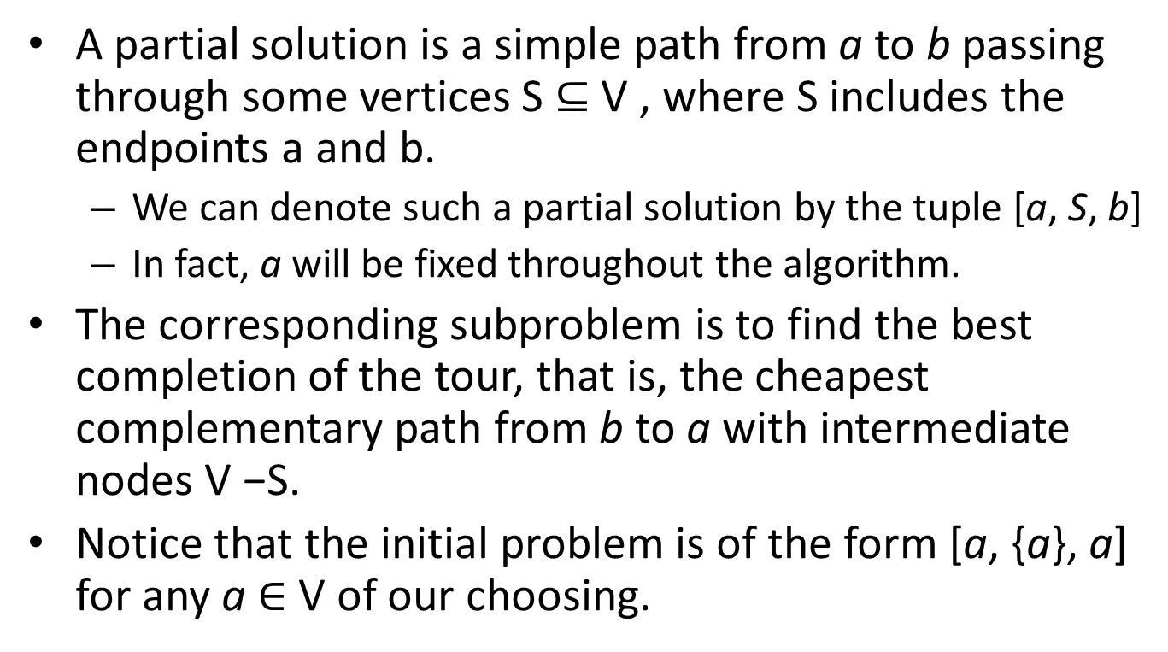
Traveling Salesman Problem
A partial solution is a simple path from a to b passing through some vertices S ⊆ V , where S includes the endpoints a and b.
We can denote such a partial solution by the tuple [a, S, b]
In fact, a will be fixed throughout the algorithm.
The corresponding subproblem is to find the best completion of the tour, that is, the cheapest complementary path from b to a with intermediate nodes V −S.
Notice that the initial problem is of the form [a, {a}, a] for any a $∈$ V of our choosing.

Slide 12
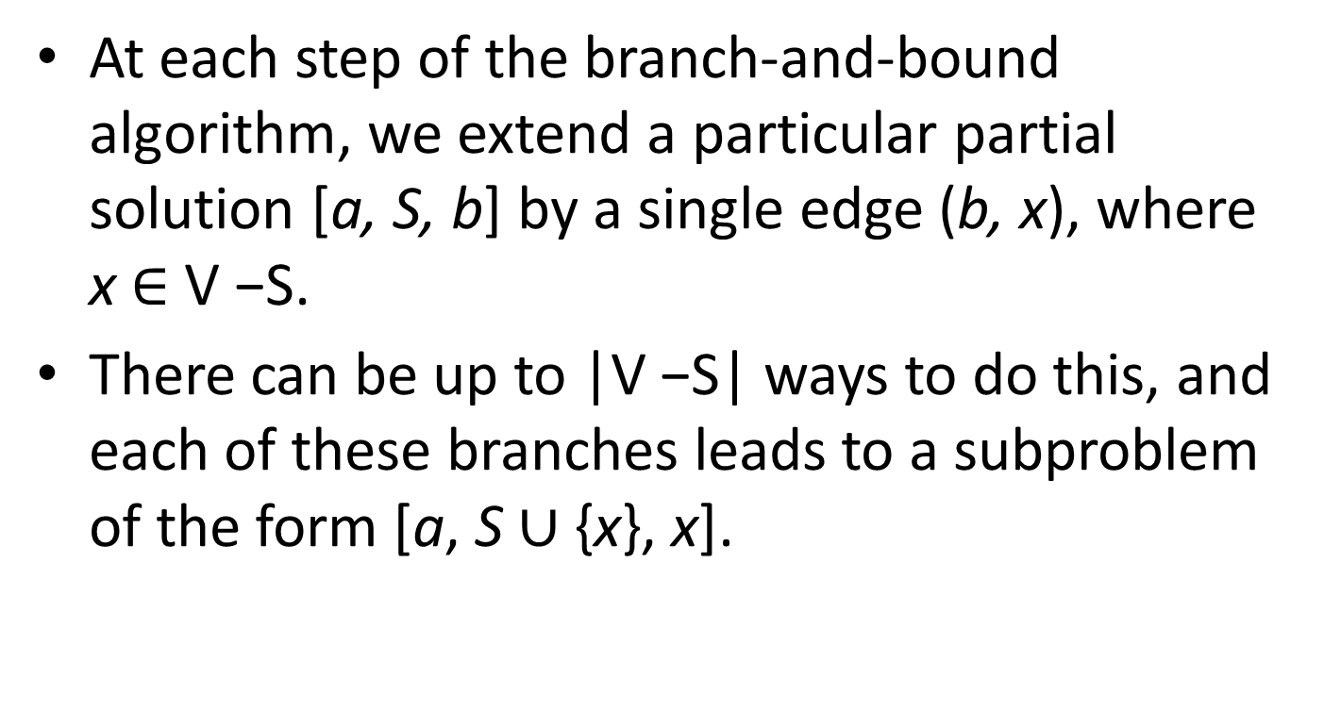
Traveling Salesman Problem (contd.)
At each step of the branch-and-bound algorithm, we extend a particular partial solution [a, S, b] by a single edge (b, x), where x $∈$ V −S.
There can be up to |V −S| ways to do this, and each of these branches leads to a subproblem of the form [a, S $∪$ {x}, x].

Slide 13
Calculating Lower Bound
How can we lower-bound the cost of completing a partial tour [a, S, b] ?
The remainder of the tour consists of a path through V −S, plus edges from b to V − S and V − S to a.
Therefore, its cost is at least the sum of the following:
The lightest edge from b to V − S
The minimum spanning tree of V − S
The lightest edge from V − S to a
And this lower bound can be computed quickly by a minimum spanning tree algorithm.
While calculating the lower bound, add the cost of the path explored so far too.

Slide 14
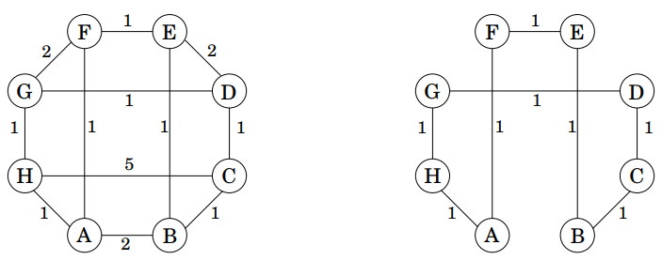
TSP Example

Slide 15
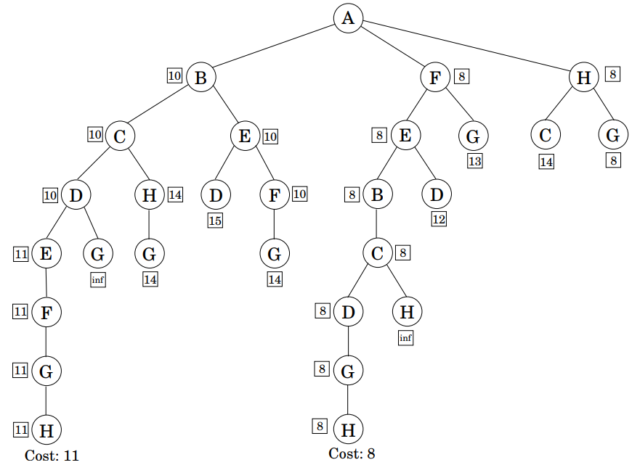
Just 28 partial solutions are considered, instead of the 7! = 5040 that would arise in a brute-force search.

Slide 16

Example: 0/1 knapsack
i | 1 | 2 | 3 | 4
V | 10 | 40 | 30 | 50
W | 5 | 4 | 6 | 3
V/W | 2 | 10 | 5 | 16.667
Capacity: 10
The maximum possible value we can achieve is bounded by
the solution of the fractional knapsack problem
(50 + 40 + 30/2 = 105)

Slide 17
Example: 0/1 knapsack
CW = 0; V = 105
i₁ = 0
i₁ = 1
Not promising (currently)
CW = 0; V = 105
CW = 5; V = 80
Promising
i₂ = 0
i₂ = 1
i | 1 | 2 | 3 | 4
V | 10 | 40 | 30 | 50
W | 5 | 4 | 6 | 3
V/W | 2 | 10 | 5 | 16.667
CW = 0; V = 80
CW = 4, V = 105
i₃ = 0
i₃ = 1
Cw = 4, V = 90
CW = 10; V = 70
Bag Full
i₄ = 0
i₄ = 1
CW = 4; V = 40
CW = 7, V = 90
Maximum value

