Slide 1
HASH TABLES
0
∅
1
025-61-0001
2
981-10-0002
3
Hash Tables
∅
4
451-22-0004
Notes:
Dictionaries

Slide 2
WHY HASH TABLE?
A hash table is an effective data structure for implementing dictionaries or maps.
The keys associated with values in a map are typically thought of as “addresses” for those values.
  Example: Compiler’s symbol table, Registry of environment variables
Hash Tables
Notes:
Dictionaries

Slide 3
WHY HASH TABLE? (CONTD.)
Although searching for an element in a hash table can take as long as searching for an element in a linked list, i.e. O(n) time in the worst case - in practice, hashing performs extremely well.
Under reasonable assumptions, the average time to search for an element in a hash table is O(1).
A hash table consists of two major components:
  A bucket array
  A hash function
Hash Tables

Slide 4
HASHING: BASIC PLAN
Save items in a key-indexed table (index is a function of the key)
Hash function: Method for computing array index from key
Issues
  Computing the hash function
  Equality test: Method for checking whether two keys are equal
  Collision resolution: Algorithm and data structure to handle two keys that hash to the same array index.
0
1
2
3
4
5
hash(“it”) = 3
Hash Tables
hash(“not”) = 3
Notes:
Dictionaries

Slide 5
CLASSIC SPACE-TIME LIMITATION
No space limitation: trivial hash function with key as index.
No time limitation: trivial collision resolution with sequential search.
Space and time limitations: hashing
Hash Tables
Notes:
Dictionaries

Slide 6
COMPUTING HASH FUNCTIONS
Idealistic goal
  Scramble the keys uniformly to produce a table index.
  Efficiently computable.
  Each table index equally likely for each key.
    Thoroughly researched problem, still problematic in practical applications
Example: Phone numbers.
  Bad: first three digits.
  Better: last three digits.
Practical challenge. Need different approach for each key type.
Hash Tables
Notes:
Dictionaries

Slide 7
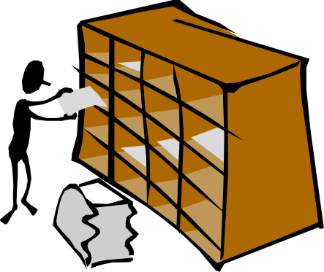
HASH FUNCTIONS AND HASH TABLES
A hash function h maps keys of a given type to integers in a fixed interval [0, N − 1]
Example:
h(x) = x mod N
is a hash function for integer keys
The integer h(x) is called the hash value of key x
Hash Tables
A hash table for a given key type consists of
  Hash function h
  Array or Vector (called “table”) of size N
When implementing a map with a hash table, the goal is to store item (k, o) at index i = h(k)
Notes:
Dictionaries

Slide 8
EXAMPLE
We design a hash table for a map storing entries as (SSN, Name), where SSN (social security number) is a nine-digit positive integer
Our hash table uses an array of size N = 10,000 and the hash function
h(x) = last four digits of x
0
∅
1
025-61-0001
2
981-10-0002
3
∅
4
451-22-0004
…
Hash Tables
9997
∅
9998
200-75-9998
9999
∅
Notes:
Dictionaries

Slide 9

HASH FUNCTIONS
A hash function is usually specified as the composition of two functions:
Hash code:
h₁: keys → integers
Compression function:
h₂: integers → [0, N − 1]
The hash code is applied first, and the compression function is applied next on the result, i.e.,
h(x) = h₂(h₁(x))
The goal of the hash function is to “disperse” the keys in a random way
Hash Tables
Notes:
Dictionaries

Slide 10

HASH CODES
Memory address:
  We reinterpret the memory address of the key object as an integer.
  Doesn’t work for primitive data types such as numeric and string keys.
  Also bad if objects can move!
Integer cast:
  We reinterpret the bits of the key as an integer
  Suitable for keys of length less than or equal to the number of bits of the integer type (e.g., byte, short, int and float in Java)
Component sum:
  We partition the bits of the key into components of fixed length (e.g., 16 or 32 bits) and we sum the components, ignoring overflows.
  Suitable for numeric keys of fixed length greater than or equal to the number of bits of the integer type (e.g., long and double in Java).
Hash Tables
Notes:
Dictionaries

Slide 11
HASH CODES (CONT.)
Polynomial accumulation:
  We partition the bits of the key into a sequence of components of fixed length (e.g., 8, 16 or 32 bits)
  a₀ a₁ … a_{n−1}
  We evaluate the polynomial
  p(z) = a₀ + a₁ z + a₂ z² + …
  … + a_{n−1}z^{n−1}
  at a fixed value z, ignoring overflows.
  Especially suitable for strings (here a₀ , a₁ , … , a_{n−1} are characters of the string)
Polynomial p(z) can be evaluated in O(n) time using Horner’s rule:
  The following polynomials are successively computed, each from the previous one in O(1) time
  p₀(z) = a_{n−1}
  p_{i} (z) = a_{n−i−1} + zp_{i−1}(z)
  (i = 1, 2, …, n −1)
We have p(z) = p_{n−1}(z)
Hash Tables
Notes:
Dictionaries

Slide 12
CYCLIC SHIFT HASH CODE
A variant of the polynomial hash code replaces multiplication by a with a cyclic shift of a partial sum by a certain number of bits.
For example, a 5-bit cyclic shift of the 32-bit value 00111101100101101010100010101000 is achieved by taking the leftmost five bits and placing those on the rightmost side of the representation, resulting in 10110010110101010001010100000111.
Hash Tables

Slide 13
HASHING FLOATING POINTS
reinterpret_cast in C++ can do the following:
4 byte float -> 4 element char array
8 byte double -> 8 element char array
Now do hashing for string.
Hash Tables

Slide 14

COMPRESSION FUNCTIONS
Division:
  h₂ (y) = y mod N
  The size N of the hash table is usually chosen to be a prime
  The reason has to do with number theory…
Multiply, Add and Divide (MAD):
  h₂ (y) = (ay + b) mod N
  a and b are nonnegative integers such that
  a mod N ≠ 0
  Otherwise, every integer would map to the same value b
Hash Tables
Notes:
Dictionaries

Slide 15

COLLISION HANDLING
Collisions occur when different elements are mapped to the same cell
Separate Chaining: let each cell in the table point to a linked list of entries that map there
  Can be single linked list or doubly linked list
0
∅
1
025-61-0001
2
∅
3
∅
4
451-22-0004
981-10-0004
Hash Tables
Separate chaining is simple, but requires additional memory outside the table
Notes:
Dictionaries

Slide 16
LOAD FACTOR
Given a hash table T with m slots that stores n elements, we define the load factor  for T as n/m, that is, the average number of elements stored in a chain.
Our analysis will be in terms of , which can be less than, equal to, or greater than 1.
  Separate chaining allows all possible values of .
Hash Tables

Slide 17
SIMPLE UNIFORM HASHING
We shall assume that any given element is equally likely to hash into any of the m slots, independently of where any other element has hashed to.
We call this the assumption of simple uniform hashing.
Hash Tables

Slide 18
AVERAGE SEARCH TIME
In a hash table in which collisions are resolved by chaining, an unsuccessful search takes average-case time Θ(1+ ), under the assumption of simple uniform hashing.
In a hash table in which collisions are resolved by chaining, a successful search takes average-case time Θ(1+ ), under the assumption of simple uniform hashing.
Hash Tables

Slide 19
TIME FOR ALL OPERATIONS IN HASH TABLE THAT USES SEPARATE CHAINING
If the number of hash-table slots is at least proportional to the number of elements in the table, we have n = O(m) and, consequently,  = n/m = O(m)/m = O(1).
Thus, searching takes constant time on average.
Since insertion takes O(1) worst-case time and deletion takes O(1) worst-case time when the lists are doubly linked, we can support all dictionary operations in O(1) time on average.
  Here we assume that we are given the pointer to the element during deletion.
  Otherwise deletion means first search then delete, which takes O(1) time on average in total.
Hash Tables

Slide 20
OPEN ADDRESSING
In open addressing, all elements occupy the hash table itself.
Each table entry contains either an element of the dynamic set or NIL.
  The colliding item is placed in a different cell of the table.
When searching for an element, we systematically examine table slots until either we find the desired element or we have ascertained that the element is not in the table.
No lists no elements are stored outside the table, unlike in chaining.
Hash Tables

Slide 21
LOAD FACTOR IN OPEN ADDRESSING
In open addressing, the hash table can “fill up” so that no further insertions can be made.
One consequence is that the load factor  can never exceed 1.
Hash Tables

Slide 22
PROBING
To perform insertion using open addressing, we successively examine, or probe, the hash table until we find an empty slot in which to put the key.
Instead of being fixed in the order 0, 1, … , m-1 (which requires O(n) search time), the sequence of positions probed depends upon the key being inserted.
To determine which slots to probe, we extend the hash function to include the probe number (starting from 0) as a second input.
Hash Tables

Slide 23
PROBE SEQUENCE
With open addressing, we require that for every key k, the probe sequence
<h(k, 0), h(k, 1), … , h(k, m-1)>
be a permutation of <0,1, … , m-1>, so that every hash-table position is eventually considered as a slot for a new key as the table fills up.
Hash Tables

Slide 24
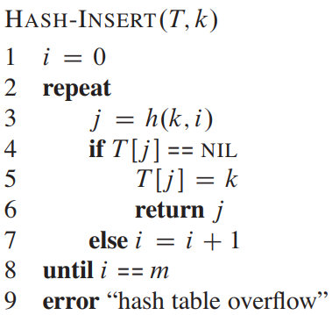
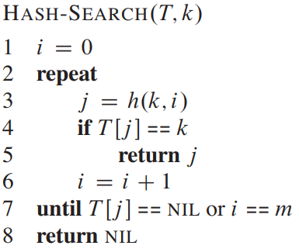
INSERT AND SEARCH WITH PROBING
Hash Tables

Slide 25
KEY DELETION IN OPEN ADDRESSING
Deletion from an open-address hash table is difficult.
When we delete a key from slot i, we cannot simply mark that slot as empty by storing NIL in it.
  If we did, we might be unable to retrieve any key k during whose insertion we had probed slot i and found it occupied.
We can solve this problem by marking the slot, storing in it the special value DELETED instead of NIL.
We would then modify the procedure HASH-INSERT to treat such a slot as if it were empty so that we can insert a new key there.
Hash Tables

Slide 26
PROBLEM WITH DELETION
When we use the special value DELETED, however, search times no longer depend on the load factor , and for this reason chaining is more commonly selected as a collision resolution technique when keys must be deleted.
Hash Tables

Slide 27
UNIFORM HASHING
In our analysis, we assume uniform hashing: the probe sequence of each key is equally likely to be any of the m! permutations of <0,1, … , m-1>.
True uniform hashing is difficult to implement, however, and in practice suitable approximations (such as double hashing) are used.
Hash Tables

Slide 28
LINEAR PROBING
Given an ordinary hash function h’ : U → {0,1, … , m-1}, which we refer to as an auxiliary hash function, the method of linear probing uses the hash function
h(k, i) = (h’(k)+i) mod m
for i = 0,1, … , m-1
Because the initial probe determines the entire probe sequence, there are only m distinct probe sequences.
Hash Tables

Slide 29
PROBLEMS OF LINEAR PROBING
Linear probing is easy to implement, but it suffers from a problem known as primary clustering.
Long runs of occupied slots build up, increasing the average search time.
Long runs of occupied slots tend to get longer, and the average search time increases.
Hash Tables

Slide 30
QUADRATIC PROBING
Quadratic probing uses a hash function of the form
h(k, i) = (h’(k) + c₁i + c₂i²) mod m
where h’ is an auxiliary hash function, c₁ and c₂ are positive auxiliary constants, and i = 0,1, … , m-1
As in linear probing, the initial probe determines the entire sequence, and so only m distinct probe sequences are used.
Hash Tables

Slide 31
PROBLEMS OF QUADRATIC PROBING
If two keys have the same initial probe position, then their probe sequences are the same, since h(k₁, 0) = h(k₂, 0) implies h(k₁, i) = h(k₂, i).
This property leads to a milder form of clustering, called secondary clustering.
Hash Tables

Slide 32
DOUBLE HASHING
Double hashing uses a hash function of the form
h(k, i) = ( h₁(k) + ih₂(k) ) mod m
where both h₁ and h₂ are auxiliary hash functions.
The value h₂(k) must be relatively prime to the hash-table size m for the entire hash table to be searched.
  A convenient way to ensure this condition is to let m be a power of 2 and to design h₂ so that it always produces an odd number.
  Another way is to let m be prime and to design h₂ so that it always returns a positive integer less than m.
Hash Tables

Slide 33
IMPROVEMENT OVER PREVIOUS ONES
When m is prime or a power of 2, double hashing improves over linear or quadratic probing in that Θ(m²) probe sequences are used, rather than Θ(m), since each possible (h₁(k), h₂(k)) pair yields a distinct probe sequence.
Hash Tables

Slide 34
TIME FOR UNSUCCESSFUL SEARCH
Given an open-address hash table with load factor  = n/m < 1, the expected number of probes in an unsuccessful search is at most 1/(1- ) assuming uniform hashing.
If  is a constant, this theorem predicts that an unsuccessful search runs in O(1) time.
  For example, if the hash table is half full, the average number of probes in an unsuccessful search is at most 1/(1- 0.5) = 2.
  If it is 90 percent full, the average number of probes is at most 1/(1- 0.9) = 10.
Hash Tables

Slide 35
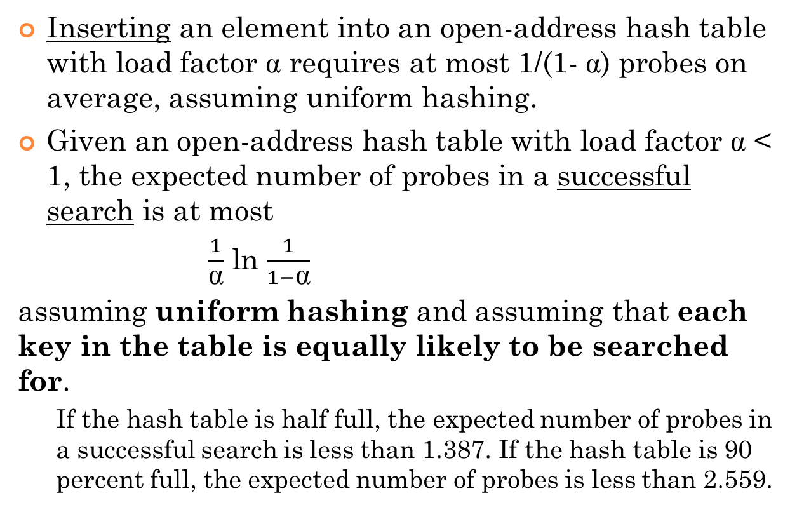
TIME FOR INSERTION & SUCCESSFUL SEARCH
Hash Tables

Slide 36
LOAD FACTORS IN PRACTICE
Experiments and average-case analyses suggest that we should maintain  < 0.9 for hash tables with separate chaining. (By default, Java’s implementation uses separate chaining with  < 0.75.)
Experiments suggest that we should maintain  < 0.5 for an open addressing scheme with linear probing, and perhaps only a bit higher for other open addressing schemes.
Hash Tables

Slide 37
REHASHING
If an insertion causes the load factor of a hash table to go above the specified threshold, then it is common to resize the table (to regain the specified load factor) and to reinsert all objects into this new table.
Although we need not define a new hash code for each object, we do need to reapply a new compression function that takes into consideration the size of the new table.
Rehashing will generally scatter the entries throughout the new bucket array.
When rehashing to a new table, it is a good requirement for the new array’s size to be a prime number approximately double the previous size.
Hash Tables

Slide 38

PERFORMANCE OF HASHING
In the worst case, searches, insertions and removals on a hash table take O(n) time
The worst case occurs when all the keys inserted into the map collide
The load factor α = n/N affects the performance of a hash table
The expected running time of all the dictionary ADT operations in a hash table is O(1)
In practice, hashing is very fast provided the load factor is not close to 100%
When the load factor gets too high, we can rehash to a new table.
Hash Tables
Notes:
Dictionaries

