Slide 1
Noise-Aware Transformer-Based Low-Light Image Enhancement with Downstream Object Detection Evaluation
Mid-semester B.Tech Project evaluation
Dhirendra Pratap Singh (2301EE49)
Supervisor: Dr. Rajib Kumar Jha
Department of Electrical Engineering, IIT Patna
Notes:
SAY: Good morning. My project is about making very dark photos look as if they were taken in good light, and checking whether that actually helps a computer find objects in the dark. In this midsem I will show what I have reproduced, what I measured, one idea of my own that I tested, and my plan for the second half.
Q: Why this topic? A: Night photos, surveillance and driving all produce dark images, and detectors fail on them; it is an active research area with open problems such as noise.

Slide 2
OVERVIEW
Project at a glance: what the title means
Goal: make dark photos bright and clean - without amplifying noise - and check whether this helps a machine see.
Transformer-based enhancement
Noise-aware
Downstream detection evaluation
Retinexformer (ICCV 2023) as the main model
SNR-weighted training loss
Does enhancement help a detector?
Reproduce it and compare with 8 baselines under one protocol (quality, no-reference, speed)
SNR map finds dark, noisy regions; the training loss gives them more weight; compared with a control run
YOLOv8m on ExDark (1,200 dark images, 12 classes): raw images vs every enhanced version
Reproduced: 25.15 dB vs paper 25.16 → pipeline verified
Pilot tested; next: noise awareness inside the network
Result: raw images best (mAP50 0.662); no enhancer helps
Dark photo
Enhancer
(Retinexformer + noise-aware loss)
Image quality
PSNR, SSIM, LPIPS, NIQE
Object detection
YOLOv8 mAP
→
→
+
Midsem BTP · Low-light image enhancement · IIT Patna
2
Notes:
SAY: Let me explain the title in three parts. Low-light image enhancement means turning a dark photo into one that looks well lit.
First, TRANSFORMER-BASED: my main model is Retinexformer, a transformer built on Retinex theory. I reproduced it and compared it
with eight other methods under one common protocol. Second, NOISE-AWARE: when you brighten a dark image, the noise in the darkest
parts is amplified the most. My idea is a loss that finds noisy regions with a signal-to-noise map and gives them more weight during
training. At midsem this is a pilot. Third, DOWNSTREAM DETECTION: instead of only measuring image quality, I ask whether enhancement
actually helps a computer find objects in the dark, using YOLOv8 on the ExDark dataset. The rest of the talk follows these three parts.
Q: What do you mean by noise-aware? A: The method uses an estimate of where the noise is (the SNR map) and treats those regions
differently - in my case it gives them more weight in the training loss.
Q: Why transformer and not CNN? A: Attention lets each region use information from the whole image, which helps decide how much to
brighten each part; Retinexformer keeps the cost low by computing attention across channels instead of pixels.
Q: Why detection? A: Real uses - surveillance, driving - care whether machines can see objects, not only whether the photo looks nice.

Slide 3
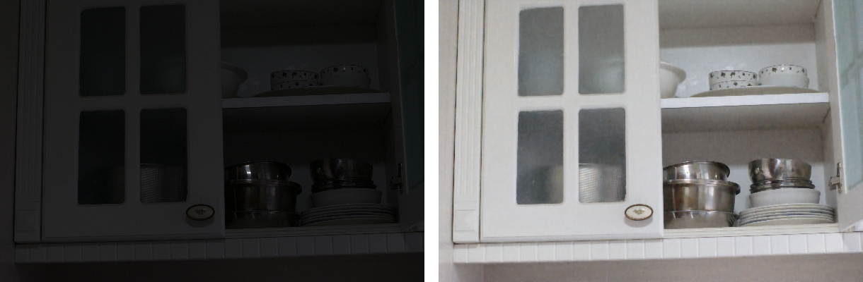
MOTIVATION
Why low-light enhancement?
Our run: LOL-v1 test image 79 - dark input (left), Retinexformer output (right)
Where dark images occur:
Phone night photography
Surveillance cameras
Night driving, robots, drones
Detectors miss objects in the dark
Midsem BTP · Low-light image enhancement · IIT Patna
3
Notes:
SAY: On the left is a real photo from the LOL test set taken in very low light; on the right is the same photo after I ran
Retinexformer on it. Dark images like this appear in phone night photography, surveillance cameras, night driving and robots.
They are hard for people to see, and object detectors also work much worse in the dark. And simply brightening is not enough,
because the noise is brightened too - that is the next slide.
Q: Can't we just increase the exposure? A: Longer exposure causes motion blur, and higher ISO adds noise; enhancement
after capture avoids both but must deal with the noise that is already there.
Q: Is this image from your results? A: Yes - the left is the LOL-v1 test input, the right is the output of Retinexformer
(released weights) that I ran myself.

Slide 4
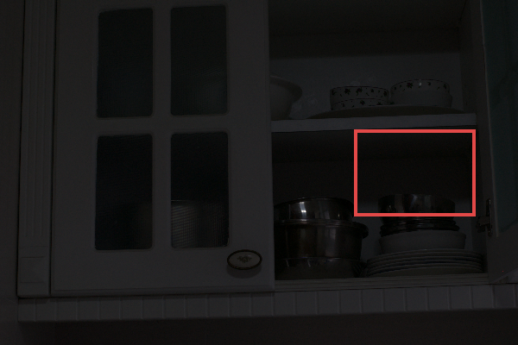
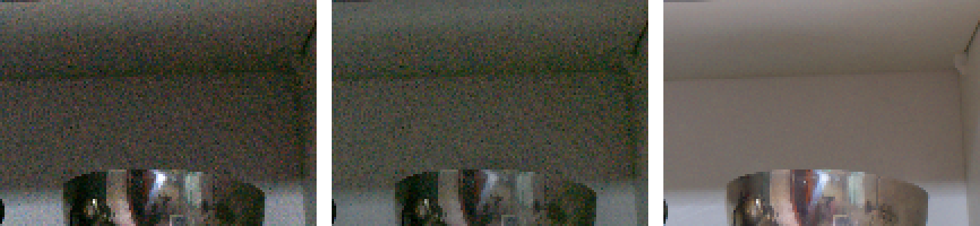
PROBLEM
The problem: darkness + noise + colour shift
Input × 6 (just brighter)
Zero-DCE
Ground truth
Dark: little light reaches the sensor, details are hidden
Noisy: few photons → low SNR (signal-to-noise ratio) → speckles
Colour shift: weak light distorts colours (grey-green instead of white)
Our LOL-v1 test image 79; red box = dark region zoomed on the right
Brightening multiplies noise as much as signal → enhancement must brighten AND denoise
Midsem BTP · Low-light image enhancement · IIT Patna
4
Notes:
SAY: Dark images have three problems at once. They are dark, they are noisy because the sensor collected few photons,
and artificial light changes the colours. The key point is on the right: if I simply multiply the dark region by six,
the noise is multiplied too - you can see the grainy speckles, and the white wall looks grey-green. A simple enhancer like
Zero-DCE also brightens the noise.
The ground truth, taken with a long exposure, is clean. So enhancement must brighten AND denoise.
Q: Where does the noise come from? A: Mostly photon shot noise and sensor read noise; with few photons the random
fluctuation is large relative to the signal, i.e. the signal-to-noise ratio (SNR) is low.

Slide 5
LITERATURE
How the field evolved
Classical
→
Supervised CNN
→
Zero-shot
→
Transformers
→
Diffusion
HE, CLAHE,
Retinex / LIME
LLNet, Retinex-Net,
KinD, MIRNet
EnlightenGAN,
Zero-DCE, RUAS, SCI
SNR-Aware, LLFormer,
Retinexformer
GSAD,
Diff-Retinex
What each stage left open
No learning,
no noise model
Needs paired
dark/bright data
Brightens the
noise too
Not noise-aware;
attention is costly
Very slow
(many passes)
Survey (Li et al., TPAMI 2022): no method wins everywhere; noise in dark regions remains open
This project: Retinexformer (ICCV 2023) as the main model, made noise-aware
Midsem BTP · Low-light image enhancement · IIT Patna
5
Notes:
SAY: The field moved through five stages. Classical methods like histogram equalization and Retinex-based LIME use hand-made
rules and ignore noise. Supervised CNNs like Retinex-Net and KinD learn from paired dark/bright images. Zero-shot methods like
Zero-DCE and SCI need no pairs and are tiny and fast, but do not denoise. Transformers - SNR-Aware, LLFormer, Retinexformer -
model long-range relations and give the best fidelity. Diffusion models like GSAD generate very realistic textures but are slow.
Q: Why did transformers help? A: Self-attention lets a dark pixel use information from distant, well-lit regions; CNNs only
see a local neighbourhood.

Slide 6
LITERATURE
Key methods compared in this project
Method | Year / venue | Key idea | Limitation
HE / CLAHE / Gamma | classical | Re-map brightness | No noise model, colour shifts
Zero-DCE | CVPR 2020 | Learned brightness curves, no pairs | Brightens noise
SCI | CVPR 2022 | Self-calibrated illumination, ~300 params | Brightens noise
SNR-Aware | CVPR 2022 | SNR map decides local vs. long-range | Heavier; no Retinex model
LLFormer | AAAI 2023 | Axis-based attention for 4K/8K images | 24.5 M params, slower
Retinexformer | ICCV 2023 | Illumination-guided channel attention | Illumination-aware, not noise-aware
GSAD | NeurIPS 2023 | Diffusion with structure regularization | Slow; GT-brightness test trick
Midsem BTP · Low-light image enhancement · IIT Patna
6
Notes:
SAY: These are the methods I actually ran. For each one: the idea in one line, and its main limitation. Notice the pattern:
the fast unsupervised methods do not remove noise, the transformers are accurate, and the diffusion model is slow. SNR-Aware
is the only one that explicitly measures noise - that idea inspired my loss.
Q: Why Retinexformer as the main model? A: Best PSNR in our tests on all three LOL sets, only 1.6 M parameters, public code
and weights, and it is built on Retinex theory, which makes it explainable.

Slide 7
MOTIVATION
Research gap and objectives of this midsem
Gap in the literature | What I did in the first half | Shown in
Noise amplification in dark regions is unsolved | SNR-weighted loss, tested against a control run | My idea, Ablation
Retinexformer: illumination-aware, not noise-aware | Retinexformer as base; SNR map adds noise information | Main model
Methods judged by PSNR/SSIM, rarely by a machine task | Detection study (YOLOv8) + dark-region PSNR | Detection
Diffusion: quality at a large speed cost | Speed of every method on one GPU | Efficiency
Papers use different test protocols | Reproduce Retinexformer + 8 baselines with one script | Results, Reproduction
Second half: plan the next step from this evidence (see Plan).
Midsem BTP · Low-light image enhancement · IIT Patna
7
Notes:
SAY: Four gaps motivate the project. First, noise in dark regions is still an open problem. Second, Retinexformer knows where the
image is dark but not where it is noisy. Third, papers mostly report PSNR and SSIM; few check whether enhancement helps a machine.
Fourth, diffusion models trade a lot of speed for quality. Each row of the table pairs a gap with what I did about it in the first half
and the slide where I show it: a noise-aware loss with a control run, detection and dark-region metrics, speed on one GPU, and a fair
reproduction of all methods with one script.
Q: What is the difference between dark and noisy? A: A dark but smooth wall can be clean; a textured dark region can be very
noisy. Illumination tells you brightness, SNR tells you how much of the signal is noise.

Slide 8
BACKGROUND
Background: Retinex theory and attention cost
Retinex model
Why attention is costly
I = R ⊙ L
softmax(QKᵀ/√d)·V
I: observed image
R: reflectance = object colours
L: illumination = light on the scene
Enhance: estimate L, replace by brighter light
Real images: noise in R and L, amplified when L is small
QKᵀ is N × N (N = number of pixels)
600×400 image: N = 240,000 → 58 billion entries
Channel attention: softmax(KᵀQ) is only C × C
So the cost grows only linearly with image size
Midsem BTP · Low-light image enhancement · IIT Patna
8
Notes:
SAY: Retinex theory says an image is reflectance times illumination: the true colours of objects times the light falling on them.
Enhancement means estimating the illumination and replacing it with brighter light. Transformers use attention: every token
compares itself with every other token, so the cost grows with the square of the number of tokens. For a 600 by 400 image that
would be 240 thousand tokens and a matrix with 58 billion entries - impossible. Retinexformer computes attention across channels
instead, a small C by C matrix, so the cost grows only linearly with image size.
Q: What are Q, K, V? A: Query = what a token is looking for, Key = what it contains, Value = what it passes on; similarity of
Q and K decides how much of each Value is mixed in. Q: Why divide by sqrt(d)? A: Keeps the dot products in a range where
softmax does not saturate.

Slide 9
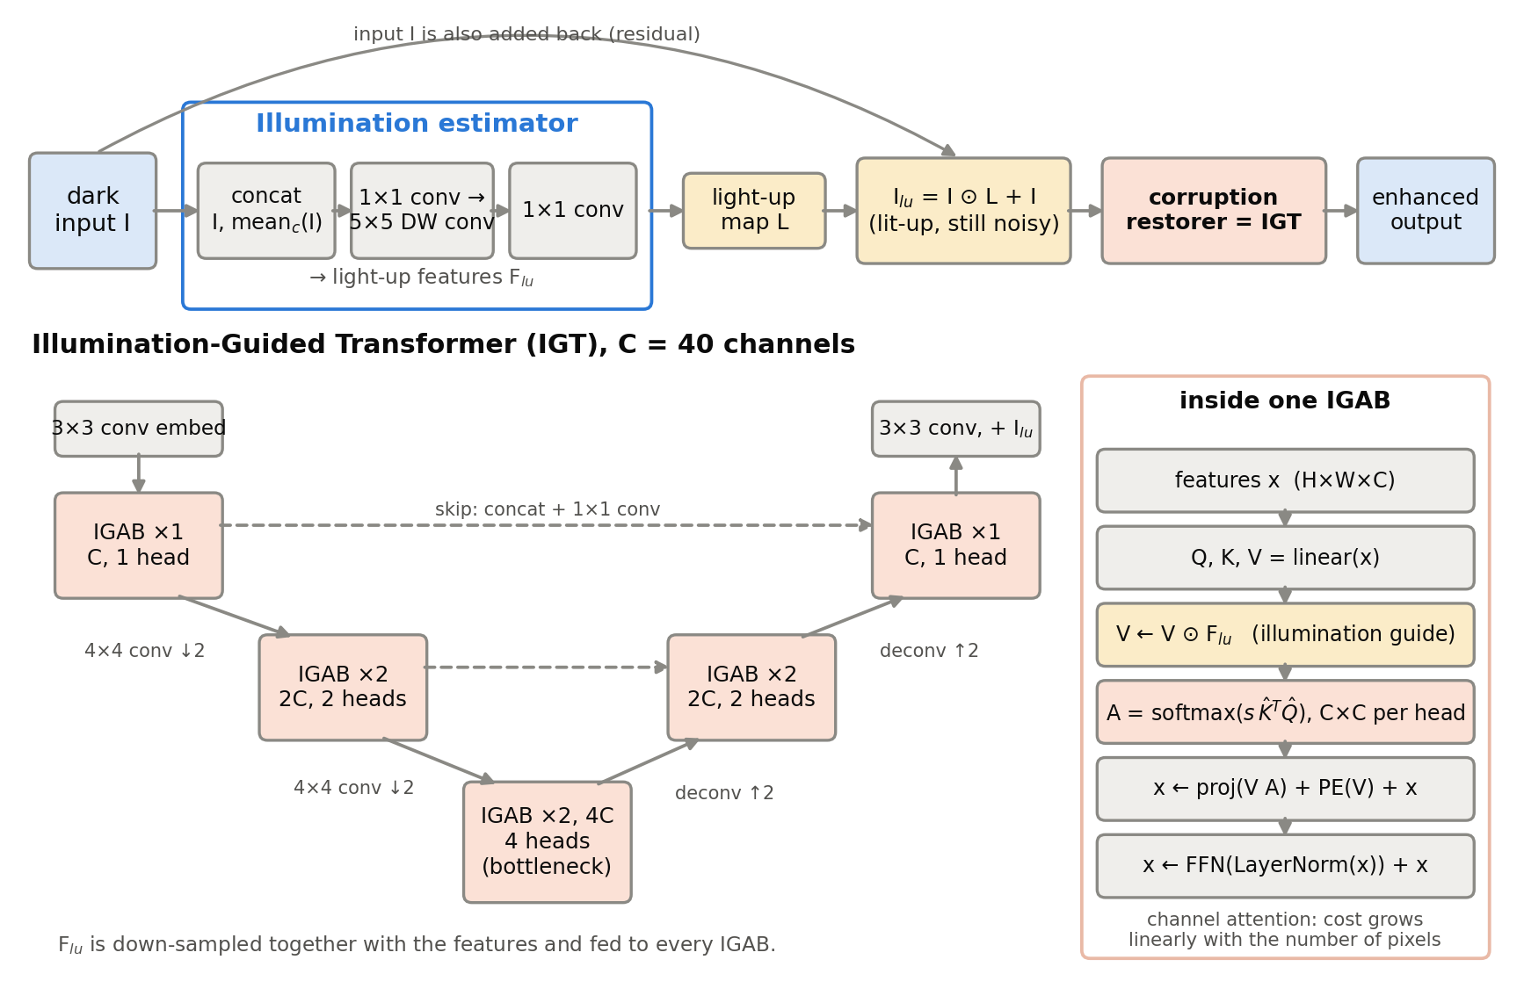
METHOD
Main model: Retinexformer (ICCV 2023)
Estimator → light-up map L
Lit-up image: I ⊙ L + I (still noisy)
Restorer: U-shaped transformer (IGT)
IG-MSA: V × light-up features, attention across channels
1.61 M params, ℓ1 loss
Midsem BTP · Low-light image enhancement · IIT Patna
9
Notes:
SAY: Retinexformer has two parts. The illumination estimator looks at the image and its mean brightness and predicts a light-up
map; multiplying and adding back gives a brighter but still noisy image. Then the corruption restorer, a U-shaped transformer,
removes the noise and artifacts. Its special block, IG-MSA, multiplies the values by light-up features, so differently lit regions
are treated differently, and computes attention across channels. The whole model has only
1.61 million parameters. I drew this diagram myself from the released code.
Q: Why add I back (I*L + I)? A: A residual form: the network only has to learn the change in brightness, which is easier and
more stable. Q: What does illumination guidance add? A: Dark regions can borrow information from well-lit regions in a controlled
way.

Slide 10
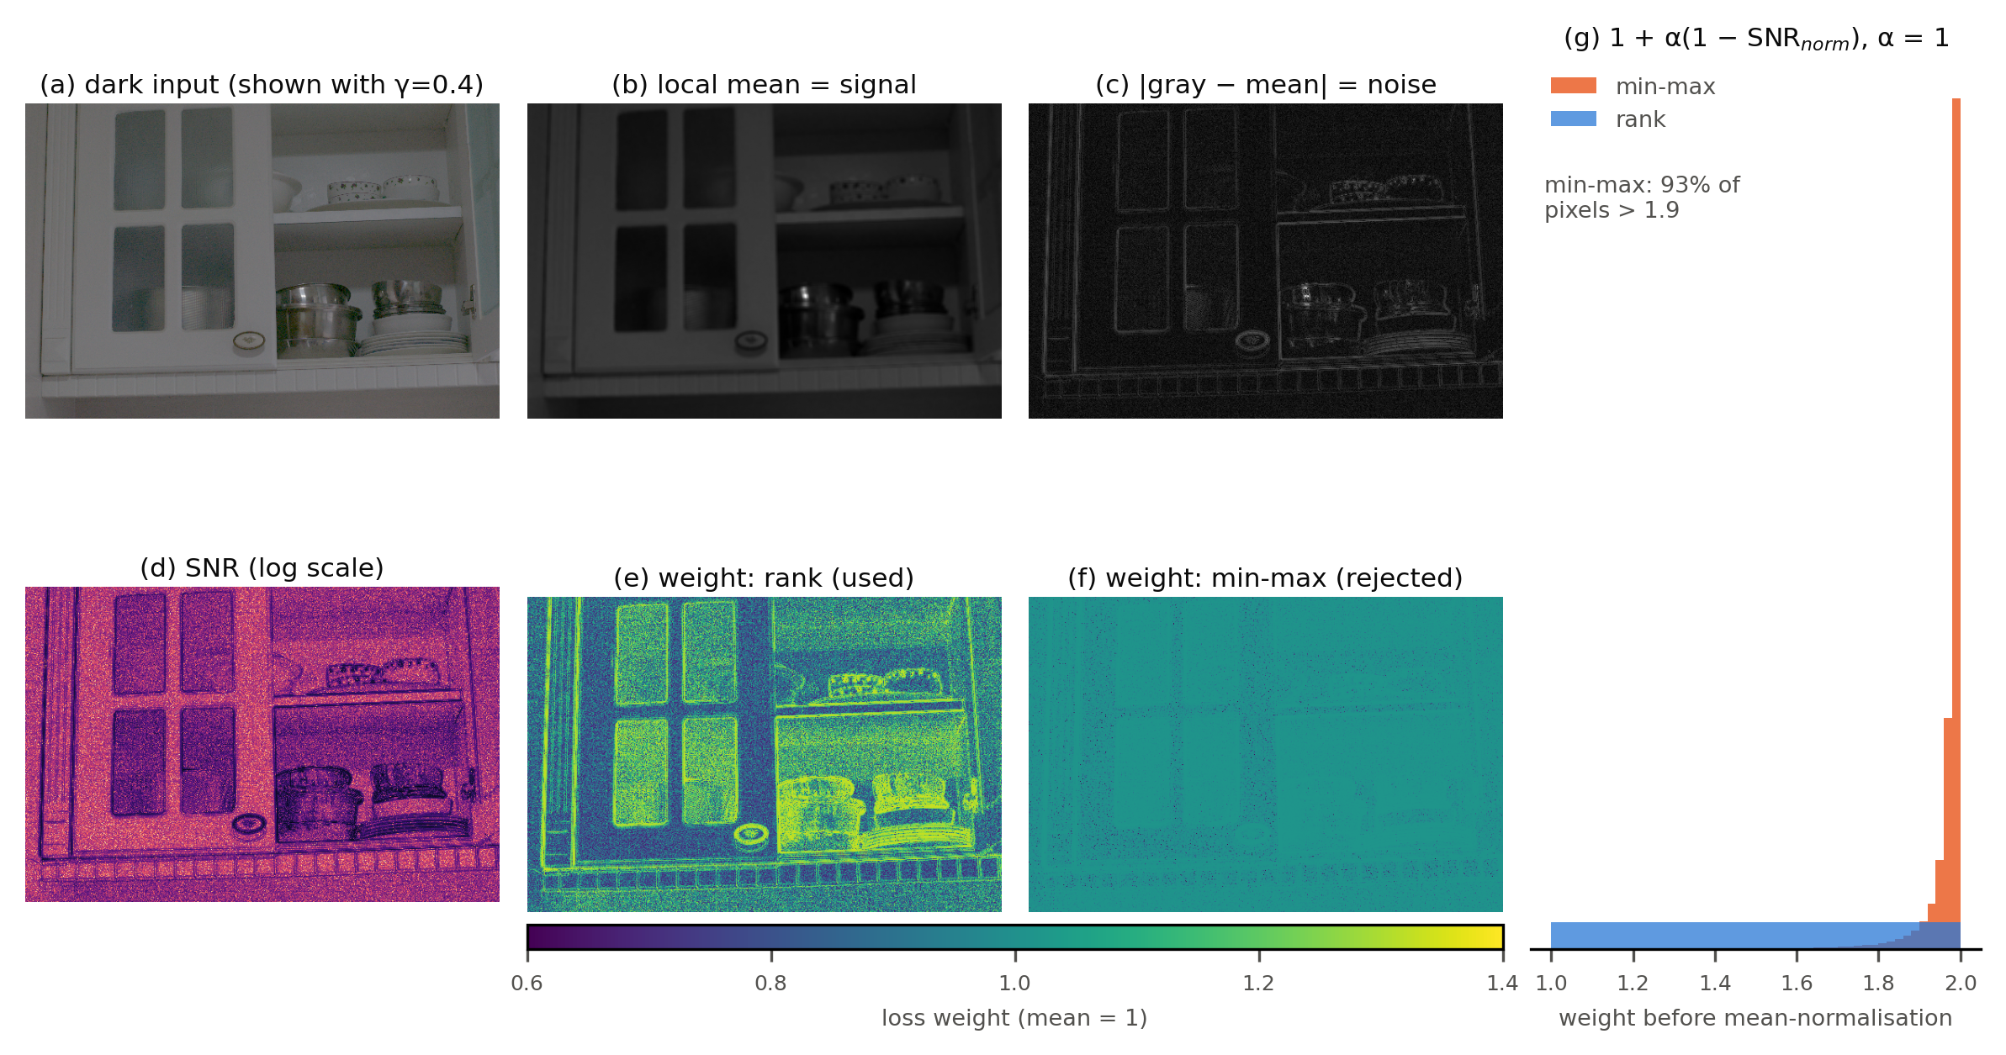
METHOD
My idea: noise-aware (SNR-weighted) loss
Steps
blur b = 5×5 mean of gray
noise n = |gray − b|
SNR = b / (n + ε)
rank r ∈ [0,1] per image
w = 1 + α(1 − r), α = 1
w ← w / mean(w)
L = mean(w · |Ŷ − Y|)
Rank normalisation (e) spreads the weights; min-max (f) gives almost every pixel the same weight (93% > 1.9).
Midsem BTP · Low-light image enhancement · IIT Patna
10
Notes:
SAY: My idea is to tell the network, during training, which pixels are noisy. I compute an SNR map from the dark input: blur it,
the difference between the image and its blur is the noise, and blur divided by noise is the SNR. Low-SNR pixels then get up to
twice the weight of clean pixels in the L1 loss. Two design decisions: first, I use the rank of each pixel's SNR, because with
min-max normalisation 93 percent of pixels got weight about 2, which would just double the learning rate - you see that in the
orange histogram. Second, I divide by the mean so the average weight is exactly 1; only the emphasis moves.
Q: Why not min-max? A: The SNR values have a huge tail; min-max squashes almost every pixel to the same weight. Q: Is the SNR map
learned? A: No, it is computed from the input, without gradients. Q: Weakness? A: The blur difference also fires on edges - see
the yellow edges in panel (e).

Slide 11
SETUP
Experimental setup
Data | Use | Test images
LOL-v1 | paired, main | 15
LOL-v2 real / syn | paired | 100 / 100
LIME / DICM / MEF | unpaired, NIQE | 10 / 69 / 17
ExDark (12 classes) | detection | 1,200 (GSAD: 200)
Metric | Measures | Better
PSNR | pixel fidelity | ↑
SSIM | structure | ↑
LPIPS | perceptual distance | ↓
NIQE | naturalness (no GT) | ↓
Dark-30% PSNR | darkest 30% of pixels | ↑
mAP50 | detection accuracy | ↑
Hardware: Kaggle Tesla T4 (training, timing); laptop for evaluation
Rules: no GT at test time · no test-chosen checkpoint · no train/test overlap
Midsem BTP · Low-light image enhancement · IIT Patna
11
Notes:
SAY: I evaluate on three paired test sets with ground truth, three sets of real unpaired photos, and 1,200 ExDark images with
object boxes. Metrics: PSNR and SSIM for fidelity, LPIPS for perceptual similarity, NIQE when there is no ground truth, my
dark-region PSNR in the darkest 30 percent of pixels, and mAP for detection. Training ran on a free Kaggle T4 GPU. Important
protocol rules: no ground-truth information at test time, no checkpoint chosen by test score, and no testing on training images.
Q: Why is LOL-v2-real excluded for models trained on LOL-v1? A: I found that 91 of its 100 test images are LOL-v1 training images.
Q: Why does SSIM differ from PSNR? A: PSNR is pixel error; SSIM compares local structure, contrast and brightness.

Slide 12
RESULTS
Quantitative results (paired test sets)
Method | LOL-v1 PSNR↑ | SSIM↑ | LPIPS↓ | LOL-v2-real PSNR↑ | SSIM↑ | LPIPS↓
Input | 7.77 | 0.191 | 0.560 | 9.72 | 0.196 | 0.519
Gamma | 14.53 | 0.620 | 0.351 | 18.70 | 0.659 | 0.318
Zero-DCE | 14.86 | 0.562 | 0.335 | 18.06 | 0.580 | 0.313
SCI | 14.85 | 0.527 | 0.339 | 17.36 | 0.542 | 0.307
SNR-Aware* | 24.61 | 0.840 | 0.151 | 21.48 | 0.848 | 0.157
LLFormer | 23.65 | 0.816 | 0.169 | – | – | –
GSAD | 22.73 | 0.850 | 0.103 | 20.14 | 0.845 | 0.114
Retinexformer | 25.15 | 0.843 | 0.131 | 22.79 | 0.839 | 0.171
Retinexformer (mine) | 23.10 | 0.828 | 0.143 | – | – | –
* images released by the SNR-Aware authors. Best value in bold. –: train/test overlap (see setup).
Retinexformer: best PSNR · GSAD: best LPIPS (most natural-looking) · classical / zero-shot ≈ 15 dB
Midsem BTP · Low-light image enhancement · IIT Patna
12
Notes:
SAY: This is the main comparison, all scored by the same script. Retinexformer has the best PSNR on both sets,
25.15 dB on LOL-v1. GSAD, the diffusion model, has the best LPIPS - its images look the most natural -
but lower PSNR. Classical and zero-shot methods brighten the image but stay around 15 dB. My own re-training of Retinexformer reached
23.10 dB - I explain that gap on the next slide.
Q: Why is GSAD lower in PSNR but better in LPIPS? A: Diffusion creates realistic texture but its overall brightness is off, and PSNR
punishes brightness errors heavily. Q: Why are dashes there? A: Those models were trained on LOL-v1, whose training set overlaps
LOL-v2-real's test set.

Slide 13
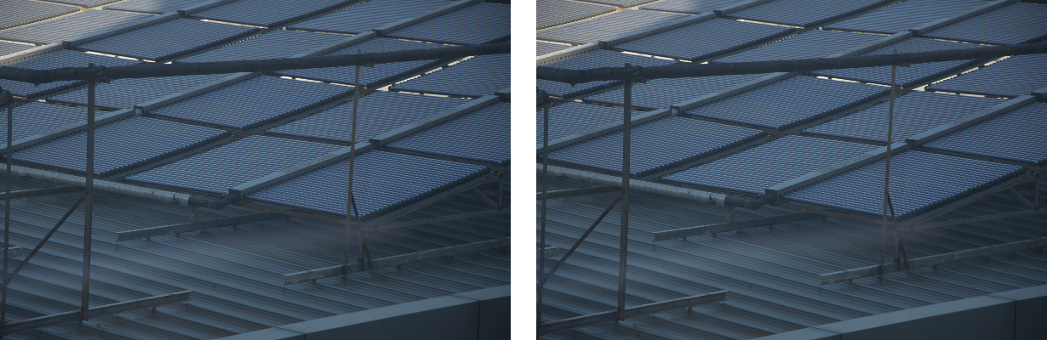
RESULTS
Reproduction and protocol findings
Method / set | Paper | Ours
Retinexformer, LOL-v1 | 25.16 | 25.15
SNR-Aware, LOL-v1 | 24.61 | 24.61
LLFormer, LOL-v1 | 23.65 | 23.65
GSAD, LOL-v1 (GT trick) | 27.84 | 27.57
GSAD, LOL-v1 (real output) | – | 22.73
GSAD's test rescales outputs to the ground-truth brightness: +4.85 dB (LOL-v1)
LOL-v2-real: 91 / 100 test images are LOL-v1 training images (example below)
My re-training: 23.10 dB vs released 25.15 (GitHub #132: 23.45)
PSNR in dB on LOL-v1
Released models reproduce their papers → my evaluation pipeline is correct
Left: LOL-v2-real TEST 00771 · Right: LOL-v1 TRAIN 771 - identical
Midsem BTP · Low-light image enhancement · IIT Patna
13
Notes:
SAY: Before trusting any comparison I checked that I reproduce the published numbers. Retinexformer, SNR-Aware and LLFormer match
their papers to 0.01 dB. GSAD's paper reports 27.84 dB, but its test script rescales every output
to the ground truth's average brightness - information a real camera never has. With that trick I get
27.57, without it 22.73 dB. Second finding: 91 of the 100
LOL-v2-real test images are copies of LOL-v1 training images - on the right is one example, the same photo in both sets. Third: training Retinexformer from scratch myself gives
23.10 dB, not 25 - another user on the authors' GitHub reported 23.45 dB.
Q: Why is your re-training 2 dB lower? A: Likely run-to-run variance on a tiny dataset (485 train, 15 test images), different
PyTorch/GPU, and the released checkpoint may be the best of several runs; my evaluation reproduces the training log exactly.
Q: Is GSAD cheating? A: It follows an older convention (KinD, LLFlow) and says so in its README, but it is not comparable with
methods that do not use the ground truth.

Slide 14
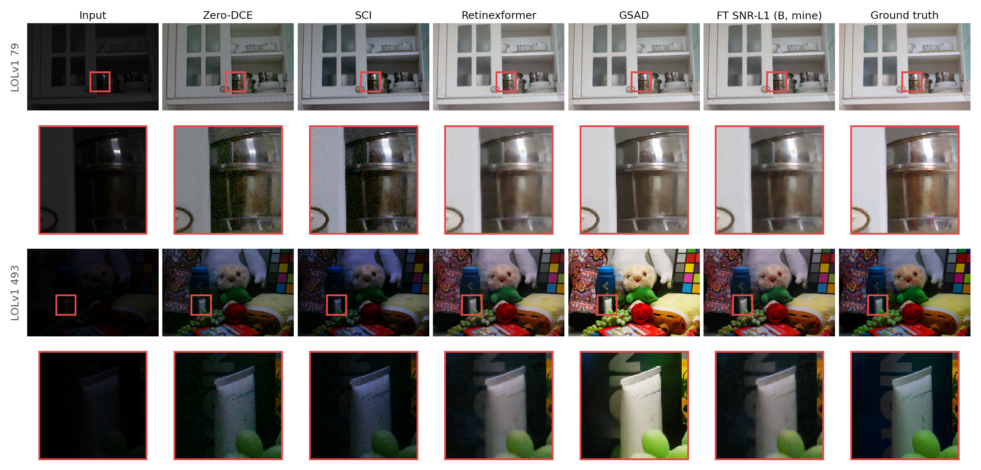
RESULTS
Qualitative results
Midsem BTP · Low-light image enhancement · IIT Patna
14
Notes:
SAY: Here are two LOL-v1 test images (79 and 493), each with a zoomed crop of a dark region below it. Zero-DCE and SCI make the
image bright but the crops are full of coloured noise. Retinexformer and my fine-tuned run B remove the noise but smooth fine
detail - for example the small green text on the tube in the bottom crop is lost. GSAD is the brightest and keeps the most texture,
but its colours drift - see the greenish background in the bottom crop. My run B looks almost identical to Retinexformer.
Q: How were the zoom boxes chosen? A: Automatically: a region that is dark in the input but has detail in the ground truth, so the
crop shows what each method recovers.

Slide 15
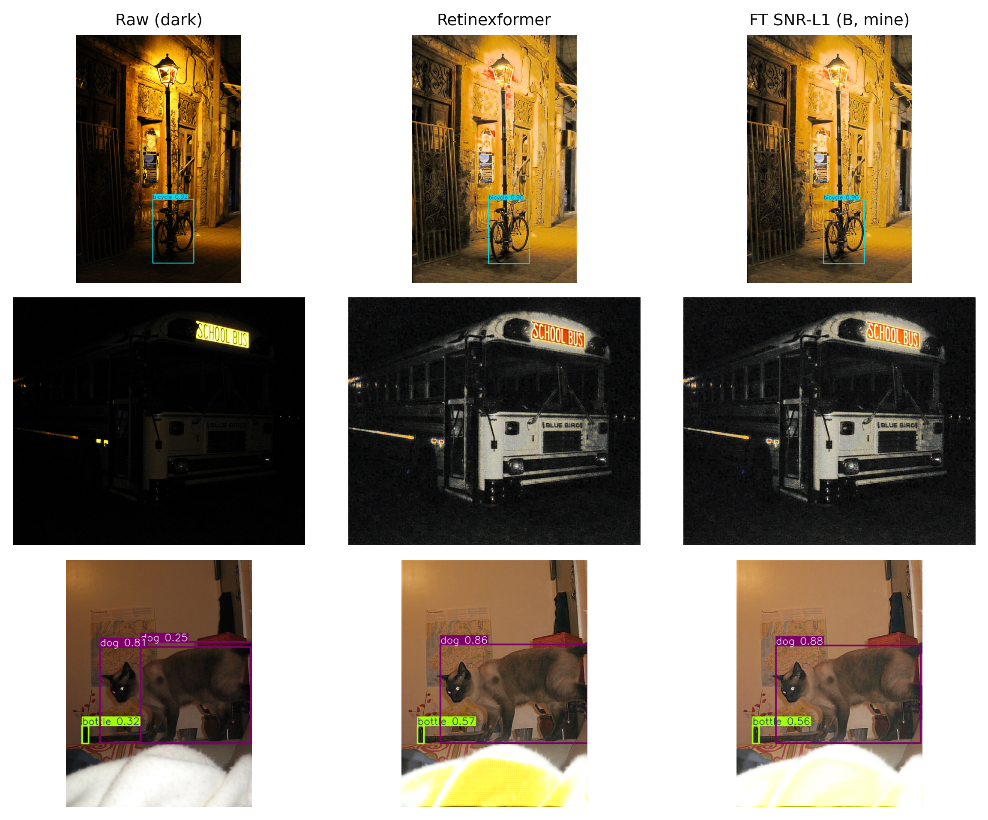
RESULTS
Does enhancement help a detector? (ExDark, YOLOv8m)
Input to YOLOv8m | mAP50 (1,200) | Recall | mAP50 (200)
Raw (no enhancement) | 0.662 | 0.611 | 0.707
Retinexformer | 0.603 | 0.540 | 0.628
SCI | 0.595 | 0.529 | 0.625
Zero-DCE | 0.572 | 0.502 | 0.603
GSAD | – | – | 0.633
Raw images give the best mAP
Enhancement lowers recall, not precision
Better restoration hurts less, none helps
Our YOLOv8m detections: bus missed in all versions; enhancement turns the white blanket yellow
Midsem BTP · Low-light image enhancement · IIT Patna
15
Notes:
SAY: I ran a standard YOLOv8 detector, trained on normal-light COCO images, on raw ExDark images and on enhanced versions of the same
images. Surprisingly, raw images are best: mAP50 0.662. Every enhancer lowers it; even the diffusion
model on the 200-image subset stays below raw. Precision hardly changes but recall drops: after enhancement the detector misses
objects. On the right, the school bus is not detected in any version, and enhancement turns the white blanket yellow.
Q: Retinexformer's paper says enhancement helps detection - contradiction? A: No: they train YOLOv3 from scratch on enhanced images and
compare enhancers with each other, with no raw-image row. I test an off-the-shelf detector. Q: Why might it hurt? A: Amplified noise,
colour shifts, and a domain gap from the normal-light images the detector learned from.

Slide 16
RESULTS
Ablation: does the noise-aware loss help?
Run | LOL-v1 PSNR | Dark-30% PSNR | Dark wins vs A | ExDark mAP50
Released (start) | 25.15 | 25.31 | – | 0.627
A: L1 (control) | 24.31 | 24.89 | – | 0.627
B: SNR-L1 (mine) | 24.32 | 24.91 | 13/15 | 0.626
C: L1 + FFT | 24.31 | 24.89 | 3/15 | 0.626
D: SNR-L1 + FFT | 24.32 | 24.91 | 12/15 | 0.626
B vs A: dark regions better on 13/15 images (p = 0.004)
…but only +0.01 to +0.05 dB: negligible
FFT loss: no effect
Fine-tuning lowers LOL-v1 PSNR for every run
Takeaway: a consistent effect in the intended place (dark regions), but far too small to matter. The idea needs to act inside the network, not only in the loss.
Midsem BTP · Low-light image enhancement · IIT Patna
16
Notes:
SAY: This is the controlled experiment. All four runs start from the same released weights, see exactly the same training batches
and use the same learning rate - only the loss changes. Run A is the control with plain L1, B is my SNR-weighted loss, C adds an FFT
loss, D both. Result: B beats A by only 0.01 dB overall.
In the darkest regions it is better on 13 of 15 images, which is unlikely by chance (p = 0.004), so the effect is consistent and
in the intended place - but it is tiny, a few hundredths of a dB, and invisible. FFT does nothing. Also, fine-tuning itself lowered
PSNR for every run, including the control.
Q: Why have a control run? A: Without it, any change could come from simply training longer; with it, the difference between A and B
can only come from the loss. Q: Statistically significant but not important? A: Yes - consistent direction, negligible size.

Slide 17
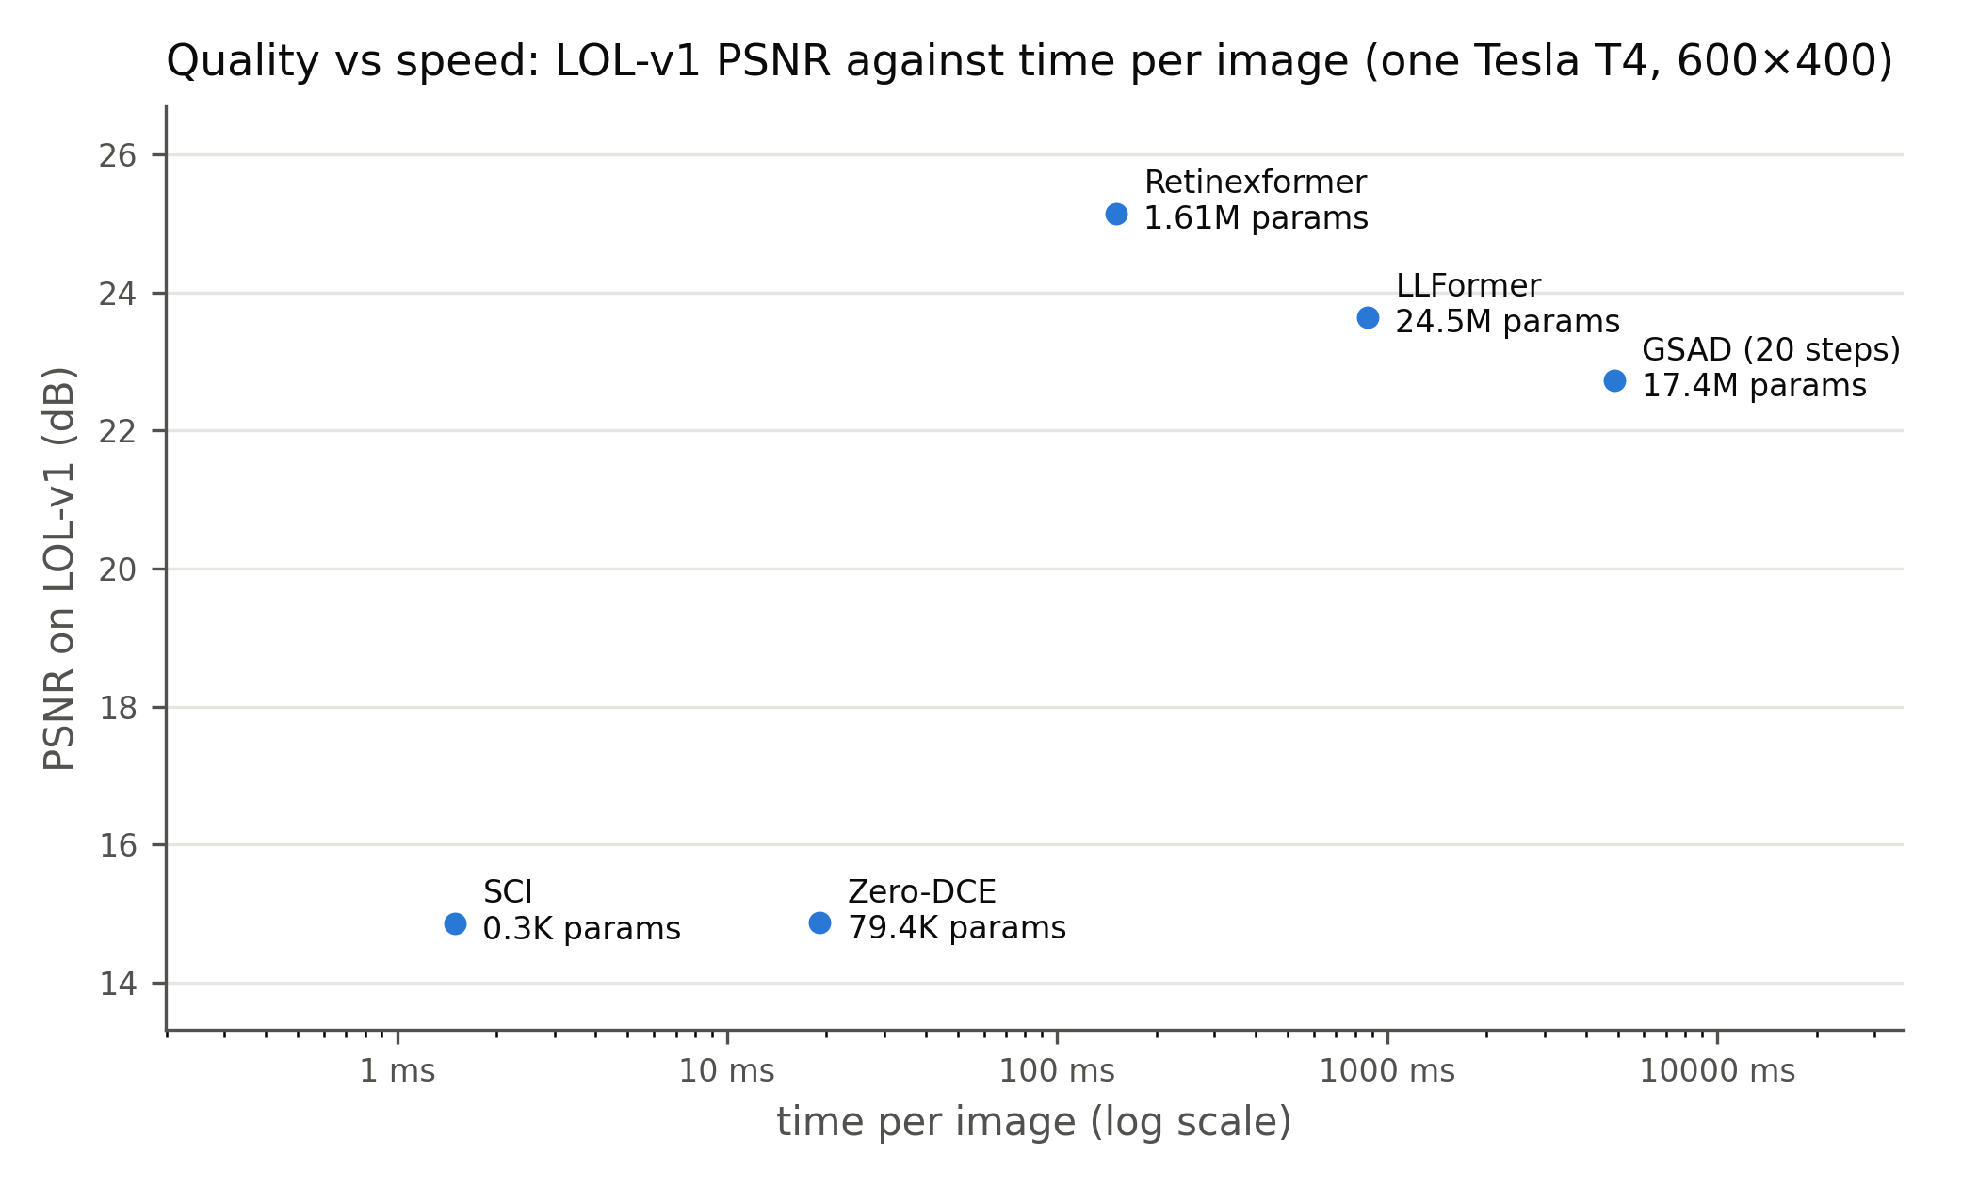
RESULTS
Efficiency: quality vs. speed (one Tesla T4)
SCI: 1.5 ms, low quality
Zero-DCE: 19 ms, low quality
Retinexformer: 151 ms, best PSNR
LLFormer: 874 ms, 24.5 M params
GSAD: 2.4–4.9 s per image
Retinexformer: best quality–speed trade-off. GSAD is 16–32× slower for lower PSNR.
Midsem BTP · Low-light image enhancement · IIT Patna
17
Notes:
SAY: Speed matters for phones and cameras. All methods were timed on the same GPU at 600 by 400. SCI takes
1.5 ms but has low quality; Retinexformer gives the best PSNR at
151 ms with 1.61 M parameters; the diffusion
model GSAD needs about 2.4 to
4.9 seconds per image - 16 to 32 times slower - for lower PSNR.
Q: Why is GSAD slow? A: Diffusion runs the network once per sampling step (10-20 steps); Retinexformer runs once. Q: Why time only on
one GPU? A: Speeds from different hardware are not comparable; my laptop's timings were unreliable.

Slide 18
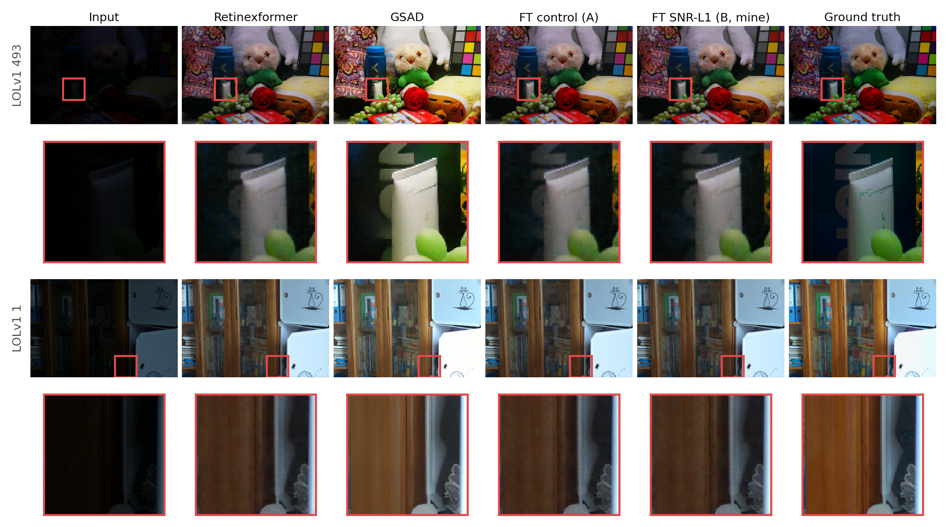
DISCUSSION
Limitations and failure cases
Only 15 LOL-v1 test images
One seed per run; limited free GPU time
SNR estimate also marks edges as noise
Detector used as-is (not fine-tuned)
SNR-Aware: released images only; GSAD on 200 ExDark images
Midsem BTP · Low-light image enhancement · IIT Patna
18
Notes:
SAY: Every method, including mine, loses the fine green text on this tube and the wood grain of this cabinet - the signal is simply not recoverable from the dark input.
Limitations of my work: LOL-v1 has only 15 test images, so small PSNR differences are not meaningful; I used one random seed per run;
free GPU time limited training; the detector was not fine-tuned; and my SNR estimate cannot tell noise from edges, which is probably
one reason the loss had little effect.
Q: What would you do differently? A: Several seeds, larger test sets, and a noise estimate that ignores edges.

Slide 19
PLAN
Plan for the second half
Weeks 1–2
SNR guidance inside IG-MSA; noise estimate that ignores edges
Weeks 3–4
Sweep α and weighting; 3 seeds per setting
Weeks 5–6
Train best variant from scratch; larger test sets
Week 7
Fine-tune YOLOv8 on enhanced vs raw ExDark
Week 8
Final report and code release
Midsem BTP · Low-light image enhancement · IIT Patna
19
Notes:
SAY: The evidence suggests moving the SNR idea from the loss into the network itself, as SNR-Aware does inside attention, and fixing the
noise estimate so it ignores edges. I will sweep the weighting strength with several seeds to measure variance, train the best version
from scratch, evaluate on larger test sets, and finally fine-tune the detector on enhanced images to see whether enhancement can help
when the detector adapts to it.
Q: Why should SNR inside attention work better than in the loss? A: The loss only changes how errors are counted; guidance inside
attention changes what information each region uses, which is where SNR-Aware gained.

Slide 20
CONCLUSION
Conclusions
Reproduced Retinexformer (25.15 dB) + 8 baselines under one protocol
Found: GT-brightness trick (GSAD), LOL-v2-real / LOL-v1 overlap
Raw images beat every enhancer for YOLOv8m (mAP50 0.662)
SNR-weighted loss: consistent but negligible gain in dark regions
Next: noise awareness inside attention, larger tests
Thank you — questions?
Key references: Cai et al., Retinexformer, ICCV 2023 · Xu et al., SNR-Aware, CVPR 2022 · Hou et al., GSAD, NeurIPS 2023 · Wang et al., LLFormer, AAAI 2023 · Guo et al., Zero-DCE, CVPR 2020 · Ma et al., SCI, CVPR 2022 · Li et al., LLIE survey, TPAMI 2022 · Loh & Chan, ExDark, CVIU 2019 (full list in the report)
Midsem BTP · Low-light image enhancement · IIT Patna
20
Notes:
SAY: To summarise: I reproduced Retinexformer and eight baselines under one fair protocol, and the released models match their papers.
The common protocol revealed three things that published tables hide: a ground-truth brightness trick, an overlap between benchmarks,
and the fact that enhancement does not help an off-the-shelf detector. My noise-aware loss, tested with a strict control, gives a
consistent but negligible gain, and the analysis points to moving noise awareness into the attention itself. Thank you.
Q: What is your main contribution so far? A: A careful, controlled evaluation - including detection and dark regions - and a tested,
explained negative result that sets up the next step.

