Slide 1
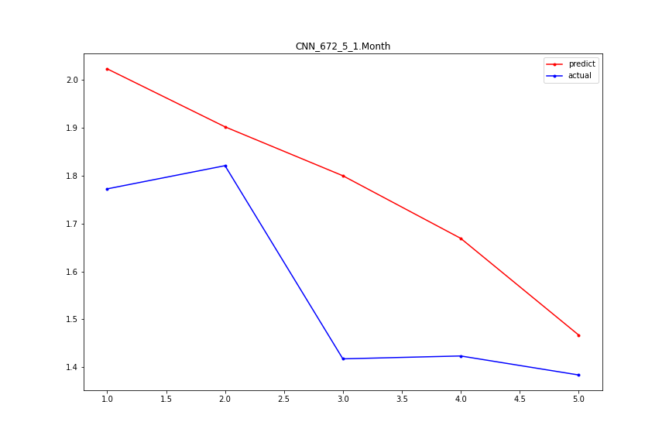
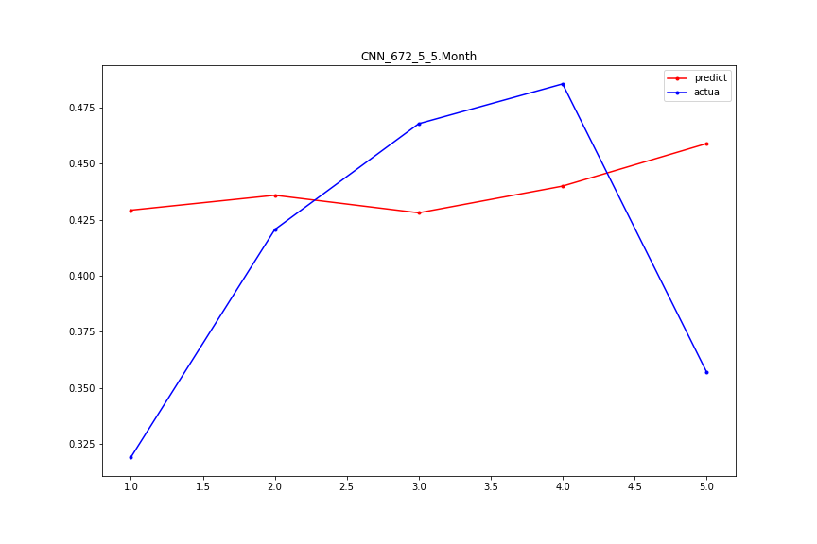
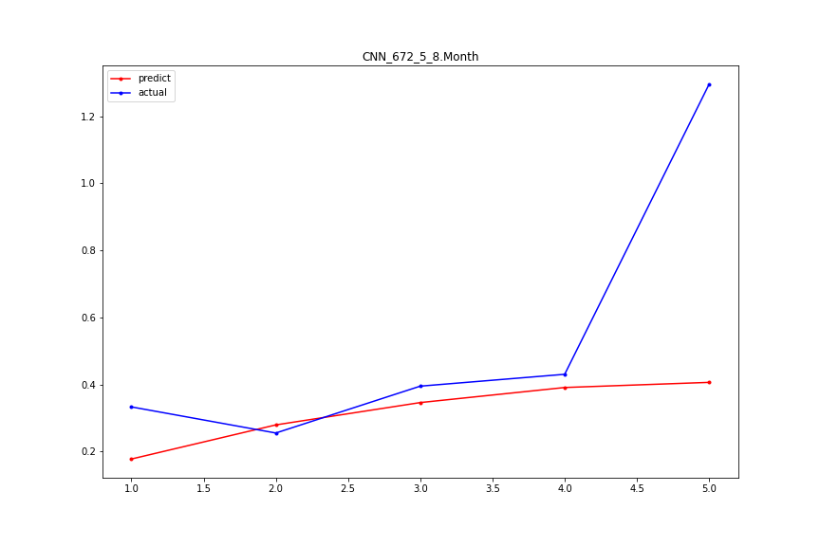
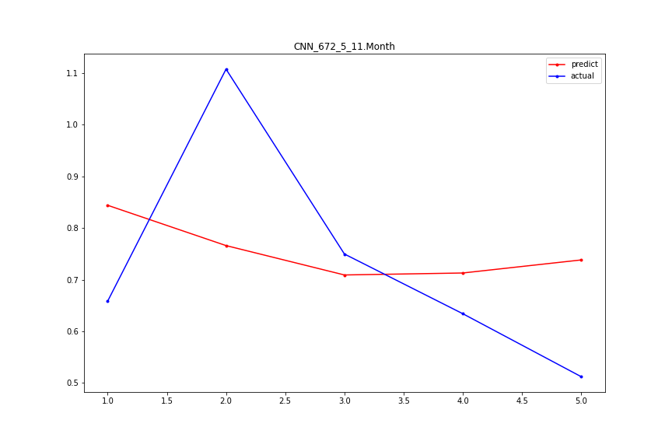
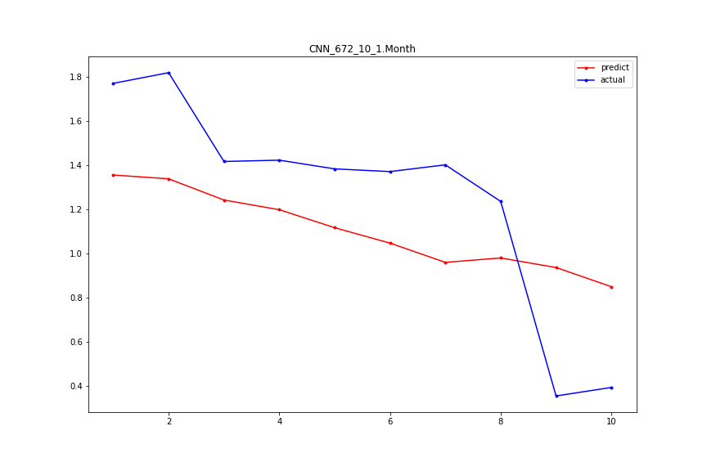
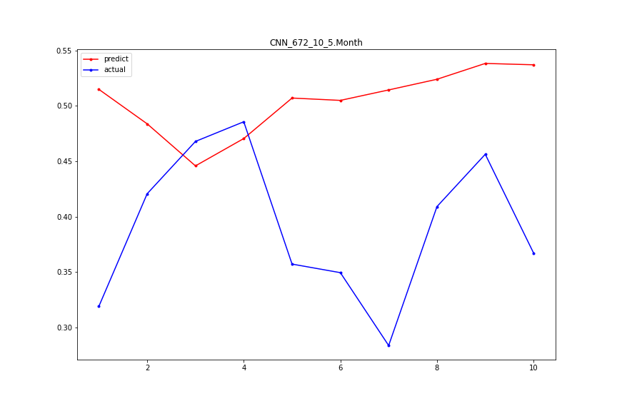
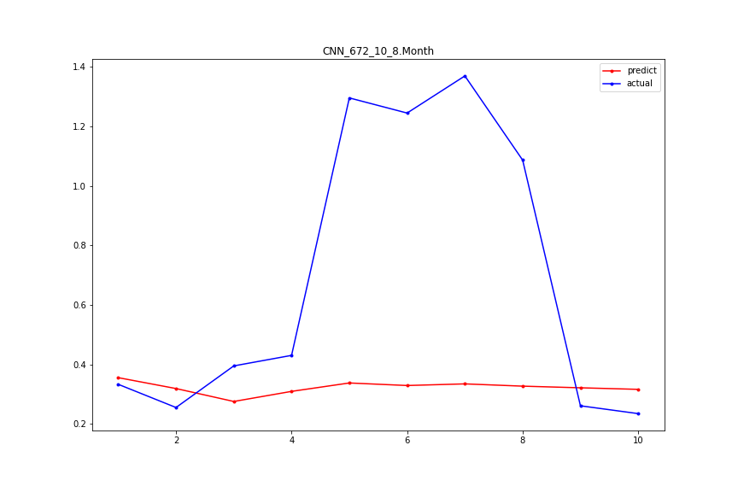
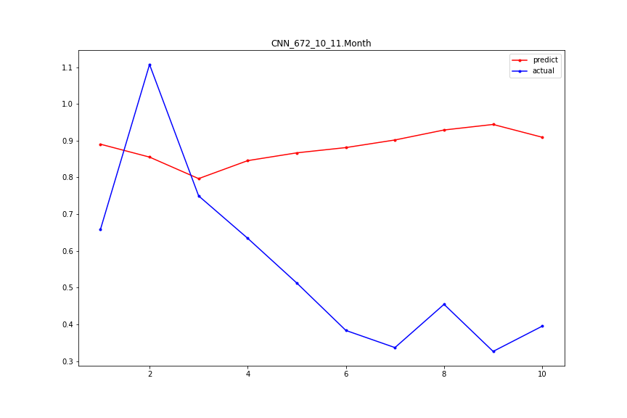
CNN

Slide 2
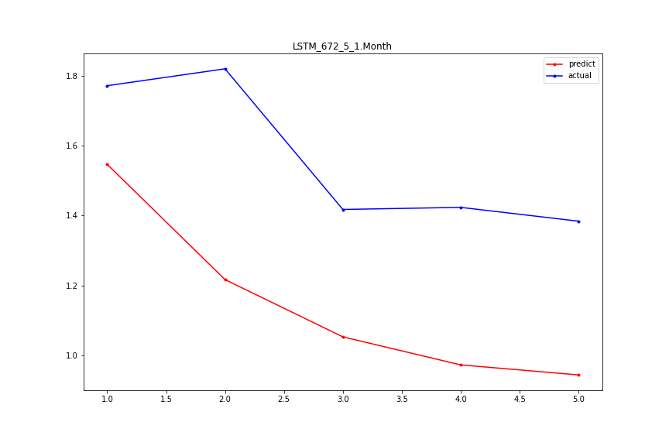
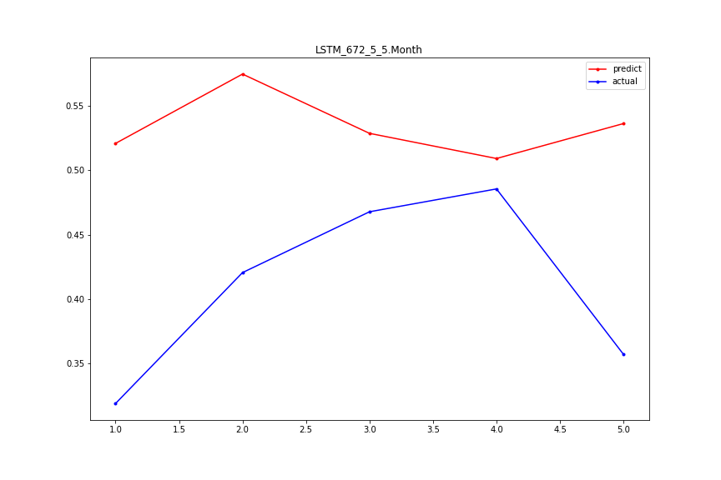
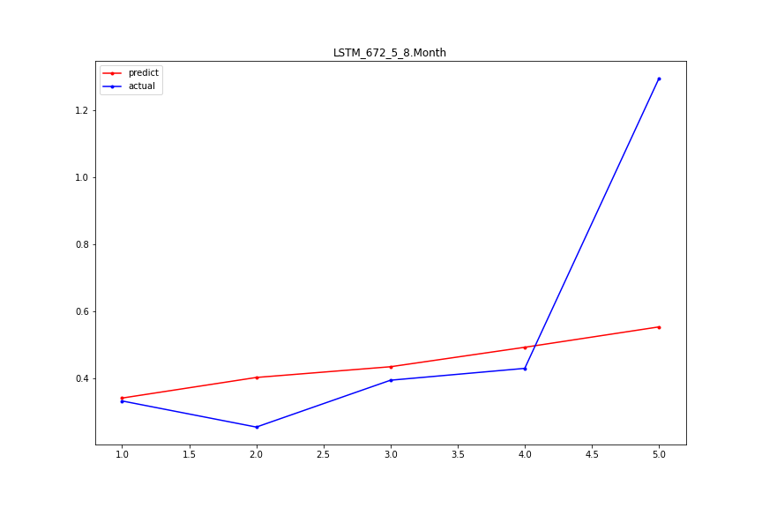
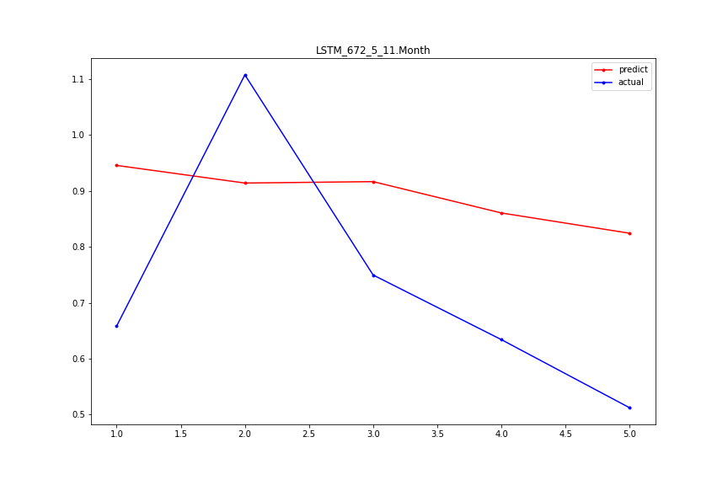
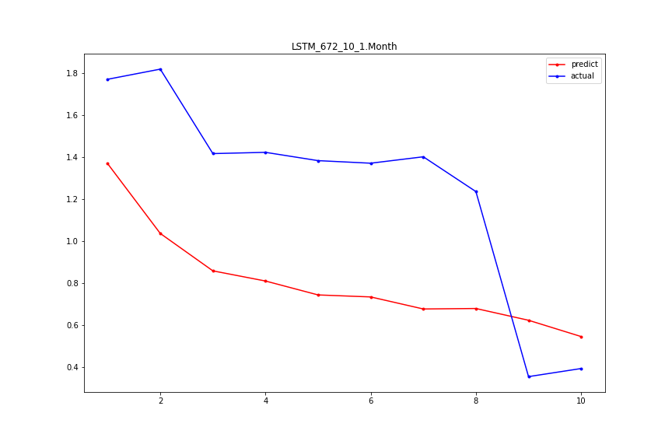
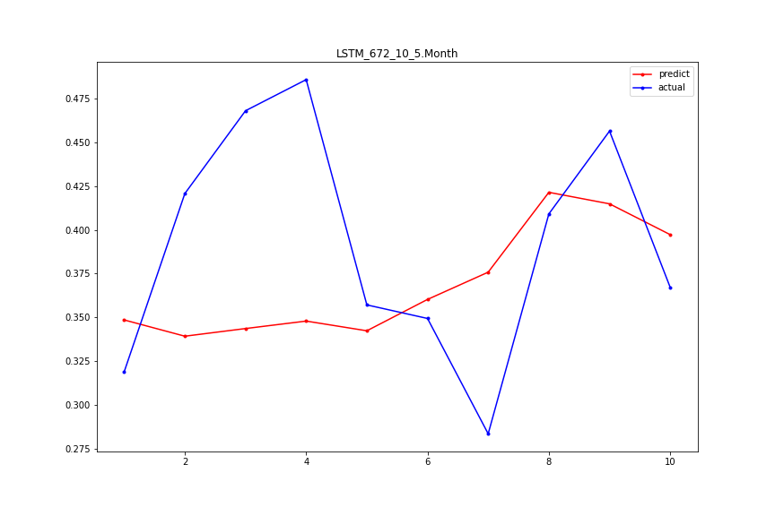
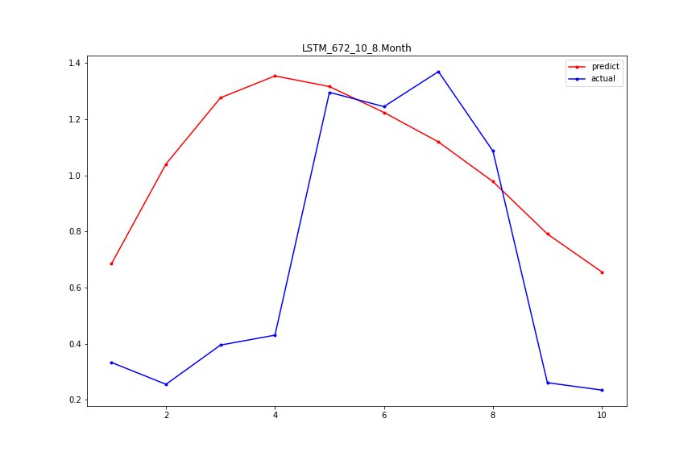
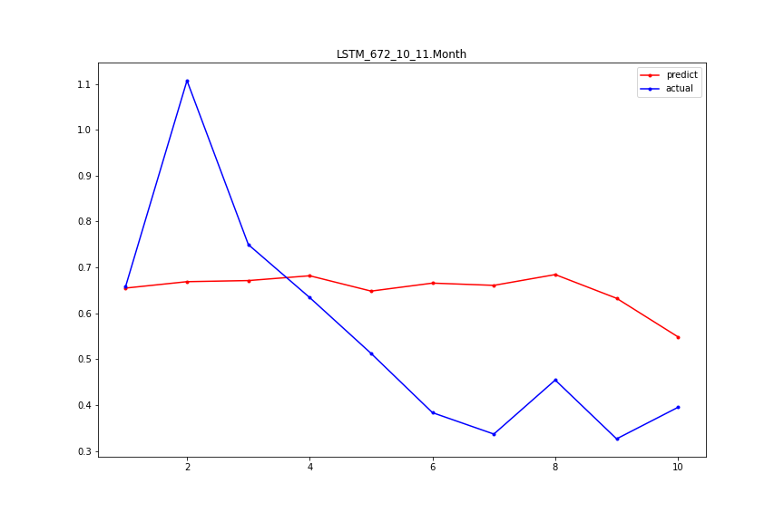
LSTM

Slide 3
CNN+LSTM

Slide 4
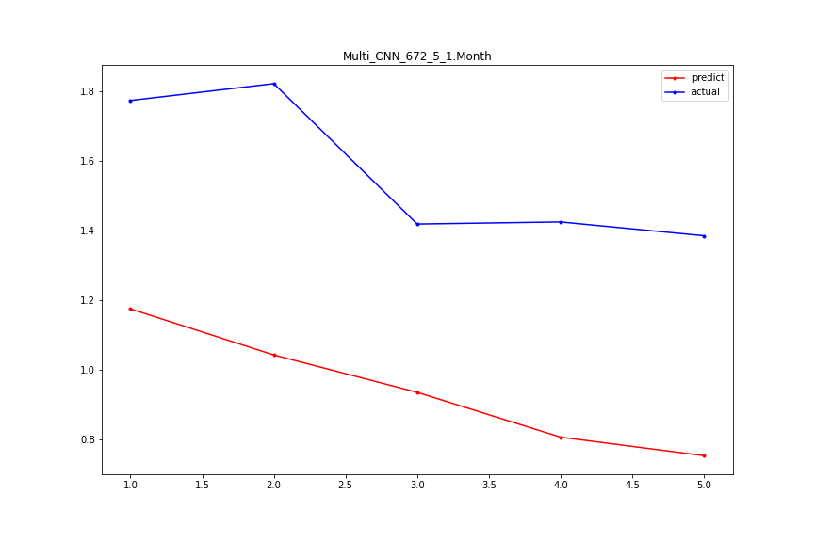
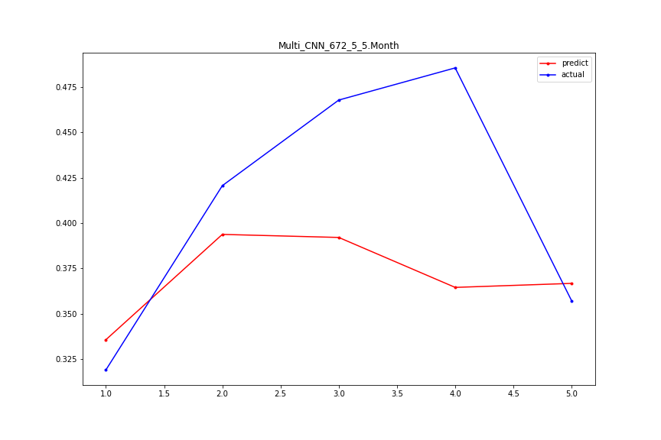
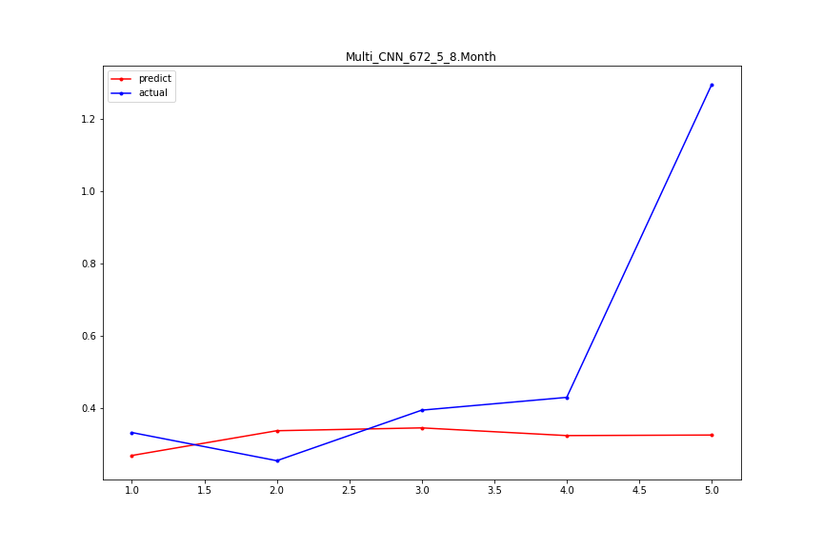
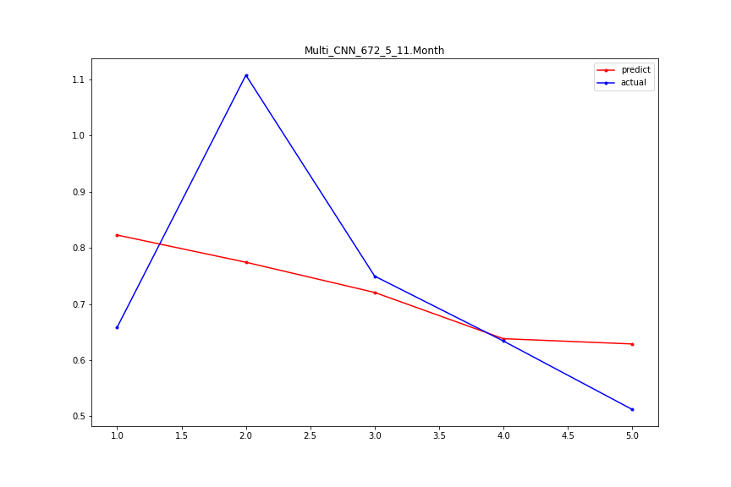
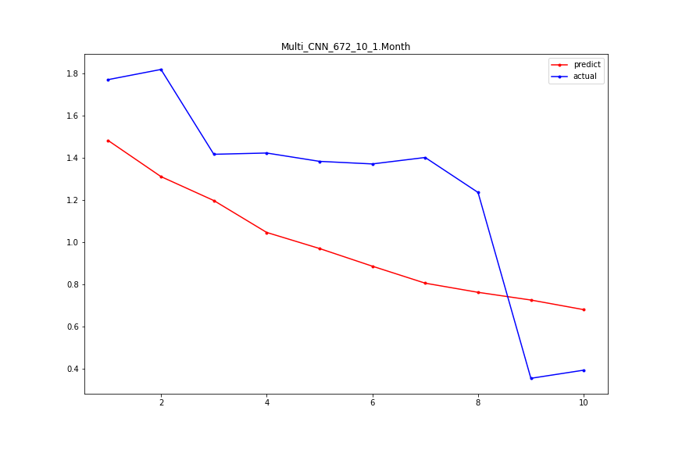
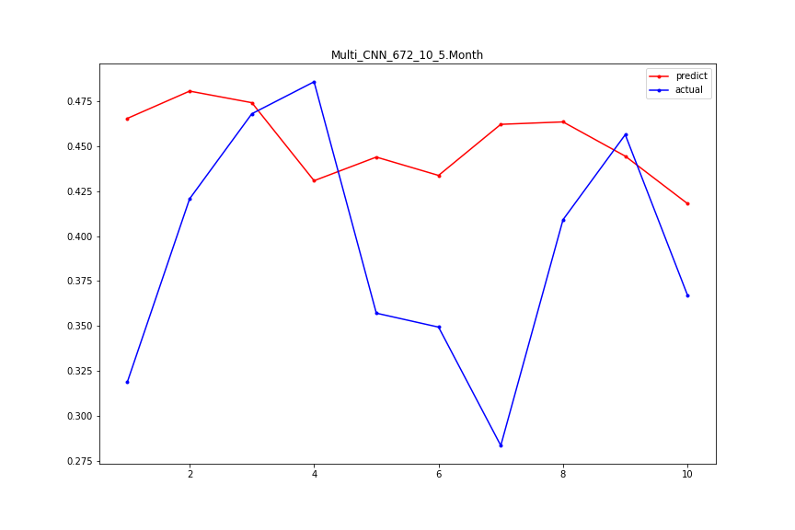
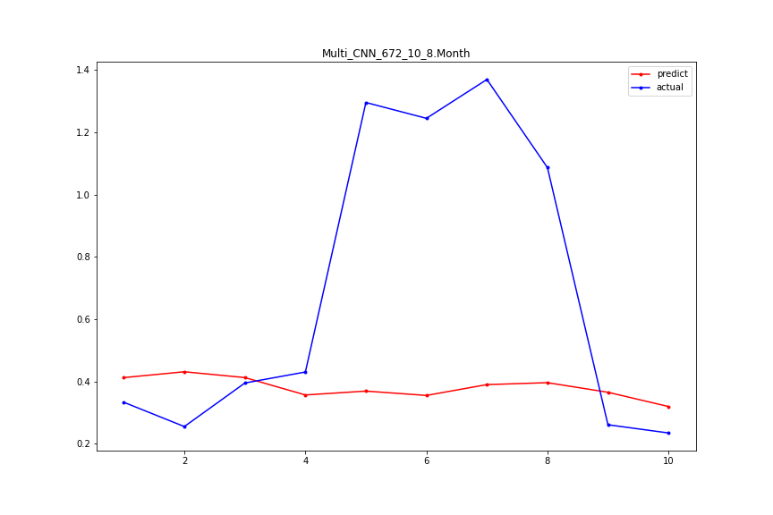
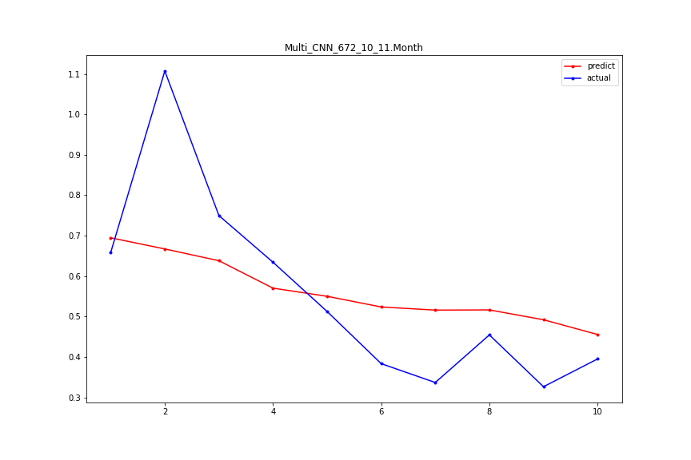
Multi_CNN

Slide 5
 | input:672 outputs:10 |  |  |  |  | input:672 outputs:5
 | CNN | Multi_CNN | LSTM | LSTM+CNN |  | CNN | Multi_CNN | LSTM | LSTM+CNN
1 | 0.36300862 | 0.402771974 | 0.534714926 | 0.335207078 |  | 0.20858328 | 0.622038769 | 0.417486319 | 0.465443022
2 | 0.315016765 | 0.468162244 | 0.330890537 | 0.270794764 |  | 0.655202434 | 0.354390026 | 0.176243087 | 0.499003971
3 | 0.3316478 | 0.29564967 | 0.370131486 | 0.377444258 |  | 0.61419871 | 0.570584308 | 0.57913356 | 0.614679712
4 | 0.122147949 | 0.09349407 | 0.144533348 | 0.123172706 |  | 0.163423896 | 0.124152378 | 0.099481835 | 0.10406515
5 | 0.11984703 | 0.073309564 | 0.057416899 | 0.597552352 |  | 0.062522391 | 0.049981006 | 0.123894608 | 0.083056297
6 | 0.265790059 | 0.122856637 | 0.120355542 | 0.146940241 |  | 0.091544144 | 0.089344294 | 0.106237768 | 0.141185975
7 | 0.732273641 | 0.304692016 | 1.038123211 | 0.490234134 |  | 0.503168877 | 0.543339398 | 0.221961998 | 0.658035752
8 | 0.413467577 | 0.401981169 | 0.42913981 | 0.394350135 |  | 0.231354163 | 0.253982207 | 0.200157887 | 0.223976491
9 | 0.360958734 | 0.352219716 | 0.335462889 | 0.347813192 |  | 0.118056804 | 0.054248272 | 0.170013936 | 0.24014203
10 | 0.299630221 | 0.246510768 | 0.484712014 | 0.293376226 |  | 0.336320916 | 0.339469046 | 0.36596947 | 0.444996303
11 | 0.376607559 | 0.129702758 | 0.200008667 | 0.483748821 |  | 0.174342344 | 0.129365543 | 0.237040903 | 0.120734802
Mean | 0.336399632 | 0.262850053 | 0.367771757 | 0.350966719 |  | 0.287156178 | 0.284626841 | 0.245238306 | 0.326847228

Slide 6
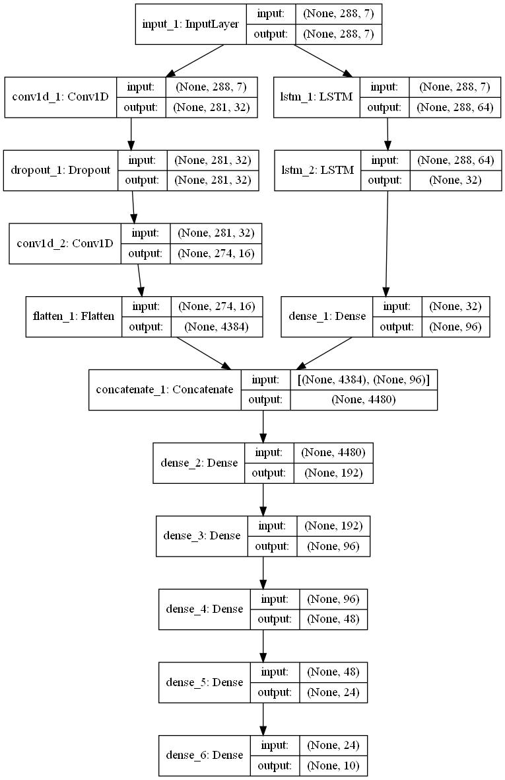
Month | Multi_CNN_lstm
1 | 0.308618481
2 | 0.874475006
3 | 0.551039298
4 | 0.084217371
5 | 0.10551846
6 | 0.082077716
7 | 0.268708615
8 | 0.203212802
9 | 0.1538299
10 | 0.437228186
11 | 0.304729721
Mean | 0.30669596

Slide 7
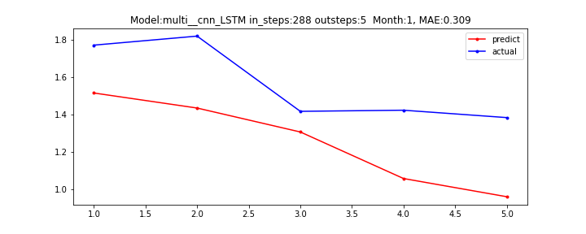
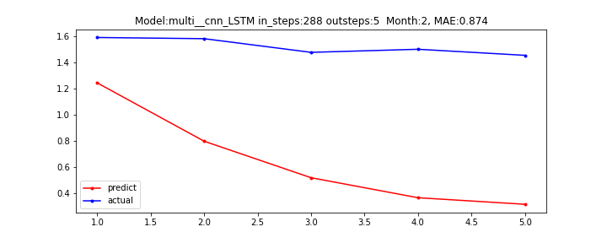
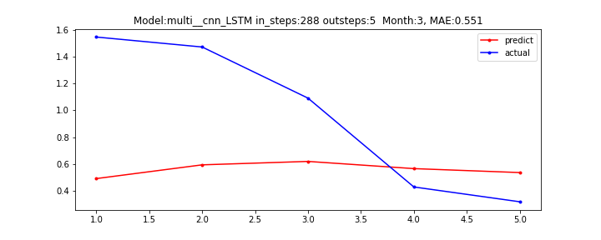
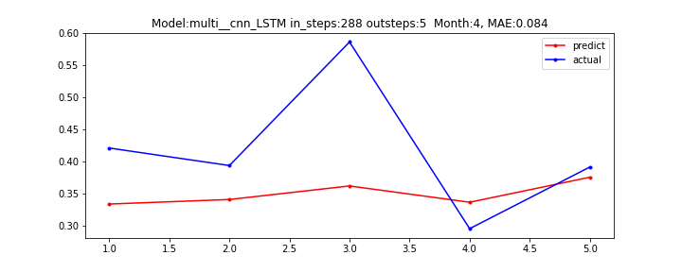
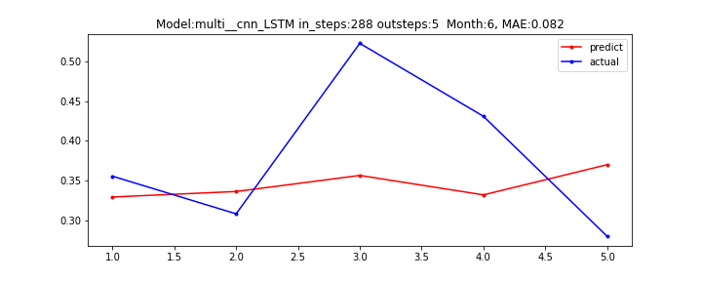
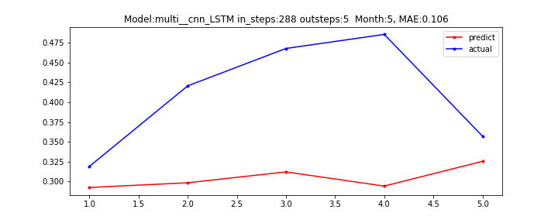

Slide 8
