Slide 1
Project 2
LLM - Pick and Place

Slide 2
Project Goals:
With multiple blocks in the scene, the system should be able to pick a specific block and place it on top of another specified block.
With multiple blocks in the scene, the system should be able to pick a specific block and place it in front of or behind another specified block.
With multiple blocks in the scene, the system should be able to pick a specific block and place it to the left of or to the right of another specified block.

Slide 3
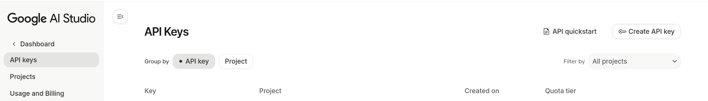
Using Gemini APIs
Step A) Installation
pip install -q -U google-genai
pip install python-dotenv
Step B) Get API key:
Step C) create a .env file and paste your api key in a python file:
GEMINI_API_KEY= your key

Slide 4
Using Gemini APIs
Gemini API Limitations: 1 – With free version, you only get 20 calls per day for each key
2 – You can make 6 keys ( 1 key per project)
GEMINI_API_KEY= your key

Slide 5
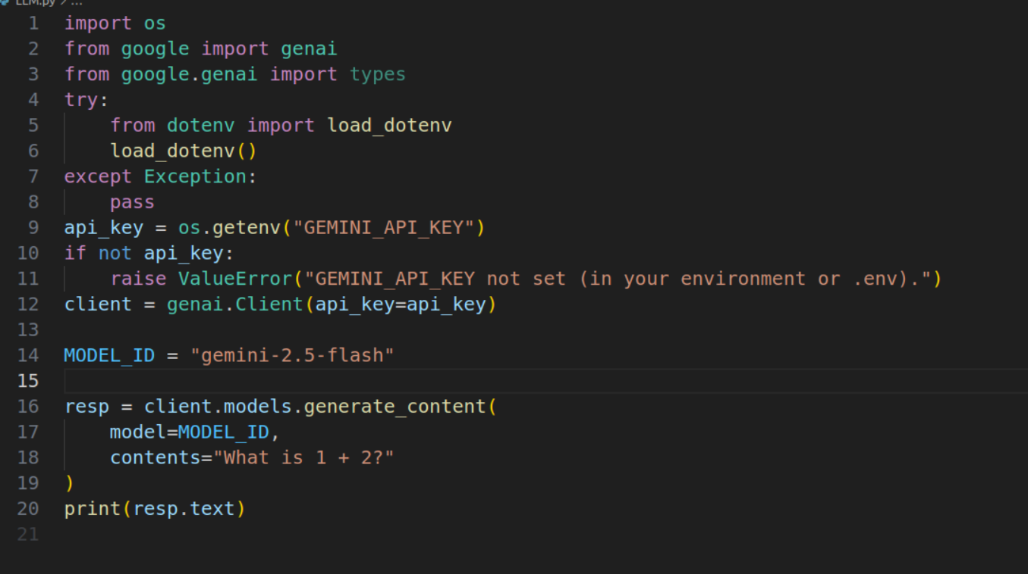
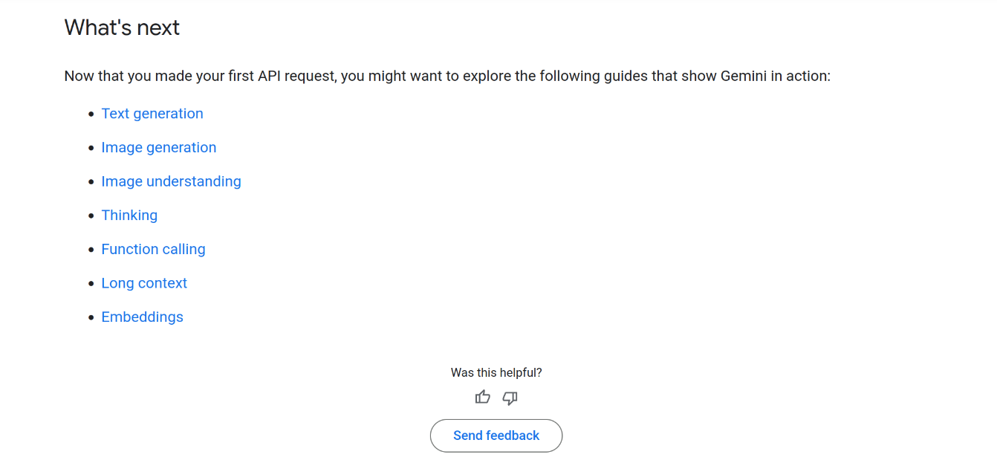
Using Gemini APIs
Your prompt will be in the contents variable, and you can access the response using the appropriate methods. Use the link to find out more:
Link: https://ai.google.dev/gemini-api/docs/quickstart

Slide 6
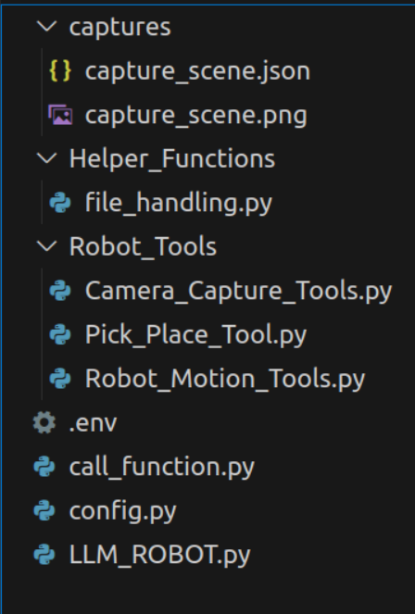
Files
Captures Folder - Holds the scene description in json file and save the frame as an image
Helper_Functions - Not Used for this implementation. Useful when you are requesting a new python code from gemini.
Robot_Tools - Functions for robot motion, camera capture and pick and place.
.env file - Holds your Gemini API key.
Call Function - The file take bridges between your helper function and gemini
Config file - configuration of all the parameters for your robot (MAKE CHANGES HERE)
LLM_ROBOT - The main that is being executed.

Slide 7
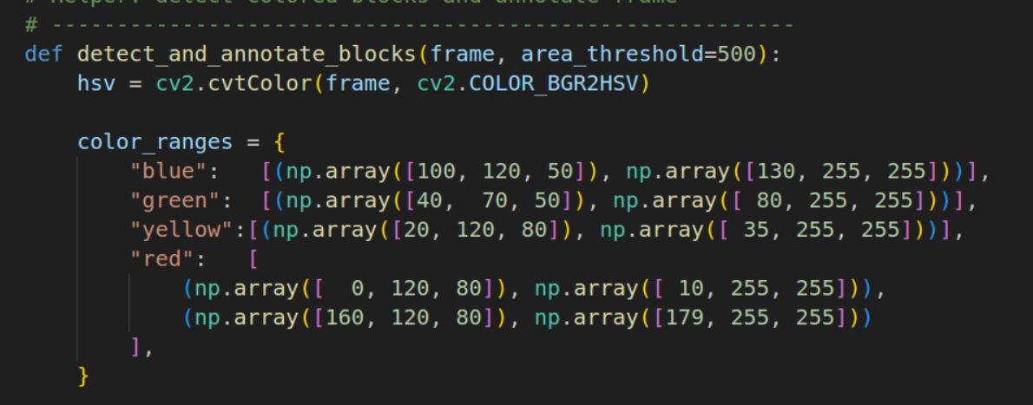
Task 1 - Block Detection - MAKE CHANGES ACCORDINGLY
In this implementation, we are identifying colors of the block and getting their centroids.
You can modify this block of code for fine tuning the coloring detection.
This function block is located in the Camera_Capture_Tools.py file

Slide 8
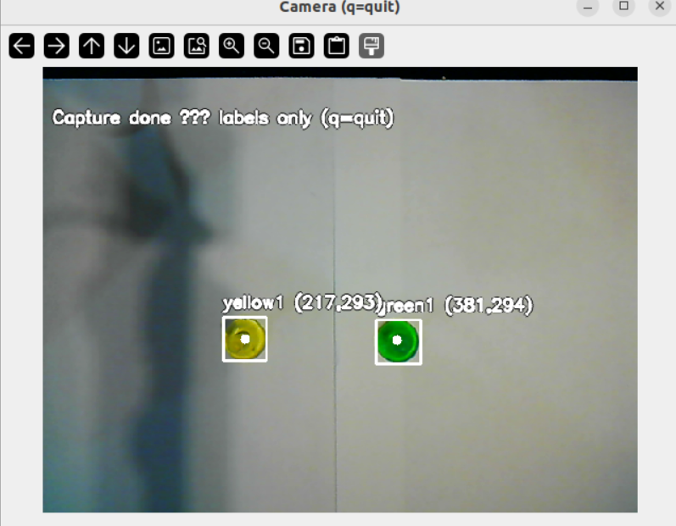
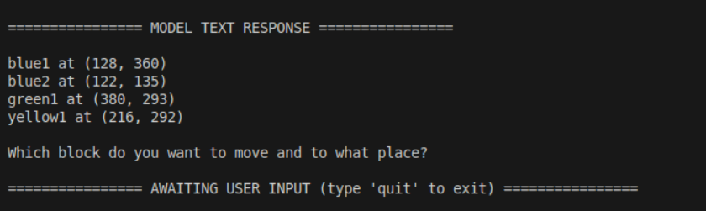
Task 2 - Understanding the scene
User Prompt - User request for the llm to process. It is pass as an argument within the command line in the form of a string. Eg: python3 LLM_ROBOT.py “Understand the scene”
It opens up a camera window and waits for 10 seconds to capture the frame. This time can be changed in the config file. Click “q” to quit and you will get the model output as,

Slide 9
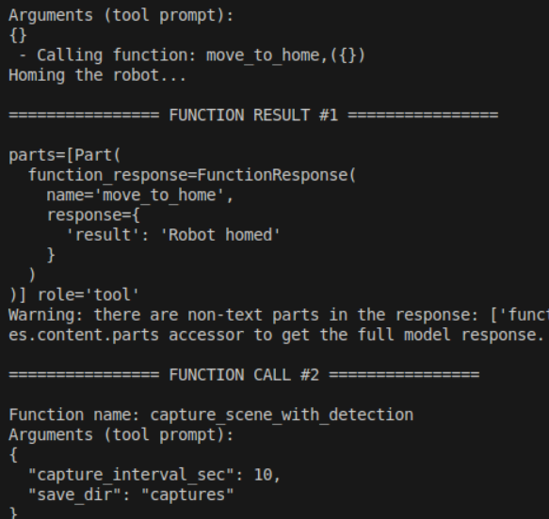
Task 2 - Understanding the scene
Based on the system prompt, the module runs different functions, in this case it runs two function,
Function1 : Home the Robot
Function2: Capture the scene.
These functions are defined in the tools folder.

Slide 10
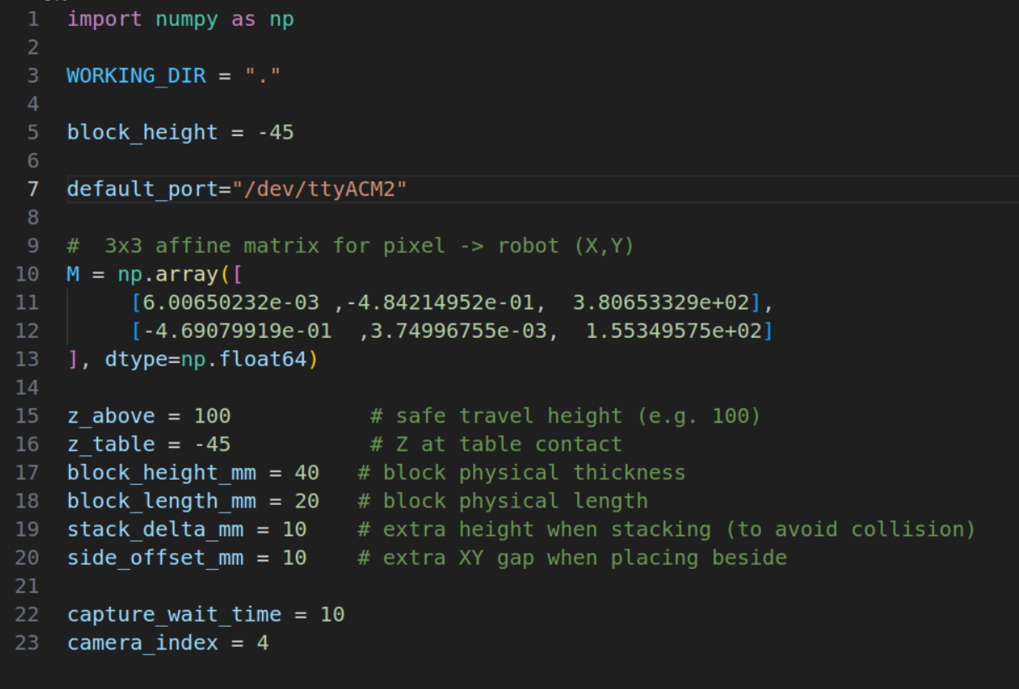
Config File - MAKE CHANGES ACCORDINGLY
The most important file, where each parameter has to set accordingly to your robot.
The M (affine matrix) is defined as the last column of list the x and y coordinates.
In this example, x = 380.65, and y = 155.34
Change these values if there is a constant offset in your robot points.

Slide 11
Robot Motion - MAKE CHANGES ACCORDINGLY
The given code assumes MODE.PTP function of dobot works for you.
If this code gives error regarding the MODE.PTP, then change the robot motion functions accordingly as done in previous labs.
The things that will change in your Robot_Motion_Tools.py file:
You wont have device.home(): Sol - Use device.move_to(x=240,y=0,z=150) for home. Note even these values might might be the actual home. You can fine tune these values.
Instead of using : dev.move_to(mode=int(MODE_PTP.MOVJ_XYZ), x=x, y=y, z=z, r=r) Use only , dev.move_to(x, y, z, r)
Remove this command:dev.speed(50, 50)
Instead of : pose, joint = dev.get_pose(), use .pose

