Slide 1
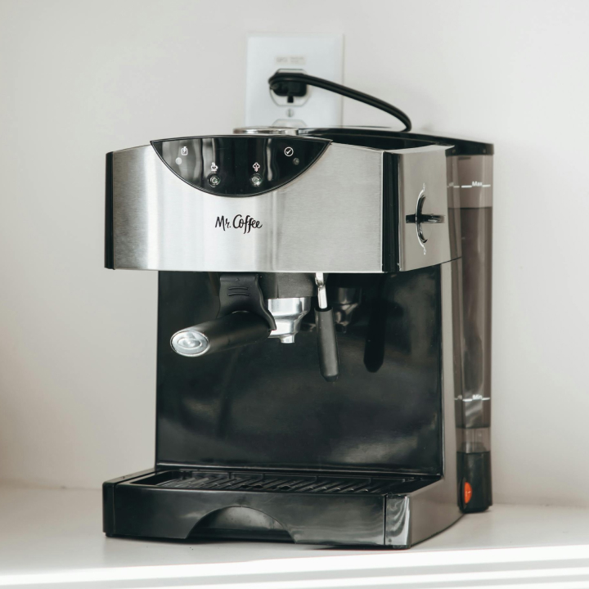
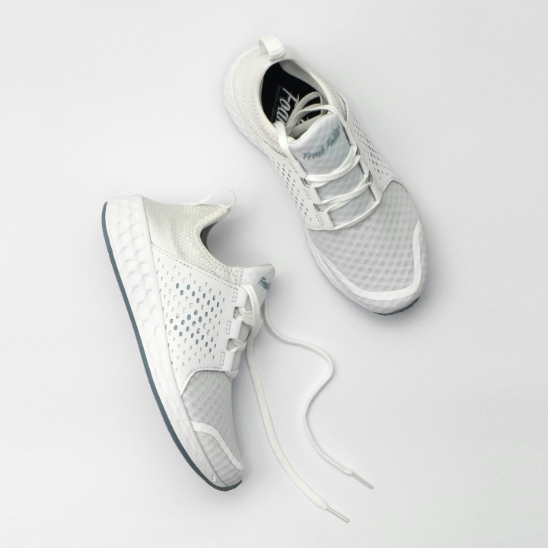


PORTFOLIO PROJECT
EcommerceShop
A full-stack shopping application with product browsing, cart management, checkout, orders, authentication, and backend tests.
Real catalog assets from the app
The project is not just an API exercise. It includes customer-facing screens and real product data seeded into the backend.
React + Spring Boot + JPA + H2
01

Slide 2
The project covers the core ecommerce journey
01
02
03
Sign in or register
Browse products
Add to cart
Users can create an account and authenticate with Basic Auth against the Spring Boot backend.
The frontend loads seeded products from public API endpoints and displays images, prices, ratings, and stock.
The cart service validates users, products, and quantities before saving cart items.
04
Checkout and orders
Checkout creates an order, reduces stock, clears the cart, and lets users review or delete eligible orders.
02

Slide 3
The architecture separates UI, API, business logic, and data
React frontend
Controllers
Services
Repositories
Pages, state, routing, API client
REST endpoints and HTTP responses
Business rules for carts, orders, users
JPA access to H2 database tables
Why this matters in an interview
Each layer has a clear job. That makes the code easier to test, easier to explain, and safer to change.
03

Slide 4
The backend models real ecommerce rules
Products have names, descriptions, prices, stock, and image URLs.
Important business behavior
Carts belong to users and contain cart items with quantities.
Checkout reduces product stock. Cancelling or deleting a pending order restores stock. Invalid quantities and missing records return clear application errors.
Checkout creates orders and order items from the cart.
Order status controls later behavior: pending, paid, delivered, or cancelled.
This shows more than CRUD: it handles state changes and protects data consistency.
04

Slide 5



The frontend gives the backend a real user experience
React pages
Sign in
Catalog
Checkout
Orders
The API client keeps HTTP calls in one place, while components focus on page state and user actions.
05

Slide 6
Security is simple, visible, and testable
Public access
Authenticated user
Admin role
Product listing and user registration are open endpoints.
Cart, checkout, order history, and /auth/me require a valid login.
Admin endpoints manage users, products, and order status.
Passwords are stored with BCrypt hashes, not plain text.
06

Slide 7
The tests prove the important paths work
17
12
5
42
JUnit tests pass
Spring Boot integration tests
Controller areas covered
Seeded catalog products
Testing approach
Unit tests use Mockito for isolated service behavior. Integration tests use Spring Boot with an in-memory H2 database, so they exercise real services and repositories without touching local app data.
07

Slide 8
This project is a practical foundation, not a finished store
What it already demonstrates
What I would improve next
Full-stack feature delivery from UI to database.
Add frontend component tests and end-to-end tests.
REST API design with DTOs and validation.
Move from Basic Auth to token or session-based auth.
Authentication, password hashing, and role-based access.
Add payment integration and order confirmation email.
Automated tests for business rules and user flows.
Add admin screens for product and order management.
08

Slide 9
The main takeaway for an employer
I can build a complete feature across the stack, explain the architecture clearly, and write tests around the behavior that matters.
Best demo path: register or sign in, add products to the cart, checkout, then show the backend tests and the password-hashing test.
09

