Slide 1

SIMPLE SHOPPING CART SYSTEM
CISC3003 - 2024-2025
DC227476 KUAN HOU IN

Slide 2

INTRODUCTION
The shopping cart system is essential for any e-commerce website. It enables users to choose products, review their selections, make adjustments such as adding or removing items, and ultimately complete the checkout process.

Slide 3
MAIN FEATURES
PRODUCT OPERATIONS
Create, Read, Update, and Delete functionality for products.
SHOPPING CARTOPERATIONS
Manage the shopping cart items with the ability to add, view, update quantities, and remove products.
ORDER MANAGEMENT
Place orders with a cancel button to manage customer purchases.

Slide 4
DEVELOPMENT ENVIRONMENT
ECLIPSE IDE FOR PHP
Visual Studio Code
Github
GOOGLE CHROME
XAMPP

Slide 5
TECH STACK
HTML & CSS:
For structuring and styling the web pages.
JAVASCRIPT:
To handle client-side interactions and dynamic content updates.
MYSQL DATABASE:
To store and manage product and order data.
PHP:
For server-side scripting and database interactions, ensuring secure database queries to prevent SQL injection attacks.

Slide 6
WEB PAGE INTRODUCTION

Slide 7
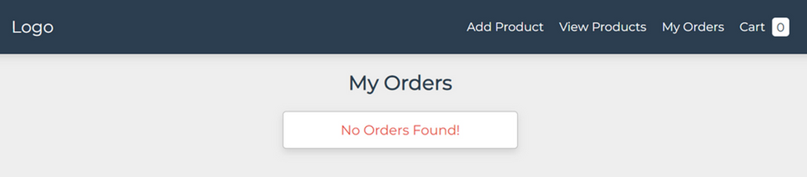
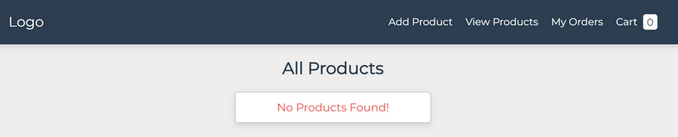
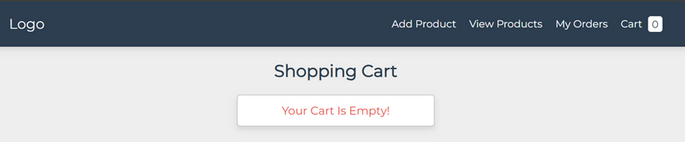
WEBPAGES
Before adding any product
•My Orders page:
No Orders Found!
•All Products page:
No Products Found!
•Shopping Cart page:
Your Cart is Empty!

Slide 8
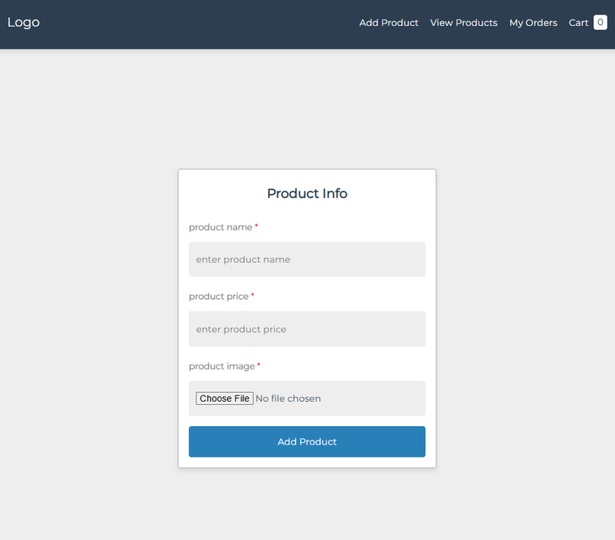
ADD PRODUCT
Information Input box
Product Name: All characters allowed
Product Price: Numeric values only
Product Image: Acceptable formats include WebP, JPEG, PNG, etc.
In order to add product:
Press the submit button

Slide 9
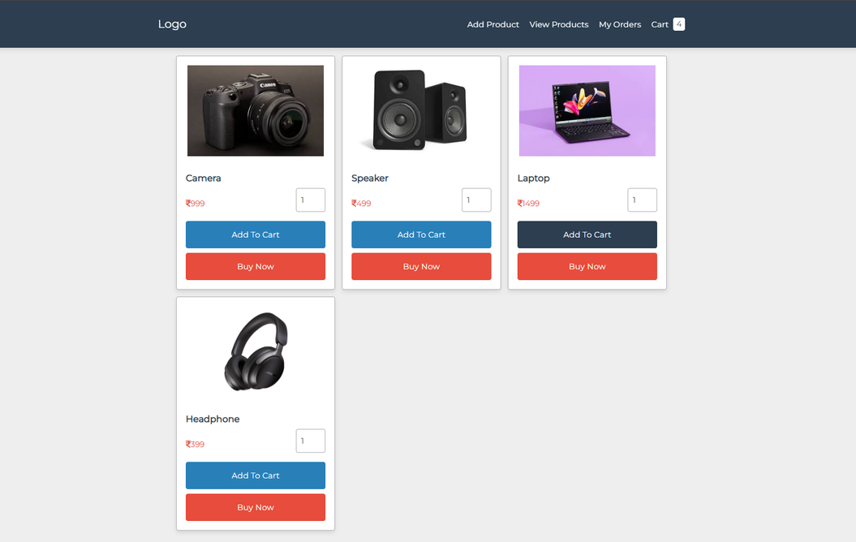
ALL PRODUCTS
After adding a product...
On the All Products page, each product is displayed in a box container:
Product Information: Image, name, and price.
Quantity Input Box: For users to specify how many they want to purchase.
Buttons:One to add the product to the cart.One to buy the product immediately.

Slide 10
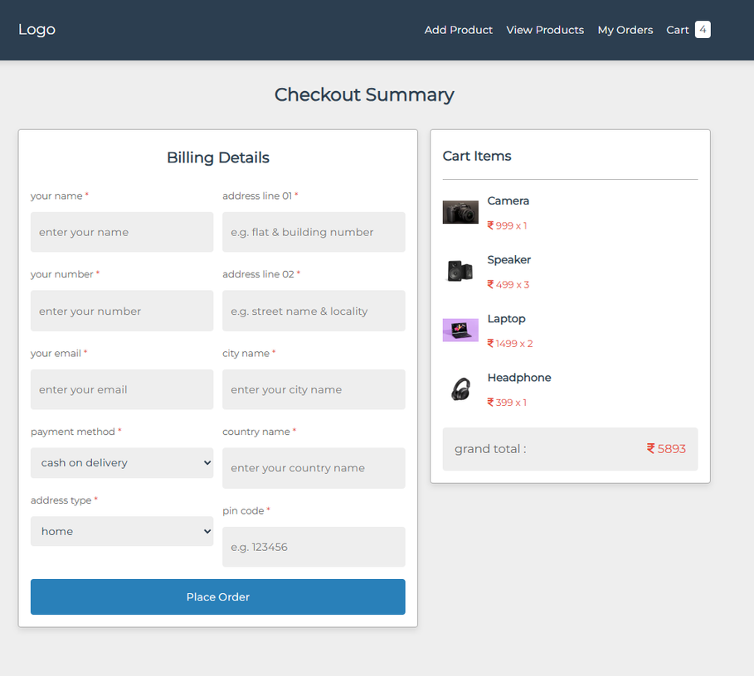
CHECKOUT
After clicking the “Buy Now” button...
The user must input and submit the following information:
Name
Phone Number
Email
Payment Method
Address Type
Address Line 1
Address Line 2
City
Country
Postal Code
(All fields are required.)
The cart items box will display:
Order Information
Grand Total

Slide 11
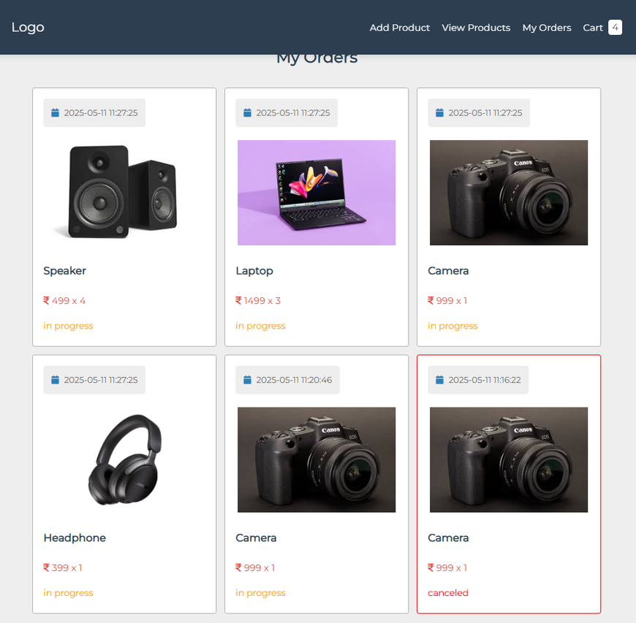
MY ORDER
After completing the billing details...
On the My Orders page, each order is displayed in a box containing:
Order Information: Product details and purchase quantity.
Date: The date the user ordered the product.
Status: The current status of the order.

Slide 12
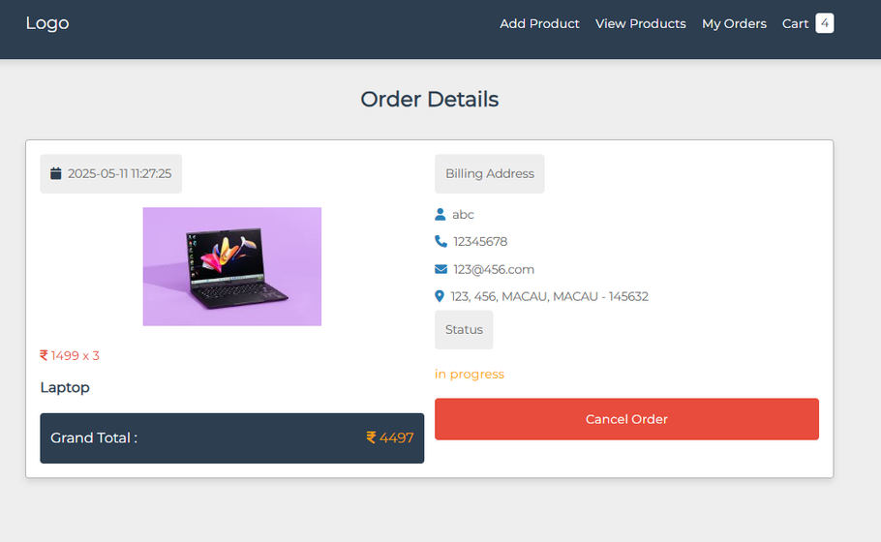
ORDER DETAILS
After clicking an order box...
The Order Details page displays:
Order Information: Product details, purchase quantity, date, and status.
Billing Address: Buyer’s name, phone number, email, and address.
Button: Option to cancel this order.

Slide 13
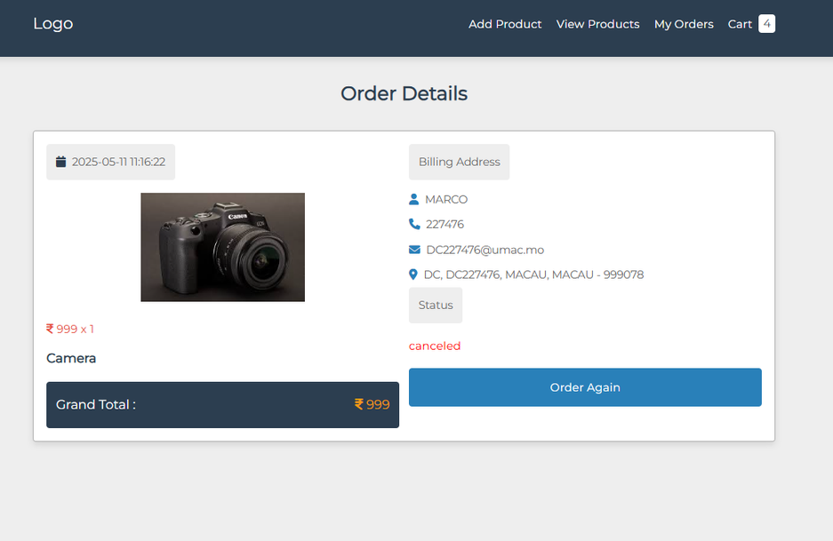
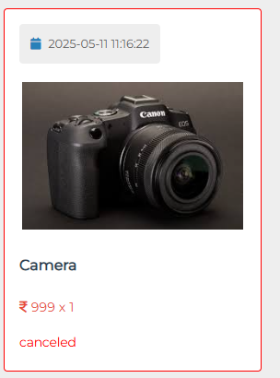
CANCEL ORDER
After clicking the “Cancel Order” button...
On the My Orders page and Order Details:
Status: Updated to Canceled.
In the Order Details:
New Button: Option to order this product aga

Slide 14
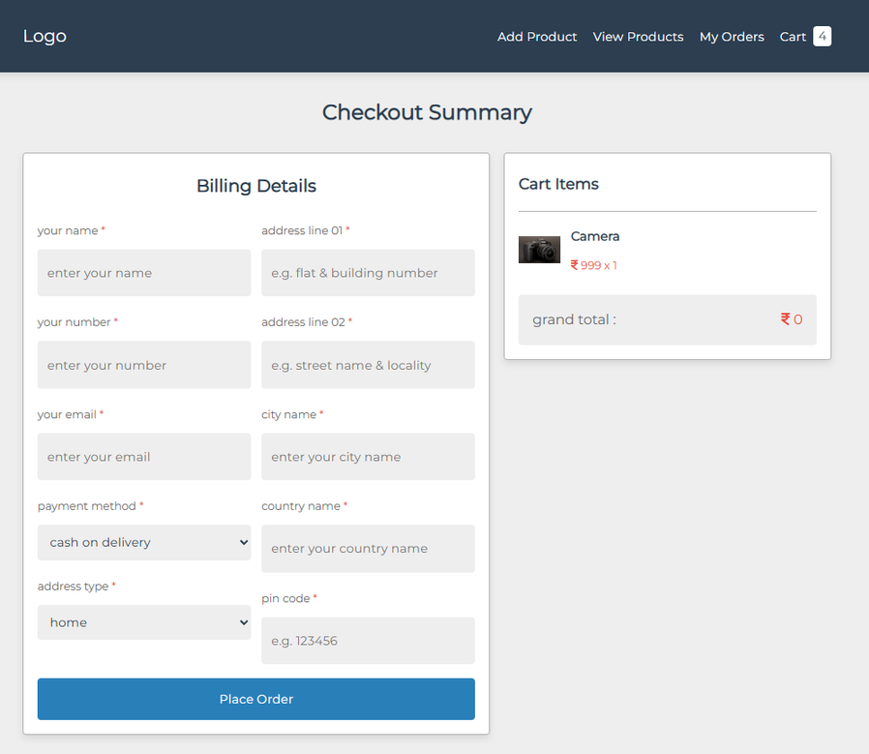
ORDER AGAIN
After clicking the “Order Again” button...
The user can reorder the product as a new order.

Slide 15
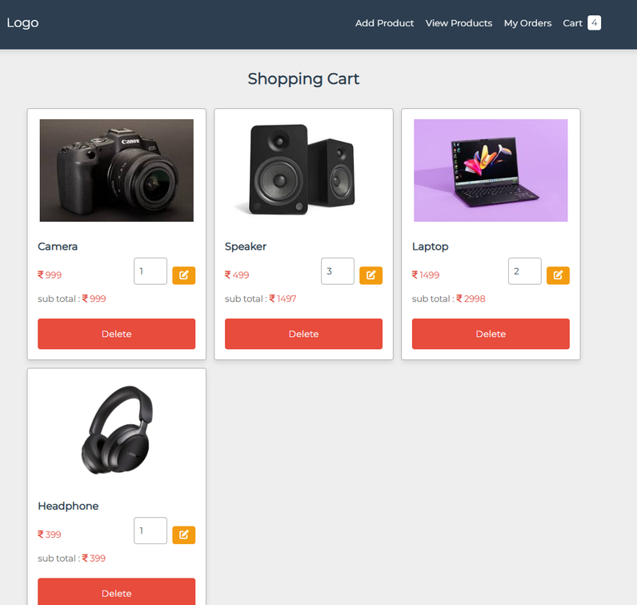
CART PAGE
After adding products to the cart...
On the Cart page, a cart box displays:
Order Information: Product details and subtotal.
Input Box: For showing or entering a quantity.
Buttons:One to delete the item from the cart.
One to submit the updated quantity.
A cart total box shows:
Grand Total
Additionally, there are two buttons:
One to empty the cart.
One to proceed to checkout.

Slide 16
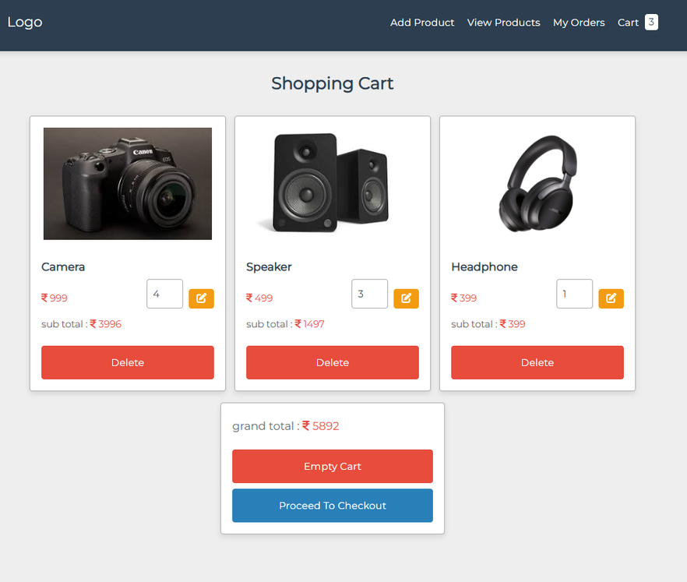
CART PAGE
After deleting the laptop and changing the amount of the camera...
On the Cart page, in the cart box:
Input Box: The quantity has been updated.
In the cart total box:
Grand Total: The total cost has been adjusted.

Slide 17
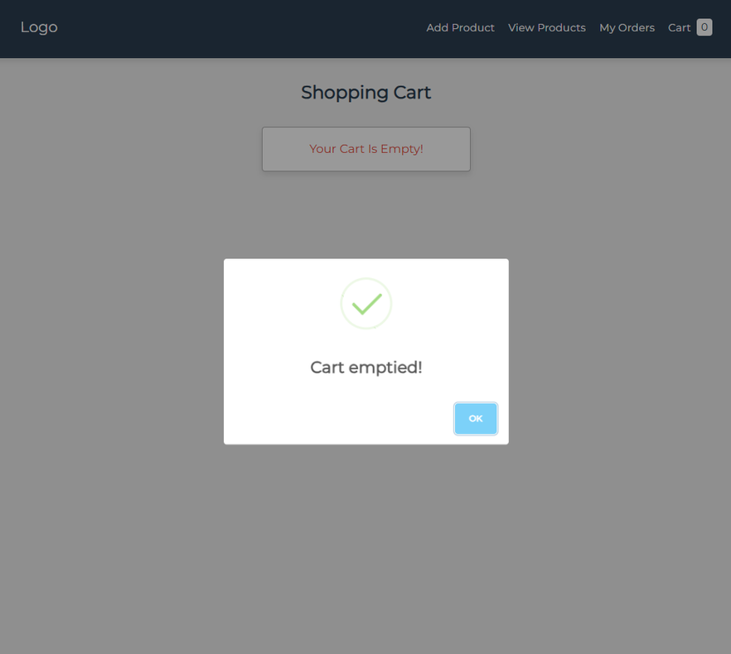
CART PAGE
After clicking the “Empty Cart” button...
On the Cart page, all items will be removed.

Slide 18
THANK YOU
CISC3003 - 2024-2025
DC227476 KUAN HOU IN

