Slide 1
26.06.10. Term Project Presentation
Generating Human-Like Mouse Cursor Trajectories from Fitts’ Law Task Data Using CVAE-GRU
Minhyeok Baek, Gyujin Gyeong
Notes:
Hello, my name is Minhyeok Baek, today I presenting Distribution Augmentation for Generative Modeling, It about data hungy, and it published ICML 2020

Slide 2


Motivation
Why Generate Mouse Cursor Trajectories?
In HCI(Human-Computer Interaction) Research -> Especially Input Devices
Cost of participant recruitment
Long experiment durations
Difficulty in repeated validation
→ Rapid prototyping and iterative experimentation become challenging.
etc...
Notes:
let’s move on to the experiment. The experiments support three main claims:
DistAug scales better than standard regularization methods
Proper transformation choices improve performance even for small models
Conditioning reduces errors and improves sample quality
DistAug에 대해서 알아보았으니, 이에 대한 검증 세션을 보도록 합시다.
experiment 에서는 다음 세 가지 주장을 뒷받침하는 증거를 제시합니다.
DistAug는 기존 정규화 기법보다 더 큰 모델에서도 안정적으로 성능을 유지한다.
적절한 transformation 선택은 작은 모델에서도 성능 향상을 이끌어낸다.
conditioning을 도입하면 오류는 감소하고 샘플 품질은 향상된다.

Slide 3
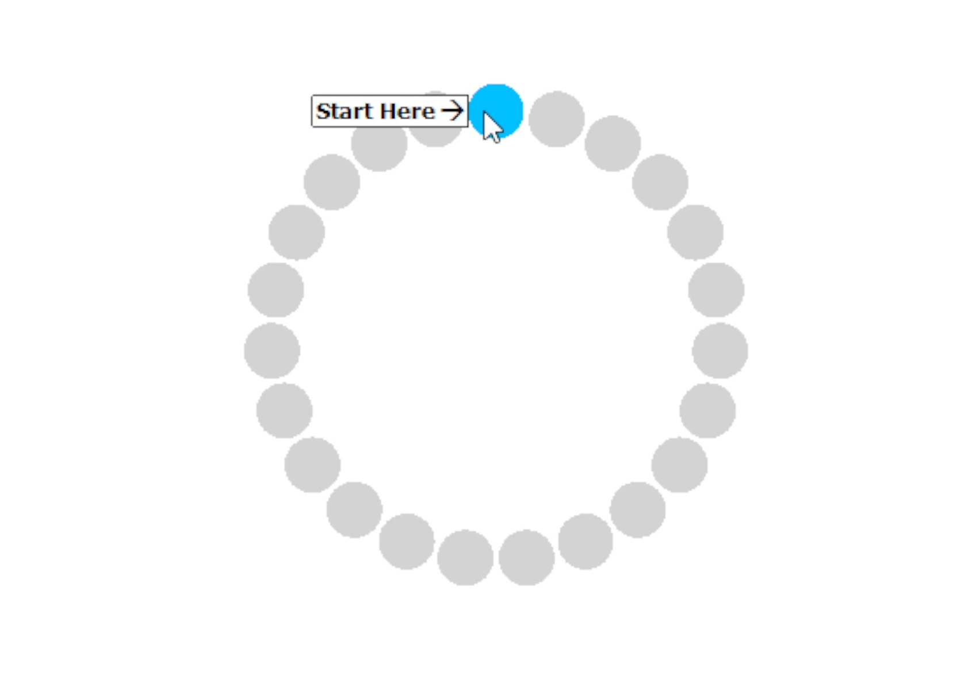
Motivation
In Mouse Research Field
ISO 9241-9 a.k.a. Fitts’ Law test
Notes:
let’s move on to the experiment. The experiments support three main claims:
DistAug scales better than standard regularization methods
Proper transformation choices improve performance even for small models
Conditioning reduces errors and improves sample quality
DistAug에 대해서 알아보았으니, 이에 대한 검증 세션을 보도록 합시다.
experiment 에서는 다음 세 가지 주장을 뒷받침하는 증거를 제시합니다.
DistAug는 기존 정규화 기법보다 더 큰 모델에서도 안정적으로 성능을 유지한다.
적절한 transformation 선택은 작은 모델에서도 성능 향상을 이끌어낸다.
conditioning을 도입하면 오류는 감소하고 샘플 품질은 향상된다.

Slide 4
Human-Like Mouse Trajectory Generation

Slide 5
Model: Conditional CVAE + GRU
Generate normalized trajectories under movement conditions
Inputs
A: movement distance
W: target width
ID: difficulty
duration
Model
Encoder: GRU
Latent z: trajectory variation
Decoder: GRU
Endpoint constrained
Output
Normalized path
start=(0,0)
target=(1,0)
remapped to screen

Slide 6
Why This Model
CVAE
Same condition has many valid human paths
Latent space captures movement variation
Supports conditional sampling
GRU Decoder
Trajectories are sequential
Generates time-ordered points
Lightweight and stable

Slide 7
Data Repair and Normalization
Issue
CSV lacked enough trial identity columns
Multiple original trajectories were merged
ID, duration, t_norm were missing
Repair
Split when point_index resets
Added segment_index
Recomputed ID, duration, t_norm
Updated GROUP_KEYS
Result: 7,525,267 rows | 43,470 segments | 41,431 usable non-error trials

Slide 8
Evaluation Setup
Original Conditions
A ∈ {300, 301, 900, 901}
W ∈ {20, 50, 120}
12 A/W combinations
Generation
temperature 0.0–0.9
20 samples per condition/temp
compare generated vs real
Metrics
path length
max deviation
peak velocity
acceleration
jerk

Slide 9
Optimization History
Model
Main Change
Outcome
Baseline
CVAE+GRU, seq64
Too smooth
Dynamic
Pointwise vel/acc loss
Dynamics still collapsed
Statistic
Acc/jerk distribution loss
Dynamics recovered
Strong late
Late correction loss
Peak velocity explosion
Late+peak
Weak late + peak control
Current best

Slide 10
Quantitative Results
Ratios are generated / real. Closer to 1.0x is better.
Model
Gap ↓
Path
Dev.
Peak
Acc.
Jerk
Dynamic
0.421
0.97x
0.79x
1.22x
0.24x
0.05x
Statistic
0.233
1.01x
0.73x
1.41x
0.72x
0.68x
Strong late
0.416
1.02x
0.97x
2.24x
0.88x
0.75x
Late+peak
0.156
1.03x
0.97x
1.18x
0.79x
0.69x
Late+peak gives the best overall balance: shape, deviation, and velocity are close to real data.

Slide 11
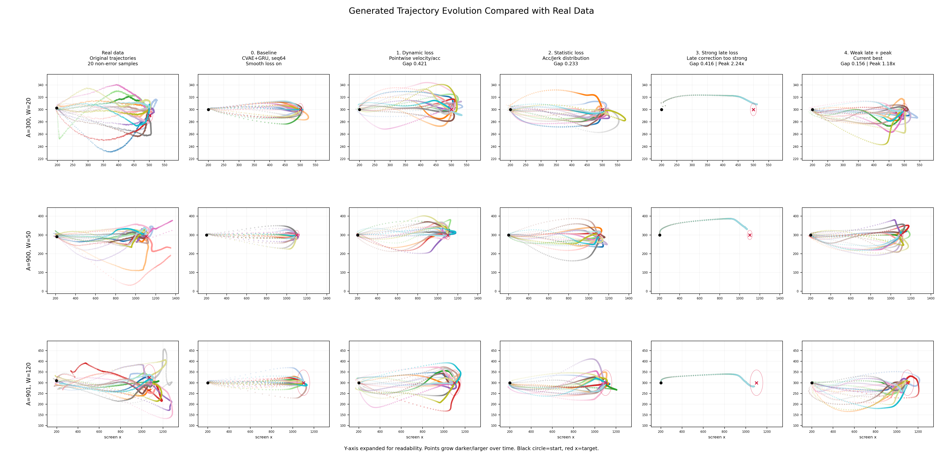
Trajectory Evolution
Real data → baseline → optimized models

Slide 12
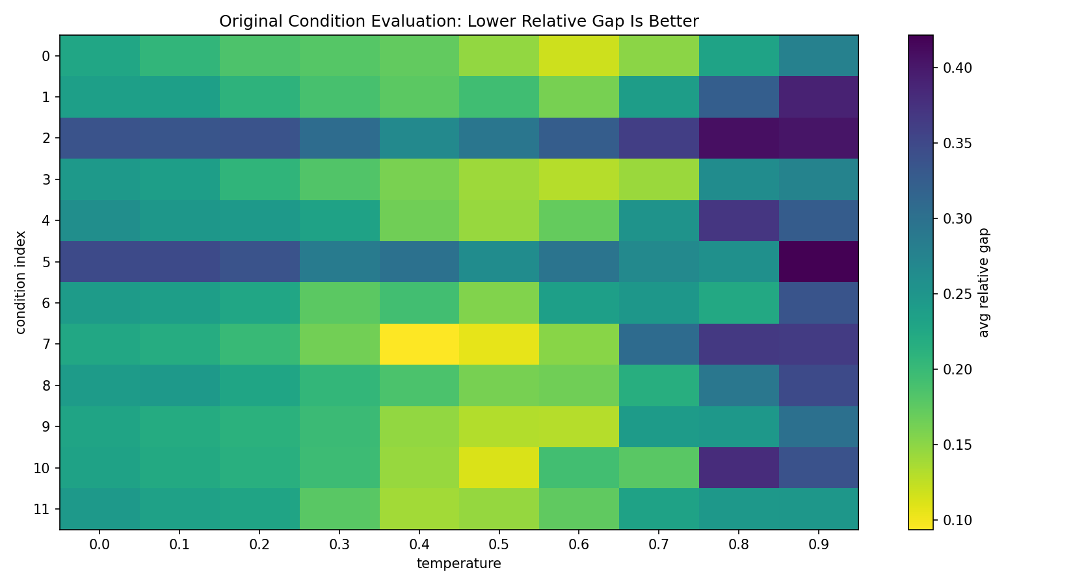
Current Best: Condition-Level Evaluation
Weak late dynamics + peak velocity control

Slide 13
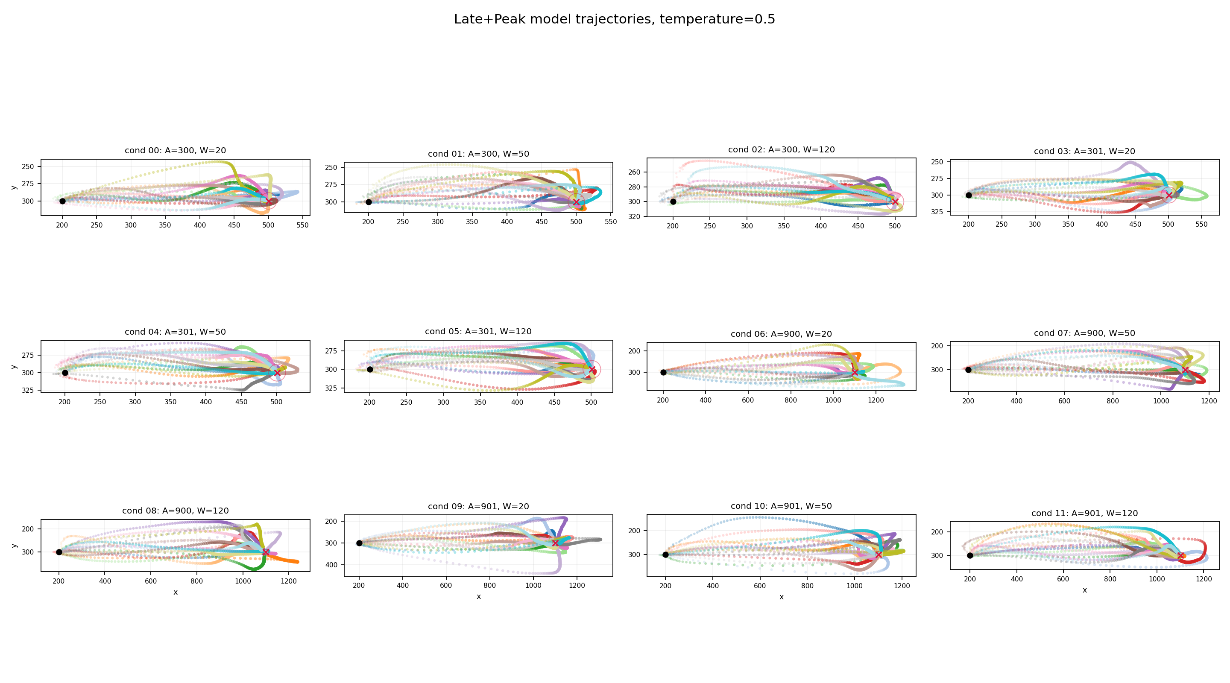
Current Best: Generated Trajectories
Temperature = 0.5, original A/W conditions

Slide 14
Similarity to Real Data
Well matched
Path length: 1.03x real
Max deviation: 0.97x real
Peak velocity: 1.18x real
Condition-dependent shapes
Remaining gaps
Acceleration: 0.79x real
Jerk: 0.69x real
Weakest: short distance + wide target
Some loop-like samples remain

Slide 15
Key Insights
Position loss alone is not enough for human-like trajectories
Pointwise dynamic losses can average out micro-adjustments
Distribution-level acceleration and jerk losses are more effective
Late correction must be weak and paired with peak velocity control
Current best balances trajectory shape and dynamics

Slide 16
Applications and Expected Impact
Applications
Human-like cursor simulation
HCI pointing task modeling
Synthetic trajectory generation
Adaptive UI / accessibility
Expected Impact
Fewer real trials needed
Condition-aware movement synthesis
Richer interaction simulation
Better evaluation of target designs

