Slide 1
Database File Table Specification
Admins Table
Purpose: Stores overarching administrator credentials with full system access.
Column Name | Data Type | Constraints | Description
id | INT | PRIMARY KEY, AUTO_INCREMENT | Unique identifier for admin records
username | VARCHAR(50) | NOT NULL | Administrator login alias
password | VARCHAR(255) | NOT NULL | Encrypted/Secure login password
email | VARCHAR(100) | None | Administrator contact email
created_at | TIMESTAMP | DEFAULT CURRENT_TIMESTAMP | Timestamp of record generation
Users Table
Purpose: Holds the registered details of clients seeking technical assistance.
Column Name | Data Type | Constraints | Description
id | INT | PRIMARY KEY, AUTO_INCREMENT | Client unique identifier
username | VARCHAR(50) | NOT NULL | Client display/login name
password | VARCHAR(255) | NOT NULL | Client secure password
email | VARCHAR(100) | None | Client registered email address
contact | VARCHAR(20) | None | Client mobile phone number
model/company | VARCHAR(100) | None | Device model and brand details

Slide 2
Database File Table Specification (Cont.)
Providers Table
Purpose: Registers service technicians along with their business identifiers and skills.
Column Name | Data Type | Constraints | Description
id | INT | PRIMARY KEY, AUTO_INCREMENT | Technician unique ID
username/password | VARCHAR | NOT NULL | Technician login credentials
email/contact | VARCHAR | None | Technician contact pathways
shop_reg_num | VARCHAR(100) | None | Verified business registration number
service_type | VARCHAR(50) | None | Core category (e.g., Hardware, Software)
short_info | TEXT | None | Brief professional bio or skill summary
Requests Table
Purpose: Manages workflow tickets linking Users to Providers.
Column Name | Data Type | Constraints | Description
id | INT | PRIMARY KEY, AUTO_INCREMENT | Unique service ticket ID
user_id | INT | FOREIGN KEY (users) | Referential link to the requesting client
provider_id | INT | FOREIGN KEY (providers) | Referential link to assigned technician
details | TEXT | None | Specific breakdown of the issue
status | ENUM | DEFAULT 'Pending' | Progress state (Pending, Completed, etc.)

Slide 3
Module Specification
1. User Interface (Client Portal)
[Service Request Module]
Acting as the primary entry point for individuals seeking technical solutions, this module allows registered users to outline their specific issues. They can input device demographics like model and company, review available technicians, initiate a direct service request, and actively monitor the live 'status' of their pending queries.
2. Provider Dashboard
[Technician Workflow Module]
Serves as the dedicated workspace for registered technicians (Providers). It allows them to showcase their professional competencies, service types, and external portfolios. Critically, it acts as an incoming queue where they can selectively review, accept, or reject incoming hardware/software service tickets dispatched by users.
3. Administrative Control Panel
[System Oversight Module]
Designed for overarching platform governors, this segment permits absolute visibility across all transactions. Administrators have the authoritative capacity to manage foundational data layers, oversee user-to-provider interactions, review system-wide contact queries, and enforce cascading database referential integrity checks.

Slide 4
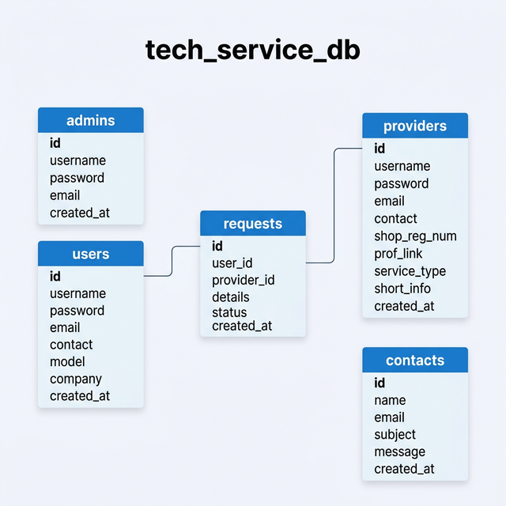
Entity-Relationship (ER) Diagram

