Slide 1
1ST PRESENTATION: BASICS AND RELATED WORK
Group C9

Slide 2
Main problems/tasks

Slide 3
Overview scientific papers
SaRNet: A Dataset for Deep Learning Assisted Search and Rescue with Satellite Imagery - https://arxiv.org/abs/2107.12469
Exploring similar dataset and its usage
Small Target Detection for Search and Rescue Operations using Distributed Deep Learning and Synthetic Data Generation - https://arxiv.org/pdf/1904.11619.pdf
“We combined image segmentation, enhancement, and convolution neural networks to reduce detection time to detect small targets. We compared the performance between the auto-detection system and the human eye. Our system detected the target within 8 seconds, but the human eye detected the target within 25 seconds. Our systems also used synthetic data generation and data augmentation techniques to improve target detection accuracy”
Automatic Person Detection in Search and Rescue Operations Using Deep CNN Detectors - https://ieeexplore.ieee.org/document/9369386/algorithms
In this paper, the reliability of existing state-of-the-art detectors such as Faster R-CNN, YOLOv4, RetinaNet, and Cascade R-CNN on a VisDrone benchmark and custom-made dataset SARD build to simulate rescue scenes was investigated. After training the models on selected datasets, detection results were compared. Because of the high speed and accuracy and the small number of false detections, the YOLOv4 detector was chosen for further examination. […] YOLOv4 has achieved the best detection performances
Deep Reinforcement Learning for Autonomous Search and Rescue - https://ieeexplore.ieee.org/document/8556642
The prototype successfully demonstrated the feasibility of using an artificial intelligence to direct unmanned aerial vehicles to search. […] However, given the real-time, real-physics nature of a single simulated run, training time simply takes too long, inhibiting the success rate of the intelligent system

Slide 4
Overview scientific papers
Search and Rescue with Airborne Optical Sectioning - https://arxiv.org/abs/2009.08835
We show that automated person detection under occlusion conditions can be significantly improved by combining multiperspective images before classification. Here, we employed image integration by Airborne Optical Sectioning (AOS)—a synthetic aperture imaging technique that uses camera drones to capture unstructured thermal light fields—to achieve this with a precision/recall of 96/93%. Finding lost or injured people in dense forests is not generally feasible with thermal recordings, but becomes practical with use of AOS integral images.

Slide 5
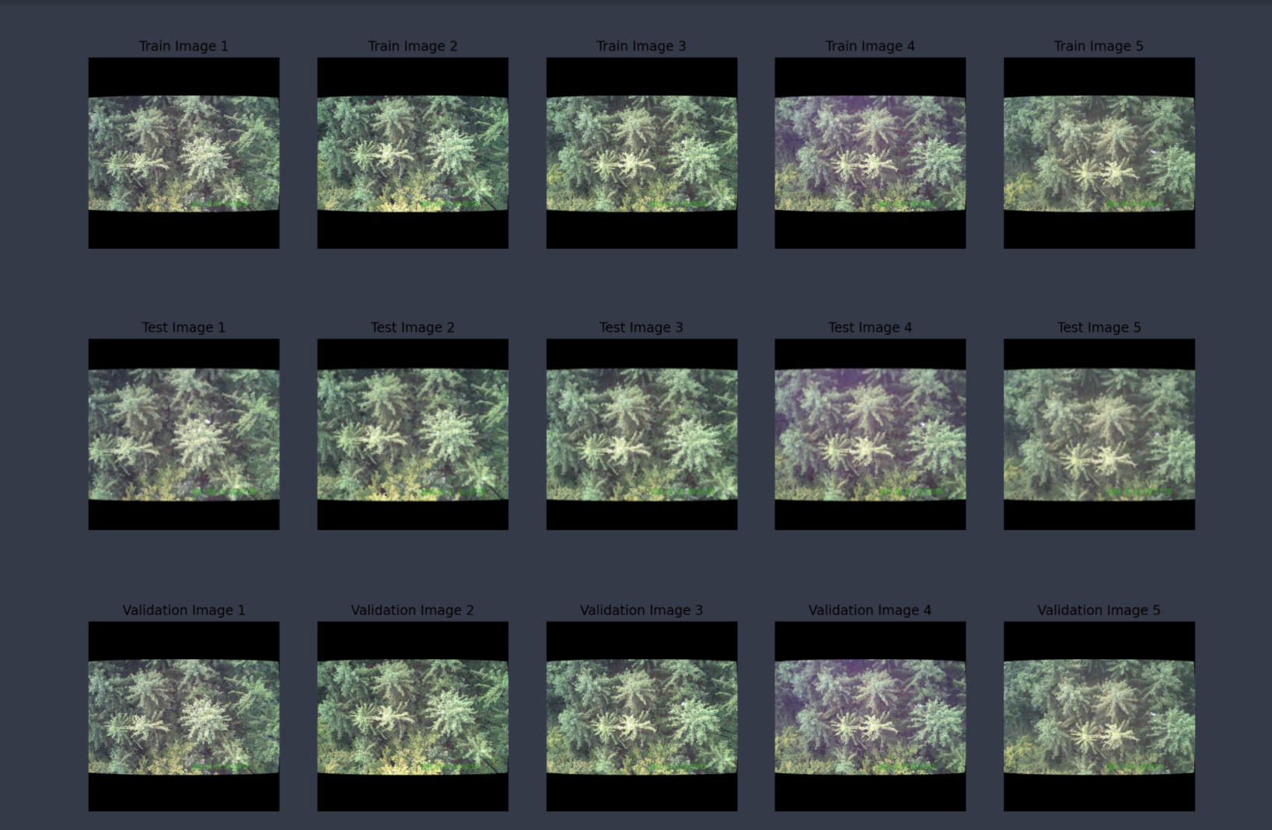
Data
Basic exploration

