Slide 1
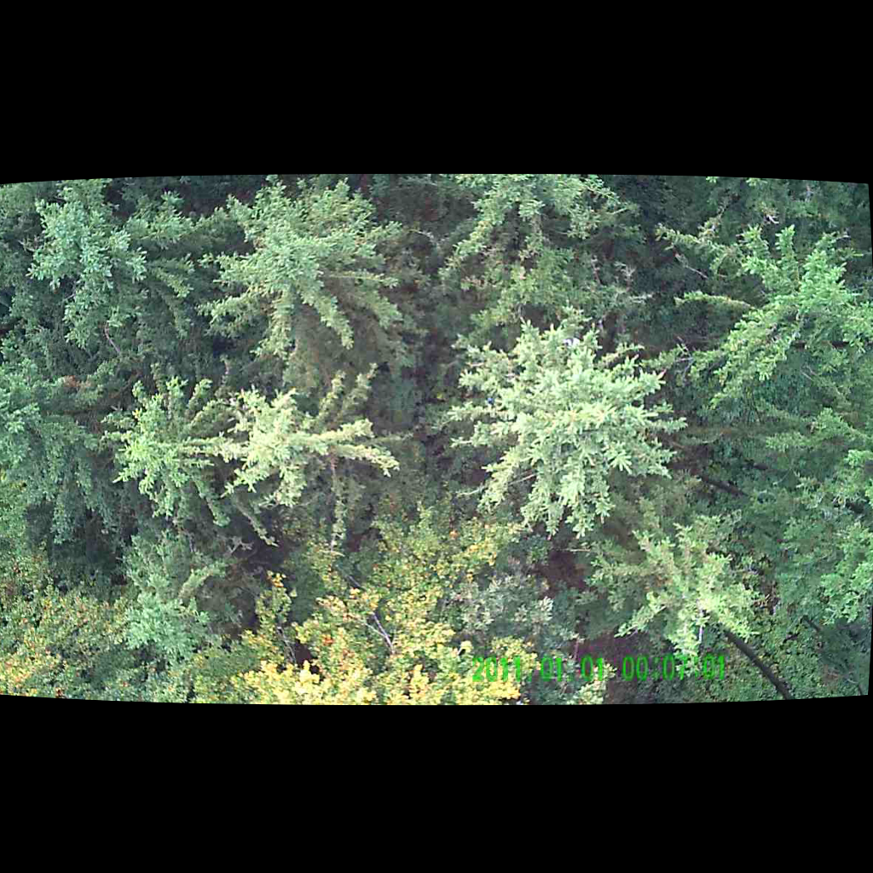
UNSUPERVISED PERSON LOCALIZATION IN WISAR Project Basics and Related Work
Team C9
Nikolas Boldis Daniel Deutsch Lisa Schneckenreiter Uta Wagner
UE Computer Vision
24th November, 2021

Slide 2
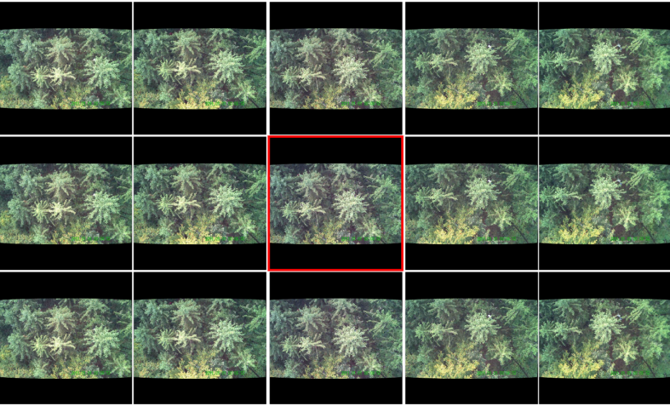
Challenges
parallel
sequential
Integration of images from sequential and parallel sampling
Schedl, D. C., Kurmi, I. & Bimber, O. Search and rescue with airborne optical sectioning. Nat Mach Intell 2, 783–790 (2020).
automated person detection in thermal images under occlusion conditions can be significantly improved by combining multiperspective images before classification
Nathan, R. J. A. A., Kurmi, I., Schedl, D. C. & Bimber, O. Through-Foliage Tracking with Airborne Optical Sectioning. arXiv:2111.06959 [cs] (2021).
colour anomaly detection in RGB images benefits significantly from integration of parallel images from a 1D camera array when compared to conventional single images
Possible solutions:
integrate over all 70 images
integrate over parallel images and compare results between time steps
UE Computer Vision, 24th November, 2021

Slide 3
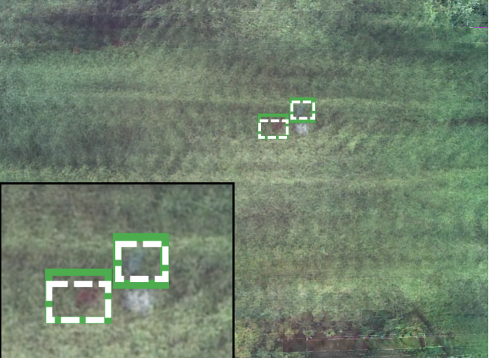
Challenges
Anomaly detection
pixel-to-pixel comparison using CV libraries
Normality-Calibrated Autoencoder (NCAE)
Deep CNN Detectors
Deep Reinforcement Learning
Generative Adversial Networks (GAN)
YOLO
...
UE Computer Vision, 24th November, 2021
UE Computer Vision, 24th November, 2021

Slide 4
Overview Anomaly Detection
Salehi, M. et al. A Unified Survey on Anomaly, Novelty, Open-Set, and Out-of-Distribution Detection: Solutions and Future Challenges. arXiv:2110.14051 [cs] (2021).
To date, several research domains tackle the problem of detecting unfamiliar samples, including anomaly detection, novelty detection, one-class learning, open set recognition, and out-of-distribution detection.
Outlier or novelty detection? Our challenge illustrates a great example for anomaly detection, as our data has mixed outliers within. (training data = polluted with outliers)
Adopting an appropriate distance metric is necessary
For instance, deviation could be computed in a raw pixel-level input or in a semantic space that is learned through a deep neural network
Last challenge is choosing the threshold to determine whether the deviation from normal samples is significant.
UE Computer Vision, 24th November, 2021

Slide 5
Normality-Calibrated Autoencoder (NCAE)
Yu, J., Oh, H., Kim, M. & Kim, J. Normality-Calibrated Autoencoder for Unsupervised Anomaly Detection on Data Contamination. arXiv:2110.14825 [cs] (2021).
In this paper a Normality-Calibrated Autoencoder (NCAE) was proposed, which can boost anomaly detection performance on the contaminated datasets without any prior information or explicit abnormal samples in the training phase.
The NCAE adversarially generates high confident normal samples from a latent space having low entropy and leverages them to predict abnormal samples in a training dataset
UE Computer Vision, 24th November, 2021

Slide 6
Deep Learning Methods for Search and Rescue
Thoreau, M. & Wilson, F. SaRNet: A Dataset for Deep Learning Assisted Search and Rescue with Satellite Imagery. arXiv:2107.12469 [cs, eess] (2021).
Exploring similar dataset and its usage
Yun, K. et al. Small Target Detection for Search and Rescue Operations using Distributed Deep Learning and Synthetic Data Generation. arXiv:1904.11619 [cs] (2019).
“We combined image segmentation, enhancement, and convolution neural networks to reduce detection time to detect small targets. We compared the performance between the auto-detection system and the human eye. Our system detected the target within 8 seconds, but the human eye detected the target within 25 seconds. Our systems also used synthetic data generation and data augmentation techniques to improve target detection accuracy”
UE Computer Vision, 24th November, 2021

Slide 7
Deep Learning Methods for Search and Rescue
Sambolek, S. & Ivasic-Kos, M. Automatic Person Detection in Search and Rescue Operations Using Deep CNN Detectors. IEEE Access 9, 37905–37922 (2021).
In this paper, the reliability of existing state-of-the-art detectors such as Faster R-CNN, YOLOv4, RetinaNet, and Cascade R-CNN on a VisDrone benchmark and custom-made dataset SARD build to simulate rescue scenes was investigated. After training the models on selected datasets, detection results were compared. Because of the high speed and accuracy and the small number of false detections, the YOLOv4 detector was chosen for further examination. […] YOLOv4 has achieved the best detection performances
Zuluaga, J. G. C., Leidig, J. P., Trefftz, C. & Wolffe, G. Deep Reinforcement Learning for Autonomous Search and Rescue. in NAECON 2018 - IEEE National Aerospace and Electronics Conference 521–524 (IEEE, 2018). doi:10.1109/NAECON.2018.8556642.
The prototype successfully demonstrated the feasibility of using an artificial intelligence to direct unmanned aerial vehicles to search. […] However, given the real-time, real-physics nature of a single simulated run, training time simply takes too long, inhibiting the success rate of the intelligent system
UE Computer Vision, 24th November, 2021

Slide 8
Generative Adversarial Networks (GAN)
GAN
is a class of machine learning frameworks
Idea is based on the "indirect" training through the discriminator, which itself is also being updated dynamically.
Benefit:
Generation of functions that result in robustness for object recognition in images with reduced quality
UE Computer Vision, 24th November, 2021

Slide 9
Generative Adversarial Networks (GAN)
Prakash, C. D. & Karam, L. J. It GAN DO Better: GAN-based Detection of Objects on Images with Varying Quality. arXiv:1912.01707 [cs] (2019).
Research object:
Effect of the number of newly trained parameters in the GAN-DO generator on the accuracy of the finally trained parameter
Used GAN framework to train object recognition models to get robust object recognition on images with reduced quality
Result:
GAN-DO Framework leads to robust object recognition
improves the accuracy and robustness of the selected base model
UE Computer Vision, 24th November, 2021
UE Computer Vision, 24th November, 2021

Slide 10
Generative Adversarial Networks (GAN)
Rabbi, J., Ray, N., Schubert, M., Chowdhury, S. & Chao, D. Small-Object Detection in Remote Sensing Images with End-to-End Edge-Enhanced GAN and Object Detector Network. arXiv:2003.09085 [cs] (2020).
Problem:
small objects difficult to see on remote sensing images (low quality)
Method:
Use of an ESRGAN showed remarkable image enhancement performance
Use of Super-Resolution (SR) techniques to further improve recognition (based on Deep Convolution Neural Network and generates artificial images)
End-to-end SR detector network improves detection accuracy compared to several other methods.
UE Computer Vision, 24th November, 2021

Slide 11
UAV-YOLO
Liu, M. et al. UAV-YOLO: Small Object Detection on Unmanned Aerial Vehicle Perspective. Sensors 20, 2238 (2020).
Object detection, as a fundamental task in computer vision, has been developed enormously, but is still challenging work, especially for Unmanned Aerial Vehicle (UAV) perspective due to small scale of the target.
In this study, the authors develop a special detection method for small objects in UAV perspective. Based on YOLOv3, the Resblock in darknet is first optimized by concatenating two ResNet units that have the same width and height. Then, the entire darknet structure is improved by increasing convolution operation at an early layer to enrich spatial information. Both these two optimizations can enlarge the receptive filed.
Furthermore, UAV-viewed dataset is collected to UAV perspective or small object detection. An optimized training method is also proposed based on collected UAV-viewed dataset. The experimental results on public dataset and our collected UAV-viewed dataset show distinct performance improvement on small object detection with keeping the same level performance on normal dataset, which means our proposed method adapts to different kinds of conditions.
UE Computer Vision, 24th November, 2021
UE Computer Vision, 24th November, 2021

Slide 12
THANK YOU FOR YOUR ATTENTION!

