Slide 1
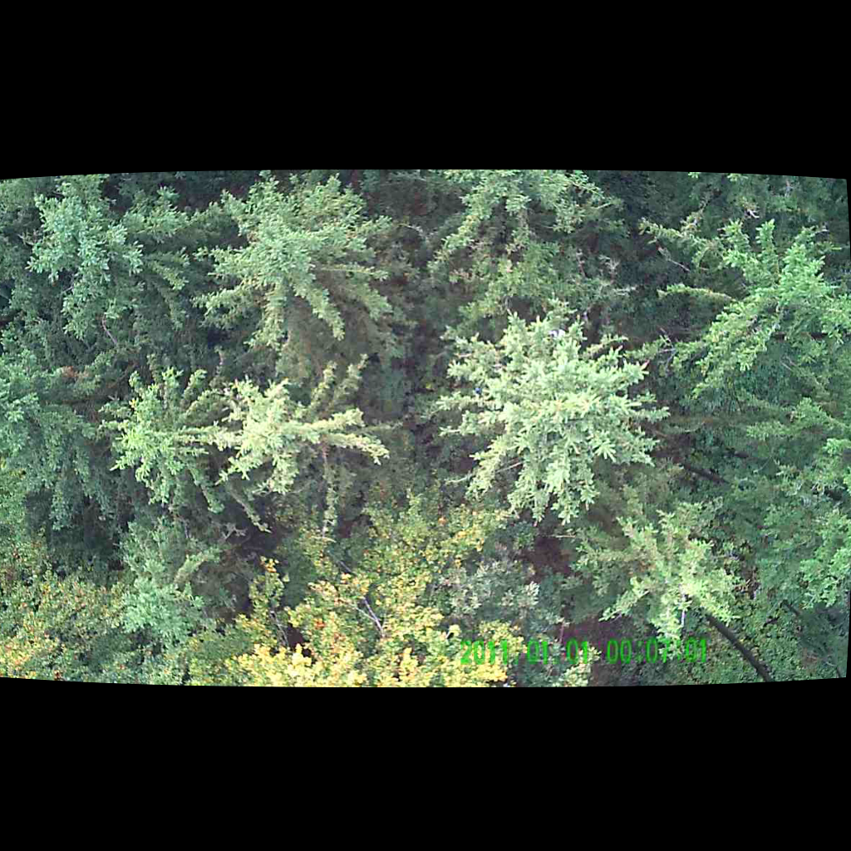
UNSUPERVISED PERSON LOCALIZATION IN WISAR Intermediate Results
Team C9
Nikolas Boldis Daniel Deutsch Lisa Schneckenreiter Uta Wagner
UE Computer Vision
12th January, 2022

Slide 2
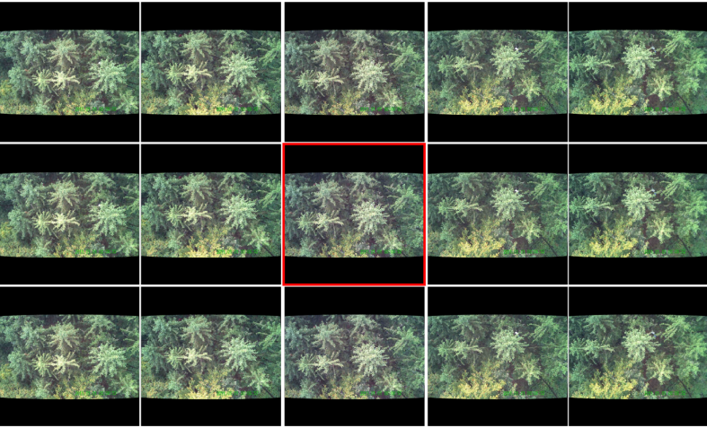
Creating new directory for integrated images
parallel
sequential
Integration of images from sequential and parallel sampling
Schedl, D. C., Kurmi, I. & Bimber, O. Search and rescue with airborne optical sectioning. Nat Mach Intell 2, 783–790 (2020).
automated person detection in thermal images under occlusion conditions can be significantly improved by combining multiperspective images before classification
Nathan, R. J. A. A., Kurmi, I., Schedl, D. C. & Bimber, O. Through-Foliage Tracking with Airborne Optical Sectioning. arXiv:2111.06959 [cs] (2021).
colour anomaly detection in RGB images benefits significantly from integration of parallel images from a 1D camera array when compared to conventional single images
Possible solutions:
integrate over all 70 images
integrate over parallel images and compare results between time steps
UE Computer Vision, 24th November, 2021

Slide 3
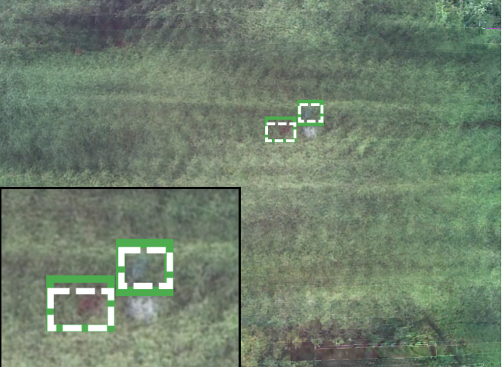
TODO
todo
UE Computer Vision, 24th November, 2021
UE Computer Vision, 24th November, 2021

Slide 4
TODO
Todo
UE Computer Vision, 24th November, 2021

Slide 5
THANK YOU FOR YOUR ATTENTION!

