Slide 1
UNSUPERVISED PERSON LOCALIZATION IN WISAR
1ST PRESENTATION: BASICS AND RELATED WORK - Group C9

Slide 2
Main problems/tasks
How to incorporate temporal images
Simply warping them again sufficient?
What type of problem do we try to solve?
Anomaly detection, Novelty detection, One-Class Classification, Out-of-Distribution detection, and Open-Set Recognition
What type of algorithm to use for anomaly detection
Plain CV libraries with simple pixel-to-pixel comparisons → fast but inefficient?
Sophisticated Deep Learning models → good but not executable in real-life application on drone?
What algorithm is most suitable to be implemented with the given time and limitions?

Slide 3
Overview scientific papers
A Unified Survey on Anomaly, Novelty, Open-Set, and Out-of-Distribution Detection: Solutions and Future Challenges - https://arxiv.org/pdf/2110.14051.pdf
To date, several research domains tackle the problem of detecting unfamiliar samples, including anomaly detection, novelty detection, one-class learning, open set recognition, and out-of-distribution detection.
Outlier or novelty detection? Our challenge illustrates a great example for anomaly detection, as our data has mixed outliers within. (training data = polluted with outliers)
Adopting an appropriate distance metric is necessary
For instance, deviation could be computed in a raw pixel-level input or in a semantic space that is learned through a deep neural network
Last challenge is choosing the threshold to determine whether the deviation from normal samples is significant.

Slide 4
Overview scientific papers
Search and Rescue with Airborne Optical Sectioning - https://arxiv.org/abs/2009.08835
We show that automated person detection under occlusion conditions can be significantly improved by combining multiperspective images before classification
Here, we employed image integration by Airborne Optical Sectioning (AOS)—a synthetic aperture imaging technique that uses camera drones to capture unstructured thermal light fields—to achieve this with a precision/recall of 96/93%.
Through-Foliage Tracking with Airborne Optical Sectioning, Remote Sensing of Environment -https://arxiv.org/abs/2111.06959
It was shown that color anomaly detection benefits significantly from AOS integral images when compared to conventional single images (on average 97% vs. 42% in precision). Color anomaly detection is often used for automatized aerial image analysis in search and rescue applications.

Slide 5
Overview scientific papers
Normality-Calibrated Autoencoder for Unsupervised Anomaly Detection on Data Contamination -https://arxiv.org/abs/2110.14825v1
In this paper a Normality-Calibrated Autoencoder (NCAE) was proposed, which can boost anomaly detection performance on the contaminated datasets without any prior information or explicit abnormal samples in the training phase.
The NCAE adversarially generates high confident normal samples from a latent space having low entropy and leverages them to predict abnormal samples in a training dataset

Slide 6
Overview scientific papers
SaRNet: A Dataset for Deep Learning Assisted Search and Rescue with Satellite Imagery - https://arxiv.org/abs/2107.12469
Exploring similar dataset and its usage
Small Target Detection for Search and Rescue Operations using Distributed Deep Learning and Synthetic Data Generation - https://arxiv.org/pdf/1904.11619.pdf
“We combined image segmentation, enhancement, and convolution neural networks to reduce detection time to detect small targets. We compared the performance between the auto-detection system and the human eye. Our system detected the target within 8 seconds, but the human eye detected the target within 25 seconds. Our systems also used synthetic data generation and data augmentation techniques to improve target detection accuracy”
Automatic Person Detection in Search and Rescue Operations Using Deep CNN Detectors - https://ieeexplore.ieee.org/document/9369386/algorithms
In this paper, the reliability of existing state-of-the-art detectors such as Faster R-CNN, YOLOv4, RetinaNet, and Cascade R-CNN on a VisDrone benchmark and custom-made dataset SARD build to simulate rescue scenes was investigated. After training the models on selected datasets, detection results were compared. Because of the high speed and accuracy and the small number of false detections, the YOLOv4 detector was chosen for further examination. […] YOLOv4 has achieved the best detection performances
Deep Reinforcement Learning for Autonomous Search and Rescue - https://ieeexplore.ieee.org/document/8556642
The prototype successfully demonstrated the feasibility of using an artificial intelligence to direct unmanned aerial vehicles to search. […] However, given the real-time, real-physics nature of a single simulated run, training time simply takes too long, inhibiting the success rate of the intelligent system

Slide 7
Overview scientific papers
Another technique GAN (Generative Adversarial Networks)
GAN
is a class of machine learning frameworks
Idea is based on the "indirect" training through the discriminator, which itself is also being updated dynamically.
Benefit:
Generation of functions that result in robustness for object recognition in images with reduced quality

Slide 8
Overview scientific papers
It GAN DO Better: GAN-based Detection of Objects on Images with Varying Quality https://arxiv.org/pdf/1912.01707.pdf
Research object :
Effect of the number of newly trained parameters in the GAN-DO generator on the accuracy of the finally trained parameter
Used GAN framework to train object recognition models to get robust object recognition on images with reduced quality
Result:
GAN-DO Framework leads to robust object recognition
improves the accuracy and robustness of the selected base model

Slide 9
Overview scientific papers
Small-Object Detection in Remote Sensing Images with End-to-End Edge-Enhanced GAN and Object Detector Network - https://arxiv.org/pdf/2003.09085v5.pdf
Problem:
small objects difficult to see on remote sensing images (low quality)
Methode :
Use of an ESRGAN showed remarkable image enhancement performance
Use of Super-Resolution (SR) techniques to further improve recognition (based on Deep Convolution Neural Network and generates artificial images)
End-to-end SR detector network improves detection accuracy compared to several other methods.

Slide 10
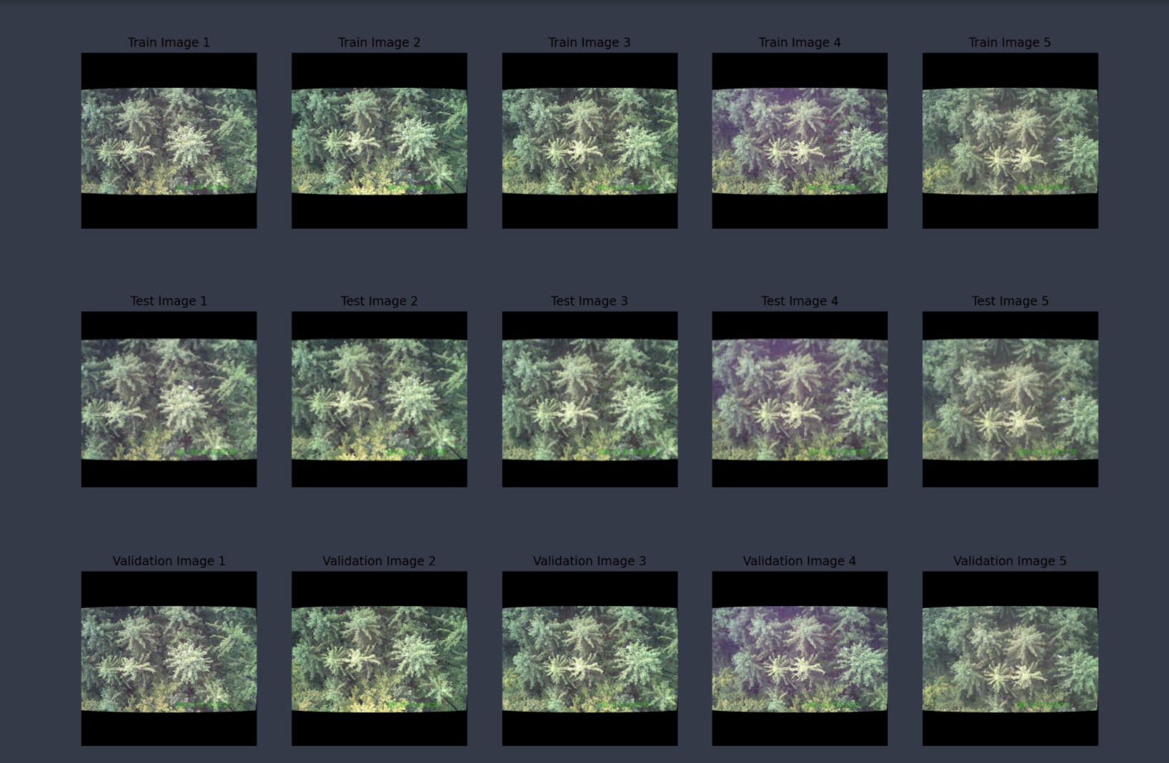
Data
Basic exploration

