Slide 1
ACTIVITY DIAGRAM

Slide 2
What is Activity Diagram?
Activity diagram is another important behavioral diagram in UML diagram to describe dynamic aspects of the system. Activity diagram is essentially an advanced version of flow chart that modeling the flow from one activity to another activity.
Activity diagrams are often used in business process modeling. They can also describe the steps in a use case diagram. Activities modeled can be sequential and concurrent. In both cases an activity diagram will have a beginning (an initial state) and an end (a final state).

Slide 3
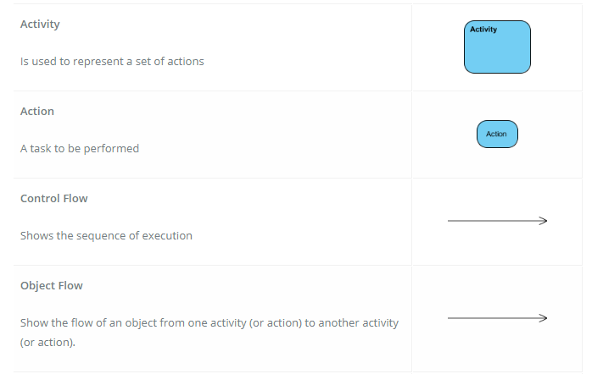
Activity Diagram Notation Summary

Slide 4
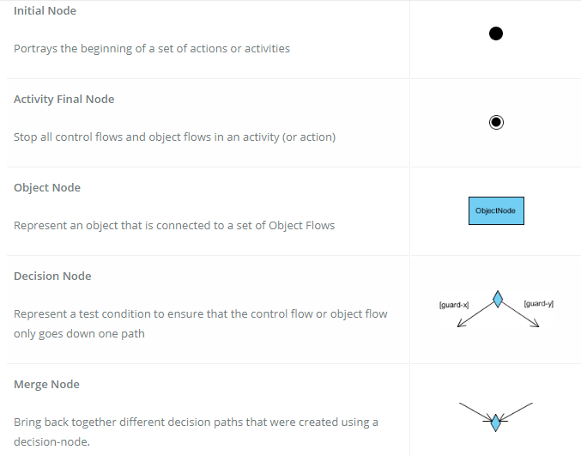

Slide 5
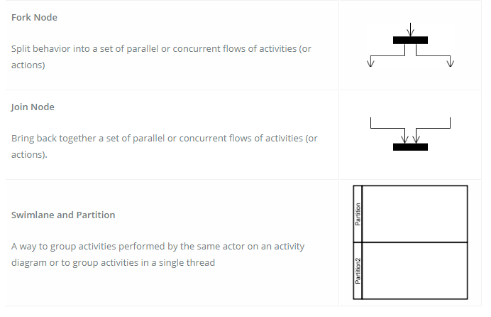

Slide 6
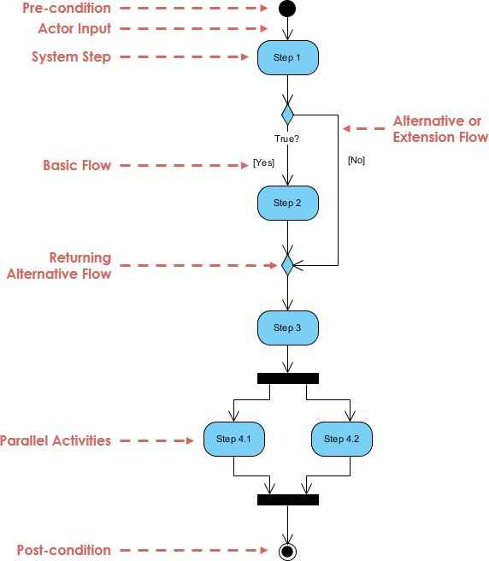

Slide 7
Activity Diagram - Modeling a Word Processor
The activity diagram example below describes the workflow for a word process to create a document through the following steps:
Open the word processing package.
Create a file.
Save the file under a unique name within its directory.
Type the document.
If graphics are necessary, open the graphics package, create the graphics, and paste the graphics into the document.
If a spreadsheet is necessary, open the spreadsheet package, create the spreadsheet, and paste the spreadsheet into the document.
Save the file.
Print a hard copy of the document.
Exit the word processing package.

Slide 8
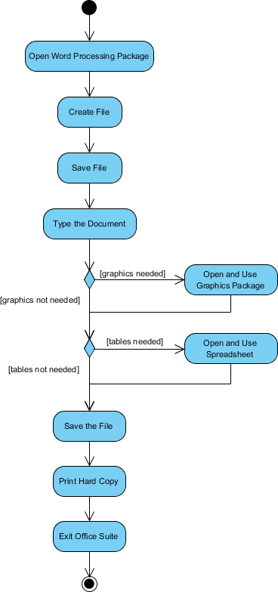

Slide 9
Activity Diagram Example - Process Order
Process Order - Problem Description
Once the order is received, the activities split into two parallel sets of activities. One side fills and sends the order while the other handles the billing.
On the Fill Order side, the method of delivery is decided conditionally. Depending on the condition either the Overnight Delivery activity or the Regular Delivery activity is performed.
Finally the parallel activities combine to close the order.

Slide 10
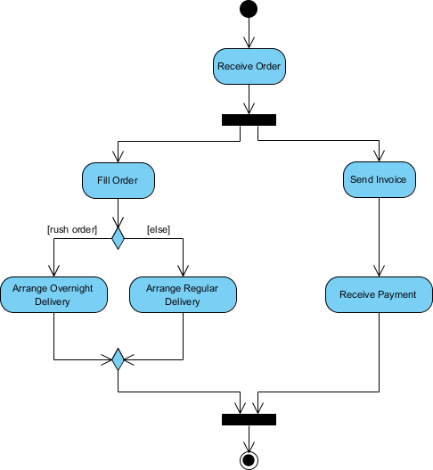

Slide 11
Activity Diagram Example - Student Enrollment
This UML activity diagram example describes a process for student enrollment in a university as follows:
An applicant wants to enroll in the university.
The applicant hands a filled out copy of Enrollment Form.
The registrar inspects the forms.
The registrar determines that the forms have been filled out properly.
The registrar informs student to attend in university overview presentation.
The registrar helps the student to enroll in seminars
The registrar asks the student to pay for the initial tuition.

Slide 12
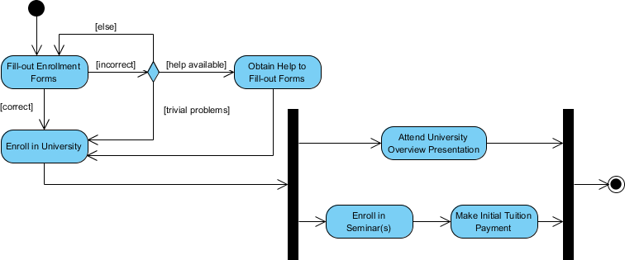

Slide 13
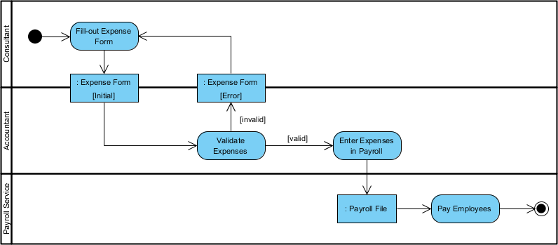
Modeling Staff Expenses Submission:

Slide 14
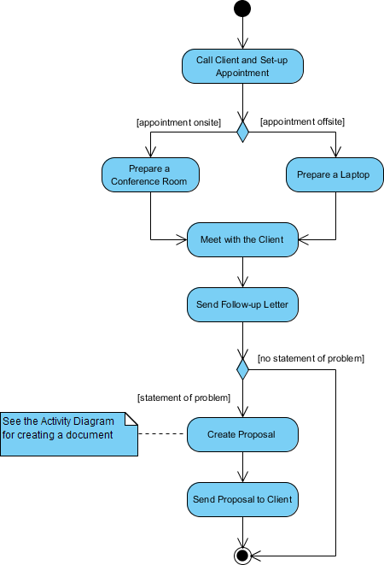
describes the business process for meeting a new client using an activity Diagram without swinlane.

Slide 15
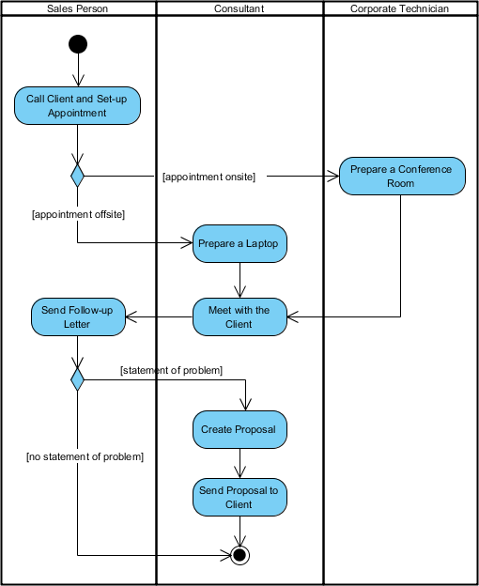

Slide 16
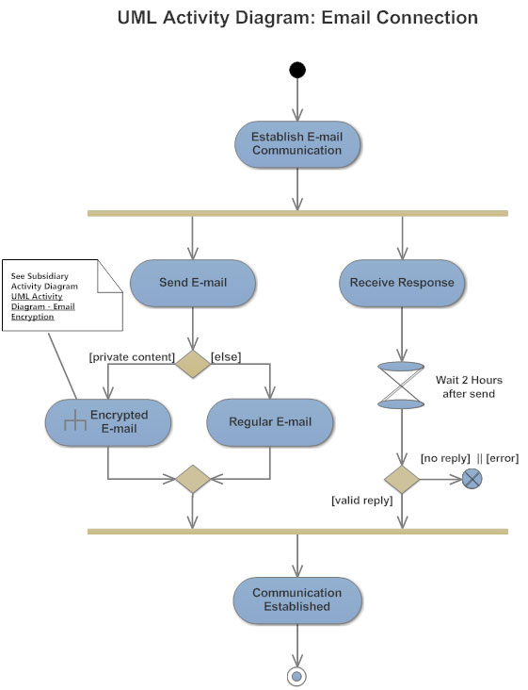

Slide 17
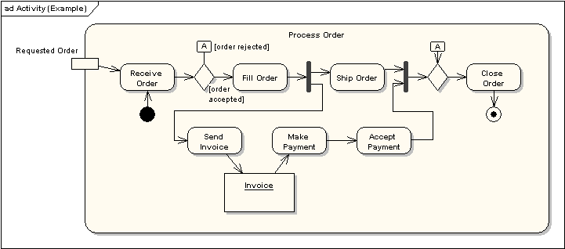

Slide 18
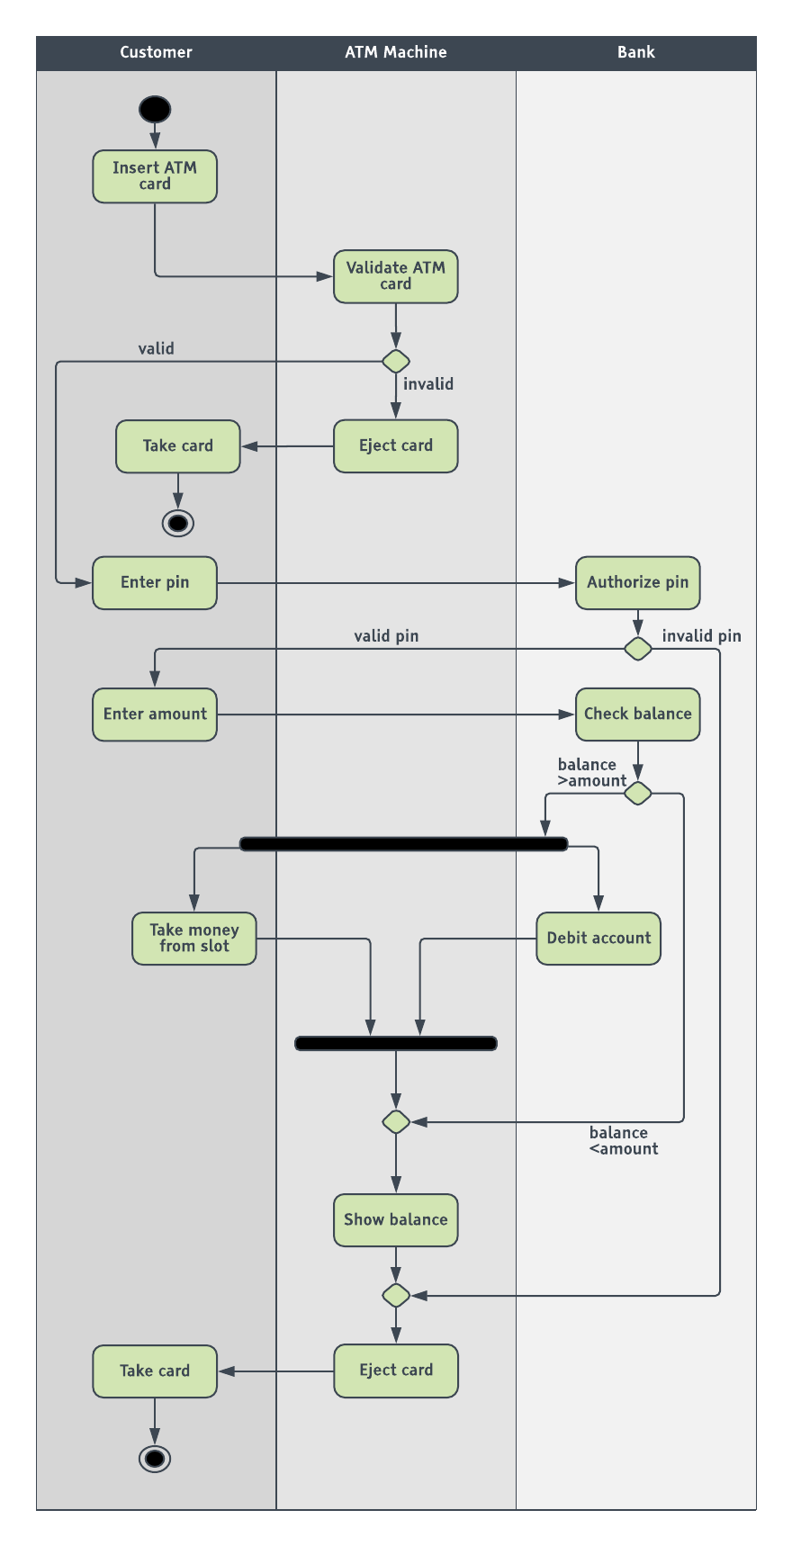

Slide 19
What is a Sequence Diagram?
Sequence diagrams describe interactions among classes in terms of an exchange of messages over time. They're also called event diagrams.
A sequence diagram is a good way to visualize and validate various runtime scenarios.
These can help to predict how a system will behave and to discover responsibilities a class may need to have in the process of modeling a new system.

Slide 20
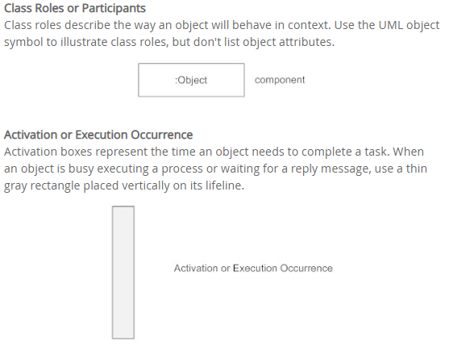
Basic Sequence Diagram Notations

Slide 21
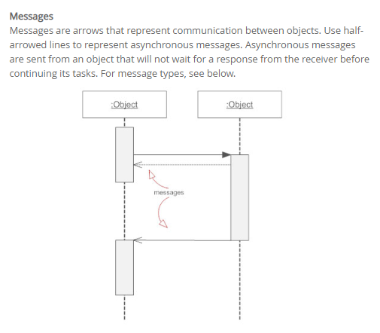

Slide 22
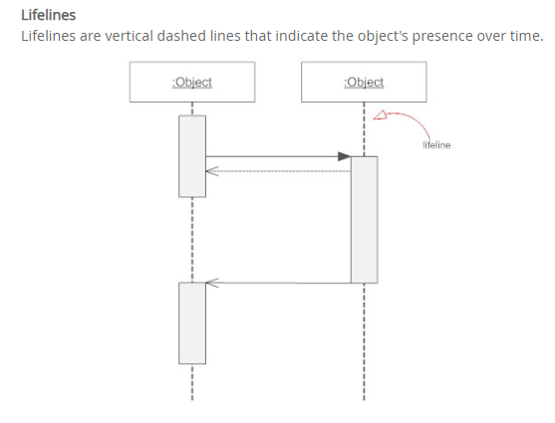
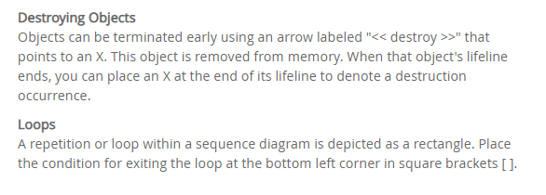

Slide 23
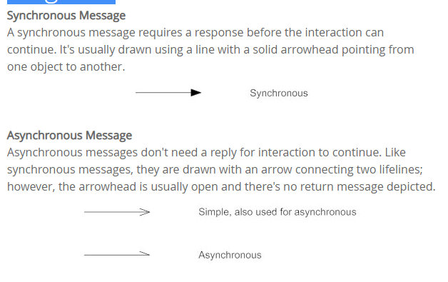
Types of Messages in Sequence Diagrams

Slide 24
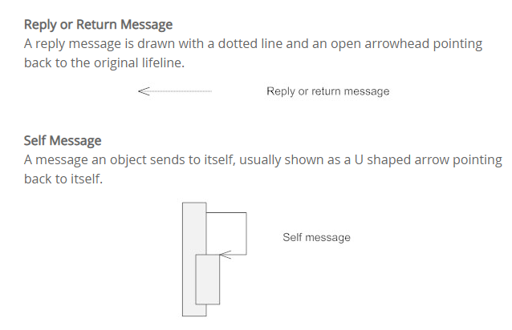

Slide 25
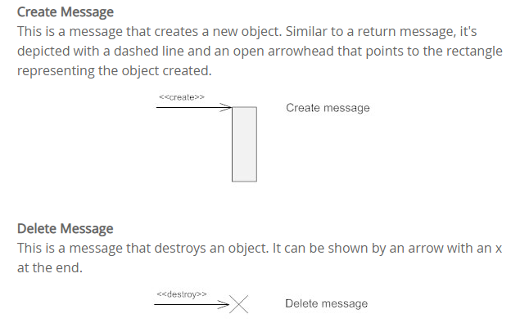
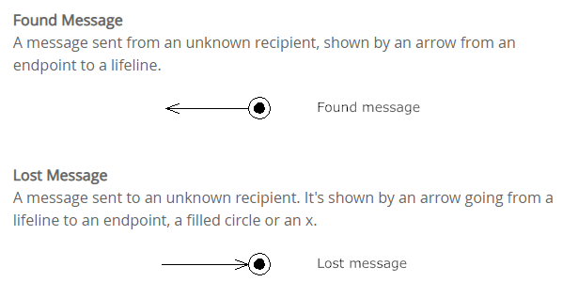

Slide 26
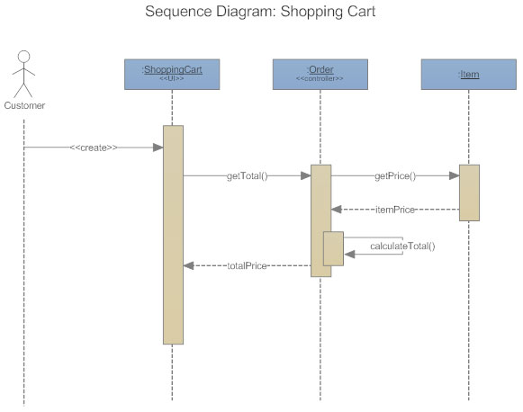

Slide 27
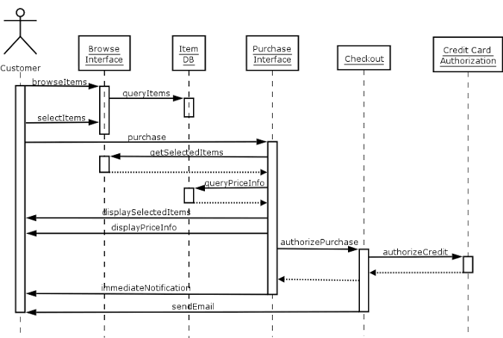

Slide 28
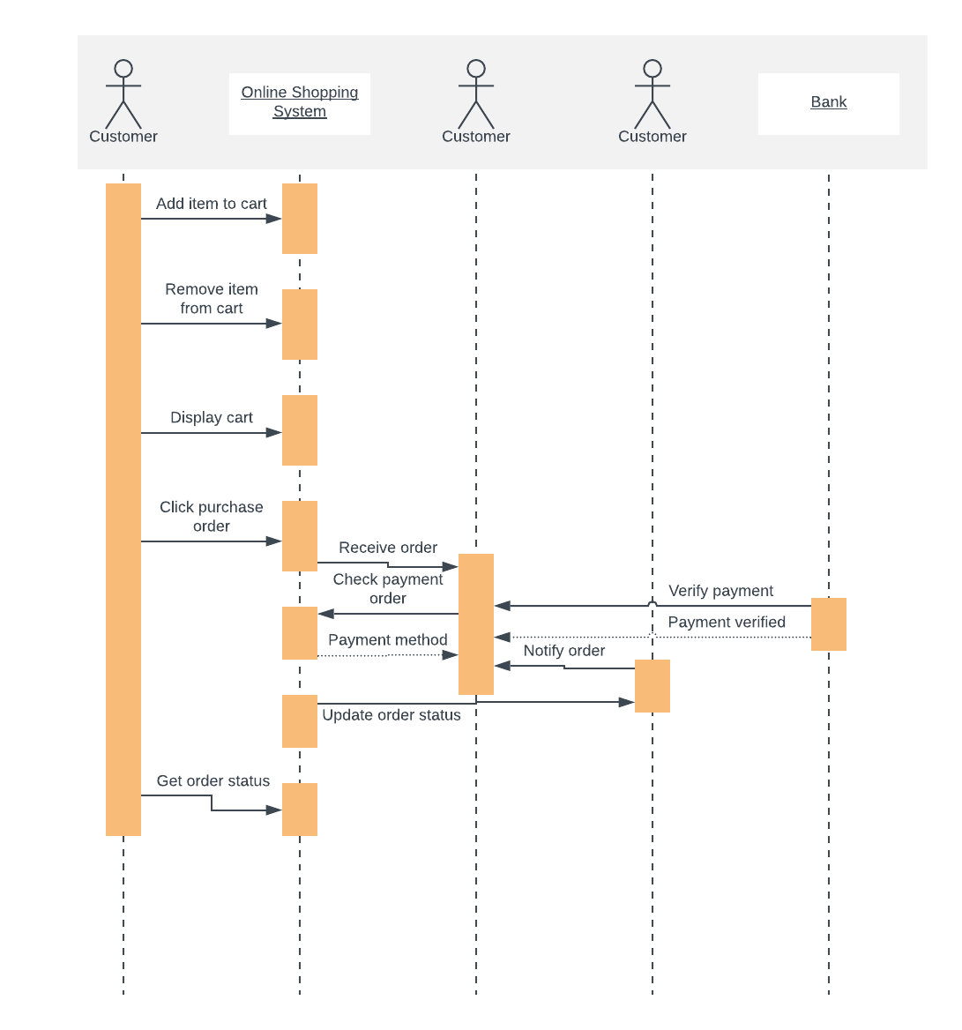

Slide 29
What is a State Diagram?
A state diagram shows the behavior of classes in response to external stimuli. Specifically a state diagram describes the behavior of a single object in response to a series of events in a system.
This UML diagram models the dynamic flow of control from state to state of a particular object within a system

Slide 30
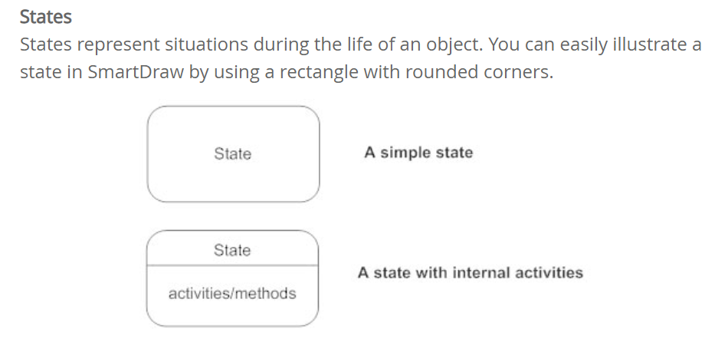
Basic State Chart Diagram Symbols and Notations

Slide 31
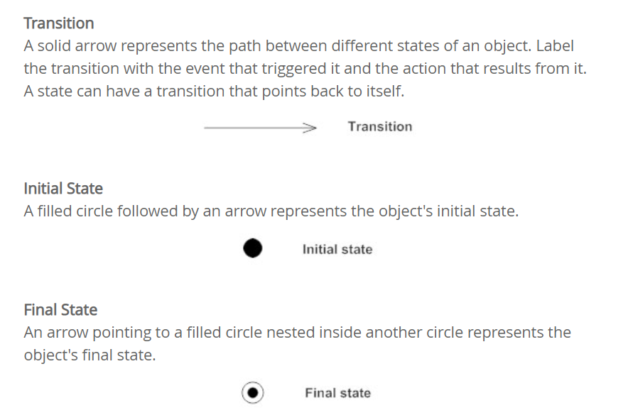

Slide 32
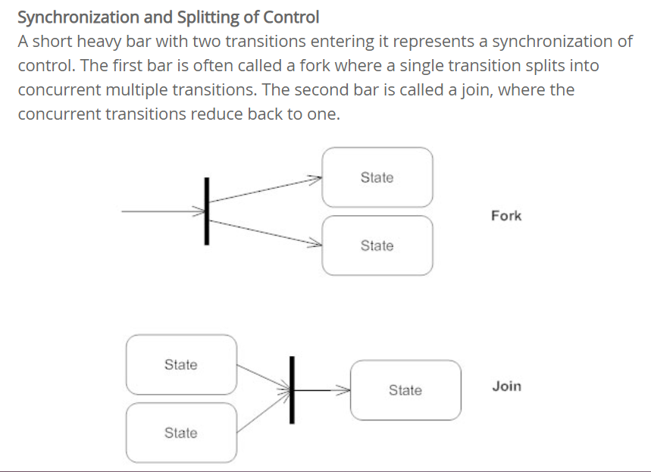

Slide 33
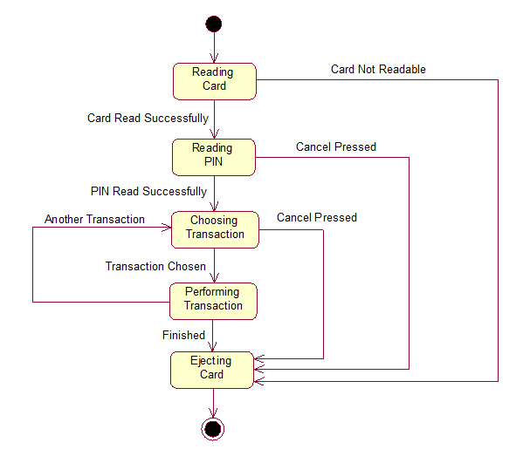

Slide 34
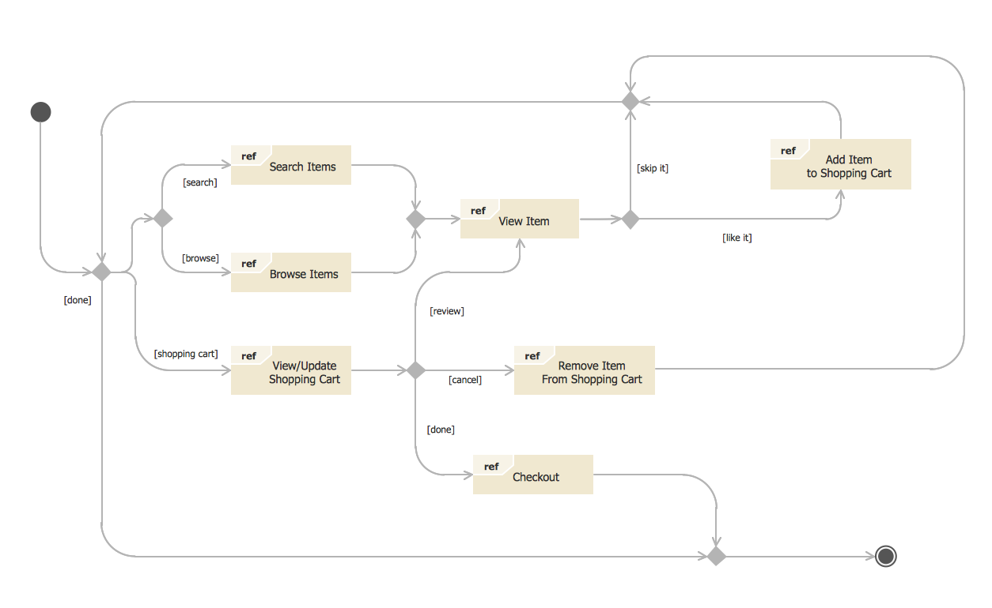

Slide 35
Component Diagram
A component diagram, also known as a UML component diagram, describes the organization and wiring of the physical components in a system.

Slide 36
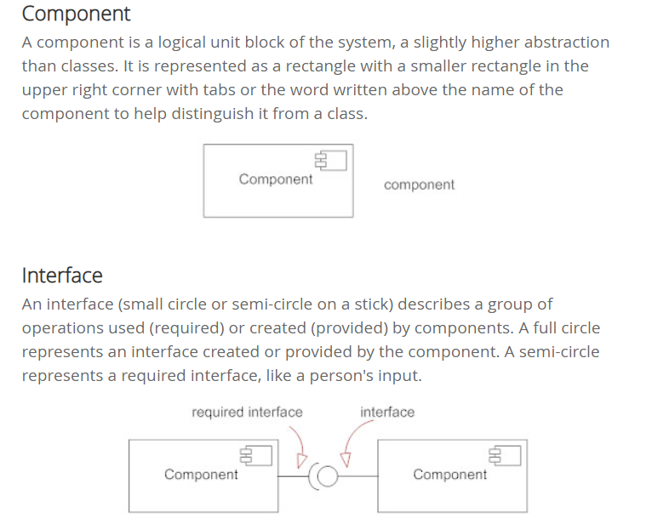
Basic Component Diagram Symbols and Notations

Slide 37
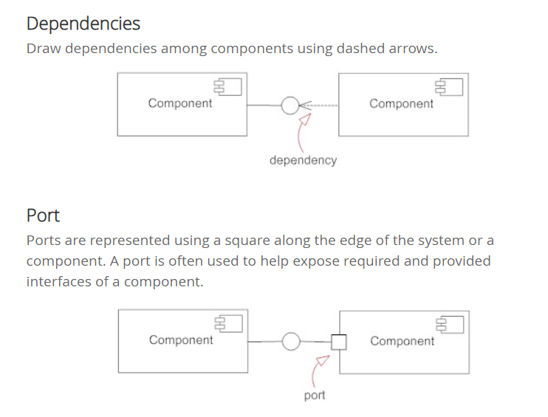

Slide 38
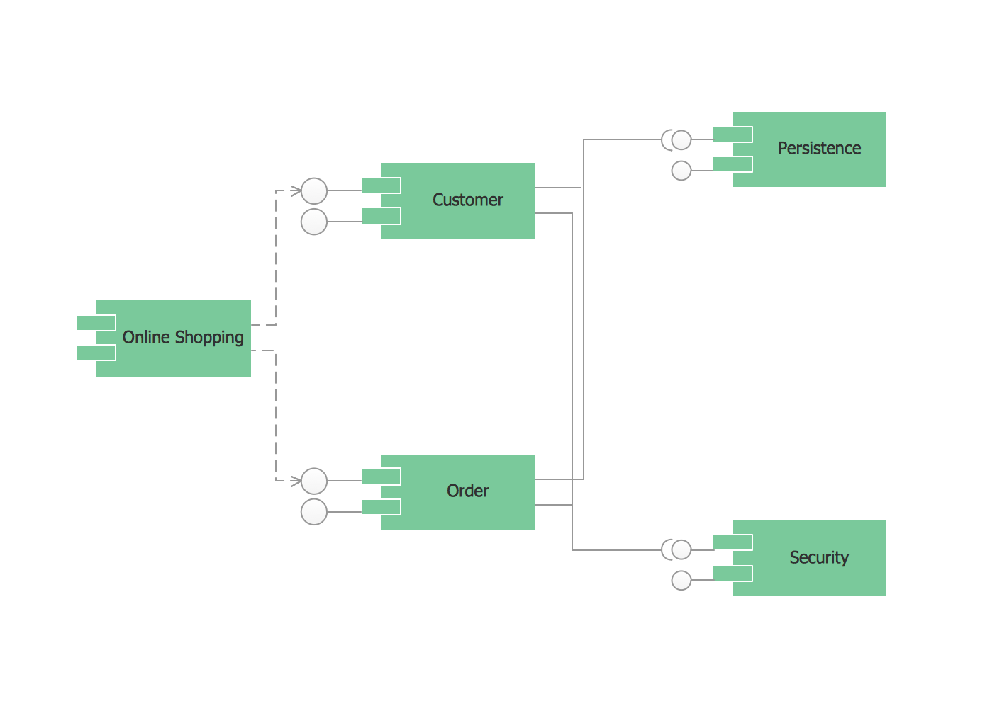

Slide 39
Collaboration Diagram
Collaboration Diagram represents the interaction of the objects to perform the behavior of a particular use case or a part of use case.
It shows the object organization as seen in the following diagram. In the collaboration diagram, the method call sequence is indicated by some numbering technique.
The number indicates how the methods are called one after another.

Slide 40
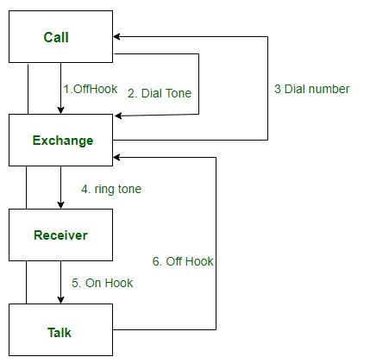

Slide 41
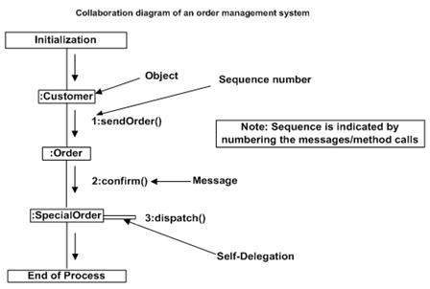

Slide 42
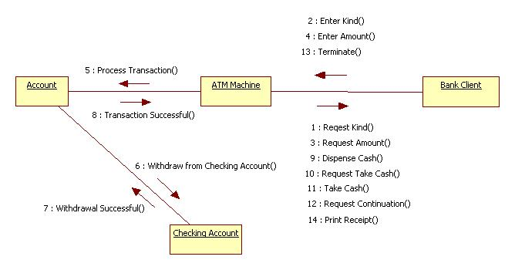

Slide 43
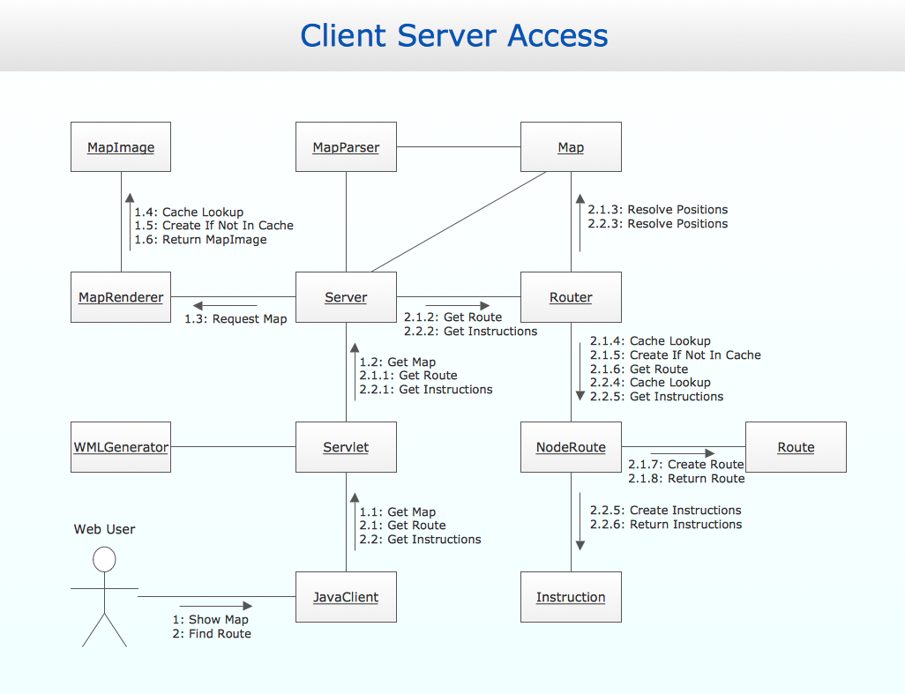

Slide 44
Deployment Diagram
UML Deployment Diagram depicts the physical deployment of artifacts on nodes: nodes is the existing hardware components and artifacts is the software components running on each node; and how the different pieces are connected.

Slide 45
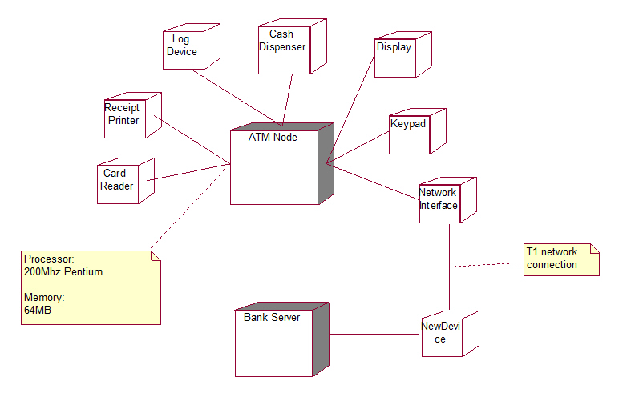

Slide 46
