Slide 1
UML

Slide 2
Introduction
UML (Unified Modeling Language) is a standard language for specifying, visualizing, constructing, and documenting the artifacts of software systems.
UML was created by the Object Management Group (OMG) and UML 1.0 specification draft was proposed to the OMG in January 1997.
It was initially started to capture the behavior of complex software and non-software system and now it has become an OMG standard.

Slide 3
The goal of UML is to provide a standard notation that can be used by all object-oriented methods and to select and integrate the best elements of precursor notations. UML has been designed for a broad range of applications. Hence, it provides constructs for a broad range of systems and activities (e.g., distributed systems, analysis, system design and deployment).
UML is a notation that resulted from the unification of OMT from
Object Modeling Technique OMT [James Rumbaugh 1991] - was best for analysis and data-intensive information systems.
Booch [Grady Booch 1994] - was excellent for design and implementation. Grady Booch had worked extensively with the Ada language, and had been a major player in the development of Object Oriented techniques for the language. Although the Booch method was strong, the notation was less well received (lots of cloud shapes dominated his models - not very tidy)
OOSE (Object-Oriented Software Engineering [Ivar Jacobson 1992]) - featured a model known as Use Cases. Use Cases are a powerful technique for understanding the behaviour of an entire system (an area where OO has traditionally been weak).

Slide 4
Role of UML in OO Design
UML is a modeling language used to model software and non-software systems. Although UML is used for non-software systems, the emphasis is on modeling OO software applications. Most of the UML diagrams discussed so far are used to model different aspects such as static, dynamic, etc. Now whatever be the aspect, the artifacts are nothing but objects.
Hence, the relation between OO design and UML is very important to understand. The OO design is transformed into UML diagrams according to the requirement. Before understanding the UML in detail, the OO concept should be learned properly. Once the OO analysis and design is done, the next step is very easy. The input from OO analysis and design is the input to UML diagrams.

Slide 5
Building blocks of UML
Things
Relationships
Diagrams

Slide 6
Things
Things are the most important building blocks of UML.
Things can be −
Structural
Behavioral
Grouping
Annotational

Slide 7
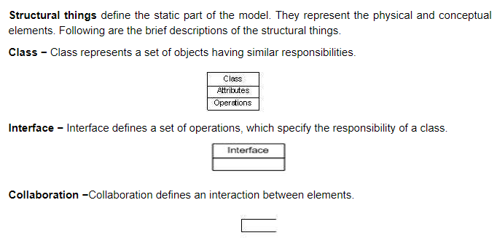
Structural Things

Slide 8
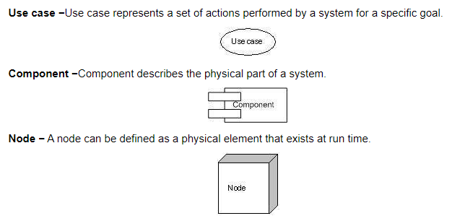

Slide 9
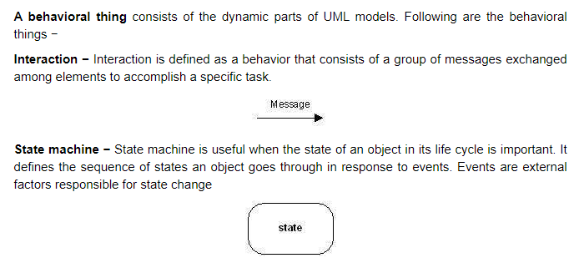
Behavioral Things

Slide 10
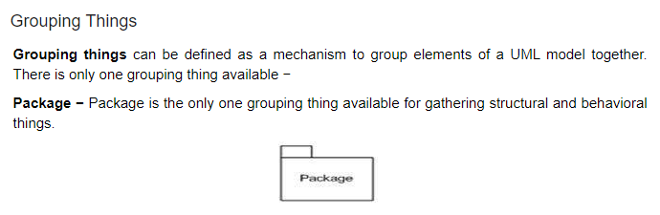

Slide 11
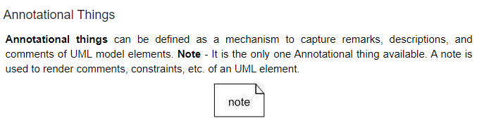

Slide 12
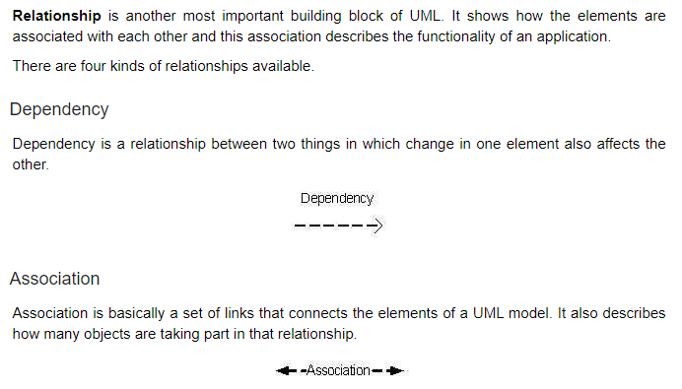
Relationship

Slide 13
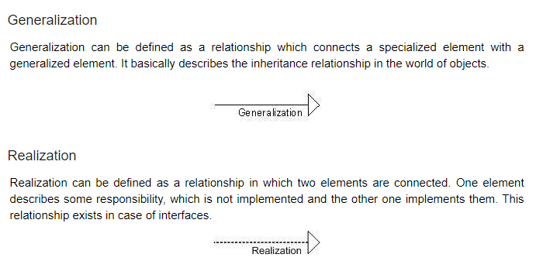

Slide 14
UML Diagrams
UML diagrams are the ultimate output of the entire discussion. All the elements, relationships are used to make a complete UML diagram and the diagram represents a system.
The visual effect of the UML diagram is the most important part of the entire process. All the other elements are used to make it complete.
UML includes the following nine:
Class diagram
Object diagram
Use case diagram
Sequence diagram
Collaboration diagram
Activity diagram
State chart diagram
Deployment diagram
Component diagram

Slide 15
UML - Modeling Types
There are three important types of UML modeling.
a) Structural Modeling
Structural modeling captures the static features of a system. They consist of the following −
Classes diagrams
Objects diagrams
Deployment diagrams
Package diagrams
Composite structure diagram
Component diagram
Structural model represents the framework for the system and this framework is the place where all other components exist. Hence, the class diagram, component diagram and deployment diagrams are part of structural modeling. They all represent the elements and the mechanism to assemble them.
The structural model never describes the dynamic behavior of the system. Class diagram is the most widely used structural diagram.

Slide 16
b) Behavioral Modeling
Behavioral model describes the interaction in the system. It represents the interaction among the structural diagrams. Behavioral modeling shows the dynamic nature of the system.
They consist of the following −
Activity diagrams
Interaction diagrams
Use case diagrams
All the above show the dynamic sequence of flow in a system.
c) Architectural Modeling
Architectural model represents the overall framework of the system. It contains both structural and behavioral elements of the system. Architectural model can be defined as the blueprint of the entire system. Package diagram comes under architectural modeling.

Slide 17
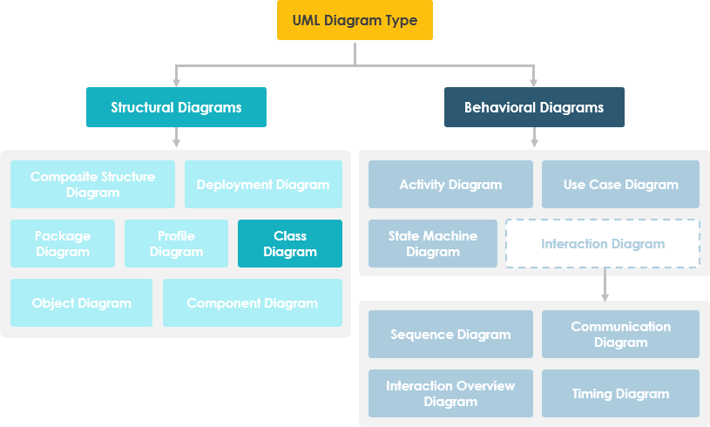

Slide 18
Use Case Diagrams
A use-case model describes a system's functional requirements in terms of use cases.
It is a model of the system's intended functionality (use cases) and its environment (actors).
Use cases enable to relate what is needed from a system to how the system delivers on those needs.
The purpose of use case diagram is to capture the dynamic aspect of a system.
Use case diagrams are used to gather the requirements of a system including internal and external influences. These requirements are mostly design requirements. Hence, when a system is analyzed to gather its functionalities, use cases are prepared and actors are identified.
When the initial task is complete, use case diagrams are modelled to present the outside view.
Use Case Diagram captures the system's functionality and requirements by using actors and use cases.

Slide 19
The purposes of use case diagrams can be said to be as follows −
Used to gather the requirements of a system.
Used to get an outside view of a system.
Identify the external and internal factors influencing the system.
Show the interaction among the requirements are actors.

Slide 20
When to use a use-case diagram?
A purpose of use case diagram is to capture core functionalities of a system and visualize the interactions of various things called as actors with the use case. This is the general use of a use case diagram.
The use case diagrams represent the core parts of a system and the workflow between them. In use case, implementation details are hidden from the external use only the event flow is represented.
With the help of use case diagrams, we can find out pre and post conditions after the interaction with the actor. These conditions can be determined using various test cases.
In general use case diagrams are used for:
Analyzing the requirements of a system
High-level visual software designing
Capturing the functionalities of a system
Modeling the basic idea behind the system
Forward and reverse engineering of a system using various test cases.

Slide 21
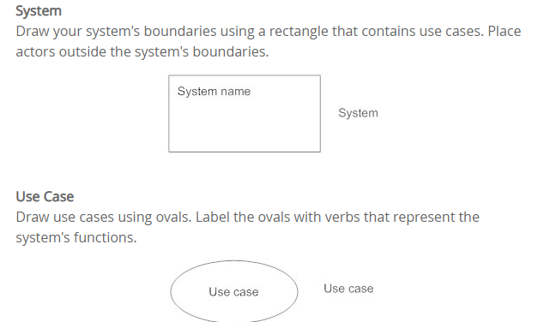
Basic Use Case Diagram Symbols and Notations

Slide 22
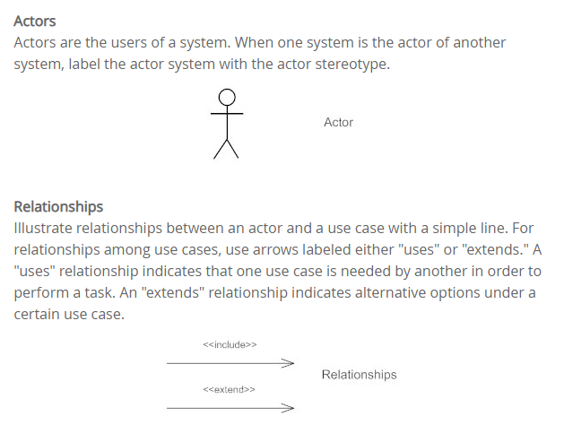

Slide 23

Association
An association is the relationship between an actor and a business use case. It indicates that an actor can use a certain functionality of the business system—the business use case:

Slide 24
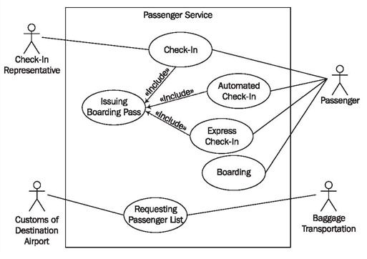

Slide 25
Class Diagram
In software engineering, a class diagram in the Unified Modeling Language (UML) is a type of static structure diagram that describes the structure of a system by showing the system's classes, their attributes, operations (or methods), and the relationships among objects.

Slide 26
Purpose of Class Diagrams
Shows static structure of classifiers in a system
Diagram provides a basic notation for other structure diagrams prescribed by UML
Helpful for developers and other team members too
Business Analysts can use class diagrams to model systems from a business perspective
A UML class diagram is made up of:
A set of classes and
A set of relationships between classes

Slide 27
What is a Class
A description of a group of objects all with similar roles in the system, which consists of:
Structural features (attributes) define what objects of the class "know"
  Represent the state of an object of the class
  Are descriptions of the structural or static features of a class
Behavioral features (operations) define what objects of the class "can do"
  Define the way in which objects may interact
  Operations are descriptions of behavioral or dynamic features of a class

Slide 28
Essential elements of A UML class diagram
Essential elements of UML class diagram are:
Class Name
Attributes
Operations

Slide 29
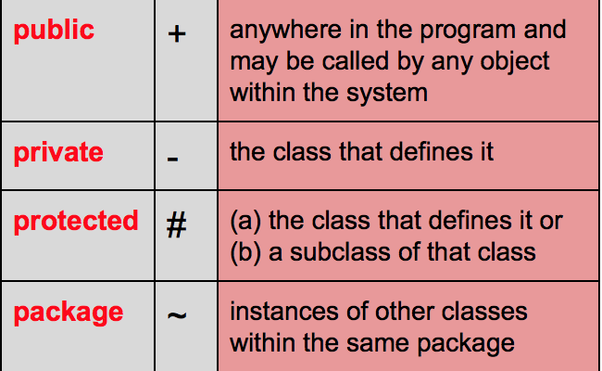
Visibility of Class Members

Slide 30
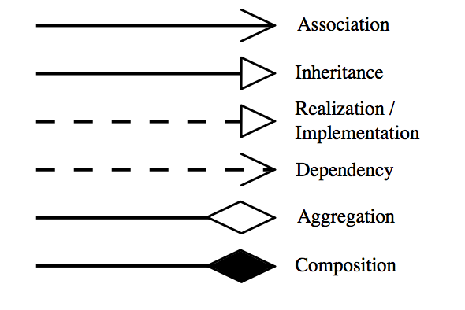
Relationships

Slide 31
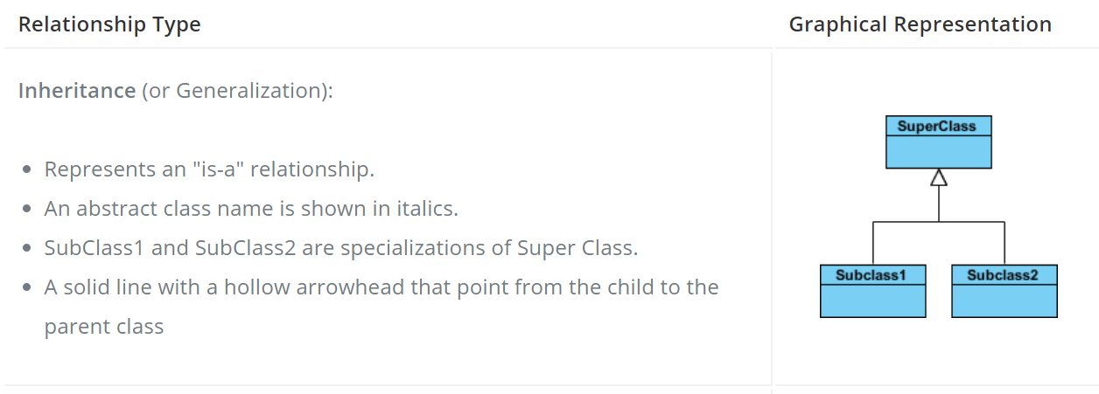

Slide 32
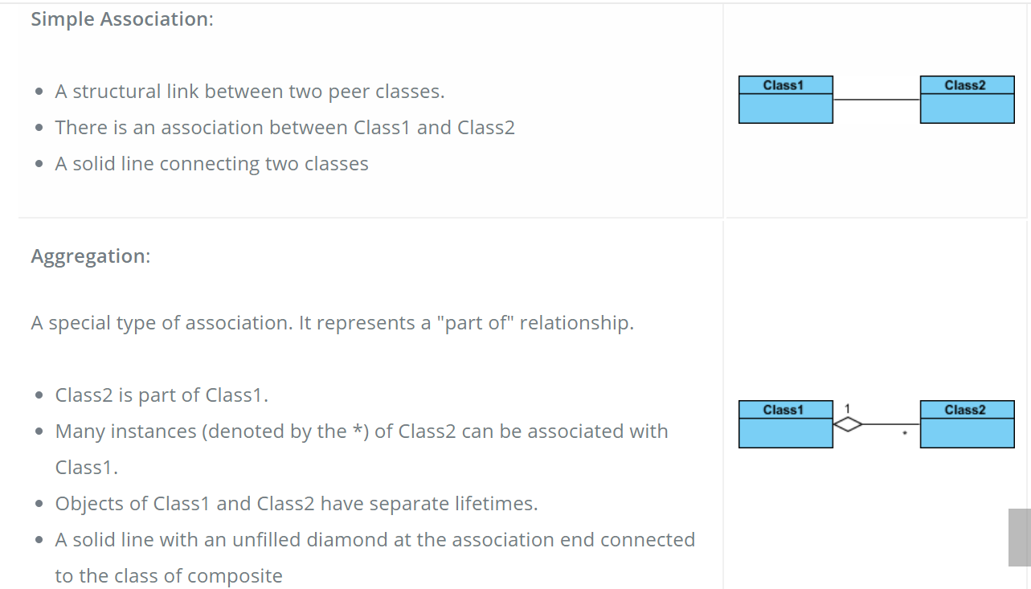

Slide 33
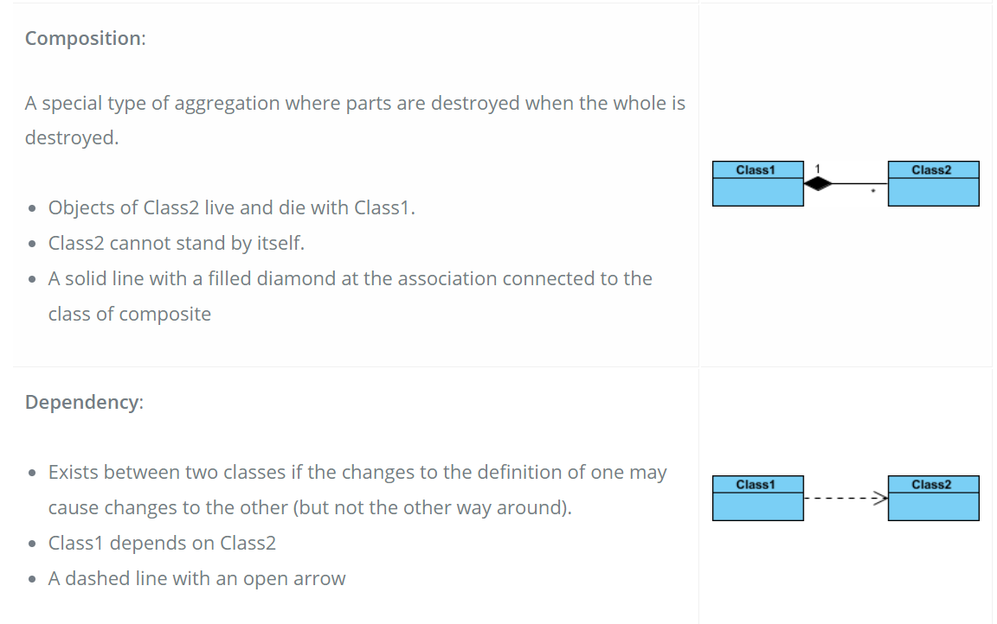

Slide 34
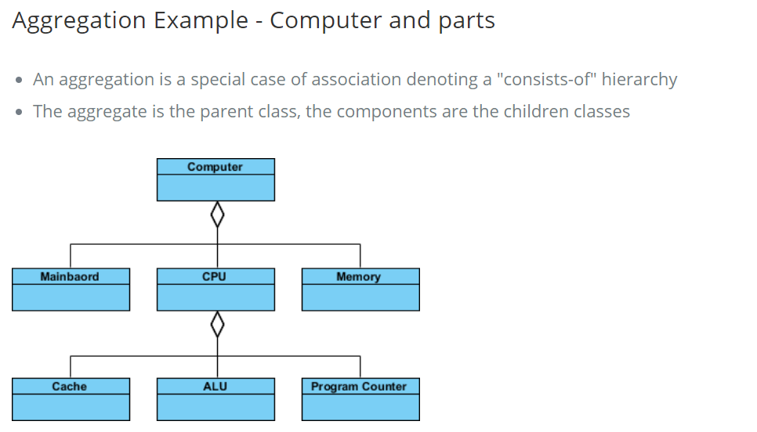

Slide 35
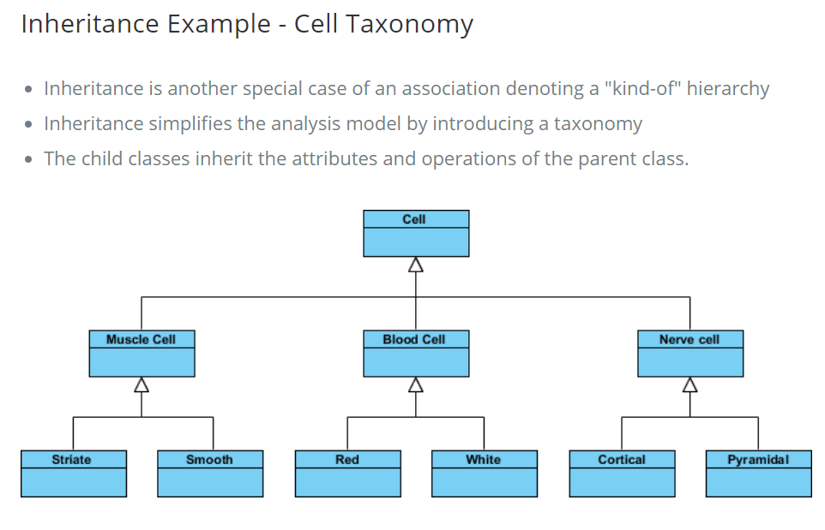

Slide 36
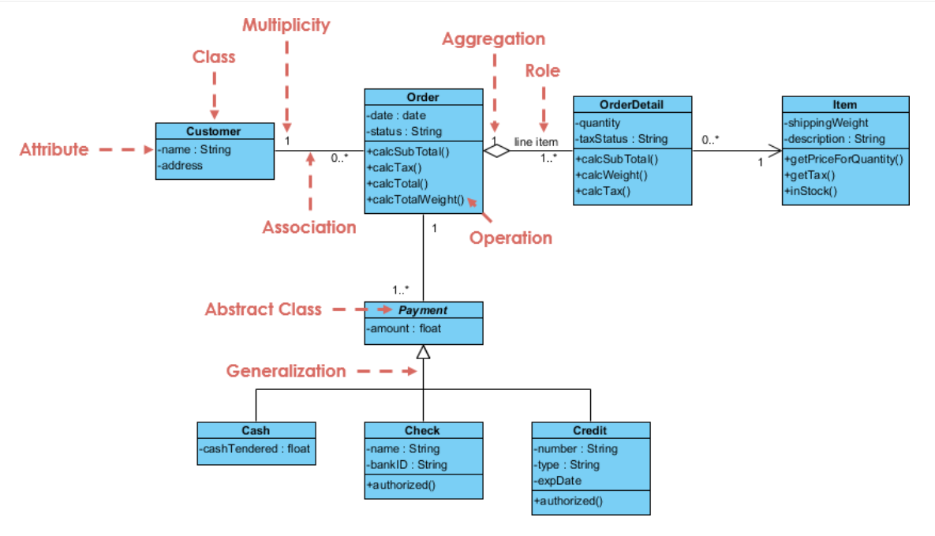

Slide 37
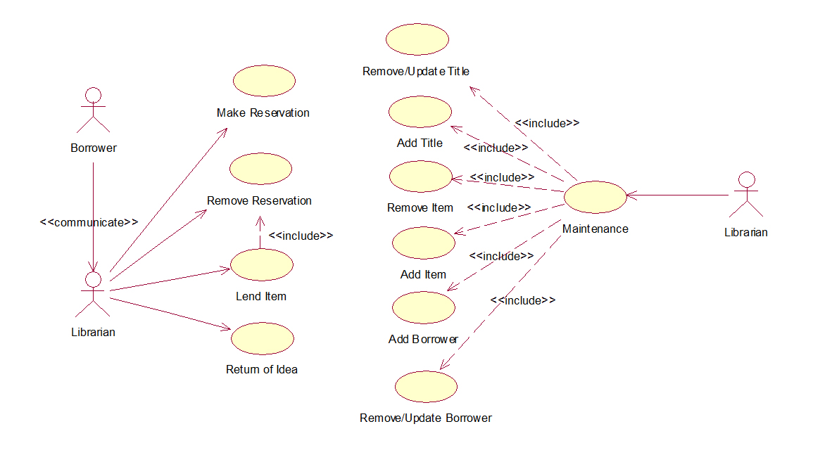

Slide 38
