Slide 1
Unit 2
SOFTWARE MEASUREMENT AND METRICS

Slide 2
SOFTWARE METRICS
Software metrics are quantifiable measures that could be used to measure different characteristics of a software system or the software-development process.
Software metrics can be defined as “The continuous application of measurement-based techniques to the software-development process and its products to supply meaningful and timely management information, together with the use of those techniques to improve that process and its products.”

Slide 3
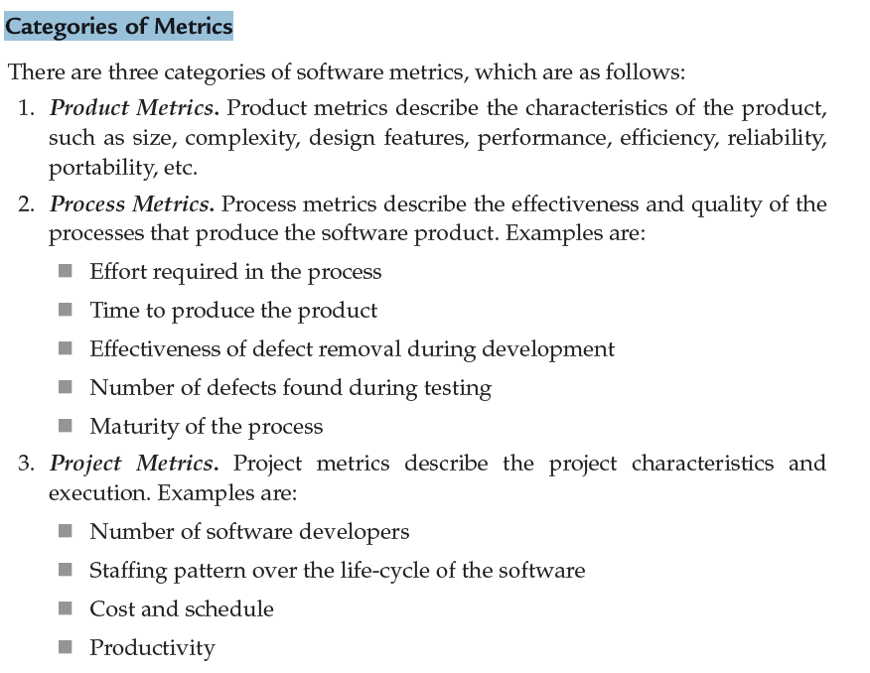

Slide 4
Measures, Metrics, and Indicators
A measure provides a quantitative indication of the extent, amount, dimension, capacity, or size of some attribute of a product or process.
Measurement is the act of determining a measure. The IEEE Standard Glossary of Software Engineering Terminology [IEE93b] defines metric as “a quantitative measure of the degree to which a system, component, or process possesses a given attribute.”
A software metric relates the individual measures in some way (e.g., the average number of errors found per review or the average number of errors found per unit test).
An indicator is a metric or combination of metrics that provides insight into the software process, a software project, or the product itself. An indicator provides insight that enables the project manager or software engineers to adjust the process, the project, or the product to make things better.

Slide 5
Measurement Principles
Roche [Roc94] suggests a measurement process that can be characterized by five activities:
• Formulation. The derivation of software measures and metrics appropriate for the representation of the software that is being considered.
• Collection. The mechanism used to accumulate data required to derive the formulated metrics.
• Analysis. The computation of metrics and the application of mathematical tools.
• Interpretation. The evaluation of metrics resulting in insight into the quality of the representation.
• Feedback. Recommendations derived from the interpretation of product metrics transmitted to the software team.

Slide 6
Metrics for Object-Oriented Design
Whitmire [Whi97] describes nine distinct and measurable characteristics of an OO design:
Size. Size is defined in terms of four views: population, volume, length, and functionality. Population is measured by taking a static count of OO entities such as classes or operations. Volume measures are identical to population measures but are collected dynamically—at a given instant of time. Length is a measure of a chain of interconnected design elements (e.g., the depth of an inheritance tree is a measure of length). Functionality metrics provide an indirect indication of the value delivered to the customer by an OO application.
Complexity. Whitmire views complexity in terms of structural characteristics by examining how classes of an OO design are interrelated to one another.
Coupling. The physical connections between elements of the OO design (e.g., the number of collaborations between classes or the number of messages passed between objects) represent coupling within an OO system.

Slide 7
Sufficiency. Whitmire defines sufficiency as “the degree to which an abstraction possesses the features required of it, or the degree to which a design component possesses features in its abstraction, from the point of view of the current application.” Stated another way, we ask: “What properties does this abstraction (class) need to possess to be useful to me?” [Whi97]. In essence, a design component (e.g., a class) is sufficient if it fully reflects all properties of the application domain object that it is modeling—that is, that the abstraction (class) possesses the features required of it.
Completeness. The only difference between completeness and sufficiency is “the feature set against which we compare the abstraction or design component” [Whi97]. Sufficiency compares the abstraction from the point of view of the current application. Completeness considers multiple points of view, asking the question: “What properties are required to fully represent the problem domain object?”

Slide 8
Cohesion. The cohesiveness of a class is determined by examining the degree to which “the set of properties it possesses is part of the problem or design domain” [Whi97].
Primitiveness. A characteristic that is similar to simplicity, primitiveness (applied to both operations and classes) is the degree to which an operation is atomic—that is, the operation cannot be constructed out of a sequence of other operations contained within a class. A class that exhibits a high degree of primitiveness encapsulates only primitive operations.
Similarity. The degree to which two or more classes are similar in terms of their structure, function, behavior, or purpose is indicated by this measure.
Volatility. Volatility of an OO design component measures the likelihood that a change will occur.

Slide 9
Operation-Oriented Metrics
Churcher and Shepperd discuss this when they state: “Results of recent studies indicate that methods tend to be small, both in terms of number of statements and in logical complexity [Wil93], suggesting that connectivity structure of a system may be more important than the content of individual modules.”
Three simple metrics, proposed by Lorenz and Kidd [Lor94], are appropriate:
Average operation size (OSavg). Size can be determined by counting the number of lines of code or the number of messages sent by the operation. As the number of messages sent by a single operation increases, it is likely that responsibilities have not been well allocated within a class.
Operation complexity (OC). The complexity of an operation can be computed using any of the complexity metrics proposed for conventional software [Zus90]. Because operations should be limited to a specific responsibility, the designer should strive to keep OC as low as possible.
Average number of parameters per operation (NPavg). The larger the number of operation parameters, the more complex the collaboration between objects. In general, NPavg should be kept as low as possible.

Slide 10
User Interface Design Metrics
Sears [Sea93] suggests that layout appropriateness (LA) is a worthwhile design metric for human/computer interfaces. A typical GUI uses layout entities—graphic icons, text, menus, windows, and the like—to assist the user in completing tasks. To accomplish a given task using a GUI, the user must move from one layout entity to the next. The absolute and relative position of each layout entity, the frequency with which it is used, and the “cost” of the transition from one layout entity to the next all contribute to the appropriateness of the interface.
A study of Web page metrics [Ivo01] indicates that simple characteristics of the elements of the layout can also have a significant impact on the perceived quality of the GUI design. The number of words, links, graphics, colors, and fonts (among other characteristics) contained within a Web page affect the perceived complexity and quality of that page.
It is important to note that the selection of a GUI design can be guided with metrics such as LA, but the final arbiter should be user input based on GUI prototypes.
Nielsen and Levy [Nie94] report that “one has a reasonably large chance of success if one chooses between interface [designs] based solely on users’ opinions.
Users’ average task performance and their subjective satisfaction with a GUI are highly Correlated.”

Slide 11
METRICS FOR SOURCE CODE
Halstead’s theory of “software science” [Hal77] proposed the first analytical “laws” for computer software.
Halstead assigned quantitative laws to the development of computer software, using a set of primitive measures that may be derived after code is generated or estimated once design is complete.
The measures are:
n1 number of distinct operators that appear in a program
n2 number of distinct operands that appear in a program
N1 total number of operator occurrences
N2 total number of operand occurrences
Halstead uses these primitive measures to develop expressions for the overall program length, potential minimum volume for an algorithm, the actual volume (number of bits required to specify a program), the program level (a measure of software complexity), the language level (a constant for a given language), and other features such as development effort, development time, and even the projected number of faults in the software

Slide 12
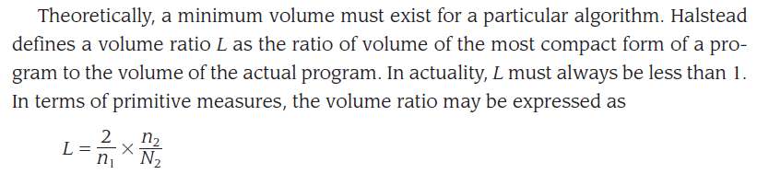
Halstead shows that length N can be estimated
N = n1 log2 n1 + n2 log2 n2
and program volume may be defined
V = N log2 (n1 n2)
It should be noted that V will vary with programming language and represents the volume of information (in bits) required to specify a program.
Halstead defines a volume ratio L as the ratio of volume of the most compact form of a program to the volume of the actual program.

Slide 13
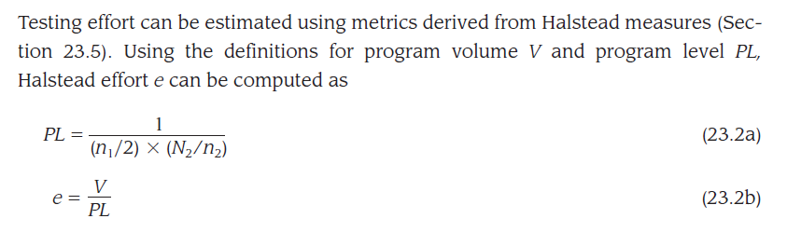
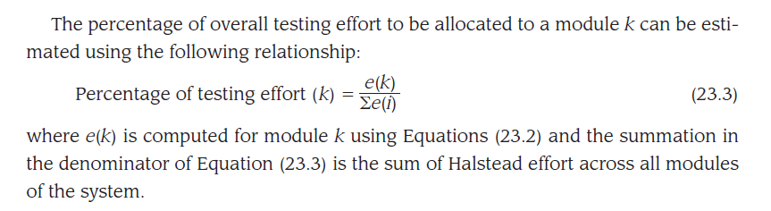
Halstead Metrics Applied to Testing

Slide 14
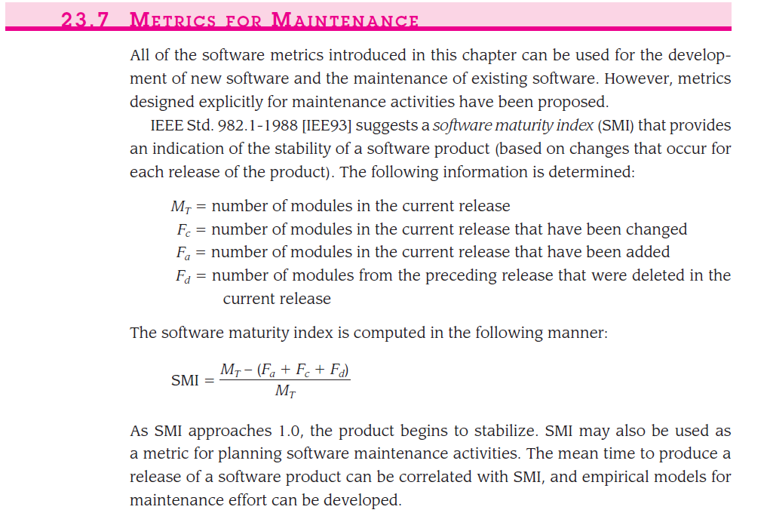

Slide 15
METRICS FOR SOFTWARE QUALITY
measures of software quality, correctness, maintainability, integrity, and usability provide useful indicators for the project team. Gilb [Gil88] suggests definitions and measures for each.
Correctness. Correctness is the degree to which the software performs its required function. The most common measure for correctness is defects per KLOC, where a defect is defined as a verified lack of conformance to requirements. When considering the overall quality of a software product, defects are those problems reported by a user of the program after the program has been released for general use. For quality assessment purposes, defects are counted over a standard period of time, typically one year.
Maintainability. Software maintenance and support accounts for more effort than any other software engineering activity. Maintainability is the ease with which a program can be corrected if an error is encountered, adapted if its environment changes, or enhanced if the customer desires a change in requirements. There is no way to measure maintainability directly; therefore, indirect measures are used. A simple time-oriented metric is mean-time-to-change (MTTC), the time it takes to analyze the change request, design an appropriate modification, implement the change, test it, and distribute the change to all users.

Slide 16
Integrity. Software integrity has become increasingly important in the age of cyber terrorists and hackers. This attribute measures a system’s ability to withstand attacks (both accidental and intentional) to its security.
Attacks can be made on all three components of software: programs, data, and documentation. To measure integrity, two additional attributes must be defined: threat and security.
Threat is the probability that an attack of a specific type will occur within a given time.
Security is the probability that the attack of a specific type will be repelled.
Usability. If a program is not easy to use, it is often doomed to failure, even if the functions that it performs are valuable. Usability is an attempt to quantify ease of use.

