Slide 1
Software Project Management

Slide 2
THE PROJECT PLANNING PROCESS
The objective of software project planning is to provide a framework that enables the manager to make reasonable estimates of resources, cost, and schedule.
The overall goal of project planning is to establish a pragmatic strategy for controlling, tracking, and monitoring a complex technical project.
Software project planning encompasses five major activities:
Estimation
Scheduling
Risk analysis
Quality management planning
Change management planning

Slide 3
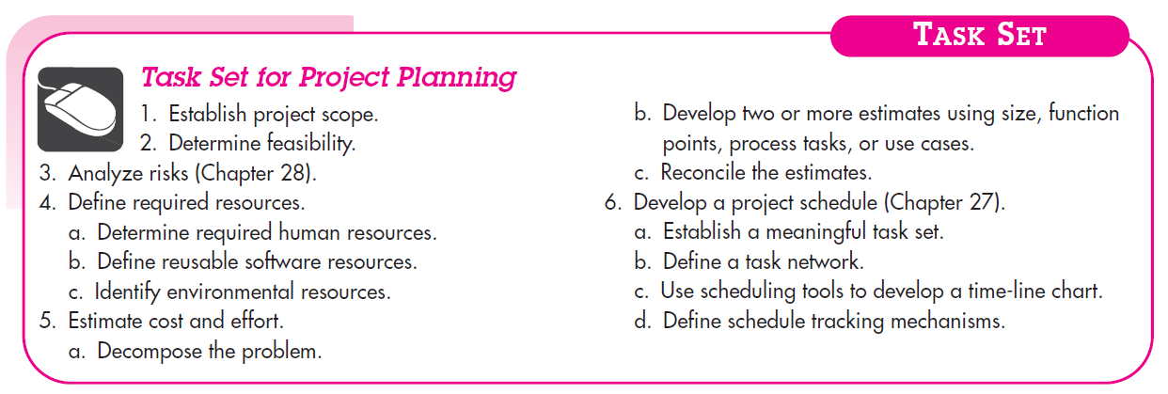

Slide 4
SOFTWARE SCOPE AND FEASIBILITY
Software scope describes
the functions and features that are to be delivered to end users;
the data that are input and output;
the “content” that is presented to users as a consequence of using the software;
the performance, constraints, interfaces, and reliability that bound the system.
Scope is defined using one of two techniques:
1. A narrative description of software scope is developed after communication with all stakeholders.
2. A set of use cases is developed by end users.

Slide 5
Once scope has been identified (with the concurrence of the customer), it is reasonable to ask: “Can we build software to meet this scope? Is the project feasible?”
After the scope is resolved, feasibility is addressed
Software feasibility has four dimensions :
Technology – Is the project technically feasible? Is it within the state of the art? Can defects be reduced to a level matching the application's needs?
Finance – Is it financially feasible? Can development be completed at a cost that the software organization, its client, or the market can afford?
Time – Will the project's time-to-market beat the competition?
Resources – Does the software organization have the resources needed to succeed in doing the project?

Slide 6
RESOURCES
The second planning task is estimation of the resources required to accomplish the software development effort.
The three major categories of software engineering resources—people, reusable software components, and the development environment (hardware and software tools).
Each resource is specified with four characteristics:
description of the resource
a statement of availability
time when the resource will be required, and
duration of time that the resource will be applied.

Slide 7
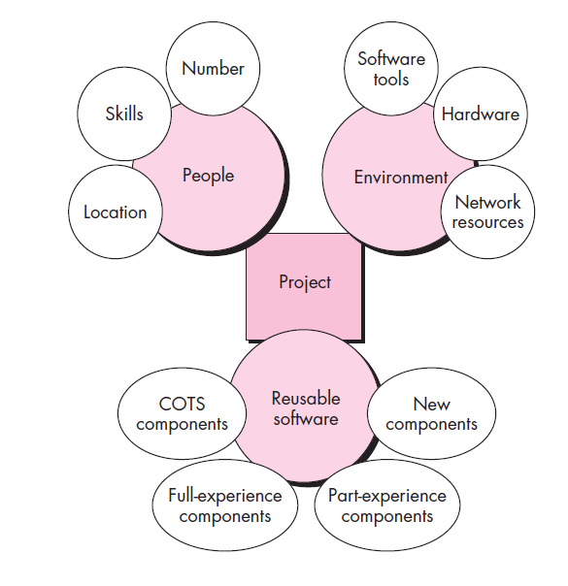

Slide 8
Human Resources
Planners need to select the number and the kind of people skills needed to complete the project
They need to specify the organizational position and job specialty for each person
Small projects of a few person-months may only need one individual
Large projects spanning many person-months or years require the location of the person to be specified also
The number of people required can be determined only after an estimate of the development effort

Slide 9
Reusable Software Resources
Off-the-shelf components
– Components are from a third party or were developed for a previous project
– Ready to use; fully validated and documented; virtually no risk
Full-experience components
– Components are similar to the software that needs to be built
– Software team has full experience in the application area of these components
– Modification of components will incur relatively low risk
• Partial-experience components
– Components are related somehow to the software that needs to be built but will require substantial modification
– Software team has only limited experience in the application area of these components
– Modifications that are required have a fair degree of risk
• New components
– Components must be built from scratch by the software team specifically for the needs of the current project
– Software team has no practical experience in the application area
– Software development of components has a high degree of risk

Slide 10
Environment Resources
A software engineering environment (SEE) incorporates hardware, software, and network resources that provide platforms and tools to develop and test software work products
Most software organizations have many projects that require access to the SEE provided by the organization
Planners must identify the time window required for hardware and software and verify that these resources will be available

Slide 11
Empirical Estimation Models – COCOMO II
COCOMO-II is the revised version of the original Cocomo (Constructive Cost Model) and is developed at University of Southern California.
It is the model that allows one to estimate the cost, effort and schedule when planning a new software development activity.
COCOMO II is actually a hierarchy of estimation models that address the following areas:
Application composition model. Used during the early stages of software engineering, when prototyping of user interfaces, consideration of software and system interaction, assessment of performance, and evaluation of technology maturity are paramount.
Early design stage model. Used once requirements have been stabilized and basic software architecture has been established.
Post-architecture-stage model. Used during the construction of the software.

Slide 12
Difference between COCOMO 1 and COCOMO 2
COCOMO 1 Model:The Constructive Cost Model was first developed by Barry W. Boehm. The model is for estimating effort, cost, and schedule for software projects. It is also called as Basic COCOMO. This model is used to give an approximate estimate of the various parameters of the project. Example of projects based on this model is business system, payroll management system and inventory management systems.
COCOMO 2 Model:The COCOMO-II is the revised version of the original Cocomo (Constructive Cost Model) and is developed at the University of Southern California. This model calculates the development time and effort taken as the total of the estimates of all the individual subsystems. In this model, whole software is divided into different modules. Example of projects based on this model is Spreadsheets and report generator.

Slide 13
Estimation for Agile Development
Estimation for agile projects uses a decomposition approach that encompasses the following steps:
1. Each user scenario (the equivalent of a mini use case created at the very start of a project by end users or other stakeholders) is considered separately for estimation purposes.
2. The scenario is decomposed into the set of software engineering tasks that will be required to develop it.
3a. The effort required for each task is estimated separately. Note: Estimation can be based on historical data, an empirical model, or “experience.”
3b. Alternatively, the “volume” of the scenario can be estimated in LOC, FP, or some other volume oriented measure (e.g., use-case count).
4a. Estimates for each task are summed to create an estimate for the scenario.
4b. Alternatively, the volume estimate for the scenario is translated into effort using historical data.
5. The effort estimates for all scenarios that are to be implemented for a given software increment are summed to develop the effort estimate for the increment.
Because the project duration required for the development of a software increment is quite short (typically three to six weeks), this estimation approach serves two purposes:
to be certain that the number of scenarios to be included in the increment conforms to the available resources, and
to establish a basis for allocating effort as the increment is developed.

Slide 14
THE MAKE/BUY DECISION
A make-or-buy analysis is a general project management technique that is used to identify if a particular work can be accomplished by the project team or should just be purchased from external sources.
The make-or-buy decision is the act of making a strategic choice between producing an item internally (in-house) or buying it externally (from an outside supplier). The buy side of the decision also is referred to as outsourcing.
Make-or-buy decisions usually arise when a firm that has developed a product or part—or significantly modified a product or part—is having trouble with current suppliers, or has diminishing capacity or changing demand.

Slide 15
Software engineering managers are faced with a make/ buy decision that can be further complicated by a number of acquisition options:
(1) software may be purchased (or licensed) off-the-shelf,
(2) “full-experience” or “partial-experience” software components may be acquired and then modified and integrated to meet specific needs, or
(3) software may be custom built by an outside contractor to meet the purchaser’s specifications.
The steps involved in Acquisition of Software are defined by the criticality of the Software to be Purchased and the end-cost.
The make/buy decision can be made based on the following conditions :
Will the software product be available sooner than internally developed software?
Will the cost of acquisition plus the cost of customization be less than the cost of developing the software internally?
Will the cost of outside support (e.g., a maintenance contract) be less than the cost of internal support?

Slide 16
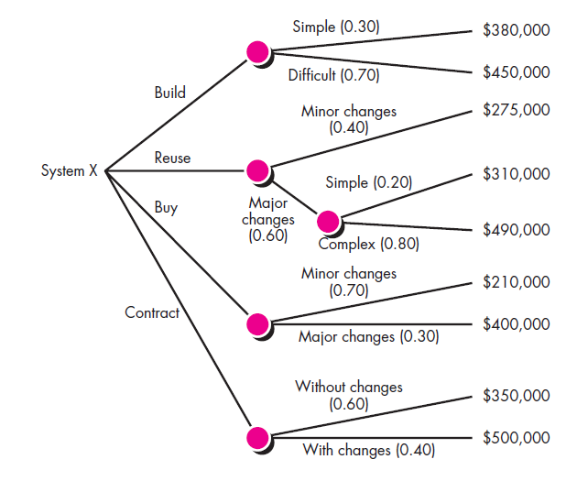
Creating a Decision Tree : A Decision Tree can be created by using a Statistical Technique to help the Management to make a Make or Buy Decision.

Slide 17
Outsourcing: Outsourcing concept is very simple. Software Engineering activities are contracted to a third party who does the work at Lower cost and hopefully High quality.
The decision to Outsource can be either Strategic or Tactical.
At the Strategic level, Business Managers consider whether a significant portion of all software work can be contracted to other.
At the Tactical level, Project Manager determine whether part or all of a Project can be best accomplished by subcontracting the Software work.

Slide 18
Advantages of Outsourcing
1. Cost reduction. Companies can secure competitive prices for contracted services, especially if the work can be outsourced offshore.
2. Faster project completion. Not only can work be done more cheaply, but it can also be done faster. Competitive pricing means more resources for the dollar. 3. High level of expertise. A high level of expertise and technology can be brought to bear on the project. A company no longer has to keep up with technological advances. Instead, it can focus on developing its core competencies and hire firms with the know-how to work on relevant segments of the project.
4. Flexibility. Organizations are no longer constrained by their own resources but can pursue a wide range of projects by combining their resources with talents of other companies.

Slide 19
Disadvantages of Outsourcing
1. Coordination breakdowns. Coordination of professionals from different organizations can be challenging, especially if the project work requires close collaboration and mutual adjustment. Breakdowns are exacerbated by physical separation with people working in different buildings, different cities, if not different countries.
2. Loss of control. There is potential loss of control over the project. The core team depends on other organizations that they have no direct authority over. While long-term survival of participating organizations depends on performance, a project may falter when one partner fails to deliver.
3. Conflict. Projects are more prone to interpersonal conflict since the different participants do not share the same values, priorities, and culture. Trust, which is essential to project success, can be difficult to forge when interactions are limited and people come from different organizations.
4. Security issues. Depending on the nature of the project, trade and business secrets may be revealed. This can be problematic if the contractor also works for your competitor. Confidentiality is another concern and companies have to be very careful when outsourcing processes like payroll, medical transcriptions, and insurance information.

