Slide 1
Project Scheduling

Slide 2
Project Scheduling in a project refers to roadmap of all activities to be done with specified order and within time slot allotted to each activity.
It is a mechanism to communicate what tasks need to get done and which organizational resources will be allocated to complete those tasks in what timeframe.
Software project scheduling is an action that distributes estimated effort across the planned project duration by allocating the effort to specific software engineering tasks.
It is the tool that communicates what work needs to be performed, which resources of the organization will perform the work and the timeframes in which that work needs to be performed.
The project schedule should reflect all of the work associated with delivering the project on time

Slide 3
Scheduling in project management is the listing of activities, deliverables, and milestones within a project. A schedule also usually includes the planned start and finish date, duration, and resources assigned to each activity. Effective project scheduling is a critical component of successful time management.
In fact, when people discuss the processes for building a schedule, they are usually referring to the first six processes of time management:
Plan schedule management.
Define project activities.
Sequence activities.
Estimate resources.
Estimate durations.
Develop the project schedule.

Slide 4
For scheduling a project, it is necessary to -
Break down the project tasks into smaller, manageable form
Find out various tasks and correlate them
Estimate time frame required for each task
Divide time into work-units
Assign adequate number of work-units for each task
Calculate total time required for the project from start to finish

Slide 5
Software Project Scheduling Principles
Compartmentalization - the product and process must be decomposed into a manageable number of activities and tasks
Interdependency - tasks that can be completed in parallel must be separated from those that must completed serially
Time allocation - every task has start and completion dates that take the task interdependencies into account
Effort validation - project manager must ensure that on any given day there are enough staff members assigned to completed the tasks within the time estimated in the project plan
Defined Responsibilities - every scheduled task needs to be assigned to a specific team member
Defined outcomes - every task in the schedule needs to have a defined outcome (usually a work product or deliverable)
Defined milestones - a milestone is accomplished when one or more work products from an engineering task have passed quality review

Slide 6
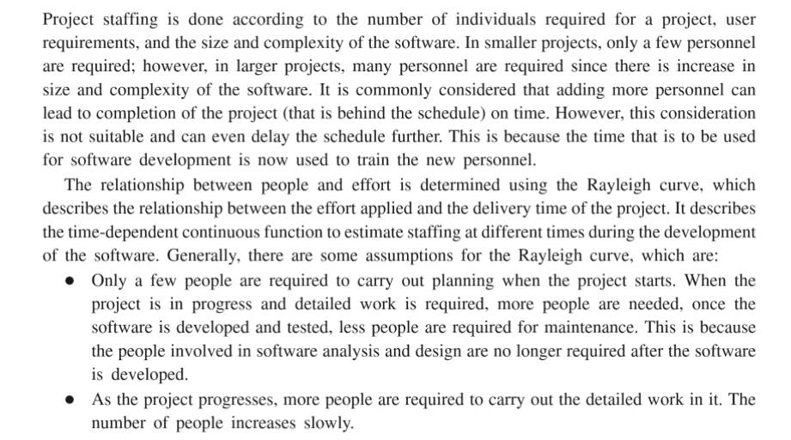
The Relationship Between People and Effort

Slide 7
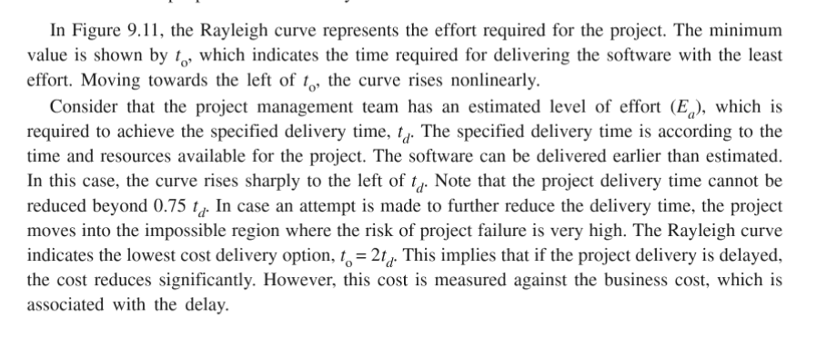

Slide 8
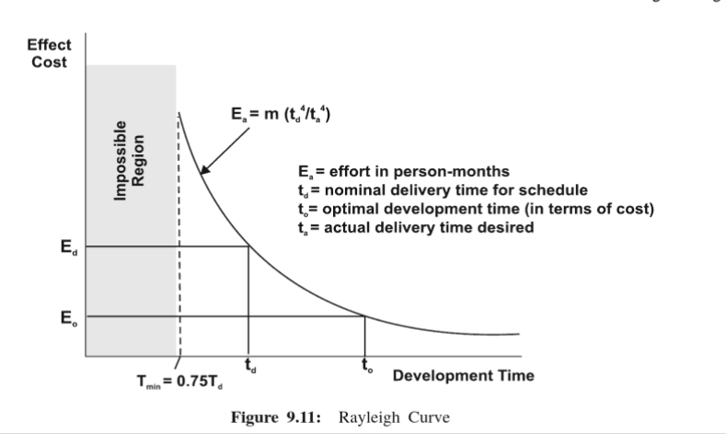

Slide 9
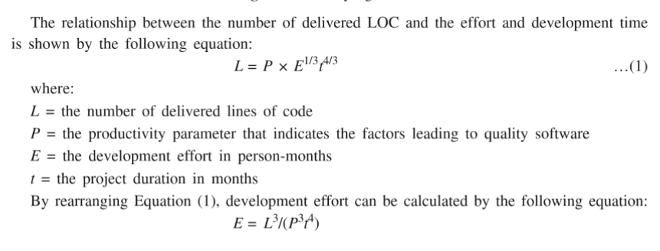

Slide 10
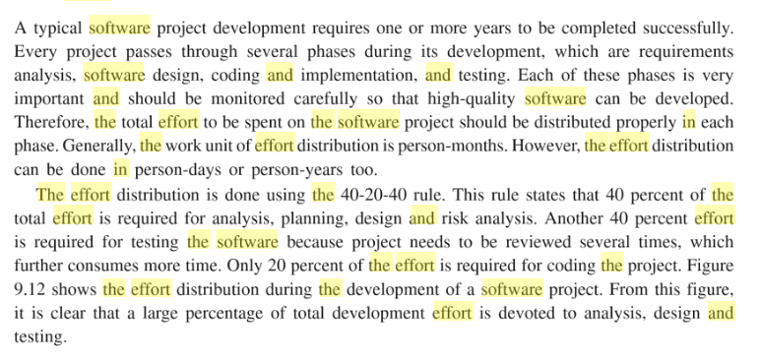
Effort Distribution

Slide 11
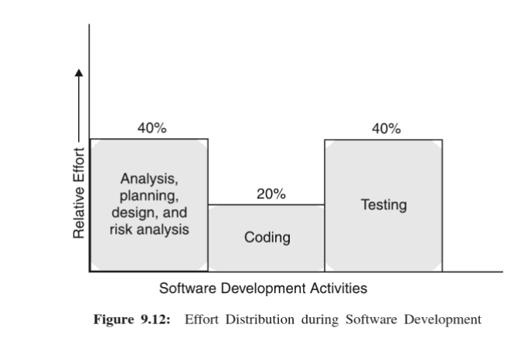

Slide 12
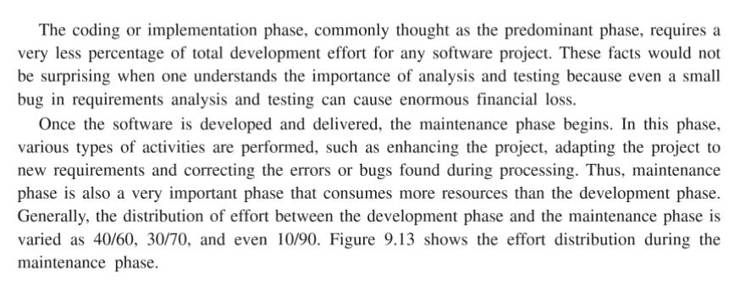
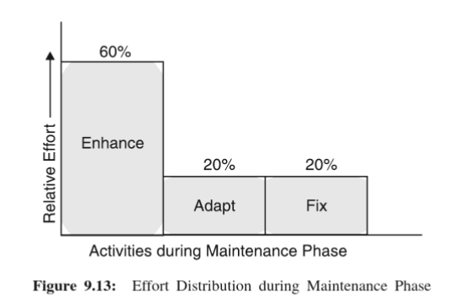

Slide 13
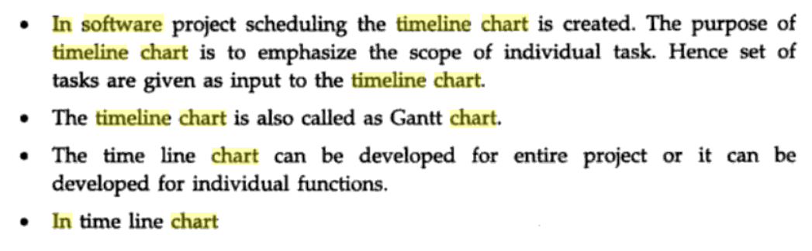
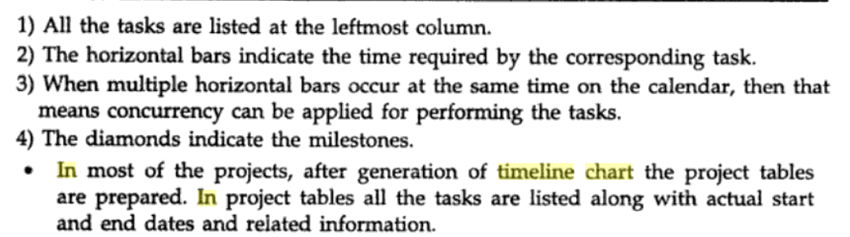
TimeLine Chart

Slide 14
