Slide 1
Global Utilities
Data Analysis Tools

Slide 2
1
2
3
5
6
4
7
4
8
10
9

Slide 3
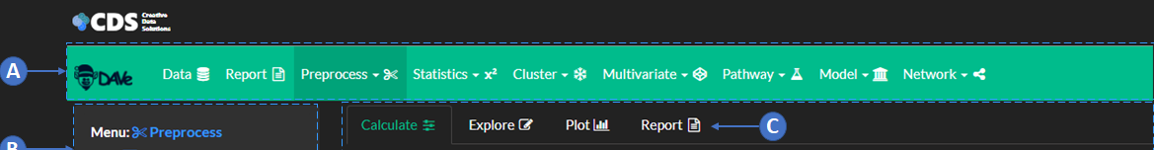


Slide 4
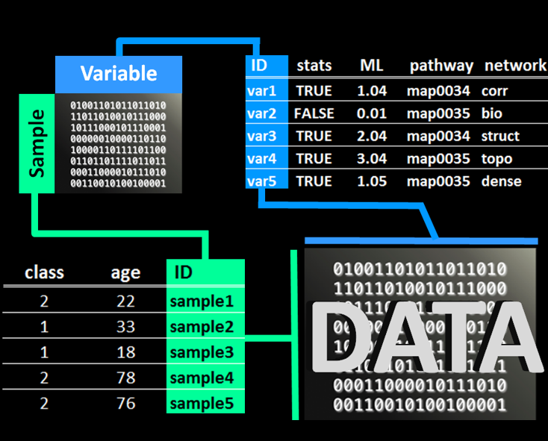
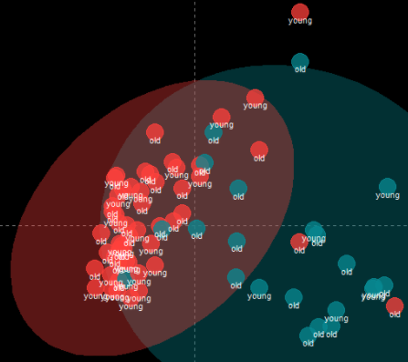
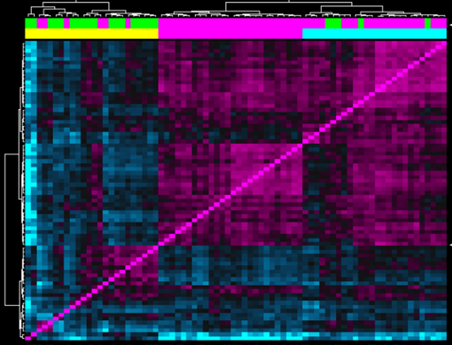
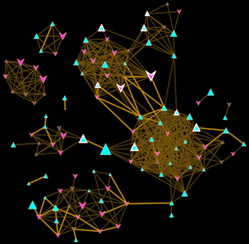
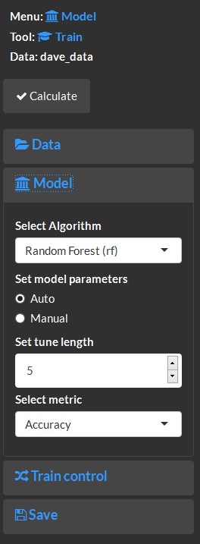
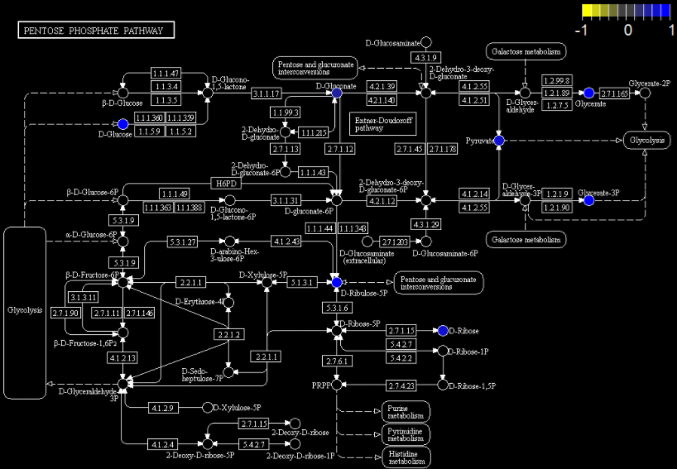
From data to mapped networks in minutes
Statistical
Analysis
Multivariate
Analysis
Clustering
Machine
Learning
Networks
Pathways

Slide 5

It looks like your subscription is out of date
No worries, you can re-subscribe in the next 30 days and pick up right where you left off!

