Slide 1

G2M Case Study
Virtual Internship
4-Oct-2021

Slide 2
Background –G2M(cab industry) case study
XYZ is a private equity firm in US. Due to remarkable growth in the Cab Industry in last few years and multiple key players in the market, it is planning for an investment in Cab industry.
Objective : Provide actionable insights to help XYZ firm in identifying the right company for making investment.
The analysis has been divided into four parts:
Data Understanding
Forecasting profit and number of rides for each cab type
Finding the most profitable Cab company
Recommendations for investment

Slide 3
Data Exploration
24 Features( including 9 derived features)
Timeframe of the data: 2016-01-31 to 2018-12-31
Total data points :355,032
Assumptions:
Outliers are present in Price_Charged feature but due to
unavailability of trip duration details ,we are not treating this as outlier.
Profit of rides are calculated keeping other factors constant and only
Price_Charged and Cost_of_Trip features used to calculate profit.
Users feature of city dataset is treated as number of cab users in the city.
we have assumed that this can be other cab users as well(including Yellow and
Pink cab)
Cab_Data.csv
Customer_ID.csv
Transaction_ID.csv
City.csv
USholiday.csv
Final cab data

Slide 4
Profit Analysis
Exploring Cab companies business performance
We are going to talk about key indicators that will help you make decisions on how to invest in cab business going forward. This will help us understand the kinds of company we will move forward with and invest in.
What are some common and important examples of KPIs?
Net profit
Revenue growth
Customer retention
Time to market
Sales lifecycle time

Slide 5
Profit Analysis
Exploring Cab companies business performance
This brings us to the following questions:
Which company is the most profitable?
Revenue growth rate?
Which company has the highest average revenue per user (ARPU) ?
Which company has the highest share of the market?
Which company has the highest number of active customer ?
Which company has the lowest churn rate?
Explore customer travel behaviors, patterns by week, month, year?

Slide 6
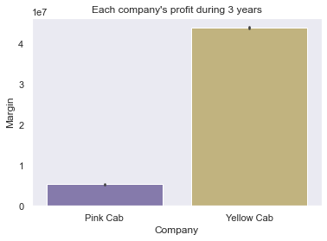
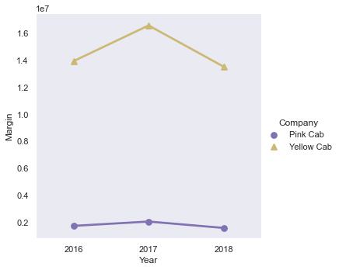
Which company is the most profitable?
Yellow company profit skyrocketed in 2017, followed by a sharp decrease in 2018. On other hand, Pink company profit remains steady all over time.
The Yellow cab generated the highest profits in three years, and 8.2 times more than Pink cab.

Slide 7
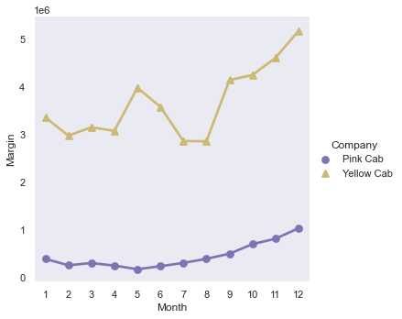
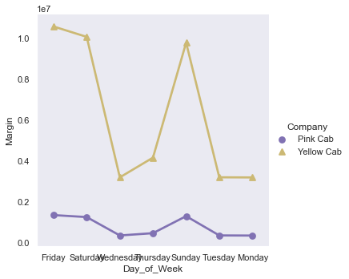
Which company is the most profitable?
Yellow cab's profit started to increase from Wednesday day to reach a peak on Friday and decrease slowly to Sunday. In contrast Pink Cab had a stable profit in everyday of a week with the slightly increase from Thursday to Friday.
We can see seasonal increase profit pattern from AUGUST to December.

Slide 8
Yellow cab's profit started to increase from Wednesday day to reach a peak on Friday and decrease slowly to Sunday. In contrast Pink Cab had a stable profit in everyday of a week with the slightly increase from Thursday to Friday.
We can see seasonal increase profit pattern from AUGUST to December.

Slide 9
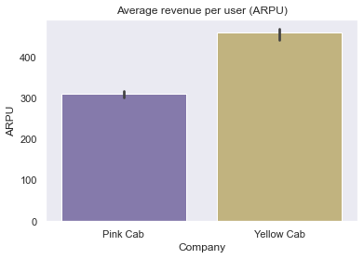
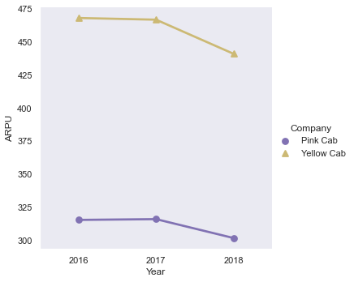
Which company has the highest average
revenue per user (ARPU) ?
Yellow Cab's profit was because of their high ARPU $458, and 94K of active customers in 2018. on other hand Pink Cab is ARPU is $310,

Slide 10
Recommendations
We have evaluated both the cab companies on following points and found Yellow cab better than Pink cab:
Profit: Yellow Cab clearly is leading, generated 8.2 times more profit than Pink cab in 3 years. One of the main reason for Yellow Cab's profit was because of their high ARPU $458, and 94K of active customers in 2018. on other hand Pink Cab is ARPU is $310, they have 29K active customers in 2018.
Customer Retention: We have analyzed this in two segments : at least 5 drive and at least 10 drive with the same cab company. And we found that Yellow cab is doing far better than Pink cab in both these segments.
ARPU: Yellow Cab's ARPU is $458, Pink Cab is ARPU is $310
Customer base: Yellow Cab's had 94K total active customers in 2018, Pink Cab had 29K active customers in 2018.
Ride count and Profit Forecasting : Both the companies are facing loss in the profit and no. of ride. Yellow cab’s forecasted profit loss is around 1.83% while Pink cab’s loss in 3.1%.Pink cab is facing more loss even when its forecasted no of ride loss is lesser than Yellow cab.
On the basis of above point , we will recommend Yellow cab for investment.

Slide 11
Thank You

