Slide 1
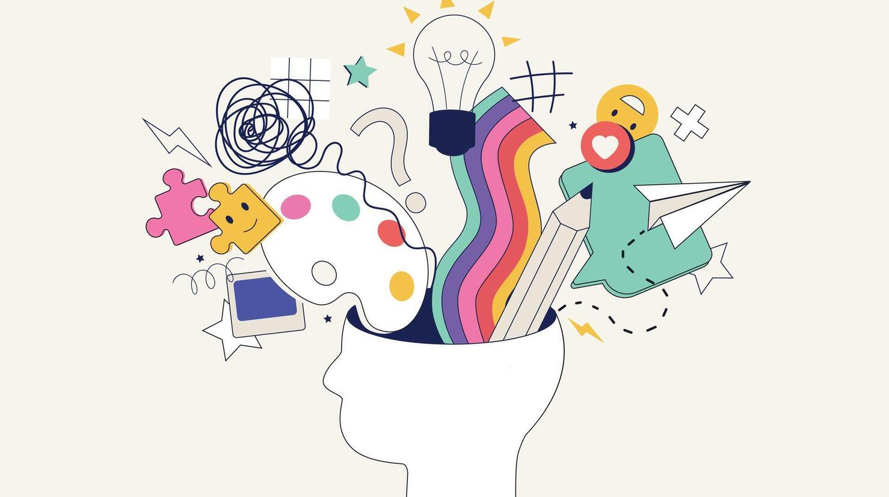
A Review of Creativity Theories: What Questions Are We Trying to Answer?

Slide 2
Why Study Creativity?
Creativity is a fundamental human capacity, shaping science, art, and innovation.
Yet it remains complex and elusive — like love or happiness.
Researchers have asked for decades:
What is creativity?
Where does it come from?
How can it be studied or developed?

Slide 3
The Core Challenge
Creativity theories are numerous and diverse.
No single theory dominates — instead, we have multiple lenses.
The authors choose to focus on key questions, not just list theories.

Slide 4
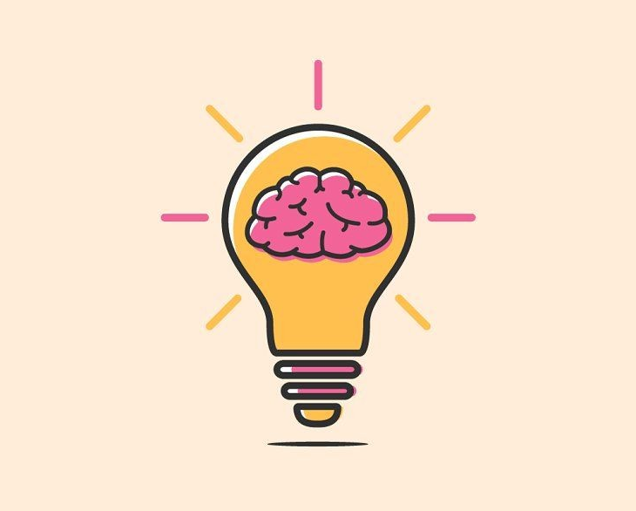
Key Questions in Creativity Research
What is the underlying structure of creativity?
What is needed to be creative?
How do we create individually and collectively?
What makes creative works endure?

Slide 5
What is the underlying structure of creativity?

Slide 6
Theories About the Structure of Creativity
Creativity can be studied from different structural perspectives.
Key models propose frameworks that define how creativity operates and is observed.

Slide 7
The Four P’s Framework (Rhodes, 1961)
Explain how creativity can be studied and enhanced across four dimensions — Product, Process, Person, Press.
4P model helps bridge theory ↔ practice.

Slide 8
Overview of the 4P Model
Product — What is produced (novel + useful)
Process — How creativity happens (cognition)
Person — Who is creative (traits/motivation)
Press — Environment supporting creativity

Slide 9
The Creative Product
Product = tangible or conceptual output judged by novelty and usefulness (Runco & Jaeger, 2012).
“Surprise” (Simonton, 2012) is sometimes added as a third criterion.
Tools:
Creative Product Semantic Scale (CPSS)
Consensual Assessment Technique (CAT) by Amabile (1983).
Functional creativity (Cropley, 2010): adds relevance, effectiveness, elegance.
Judging creativity is subjective — context and culture matter.

Slide 10
Creative Processes and Mechanisms
Wallas (1926): Preparation → Incubation → Illumination → Verification.
Geneplore model: Generative + Exploratory phases (Finke et al., 1992).
Practical methods: Osborn’s Creative Problem Solving (CPS) — six steps from problem finding to acceptance.
Creative thinking techniques improve performance when they develop cognitive heuristics (Scott et al., 2004).

Slide 11
Who Is Creative?
Personality: Openness to experience consistently predicts creativity (Feist, 1998).
Motivation: Intrinsic motivation (curiosity, enjoyment) is stronger than external reward.
But synergistic extrinsic motivators (feedback, recognition) can enhance creativity (Amabile, 1993).
Flow (Csikszentmihalyi, 1990): deep engagement where time disappears.

Slide 12
Environmental and Social Influences
Press = interaction between person and environment.
Levels: family → school → workplace → culture → history (Runco & Pagnani, 2011).
Amabile’s KEYS — identifies 8 creativity-supportive factors (freedom, challenge, support, resources, etc.).
Ekvall’s Creative Climate Questionnaire (CCQ) — 10 dimensions including trust, humor, and risk-taking.
Too much control or time pressure stifles creativity.

Slide 13
Integrating the 4Ps
Creativity arises from the interaction among product, process, person, and press.
Examples:
Amabile’s Componential Model
Csikszentmihalyi’s Systems Theory
Sternberg’s Investment Theory
Rejects the “lone genius” myth — creativity is systemic.
Encourages multi-level interventions (personal, organizational, cultural).

Slide 14
Five A’s (Glăveanu, 2013)
A | Meaning | Focus
Actors | People engaged in creative activity | Agency
Actions | Processes and practices of creation | Behavior
Artifacts | The created products | Outcome
Audiences | Those who evaluate or engage with the product | Reception
Affordances | Opportunities and resources enabling creativity | Environment (social + material)

Slide 15
The Four C’s Model (Beghetto & Kaufman, 2007; 2009)
Level | Description | Example
Mini-C | Personal insights or learning moments | A child discovering a new way to solve a puzzle
Little-C | Everyday creativity recognized by others | Writing a unique blog post
Pro-C | Professional-level creativity | Skilled designer or composer
Big-C | Eminent, legendary creativity | Einstein, Picasso, Mozart

Slide 16
THANKS!

