Slide 1
Web Programming Fundamentals
February 2019
These slides are based on Victoria Kirst (vrk@stanford.edu) course CS193X. You can equally check out here (https://cs193x.stanford.edu) for the original course materials

Slide 2
Today's schedule
Announcements:
Schedule:
HTML and CSS
Inline vs block
Classes and Ids

Slide 3
Waitlist??
If you have an access code and have not enrolled:
Please do so ASAP
If you do not have an access code yet:
Please email me!

Slide 4

Suggestion: Bring your laptop!
Bring your laptop to lecture so you can follow along with the lecture slides and check out the live examples
I will be using CodePen in lecture, which lets you livestream the code I write, which might be hard to see on the projector screen
(But, y'know, don't look ahead for the answers to lecture questions and then pretend like you knew them all along.)

Slide 5
HTML and CSS

Slide 6
Quick review

Slide 7
Recall: HTML
HTML (Hypertext Markup Language)
Describes the content and structure of a web page; not a programming language.
Made up of building blocks called elements.
<p>
HTML is <em>awesome!!!</em>
<img src="puppy.png" />
</p>

Slide 8
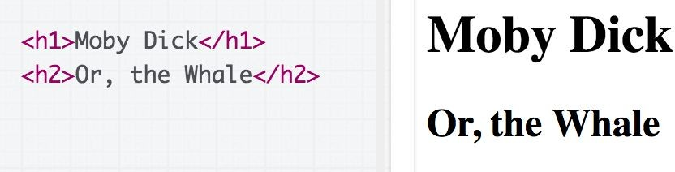

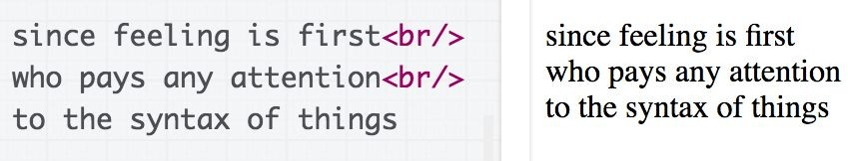
Some HTML elements
Top-level heading: h1, h2, ... h6
Paragraph: p
Line break: br

Slide 9
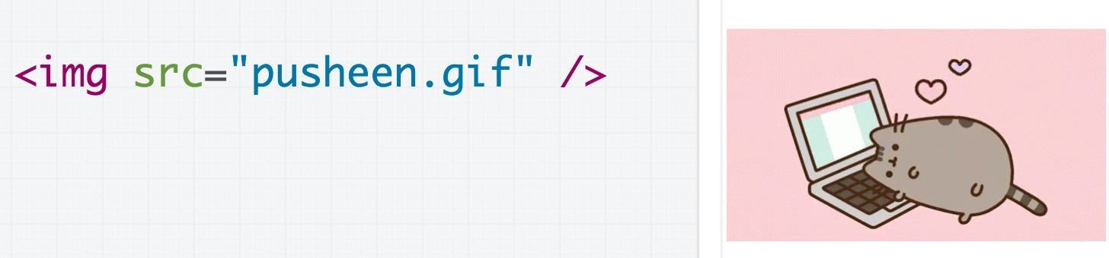

Some HTML elements
Image: img
Link: a (note: not link)
Strong (bold): strong (note: don't use b)
Emphasis (italic): em (note: don't use i)

Slide 10
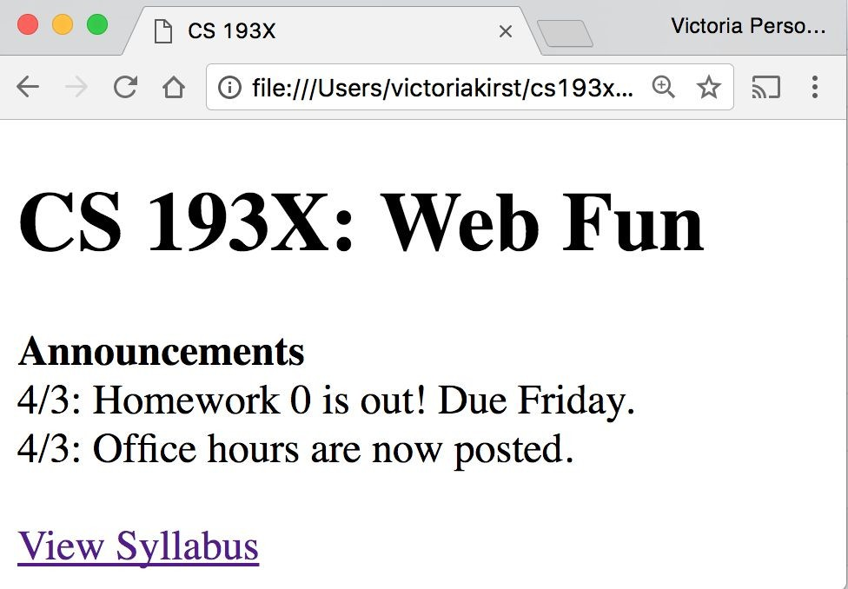
Recall: Course web page
We wrote some HTML to make the following page:

Slide 11
That was weird
- We saw that HTML whitespace collapses into one space…
<h1>CS 193X: Web Fun</h1>
<strong>Announcements</strong><br/>
4/3: Homework 0 is out!<br/>
- Except weirdly the <h1> heading was on a line of its own, and <strong> was not.
Hmmm… strange…
Oh well, it works! Let's move on!!!

Slide 12
CSS

Slide 13
Recall: CSS
CSS: Cascading Style Sheets
Describes the appearance and layout of a web page
Composed of CSS rules, which define sets of styles
selector {
property: value;
}

Slide 14
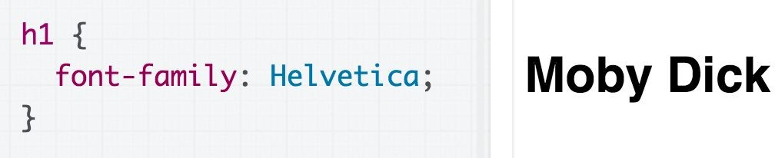
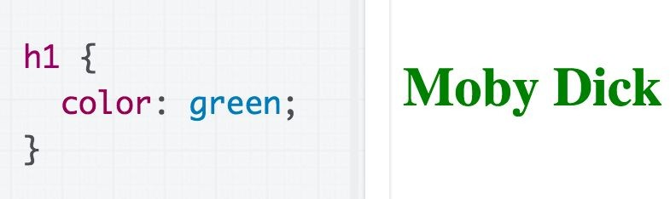
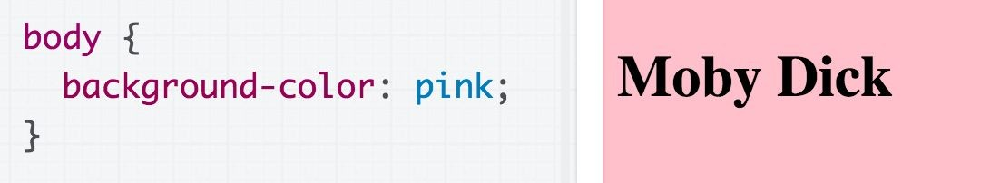
Some CSS properties
Font face: font-family
Font color: color
Note that color always refers to font color, and there's no way to make it mean anything other than font color.
Background color: background-color
Assign a background-color to body to make the page a different color.

Slide 15
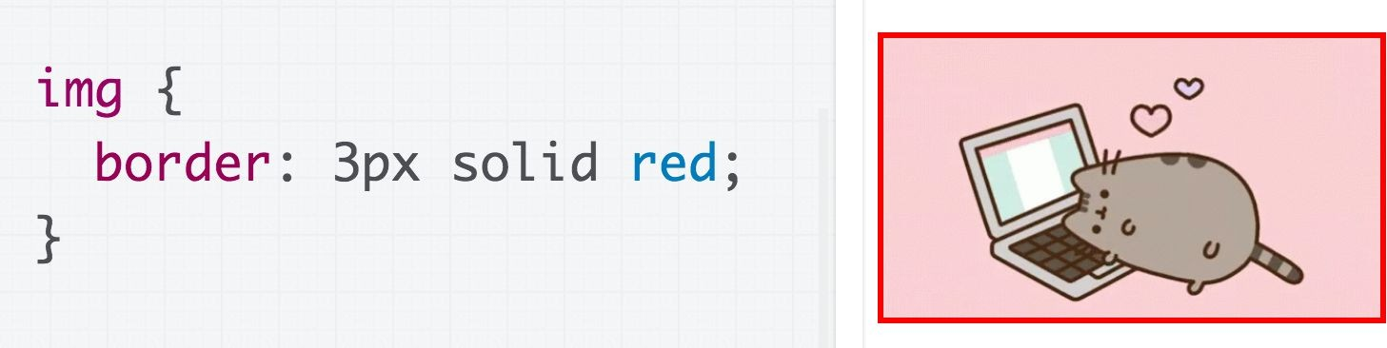
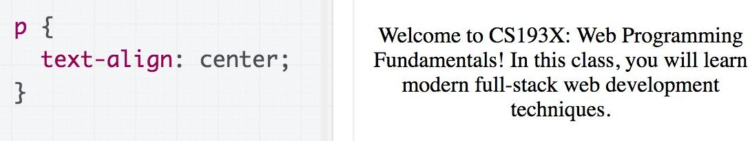
Some CSS properties
Border: border
(border shorthand syntax)
Text alignment: text-align (note: don't use <center>)

Slide 16
CSS colors
140 predefined names (list)
color: black;
The "a" in rgba stands for alpha channel and is a transparency value
Prefer more descriptive:
Predefined name
rgb / rgba
Hex
Hex values
color: #00ff00; color: #0f0; color: #00ff0080;
rgb() and rgba()
color: rgb(34, 12, 64);
color: rgba(0, 0, 0, 0.5);

Slide 17
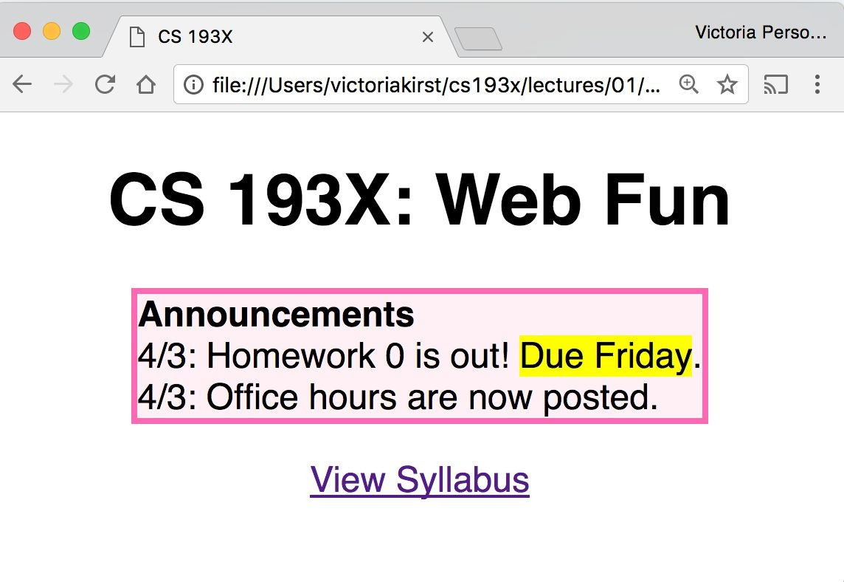
Exercise: Course web page
Let's write some CSS to style our page:
✨ CodePen link: Follow along! ✨

Slide 18
Exercise: Course web page
Let's write some CSS to style our page:
Font face: Helvetica
Border: hotpink 3px Background color: lavenderblush Highlight: yellow
Box is centered
Header and link are
centered
Box contents are
left-aligned
✨ CodePen link: Follow along! ✨

Slide 19
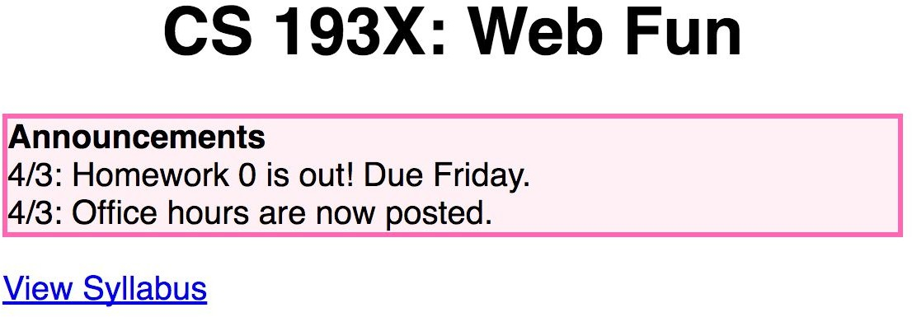
Solution?!
body {
font-family: Helvetica;
}
h1 {
text-align: center;
}
a {
text-align: center;
}
p {
border: 3px solid hotpink;
Produces:
background-color: lavenderblush;
}

Slide 20
CSS exercise debrief
We used some key techniques:
Add invisible containers in HTML to select groups of elements in CSS.
Apply styles to parent / ancestor element to style parent and all its children. (Will talk more about this later.)

Slide 21
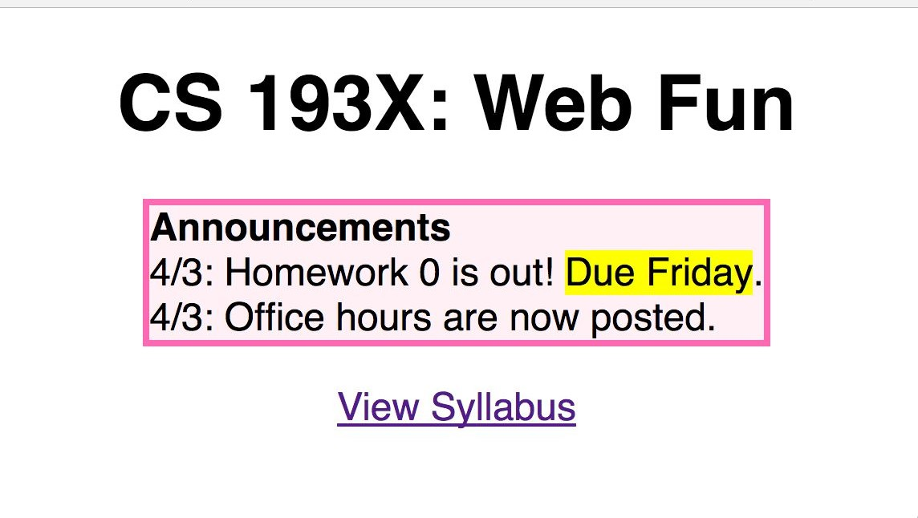
CSS exercise debrief
But we encountered more weirdness...
text-align: center; didn't work on the <a> tag
The box was reaaaaaally wide!
How to center the box?!
How do you highlight?!
How do we get from this… … to this?

Slide 22
Q: Why is HTML/CSS so bizarre??

Slide 23
A: There is one crucial set of rules we haven't learned yet…
block vs inline display

Slide 24
What is HTML?
HTML (Hypertext Markup Language)
Describes the content and structure of a web page
Made up of building blocks called elements.
<p>
HTML is <em>awesome!!!</em>
<img src="puppy.png" />
</p>
And there are 3 basic types.

Slide 25
Types of HTML elements
Each HTML element is categorized by the HTML spec into one of three-ish categories:
block: large blocks of content, has height and width
<p>, <h1>, <blockquote>, <ol>, <ul>, <table>
inline: small amount of content, no height or width
<a>, <em>, <strong>,<br>
inline block: inline content with height and width
<img>
metadata: information about the page, usually not visible
<title>, <meta>

Slide 26
Block elements
Examples:
<p>, <h1>, <blockquote>, <ol>, <ul>, <table>
Take up the full width of the page (flows top to bottom)
Have a height and
width
Can have block or inline elements as children

Slide 27
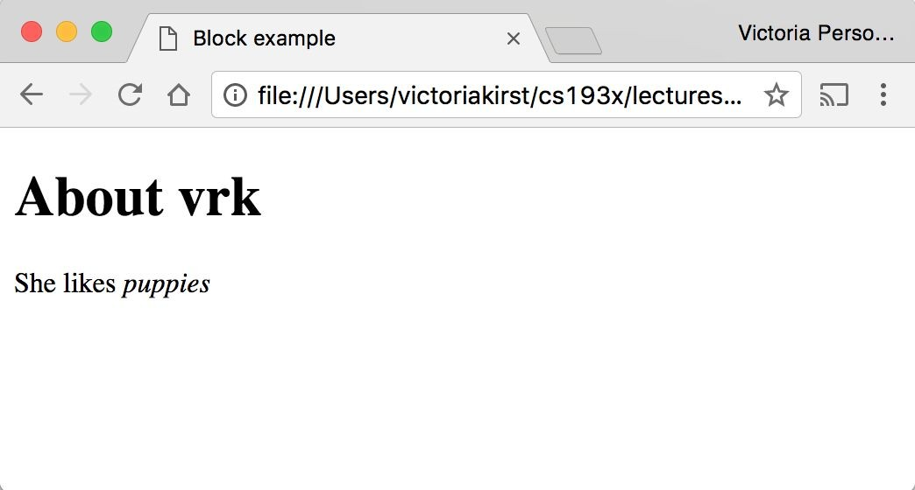
Example: Block
 | <h1>About vrk</h1> <p> She likes <em>puppies</em>
 | </p>

Slide 28
Q: What does this look like in the
browser?
h1 {
border: 5px solid red;
}
 | <h1>About vrk</h1> <p> She likes <em>puppies</e | m>
 | </p>

Slide 29
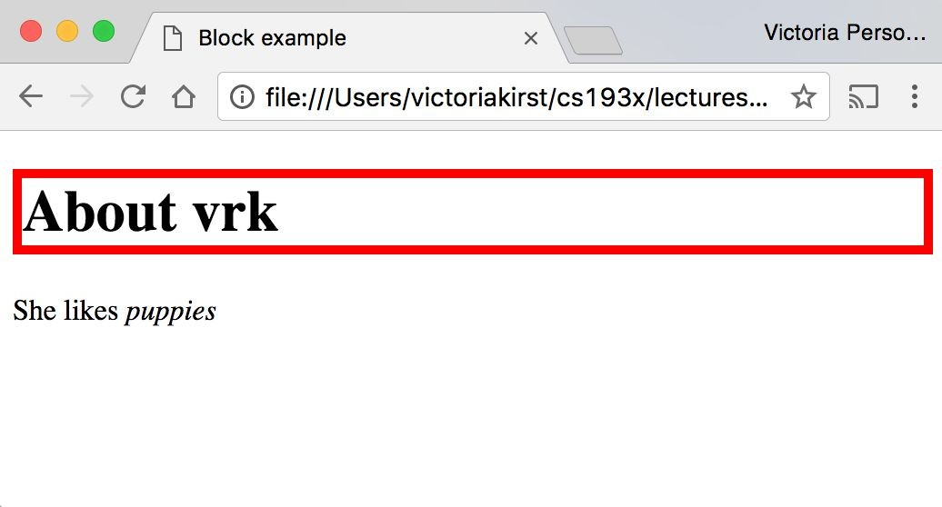
(Codepen)

Slide 30
Block-level:
extends the full width of the page
h1 {
border: 5px solid red;
}
<h1>About vrk</h1>
<p>
She likes <em>puppies</em>
</p>
<h1> is block-level, so it extends the full width of the page by default
Note how block-level elements (h1, p) flow top to bottom
See: Codepen

Slide 31
Q: What does this look like in the
browser?
h1 {
border: 5px solid red;
width: 50%;
}
 | <h1>About vrk</h1> <p> She likes <em>puppies</em </p> | >

Slide 32
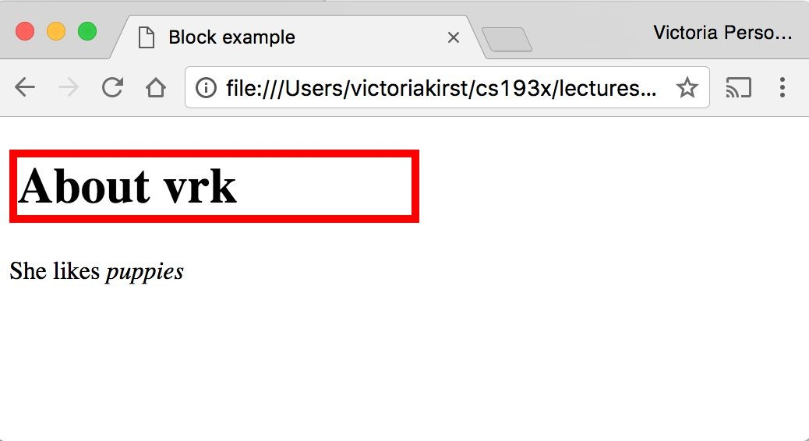
(Codepen)

Slide 33
Block-level
width can be modified
h1 { border: 5px | solid | red; |  | <h1>About vrk</h1> <p>
width: 50%; |  |  |  | She likes <em>puppies</em>
} |  |  |  | </p>
<h1> is block-level, so its width can be modified
Block-level elements still flow top to bottom
See: Codepen

Slide 34
Inline elements
Examples:
<a>, <em>, <strong>, <br>
Take up only as much width as needed (flows left to right)
Cannot have height and width
Cannot have a block element child
Cannot be positioned (i.e. CSS properties like float and position do not apply to inline elements)
Must position its containing block element instead

Slide 35
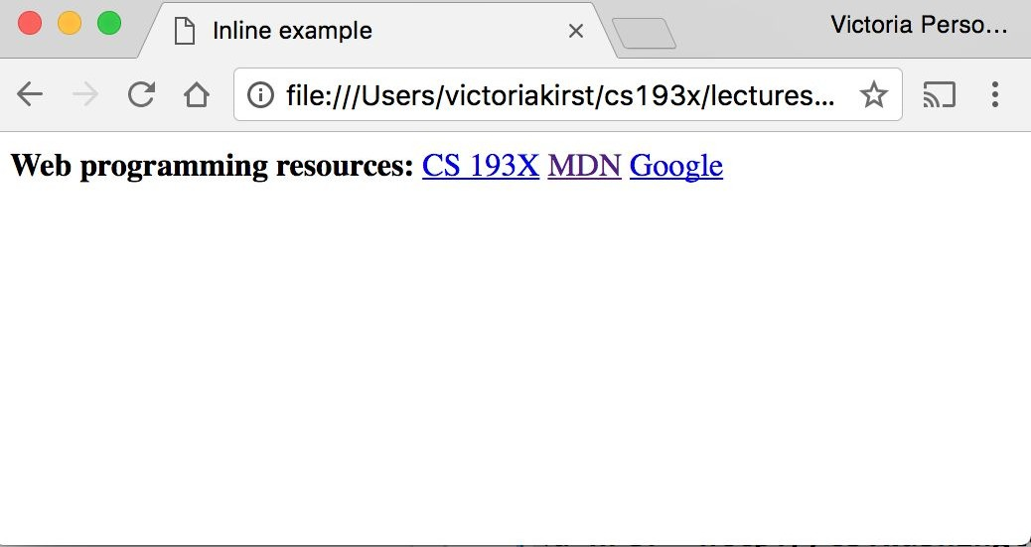
Example: Inline
< < < | strong>Web programming resources:</strong> a href="http://cs193x.stanford.edu">CS 193X</a> a href="https://developer.mozilla.org/en-US/">MDN</a>
<a href="http://google.com">Google</a>

Slide 36
Q: What does this look like in the
browser?
strong {
border: 5px solid red; width: 1000px;
}
 | strong>Web programming resources:</strong>
 | a href="http://cs193x.stanford.edu">CS 193X</a>
 | a href="https://developer.mozilla.org/en-US/">MDN</a>
 | a href="http://google.com">Google</a>

Slide 37
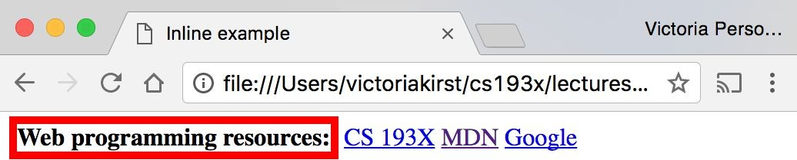
(Codepen)

Slide 38
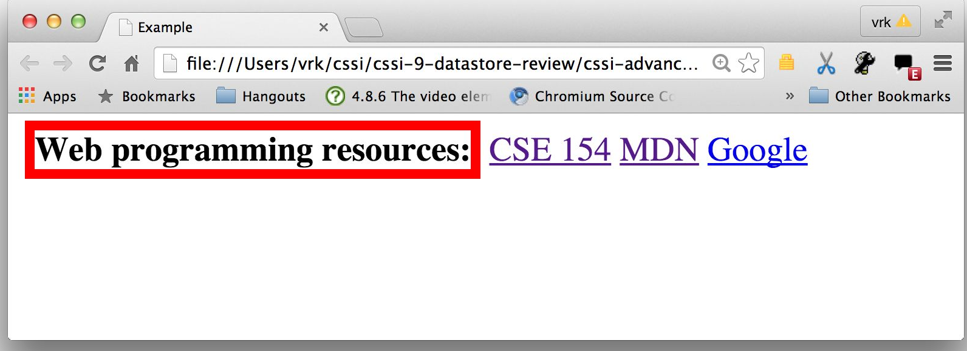
Inline elements ignore width
width cannot be modified
strong {
border: 5px solid red;
width: 1000px;
/* Will not work; strong is inline! */
}
<strong>Web programming reso
<a href="http://cs193x.stanf
<a href="https://developer.m
<a href="http://google.com">
Cannot set width on inline element, so it is ignored (Codepen)

Slide 39
inline-block
Examples: <img>, any element with
display: inline-block;
Width is the size of the content, i.e. it takes only as much space as needed (flows left to right)
Can have height and width
Can have a block element as a child
Can be positioned (i.e. CSS properties like float and position apply)

Slide 40

Example: Inline-block
img {
width: 50px;
}
Q: What does this look like in the browser?
<img | src="http://i.imgur.com/WJToVGv.jpg" | />
<img | src="http://i.imgur.com/WJToVGv.jpg" | />
<img | src="http://i.imgur.com/WJToVGv.jpg" | />
<img | src="http://i.imgur.com/WJToVGv.jpg" | />
<img | src="http://i.imgur.com/WJToVGv.jpg" | />
http://i.imgur.com/WJToVGv.jpg =

Slide 41
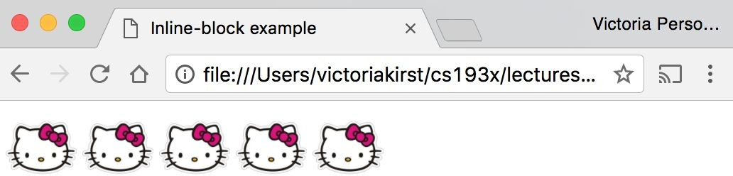
(Codepen)

Slide 42
Inline-block
Has width and height; flows left to right
Can set width on inline-block element, so image width is set to 50px. (Codepen)
inline-block flows left to right, so images are right next to each other.
<img | src="http://i.imgur.com/WJToVGv.jpg" | />
<img | src="http://i.imgur.com/WJToVGv.jpg" | />
<img | src="http://i.imgur.com/WJToVGv.jpg" | />
<img | src="http://i.imgur.com/WJToVGv.jpg" | />
<img | src="http://i.imgur.com/WJToVGv.jpg" | />
img {
width: 50px;
}

Slide 43
The display CSS property
You can change an element's default rendering type by changing the display property. Examples:
p {
display: inline;
}
a {
display: block;
}
Possible values for display:
block
inline
inline-block
- some others: link

Slide 44
Review
block: flows top-to-bottom; has height and width
<p>, <h1>, <blockquote>, <ol>, <ul>, <table>
inline: flows left-to-right; does not have height and width
<a>, <em>, <strong>,<br>
inline block: flows left-to-right; has height and width
equal to size of the content
<img>
Questions?

Slide 45
Moral of the story:
If your CSS isn't working, see if you're trying to apply block-level properties to inline elements

Slide 46
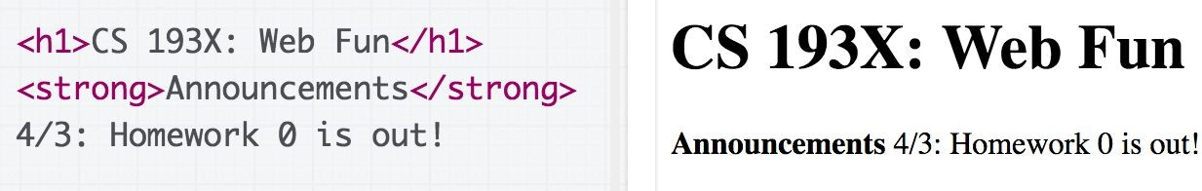
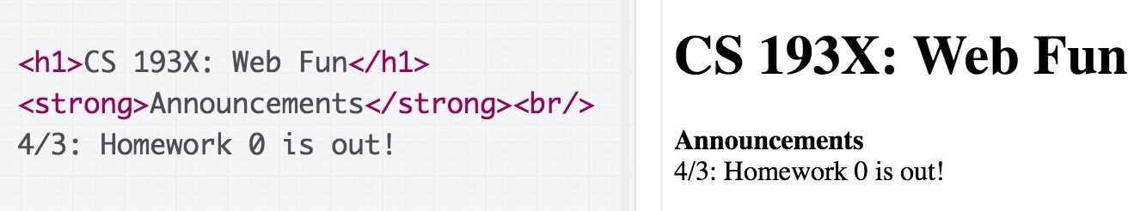
h1 vs strong mystery
Recall: Weirdly the <h1> heading was on a line of its own, and
<strong> was not. -- Why?

Slide 47
h1 vs strong demystified!
Recall: Weirdly the <h1> heading was on a line of its own, and
<strong> was not. -- Why?
Because h1 is a block-level element, and strong is an inline-level element

Slide 48
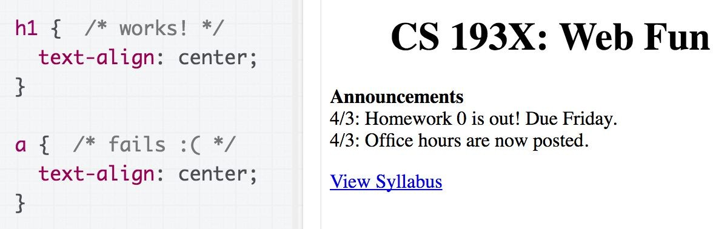
text-align mystery
Recall: We couldn't set text-align: center; on the <a> tag directly, but we could center <h1>. Why?
Let's try looking at the MDN description of text-align...

Slide 49
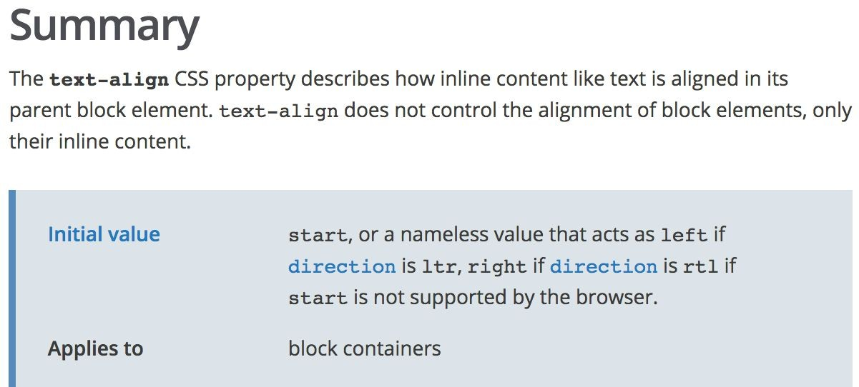
text-align mystery
(source)

Slide 50
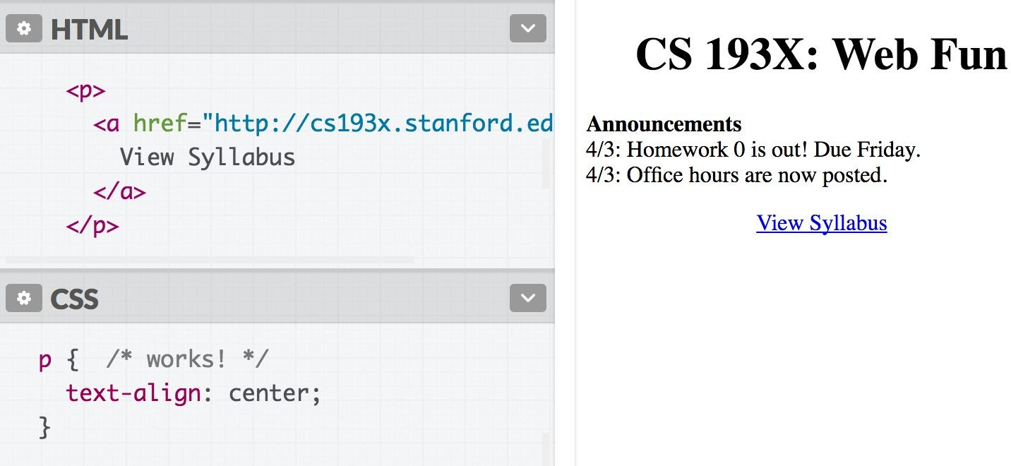
text-align demystified!
Why? From the spec, can't apply text-align to an inline element; must apply text-align to its block container, or set a { display : block; }

Slide 51
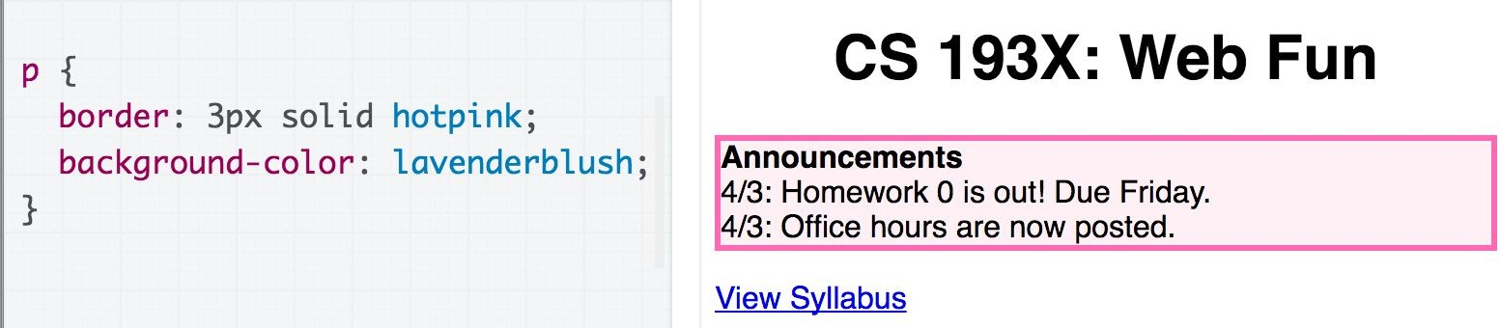
Box size mystery
Recall: The pink box we put around the announcements extended the entirety of the page.
Why?
How do we fix this?

Slide 52
Box size mystery
Recall: The pink box we put around the announcements extended the entirety of the page.
Why? Because p is block-level, so width == width of the page
How do we fix this?

Slide 53
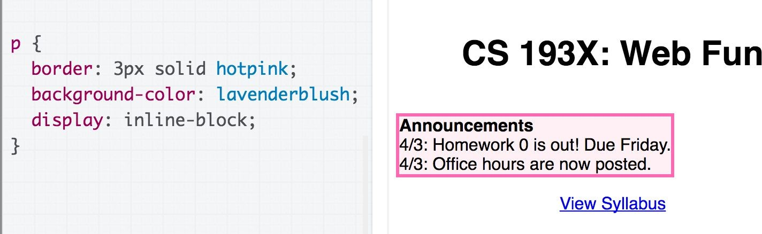
Box size mystery: demystified!
Recall: The pink box we put around the announcements extended the entirety of the page.
Why? Because p is block-level, so width == width of the page
How do we fix this? Change display to inline-block (though now the space above the box has increased… will address later!)

Slide 54
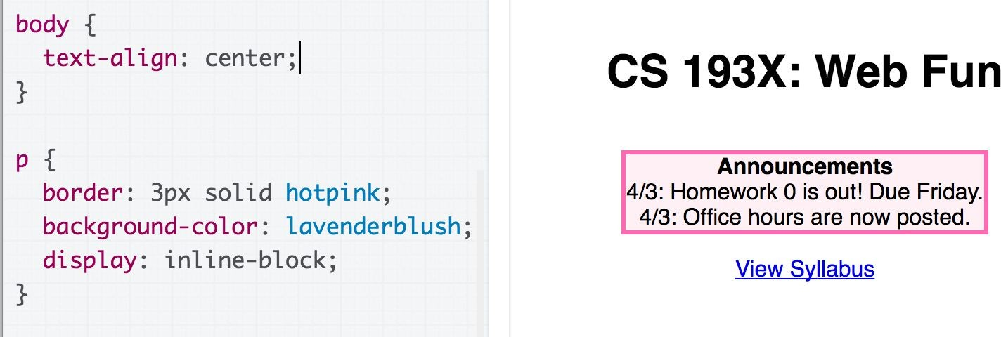
Centering the box
We can also center the box by centering the body tag, since p is now inline-block.

Slide 55
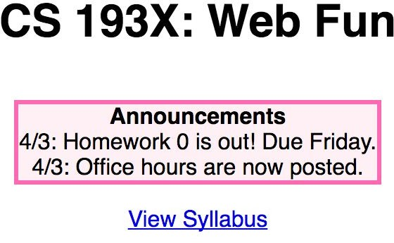
Highlight mystery
Recall: We didn't know how to select a random snippet of text to change its background.
How do we fix this?

Slide 56
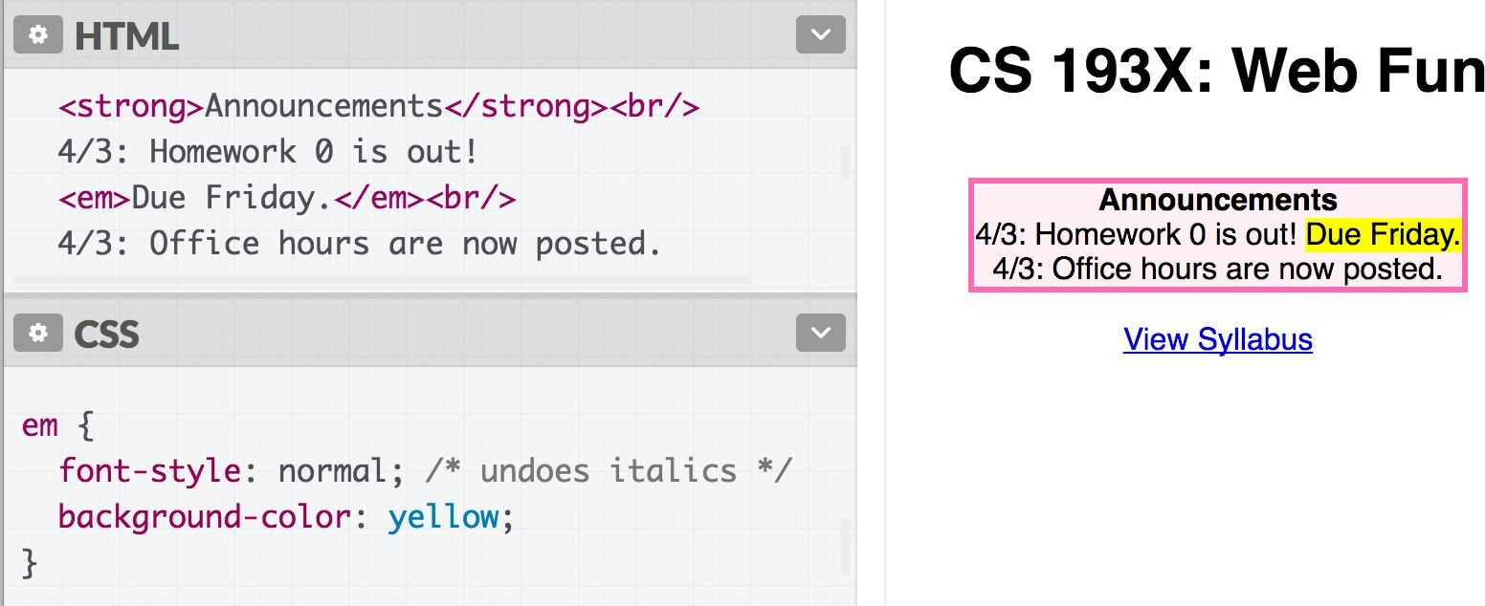
Highlight: demystified!
We can select a random segment of text by wrapping it in an
inline element:
Hmmm… but wouldn't it be better to have a "highlight" element?

Slide 57
Highlight: demystified!
We can select a random segment of text by wrapping it in an
inline element:
Hmmm… but wouldn't it be better to have a "highlight" element?
How do we make a generic HTML element?

Slide 58
Have you heard of <div> and <span>?
What are they?

Slide 59
<div> and <span>
Two generic tags with no intended purpose or style:
<div>: a generic block element
<span>: a generic inline element

Slide 60
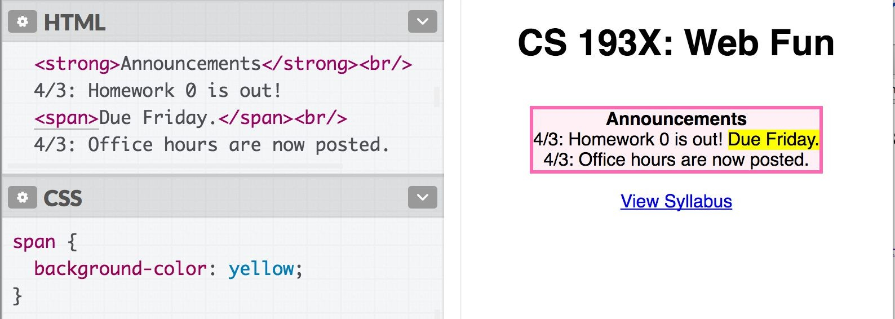
<span> in action
We can use <span> as a generic inline HTML container:

Slide 61
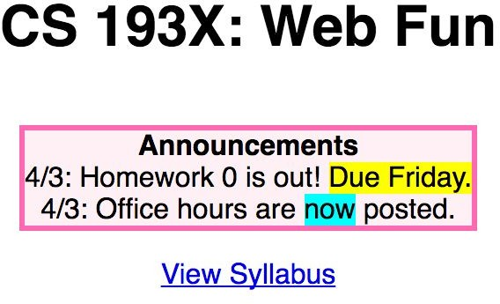
Multiple generic containers?
But won't we often want multiple generic containers? How do we distinguish two generic containers?
In other words, how do we select a subset of elements instead of
all elements on the page?

Slide 62
CSS Selectors: Classes and Ids

Slide 63
Classes and ids
There are 3 basic types of CSS selectors:
Element selector (this is the one we've been using) | p | All <p> elements
✨ID selector✨ | #abc | element with id="abc"
✨Class selector✨ | .abc | elements with class="abc"
<h1 id="title">Homework</h1>
<em class="hw">HW0</em> is due Friday.<br/>
<em class="hw">HW1</em> goes out Monday.<br/>
<em>All homework due at 11:59pm.</em>

Slide 64
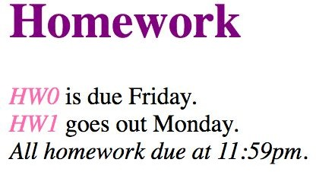
Classes and ids
<h1 id="title">Homework</h1>
<em class="hw">HW0</em> is due Friday.<br/>
<em class="hw">HW1</em> goes out Monday.<br/>
<em>All homework due at 11:59pm.</em>
.hw {
color: hotpink;
}
#title {
color: purple;
}

Slide 65
More on class and id
class and id are special HTML attributes that can be used on any HTML element
class: Used on 1 or more elements; identifies a
collection of elements
id: Used on exactly 1 element per page; identifies
one unique element
Can apply multiple classes by space-separating them:
<span class="hw new">HW1</span>
Often used with span and div to create generic elements: e.g. <span class="highlight"> is like creating a "highlight" element

Slide 66
Other selectors: Next time!

Slide 67
Overflow slides
(we didn't cover these)

Slide 68
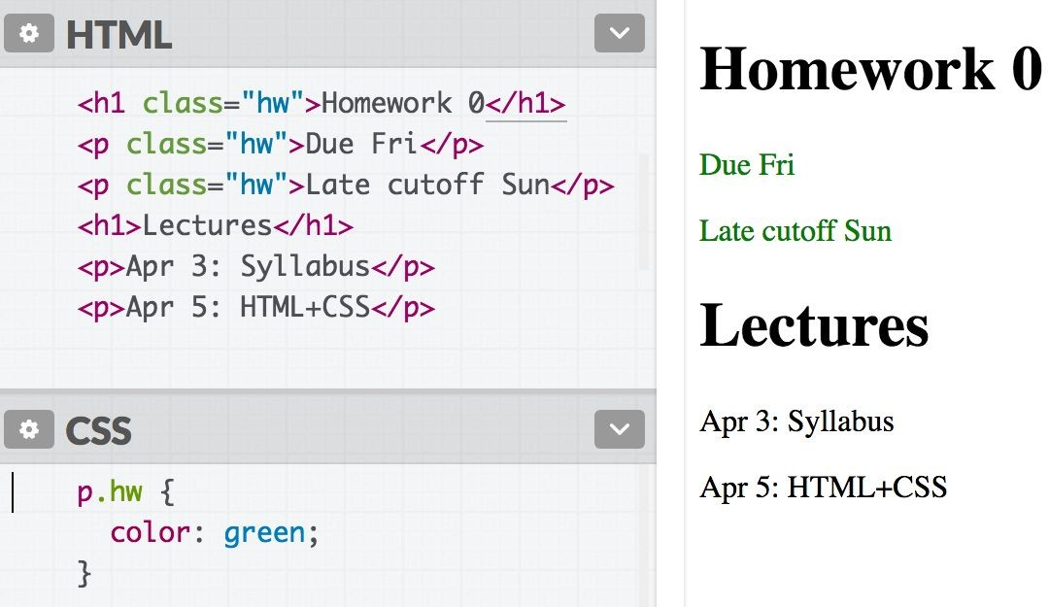
element.className
Syntax | Example | Example described
element.className | p.abc | <p> elements with abc class

Slide 69
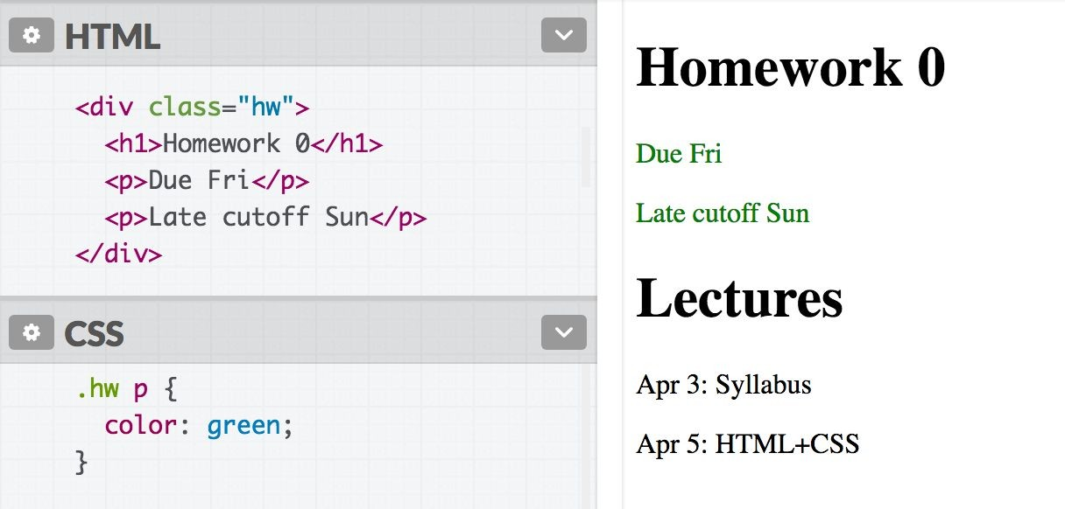
Descendent selector
Syntax | Example | Example described
selector selector | div strong | <strong> elements that are descendants of a <div>

Slide 70
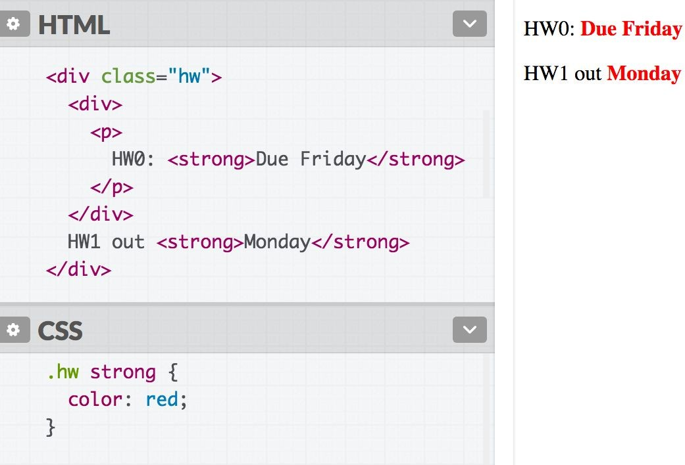
Descendent selector
Syntax | Example | Example described
selector selector | div strong | <strong> elements that are descendants of a <div>
Note: The element does not have to be a direct child. The descendent may be nested many
layers in.

Slide 71
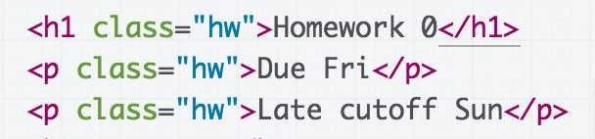
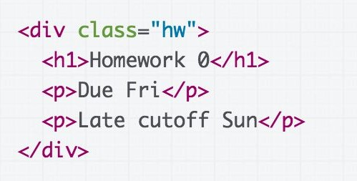
Descendent selector
Syntax | Example | Example described
selector selector | div strong | <strong> elements that are descendants of a <div>
Discouraged:
Preferred:
vs
Instead of applying a class to several adjacent elements, wrap the group in a <div> container and style the contents via descendent selectors.

Slide 72
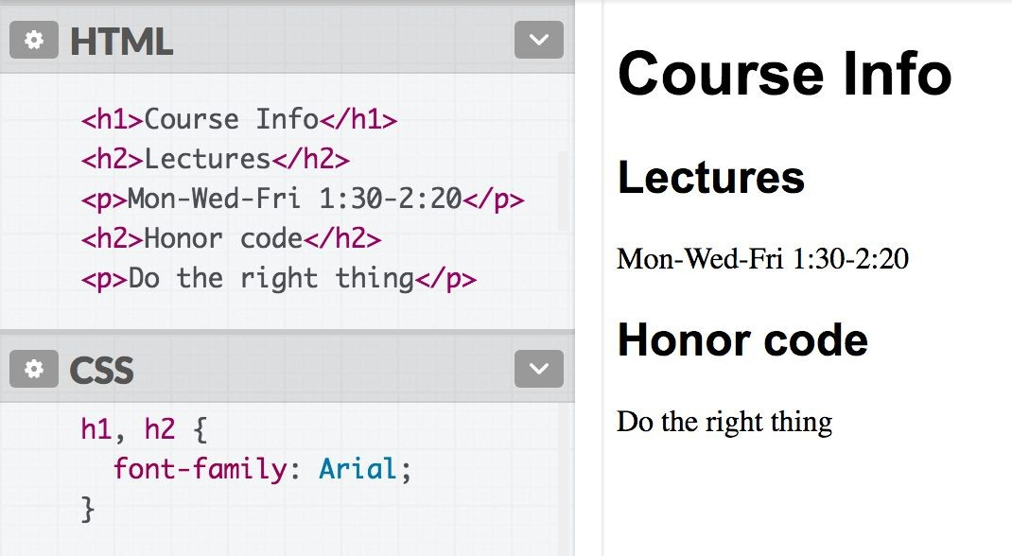
selector, selector (comma)
Syntax | Example | Example described
selector, selector | h2, div | <h2> elements and <div>s

Slide 73
Selector summary
Example | Example described
p | All <p> elements
.abc | All elements with the abc class, i.e. class="abc"
#abc | Element with the abc id, i.e. id="abc"
p.abc | <p> elements with abc class
p#abc | <p> element with abc id (p is redundant)
div strong | <strong> elements that are descendants of a <div>
h2, div | <h2> elements and <div>s

Slide 74
Grouping selectors
2 Common bugs:
p.abc p .abc
vs p .abc
vs p, .abc
A <p> element with the abc class vs
An element with the abc class that descends from <p>
An element with the abc class that descends from <p> vs
All <p> elements and all elements with the abc class

Slide 75
Combining selectors
You can combine selectors:
#main li.important strong { color: red;
}
Q: What does this select?

Slide 76
Grouping selectors
Q: What does this select?
#main li.important strong { color: red;
}
A: Read from right to left:
<strong> tags that are children of <li> tags that have an "important" class that are children of the element with the "main" id.

Slide 77
Colliding styles
When styles collide, the most specific rule wins (specificity)
div strong { color: red; } strong { color: blue; }
<div>
<strong>What color am I?</strong>
</div>

Slide 78
Colliding styles
When styles collide, the most specific rule wins (specificity)
div strong { color: red; } strong { color: blue; }
<div>
<strong>What color am I?</strong>
</div>

Slide 79
Colliding styles
Specificity precedence rules (details):
ids are more specific than classes
classes are more specific than element names
elements are more specific than children of those elements

Slide 80
Colliding styles
- If elements have the same specificity, the later rule wins.
strong { color: red; } strong { color: blue; }
<div>
<strong>What color am I?</strong>
</div>
Aside: The process of figuring out what rule applies to a given element is called the cascade. This is where the "C" in Cascading Style Sheets comes from.

Slide 81
Inheritance
We saw earlier that CSS styles are inherited from parent to child.
a, h1, p, strong {
font-family: Helvetica;
}
Instead of selecting all elements individually:
You can style the parent and the children will inherit the styles.
body {
font-family: Helvetica;
}
h1, h2 {
font-family: Consolas;
}
You can override this style via specificity:

Slide 82

Inheritance
While many CSS styles are inherited from parent to child,
not all CSS properties are inherited.
a {
display: block; font-family: Arial;
}
<em> inherits the
font-family property, but not display:
<a href="/home">
Back to <em>Home</em>
</a>

Slide 83


Inheritance
While many CSS styles are inherited from parent to child,
not all CSS properties are inherited.
There's no rule for what properties are inherited or not; the inheritance behavior defined in the CSS spec.
You can look it up via MDN, e.g.
font-family: display:
Generally text-related properties are inherited and layout-related properties are not.
(You can also change this via the inherit CSS property, which is somewhat esoteric and not often use)

Slide 84
Before we move on: A few style notes

Slide 85
Why not <div> everywhere?
Technically, you can define your entire web page using
<div> and the class attribute.
Is this a good idea?
Why does HTML have ids when you have classes?
Why does HTML have <p>, <h1>, <strong>, etc. when you have <div>, <span>, class, and id?

Slide 86
CSS Box Model

Slide 87
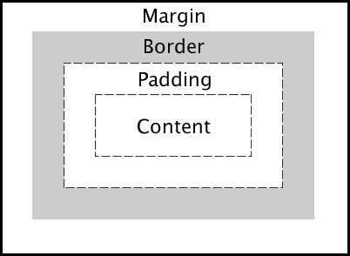
The CSS Box Model
Every element is composed of 4 layers:
the element's content
the border around the element's content
padding space between the content and border (inside)
a margin clears the area around border (outside)
You should mostly consider the box model properties for
block-level elements!
- It can be used on inline elements but it behaves differently

Slide 88
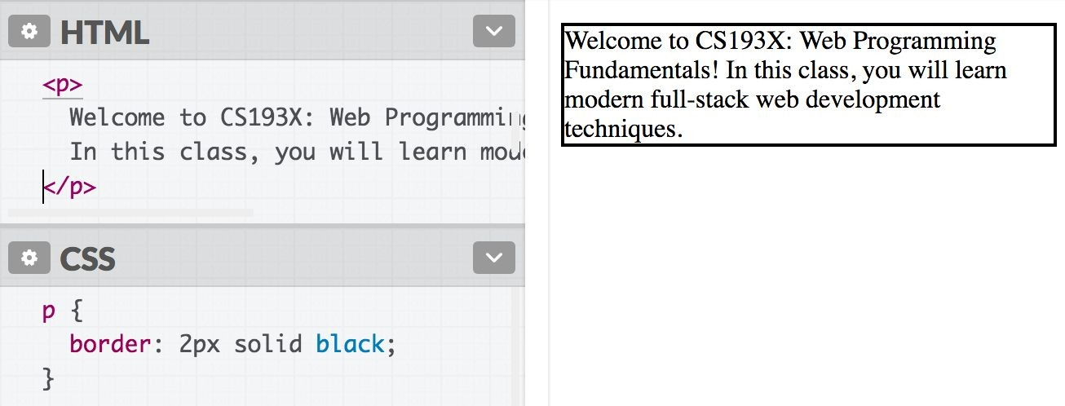
border
We've used the shorthand:
border: width style color;

Slide 89
border
Can also specify each border individually:
border-top border-bottom border-left border-right
And can set each property individually:
border-style: dotted; border-width: 3px; border-color: purple;
(all styles)

Slide 90
border
Can also specify each border individually:
border-top border-bottom border-left border-right
And can set each property individually:
border-style: dotted; border-width: 3px; border-color: purple;
(all styles)
There are other units besides pixels (px) but we will address them in the next couple lectures.

Slide 91
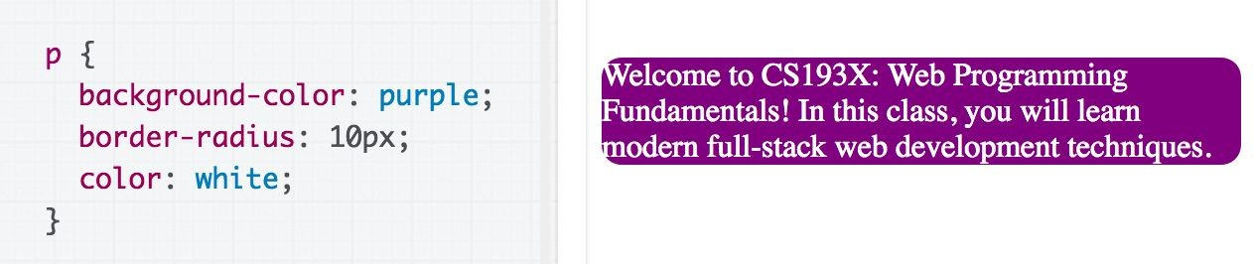
Rounded border
Can specify the border-radius to make rounded corners:
border-radius: 10px;
You don't actually need to set a border to use border-radius.

Slide 92
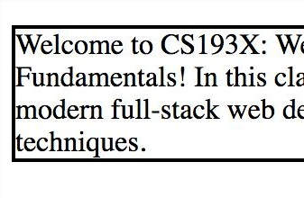
Borders look a little squished
When we add a border to an element, it sits flush against the text:
Q: How do we add space between the border and the content of the element?

Slide 93
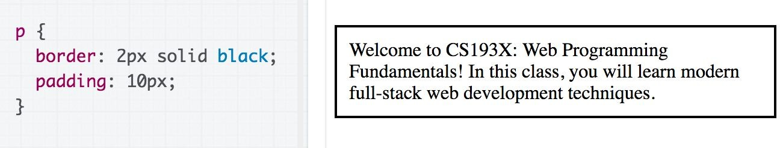
padding
padding is the space between the border and the content.
Can specify padding-top, padding-bottom, padding-left, padding-right
There's also a shorthand:
padding: 2px 4px 3px 1px; <- top|left|bottom|right
padding: 10px 2px; <- top+bottom|left+right

Slide 94
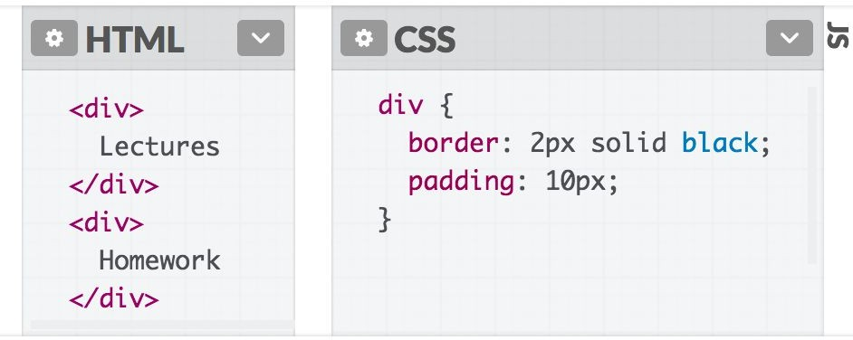
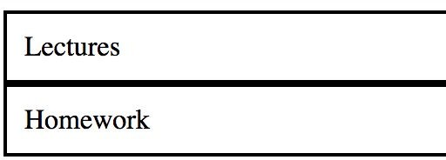
<div>s look a little squished
When we add a border to multiple divs, they sit flush against each other:
Q: How do we add space between multiple elements?

Slide 95
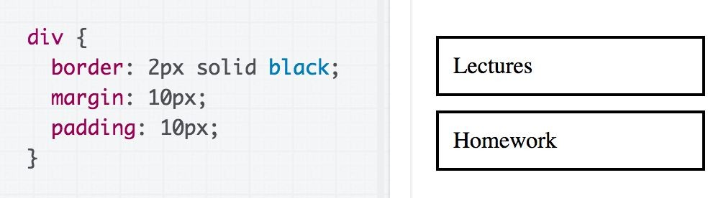
margin
margin is the space between the border and other elements.
Can specify margin-top, margin-bottom, margin-left, margin-right
There's also a shorthand:
margin: 2px 4px 3px 1px; <- top|left|bottom|right
margin: 10px 2px; <- top+bottom|left+right

Slide 96
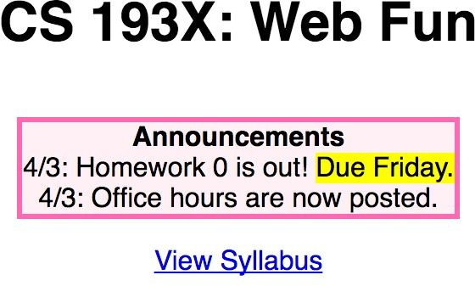
The CSS Box Model
Let's revisit our Course web page example:

Slide 97
The CSS Box Model
width by default refers to content-width, which is almost never what you want
Use box-sizing: border-box; to calculate
width based on the border size
Margin collapsing is something to know about and consider
When in doubt, use the browser's Page Inspector to see what's going on
(Also, the Box Model works a little differently for inline elements)

Slide 98
Q: What does this look like in the browser?
div {
display: inline-block; background-color: yellow;
}
<body>
<div>
<p>Make the background color yellow!</p>
<p>Surrounding these paragraphs</p>
</div>
</body>

Slide 99
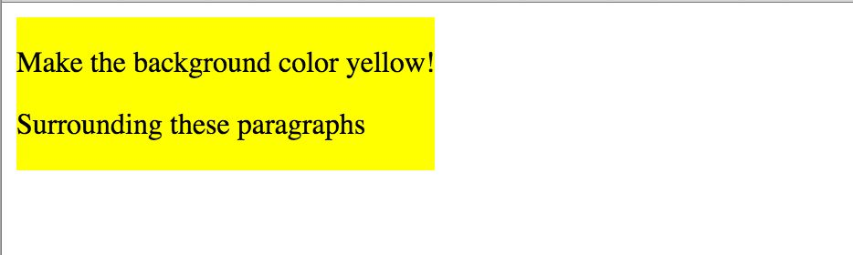
Q: Why is there a white space around the box?
We can use the browser's Page Inspector to help us figure it out!

