Slide 1
Web Programming Fundamentals
February 2019
These slides are based on Victoria Kirst (vrk@stanford.edu) course CS193X. You can equally check out here (https://cs193x.stanford.edu) for the original course materials

Slide 2
Today's schedule
Announcements:
Schedule:
HTML and CSS
Inline vs block
Classes and Ids

Slide 3

Suggestion: Bring your laptop!
Bring your laptop to lecture so you can follow along with the lecture slides and check out the live examples
I will be using CodePen in lecture, which lets you livestream the code I write, which might be hard to see on the projector screen
(But, y'know, don't look ahead for the answers to lecture questions and then pretend like you knew them all along.)

Slide 4
HTML and CSS

Slide 5
Quick review

Slide 6
Recall: HTML
HTML (Hypertext Markup Language)
Describes the content and structure of a web page; not a programming language.
Made up of building blocks called elements.
<p>
HTML is <em>awesome!!!</em>
<img src="puppy.png" />
</p>

Slide 7
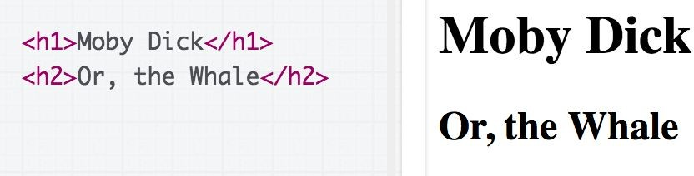

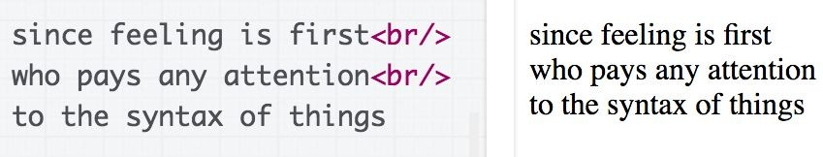
Some HTML elements
Top-level heading: h1, h2, ... h6
Paragraph: p
Line break: br

Slide 8
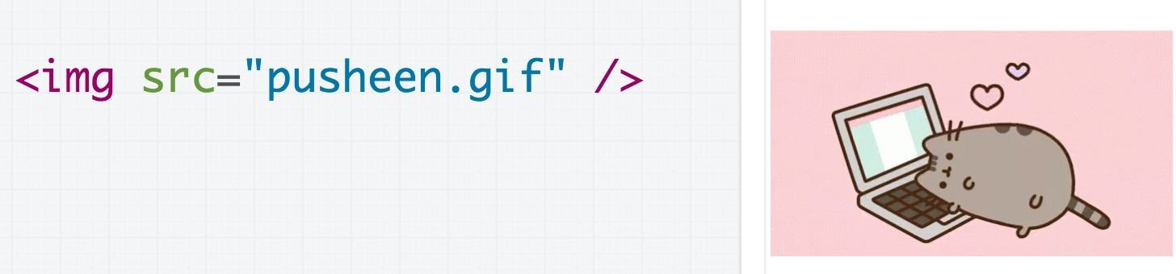

Some HTML elements
Image: img
Link: a (note: not link)
Strong (bold): strong (note: don't use b)
Emphasis (italic): em (note: don't use i)

Slide 9
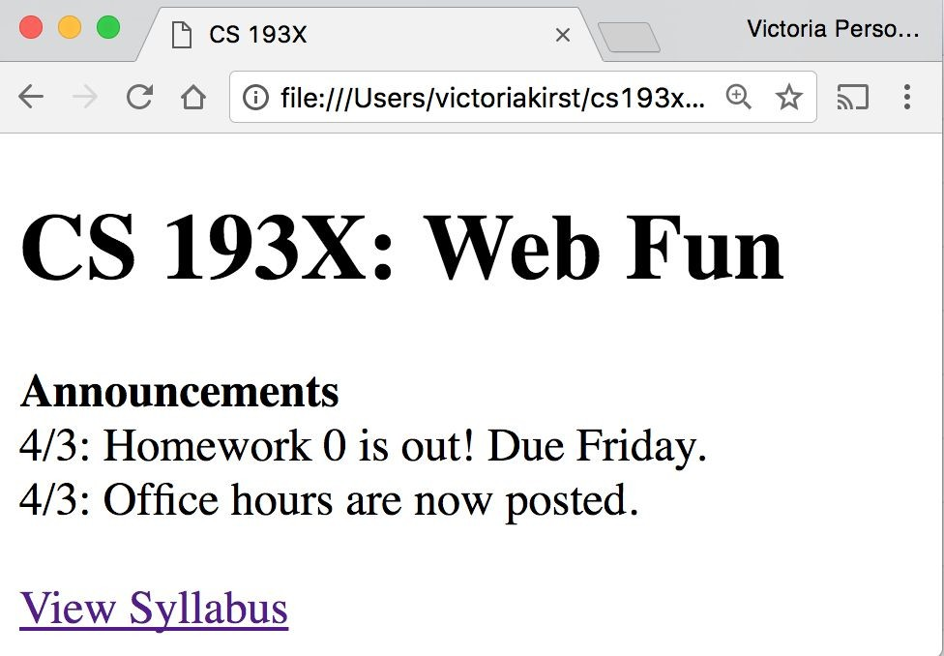
Recall: Course web page
We wrote some HTML to make the following page:

Slide 10
That was weird
- We saw that HTML whitespace collapses into one space…
<h1>CS 193X: Web Fun</h1>
<strong>Announcements</strong><br/>
4/3: Homework 0 is out!<br/>
- Except weirdly the <h1> heading was on a line of its own, and <strong> was not.
Hmmm… strange…
Oh well, it works! Let's move on!!!

Slide 11
CSS

Slide 12
Recall: CSS
CSS: Cascading Style Sheets
Describes the appearance and layout of a web page
Composed of CSS rules, which define sets of styles
selector {
property: value;
}

Slide 13
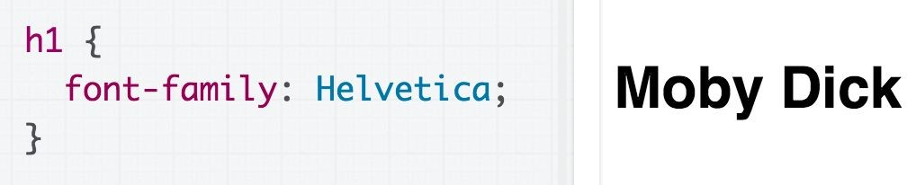
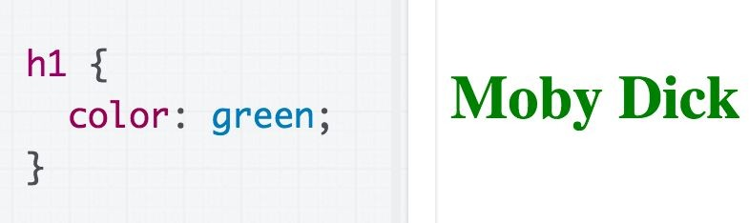
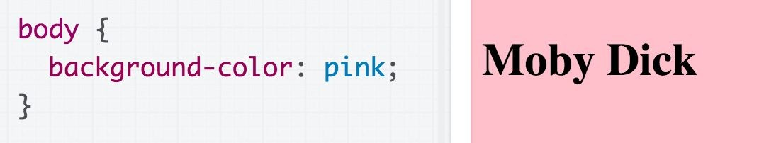
Some CSS properties
Font face: font-family
Font color: color
Note that color always refers to font color, and there's no way to make it mean anything other than font color.
Background color: background-color
Assign a background-color to body to make the page a different color.

Slide 14
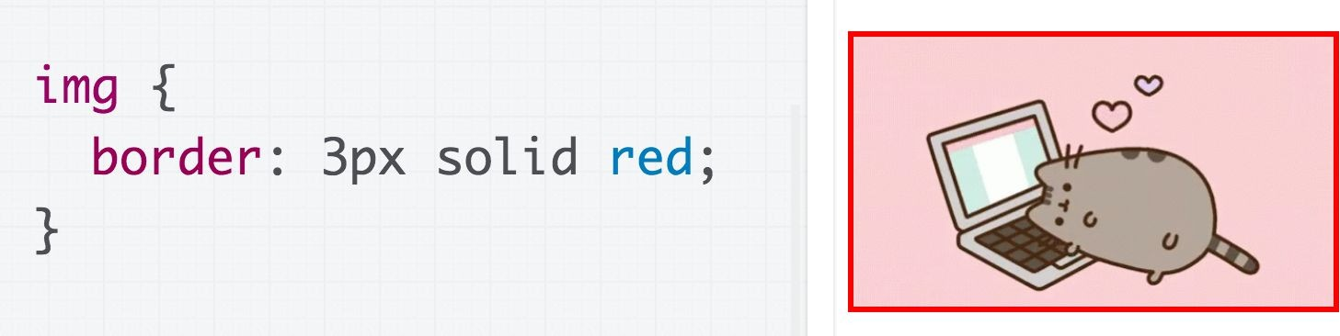
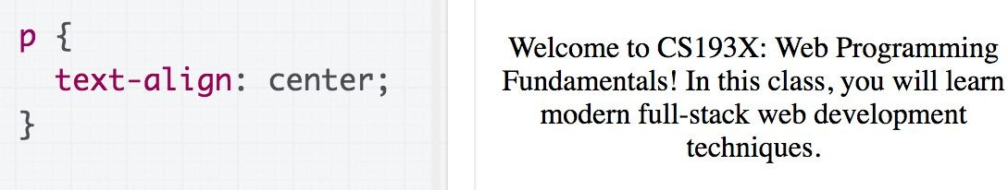
Some CSS properties
Border: border
(border shorthand syntax)
Text alignment: text-align (note: don't use <center>)

Slide 15
CSS colors
140 predefined names (list)
color: black;
The "a" in rgba stands for alpha channel and is a transparency value
Prefer more descriptive:
Predefined name
rgb / rgba
Hex
Hex values
color: #00ff00; color: #0f0; color: #00ff0080;
rgb() and rgba()
color: rgb(34, 12, 64);
color: rgba(0, 0, 0, 0.5);

Slide 16
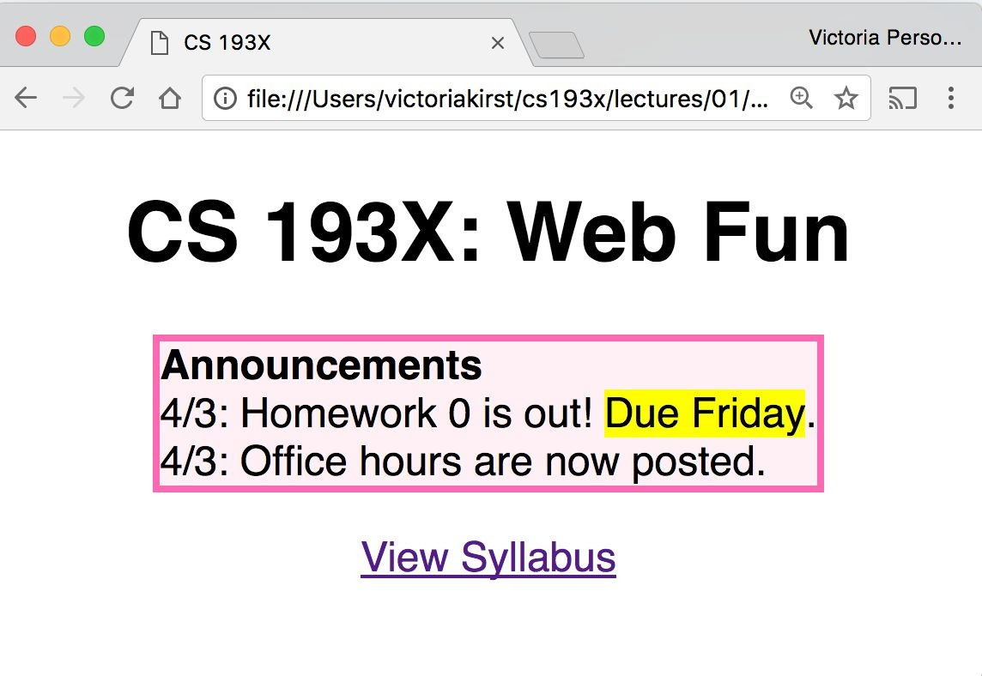
Exercise: Course web page
Let's write some CSS to style our page:
✨ CodePen link: Follow along! ✨

Slide 17
Exercise: Course web page
Let's write some CSS to style our page:
Font face: Helvetica
Border: hotpink 3px Background color: lavenderblush Highlight: yellow
Box is centered
Header and link are
centered
Box contents are
left-aligned
✨ CodePen link: Follow along! ✨

Slide 18
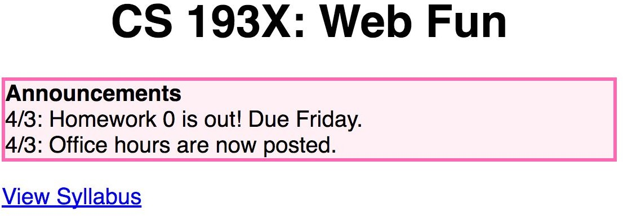
Solution?!
body {
font-family: Helvetica;
}
h1 {
text-align: center;
}
a {
text-align: center;
}
p {
border: 3px solid hotpink;
Produces:
background-color: lavenderblush;
}

Slide 19
CSS exercise debrief
We used some key techniques:
Add invisible containers in HTML to select groups of elements in CSS.
Apply styles to parent / ancestor element to style parent and all its children. (Will talk more about this later.)

Slide 20
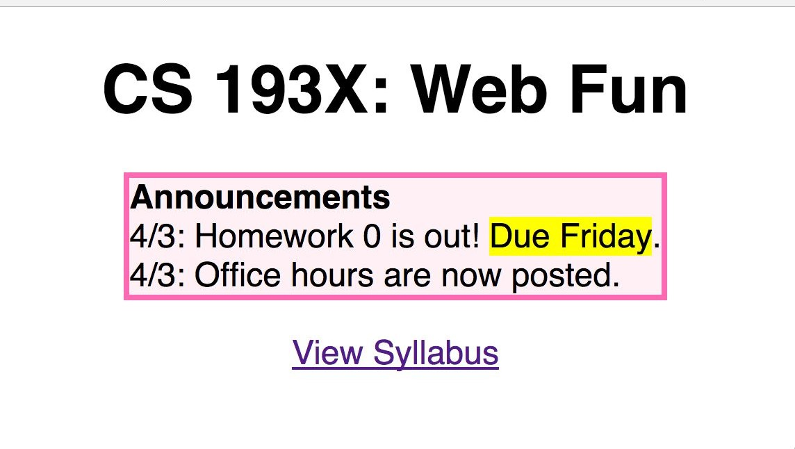
CSS exercise debrief
But we encountered more weirdness...
text-align: center; didn't work on the <a> tag
The box was reaaaaaally wide!
How to center the box?!
How do you highlight?!
How do we get from this… … to this?

Slide 21
Q: Why is HTML/CSS so bizarre??

Slide 22
A: There is one crucial set of rules we haven't learned yet…
block vs inline display

Slide 23
What is HTML?
HTML (Hypertext Markup Language)
Describes the content and structure of a web page
Made up of building blocks called elements.
<p>
HTML is <em>awesome!!!</em>
<img src="puppy.png" />
</p>
And there are 3 basic types.

Slide 24
Types of HTML elements
Each HTML element is categorized by the HTML spec into one of three-ish categories:
block: large blocks of content, has height and width
<p>, <h1>, <blockquote>, <ol>, <ul>, <table>
inline: small amount of content, no height or width
<a>, <em>, <strong>,<br>
inline block: inline content with height and width
<img>
metadata: information about the page, usually not visible
<title>, <meta>

Slide 25
Block elements
Examples:
<p>, <h1>, <blockquote>, <ol>, <ul>, <table>
Take up the full width of the page (flows top to bottom)
Have a height and
width
Can have block or inline elements as children

Slide 26
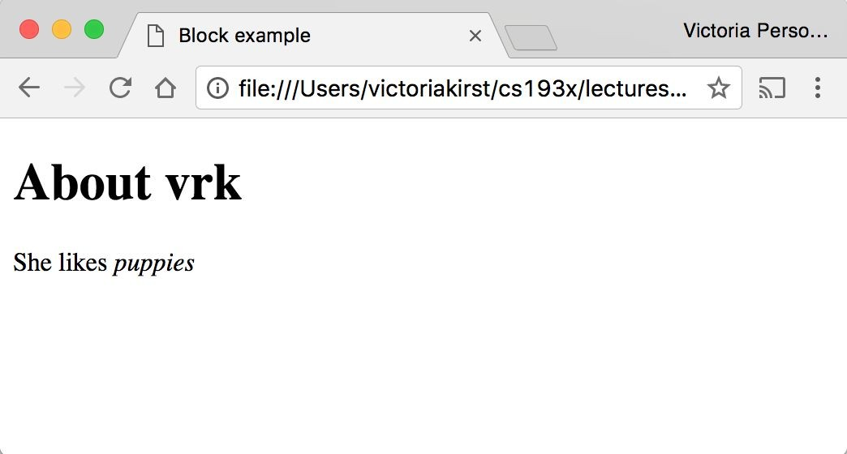
Example: Block
 | <h1>About vrk</h1> <p> She likes <em>puppies</em>
 | </p>

Slide 27
Q: What does this look like in the
browser?
h1 {
border: 5px solid red;
}
 | <h1>About vrk</h1> <p> She likes <em>puppies</e | m>
 | </p>

Slide 28
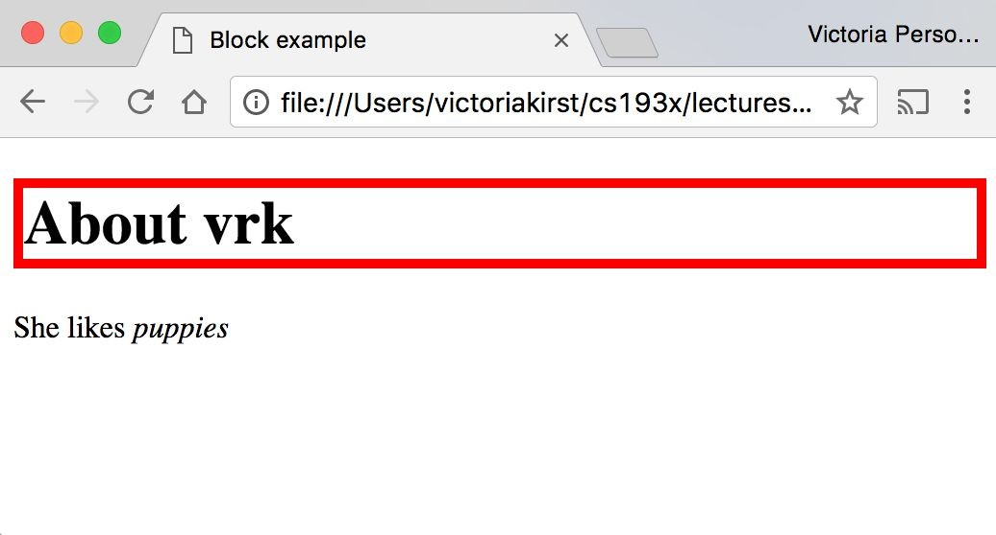
(Codepen)

Slide 29
Block-level:
extends the full width of the page
h1 {
border: 5px solid red;
}
<h1>About vrk</h1>
<p>
She likes <em>puppies</em>
</p>
<h1> is block-level, so it extends the full width of the page by default
Note how block-level elements (h1, p) flow top to bottom
See: Codepen

Slide 30
Q: What does this look like in the
browser?
h1 {
border: 5px solid red;
width: 50%;
}
 | <h1>About vrk</h1> <p> She likes <em>puppies</em </p> | >

Slide 31
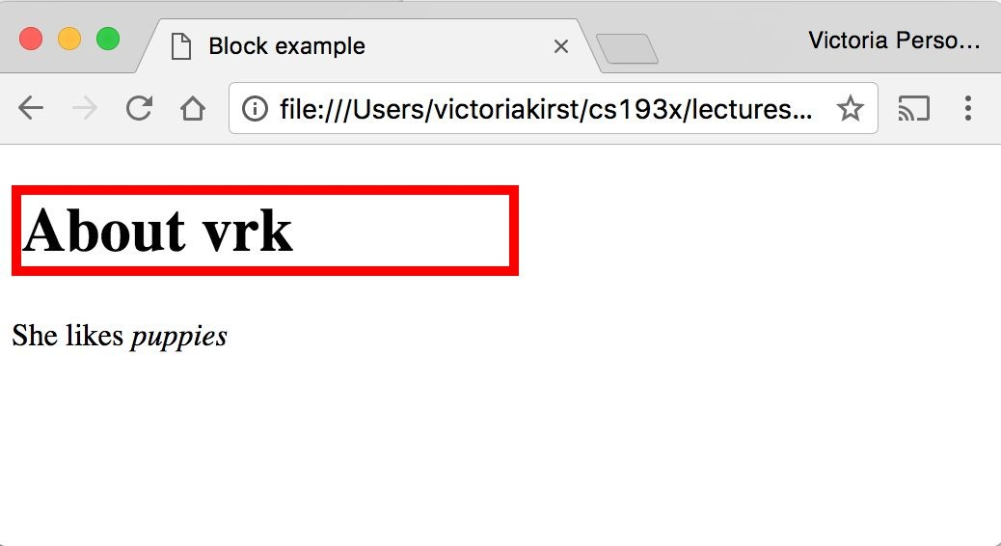
(Codepen)

Slide 32
Block-level
width can be modified
h1 { border: 5px | solid | red; |  | <h1>About vrk</h1> <p>
width: 50%; |  |  |  | She likes <em>puppies</em>
} |  |  |  | </p>
<h1> is block-level, so its width can be modified
Block-level elements still flow top to bottom
See: Codepen

Slide 33
Inline elements
Examples:
<a>, <em>, <strong>, <br>
Take up only as much width as needed (flows left to right)
Cannot have height and width
Cannot have a block element child
Cannot be positioned (i.e. CSS properties like float and position do not apply to inline elements)
Must position its containing block element instead

Slide 34
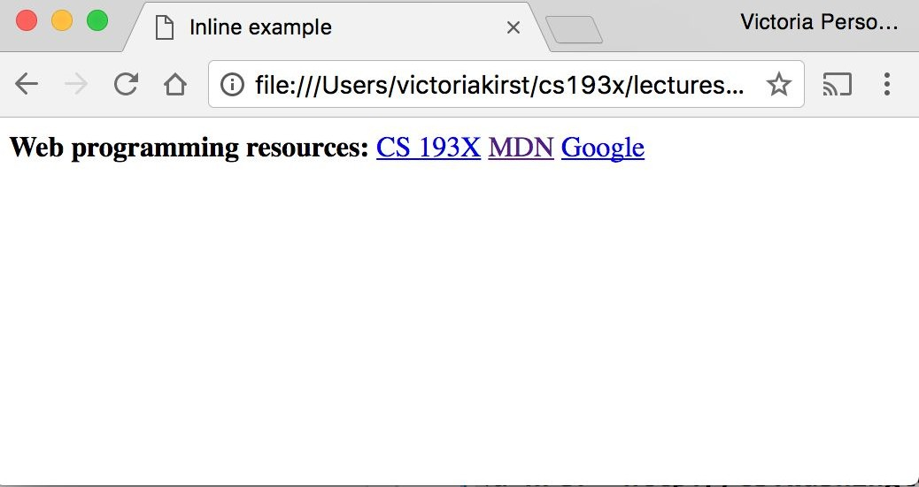
Example: Inline
< < < | strong>Web programming resources:</strong> a href="http://cs193x.stanford.edu">CS 193X</a> a href="https://developer.mozilla.org/en-US/">MDN</a>
<a href="http://google.com">Google</a>

Slide 35
Q: What does this look like in the
browser?
strong {
border: 5px solid red; width: 1000px;
}
 | strong>Web programming resources:</strong>
 | a href="http://cs193x.stanford.edu">CS 193X</a>
 | a href="https://developer.mozilla.org/en-US/">MDN</a>
 | a href="http://google.com">Google</a>

Slide 36
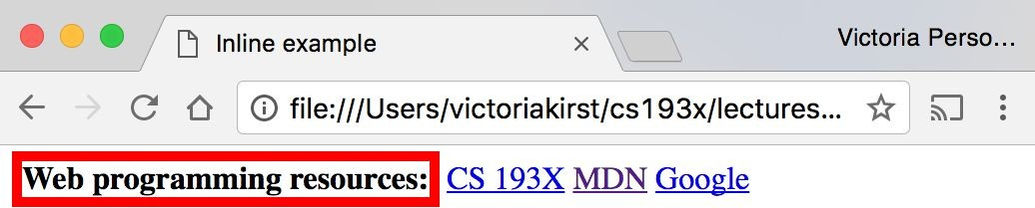
(Codepen)

Slide 37
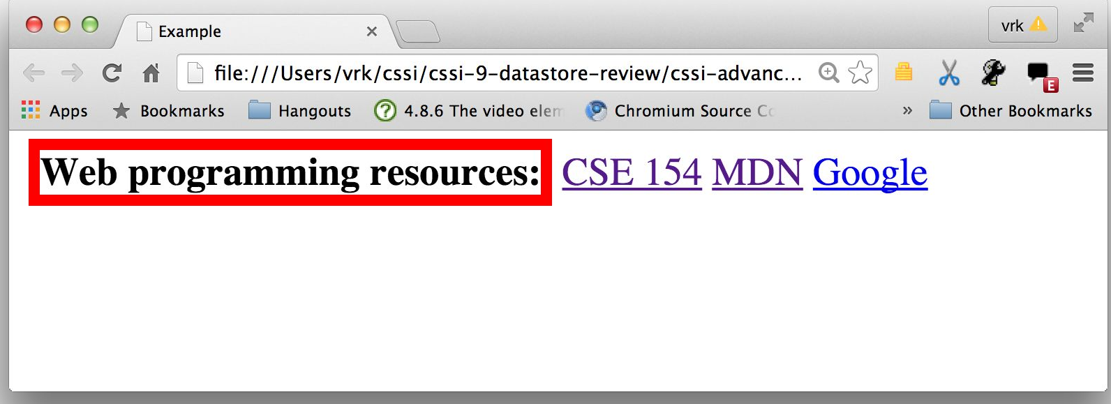
Inline elements ignore width
width cannot be modified
strong {
border: 5px solid red;
width: 1000px;
/* Will not work; strong is inline! */
}
<strong>Web programming reso
<a href="http://cs193x.stanf
<a href="https://developer.m
<a href="http://google.com">
Cannot set width on inline element, so it is ignored (Codepen)

Slide 38
inline-block
Examples: <img>, any element with
display: inline-block;
Width is the size of the content, i.e. it takes only as much space as needed (flows left to right)
Can have height and width
Can have a block element as a child
Can be positioned (i.e. CSS properties like float and position apply)

Slide 39

Example: Inline-block
img {
width: 50px;
}
Q: What does this look like in the browser?
<img | src="http://i.imgur.com/WJToVGv.jpg" | />
<img | src="http://i.imgur.com/WJToVGv.jpg" | />
<img | src="http://i.imgur.com/WJToVGv.jpg" | />
<img | src="http://i.imgur.com/WJToVGv.jpg" | />
<img | src="http://i.imgur.com/WJToVGv.jpg" | />
http://i.imgur.com/WJToVGv.jpg =

Slide 40
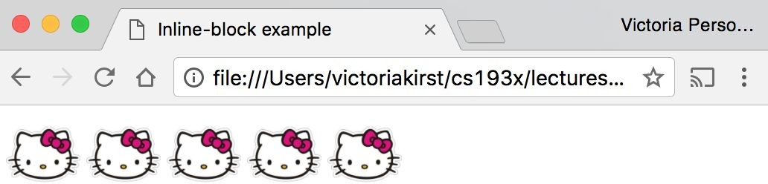
(Codepen)

Slide 41
Inline-block
Has width and height; flows left to right
Can set width on inline-block element, so image width is set to 50px. (Codepen)
inline-block flows left to right, so images are right next to each other.
<img | src="http://i.imgur.com/WJToVGv.jpg" | />
<img | src="http://i.imgur.com/WJToVGv.jpg" | />
<img | src="http://i.imgur.com/WJToVGv.jpg" | />
<img | src="http://i.imgur.com/WJToVGv.jpg" | />
<img | src="http://i.imgur.com/WJToVGv.jpg" | />
img {
width: 50px;
}

Slide 42
The display CSS property
You can change an element's default rendering type by changing the display property. Examples:
p {
display: inline;
}
a {
display: block;
}
Possible values for display:
block
inline
inline-block
- some others: link

Slide 43
Review
block: flows top-to-bottom; has height and width
<p>, <h1>, <blockquote>, <ol>, <ul>, <table>
inline: flows left-to-right; does not have height and width
<a>, <em>, <strong>,<br>
inline block: flows left-to-right; has height and width
equal to size of the content
<img>
Questions?

Slide 44
Moral of the story:
If your CSS isn't working, see if you're trying to apply block-level properties to inline elements

Slide 45
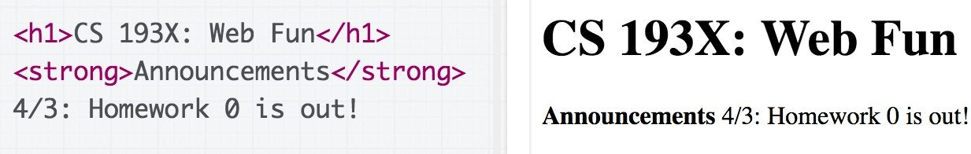
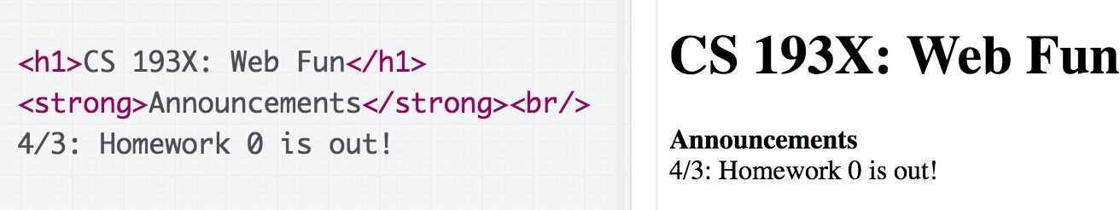
h1 vs strong mystery
Recall: Weirdly the <h1> heading was on a line of its own, and
<strong> was not. -- Why?

Slide 46
h1 vs strong demystified!
Recall: Weirdly the <h1> heading was on a line of its own, and
<strong> was not. -- Why?
Because h1 is a block-level element, and strong is an inline-level element

Slide 47
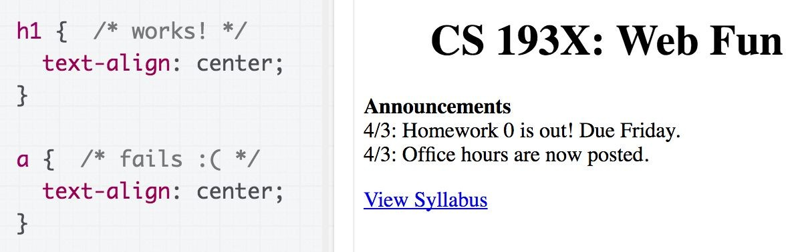
text-align mystery
Recall: We couldn't set text-align: center; on the <a> tag directly, but we could center <h1>. Why?
Let's try looking at the MDN description of text-align...

Slide 48
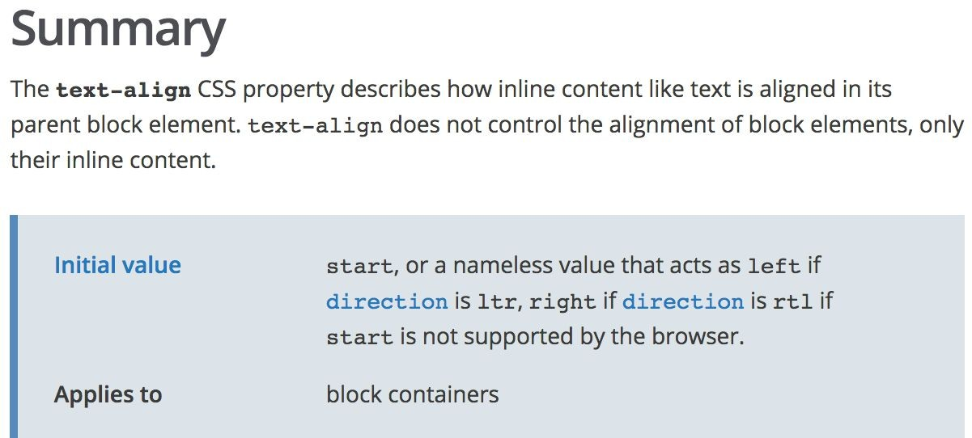
text-align mystery
(source)

Slide 49
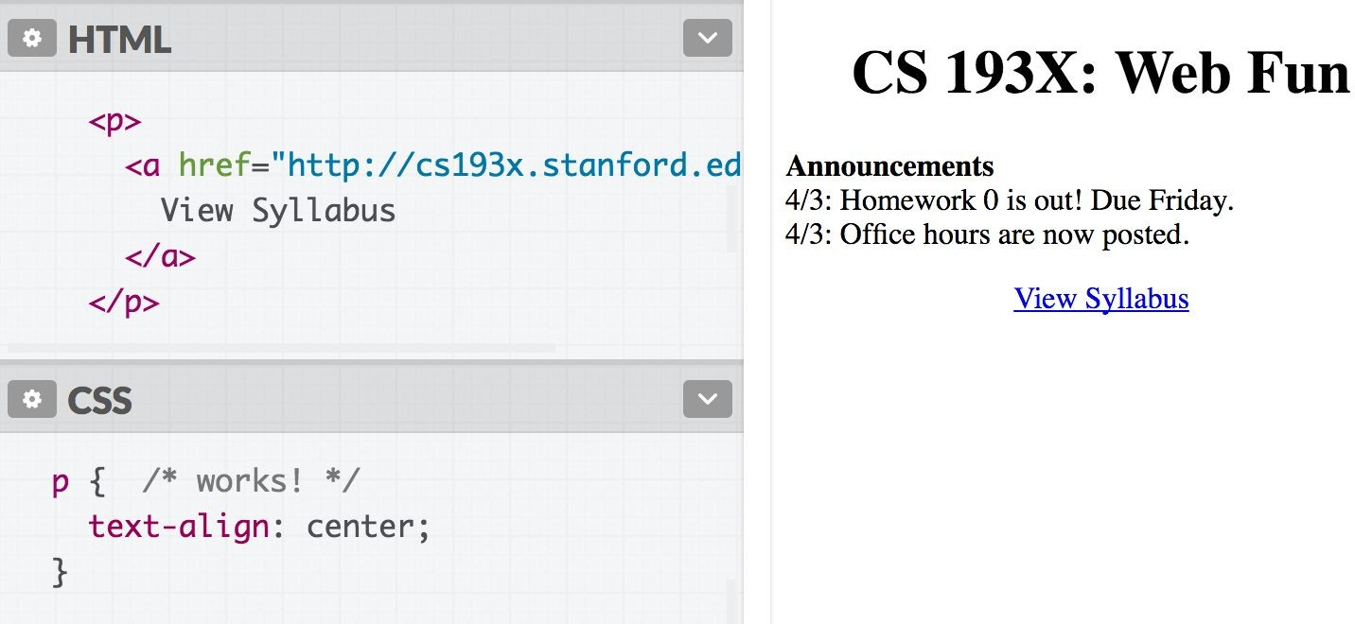
text-align demystified!
Why? From the spec, can't apply text-align to an inline element; must apply text-align to its block container, or set a { display : block; }

Slide 50
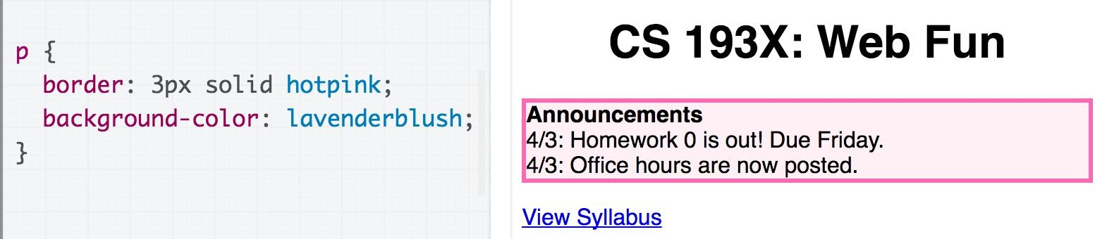
Box size mystery
Recall: The pink box we put around the announcements extended the entirety of the page.
Why?
How do we fix this?

Slide 51
Box size mystery
Recall: The pink box we put around the announcements extended the entirety of the page.
Why? Because p is block-level, so width == width of the page
How do we fix this?

Slide 52
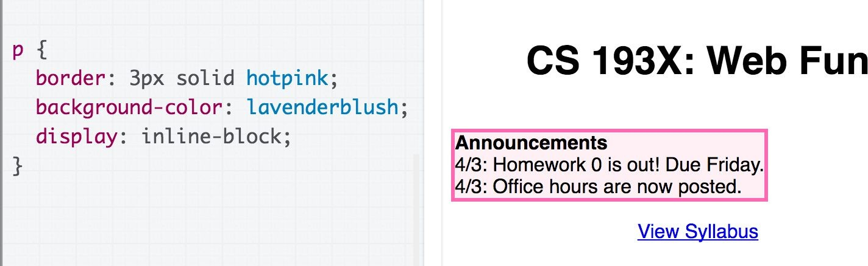
Box size mystery: demystified!
Recall: The pink box we put around the announcements extended the entirety of the page.
Why? Because p is block-level, so width == width of the page
How do we fix this? Change display to inline-block (though now the space above the box has increased… will address later!)

Slide 53
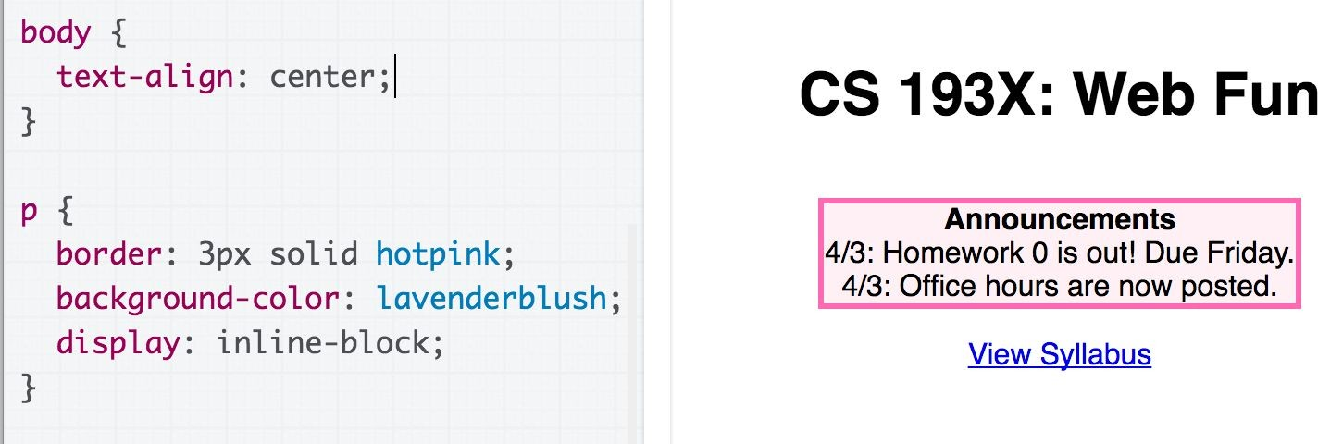
Centering the box
We can also center the box by centering the body tag, since p is now inline-block.

Slide 54
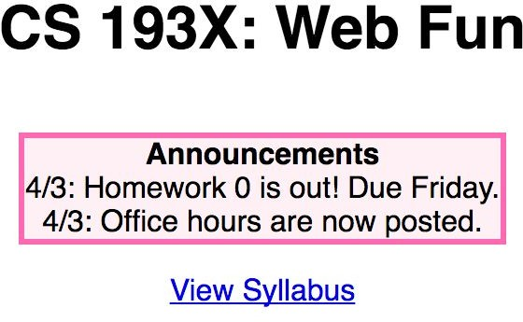
Highlight mystery
Recall: We didn't know how to select a random snippet of text to change its background.
How do we fix this?

Slide 55
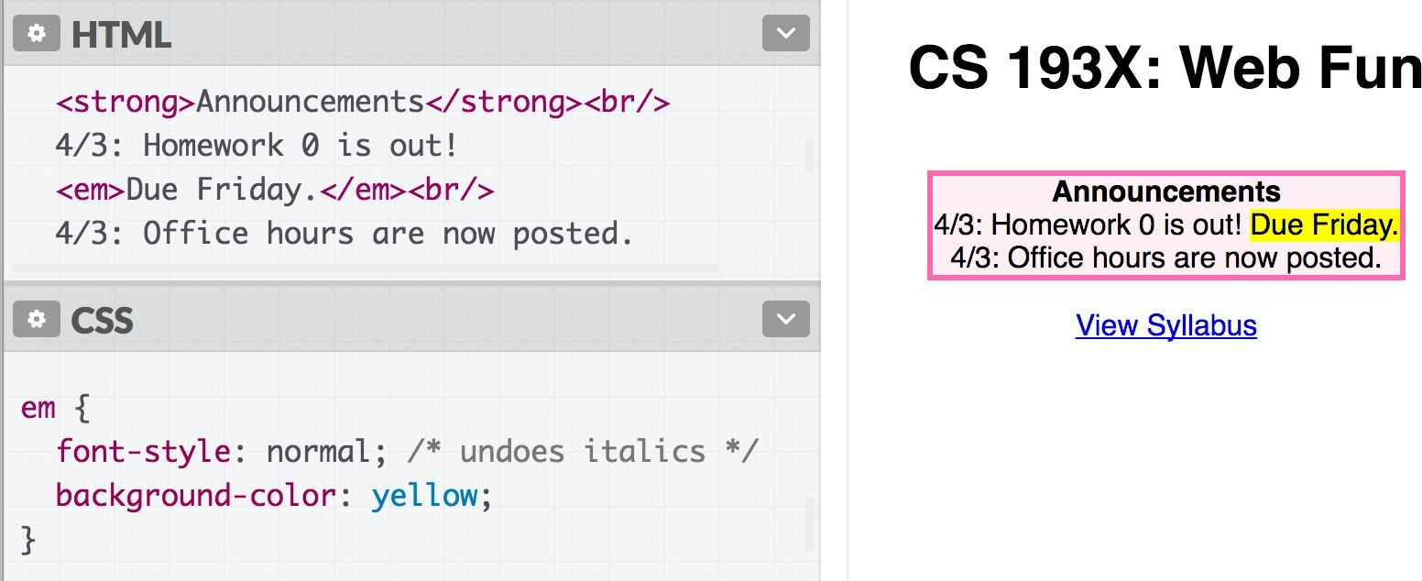
Highlight: demystified!
We can select a random segment of text by wrapping it in an
inline element:
Hmmm… but wouldn't it be better to have a "highlight" element?

Slide 56
Highlight: demystified!
We can select a random segment of text by wrapping it in an
inline element:
Hmmm… but wouldn't it be better to have a "highlight" element?
How do we make a generic HTML element?

Slide 57
Have you heard of <div> and <span>?
What are they?

Slide 58
<div> and <span>
Two generic tags with no intended purpose or style:
<div>: a generic block element
<span>: a generic inline element

Slide 59
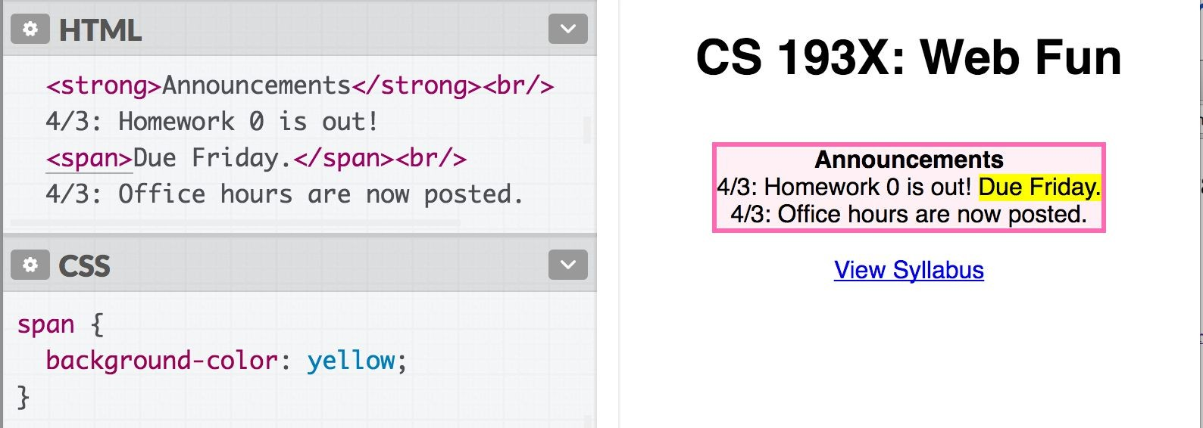
<span> in action
We can use <span> as a generic inline HTML container:

Slide 60
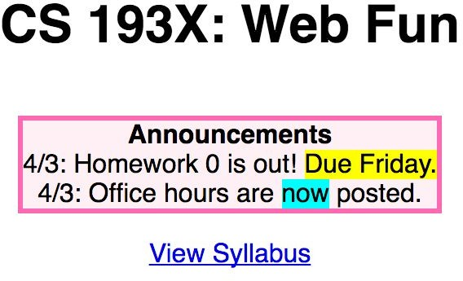
Multiple generic containers?
But won't we often want multiple generic containers? How do we distinguish two generic containers?
In other words, how do we select a subset of elements instead of
all elements on the page?

Slide 61
CSS Selectors: Classes and Ids

Slide 62
Classes and ids
There are 3 basic types of CSS selectors:
Element selector (this is the one we've been using) | p | All <p> elements
✨ID selector✨ | #abc | element with id="abc"
✨Class selector✨ | .abc | elements with class="abc"
<h1 id="title">Homework</h1>
<em class="hw">HW0</em> is due Friday.<br/>
<em class="hw">HW1</em> goes out Monday.<br/>
<em>All homework due at 11:59pm.</em>

Slide 63
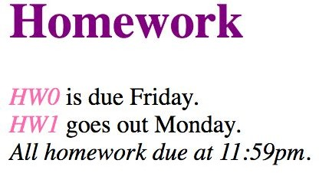
Classes and ids
<h1 id="title">Homework</h1>
<em class="hw">HW0</em> is due Friday.<br/>
<em class="hw">HW1</em> goes out Monday.<br/>
<em>All homework due at 11:59pm.</em>
.hw {
color: hotpink;
}
#title {
color: purple;
}

Slide 64
More on class and id
class and id are special HTML attributes that can be used on any HTML element
class: Used on 1 or more elements; identifies a
collection of elements
id: Used on exactly 1 element per page; identifies
one unique element
Can apply multiple classes by space-separating them:
<span class="hw new">HW1</span>
Often used with span and div to create generic elements: e.g. <span class="highlight"> is like creating a "highlight" element

Slide 65
Other selectors: Next time!

Slide 66
Overflow slides
(we didn't cover these)

Slide 67
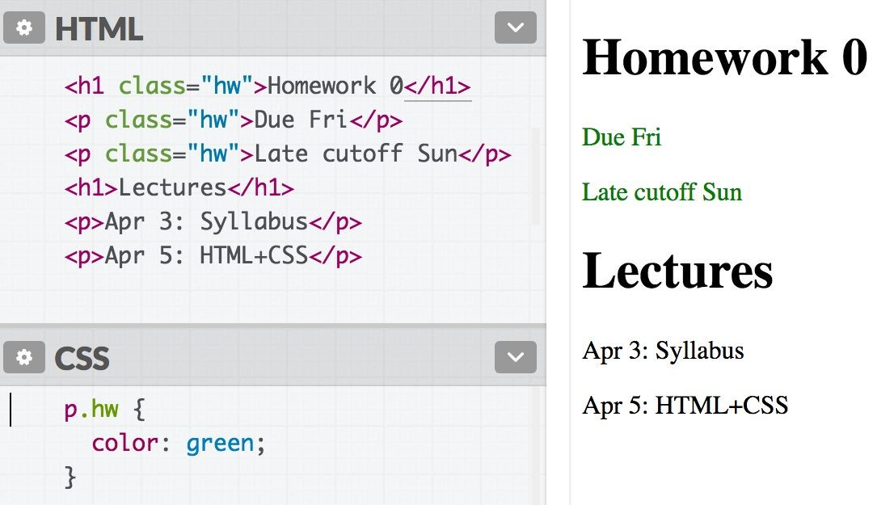
element.className
Syntax | Example | Example described
element.className | p.abc | <p> elements with abc class

Slide 68
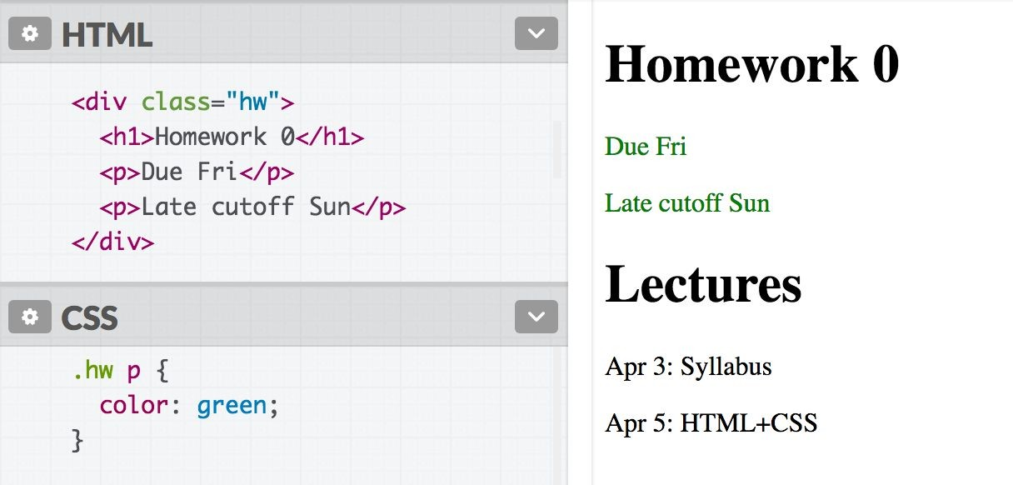
Descendent selector
Syntax | Example | Example described
selector selector | div strong | <strong> elements that are descendants of a <div>

Slide 69
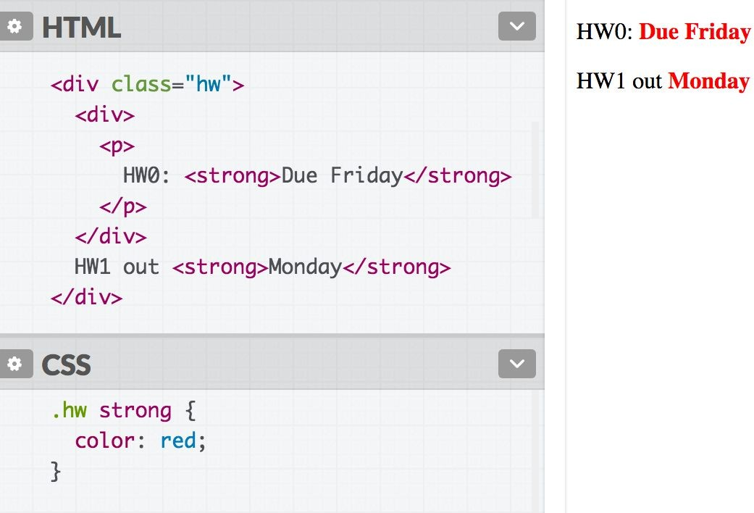
Descendent selector
Syntax | Example | Example described
selector selector | div strong | <strong> elements that are descendants of a <div>
Note: The element does not have to be a direct child. The descendent may be nested many
layers in.

Slide 70
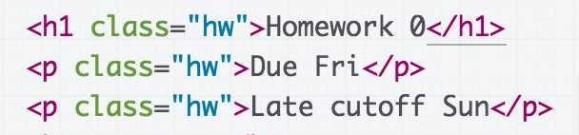
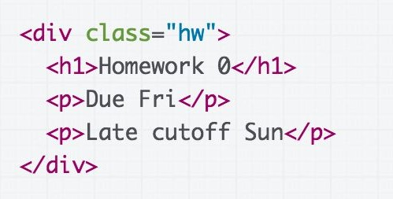
Descendent selector
Syntax | Example | Example described
selector selector | div strong | <strong> elements that are descendants of a <div>
Discouraged:
Preferred:
vs
Instead of applying a class to several adjacent elements, wrap the group in a <div> container and style the contents via descendent selectors.

Slide 71
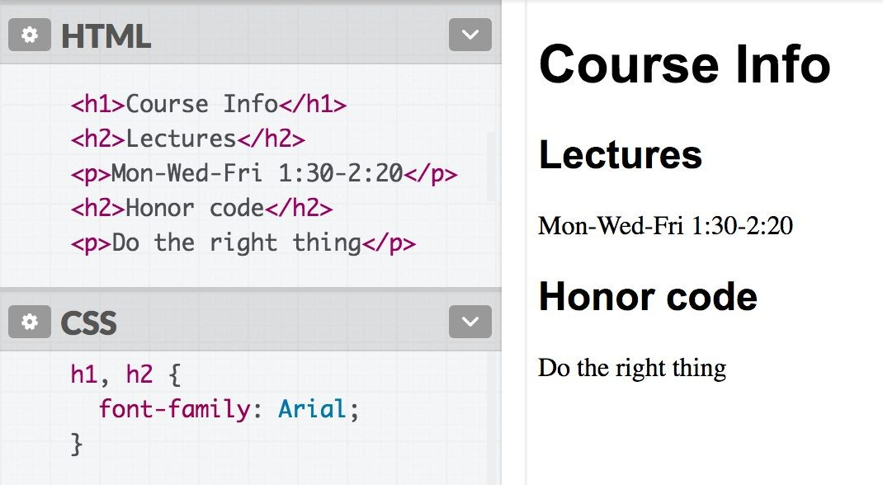
selector, selector (comma)
Syntax | Example | Example described
selector, selector | h2, div | <h2> elements and <div>s

Slide 72
Selector summary
Example | Example described
p | All <p> elements
.abc | All elements with the abc class, i.e. class="abc"
#abc | Element with the abc id, i.e. id="abc"
p.abc | <p> elements with abc class
p#abc | <p> element with abc id (p is redundant)
div strong | <strong> elements that are descendants of a <div>
h2, div | <h2> elements and <div>s

Slide 73
Grouping selectors
2 Common bugs:
p.abc p .abc
vs p .abc
vs p, .abc
A <p> element with the abc class vs
An element with the abc class that descends from <p>
An element with the abc class that descends from <p> vs
All <p> elements and all elements with the abc class

Slide 74
Combining selectors
You can combine selectors:
#main li.important strong { color: red;
}
Q: What does this select?

Slide 75
Grouping selectors
Q: What does this select?
#main li.important strong { color: red;
}
A: Read from right to left:
<strong> tags that are children of <li> tags that have an "important" class that are children of the element with the "main" id.

Slide 76
Colliding styles
When styles collide, the most specific rule wins (specificity)
div strong { color: red; } strong { color: blue; }
<div>
<strong>What color am I?</strong>
</div>

Slide 77
Colliding styles
When styles collide, the most specific rule wins (specificity)
div strong { color: red; } strong { color: blue; }
<div>
<strong>What color am I?</strong>
</div>

Slide 78
Colliding styles
Specificity precedence rules (details):
ids are more specific than classes
classes are more specific than element names
elements are more specific than children of those elements

Slide 79
Colliding styles
- If elements have the same specificity, the later rule wins.
strong { color: red; } strong { color: blue; }
<div>
<strong>What color am I?</strong>
</div>
Aside: The process of figuring out what rule applies to a given element is called the cascade. This is where the "C" in Cascading Style Sheets comes from.

Slide 80
Inheritance
We saw earlier that CSS styles are inherited from parent to child.
a, h1, p, strong {
font-family: Helvetica;
}
Instead of selecting all elements individually:
You can style the parent and the children will inherit the styles.
body {
font-family: Helvetica;
}
h1, h2 {
font-family: Consolas;
}
You can override this style via specificity:

Slide 81

Inheritance
While many CSS styles are inherited from parent to child,
not all CSS properties are inherited.
a {
display: block; font-family: Arial;
}
<em> inherits the
font-family property, but not display:
<a href="/home">
Back to <em>Home</em>
</a>

Slide 82


Inheritance
While many CSS styles are inherited from parent to child,
not all CSS properties are inherited.
There's no rule for what properties are inherited or not; the inheritance behavior defined in the CSS spec.
You can look it up via MDN, e.g.
font-family: display:
Generally text-related properties are inherited and layout-related properties are not.
(You can also change this via the inherit CSS property, which is somewhat esoteric and not often use)

Slide 83
Before we move on: A few style notes

Slide 84
Why not <div> everywhere?
Technically, you can define your entire web page using
<div> and the class attribute.
Is this a good idea?
Why does HTML have ids when you have classes?
Why does HTML have <p>, <h1>, <strong>, etc. when you have <div>, <span>, class, and id?

Slide 85
CSS Box Model

Slide 86
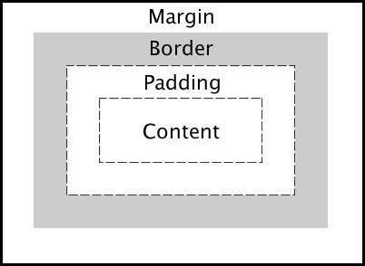
The CSS Box Model
Every element is composed of 4 layers:
the element's content
the border around the element's content
padding space between the content and border (inside)
a margin clears the area around border (outside)
You should mostly consider the box model properties for
block-level elements!
- It can be used on inline elements but it behaves differently

Slide 87
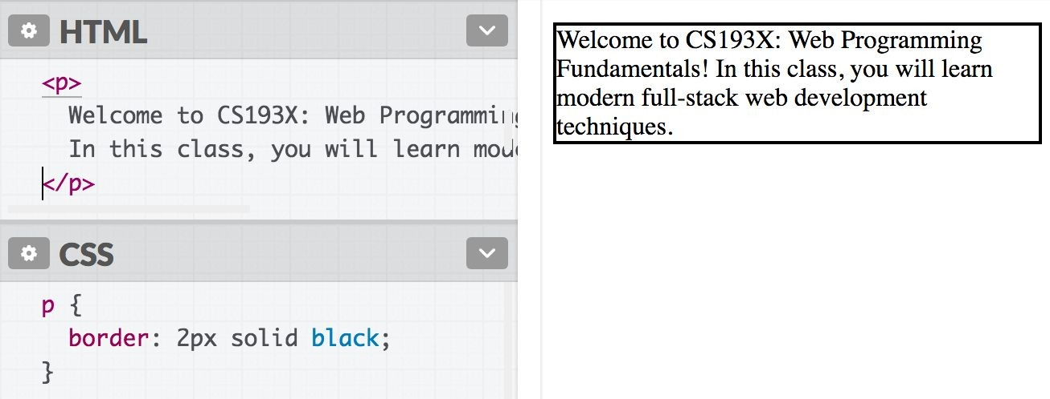
border
We've used the shorthand:
border: width style color;

Slide 88
border
Can also specify each border individually:
border-top border-bottom border-left border-right
And can set each property individually:
border-style: dotted; border-width: 3px; border-color: purple;
(all styles)

Slide 89
border
Can also specify each border individually:
border-top border-bottom border-left border-right
And can set each property individually:
border-style: dotted; border-width: 3px; border-color: purple;
(all styles)
There are other units besides pixels (px) but we will address them in the next couple lectures.

Slide 90
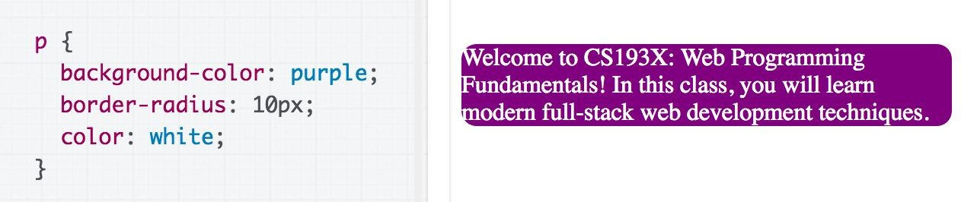
Rounded border
Can specify the border-radius to make rounded corners:
border-radius: 10px;
You don't actually need to set a border to use border-radius.

Slide 91
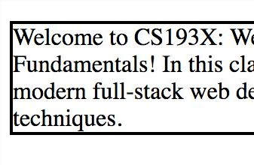
Borders look a little squished
When we add a border to an element, it sits flush against the text:
Q: How do we add space between the border and the content of the element?

Slide 92
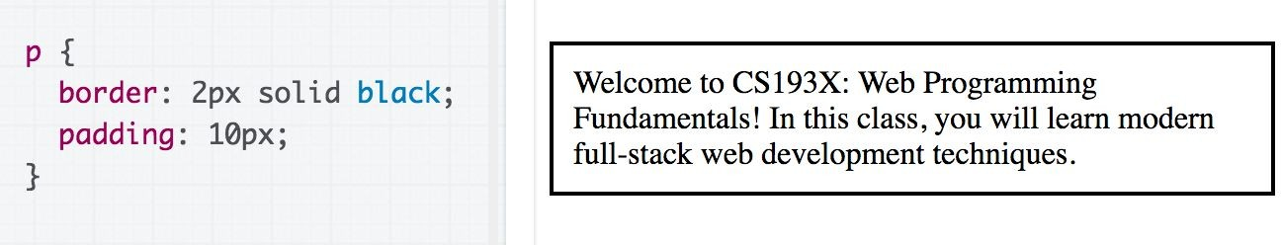
padding
padding is the space between the border and the content.
Can specify padding-top, padding-bottom, padding-left, padding-right
There's also a shorthand:
padding: 2px 4px 3px 1px; <- top|left|bottom|right
padding: 10px 2px; <- top+bottom|left+right

Slide 93
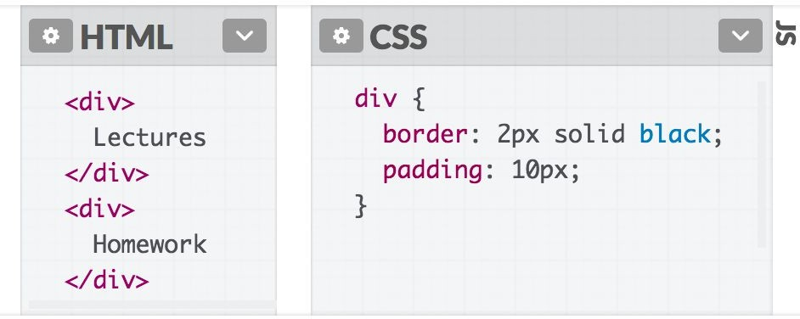
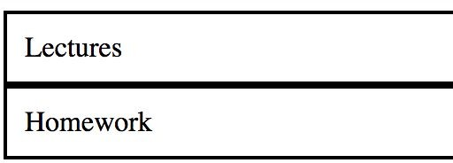
<div>s look a little squished
When we add a border to multiple divs, they sit flush against each other:
Q: How do we add space between multiple elements?

Slide 94
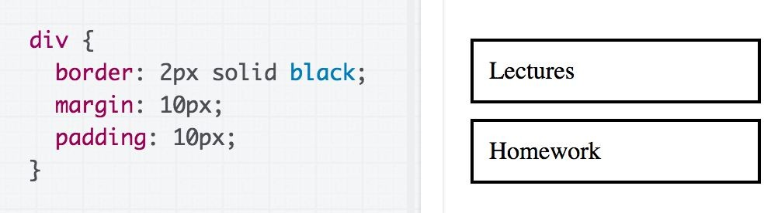
margin
margin is the space between the border and other elements.
Can specify margin-top, margin-bottom, margin-left, margin-right
There's also a shorthand:
margin: 2px 4px 3px 1px; <- top|left|bottom|right
margin: 10px 2px; <- top+bottom|left+right

Slide 95
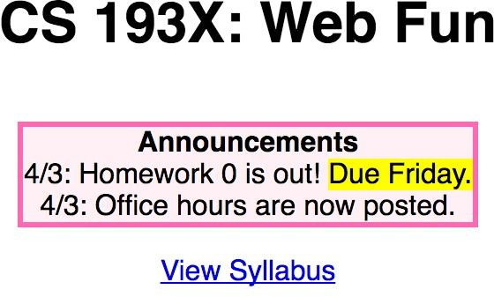
The CSS Box Model
Let's revisit our Course web page example:

Slide 96
The CSS Box Model
width by default refers to content-width, which is almost never what you want
Use box-sizing: border-box; to calculate
width based on the border size
Margin collapsing is something to know about and consider
When in doubt, use the browser's Page Inspector to see what's going on
(Also, the Box Model works a little differently for inline elements)

Slide 97
Q: What does this look like in the browser?
div {
display: inline-block; background-color: yellow;
}
<body>
<div>
<p>Make the background color yellow!</p>
<p>Surrounding these paragraphs</p>
</div>
</body>

Slide 98
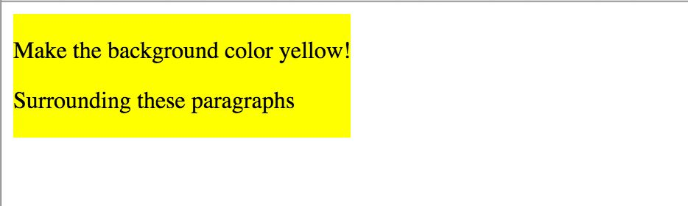
Q: Why is there a white space around the box?
We can use the browser's Page Inspector to help us figure it out!

