Slide 1
NetSec Visual Analyzer
DNS security analysis, threat intelligence, and audit reporting
What the project does
The app checks domain security signals, explains the score in plain language, compares sites side by side, and keeps a visible audit trail for follow-up analysis.
Security teams
IT admins
Real-world value
Quickly judge whether DNSSEC, SPF, and DMARC are configured well enough to reduce spoofing risk.
Spot missing records, weak policy settings, and trending changes before they become incidents.
Useful for security reviews, phishing defense, board reporting, MSP audits, and pre-launch domain checks.
Includes live result explanations and output screenshots from the running app.

Slide 2
Why It Matters
The app turns DNS data into decisions that non-specialists can understand.
Phishing defense
Trust and integrity
Operational visibility
Helps identify weak SPF or DMARC settings that attackers can exploit for spoofed email campaigns.
Shows whether DNSSEC is present, which protects DNS answers from tampering and cache poisoning.
Stores history so a team can compare audits over time instead of relying on a single point-in-time result.
Typical usage
1. Check a domain on the dashboard.
2. Compare it with another site.
3. Review the history page for prior audits.
4. Open the threat feed to see live phishing indicators.
5. Use the explanation page to understand why the score changed.
Score model summary
Base score + DNSSEC + SPF + DMARC + MX coverage = a transparent score that can be explained to technical and non-technical users.

Slide 3
How the App Works
The app takes a domain, runs live checks, then turns the results into a visual story.
Input
Fetch
Analyze
Score
Explain
Domain entered by user
>
Live DNS and threat data
>
DNSSEC, SPF, DMARC, MX checks
>
Weighted result and status labels
>
Simple reasons and history
What makes the output easy to trust
The same analysis engine feeds the dashboard, compare page, history page, threat feed, and the result explanation page, so the UI stays consistent.
This is useful for audits, executive summaries, and practical security reviews where the team needs both the number and the reason behind it.

Slide 4
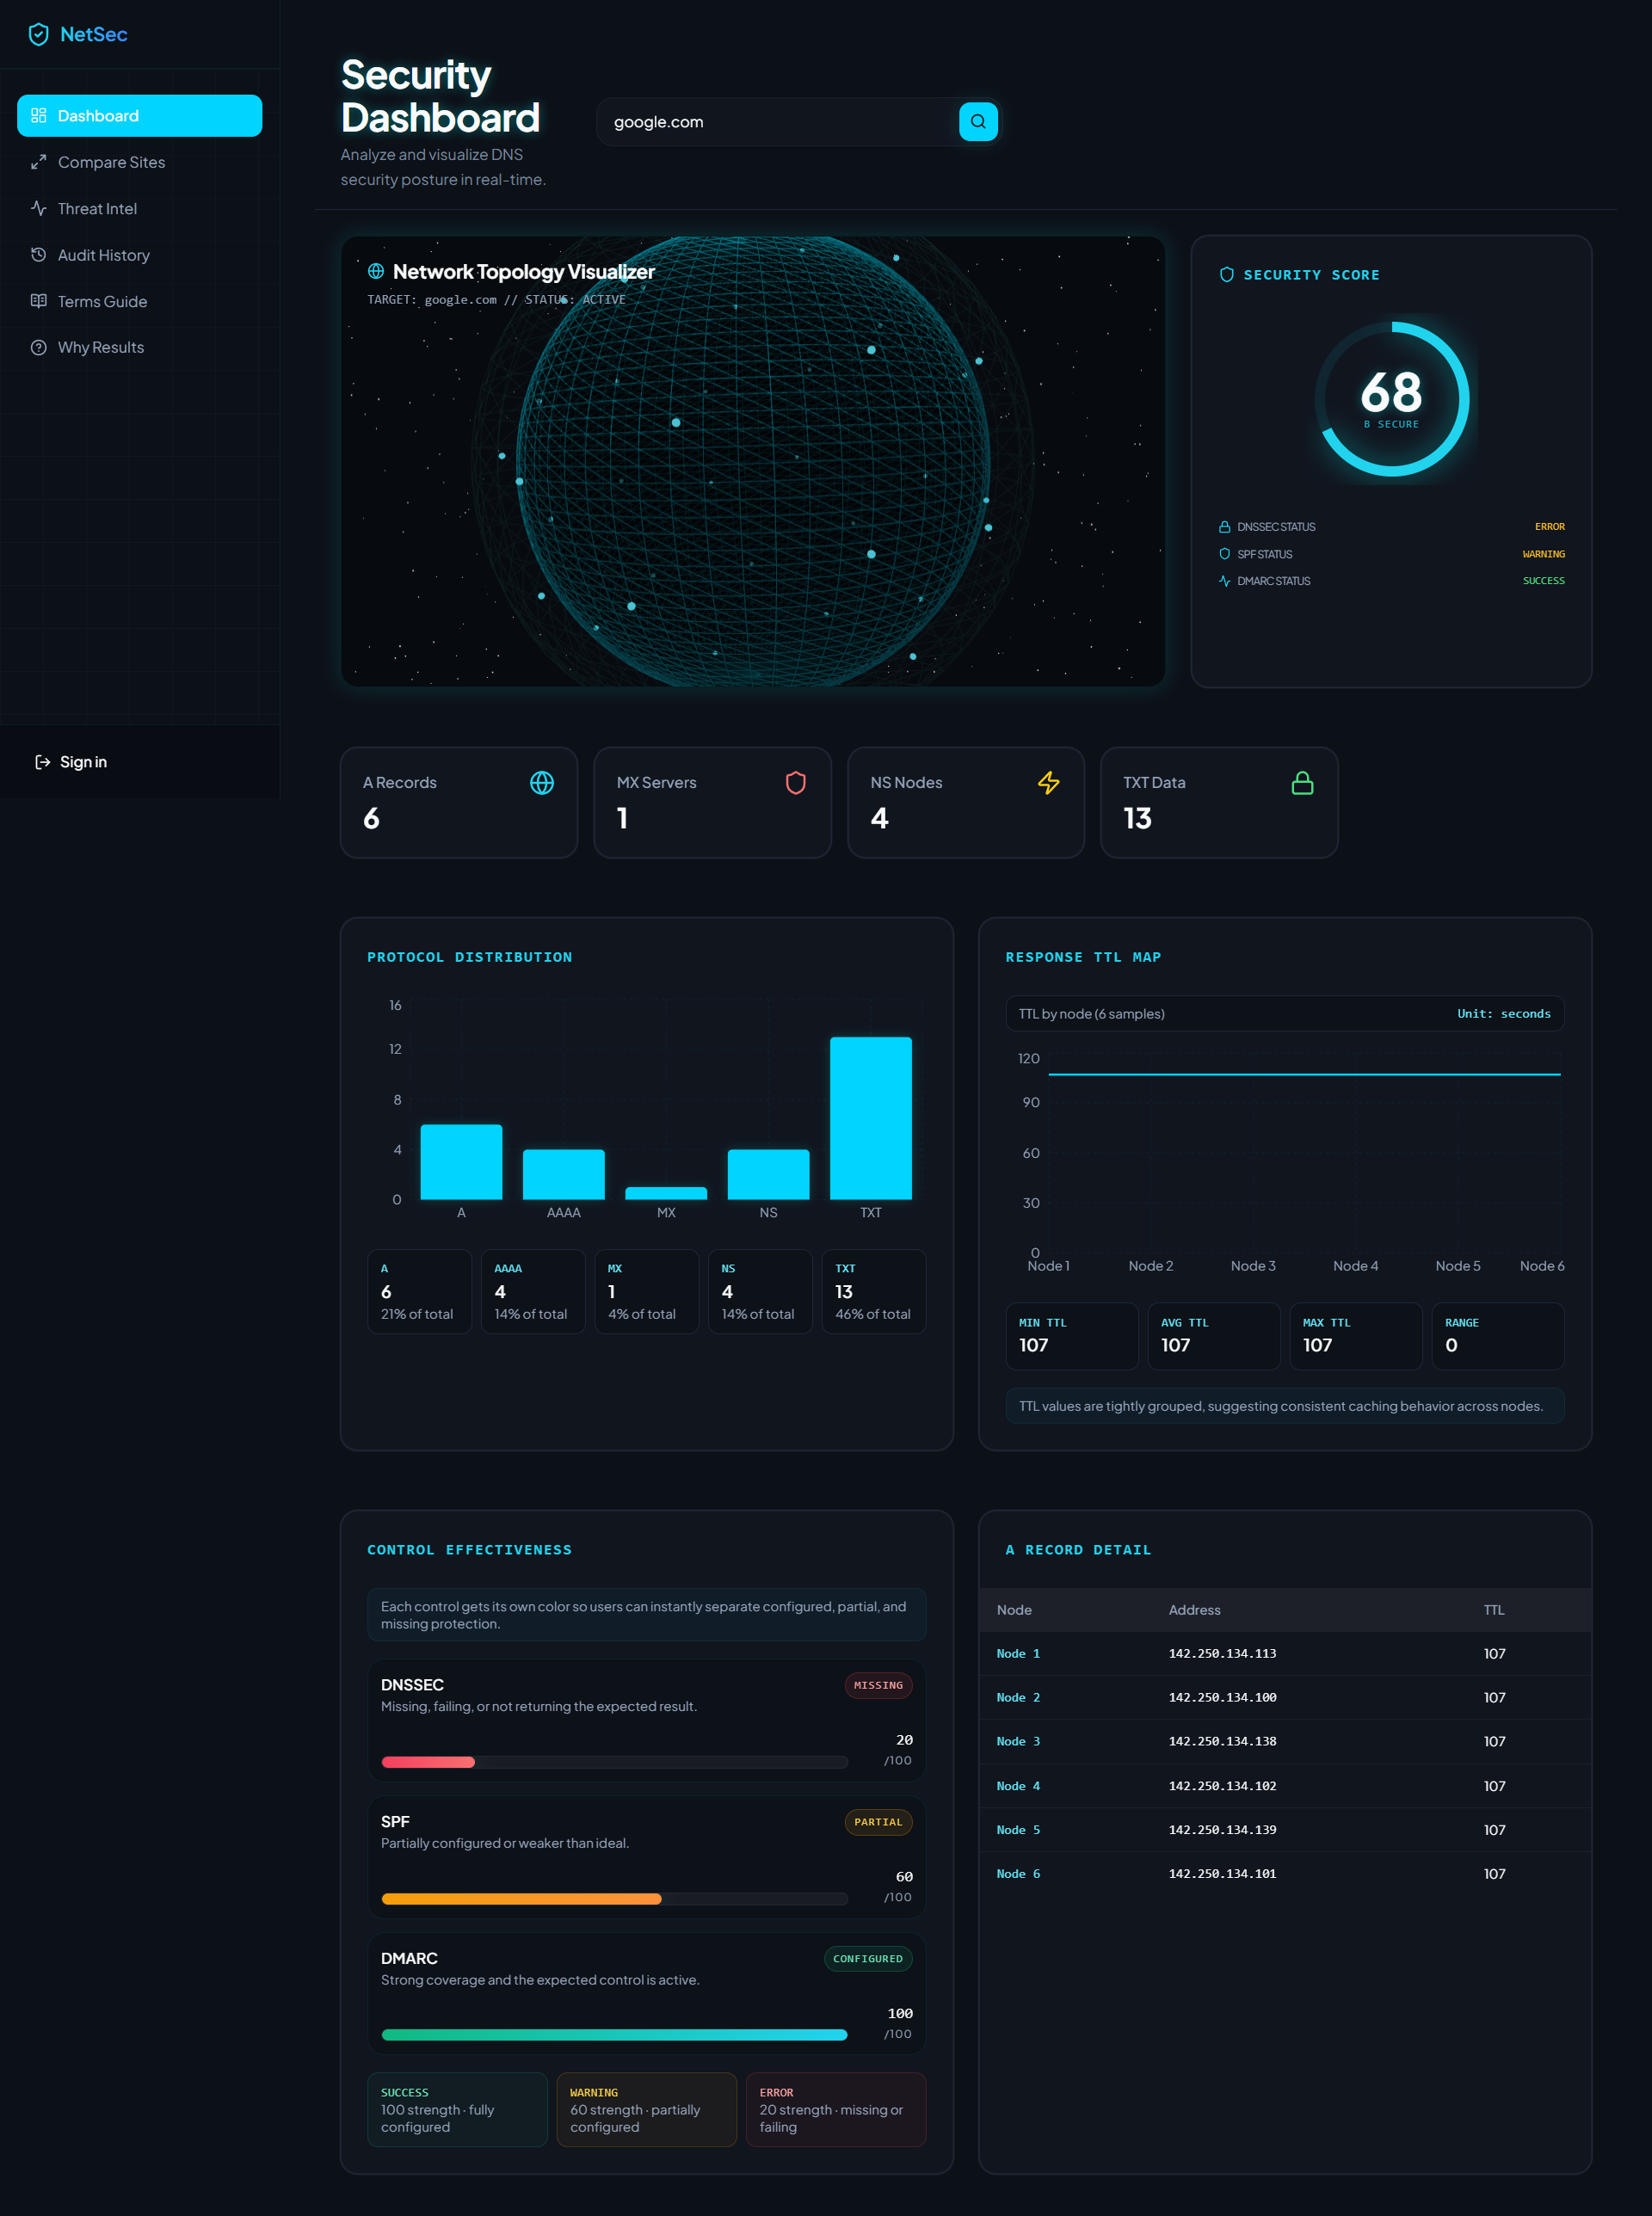

Slide 5
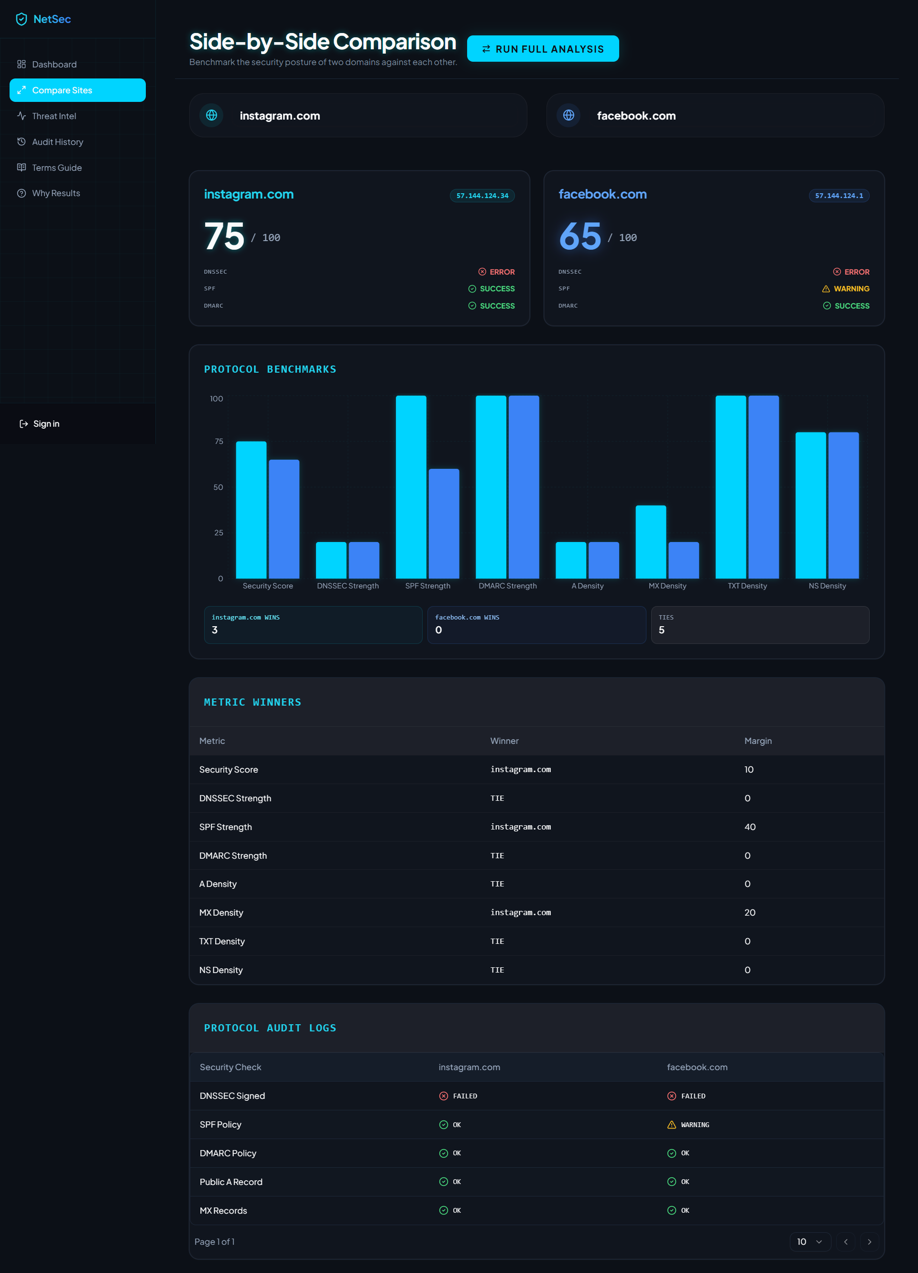

Slide 6
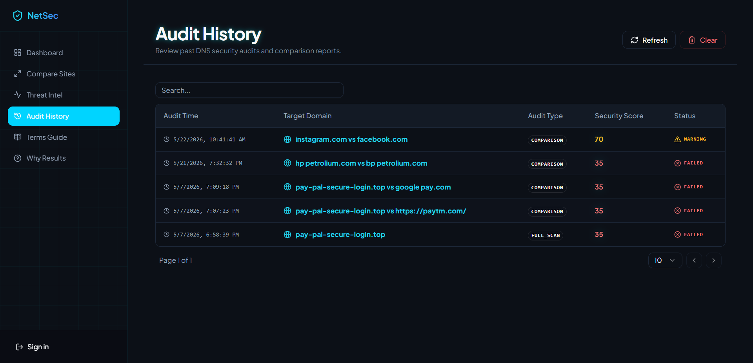

Slide 7
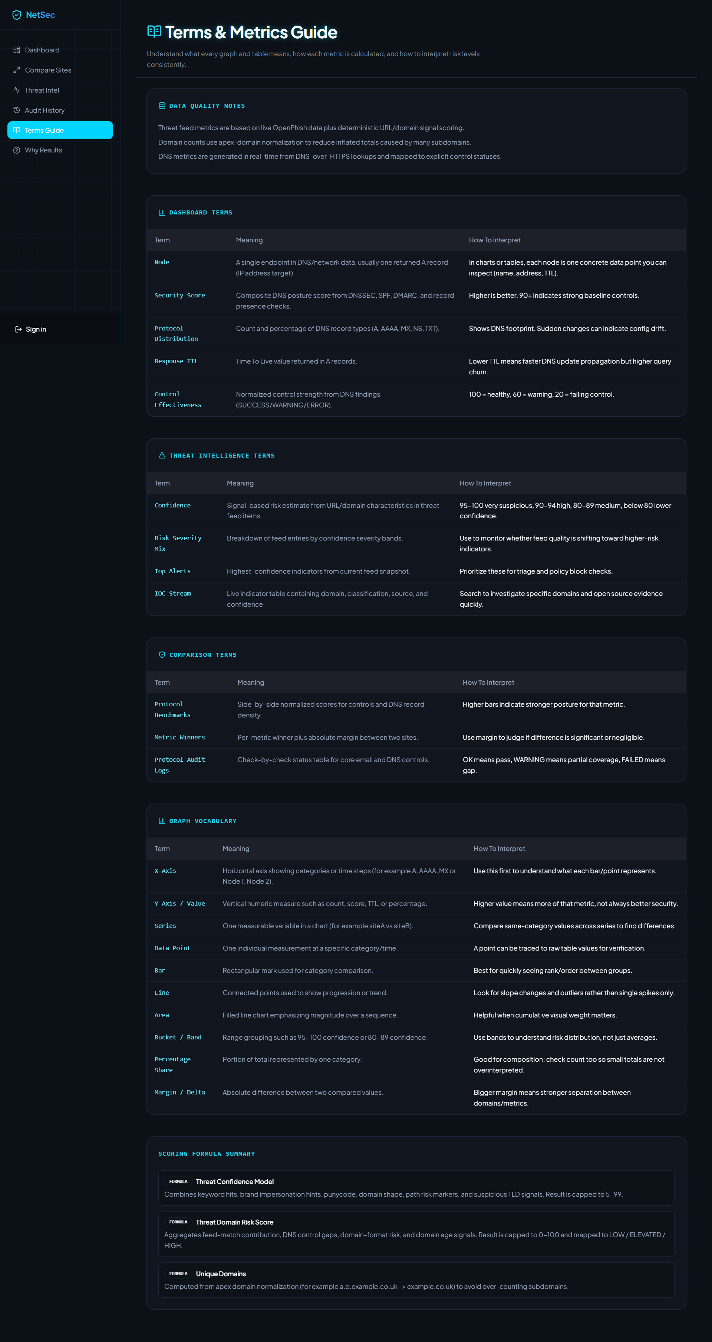

Slide 8
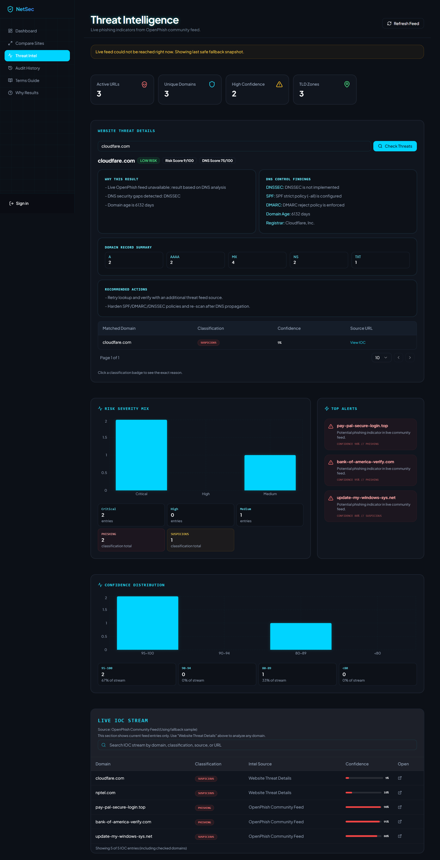

Slide 9
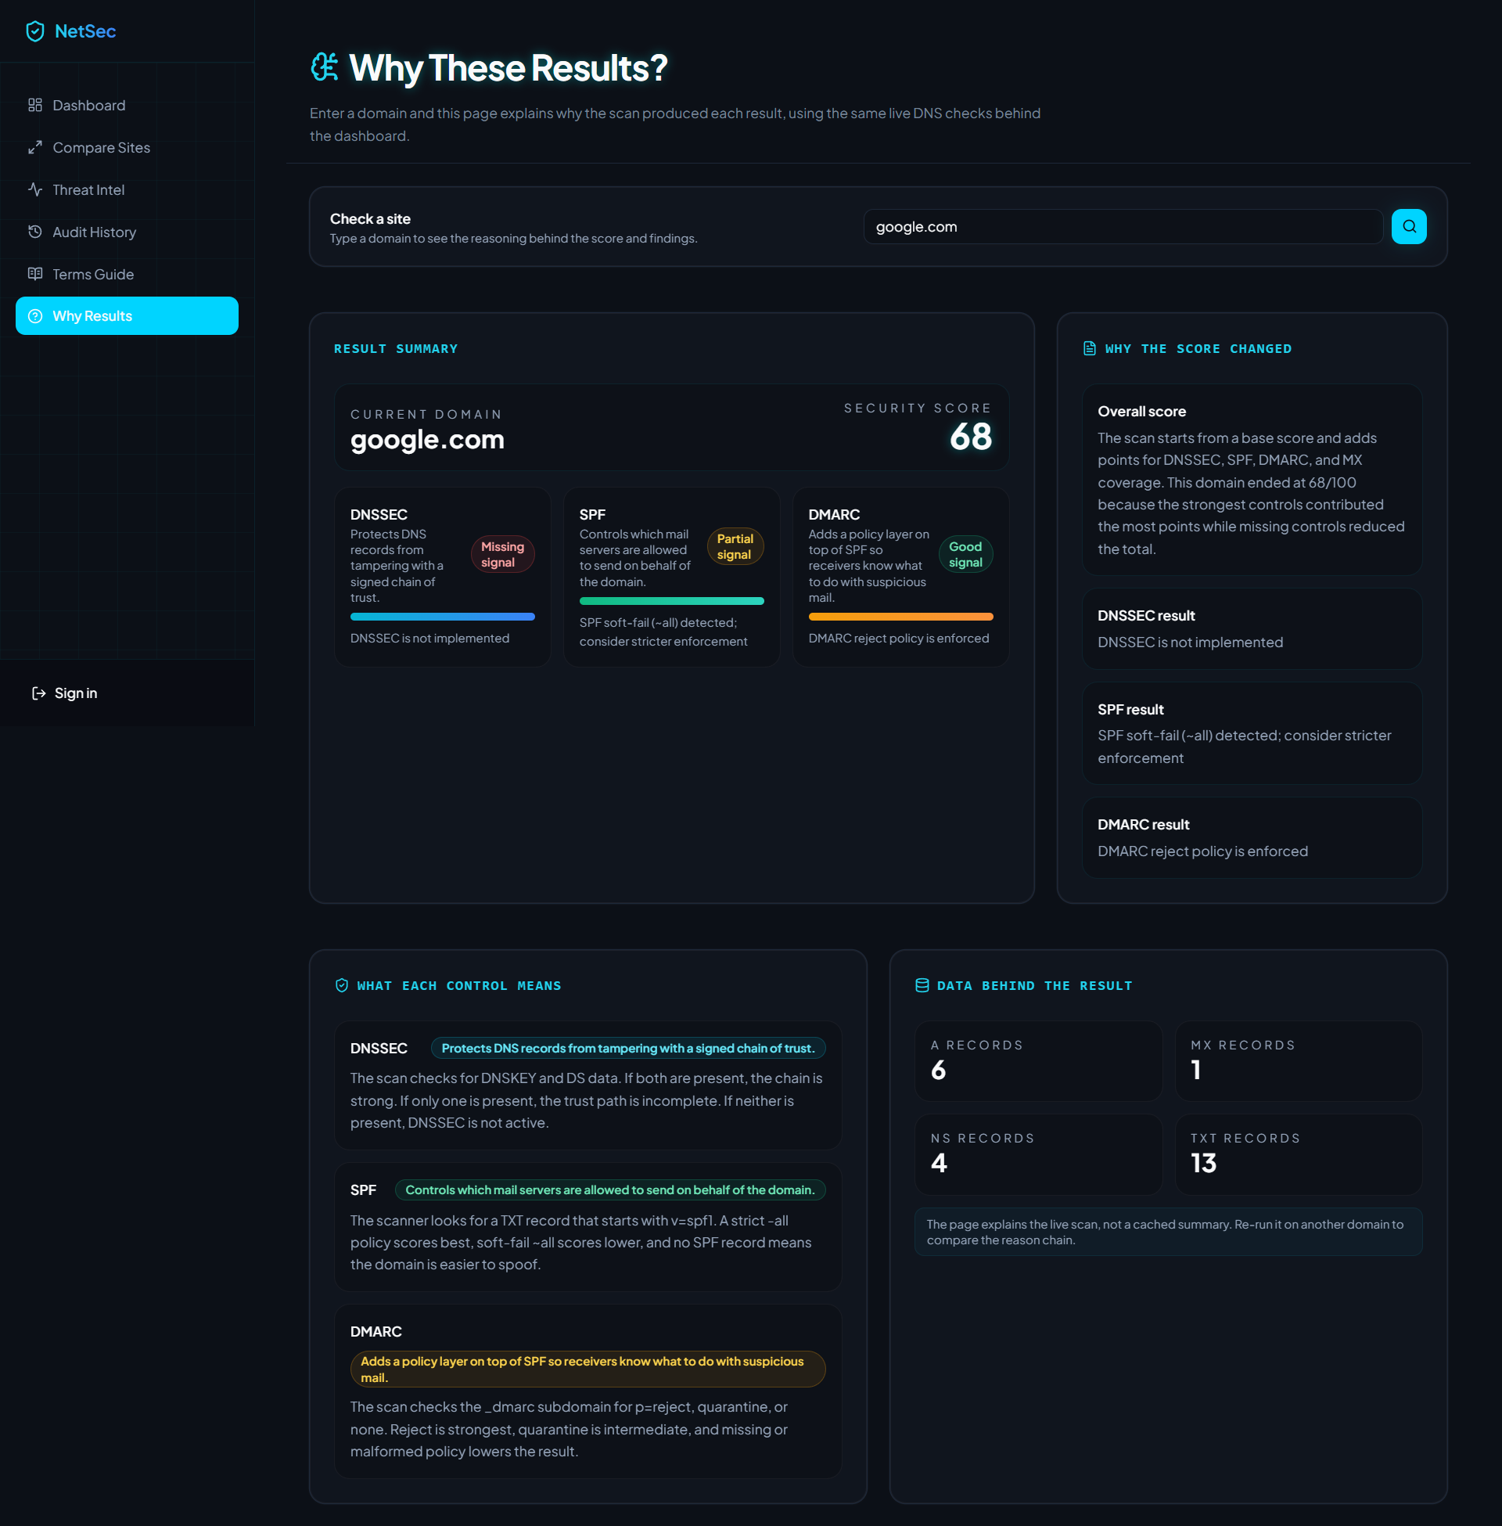

Slide 10
Wrap-Up
NetSec Visual Analyzer turns DNS data into an actionable security story.
Project strength
Real-world usage
Clear visuals, accurate scoring, live threat context, and a dedicated explanation page make the app easier to understand than a raw report.
Useful for security teams, MSPs, compliance reviews, and anyone who needs to explain DNS posture without reading raw records.
The presentation deck and all screenshots are saved in the docs folder.
Output file: docs/NetSec-Visual-Analyzer-Overview.pptx

