Slide 1
NetSec Visual Analyzer
DNS security analysis, threat intelligence, and audit reporting
What the project does
The app checks domain security signals, explains the score in plain language, compares sites side by side, and keeps a visible audit trail for follow-up analysis.
Security teams
IT admins
Real-world value
Quickly judge whether DNSSEC, SPF, and DMARC are configured well enough to reduce spoofing risk.
Spot missing records, weak policy settings, and trending changes before they become incidents.
Useful for security reviews, phishing defense, board reporting, MSP audits, and pre-launch domain checks.
Includes live result explanations and output screenshots from the running app.

Slide 2
Why It Matters
The app turns DNS data into decisions that non-specialists can understand.
Phishing defense
Trust and integrity
Operational visibility
Helps identify weak SPF or DMARC settings that attackers can exploit for spoofed email campaigns.
Shows whether DNSSEC is present, which protects DNS answers from tampering and cache poisoning.
Stores history so a team can compare audits over time instead of relying on a single point-in-time result.
Typical usage
1. Check a domain on the dashboard.
2. Compare it with another site.
3. Review the history page for prior audits.
4. Open the threat feed to see live phishing indicators.
5. Use the explanation page to understand why the score changed.
Score model summary
Base score + DNSSEC + SPF + DMARC + MX coverage = a transparent score that can be explained to technical and non-technical users.

Slide 3
How the App Works
The app takes a domain, runs live checks, then turns the results into a visual story.
Input
The same analysis engine feeds the dashboard, compare page, history page, threat feed, and the result explanation page, so the UI stays consistent.
Domain entered by user
1
Fetch
2
This is useful for audits, executive summaries, and practical security reviews where the team needs both the number and the reason behind it.
Live DNS and threat data
Analyze
3
DNSSEC, SPF, DMARC, MX checks
Score
4
Weighted result and status labels
Explain
5
Simple reasons and history

Slide 4
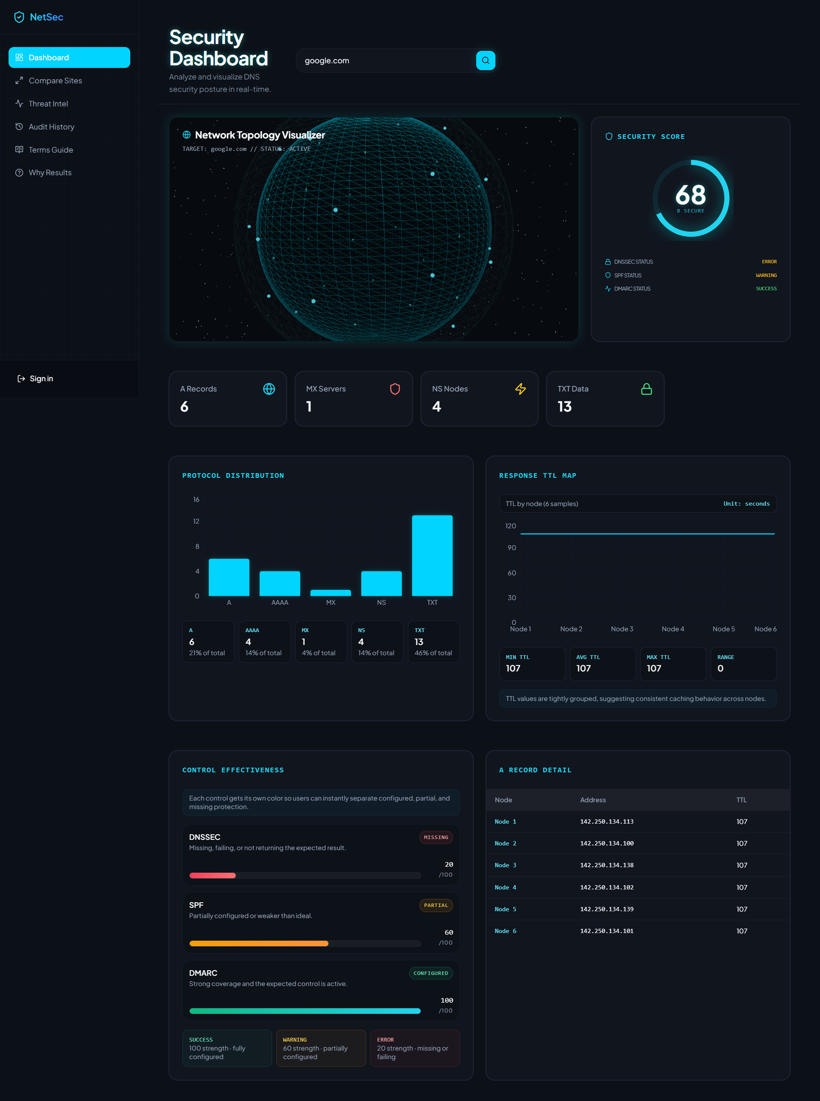
Dashboard Overview
Main score, control breakdown, and network view.
Dashboard screenshot captured from the running app.

Slide 5
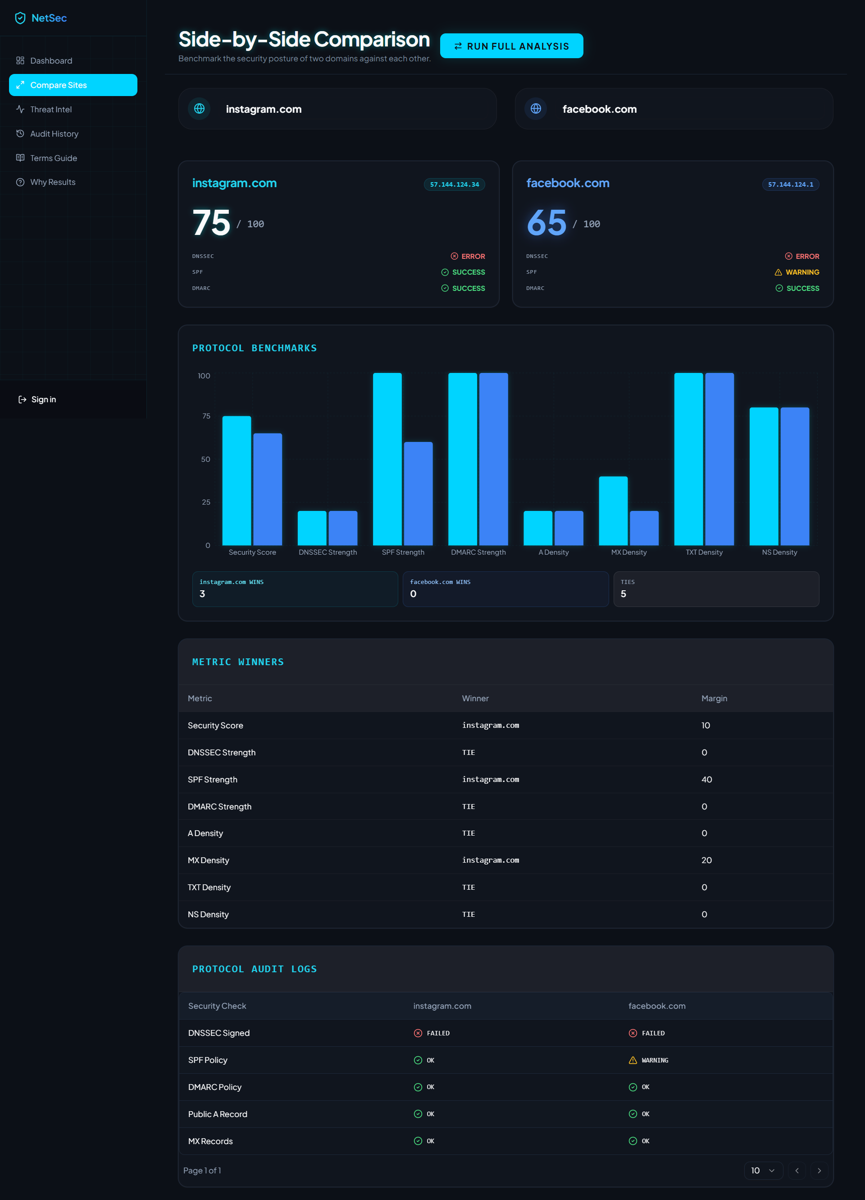
Domain Comparison
Compare two domains side by side to see which one is stronger.
Comparison view used for risk evaluation.

Slide 6
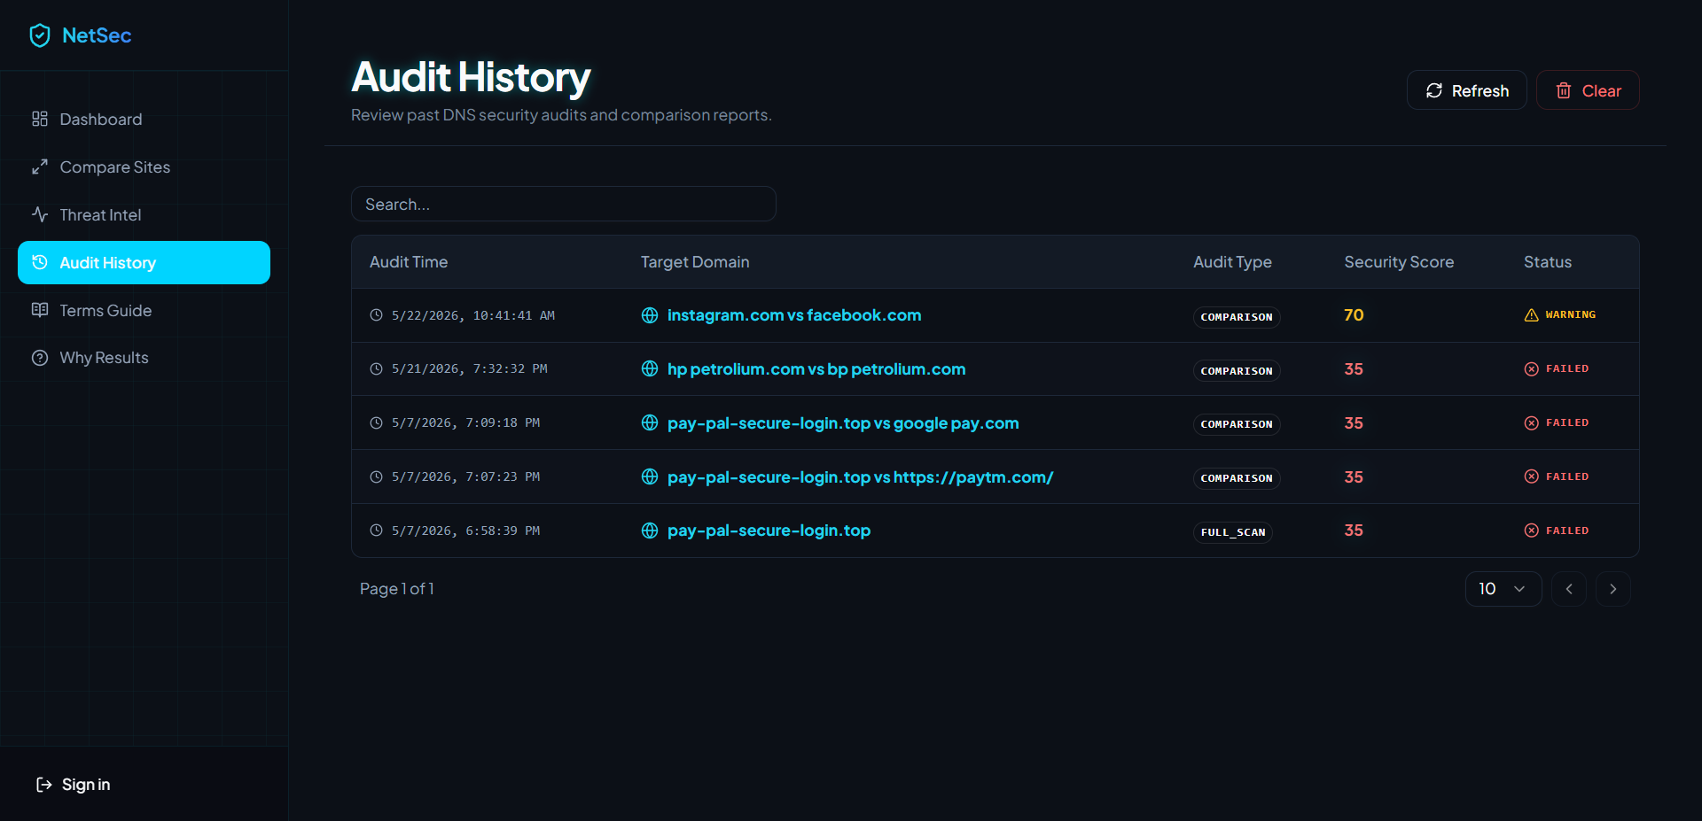
Audit History
Track previous scans and review changes over time.
History view used for audit trails and repeat checks.

Slide 7
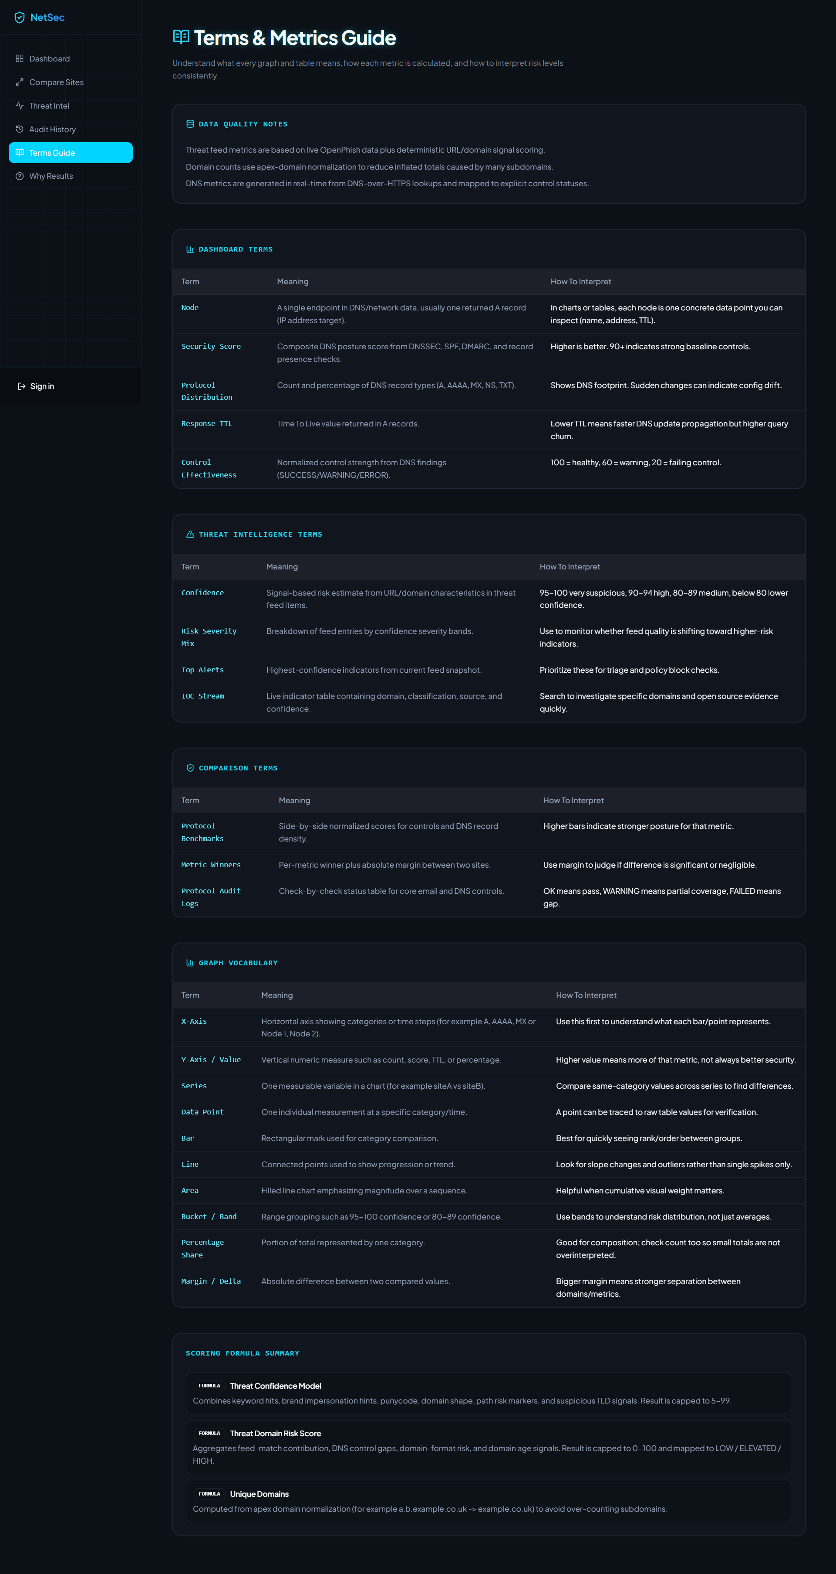
Terms Guide
Explain the labels and terms used across graphs and tables.
Terms guide view used as a glossary for the app.

Slide 8
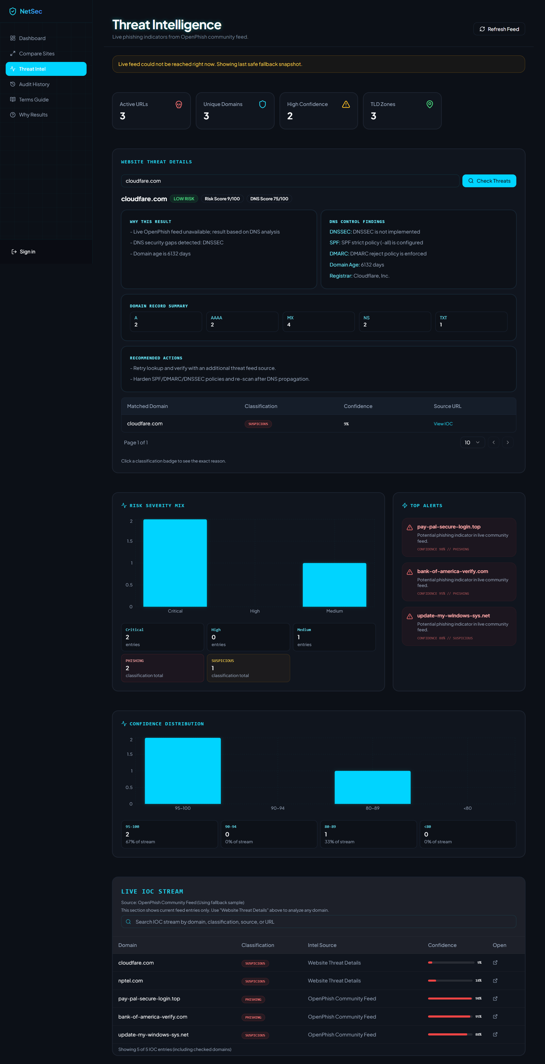
Threat Intelligence
Live phishing feed to connect domain posture with active threats.
Threat feed view shown with the full browser viewport.

Slide 9
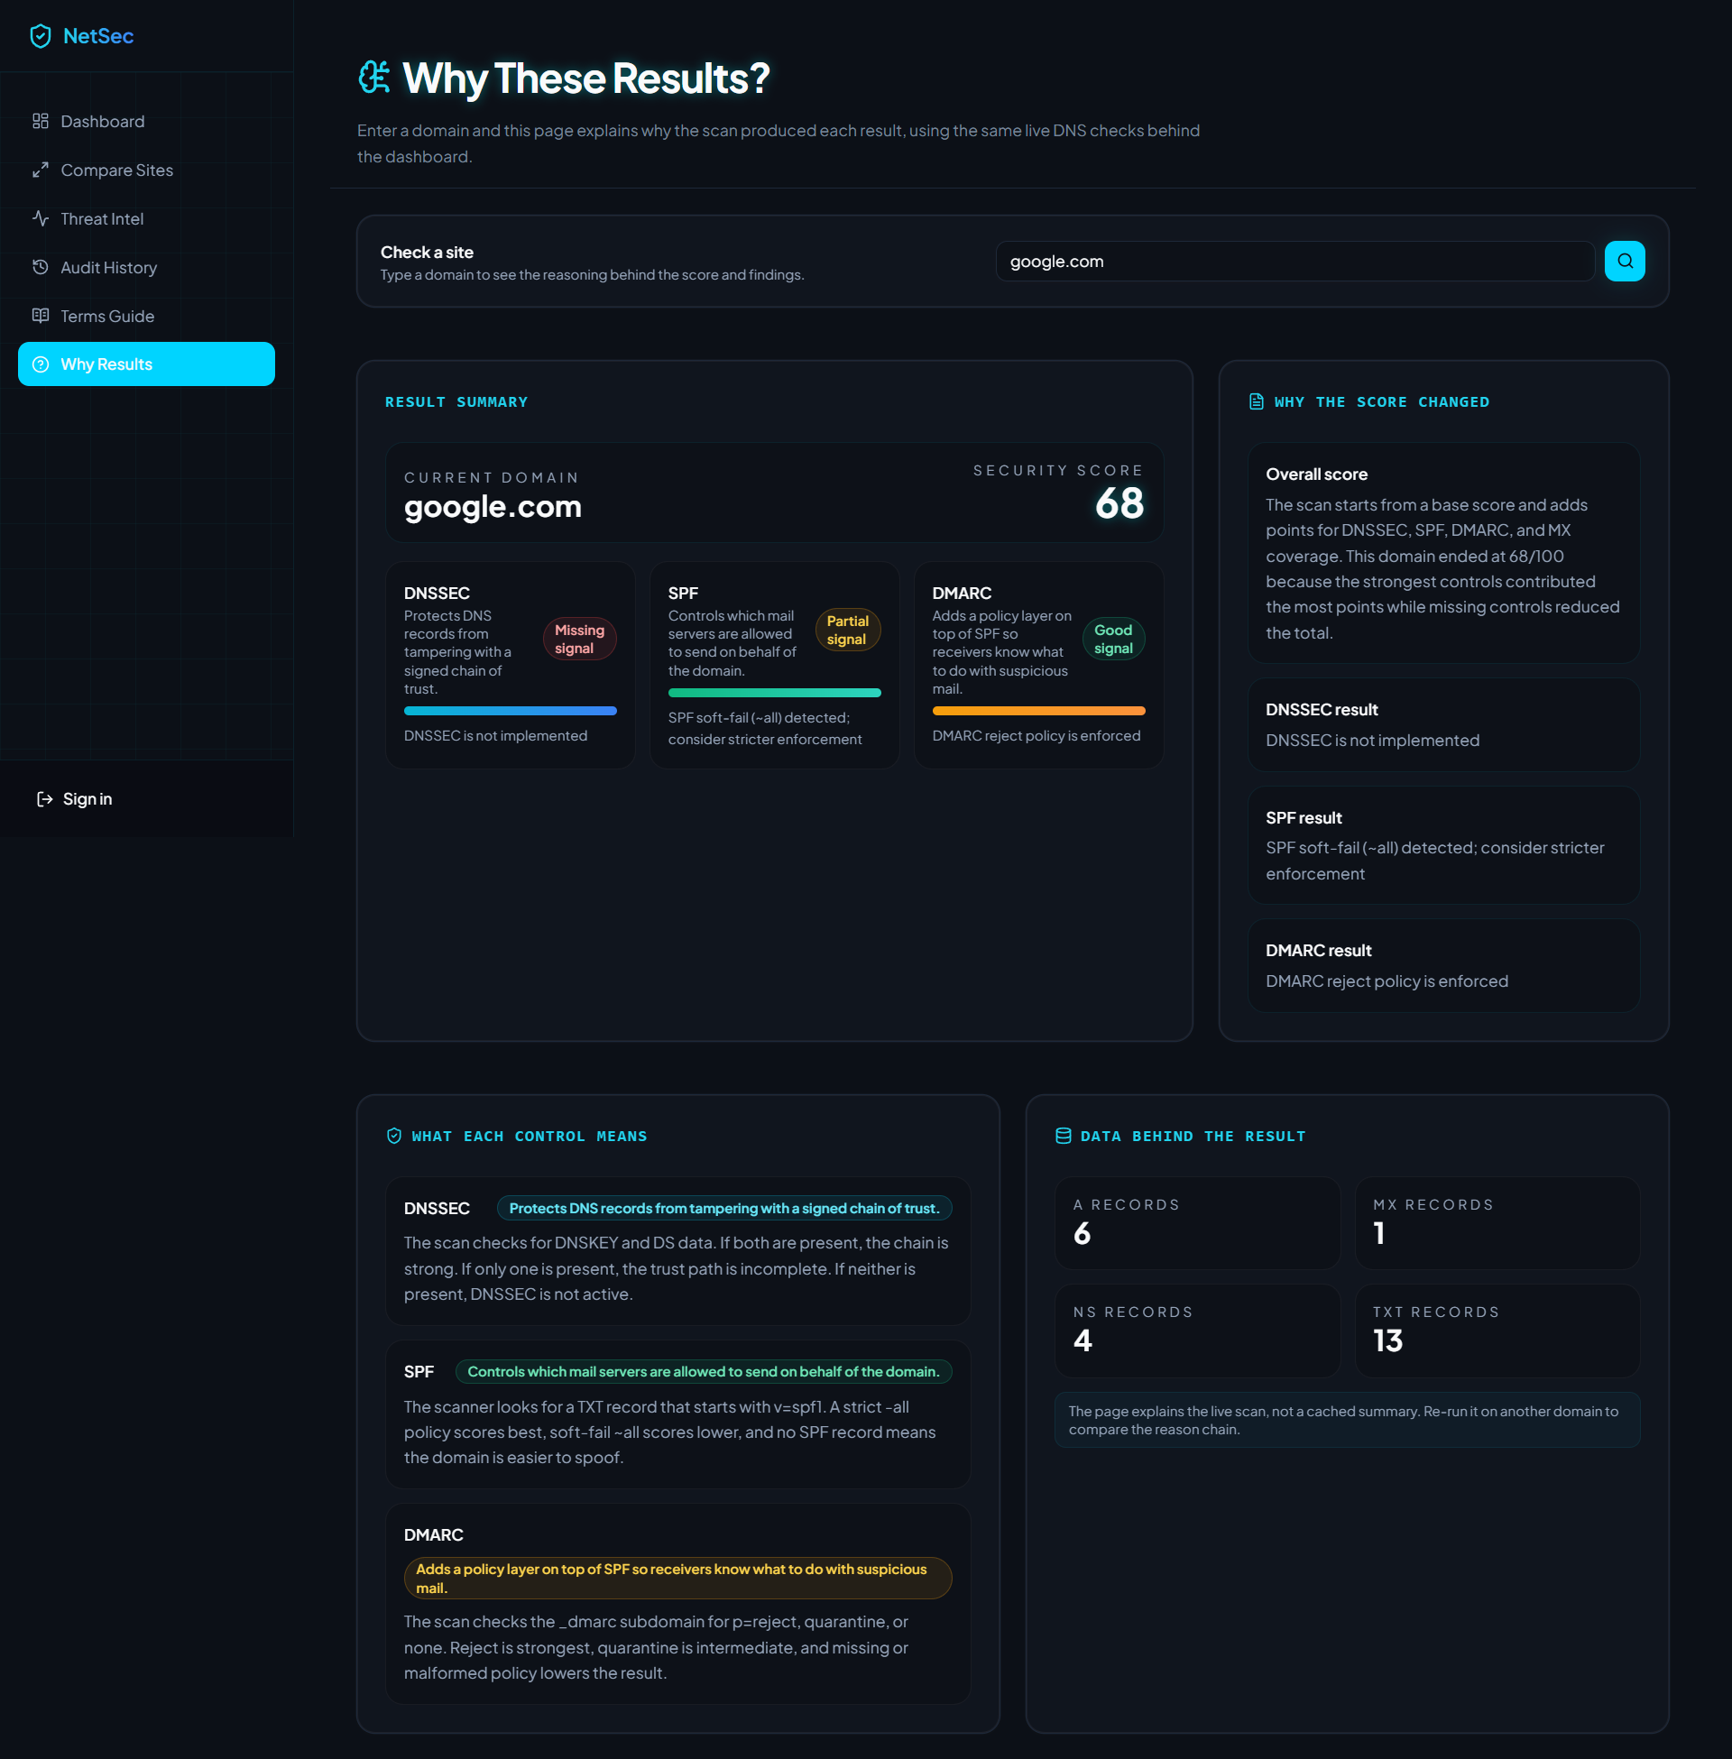
Why These Results?
Plain-language explanations that show how the score was derived.
Explanation page that connects the score to the live checks behind it.

Slide 10
Wrap-Up
NetSec Visual Analyzer turns DNS data into an actionable security story.
Project strength
Real-world usage
Clear visuals, accurate scoring, live threat context, and a dedicated explanation page make the app easier to understand than a raw report.
Useful for security teams, MSPs, compliance reviews, and anyone who needs to explain DNS posture without reading raw records.
The presentation deck and all screenshots are saved in the docs folder.
Output file: docs/NetSec-Visual-Analyzer-Overview.pptx

