Slide 1
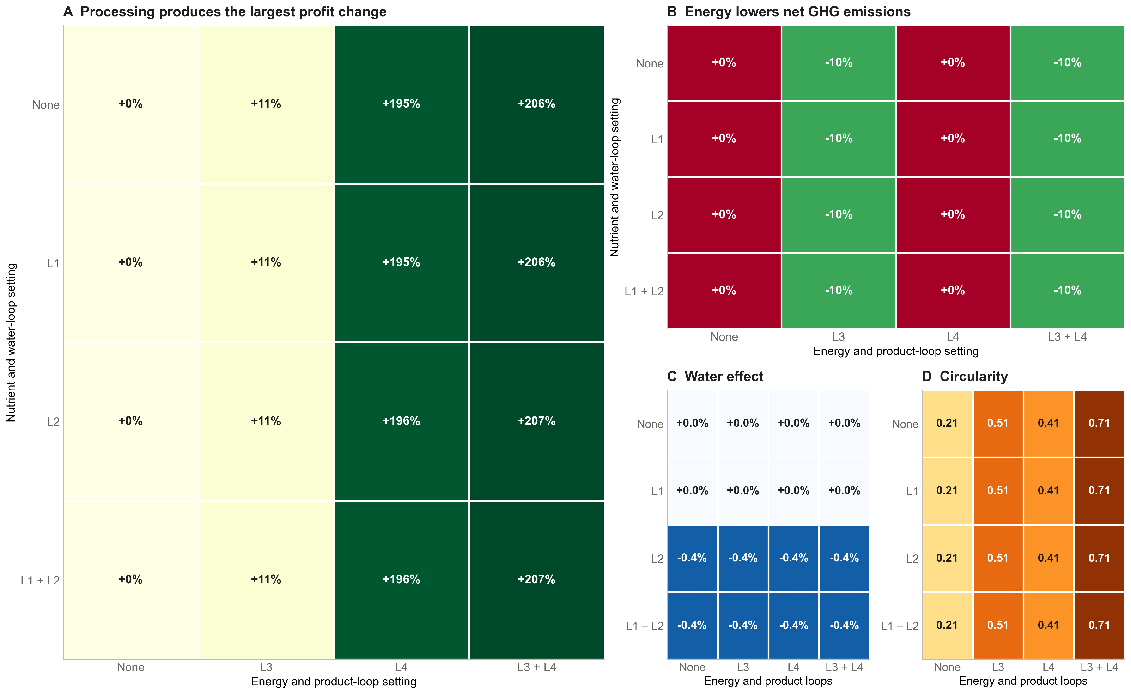
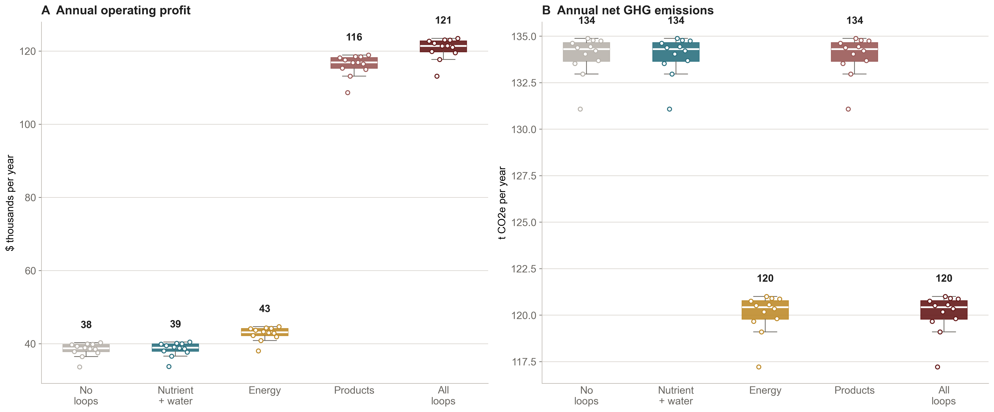
Not All Circular Loops Pay Off:
Product Loops Drive Profit, Energy Loops Cut Emissions
Evidence from a 365-day simulated dairy farm using ViCBio DM
¹Department of Animal Science ²Department of Statistics Texas A&M University
Megha Poyyara Saiju¹ Manogna Rayala² Karun Kaniyamattam¹
Why this matters
OPERATING PROFIT
NET GHG
FRESHWATER
CIRCULARITY
What drives the result
Feed accounts for 46% of specialized dairy production costs, while U.S. milk sales reached $52.8 billion in 2022. Farms need to know which circular technologies recover enough value to justify further testing. Most studies evaluate nutrient, water, energy, and product recovery separately. ViCBio DM runs all four routes within the same herd and shared resource balance, using one consistent price set.
$124k
121 t CO2e
38.7 ML
0.71
L4 created the economic result. Turning on processing and product routing raised seed-42 operating profit by about $79,000 under the modeled product mix and prices.
The energy loop added about $4,400 and reduced net emissions by 13.9 t CO2e.
L2 saved about 160,000 L of freshwater and $160.
The L1 nutrient loop generated 71 t of feed-offset credit. Farm-grown feed was not a limiting input, so the credit did not change operating profit.
about +207%
about −10%
0.16 ML less
+0.50
All-loop run at seed 42. Milk output remained 720,000 L per year.
Loop effects across all 16 configurations
Research question and expectation
We asked which loops materially change profit or environmental performance when all four draw on the same farm resources. We expected the energy and product loops to dominate because they create priced outputs. Nutrient and water recovery would matter most when feed or freshwater became limiting.
Conclusion
ViCBio DM architecture
Use the model to decide which loop deserves field calibration first. For this farm setup, product prices control the economic case, while energy recovery controls the emissions result. Nutrient and water loops need scarcity scenarios before their value can be judged.
13 linked components with fixed daily order and seeded stochastic replay
Market + sensors
Land + feed/crop
Individual cows + disease
Limitations
Processing + manure routing
• Results come from one simulated farm-year and have not been compared with measured farm data.
• The model omits capital costs, financing, taxes, and depreciation.
• L4 results depend on calibrated processing yields and product prices.
• Wastewater treatment and nutrient return stay active when L1 and L2 are off. Those toggles add next-day credits rather than removing all reuse.
• Five real-world farm-system comparisons are planned but not yet implemented.
• Unit tests check model logic and accounting equations. Field data have not yet tested the biological and financial estimates.
L1
Energy + water accounting
L4
L2
Environment + farm manager
L3
Genetics records daily intake and annual gain separately. Agents exchange dated packets that retain source, period, quality, and confidence.
L1 represents nutrient recovery, L2 water recovery, L3 energy recovery, and L4 on-farm processing with byproduct routing. Changes use the no-loop configuration at seed 42 as the baseline.
Computational experiment
Product and energy effects persist across 12 seeds
We simulated a 100-cow high-intensity farm for 365 days, with 80 ha of cropland and 40 ha of pasture. The full 2⁴ design tested all 16 loop combinations at seed 42. We repeated five representative configurations across seeds 1 through 12.
Processor, whey, and land components stayed available in every run. We turned off amino-acid water savings and automatic manager responses so we could isolate loop effects. The model applied its calibration prices and configured price shock. We aggregated daily records into annual totals.
Next research steps
ECONOMICS
Add loop-specific capital and operating costs, then calculate ROI.
CALIBRATION
Replace default prices and yields with observed farm and market data.
EXTERNAL VALIDATION
Implement the five farm systems, run global sensitivity analysis, and compare results with farm mass-balance and financial records.
References and acknowledgments
We did not include capital costs, so this poster does not report ROI or payback.
1. USDA NASS. 2022 Census of Agriculture: Dairy Cattle and Milk Production. 2024.
2. Wood, P.D.P. Algebraic Model of the Lactation Curve in Cattle. Nature 216, 164–165 (1967). doi:10.1038/216164a0.
3. Muell, J.D. et al. Farm-Scale Water-Energy-Food-Waste Nexus Analysis for a Closed-Loop Dairy System. Frontiers in Environmental Science 10:880839 (2022). doi:10.3389/fenvs.2022.880839.
4. ViCBio DM model code. github.com/Creator101-commits/research-agents. Version accessed September 2026.
Acknowledgments: Texas A&M University Department of Animal Science and Department of Statistics.
Each point shows one seed. Boxes show the interquartile range and median. Product-loop values include modeled product revenue under calibration prices.
Notes:
FIVE-MINUTE POSTER TALK
0:00 to 0:35. Why this matters
Feed represents 46 percent of specialized dairy production costs, while U.S. milk sales reached 52.8 billion dollars in 2022. Farms need to know which circular technologies recover enough value to justify detailed field and engineering work. Existing analyses often isolate one route. ViCBio DM places nutrient, water, energy, and processing routes inside the same herd and resource balance.
0:35 to 1:15. Question and expectation
We asked which loop materially changes economic or environmental performance when all four compete within the same farm. We expected the product and energy loops to dominate because they create priced outputs. We expected nutrient and water recovery to become valuable mainly when feed or freshwater became limiting.
1:15 to 1:55. Experiment
We simulated a 100-cow high-intensity farm for 365 days, with 80 hectares of cropland and 40 hectares of pasture. The full two-by-two-by-two-by-two design tested all sixteen loop configurations at seed 42. Five representative configurations were repeated across seeds 1 through 12. Processor, whey, and land components remained available in every run. We disabled amino-acid water savings and automatic manager responses to isolate loop effects.
1:55 to 3:15. Factorial results
The figure uses area to match importance. Profit is the largest panel because the processing and product loop produces the largest change. At seed 42, L4 raises annual operating profit by about 79,000 dollars under the modeled product mix and prices. The energy loop adds about 4,400 dollars and reduces net emissions by 13.9 tonnes of carbon dioxide equivalent. L2 saves about 160,000 liters of freshwater and about 160 dollars. L1 generates 71 tonnes of feed-offset credit. Since farm-grown feed is not limiting in this scenario, the credit does not change operating profit.
3:15 to 4:05. Combined and repeated-seed results
With all loops active, annual operating profit is about 124,000 dollars, net emissions are 121 tonnes of carbon dioxide equivalent, freshwater withdrawal is 38.7 megaliters, and circularity is 0.71. Milk output remains about 720,000 liters. Across twelve seeds, the route ranking is stable. Product configurations remain the high-profit cases, while energy configurations remain the low-emission cases.
4:05 to 5:00. Decision and boundary
The practical use is to choose the next calibration target. Product pricing controls the economic case, so L4 needs observed yields, prices, capital cost, and operating cost before investment analysis. Energy recovery controls emissions, so L3 needs equipment and methane-capture calibration. Nutrient and water routes need explicit scarcity scenarios. This poster does not report ROI or payback because the experiment contains no capital-cost basis.
Q&A NOTES
Why is L4 large? The loop combines modeled processing revenue with byproduct routing and depends on product yields and prices.
Why is baseline circularity above zero? Physical wastewater treatment and nutrient return stay active when L1 and L2 are off. Those switches add next-day credits instead of disabling all recovery.
Were five farm types compared? No. Five real-world farm-system comparisons are planned but are not implemented in this code revision.
What do the tests establish? Unit tests check model logic, deterministic replay, and accounting equations. They do not validate biology, observed prices, capital performance, or field transferability.
SOURCES
USDA NASS. 2022 Census of Agriculture: Dairy Cattle and Milk Production. 2024. https://data.nass.usda.gov/Publications/Highlights/2024/Census22_HL_Dairy.pdf
Wood, P.D.P. Algebraic model of the lactation curve in cattle. Nature 216, 164–165. https://doi.org/10.1038/216164a0
Muell, J.D. et al. Farm-scale water-energy-food-waste nexus analysis for a closed-loop dairy system. Frontiers in Environmental Science 10:880839. https://doi.org/10.3389/fenvs.2022.880839
ViCBio DM model code. https://github.com/Creator101-commits/research-agents. Version accessed September 2026.

