Slide 1
South Korea - Switzerland Currency Analysis
KRW/CHF Exchange Rate & Economic Impact • January 2026

Slide 2
Part A: Why Switzerland?
Critical trading partner: $5.2B bilateral trade
Korea exports: Semiconductors, electronics, vehicles ($2.1B)
Korea imports: Precision machinery, pharmaceuticals, watches ($3.1B)
Trade deficit: $1.0B (Korea imports more)
Strategic: Swiss precision tools enable Korean semiconductor manufacturing

Slide 3
Part B: KRW/CHF Exchange Rate Change
Historical (Aug 01, 2025): 1 KRW = 0.000585 CHF
Current (Jan 29, 2026): 1 KRW = 0.000536 CHF
Change: -8.40%
Direction: Depreciation
Impact: Korean exporters benefit, importers face cost pressure

Slide 4
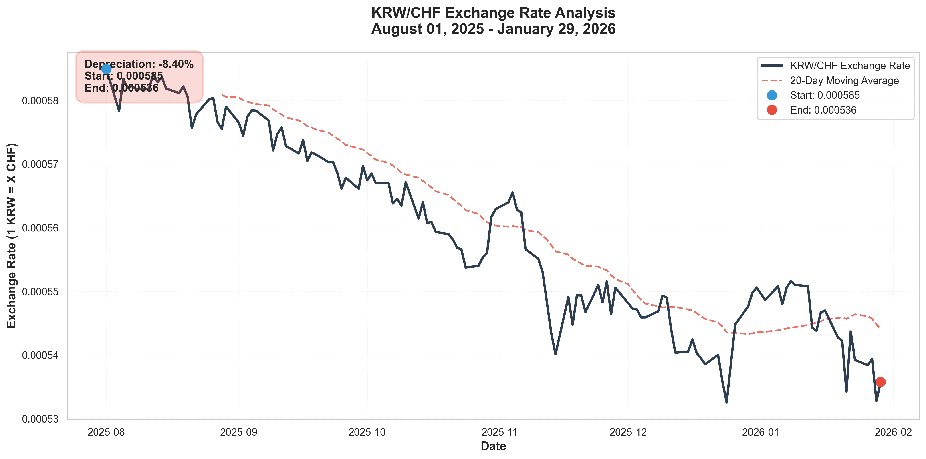
KRW/CHF Exchange Rate Trend
6-month trend showing 8.40% depreciation

Slide 5
Stakeholder Impact Analysis
• WINNERS:
• • Korean exporters (BENEFIT)
• - Samsung, Hyundai, LG benefit
• - Goods cheaper for Swiss buyers
• • Forex traders
• - Carry trade opportunities
• LOSERS:
• • Korean importers (LOSS)
• - Swiss machinery costlier
• - Roche/Novartis drugs expensive
• • Korean SMEs
• - Lack hedging capacity
• - Vulnerable to shocks

Slide 6
Part C: Interest Rate Parity (IRP)
Korea interest rate: 3.25%
Switzerland interest rate: 1.25%
Differential: +2.00% (Korea higher)
Forward rate (IRP): 0.000525 CHF per KRW
Implied KRW movement: -1.94%
Interpretation: Higher Korean rates offset by expected 1.94% depreciation

Slide 7
Part C: Purchasing Power Parity (PPP)
Korea inflation: 2.30%
Switzerland inflation: 1.40%
Differential: +0.90%
PPP expected rate: 0.000531 CHF per KRW
Implication: Higher Korean inflation → KRW depreciation pressure
Both IRP and PPP predict Won weakness

Slide 8
Part D: Policy Recommendations for South Korea
CHALLENGE: 'Impossible Trinity'
- Can't control exchange rate, capital flows, AND monetary policy simultaneously
RISK: Safe haven squeeze during global stress (KRW → CHF flight)
RISK: Imported inflation from Won depreciation
RECOMMENDATION: 'SME Forex Liquidity Facility'
- Provide hedging instruments to small Korean businesses
- Protect against import cost shocks
- Stabilize supply chains while maintaining export competitiveness

Slide 9
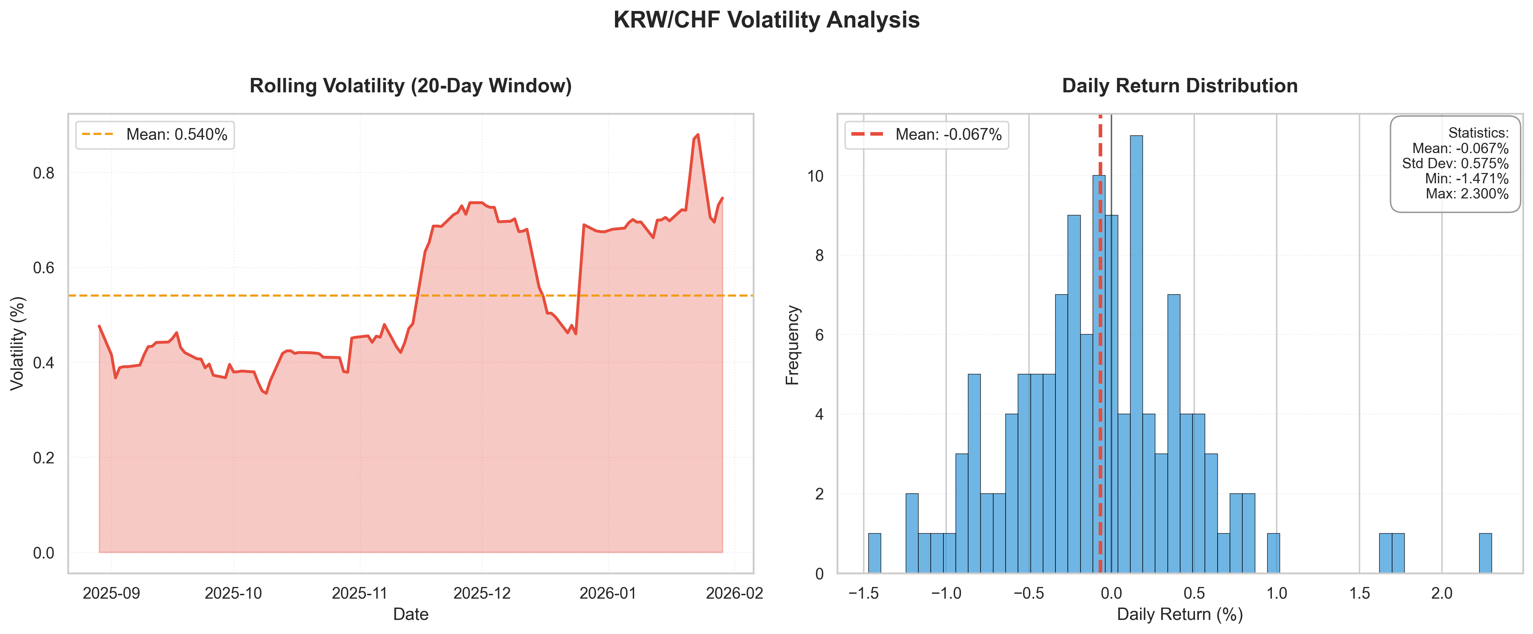
Volatility Analysis
Rolling volatility and return distribution

Slide 10
Part E: Key Takeaways
✓ KRW depreciationd 8.40% vs CHF over 6 months
✓ IRP and PPP both predict Won depreciation (fundamentals-driven)
✓ Korean exporters (Samsung, Hyundai) gain competitiveness
✓ Korean importers face margin pressure from expensive Swiss goods
✓ Policy challenge: Balance export growth vs. imported inflation
✓ Solution: SME Forex Facility to protect vulnerable businesses

