Slide 1

Intrusion Detection Using Recurrent Neural Networks
Presented by
M.Aswini Kumar
(20VV1D5807)
Supervisor
Dr. T. Siva Rama Krishna
Assistant Professor
Department of CSE
JNTUGV UNIVERSITY COLLEGE OF ENGINEERING VIZIANAGARAM

Slide 2
PROBLEM STATEMENT
Intrusion detection is an important role of information security.
we study the performance of the model in
Binary classification
Multiclass classification,
The number of neurons and different learning rate impacts on the performance of the existing models.
Existing Models:
J48
Artificial neural network
Random forest
Support vector machine, and other machine learning methods

Slide 3
LITERATURE SURVEY
Sl.No | Authors | Methods | Results
1 | F. Kuang,W. Xu, and S. Zhang, | J48 | BC -81.05%, MC – 74.60%
2 | R. R. Reddy, Y. Ramadevi, and K. V. N. Sunitha, | SVM | BC-76.56%, MC – 74.60%
3 | W. Li, P. Yi, Y. Wu, L. Pan | KNN | BC-82.02%, MC – 74.60%
4 | B. Ingre and A. Yadav, | ANN | BC-77.41%, MC – 74.60%
5 | N. Farnaaz and M. A. Jabbar, | Random Forest | BC-80.67%, MC – 74.00%
6 | J. Zhang, M. Zulkernine, | Random Forest | BC-81.59%, MC – 72.80%
7 | J. A. Khan and N. Jain, | SVM | BC-69.52%, MC – 74.00%
BC – Binary Classification
MC – Multi Classification

Slide 4
ABSTRACT
We explore Intrusion detection system based on Deep learning.
We propose a deep learning approach for intrusion detection using recurrent neural networks (RNN-IDS).
We will perform an experiment that RNN-IDS is very suitable for modelling a classification with high accuracy and that performance is superior to that of traditional machine learning classification methods in both binary and multiclass classification.
The RNN-IDS model improves the accuracy of the intrusion detection.

Slide 5
INTRODUCTION
This project develops a new Intrusion Detection Using
Recurrent Neural Networks (RNN-IDS)
CONTENTS
Intruders
Classes of Intruders
Intrusion Detection System (IDS)
IDS Principles
Deep Learning
Architectures
Recurrent Neural Network
System flow

Slide 6

INTRUDERS
A significant security problem for networked system is unwanted trespass by users or software.
User Trespass
Software Trespass
Classes of Intruders
Masquerader
Misfeasor
Clandestine

Slide 7
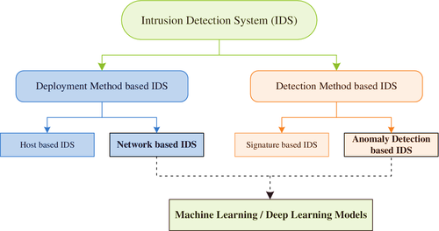
INTRUSION DETECTION SYSTEM
Intrusion detection is a set of techniques and methods that are used to detect suspicious activity both at the network and host level.

Slide 8
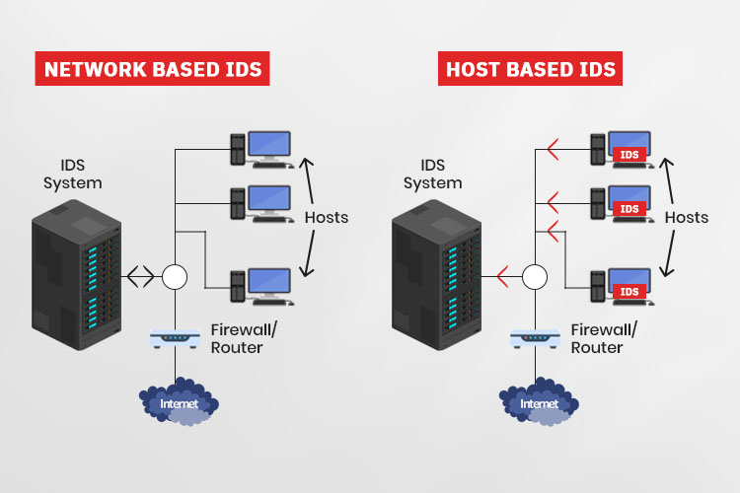
HOST-BASED IDS
Specialized software to monitor system activity to detect suspicious behavior
Primary purpose is to detect intrusions, log suspicious events, and send alerts.
Can detect both external and internal intrusions.
Anomaly detection – defines normal/ expected behavior
Threshold detection
Profile based
Signature detection – define proper behavior

Slide 9
NETWORK-BASED IDS
Monitor traffic at selected points on a network
In( near) real time to detect intrusion patterns
May examine network, transport and application level protocol activity directed towards system
Inline (Possible as part of other net device)
Passive (monitors copy of traffic)

Slide 10

DEEP LEARNING
Deep Learning is a subset of Artificial Intelligence – a machine learning technique that teaches computers and devices logical functioning. Deep learning gets its name from the fact that it involves going deep into several layers of network, which also includes a hidden layer

Slide 11
DEEP LEARNING ARCHITECTURES
Artificial Neural Network (ANN), is a group of multiple perceptrons or neurons at each layer. ANN is also known as a Feed-Forward Neural network because inputs are processed only in the forward direction.
2. Convolutional Neural Networks (CNN) are one of the most popular models used today. This neural network computational model uses a variation of multilayer perceptrons and contains one or more convolutional layers that can be either entirely connected or pooled.
3. Recurrent Neural Networks (RNN) are a powerful and robust type of neural network. RNN is helpful in model sequence data.

Slide 12
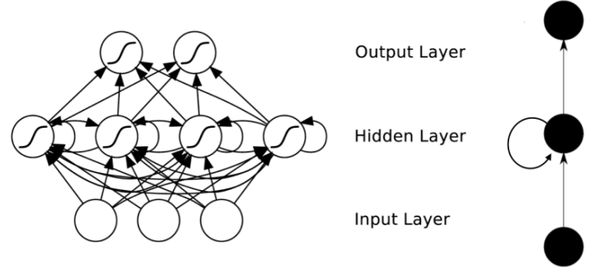
RNN ARCHITECTURE

Slide 13
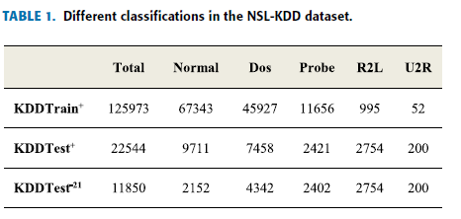
SYSTEM FLOW
Step:1 DATASET DESCRIPTION
NSL-KDD dataset 2009 The dataset contains 41 features, and falls into 4 attacks categories (DoS, Probe, U2R, and R2L).
Step:2 DATA PREPROCESSING
Numericalization
Normalization

Slide 14
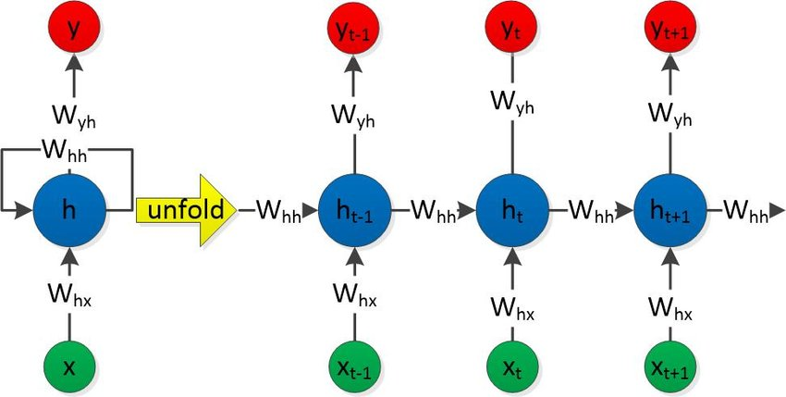
Step:3 METHODOLOGY
Step:4 EVALUATION METRICS
True Positive Rate (TPR)
False Positive Rate (FPR)
Step:5 RESULTS

Slide 15
Thank You

