Slide 1
DEGRADATION OF SOIL AND HOW TO CONSERVE IT
Stefin Roy

Slide 2
What is Soil Degradation?
Soil degradation is the decline in soil condition caused by its improper use or poor management, usually for agricultural, industrial, or urban purposes. It is a serious environmental problem.
It occurs whenever the natural balances in the landscape are changed by human activity through misuse or overuse of soil.

Slide 3
Causes of Soil Degradation
Here are some examples of soil degradation.
Nutrient deficiency: Little or no nutrients in the soil.
Water Logging: Too much water in the soil.
Salinity: Too much salt or too little salt.
Soil Erosion: In soil erosion, the uppermost fertile layer which contains essential nutrients is lost.

Slide 4
What is Soil Conservation?
Soil conservation is a set of ways to prevent soil from being lost from the earth or being chemically changed.
I shall now show you some methods of Conserving the Soil.

Slide 5
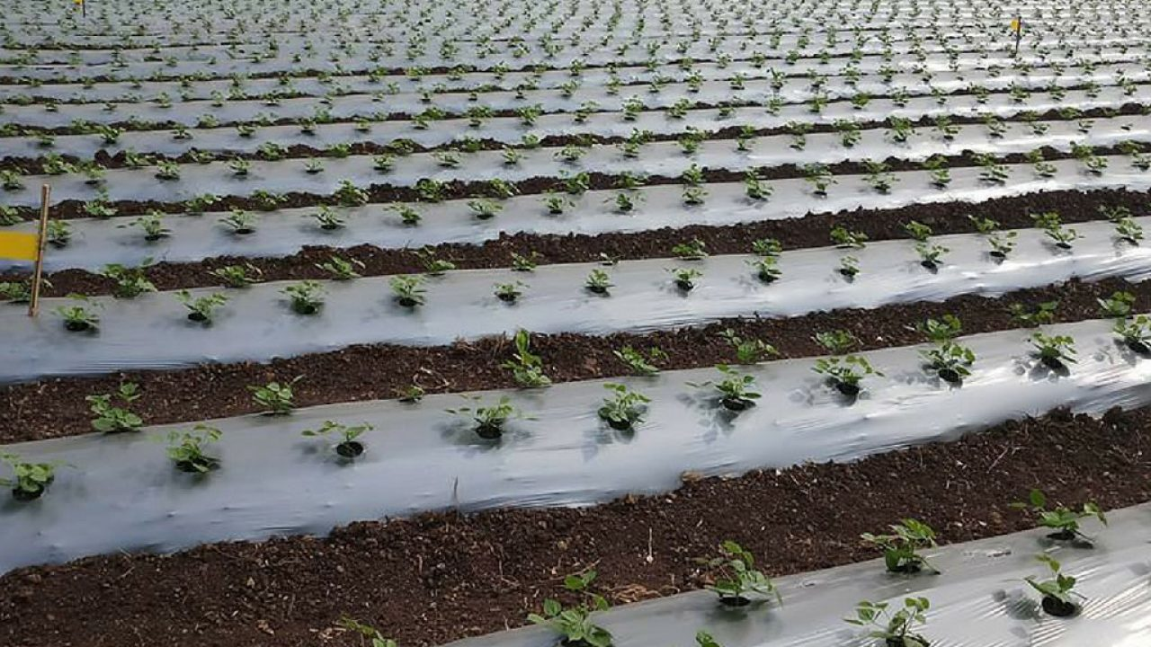
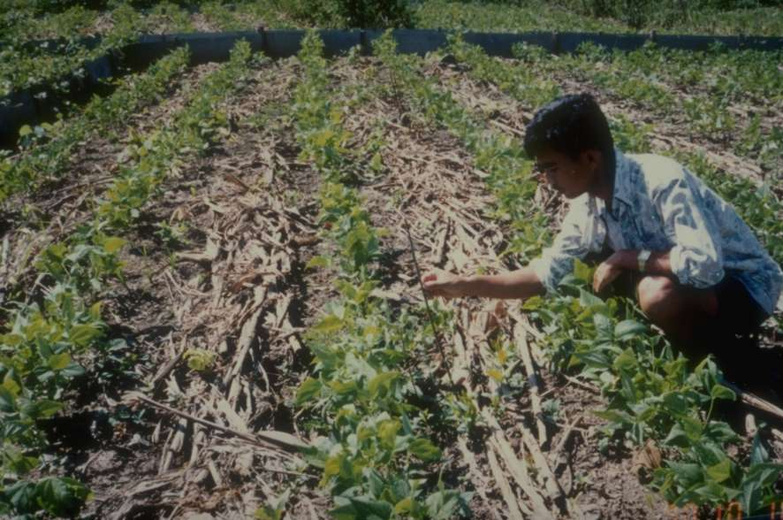
Mulching
Mulching is a method of soil conservation in which the bare ground between plants is covered with a layer of organic matter like straw. It helps to retain soil moisture.

Slide 6
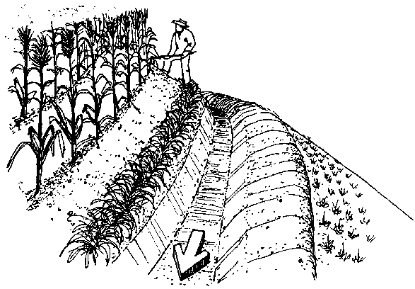
Contour barriers
Contour barriers are made by placing stone, grass or soil along the contour. Trenches are made in front of the barriers to collect water. Contour barriers help in preventing soil degradation which may happen due to rain wash.

Slide 7
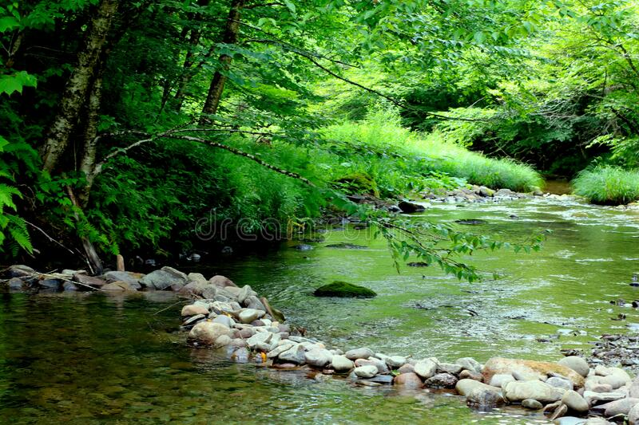
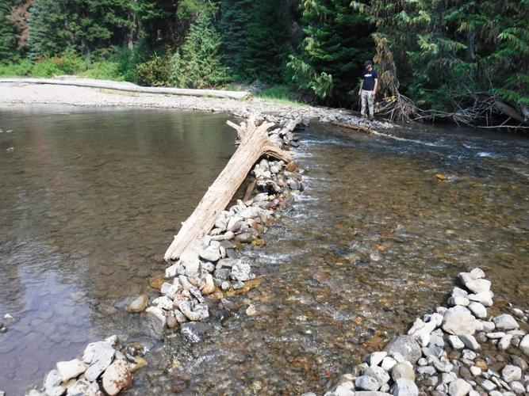
Rock Dams
Rocks are piled up to make a dam. Such dams slow down the flow of water. Thus, it prevents gullies and soil loss.

Slide 8
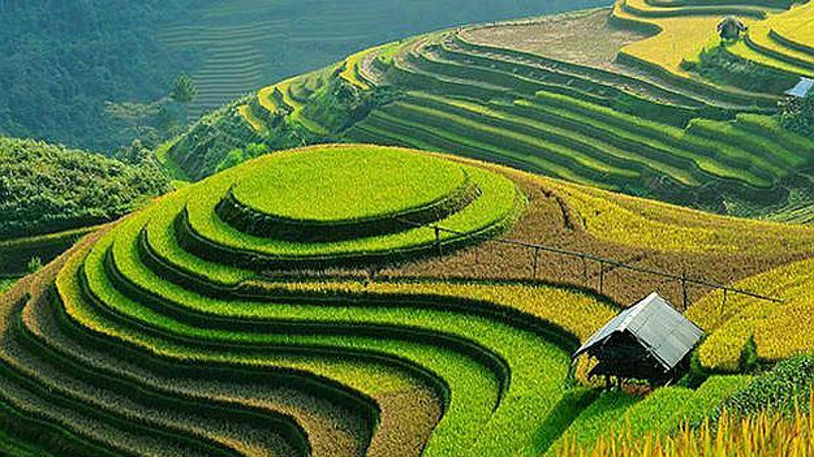
Terrace Farming
Terrace farming is done in hilly areas. Plots are made in the shape of terraces to ensure flat surface for growing the crops. It helps in reducing soil erosion which may happen because of run-off.

Slide 9
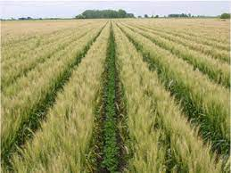
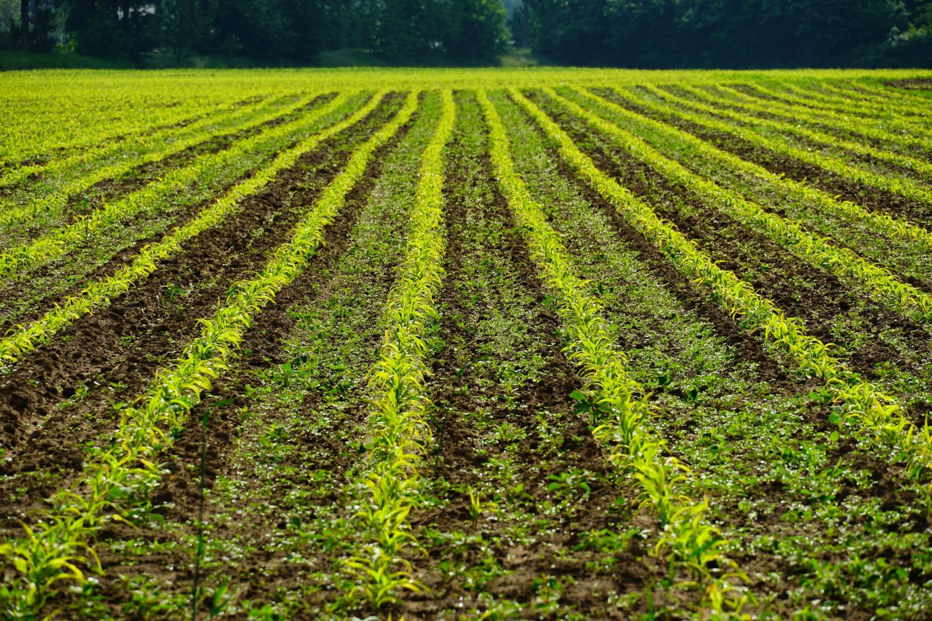
Intercropping
In this method, different crops are grown in alternate rows. Crops are grown at different times. It helps in preventing soil erosion from rain wash.

Slide 10
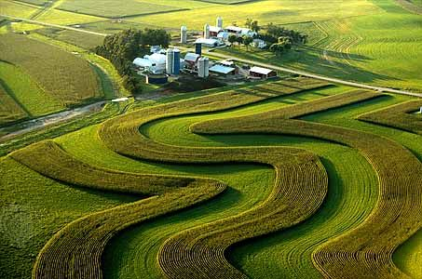
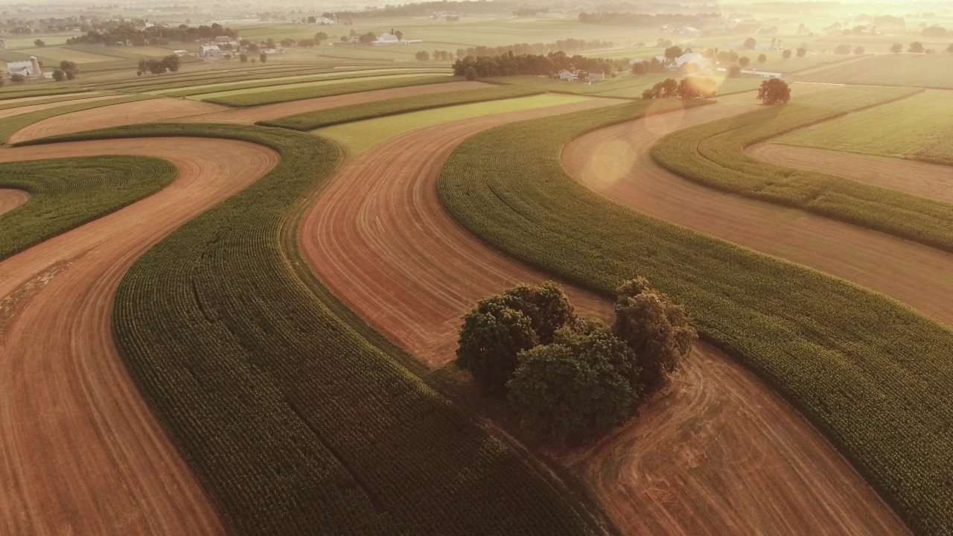
Contour Ploughing
In this method, ploughing is done parallel to the contours of the hill slope. This helps in forming a natural barrier and prevents water from flowing down the slope.

Slide 11
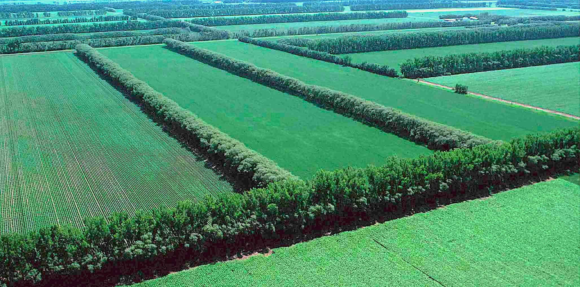
Shelter Belts
This method is used in coastal areas and in dry regions. Rows of trees are planted along the boundary of the farmland. This helps in preventing soil erosion from wind.

Slide 12
Thank You

